Slide 1
Funkcionalna verifikacija hardvera
Predavanje I-II

Slide 2
Lecture Content
Introduction to Verification
  The verification challenge
  Mission and goals of verification
  Cost of verification
  The verification cycle
Verification Flow
  Verification hierarchy
  Strategy of verification
Fundamentals of Simulation Based Verification
  Basic verification environment: a test bench
  Observation points
  Test benches and testing strategies

Slide 3
Introduction to Verification

Slide 4
Introduction to Functional Verification I
Functional verification has become a major challenge in the chip and system design arena.
As engineers place more and more function in increasingly dense chips, the discipline required for successful chip and system verification has advanced.
As a result, the verification engineer, little known 10 years ago, has become a treasured member of the chip design team.
Notes:
Silicon chip technology powers many of today’s innovations and newest products. Rapid technology advancement fuels ever-increasing chip complexity, which in turn enables the latest round of amazing products. These chips touch many aspects of our everyday life, from the pocket-sized combination cell phone, pager, and digital camera to the high-end server that searches an online bookseller’s database, verifies credit card funds, and sends the order to the warehouse for immediate delivery. Expectations for these chips grow at an equal rate, despite the additional complexity. For example, consumers do not expect the chips that monitor safety processes in our cars to fail during the normal life of the vehicle. Nor is it acceptable to be denied access to our on-line brokerage accounts because the server is down. Thus, it has become a major engineering feat to design these silicon chips correctly.
An enormous amount of engineering goes into each of these chips, whether it is a microprocessor, memory device, or entire system on a chip (SoC). All types of chips have a set of challenges that the engineers must solve for the final product to be successful in the marketplace.

Slide 5
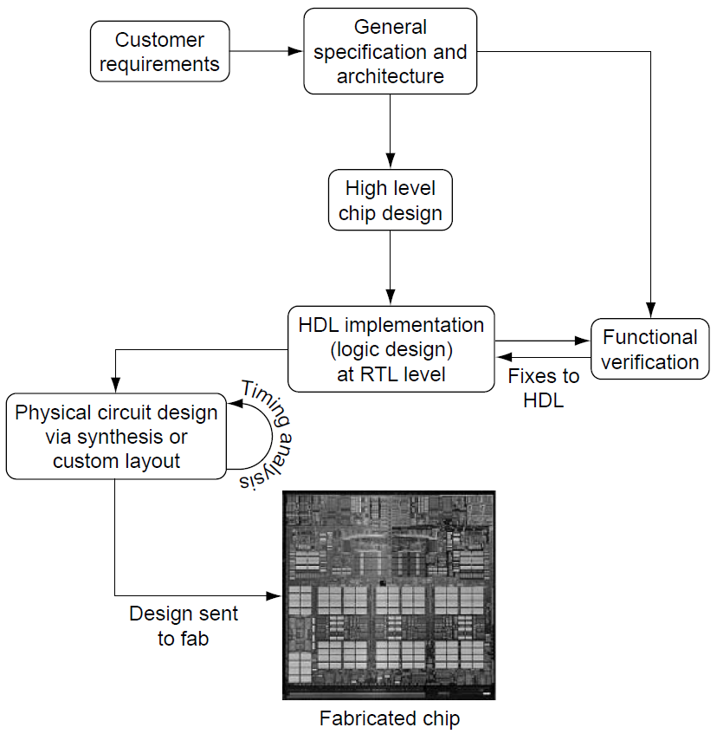
Introduction to Functional Verification II
The chip design process is presented in the Figure to the right.
All silicon design starts with the customer’s requirements, which drive the general specification and architecture.
The chip components then take shape during the high-level design stage, followed by the register transfer level (RTL) implementation in a hardware description language (HDL; usually Verilog or VHDL).
Circuit design and timing analysis are based on the HDL, whereas functional verification explores the state space of the logic design to compare the implementation against the specification and design intent.
Notes:
Figure shows a chip’s design flow, which starts with the customer’s requirements. Those requirements include (but are not limited to) function, chip size, chip power consumption, and processing speed. Requirements are compiled and prioritized during the concept and high-level design phase, in which designers architect the chip’s main internal components and goals. As the chip design process progresses, engineers face challenges to balance goals that often conflict: higher chip performance may require faster cycle times, but that will raise power consumption; faster cycle times may require adding more stages in the logic, but that increases chip complexity and area.
Throughout the chip design process, design automation (DA) tools accurately predict chip area, timing, and power aid the engineers. After an engineer creates logic, written in a hardware description language (HDL), DA tools can synthesize that logic into appropriate gates that correspond to the original design. Verilog and VHDL are the two most common HDLs. But two questions remain: (1) what if the HDL did not express the correct function in the first place, and (2) what if the designer missed a critical corner condition? Detecting incorrect function has become one of the trickiest challenges in the entire chip design process. This is the challenge of functional verification.
Functional verification ensures that the design performs the tasks as intended by the overall system architecture. It differs from circuit level validation in multiple ways. First, verification engineers work predominantly on the register transfer level (RTL) of the design rather than on the gate level. RTL is a more abstract way to specify the logic design than are the low-level ANDs and ORs of the gate level. RTL languages (HDLs) allow the designer to specify the behavior by using higher-level constructs such as Boolean equations and IF-THEN-ELSE structures. Second, although the main challenge for the circuit designers is to fit the gates into the available chip area and ensure that timing goals are met, it is the verification engineer’s role to ensure that the design is functionally correct in the first place.

Slide 6
Introduction to Verification
The Verification Challenge

Slide 7
The Verification Challenge
Chip designs can easily consist of hundreds of thousands of lines of HDL.
A verification engineer’s job is to seek out problems in the HDL implementation, flagging flaws or bugs when the HDL does not act according to specification.
A verification engineer exposes these bugs by running complex simulations on the design.
The verification engineer faces two major challenges:
  dealing with enormous state space size and
  detecting incorrect behavior.

Slide 8
The Challenge of State Explosion I
Typically, HDL contains thousands of latches, large arrays (RAM), and combinatorial logic, all of which control the behavior of the chip.
At a given point in time, a chip can be in any one of an enormous number of possible current states.
To verify exhaustively that a chip is functionally correct, the verification engineer would have the daunting task of checking that each possible current state and each possible input combination yields the correct next state.
Notes:
The scale of the state space is the first verification challenge. Typically, HDL contains thousands of latches, large arrays (RAM), and combinatorial logic, all of which control the behavior of the chip. The chip inputs manipulate the internal logic, causing it to act on the applied stimulus. These inputs transform the current state of the chip, defined by the stored values in the latches and arrays, into the next and future states of the chip. At a given point in time, a chip can be in any one of an enormous number of possible current states (The number of possible states is 2^{n}, where n is the total number of bits of latches and arrays.). Furthermore, the next state of the chip, determined by the current state and the current inputs, can be any of the possible states. To verify exhaustively that a chip is functionally correct, the verification engineer would have the daunting task of checking that each possible current state and each possible input combination yields the correct next state.
To combat state space explosion, verification engineers break the problem down into smaller pieces. A typical chip may have 100,000 latches, imbedded arrays, and hundreds of input pins. Rather than verify the entire chip at once, the verification team will carve out subcomponents of the design and verify these pieces separately. Once the smaller, more manageable pieces are verified, the team stitches the chip subcomponents back together and ensures that they work.
Furthermore, many of the possible states of the chip and many of the possible input combinations are defined as illegal based on design specifications. An illegal state is a state that the design should never enter. Illegal states cut down the size of the current states that must be evaluated by the verification engineer.
But, the verification engineers cannot ignore illegal states in certain chip designs, specifically those chips that must be tolerant of errors. Illegal states can occur because of many factors, including erroneous input, alpha particles flipping a latch, or circuit failures. The verification task may require ensuring that the hardware can recover from these unexpected conditions.

Slide 9
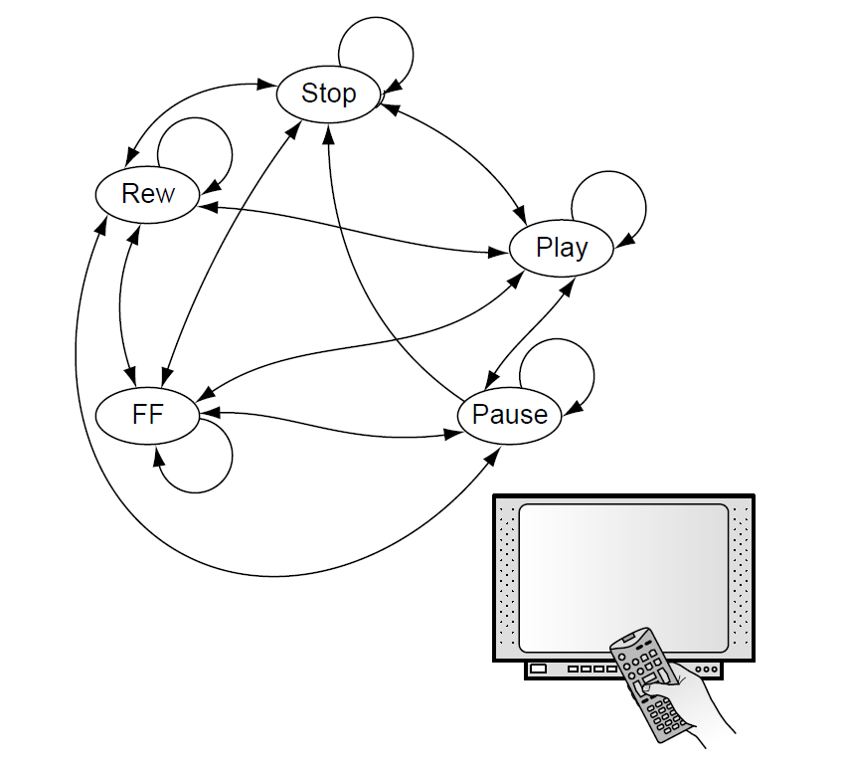
The Challenge of State Explosion II
Example: STB and a remote control with 6 inputs (nothing pressed, play, stop, pause, fast forward and reverse)
Internally, system uses 5 states: play at normal speed, paused, forward at 2x speed, reverse at 2x speed and stopped
However, messages have to be shown on TV for each key press, hence, assuming TV resolution 1024x768 with "true color" (32-bit) total number of current states and number of possible next states are:
  (1024 x 768) x 5 x 2³² = 16,888,498,602,639,360
  (1024 x 768) x 2³² x 6= 20, 266,198,323,167,232
To exhaustively verify the chip, all transitions from all possible current states have to be checked which is 3.4 x 10³²
With a simulation engine that can run up to 1000000 transitions each seconds, one would need 10,853,172,947,159,498,300 years
Notes:
The scale of the state space is the first verification challenge. Typically, HDL contains thousands of latches, large arrays (RAM), and combinatorial logic, all of which control the behavior of the chip. The chip inputs manipulate the internal logic, causing it to act on the applied stimulus. These inputs transform the current state of the chip, defined by the stored values in the latches and arrays, into the next and future states of the chip. At a given point in time, a chip can be in any one of an enormous number of possible current states (The number of possible states is 2^{n}, where n is the total number of bits of latches and arrays.). Furthermore, the next state of the chip, determined by the current state and the current inputs, can be any of the possible states. To verify exhaustively that a chip is functionally correct, the verification engineer would have the daunting task of checking that each possible current state and each possible input combination yields the correct next state.
To combat state space explosion, verification engineers break the problem down into smaller pieces. A typical chip may have 100,000 latches, imbedded arrays, and hundreds of input pins. Rather than verify the entire chip at once, the verification team will carve out subcomponents of the design and verify these pieces separately. Once the smaller, more manageable pieces are verified, the team stitches the chip subcomponents back together and ensures that they work.
Furthermore, many of the possible states of the chip and many of the possible input combinations are defined as illegal based on design specifications. An illegal state is a state that the design should never enter. Illegal states cut down the size of the current states that must be evaluated by the verification engineer.
But, the verification engineers cannot ignore illegal states in certain chip designs, specifically those chips that must be tolerant of errors. Illegal states can occur because of many factors, including erroneous input, alpha particles flipping a latch, or circuit failures. The verification task may require ensuring that the hardware can recover from these unexpected conditions.

Slide 10
The Challenge of State Explosion II
To combat state space explosion, verification engineers break the problem down into smaller pieces.
Rather than verify the entire chip at once, the verification team will carve out subcomponents of the design and verify these pieces separately.
Once the smaller, more manageable pieces are verified, the team stitches the chip subcomponents back together and ensures that they work.
Notes:
The scale of the state space is the first verification challenge. Typically, HDL contains thousands of latches, large arrays (RAM), and combinatorial logic, all of which control the behavior of the chip. The chip inputs manipulate the internal logic, causing it to act on the applied stimulus. These inputs transform the current state of the chip, defined by the stored values in the latches and arrays, into the next and future states of the chip. At a given point in time, a chip can be in any one of an enormous number of possible current states (The number of possible states is 2^{n}, where n is the total number of bits of latches and arrays.). Furthermore, the next state of the chip, determined by the current state and the current inputs, can be any of the possible states. To verify exhaustively that a chip is functionally correct, the verification engineer would have the daunting task of checking that each possible current state and each possible input combination yields the correct next state.
To combat state space explosion, verification engineers break the problem down into smaller pieces. A typical chip may have 100,000 latches, imbedded arrays, and hundreds of input pins. Rather than verify the entire chip at once, the verification team will carve out subcomponents of the design and verify these pieces separately. Once the smaller, more manageable pieces are verified, the team stitches the chip subcomponents back together and ensures that they work.
Furthermore, many of the possible states of the chip and many of the possible input combinations are defined as illegal based on design specifications. An illegal state is a state that the design should never enter. Illegal states cut down the size of the current states that must be evaluated by the verification engineer.
But, the verification engineers cannot ignore illegal states in certain chip designs, specifically those chips that must be tolerant of errors. Illegal states can occur because of many factors, including erroneous input, alpha particles flipping a latch, or circuit failures. The verification task may require ensuring that the hardware can recover from these unexpected conditions.

Slide 11
The Challenge of Detecting Incorrect Behavior I
The second verification challenge is detecting when the design violates the expected behavior or specification.
With all of the possible transitions from one state to the next, the verification engineer must be able to identify whether or not the design acted correctly based on the current state and input.
In simplest terms, then, the verification challenge comes down to two fundamentals:
  Drive the state transitions and input scenarios
  Flag any incorrect behavior exhibited by the design
Verification engineers attack the challenge by using two fundamental methods:
  simulation-based verification and
  formal verification
Notes:
The second verification challenge is detecting when the design violates the expected behavior or specification. With all of the possible transitions from one state to the next, the verification engineer must be able to identify whether or not the design acted correctly based on the current state and input.
Rather than focusing on each of the possible states of the hardware, verification engineers validate the logic at a higher level of abstraction: inputs are grouped into valid command and data sets, and the verification engineer concentrates on the behavior of the design based on the functional input stimulus.
In simplest terms, then, the verification challenge comes down to two fundamentals:
1. Drive the state transitions and input scenarios
2. Flag any incorrect behavior exhibited by the design
Verification engineers attack the challenge by using two fundamental methods: (1) simulation-based verification and (2) formal verification, or verifying the design adheres to protocols by using formal proof engines.
In simulation-based verification, the verification engineer applies stimulus to a software model of the design. The sim model runs in conjunction with a simulation engine, which accurately reflects the behavior of the design. As inputs are applied, the simulation engine evaluates the design’s reaction to the specific inputs on the current state, and updates the internal state of the design accordingly. The simulation engine is often run on a desk-side workstation (a general purpose computer), and the verification engineer uses the user interface to query the behavior of the model to check for results and to flag incorrect behavior.
Formal verification, a newer technique, is a great complement to simulation. Rather than verifying possible input sequences and internal-state machine values individually or in sequence, formal verification proves that a protocol, assertion, or design rule holds true for all possible cases in the design. The major drawback of formal verification is that it can only verify a limited size design. Because all possible values in a design are checked, formal verification engines can consume enormous amounts of computer resources, even on small designs. For this reason, formal verification most often is applied to portions of the entire design rather than the whole so the engine can digest the design and return results in a reasonable timeframe.

Slide 12
Introduction to Verification
Mission and Goals of Verification

Slide 13
Mission and Goals of Verification
Design teams manage the process of developing computer hardware by balancing the triple constraints:
  Schedule: Computer product success depends heavily on hitting the marketplace at the right time.
  Cost: At the same time, a company must endeavor to maximize the profit created by a digital hardware product. A key profit lever is to keep the manufacturing and development expense for a product at a minimum.
  Quality: Customers expect that delivered products will meet quality standards.
Finding the correct balance of schedule, cost, and quality will depend on the product.
However, the balancing act is tricky, as optimizing for two of the constraints will often hurt the third.
For example, maximizing quality while minimizing schedule often inflates product cost.
Notes:
Design teams manage the process of developing computer hardware by balancing the triple constraints:
Schedule: Computer product success depends heavily on hitting the marketplace at the right time. Delays in getting products to market can be deadly for a company, as, more than in any other industry, a disproportionate amount of revenue goes to the product that gets to market first.
Cost: At the same time, a company must endeavor to maximize the profit created by a digital hardware product. A key profit lever is to keep the manufacturing and development expense for a product at a minimum. An expanded look at the verification cycle, as pictured in the figure, shows that after silicon fabrication, engineers perform testing on the entire system using fabricated hardware running end-user applications. Frequently, bugs missed by verification are discovered by engineers during this systems testing, causing design updates and re-fabrication of the hardware. These changes costs money and time, as fabrication facilities charge additional money for re-doing a chip, and some chips, depending on the technology used, may take up to 2 months to process. After a completed systems test, the company manufactures the product and ships it to customers. Customers provide the company with feedback about the product, which, in turn, feeds the requirements for follow-up products. Examples of customer feedback include requests for new features or higher quality.
Quality: Customers expect that delivered products will meet quality standards. Component failures invoke warranty costs, which affect the company’s bottom-line. Furthermore, if the marketplace perceives that a product is of poor quality, it can have a devastating effect on the company.
Finding the correct balance of schedule, cost, and quality will depend on the product. However, the balancing act is tricky, as optimizing for two of the constraints will often hurt the third. For example, maximizing quality while minimizing schedule often inflates product cost.

Slide 14
Cost of Undetected Bugs
Figure on the right shows how the costs of undetected bugs grow over time.
If a bug is uncovered early during verification, it costs little to fix: the designer reworks the HDL and the verification team shows that the update fixed the original problem.
A bug found in a systems test, however, may cost hundreds of thousands of dollars: hardware must be re-fabricated and there is additional time-to-market.
Finally, and most costly, a customer discovering a bug not only invokes warranty replacement or upgrades but may tarnish the image of the company or brand of products - a problem from which the company may never recover.
Notes:
Figure shows how the costs of undetected bugs grow over time. If a bug is uncovered early during verification, it costs little to fix: the designer reworks the HDL and the verification team shows that the update fixed the original problem. A bug found in a systems test, however, may cost hundreds of thousands of dollars: hardware must be re-fabricated and there is additional time-to-market. Finally, and most costly, a customer discovering a bug not only invokes warranty replacement or upgrades but may tarnish the image of the company or brand of products - a problem from which the company may never recover.
Verification is the single biggest lever that affects all three of the triple constraints. A chip can be fabricated sooner rather than later if the verification team is able to remove errors quickly and efficiently. Furthermore, costs of re-fabricating a chip multiple times (“re-spins”) can drive development expenses to an unacceptable level and negatively affect the product schedule. A solid verification effort reduces the number of re-spins and removes latent problems, which, if not discovered by verification and a systems test, can show up in customer environments and cause quality problems.

Slide 15
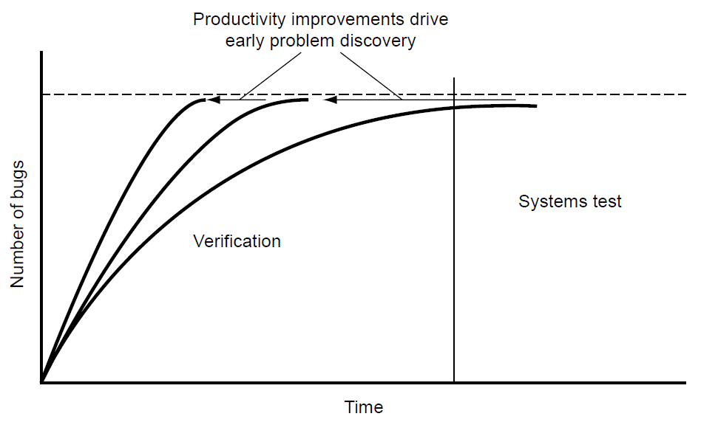
Increasing Verification Productivity
Because verification has such a strong effect on the triple constraints, it is prudent to track verification productivity.
The design team measures verification productivity by two factors:
  schedule time and
  quality of bugs found.
Increasing verification productivity reduces schedule and costs. The figure shows three possible “bug curves.”
The longest one stretches into the systems test, where engineers find the last bugs on the hardware.
Improvements in verification, depicted by the two other curves, will drive the bug discovery earlier, reducing schedule and costs.
Notes:
Because verification has such a strong effect on the triple constraints, it is prudent to track verification productivity. The design team measures verification productivity by two factors: schedule time and quality of bugs found.
Project teams track productivity with respect to schedule time by measuring the steepness of the “bug curve”, as shown in the figure. An efficient verification team with a robust process will remove bugs at a faster pace than will a less effective team and process. Therefore, it is a good practice to maintain a history of bug curve rates from each project to track improvements in verification productivity.
The second measure of verification productivity, quality of bugs found, is a more qualitative evaluation than is measuring bug curve rates. The verification team measures the quality of a bug by analyzing the scenario and test case that uncovered the design flaw: the more difficult, esoteric, or complex the scenario, the higher the quality of bug. A productive verification team should find any “easy” or low-quality bugs early in the verification schedule. Throughout the process, the average complexity of the design flaws that the verification team uncovers should grow. Simple bugs found late in the verification cycle signal that the verification environment and test plans need to be analyzed.

Slide 16
Verification Engineer “Musts”
A strong verification team is an invaluable asset to a company that develops hardware.
The mission of the verification team is to remove all of the functional design problems as quickly as possible.
To do this, verification engineers must gain specific skills.
Successful verification engineers:
  must understand the design (specification and implementation level),
  must be able to work closely and cordially with designers,
  must understand the strengths and weaknesses of the variety of verification methods and tools used to measure state space covered by test, and
  must be able to use these tools efficiently to develop verification environment and ensure that required test scenarios occur and proper checking is performed
Notes:
Verification requires detailed knowledge of the design that is being verified (the design under verification, or DUV). Understanding of the design comes at two levels: the specification level and the implementation level.
The specification dictates the overall function of the design. It includes the architecture, the inputs and outputs, and the performance requirements. The architecture is the main specification of the device: for a microprocessor, this is the instruction set and definitions; for an I/O device, this is the protocols. The architecture is well documented and often globally published. The inputs and outputs of the DUV define the chip or system pins and include the required timings and protocols. The performance requirements of the DUV include the desired throughput of the design, processing speed, and bandwidth, as well as associative cache size and cache.
The implementation of the design deals with the internal constructs used to perform the specification. This is known as the microarchitecture of the design. Implementation components include the following:
Queues and buffers that hold data and commands
Internal state machines
Pipelines
Data and control flows
Designers or system-level architects (in the company or in industry) write the specifications of the design, documents that are available for the verification engineer to study and are the arbiter when design questions arise. Less formal documentation exists for implementation details, and this information must come from the designers. If necessary, verification engineers must extract the implementation details by interviewing the designers. These implementation details are needed so appropriate verification tests that stress the many structures within the design can be created.
Throughout a project, the verification engineer must have a strong relationship with the designer team. This does take some finesse, as it is the verification engineer’s role to find a designer’s mistakes and oversights.
With the wealth of techniques available for verification, it is important for a verification engineer to understand the strengths and weaknesses of each method. Some methods may be very effective on small portions of the design but not on large chips (e.g., formal verification). Other methods might require long lead times to create the code necessary for the environment. A verification engineer must also understand the tools that assist in gauging the state space covered by the testing. Each of these tools must be evaluated for
Effectiveness of approach for this design implementation
Effect of the approach on simulation throughput
Amount of time required to create the verification environment
Finally, when a verification approach is selected, the verification engineer must be able to create the verification environment, ensuring that the required functional test scenarios occur and that the checking is complete. This requires proficiency in multiple verification techniques, all of which rely on the verification engineer’s knack for sniffing out bugs in the design.

Slide 17
Introduction to Verification
Cost of Verification

Slide 18
Cost of Verification
Functional verification is essential to the hardware design process.
How does the development team gauge just how many resources to put into verification?
Too few resources and the hardware will need multiple passes through the fabrication process, which costs orders of magnitude more dollars in time-to-market and development expenses than would allocation of enough verification resources.
At the same time, a design team does not want to over-invest in any area, including verification, as overinvestment would indicate costly redundancy.
Therefore, the development team must strike the right balance.
Verification resource costs fall into three areas:
  engineering costs (a separate verification team, designers as a "first line" defense, 1:1 to 1:4)
  DA tools (simulators vs formal v.e, but also tools for coverage, trace viewers, HLVL, ABT..) , and
  Time (commitment as a key management requirement for successful verification).
A successful verification effort requires appropriate investment in all three areas.
Notes:
Verification engineering cost is a measure of the number of people performing verification. Some design teams employ separate verification engineers, whereas other teams use their logic designers to perform verification after writing their HDL. However, there are clear advantages to using an independent verification team and not having the design team play a dual role. Some of these advantages are listed here.
Verification is a separate vocation that requires different skills than does logic design. The ability to create the scenarios and checkers needed to find bugs is detective work unlike the skills needed to create HDL that meets logical and physical requirements. A second reason for an independent verification team is these verification engineers will not be biased by the thought process that goes into the design. If a designer overlooked a case while creating the logic, the same designer should not be expected to write a test scenario for that missed case. Finally, when creating logic, a designer makes assumptions about the design. It is the verification engineer’s job to judge separately the verification environment requirements without the bias of the designer’s assumptions.
However, for many reasons, the design team is crucial to the verification effort. First, designers are the initial line of defense against bugs. Designers should perform a suite of verification tests that ensures a level of quality before delivering HDL to the verification team. Designers also have keen insight into tricky areas of the logic. The designer should highlight these areas of the design to the verification team as potential sources of bugs. A final key element for designers to assist in the verification effort is through accurate and timely documentation. This information guides the verification team in creating complete test plans and executing their work.
The basic building blocks of DA tools for verification are simulation engines and formal verification engines. Other DA tools build on the two basic engines. Software includes: “Coverage” tools that assist in evaluating the effectiveness of the scenarios driven into the logic during simulation; Trace viewers that show graphical (waveform) representations of the scenarios and the values of the latches, arrays, and wires in the HDL; High-level verification languages that assist the verification engineer in writing complex simulation environments; Test case generation software that can create multiple simulation test cases based on abstract templates; Simulation farm control software that allows simulation jobs to be run across multiple workstations simultaneously and collects the test scenario results; Assertion-based tools that assist in debug, allowing a bug to be flagged at the moment it occurs and enabling the engineer to know exactly where the HDL failed. Electronic DA (EDA) vendors supply these tools to the industry. DA software costs generally are based on licensing fees.
The amount of time spent on verification is key in the overall cost equation. Design teams must balance engineering costs and DA software licensing with schedule time. If a design team has an aggressive schedule (based on fabrication passes, experience, and industry benchmarks), then more verification skills and software will be required to meet the goals. If the verification team is not allocated enough resources for the allotted schedule, either the schedule will slip or the results seen in the fabricated hardware will be poor. Time is money in the equation.

Slide 19
Introduction to Verification
The Verification Cycle

Slide 20
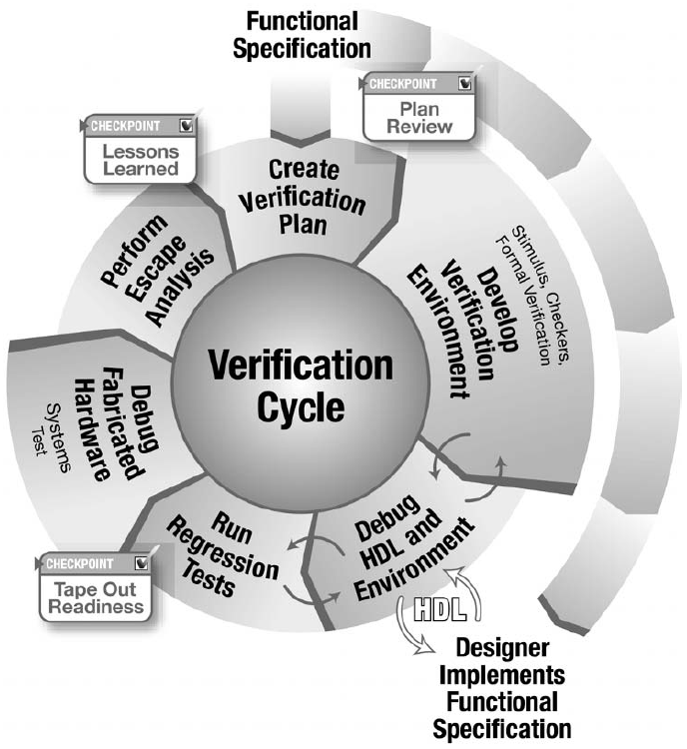
The Verification Cycle
The verification cycle proceeds in a clockwise direction, starting from the functional specification, a key delivery to both the design and verification teams.
After completing the verification plan based on the specifications, the entire engineering team reviews the plan to look for enhancements
Two stages in the process provide feedback to previous stages. These stages are the debug and regression stages in which the verification team detects problems either in the HDL or in their environment code.
The cycle proceeds through the manufacturing and systems test.
Once the team receives fabricated hardware, they evaluate the quality of their verification effort through escape analysis, which provides feedback into the process to plug holes in the verification environment.
Notes:
Structure is necessary in any complex field. In verification, structure comes from a well-defined process. The verification process identifies the required steps toward developing a bug-free chip release. Because the verification team enhances their environment based on previous experiences, the process is called the verification cycle.
Generally, verification teams stay together across multiple products. The verification cycle shadows the product cycle, allowing verification engineers to incorporate enhancements into the methodology continuously. Verification engineers gain experience through multiple passes of this cycle.
Figure shows the stages of the verification cycle. The cycle proceeds in a clockwise direction, starting from the functional specification, a key delivery to both the design and verification teams. As the team starts development of the verification environment, they reach the first checkpoint. After completing the verification plan based on the specifications, the entire engineering team reviews the plan to look for enhancements.
Two stages in the process provide feedback to previous stages. These stages are the debug and regression stages in which the verification team detects problems either in the HDL or in their environment code. As regression winds down, the team prepares the product for fabrication. This is the second checkpoint in the cycle, when the design and verification teams review all of the verification work against the tape-out criteria.
The cycle proceeds through the manufacturing and systems test. Once the team receives fabricated hardware, they evaluate the quality of their verification effort through escape analysis, which provides feedback into the process to plug holes in the verification environment. The final checkpoint in the cycle, lessons learned, uses escape analysis and the entire verification cycle experience to compile a list of items to improve on as they start the cycle again.

Slide 21
Functional Specification
The functional specification describes the desired product. It contains the specification of the interfaces with which it communicates, the function that it must perform, and the conditions that affect the design.
The system architect determines the functional specification.
The functional specification is the foundation of the verification cycle.
While the designers implement the functional specification in HDL, verification engineers incorporate the functional specification into the verification environment.
This may seem redundant, but it is the foundation of verification.
A second implementation of the functional specification by the verification environment forms the cross-check in the cycle.
This redundancy ensures that the designer’s assumptions and implementation match the architect’s intent.

Slide 22
Create Verification Plan
A verification plan is crucial because it presents a detailed description of the verification effort. It answers the questions “what am I verifying?” and “how am I going to verify it?”
Verification plans include many of the following elements:
  Specific tests and methods - define the type of environment that the verification engineers will create.
  Required tools - list the software necessary to support the described environment. This list may drive requirements on the software procurement team or on internal software development teams.
  Completion criteria - define the measurements that indicate that verification is complete.
  Resources (people, hardware, and software) required and schedule details—tie plan to program management by estimating the cost of verification.
  Functions to be verified - list the functions that will be verified at this level of verification.
  Functions not covered - describe any functions that must be verified at a different level of the hierarchy. The verification of these functions will be specified in a different section of the verification plan.
Notes:
A verification plan is crucial because it presents a detailed description of the verification effort. It answers the questions “what am I verifying?” and “how am I going to verify it?”
The verification leaders write the verification plan, using the logic designers and system architects as consultants during the process.
Unless the design is simple, a hierarchical approach to verification is required. This approach allows the verification engineer to work on smaller components before building up to the system level. The verification plan contains sections for each component at each level of the hierarchy.
Verification plans include many of the following elements:
Specific tests and methods—define the type of environment that the verification engineers will create.
Required tools—list the software necessary to support the described environment. This list may drive requirements on the software procurement team or on internal software development teams.
Completion criteria—define the measurements that indicate that verification is complete.
Resources (people, hardware, and software) required and schedule details—tie plan to program management by estimating the cost of verification.
Functions to be verified—list the functions that will be verified at this level of verification.
Functions not covered—describe any functions that must be verified at a different level of the hierarchy. The verification of these functions will be specified in a different section of the verification plan.
The team reviews the final verification plans with the architects and designers. This is the first checkpoint in the cycle. The designers and architects compare the verification plans with the design specification and internal structures, suggesting enhancements and modifications to the verification environment plans.

Slide 23
Develop Environment
Once the verification plan is in place, construction of the verification environment begins.
Major components in the verification environment are stimuli and checking.
The verification environment is the set of software code and tools that enable the verification engineer to identify flaws in the design.
The software code tends to be specific to the design, whereas the tools are more generic and are used across multiple verification projects.
There are many different types of environments, including
  deterministic,
  random based,
  formal based, and
  test case generators.
Each of these environments has different mechanisms to create stimuli and check results against the DUV.
Notes:
Once the verification plan is in place, construction of the verification environment begins. Verification engineers spend the majority of their time on this stage of the cycle. As such, much of this course describes methods for developing verification environments. Major components in the verification environment are stimuli and checking for simulation-based environments, as well as rules generation for formal verification environments.
The verification environment is the set of software code and tools that enable the verification engineer to identify flaws in the design. The software code tends to be specific to the design, whereas the tools are more generic and are used across multiple verification projects.
There are many different types of environments, including deterministic, random based, formal based, and test case generators. Each of these environments has different mechanisms to create stimuli and check results against the DUV. In all cases, a reference model cross-checks the behavior against the design intent. The verification team creates the reference model to implement independently the design specification. A reference model makes a prediction of the test case results based on the test case stimulus. The verification team builds the knowledge of the function and design into the reference model. The reference model provides the checking components with the predicted data. The checking components compare the predicted data to the actual data from the DUV.
The environment is continually refined throughout the verification cycle. Refinements include fixes and additions to the software code.

Slide 24
Debug HDL and Environment
The next step of the verification cycle integrates the verification environment with the HDL.
This is when verification engineers begin to debug the hardware by running tests.
As these tests run, verification engineers find anomalies and examine them.
Examination reveals the failure source, which will be either in the verification environment or in the HDL design. The anomaly occurs because the verification environment has predicted different behavior than has the HDL.
This is the payoff of the redundant path in the cycle.
Notes:
The next step of the verification cycle integrates the verification environment with the HDL. This is when verification engineers begin to debug the hardware by running tests. As these tests run, verification engineers find anomalies and examine them. Examination reveals the failure source, which will be either in the verification environment or in the HDL design. The anomaly occurs because the verification environment has predicted different behavior than has the HDL. This is the payoff of the redundant path in the cycle.
If the error is in the verification environment, the verification engineer updates the software to correct the predicted behavior. Otherwise, the HDL has a bug that the design team must correct. Once fixed, the verification engineer reruns the exact same test. This ensures that the update corrects the original anomaly and does not introduce new ones. The team applies this iterative approach until all tests pass.

Slide 25
Regression
Regression is the continuous running of the tests defined in the verification plan.
This is a required step in the verification cycle for two main reasons:
  The first reason is that verification environments often have elements of randomization, which drive different input scenarios each time the team runs the test.
  The second reason is that the team must repeat all tests after fixes have been applied to the design.
The failure occurrence rate drops as the verification cycle reaches the regression stage.
To uncover hard-to-find bugs, verification teams leverage large workstation pools, or “farms,” to run an ever-increasing number of verification jobs.
The randomization built into the environment enables new test scenarios on each of the jobs.
Notes:
Regression is the continuous running of the tests defined in the verification plan. This is a required step in the verification cycle for two main reasons. The first reason is that verification environments often have elements of randomization, which drive different input scenarios each time the team runs the test. The second reason is that the team must repeat all tests after fixes have been applied to the design.
The failure occurrence rate drops as the verification cycle reaches the regression stage. To uncover hard-to-find bugs, verification teams leverage large workstation pools, or “farms,” to run an ever-increasing number of verification jobs. The randomization built into the environment enables new test scenarios on each of the jobs.
When the team finds a bug during regression, they use the same process as during HDL and environment debug. The bug is isolated and fixed, and then the verification team re-runs the exact same test.
With chip fabrication on the horizon, the verification team must reflect on the environment to ensure that they have applied all valid scenarios to the design and performed all pertinent checks. This is the tape-out readiness checkpoint.

Slide 26
Fabricate Hardware
The design team releases the hardware to the fabrication facility when they meet all fabrication criteria.
Releasing a chip to the fabrication facility, or fab, is also known as the tape-out, a reference to the past when the design team stored the chip’s physical design information onto magnetic tape and sent it to the fabrication facility.
The chip design team uses a checklist, or tape-out criteria, to track all of the items, both physical and logical, that they must complete before sending the design to manufacturing.
Verification is a major part of the checklist, being the independent judge of the logical capabilities of the chip.
The verification team creates and maintains their portion of the tape-out criteria, initially basing it on the test plan. This tape-out criteria is the formalized requirements for the verification cycle.
Notes:
At this point, the failure occurrence rate in the regression stage has dropped to near zero, indicating that the verification environments have exhausted their bug-finding capability. However, environments that include randomization parameters continue in the regression stage after the design is sent to manufacturing. During the time between tape-out and receiving parts back from manufacturing (about 2 months’ duration), continued regression using randomization parameters may uncover further logical bugs. In complex designs, random-based verification environments continually create logical states in the design or scenarios that were never encountered before tape-out. Occasionally, one of these new states yields a bug, making the continued regression worthwhile. Designers integrate fixes for bugs found after the initial tape-out into revised HDL code, which will also contain fixes for any problems found during the hardware debug of the systems test.

Slide 27
Debug Fabricated Hardware
The design team receives the hardware once the chip fabrication completes and the manufacturing test of the chip has been applied (this validates that there are no physical defects that may affect the function).
The hardware is then mounted onto test vehicles or into the planned systems for these chips.
At this point, the hardware debug team (which often consists of designers and verification engineers) performs the hardware bring-up.
During hardware bring-up, further anomalies may present themselves.
The overall verification goal is to avoid finding bugs on the real hardware, as it is very expensive.
Notes:
Again, the design and verification teams must investigate these anomalies. The overall verification goal is to avoid finding bugs on the real hardware, as it is very expensive. Debugging on the real hardware is much more difficult than in a verification environment, mainly because the real hardware does not provide the full tracing capabilities of the verification environment. If an anomaly is determined to be a functional bug, the design team must fix it. There may be multiple options for fixing the bug, which include using system microcode to avoid the failing condition. However, if the fix must be made in the hardware, re-fabrication is required.

Slide 28
Escape Analysis
If bugs are uncovered during the hardware bring-up, then the verification team must perform escape analysis.
This often overlooked but critical part of the verification cycle ensures that the verification team fully understands the bug and the reasons why it was not discovered in the verification environments.
The verification team must reproduce the bug in a simulation environment, if possible, to confirm they understand the bug and to assess how the bug got through the verification stage and into the real hardware.
The team cannot assert that the bug fix is correct without reproducing the original bug in verification.
The escape analysis assessment feeds back to the beginning of the verification cycle, as the verification team learns from escapes.
Future hardware benefits from the learning, as verification test plans and environments are continually improved. This is the lessons-learned checkpoint.

Slide 29
Verification Flow
Verification Hierarchy

Slide 30
Introduction
The verification team spends the majority of their time in two stages of the verification cycle:
  develop verification environment and
  debug hardware design language (HDL) and environment.
These two stages are at the heart of verification work, and at their foundation are hierarchical verification and the strategies for driving and checking designs under verification (DUVs).
A basic practice with a complex problem is to break the large problem into smaller, more manageable challenges. Verification accomplishes this by using the existing hierarchical structure of the design. Rather than verifying an entire system from the start, the verification team will first attack the smaller building blocks of the system before advancing to larger portions.
No matter where in the hierarchy a verification engineer works, the basic strategy of driving stimuli and detecting errors is vital to verification. With driving stimuli and detecting errors as the underlying requirement, it is useful to understand the roots of today’s verification methodologies.

Slide 31
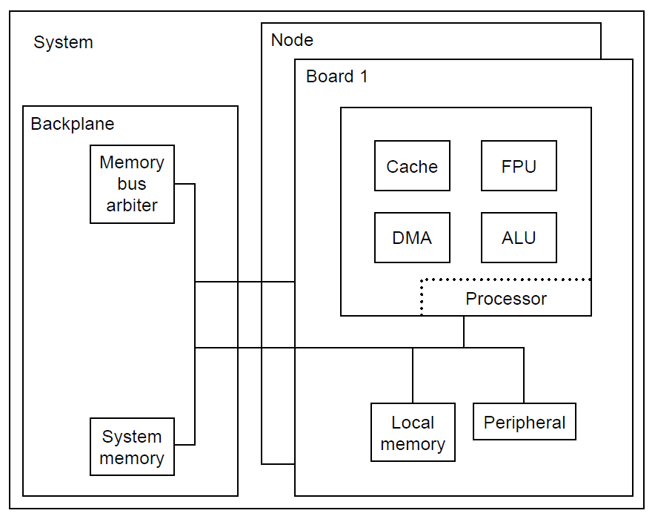
Verification Hierarchy
Designers of today’s complex chips do not create “flat” HDL. Instead, designers divide the system and chips into logical units. These logical units usually, but are not required to, follow the architecture for the system and chip.
This common practice is called hierarchical design.
Hierarchical design allows a designer to subdivide a complex problem into more manageable blocks. The design team combines these more manageable blocks to form bigger blocks; these blocks are merged until the chip or system is complete. Figure on the right shows an example of a large, complex system.
Can verification capitalize on this inherent design style? The answer is “absolutely!”
The same factors that drive the design team to break a complex chip into simpler components also suggest that verification teams take advantage of the same hierarchical designs.
A block diagram showing the multiple components of a large system. This system contains multiple processor boards, or nodes, hooked together with a backplane containing a bus adapter and system memory.

Slide 32
Levels of Hierarchy
Because designers divide the logic into hierarchical components, verification takes advantage of the same hierarchical boundaries, or “levels”.
There can be many levels of verification. Presented here are some typical levels, but actual implementations may have more or fewer levels depending on the complexity of the design.
The following list represents some potential levels, from lowest to highest:
  1. Designer
  2. Unit
  3. Core
  4. Chip
  5. Board and system
  6. Hardware/software co-verification
Figure on the right shows how the above hierarchical verification levels correspond to the large, complex system shown in the previous slide.
A hierarchical diagram of the multiple node system from previous slide showing the system built from the lower-level components. The designer level contains the HDL building blocks. For space reasons, the figure only shows the lowest level of the cache unit. However, every chip has units, and every unit has designer level HDL. Each of the next levels -unit, chip, board, and system - stitch together multiple lower-level blocks.
Notes:
Each of these levels of verification has strengths and weaknesses. Although most projects do not require all of these levels, complex designs need at least two levels of verification. Verification teams choose levels based on their unique design features and the complexity of the logic within the hierarchy.

Slide 33
Designers-Level Verification
The designer level (also called macro) is the lowest level. This level is often verified by the designer, hence its name. This level may be simply a “smoke test” in which the designer “certifies” the design’s use for the “real” verification environment.
The designer level of verification ensures that the design will load into the simulation engine and that the basic functions are correct.
The designer level tends to be very dynamic, especially at the beginning of a project. At this level, interfaces and functionality tend to change often. During the design phase, engineers often uncover problems that make altering or moving functions across HDL macro boundaries necessary, which, in turn, causes interfaces to change.
Because of the high number of designer level blocks in a system, it is not feasible to have a verification engineer verify each block independently, but due to a small size of these blocks verification engineers often use formal verification at this level of the hierarchy.
However, the blocks at the most risk should have an independent verification effort.

Slide 34
Unit-Level Verification
In large and complex designs, unit-level verification is needed. In the previous system diagram, the DMA, ALU, FPU, and cache blocks are all units.
The unit contains multiple designer level pieces of HDL that are stitched together into units. Interfaces and function are more stable than at the designer level, because units tend to have formalized specifications and physical or timing contracts to which designers adhere.
Because interfaces and specifications are more stable, the verification team can create a more advanced environment (using randomized stimuli and autonomous checking).
To facilitate verification, the design should be partitioned so that the units have fully contained functions. These verification requirements are synergetic with the hierarchical design partitioning, which facilitates larger design efforts.
Although the purpose of the unit level is to verify fully the functionality of the unit, there may be certain functions that the verification team cannot verify here, such as function split across multiple units.
Once the unit level is verified, the verification engineer can proceed to higher levels of verification, knowing that the unit’s basic functionality is correct. The higher levels must then verify that the connectivity and interface protocols to and from the unit are correct.

Slide 35
Core-Level Verification
A core is a special, reusable unit which requires a complete functional specification with stable interfaces. Designers may use a core multiple times within a system and across multiple systems. They may create the core internally or obtain it from an external source.
The verification of a core is a double-edged sword. The positive is that once verified, reusing a core should not add a burden to the verification effort.
The drawback to core-level verification is that because designers may use cores in many different applications across a system or multiple systems, the usage of each instance may be different.
This drives a broader verification effort because the verification team may not know all of the actual interface and application parameters in which the design team will place the core.
The verification cycle for a reusable core includes a regression suite, well-documented specification (functions and interfaces), coverage items (to help indicate what has been verified), and possibly verification scenarios (these scenarios are the ones in the regression suite).
Notes:
A core is a special, reusable unit which requires a complete functional specification with stable interfaces. Designers may use a core multiple times within a system and across multiple systems. They may create the core internally, or obtain it from an external source.
The verification of a core is a double-edged sword. The positive is that once verified, reusing a core should not add a burden to the verification effort. For example, a core that the engineering team reuses 10 times in a design needs just one strong verification effort, saving the need to verify it nine other times. The drawback to core-level verification is that because designers may use cores in many different applications across a system or multiple systems, the usage of each instance may be different. This drives a broader verification effort because the verification team may not know all of the actual interface and application parameters in which the design team will place the core. Engineers can be very creative when it comes to using a core, exercising it in ways different from the primary intentions. Therefore, the verification team must think outside the box when verifying a core, allowing for a broader range of input scenarios than the core’s initial use. Thus, the bounds in which the verification team works on a core are less defined and put a bigger burden on the team to verify the core in a more aggressive manner, as they must dream of “weird” scenarios.
When the core will be used by outside design teams, the verification team must employ a well-defined process, as engineers shy away from cores they do not trust. The key question when designing and verifying a core that other design teams will use is, “How do I gain my customers’ confidence?” This is where a well-defined process helps. The verification cycle for a reusable core includes a regression suite, well-documented specification (functions and interfaces), coverage items (to help indicate what has been verified), and possibly verification scenarios (these scenarios are the ones in the regression suite). The well-documented specification teaches the end-user about the core, and the verification scenarios indicate the bounds and depth of the core verification effort. The regression suite exists for when designers make changes to the core. When this occurs, the verification team runs this suite of verification tests to ensure that this fix or enhancement did not cause any other problems within the core.

Slide 36
Chip-Level Verification
The chip level is composed of multiple units. At this level, there are very well defined interface boundaries.
The purpose of this verification is to ensure that the units are properly connected and that the design adheres to all unit interface protocols.
However, there may also be functions that could not be validated at the unit level; these functions require full testing at the chip level.
The well-defined interface of a chip creates a huge advantage for the verification team at this level.
Designers must solidify the physical chip pin definitions early in the design process, giving the verification team a stable base on which they can create chip level test suites.
Although lower-level environments and designs tend to evolve throughout the project, chip-level verification requires less maintenance.

Slide 37
Board and System-Level Verification
A board is a collection of chips that may also contain some discrete, “glue” logic (AND gates, OR gates, etc.).
The purpose of this level of verification is to confirm the chip interconnection, integration, and board design.
The definition of a system is different across industry segments and product lines.
The verification focus at the system level is that of interaction rather than particular functions buried inside a chip or unit.
As a result, a verification team working on a large ASIC or FPGA will assume that previous verification efforts on its units and cores specified, documented, and fully verified the lower levels below the system level.
Because the focus is on component interaction, the verification engineer assumes that the individual chips, cores, or units are functionally correct.

Slide 38
What Level to Choose?
Choosing which verification levels to use is not as easy as it may seem.
Although six levels of hardware verification were described above, most verification projects will use an appropriate subset of these levels based on the design details.
There are technical factors that help teams decide which levels to choose for a given design. These factors are highlighted here.
  Always choose the lowest level that completely contains the targeted function.
  Each verifiable piece should have its own specification document.
  New or complex components need focus.
  The appropriate level of control and observability drives decisions on which levels to verify.
  Function may dictate verification levels.
Notes:
Choosing which verification levels to use is not as easy as it may seem. Although six levels of hardware verification were described above, most verification projects will use an appropriate subset of these levels based on the design details. A single system on chip (SoC) may need unit-level verification on certain new blocks, followed by a chip/system-level effort. On the other hand, a complex server would need verification at the designer, unit, chip, system, and coverification levels.
There are technical factors that help teams decide which levels to choose for a given design. These factors are highlighted here.
Always choose the lowest level that completely contains the targeted function. The smaller the model, the more direct control the verification engineer has over creating the required test scenarios. A test that exercises the board in the previous does not need a system-level model containing the node and the backplane. These extra design pieces have a negative effect on simulation engine performance without providing any benefit to the test.
Each verifiable piece should have its own specification document. This helps keep interfaces and the function more stable, as well as allows everyone on the team to be “reading from the same sheet of music.” If functions and interfaces change often, then verification environments must change as well (with recoding each time).
New or complex components need focus. If a portion of function is new (versus function inherited from previous designs) or complex, then the verification team should isolate this function and create an environment to test it. Complex functions often have arbitration logic or multiple requestors vying for a single resource. This type of function lends itself to creation of robust, focused verification environments.
The appropriate level of control and observability drives decisions on which levels to verify. The lower the verification level, the more control the verification engineer has on the interface inputs, and the more observability on the outputs. This comes at a price of additional effort. Robust designer-level verification on all macrocomponents in a large system is not realistic, as more effort is required to construct each environment for each macro. Instead, only the complex macros have individual verification, leaving the less risky components to the higher levels. When dealing with higher levels of verification (chip, board, system), the team implicitly verifies the smaller components at the cost of lower control and observability.
Function may dictate verification levels. Verification engineers cannot verify certain functions at the lower levels. Often, this is because a function spans multiple components. Although the verification environment can test each component individually, the environment can prove only portions of the whole function. At a higher level, the team assembles all of the components and verifies the entire function.

Slide 39
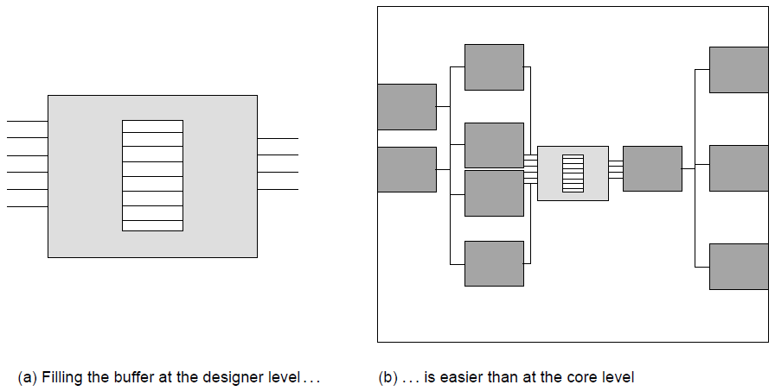
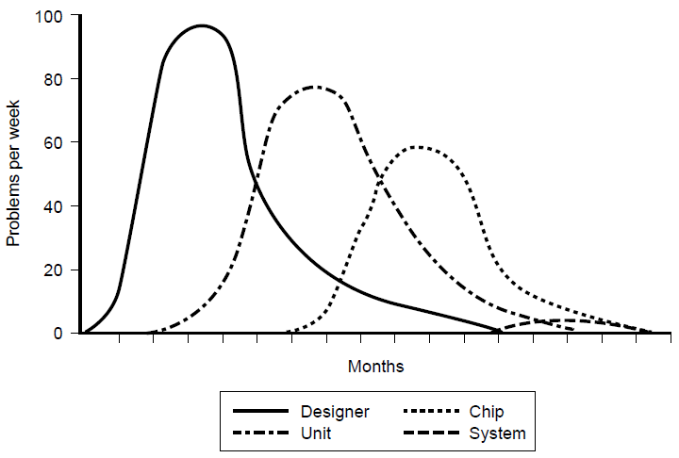
Bug Rates and the Levels at Which They are Found
The amount of controllability and observability that the verification engineer has directly correlates to the ability to find bugs in the design.
Controllability indicates the ease at which the verification engineer creates the specific scenarios that are of interest. Controllability and the verification level of hierarchy are closely related, as shown on the top figure.
Observability indicates the ease with which the verification engineer can identify when the design acts appropriately versus when it demonstrates incorrect behavior.
The increased ability to find bugs at the lower levels fit nicely with the design cycle as well.
It is good practice to progress the verification focus from the lower levels to the higher levels over time, yielding bug rates and trends as shown in the bottom figure.
Notes:
The amount of controllability and observability that the verification engineer has directly correlates to the ability to find bugs in the design. Controllability indicates the ease at which the verification engineer creates the specific scenarios that are of interest. If a design contains a bug but the input scenario conditions that create the bug never occur, the verification engineer will not discover the bug in simulation. Controllability and the verification level of hierarchy are closely related. The higher the level of the hierarchy, the less controllability the verification engineer has. Verification engineers have greater controllability at lower levels because there are fewer dependencies on the surrounding units to cause the scenario.
As an example, a verification engineer wants to create a buffer-full condition in a macro within a core. If the level of hierarchy is the designer level, in which just the macro exists in the simulation environment, the verification engineer simply controls the input signals by pushing data into the buffer without ever popping the data. However, at the higher core level of verification, it is much harder to create this condition because the core level inputs are further from the buffer, and the behavior of the surrounding macros and units may continuously pop data from the buffer unless a very specific core level event occurs. This makes it difficult to fill the buffer. Top figure depicts these two cases: in Figure (a), the verification engineer can directly control the state of the buffer; in Figure (b), the control is indirect because of all of the surrounding logic.
Observability is the other aspect in discovering bugs. Observability indicates the ease with which the verification engineer can identify when the design acts appropriately versus when it demonstrates incorrect behavior. Lower levels of verification are conducive to observability because bugs are more likely to manifest themselves on the outputs. At the higher levels, it is often harder to observe interesting bugs without internal observation points.
The increased ability to find bugs at the lower levels fit nicely with the design cycle as well. Each designer on the team works at a different rate and pace. Therefore, not all macros in a project are ready for verification simultaneously. Designer- or unit-level verification may be available on early blocks long before an entire chip is ready for verification. As a result, it is good practice to progress the verification focus from the lower levels to the higher levels over time. This practice typically yields bug rates and trends as shown in the bottom figure. It is an efficient practice to wait until the bug rate begins to drop in a lower level before moving to the next level.
Cost of Bugs
A bug found at the designer level has little cost. The designer has the algorithms and decision process of the HDL fresh in his or her mind, and finding a bug quickly may drive the designer to implement the function differently, long before physical design or timing of the macro occurs. That same bug found at chip or system level has moderate cost because it will require more problem isolation and debug time. Furthermore, the designer may no longer be able to re-implement the function in a more effective manner because the required rework of physical design on this and other macros would break the schedule.

Slide 40
Verification Flow
Strategy of Verification

Slide 41
Strategy of Verification
The previous discussion of controllability and observability illustrates that the verification engineer divides work into two separate tasks:
  driving (controllability) and
  checking (observability) the design under test.
The two tasks correspond to the following basic questions a verification engineer must ask:
  1. Am I driving all possible input scenarios?
  2. How will I know when a failure has occurred?
These tasks are separate but must work together to succeed. A verification engineer captures a bug if the design inputs aggravate the failing condition and if a checker flags an illegal state. One is inadequate without the other.
Driving all possible combinations of inputs cannot uncover a bug if the checkers fail to identify the bad condition. Likewise, checking for all possible failures is futile if the drivers fail to stimulate the conditions that cause the failure. Drivers and checkers are the yin and yang of verification.

Slide 42
Driving Principles I
When charged with verifying a piece of design, the verification engineer should first read whatever documentation exists for that design. The first task is to understand all input and output lines. The verification engineer must then understand the design’s function and thereby be able to predict the outputs based on the inputs. It is important that the verification engineer obtain the input descriptions from a source other than the author of the HDL under test.
With the input definitions understood, the verification engineer begins to plan a stimulus strategy. The verification engineer will group multiple signals together based on their logical function. This is important because separate driving strategies for each set of grouped input signals will be developed.
In developing a stimulus strategy, the verification engineer must always remember the goal is to maximize the scenarios that the verification environment creates.
For control signals, this means ensuring that the environment exercises all possible commands and modifiers. For data busses, the environment should create a wide assortment of possible data patterns. It is especially important for the environment to exercise edge cases when data patterns are chosen.
Notes:
What does it mean to “drive all possible input scenarios”? Although driving all possible input scenarios is trivial with a two-latch design, it is very hard to gauge completeness of input scenarios in a complex design. And what does it mean to “know when it fails”? How can we know if a complete set of checkers are in place?
To analyze these questions, first look at the “black box”. The black box is a piece of HDL, which is called a black box because verification engineers do not look inside the design implementation. The verification engineer does look at its inputs and outputs, their definitions, and their functions. The actual behavior of the black box and its outputs will depend on the inputs supplied to it over time and the function it performs. Given a set of input stimuli, the function of the black box will yield specific, predictable values over one or more machine cycles.
The black box may have complete documentation, or not. The amount of documentation required and the quality of documentation varies by the designer, the company policy, and the size of the black box. Larger pieces of design (which are higher in the design’s hierarchy) tend to have more documentation. Smaller portions of HDL (lowest levels of the hierarchy) tend to have embedded documentation but not separate functional descriptions.
When charged with verifying a piece of design, the verification engineer should first read whatever documentation exists for that design. The first task is to understand all input and output lines. The verification engineer must then understand the design’s function and thereby be able to predict the outputs based on the inputs. This is the design’s specification.
It is important that the verification engineer obtain the input descriptions from a source other than the author of the HDL under test. This source might be an industry standard specification (such as a Peripheral Component Interconnect (PCI) protocol) or another designer whose HDL outputs are the inputs to the HDL under test. This is significant because the verification engineer must maintain independence in understanding the design inputs in order to break the redundancy path. If the DUV designer authors the input specification, the verification engineer would duplicate any incorrect input understanding that the DUV designer has and bugs may be missed. If the interface specification must come from the designer whose logic is under test, the verification engineer should ensure that other designers sign off on the contents as matching their expectations of what their logic will drive into the DUV.
With the input definitions understood, the verification engineer begins to plan a stimulus strategy. Often, a design has a large number of input signals. In this case, the verification engineer will group multiple signals together based on their logical function. For example, a memory design’s command and address busses function hand in hand to access or store data at the intended memory location. Other memory DUV input signals might support different functions such as resetting the design. Grouping signals and busses together is important because the verification engineer will develop separate driving strategies for each set of grouped input signals.
In developing a stimulus strategy, the verification engineer must always remember the goal is to maximize the scenarios that the verification environment creates. For control signals, this means ensuring that the environment exercises all possible commands and modifiers. For data busses, the environment should create a wide assortment of possible data patterns. It is especially important for the environment to exercise edge cases when data patterns are choosen. Edge cases create odd, exception, or end conditions in the design such as storing to the last address in memory or causing an overflow in an adder.

Slide 43
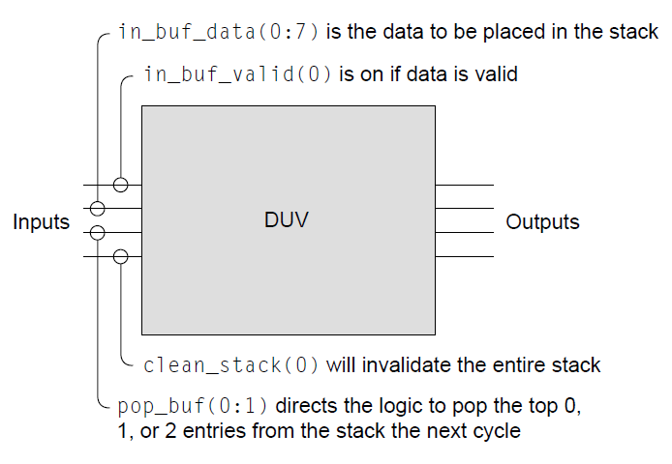
Driving Principles II
Consider black box with brief description of four inputs
From what we see, we can conclude that:
  There is a stack inside
  The stack is at least two deep
  The stack is 8 bits wide
  Only one entry can be written at the time
There are still plenty of unknowns like:
  Is the stack LIFO or FIFO?
  How deep is the stack?
  What condition indicates a full stack?
  When do the contents become valid?
  What is the behavior if a read and write occur on the same cycle? Is this even allowed?
  How long does it take to clean the stack?
  Do the entries get zeroed-out or just marked invalid?
  What happens if a read operation occurs when the stack is empty?
  In case of reading two entries, how are the two data items returned? Back to back or one at the time?
  What happens if pop_buf(0:1) is set to "11"b (three reads)?
Notes:
What does it mean to “drive all possible input scenarios”? Although driving all possible input scenarios is trivial with a two-latch design, it is very hard to gauge completeness of input scenarios in a complex design. And what does it mean to “know when it fails”? How can we know if a complete set of checkers are in place?
To analyze these questions, first look at the “black box”. The black box is a piece of HDL, which is called a black box because verification engineers do not look inside the design implementation. The verification engineer does look at its inputs and outputs, their definitions, and their functions. The actual behavior of the black box and its outputs will depend on the inputs supplied to it over time and the function it performs. Given a set of input stimuli, the function of the black box will yield specific, predictable values over one or more machine cycles.
The black box may have complete documentation, or not. The amount of documentation required and the quality of documentation varies by the designer, the company policy, and the size of the black box. Larger pieces of design (which are higher in the design’s hierarchy) tend to have more documentation. Smaller portions of HDL (lowest levels of the hierarchy) tend to have embedded documentation but not separate functional descriptions.
When charged with verifying a piece of design, the verification engineer should first read whatever documentation exists for that design. The first task is to understand all input and output lines. The verification engineer must then understand the design’s function and thereby be able to predict the outputs based on the inputs. This is the design’s specification.
It is important that the verification engineer obtain the input descriptions from a source other than the author of the HDL under test. This source might be an industry standard specification (such as a Peripheral Component Interconnect (PCI) protocol) or another designer whose HDL outputs are the inputs to the HDL under test. This is significant because the verification engineer must maintain independence in understanding the design inputs in order to break the redundancy path. If the DUV designer authors the input specification, the verification engineer would duplicate any incorrect input understanding that the DUV designer has and bugs may be missed. If the interface specification must come from the designer whose logic is under test, the verification engineer should ensure that other designers sign off on the contents as matching their expectations of what their logic will drive into the DUV.
With the input definitions understood, the verification engineer begins to plan a stimulus strategy. Often, a design has a large number of input signals. In this case, the verification engineer will group multiple signals together based on their logical function. For example, a memory design’s command and address busses function hand in hand to access or store data at the intended memory location. Other memory DUV input signals might support different functions such as resetting the design. Grouping signals and busses together is important because the verification engineer will develop separate driving strategies for each set of grouped input signals.
In developing a stimulus strategy, the verification engineer must always remember the goal is to maximize the scenarios that the verification environment creates. For control signals, this means ensuring that the environment exercises all possible commands and modifiers. For data busses, the environment should create a wide assortment of possible data patterns. It is especially important for the environment to exercise edge cases when data patterns are choosen. Edge cases create odd, exception, or end conditions in the design such as storing to the last address in memory or causing an overflow in an adder.

Slide 44
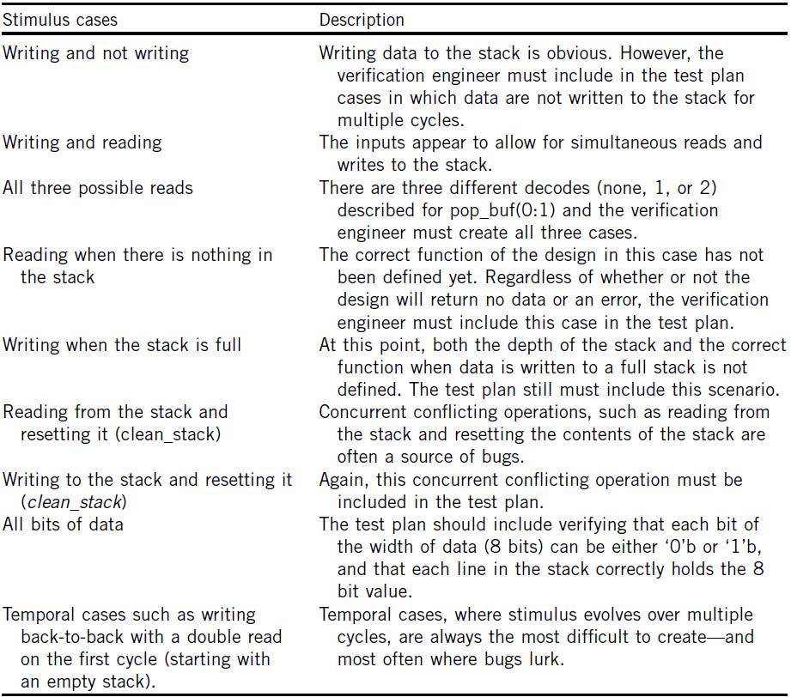
Driving Principles III – what tests to include?
Notes:
What does it mean to “drive all possible input scenarios”? Although driving all possible input scenarios is trivial with a two-latch design, it is very hard to gauge completeness of input scenarios in a complex design. And what does it mean to “know when it fails”? How can we know if a complete set of checkers are in place?
To analyze these questions, first look at the “black box”. The black box is a piece of HDL, which is called a black box because verification engineers do not look inside the design implementation. The verification engineer does look at its inputs and outputs, their definitions, and their functions. The actual behavior of the black box and its outputs will depend on the inputs supplied to it over time and the function it performs. Given a set of input stimuli, the function of the black box will yield specific, predictable values over one or more machine cycles.
The black box may have complete documentation, or not. The amount of documentation required and the quality of documentation varies by the designer, the company policy, and the size of the black box. Larger pieces of design (which are higher in the design’s hierarchy) tend to have more documentation. Smaller portions of HDL (lowest levels of the hierarchy) tend to have embedded documentation but not separate functional descriptions.
When charged with verifying a piece of design, the verification engineer should first read whatever documentation exists for that design. The first task is to understand all input and output lines. The verification engineer must then understand the design’s function and thereby be able to predict the outputs based on the inputs. This is the design’s specification.
It is important that the verification engineer obtain the input descriptions from a source other than the author of the HDL under test. This source might be an industry standard specification (such as a Peripheral Component Interconnect (PCI) protocol) or another designer whose HDL outputs are the inputs to the HDL under test. This is significant because the verification engineer must maintain independence in understanding the design inputs in order to break the redundancy path. If the DUV designer authors the input specification, the verification engineer would duplicate any incorrect input understanding that the DUV designer has and bugs may be missed. If the interface specification must come from the designer whose logic is under test, the verification engineer should ensure that other designers sign off on the contents as matching their expectations of what their logic will drive into the DUV.
With the input definitions understood, the verification engineer begins to plan a stimulus strategy. Often, a design has a large number of input signals. In this case, the verification engineer will group multiple signals together based on their logical function. For example, a memory design’s command and address busses function hand in hand to access or store data at the intended memory location. Other memory DUV input signals might support different functions such as resetting the design. Grouping signals and busses together is important because the verification engineer will develop separate driving strategies for each set of grouped input signals.
In developing a stimulus strategy, the verification engineer must always remember the goal is to maximize the scenarios that the verification environment creates. For control signals, this means ensuring that the environment exercises all possible commands and modifiers. For data busses, the environment should create a wide assortment of possible data patterns. It is especially important for the environment to exercise edge cases when data patterns are choosen. Edge cases create odd, exception, or end conditions in the design such as storing to the last address in memory or causing an overflow in an adder.

Slide 45
Checking Strategies
Stimulus and checking are tightly coupled. Although the verification stimulus engines drive inputs, it is the checker’s job to ensure that the DUV behaves correctly based on the stimulus.
A DUV behaves correctly when it abides by the design specification and intended function.
There are four main sources of checkers. The design and architecture teams document these sources in various specifications, and the verification engineer must understand each of these sources to create environments that contain complete checking.
The four sources are as follows:
  The inputs and outputs of the design
  The context of the design
  The microarchitecture rules of the design
  The architecture of the design
Notes:
A fundamental source of checkers is the outputs of the DUV because any bug in the design will at some point manifest itself at the outputs of the design. With robust drivers, most bugs will show up as a miscompare on an output of the design. A miscompare occurs when the actual DUV data does not match the expected data from the checker.
When verifying HDL at the lower levels of the design hierarchy, it is important for the verification engineer to understand the design’s higher level functionality, or design context. A verification engineer must understand the big picture, even when focusing on a specific portion of the design.
Verification teams derive many checkers from properties based on the microarchitecture, or internal structures of the design, so verification engineers must understand the internals of the design.
Most verification checkers have their roots in the design architecture. Although the microarchitecture defines the structures that compose the design, the architecture dictates how the design must act. Industry standards groups and companies publish architecture specifications for public protocols, programmable processing units, and system structures. Hardware designs must abide by these specifications. The architecture lends itself to being the verification engineer’s main source of checkers because of the strict requirements on documenting the architecture.

Slide 46
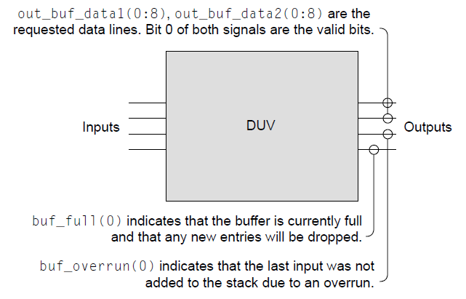
Checking the black box I
With short description of the outputs, some questions from before are answered:
  In the case of double read, entries come simultaneously
  The logic within the black box indicates when the stack is full
  The input driver must retry when overflow occurs, as the data is discarded
The design and architecture team produces a specification which reveals the following:
  The stack is seven deep
  A new stack entry is valid for reading the next cycle
  The stack reset completes the cycle after a clean command, and the design ignores inputs arriving simultaneous with a clean command
  The clean command turns the valid bit off on all seven entries
  No data are returned for a read if the stack is empty
  The stack is a FIFO
  Buff_full and buff_overrun outputs are both required because buf_full becomes active the cycle after the design receives the data that fill the stack
Notes:
A fundamental source of checkers is the outputs of the DUV because any bug in the design will at some point manifest itself at the outputs of the design. With robust drivers, most bugs will show up as a miscompare on an output of the design. A miscompare occurs when the actual DUV data does not match the expected data from the checker.
When verifying HDL at the lower levels of the design hierarchy, it is important for the verification engineer to understand the design’s higher level functionality, or design context. A verification engineer must understand the big picture, even when focusing on a specific portion of the design.
Verification teams derive many checkers from properties based on the microarchitecture, or internal structures of the design, so verification engineers must understand the internals of the design.
Most verification checkers have their roots in the design architecture. Although the microarchitecture defines the structures that compose the design, the architecture dictates how the design must act. Industry standards groups and companies publish architecture specifications for public protocols, programmable processing units, and system structures. Hardware designs must abide by these specifications. The architecture lends itself to being the verification engineer’s main source of checkers because of the strict requirements on documenting the architecture.

Slide 47
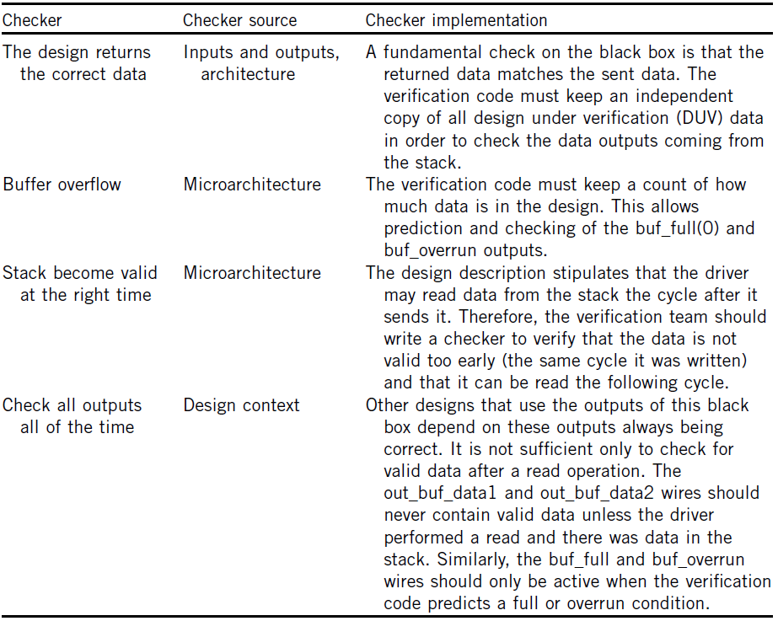
Checking the black box II – test plan for checkers
Notes:
A fundamental source of checkers is the outputs of the DUV because any bug in the design will at some point manifest itself at the outputs of the design. With robust drivers, most bugs will show up as a miscompare on an output of the design. A miscompare occurs when the actual DUV data does not match the expected data from the checker.
When verifying HDL at the lower levels of the design hierarchy, it is important for the verification engineer to understand the design’s higher level functionality, or design context. A verification engineer must understand the big picture, even when focusing on a specific portion of the design.
Verification teams derive many checkers from properties based on the microarchitecture, or internal structures of the design, so verification engineers must understand the internals of the design.
Most verification checkers have their roots in the design architecture. Although the microarchitecture defines the structures that compose the design, the architecture dictates how the design must act. Industry standards groups and companies publish architecture specifications for public protocols, programmable processing units, and system structures. Hardware designs must abide by these specifications. The architecture lends itself to being the verification engineer’s main source of checkers because of the strict requirements on documenting the architecture.

Slide 48
Verification Checking Shouldn't Reimplement the Design I
The verification engineer must remain independent while maintaining a close working relationship with the design team.
This is especially important when checking code for verification is being created.
Although the verification engineer is allowed to know the design implementation, the checking code should not mirror the design algorithm.
The verification engineer must always start with the assumption that the design implementation is wrong.
If the checking code mirrors the design, the potential exists for the checkers to implement a bug in the same fashion that the design did.
This breaks the redundancy path and would cause the bug to go undetected, as both the design and checker results match.

Slide 49
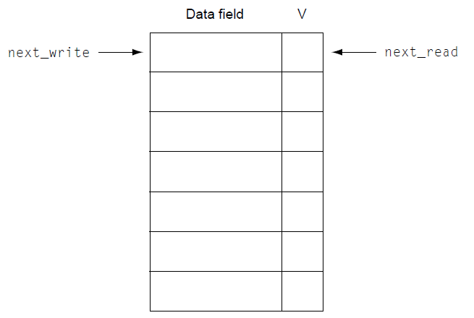
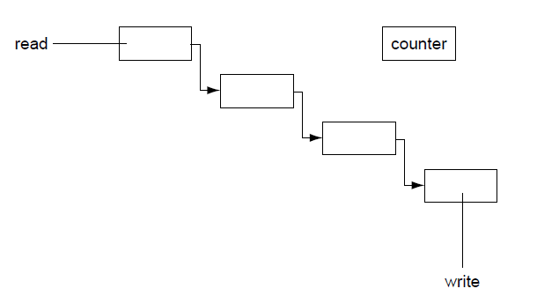
Verification Checking Shouldn't Reimplement the Design II
As example, consider design implementation of a stack from a black box:
  Next_read pointer indicates which position to read for the next read command
  Next_write pointer indicates on which position to put next written data
  V is a valid bit for the each entry
  When pointers are the same, stack is either full or emtpy, depending on the value of V
Verification checking code can:
  Create a seven-deep stack and use pointers as in the design or
  Create a linked list, checking structure with different and independent implementation (with additional counter incremented for each write decremented for each read)

Slide 50
Putting it all together – complex bug example I
Consider following bug scenario:
  Design description states that asserting clean_stack to "1" will clear all data valid bits in the stack
  Both next_read and next_write pointer will be set to the top of the stack
  If the driver sets in_buf_valid to "1" with data in the same cycle as clean_stack, the logic resets the pointers as intended but erroneously puts the data in the stack
  This case only occurs when the stack has 6 valid entries when clean_stack and in_buf_valid are set, since the bug is in the logic that tries to set buf_full output
In order to find a bug, a verification engineer must:
  Enough writes to stack to make sure 6 entries are there
  Test case must set the clean_stack and in_buf_valid signals simultaneously
  Now stack has erroneous value, but the bug will not be manifested at the outputs
  If a second clean_stack occurs over the next few cycles the design would clear its erroneous behavior and the bug will escape undetected
Notes:
A fundamental source of checkers is the outputs of the DUV because any bug in the design will at some point manifest itself at the outputs of the design. With robust drivers, most bugs will show up as a miscompare on an output of the design. A miscompare occurs when the actual DUV data does not match the expected data from the checker.
When verifying HDL at the lower levels of the design hierarchy, it is important for the verification engineer to understand the design’s higher level functionality, or design context. A verification engineer must understand the big picture, even when focusing on a specific portion of the design.
Verification teams derive many checkers from properties based on the microarchitecture, or internal structures of the design, so verification engineers must understand the internals of the design.
Most verification checkers have their roots in the design architecture. Although the microarchitecture defines the structures that compose the design, the architecture dictates how the design must act. Industry standards groups and companies publish architecture specifications for public protocols, programmable processing units, and system structures. Hardware designs must abide by these specifications. The architecture lends itself to being the verification engineer’s main source of checkers because of the strict requirements on documenting the architecture.

Slide 51
Putting it all together – complex bug example II
To detect the bug, checkers are equally important
The bug could show up in any one of the following three ways:
  The first is a mis-compare on the buf_full output signal: the buf_full is set to "1" because the next_write points to an entry marked valid when it should not be valid: because there is supposed to be only six entries in the seven-deep stack, the checker flags the bug
  The second one is the incorrect data on the out_buf_data1 or out_buf_data2, which occurs when the HDL responds to a read request by sending the data in the stack position of the erroneously set valid bit: the checking code predicts the output data to be the first data written after clean_stack occurred, but the HDL returns different data and environment finds the bug
  The last one is that the checkers may discover the bug when the HDL sets the buf_overrun output signal too soon: HDL's write pointer detects that it is pointing to a valid entry when another write comes in, only after writing six values to the stack, but all seven locations containing valid bits set
Notes:
A fundamental source of checkers is the outputs of the DUV because any bug in the design will at some point manifest itself at the outputs of the design. With robust drivers, most bugs will show up as a miscompare on an output of the design. A miscompare occurs when the actual DUV data does not match the expected data from the checker.
When verifying HDL at the lower levels of the design hierarchy, it is important for the verification engineer to understand the design’s higher level functionality, or design context. A verification engineer must understand the big picture, even when focusing on a specific portion of the design.
Verification teams derive many checkers from properties based on the microarchitecture, or internal structures of the design, so verification engineers must understand the internals of the design.
Most verification checkers have their roots in the design architecture. Although the microarchitecture defines the structures that compose the design, the architecture dictates how the design must act. Industry standards groups and companies publish architecture specifications for public protocols, programmable processing units, and system structures. Hardware designs must abide by these specifications. The architecture lends itself to being the verification engineer’s main source of checkers because of the strict requirements on documenting the architecture.

Slide 52
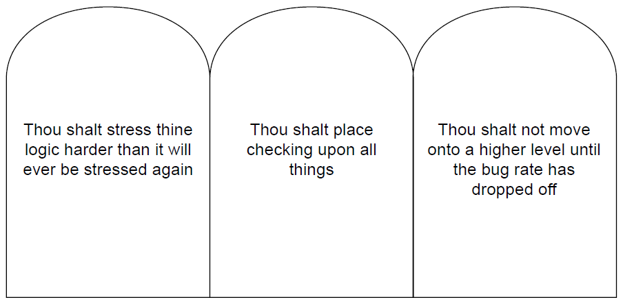
Putting it All Together – The Three Simulation Commandments
The essence of verification lies in the fundamental completeness of the stimulus and checking components, and the use of these components across verification levels.
This foundation is so important that it comprises the three simulation commandments shown in the figure.
The commandments edict the highest quality of stimulus, checker, and monitor components and the appropriate time to move from one verification level to the next.

Slide 53
The General Simulation Environment
Figure shows the flow of the general simulation-based verification environment.
The verification engineer writes a test case and supplies environmental data, such as initial values, to the simulation engine, and the designer supplies the logic description in the form of an HDL.
The environmental data may be required for both the test case driver and simulation engine.
A step called model-build compiles the HDL into a simulation model, which is the format that the simulation engine uses to step through cycles and reproduce the behavior of the design.
Simulation engines provide many types of outputs. Designers and verification engineers use these files to analyze the behavior of the DUV.
Notes:
Verification methodologies continue to evolve. In earlier days of hardware design, engineers first performed verification on the fabricated hardware itself. As the designs became more complex, design automation teams created simulation engines to model the behavior of the design. A description of the general simulation-based verification environment, which became the springboard for the evolution of the methodology, now follows.
Figure shows the flow of the general simulation-based verification environment. The verification engineer writes a test case and supplies environmental data, such as initial values, to the simulation engine, and the designer supplies the logic description in the form of an HDL. In this picture, the test case is generic. No matter what the form of the test case, the environment presents it to the simulation engine either directly or indirectly through a compiler or test case driver. The environmental data may be required for both the test case driver and simulation engine. A step called model-build compiles the HDL into a simulation model, which is the format that the simulation engine uses to step through cycles and reproduce the behavior of the design.
Simulation engines provide many types of outputs. All simulation engines have the ability to produce traces of the activity that took place within the design during the simulation run. Designers and verification engineers use waveform viewers to read the trace output files. Depending on the type of test case, other output files include data on miscompares identified by the verification code, as well as text-based results files.

Slide 54
Fundamentals of Simulation-Based Verification
Basic Verification Environment: A Test Bench

Slide 55
Basic Verification Environment: A Test Bench
The verification environment models the universe for the design and must support all actions that can happen to the design.
The basic environment, shown on the figure, consists of the design or logic that is being verified, stimulus components, monitor components, checking components, and scoreboard components.
This environment is referred to as a test bench. In general, a test bench is all the code used to create, observe, and check a pre-determined (“deterministic”) input sequence to the design.
The test bench, or environment, is a closed system, meaning that the top level of the test bench has no inputs or outputs. It is effectively a model of the universe from the design-under-verification (DUV) standpoint.
Next, we will look at each component in the test bench.
Notes:
The verification environment models the universe for the design and must support all actions that can happen to the design. The basic environment consists of the design or logic that is being verified, stimulus components, monitor components, checking components, and scoreboard components (some environments may not include a scoreboard). Figure on the right shows a diagram of a basic verification environment.
This environment is referred to as a test bench. In general, a test bench is all the code used to create, observe, and check a pre-determined (“deterministic”) input sequence to the design. This pre-determined input sequence may be generated in a direct approach or by a random method. The test bench, or environment, is a closed system, meaning that the top level of the test bench has no inputs or outputs. It is effectively a model of the universe from the design-under-verification (DUV) standpoint.
The verification engineer must create the code for the components of this test bench universe, and the logic designer creates the hardware description language (HDL) for the DUV. These components can be written in the HDL itself, in a language that was designed for verification (HVL, a high-level verification language), or in a general-purpose programming language such as C/C++. In the case of an HVL or programming language, the code communicates to the simulation engine through an application programming interface (API). Occasionally, it is necessary to mix and match the languages in which the components are written. An outside customer’s model may even be required in the verification environment.
The challenge for a verification engineer is to create a test bench that stimulates the design with interesting input patterns (ideally, these patterns should cover all the functionality of the design if possible, or at least as much as possible) and calculates the expected responses for the outputs based on those input patterns. The design can be said to be functioning as intended by exercising all the functionality and by predicting and checking all responses.

Slide 56
Stimulus Component
The stimulus component manipulates inputs to the DUV.
Typically, the stimulus component code mimics the behavior of a neighboring design entity or entities.
In creating the stimulus component, the verification engineer should not model the entire behavior of the neighboring design component; instead, the stimulus component should only mimic the interface inputs to the DUV.
The stimulus engine must drive what the DUV is capable of accepting and not restrict itself to what the real neighboring design component might send.
This allows the verification engineer to exert a maximum amount of stress on the DUV. If possible, this stress level should exceed that which will ever occur in a customer environment.
By exceeding the limits of the design, the verification engineer is more likely to encounter seldom seen occurrences, called corner cases, in the DUV. These corner cases otherwise might never be seen until hundreds of trillions of cycles of hardware test.
Notes:
The stimulus component manipulates inputs to the DUV. Stimulus models are also known as drivers, behaviorals, agitators, irritators, or generators. Typically, the stimulus component code mimics the behavior of a neighboring design entity or entities. In creating the stimulus component, the verification engineer should not model the entire behavior of the neighboring design component; instead, the stimulus component should only mimic the interface inputs to the DUV. This not only makes the simulation code easier to maintain but also allows the stimulus engine to drive the interfaces free of the burden of the realities of the neighboring design component it is mimicking. The stimulus component only needs to concern itself with the behavior of the inputs that affect the DUV.
For example, the real design component may have an eight-deep queue that, when full, inhibits sending a control signal to the DUV, even if the DUV could accept the control signal. The stimulus component only concerns itself with the availability of the DUV to accept the control signal, not whether the real design component’s queue is full.
This is a key concept in verification. The stimulus engine must drive what the DUV is capable of accepting and not restrict itself to what the real neighboring design component might send. This allows the verification engineer to exert a maximum amount of stress on the DUV. If possible, this stress level should exceed that which will ever occur in a customer environment. By exceeding the limits of the design, the verification engineer is more likely to encounter seldom seen occurrences, called corner cases, in the DUV. These corner cases otherwise might never be seen until hundreds of trillions of cycles of hardware test. This concept of “over-stressing” the DUV allows the verification engineer to compete with the relatively infinite number of cycles run in fabricated hardware.
All stimulus components must understand the complete interface protocol; that is, they must be capable of mimicking all possible variations of the protocol. This must occur so that the DUV is stimulated in all possible ways. Without full protocol stimulus capability, the model is incomplete.
Sometimes these verification components have configuration settings that allow the model to work in different environments or levels. These settings indicate to the stimulus component how it should behave.
It is also interesting to place a model in a mode in which all it does is generate bus traffic that is not used. This just irritates the system with “noise.” Then when real bus commands are performed, different results occur because the irritator is running.
A final job of the stimulus component is to track its activity for possible post-simulation analysis of the test case. The stimulus components should record events into a file used for initial test case debugging.

Slide 57
Deciding What To Model
The verification engineer should use the design specification when deciding on what to model from a behavioral standpoint.
If the DUV does not have a specification, the verification engineer should interview the designer of the neighboring design component to understand the protocols.
The verification engineer should not rely on the DUV designer for interface protocol specification because this breaks the redundancy model built into the verification cycle.
There are two types of stimulus models:
  initiators and
  responders.
Notes:
The verification engineer should use the design specification when deciding on what to model from a behavioral standpoint. If the DUV does not have a specification, the verification engineer should interview the designer of the neighboring design component to understand the protocols. This provides a cross-check of the DUV designer’s assumptions. At this level, the verification team should find miscommunications between designers.
The verification engineer should not rely on the DUV designer for interface protocol specification because this breaks the redundancy model built into the verification cycle. The designer could misunderstand a part of the agreed on communications scheme and thus bias the stimulus model such that both the HDL and the stimulus component code the incorrect or incomplete behavior. A second concern with receiving input definitions from the designer of the DUV is that the designer may bias the verification engineer about what will occur on the interface. This could lead the verification engineer to miss stimulating certain boundary conditions.
The deterministic test bench stimulus component mainly has outputs that drive the DUV. The only inputs to these stimulus components will be those necessary for their behavior, such as a clock or reset signal. However, more complex stimulus generation components will have inputs that control the stimulus generation.
There are two types of stimulus models: initiators and responders. An initiator is a stimulus model that will initiate a transaction or transactions to the DUV; a responder reacts to outputs from the DUV and feeds stimulus back into the DUV.

Slide 58
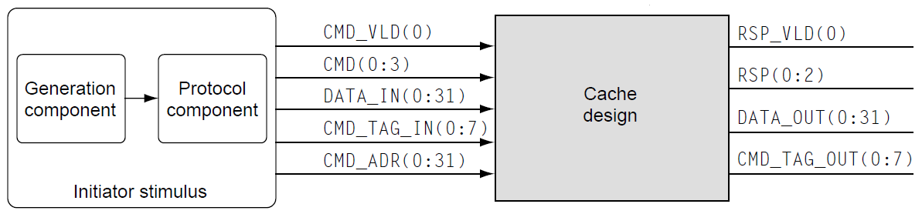
Initiators I
An initiator is a stimulus model that will initiate a transaction or transactions to the DUV.
Typically, initiator consists from two components:
  protocol component, that handles low-level bit manipulation into the DUV and
  generation component, that supplies the higher-level request
The separation of the generation and protocol components is important because:
  a separate protocol component allows the test case writer to think more about the transactions rather than focus on the bit-level manipulations, and
  a well-defined interface between the generation component and the protocol component allows for substitution of generation components.
Notes:
An initiator is a stimulus model that will initiate a transaction or transactions to the DUV.
All verification environments, simple simulation based or advanced, require driving the bit-level stimulus into the DUV as defined by the protocols. This portion of the environment requires the verification engineer to have detailed knowledge of the complete interface definition. This is the protocol component of the initiator. The protocol component acts as a slave to the generation component. Although the protocol component handles low-level bit manipulation into the DUV, it is the role of the generation component to supply the higher-level request. As an example, let us consider the cache design that needs to be verified. Figure on the bottom shows that the protocol component needs to drive five separate signals and buses comprising 77 total bits.
The microarchitecture of the DUV will dictate how the generation component knows when it is legal to supply a new command to the DUV. Invariably there are two ways that any design communicates availability of its resources to a requestor. The two choices are as follows:
1. The requestor knows the depth of the resource and keeps track of it.
2. The owner of the resource supplies an “available” signal to the requestor.
To illustrate this, suppose that the microarchitecture of the cache example contains a buffer than can hold up to eight fetch requests concurrently. If at any time during the test case, the generation component (requestor) sends a request to the DUV such that the cache had nine outstanding fetch requests, then an illegal test case with an overwrite condition occurs. Therefore, the generation component must implement the same resource availability determination as the microarchitecture. Either the generation component must keep count of the number of outstanding fetches in the cache (number of fetches sent minus the number of fetches completed), or the cache must supply a signal indicating that the buffer is full.
The separation of the generation and protocol components is important. Most interfaces are not as trivial as this cache example and have multiple concurrent or overlapping interactions and many more control and data signals. Breaking these components apart simplifies the coding of the environment. This structure has other benefits as well: a separate protocol component allows the test case writer to think more about the transactions rather than focus on the bit-level manipulations, and furthermore, a well-defined interface between the generation component and the protocol component allows for substitution of generation components. Simple test bench environments often precede complex random environments. The verification team avoids redundant work by creating stand-alone protocol components, allowing current and future generation components to plug into them. The stand-alone protocol component is also referred to as a Bus Functional Model (BFM), a model that performs the bus function.
This type of stimulation of the DUV is called “transaction-based” verification. The basis for the simulation is all types of transactions, generated in a random or directed fashion.

Slide 59
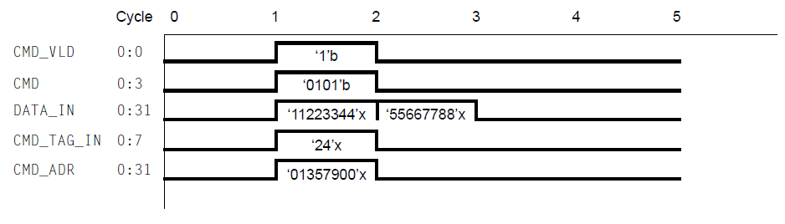
Initiators II
CMD (command) for 64-bit store request is 0x5
Valid bit CMD_VLD must accompany the request along with a tag, address and first 32 bits of data
The next 32 bits of data follow on the next cycle
Protocol component must understand the decode values and timings required by the cache for initiating a valid request
Although the protocol component handles low-level bit manipulation into the DUV, it is the role of a generation component to supply the higher-level request
In this cache example, the generation component dictated the sending of 64-bit store reques to address 0x01357900
Notes:
An initiator is a stimulus model that will initiate a transaction or transactions to the DUV.
All verification environments, simple simulation based or advanced, require driving the bit-level stimulus into the DUV as defined by the protocols. This portion of the environment requires the verification engineer to have detailed knowledge of the complete interface definition. This is the protocol component of the initiator. The protocol component acts as a slave to the generation component. Although the protocol component handles low-level bit manipulation into the DUV, it is the role of the generation component to supply the higher-level request. As an example, let us consider the cache design that needs to be verified. Figure on the bottom shows that the protocol component needs to drive five separate signals and buses comprising 77 total bits.
The microarchitecture of the DUV will dictate how the generation component knows when it is legal to supply a new command to the DUV. Invariably there are two ways that any design communicates availability of its resources to a requestor. The two choices are as follows:
1. The requestor knows the depth of the resource and keeps track of it.
2. The owner of the resource supplies an “available” signal to the requestor.
To illustrate this, suppose that the microarchitecture of the cache example contains a buffer than can hold up to eight fetch requests concurrently. If at any time during the test case, the generation component (requestor) sends a request to the DUV such that the cache had nine outstanding fetch requests, then an illegal test case with an overwrite condition occurs. Therefore, the generation component must implement the same resource availability determination as the microarchitecture. Either the generation component must keep count of the number of outstanding fetches in the cache (number of fetches sent minus the number of fetches completed), or the cache must supply a signal indicating that the buffer is full.
The separation of the generation and protocol components is important. Most interfaces are not as trivial as this cache example and have multiple concurrent or overlapping interactions and many more control and data signals. Breaking these components apart simplifies the coding of the environment. This structure has other benefits as well: a separate protocol component allows the test case writer to think more about the transactions rather than focus on the bit-level manipulations, and furthermore, a well-defined interface between the generation component and the protocol component allows for substitution of generation components. Simple test bench environments often precede complex random environments. The verification team avoids redundant work by creating stand-alone protocol components, allowing current and future generation components to plug into them. The stand-alone protocol component is also referred to as a Bus Functional Model (BFM), a model that performs the bus function.
This type of stimulation of the DUV is called “transaction-based” verification. The basis for the simulation is all types of transactions, generated in a random or directed fashion.

Slide 60
Responders
The second type of stimulus component, responders, reacts to outputs from the DUV and feeds stimulus back into the DUV.
The difference between an initiator and a responder is that the responder acts as a slave to the DUV.
Responder will only send stimulus back into the DUV as a result of a request, command, or other demand from the DUV.
Notes:
The second type of stimulus component, responders, reacts to outputs from the DUV and feeds stimulus back into the DUV. The difference between an initiator and a responder is that the responder acts as a slave to the DUV. It will only send stimulus back into the DUV as a result of a request, command, or other demand from the DUV.
Continuing with the cache example, figure below shows a main storage memory component that communicates with the cache. The memory receives either a store or fetch command from the cache and must act on that request. The memory itself never initiates communication. For verification of the cache, the memory is replaced by a main store responder stimulus component. When receiving a store command along with an address and data, the main store will react at the appropriate time with a response. For a fetch command, the main store component will return both a response and the requested data.
Variability is allowed in the sequence with the responder. In the cache to main store example, there can be variability in the response (successful completion or failure) and in the number of cycles between command and response (if the timing is not fixed allows). However, in simple simulation environments, the test case writer pre-determines the timings and values.

Slide 61
Monitor
A monitor is a model that observes different aspects of the environment. Monitors are self-contained components that observe
  Outputs of the DUV for protocol adherence
  Inputs to the DUV for functional coverage analysis and scoreboard updates
  Internals of the DUV for events of interest to the environment
At a minimum, the monitor must observe the outputs of the DUV. If the DUV does not adhere to the protocol, then the monitor must return an error.
The monitor can use collected information to generate functional coverage data. The stimulus components may use coverage information to adapt the stimulus for a more stressful or diverse DUV simulation.
A final job of the monitor is to provide post-simulation information to the verification engineer. The monitor should be able to record interface events to a runtime file, formatting it for readability and debugging assistance.
Notes:
A monitor is a model that observes different aspects of the environment. Monitors are self-contained components that observe
Outputs of the DUV for protocol adherence
Inputs to the DUV for functional coverage analysis and scoreboard updates
Internals of the DUV for events of interest to the environment
At a minimum, the monitor must observe the outputs of the DUV. If the DUV does not adhere to the protocol, then the monitor must return an error. The monitor does not drive any signals or wires into the DUV; it only receives inputs and/or callbacks to it. By developing a monitor in this fashion, the verification engineer ensures it is reusable at other levels.
Figure shows the monitor added to the cache environment. The monitor verifies that the DUV obeys the output protocols at all times. In this case, the monitor must check the following:
RSP_VLD(0) (the response valid signal) always accompanies a valid response.
The RSP(0:2) signal, when accompanied by the valid signal, has legal values (e.g., 001 = success; 010 = parity error; 011 = retry due to busy; 100 = illegal command sent; all others are illegal response decodes).
In addition, the monitor may check for the following, depending on the environment and protocols:
The RSP(0:2) signal never is on in the absence of the RSP_VLD(0) signal. Depending on the protocol, the outputs may be required to be zero unless a valid response is being sent.
The tag is correct; that is, it matches with a tag sent previously by the initiator component.
When deciding on how to monitor the outputs for protocol adherence, the verification engineer should refer to the specification. Similar to the stimulus model, if the DUV does not have a specification, then at a minimum, the verification engineer should communicate with the architect and the designer of the piece of logic on the receiving side of the DUV. The independence of the verification engineer is lost if information on how the monitor should work is obtained from the designer, who could misunderstand a part of the correct communication and protocol scheme and thus bias the verification checking.
However, the monitor may need to probe internals of the DUV to collect information to pass on to the checker or scoreboard components. In this case, the verification engineer should limit the internal probes and beware of breaking the redundancy path by relying on the design for too much information.
In all the above scenarios, the monitor can use this information to generate functional coverage data. In sophisticated environments, the stimulus components may use coverage information (either from internal DUV probes or from DUV inputs) collected by the monitor to adapt the stimulus for a more stressful or diverse DUV simulation. This is called coverage directed generation.
A final job of the monitor is to provide post-simulation information to the verification engineer. The monitor should be able to record interface events to a runtime file, formatting it for readability and debugging assistance.

Slide 62
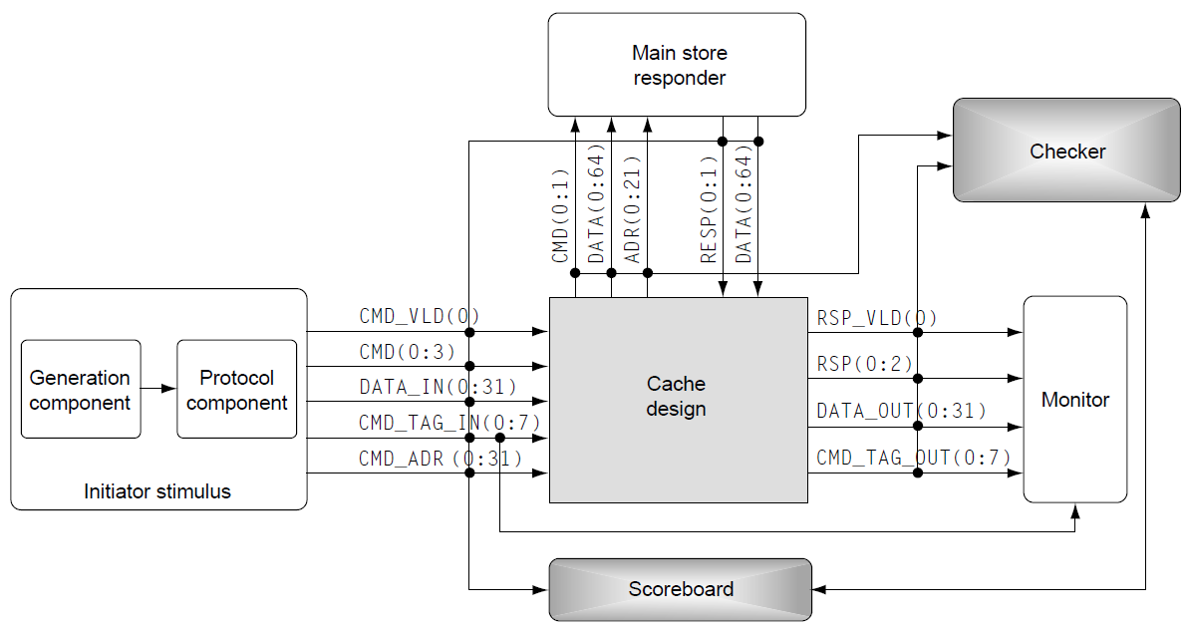
Checker
A checker is a special type of monitor that only collects DUV outputs. However, it validates that the design is working as intended from a functional standpoint, not just from a protocol standpoint. The checker may need knowledge from a monitor or scoreboard to accomplish its task.
The checker code compares expected results against actual outputs of the DUV. If the results match, the test case continues or completes successfully. If the results miscompare, the checker will write a failure message to a debug file, noting the actual and expected results along with other information needed to understand the failure.
Checkers monitor for various types of error types:
  All requests receive responses (no lost data, commands, packets, etc.)
  All outputs match predicted values (response codes, data, packets, etc.)
  No superfluous output activity (outputs that do not correspond to any stimulus)
Notes:
A checker is a special type of monitor that only collects DUV outputs. However, it validates that the design is working as intended from a functional standpoint, not just from a protocol standpoint.
The checker tends to be one of the harder components in the environment to get correct, as the verification engineer must implement many functional checks within the component. It is not only challenging to get individual checkers working correctly for all cases but also imperative that the verification engineer conceive of all the required checking. This is fundamental to the question, “How will I know if the design has a flaw?”
In the past, verification engineers performed the functional checking by reviewing the test case traces by hand and looking for specific results on the DUV outputs. Often, the reference model for the DUV was in the verification engineer’s head. Although this was an arduous process, the designs were simpler and contained fewer corner conditions and complex interactions. As design complexity increased, verification engineers transferred the intelligence behind the checking from their own knowledge to automated software checker components.
The checker may need knowledge from a monitor or scoreboard to accomplish its task. The checker needs to understand what stimulus has occurred in order to independently predict functional results. Because there may be multiple requests and interaction stimulus in a single test case, the checker needs to correlate input requests with output responses. The checker code compares these expected results against actual outputs of the DUV. If the results match, the test case continues or completes successfully. If the results miscompare, the checker will write a failure message to a debug file, noting the actual and expected results along with other information needed to understand the failure.
Checkers monitor for various types of error types:
All requests receive responses (no lost data, commands, packets, etc.)
All outputs match predicted values (response codes, data, packets, etc.)
No superfluous output activity (outputs that do not correspond to any stimulus)
Remember, the monitor component performs checks that are more mundane:
Parity and check-bit correctness
Actual data transfer length corresponds to header transfer length
Other checking that does not require knowledge from the stimulus components

Slide 63
Scoreboard
In the simplest terms, a scoreboard is a temporary holding location for information the checker will require.
A checker can use a scoreboard in two ways. The main difference between the two methods centers on which component does the translation from inputs and expected outputs. The component that performs this function acts as the DUV reference model and contains the checking intelligence.
In the first method, the checker component contains the reference model. The scoreboard’s role is to examine the inputs for transactions to occur, capture pertinent information, and store the information for later use.
In the second method, the scoreboard is the reference model and does the expected result calculation based on the input stimulus it observes. When the checker observes DUV output events, it then queries the scoreboard for the expected data and performs the compare.
Either of the above divisions of work between scoreboard and checker is acceptable. However, it is important that the choice of reference model placement remains consistent. The same paradigm should be followed for all DUV checking throughout the environment.
Notes:
A scoreboard is a relatively new term, although the concept has been around for a long time. In the simplest terms, a scoreboard is a temporary holding location for information the checker will require.
A checker can use a scoreboard in two ways. The main difference between the two methods centers on which component does the translation from inputs and expected outputs. The component that performs this function acts as the DUV reference model and contains the checking intelligence.
In the first method, the checker component contains the reference model. The scoreboard’s role is to examine the inputs for transactions to occur, capture pertinent information, and store the information for later use. Then when the checker observes some condition on the outputs of the DUV, it makes a call to the scoreboard to get the data (referred to as a callback).
The scoreboard implementation depends on the functionality that is contained in the DUV. If the DUV has a simple first in, first out (FIFO) protocol, then the scoreboard would also contain a simple FIFO, and the data returned would be from a callback such as “pop expect from port 1.” Or if the DUV had a complex queuing algorithm, then a much more complex function such as a search based on port number would need to be performed in the scoreboard in order to return the correct data. Once the scoreboard returns the data, the reference model in the checker “transforms the data” into expected results and then compares those results to the actual DUV output signals.
In the second method, the scoreboard is the reference model and does the expected result calculation based on the input stimulus it observes. When the checker observes DUV output events, it then queries the scoreboard for the expected data and performs the compare.
Either of the above divisions of work between scoreboard and checker is acceptable. However, it is important that the choice of reference model placement remains consistent. The same paradigm should be followed for all DUV checking throughout the environment.

Slide 64
Design Under Verification
The last component, the DUV, is the center of the verification environment and is also known as the unit under test (UUT) or the device under test (DUT).
Most of the other components interact with the DUV. If there are bugs in the DUV, the verification team must find them.
The DUV source is the HDL itself. This source HDL gets interpreted or compiled into the DUV model (depending on the tools and HDL source used), which the verification team uses for its simulation.
The DUV can represent a sole designer macro, a logical unit, a chip, or an entire system. Regardless of the level, the verification engineer must customize stimulus and checking components, scoreboards, and monitors to exercise and validate the particular DUV.
The abstraction level at which the DUV is described can be different as well. The source HDL may describe the function at the RTL level, gate level, transistor level, or even behavioral level (non-synthesizable).
Notes:
The last component, the DUV, is the center of the verification environment and is also known as the unit under test (UUT) or the device under test (DUT). Most of the other components interact with the DUV. If there are bugs in the DUV, the verification team must find them.
The DUV source is the HDL itself. Whether running a simulation or formal verification, the source HDL gets interpreted or compiled into the DUV model (depending on the tools and HDL source used), which the verification team uses for its simulation. The specific interpreter or compiler differs depending on the electronic design automation vendor, but in all cases, the DUV is an accurate representation of the HDL.
The DUV can be from any level of the hierarchy. The DUV in the previous figures can represent a sole designer macro, a logical unit, a chip, or an entire system. Regardless of the level, the verification engineer must customize stimulus and checking components, scoreboards, and monitors to exercise and validate the particular DUV.
The abstraction level at which the DUV is described can be different as well. The source HDL may describe the function at the RTL level, gate level, transistor level, or even behavioral level (non-synthesisable).
The DUV interacts directly with the stimulus and checking components. The stimulus component manipulates the DUV’s inputs, and the monitor and checking components observe its outputs. In some situations, monitors and checkers may reside inside the DUV, which could be attributed to the need for additional observation or checking points.

Slide 65
Fundamentals of Simulation-Based Verification
Observation Points

Slide 66
Black Box
When all of the verification code is restricted to interfacing with external interfaces of the DUV, this is known as black box verification, because the verification environment is “in the dark” about internal details of the DUV.
The key to black box verification is the ability to predict the outputs based on the inputs. To do this, the specification must clearly explain the function of the DUV.
The black box environment has pros and cons:
  The good points are that structural changes inside the DUV have little impact on the verification code, as the function is independent of implementation.
  Furthermore, the ability to predict functional results based on inputs alone ensures that the reference model remains independent from the DUV algorithms.
  On the other hand, because the black box environment can only control the inputs and observe the outputs, it lacks control and observation points.
Notes:
When all of the verification code is restricted to interfacing with external interfaces of the DUV, this is known as black box verification, because the verification environment is “in the dark” about internal details of the DUV.
Most simulation-based environments begin as black box environments. The verification engineers begin reading a specification of the DUV that contains the function and the definition of the external interfaces. As the team writes the verification code, the drivers, monitors, checkers, and scoreboard use only the external interfaces as defined by the specification. The internal signals and constructs remain in the dark.
The key to black box verification is the ability to predict the outputs based on the inputs. To do this, the specification must clearly explain the function of the DUV.
The black box environment has pros and cons. The good points are that structural changes inside the DUV have little impact on the verification code, as the function is independent of implementation. If an internal pipeline had to change because of a timing constraint, there is little to no impact on the verification environment. Furthermore, the ability to predict functional results based on inputs alone ensures that the reference model remains independent from the DUV algorithms.
On the other hand, because the black box environment can only control the inputs and observe the outputs, it lacks control and observation points. There are many cases in which a verification environment can be more robust just by keying off internal signals in the DUV. Similarly, checking ambiguous cases becomes trivial if the scoreboard component monitors internal signals. By using internal signals, the verification engineers can shed some light on the black box.

Slide 67
White Box
The advantages and disadvantages of black box testing are reversed in the white box environment, which provides a full understanding of the internal structures of the DUV.
The verification engineer observes and places checking on internal signals, as well as models and predicts the behavior of internal queues, pipelines, state machines, and other portions of the microarchitecture.
A white box environment will flag a bug at its source, whereas the black box environment captures a failure indirectly as its symptoms appear on the DUV output.
White box verification has its drawbacks in the amount of maintenance required on the environment.
Verification environments coded in a white box paradigm must also take care to remain independent of the DUV.
Notes:
The advantages and disadvantages of black box testing are reversed in the white box environment, which provides a full understanding of the internal structures of the DUV. The verification engineer observes and places checking on internal signals, as well as models and predicts the behavior of internal queues, pipelines, state machines, and other portions of the microarchitecture.
The white box environment contrasts with the black box environment through its direct measurement of the DUV. A white box environment will flag a bug at its source, whereas the black box environment captures a failure indirectly as its symptoms appear on the DUV output. More details of the cache design described above can illustrate the white box methods.
Figure shows that the incoming command, tag, and address are placed into an eight-deep command queue. In the white box environment, the verification engineer might keep a reference model of the command queue and use that model to constantly check the contents of the queue. If the design has a bug such that a valid entry in the queue was dropped or overwritten, the white box environment checker would immediately flag the flaw. This is a direct capture of the failure where valid data is destroyed. The black box environment would also flag this bug, as the cache design would never give a response to a command that was recorded in the scoreboard. In this case, the checker is indirect, detecting the symptoms (a lost command). Both paradigms are successful.
White box verification has its drawbacks in the amount of maintenance required on the environment. The problem is that the environment is tightly integrated with the implementation: if a signal name changes, the white box checker component must change as well, which can become a maintenance nightmare. Therefore, this type of verification is typically done only at the low levels of the hierarchy.
Verification environments coded in a white box paradigm must also take care to remain independent of the DUV. Despite knowledge of the internal microarchitecture, the verification engineer must not use the HDL algorithms as a source of checking. This would break the redundancy path required to find bugs in the design.

Slide 68
Grey Box
Grey box verification is the combination of both black box and white box verifications.
In the grey box environment, the verification engineer monitors or observes some internal signals, which assist in validating the functional specification of the black box level; the rest of the DUV remains “in the dark.”
Grey box is typically the model used for most environments, mainly because some prediction of interface level results is nearly impossible without viewing an internal signal.
There are also certain test scenarios that are desirable but rarely occur without verification intervention inside the DUV structures.
Often, designs have counters used to initiate actions on a repetitive basis. In many cases, these counters “go off” after thousands or even millions of machine cycles. Although this may be only milliseconds on real hardware, it is an eternity in simulation cycles. To cause the counter-initiated event multiple times in a single test case, the verification engineer must overwrite the counter to a value close to its limit. This activity falls into the realm of grey box verification.

Slide 69
Fundamentals of Simulation-Based Verification
Test Benches and Testing Strategies

Slide 70
Test Benches
With the test bench environment and components defined, focus is now on the test case.
A test case constrains the stimulus components such that a specific function (or set of functions) within the DUV is targeted to be exercised.
We also call this deterministic testing, or a deterministic test bench, because the targeted function is determined before the test runs.
There are also self-checking test benches in which the test bench always performs checking regardless of the stimulus.
This allows for the functionality of the DUV to be checked regardless of the test case.

Slide 71
Deterministic Test Benches I
Verification teams use deterministic test cases predominantly early in the verification cycle to prove basic DUV functionality.
An example of deterministic test case involving the cache design would be to ensure that particular sequences of operations maintain data coherency.
Coherency dictates that data requestors always get the latest copy of the data. This inherently implies that for every address in the system, there is only one current data value associated with that address.
In this cache design, a fetch cannot return data that does not represent the latest value for that address.
A verification engineer could write many deterministic test cases to verify coherency.
Notes:
Verification teams use deterministic test cases predominantly early in the verification cycle to prove basic DUV functionality. Here, the verification engineer looks to the specification for guidance on the basic commands and protocols to test and monitor, creates deterministic test cases to pinpoint specific points of contention in the DUV specification, and relies in part on the design engineers for advice on scenarios to exercise.
A very simple example is a “two-input AND gate.” There are four deterministic tests for the DUV. A verification engineer charged with verifying this two-input AND gate could create four individual deterministic test cases. Alternatively, the verification engineer could decide that the four scenarios are simplistic enough to merge into a single deterministic test case that drives the four scenarios in sequence.
A more interesting deterministic test case involving the cache design would be to ensure that particular sequences of operations maintain data coherency. Coherency dictates that data requestors always get the latest copy of the data. This inherently implies that for every address in the system, there is only one current data value associated with that address. In this cache design, a fetch cannot return data that does not represent the latest value for that address. A verification engineer could write many deterministic test cases to verify coherency. One such case is described here.
Figure shows a decode mux in front of separate store and fetch queues in the cache design. As commands enter the cache DUV, the design directs the address, tag, and the data (for stores) toward the appropriate logic based on the type of command.
A deterministic sequence to verify coherency might consist of the following inputs:
Three store commands to various addresses are sent. These commands initially fill three of the four positions in the store queue.
A fourth store request to address X is sent. This store request is the last in line to be executed
A fetch request to address X is sent.
Because the fetch request is at the top of the queue and a previous store request is buried in the store queue, this test case is designed to uncover a design flaw that would return fetch data other than that in the store queue. Coherency requires that the fetch request return the latest data, which may be in the store queue rather than in the cache or main memory. The cache design must deal with this case by one of these means:
Give stores higher priority than that of fetches, allowing the store queue to drain before processing fetches.
Do an address comparison of all stores addresses pending based on the fetch address and block the fetch.
Do an address comparison of all stores addresses pending based on the fetch address and provide a cache and main store bypass by the store queue data that would feed the fetch response data.

Slide 72
Deterministic Test Benches II
One case of deterministic test case would be:
  Three store commands to various addresses are sent. These commands initially fill three of the four positions in the store queue
  A fourth store requests to address X is sent. This store request is the last in line to be executed
  A fetch request to address X is sent
Coherency requires that the fetch request return the latest data, which may be in the store queue rather than in the cache or main memory, so
The cache design must deal with this case by one of these means:
  Give stores higher priority than that of fetches, allowing the store queue to drain before processing fetches
  Do an address comparison of all store addresses pending based on the fetch address and block the fetch
  Do an address comparison of all store addresses pending based on the fetch address and provide a cache and main store bypass by the store queue data that would feed the fetch response data
Notes:
Verification teams use deterministic test cases predominantly early in the verification cycle to prove basic DUV functionality. Here, the verification engineer looks to the specification for guidance on the basic commands and protocols to test and monitor, creates deterministic test cases to pinpoint specific points of contention in the DUV specification, and relies in part on the design engineers for advice on scenarios to exercise.
A very simple example is a “two-input AND gate.” There are four deterministic tests for the DUV. A verification engineer charged with verifying this two-input AND gate could create four individual deterministic test cases. Alternatively, the verification engineer could decide that the four scenarios are simplistic enough to merge into a single deterministic test case that drives the four scenarios in sequence.
A more interesting deterministic test case involving the cache design would be to ensure that particular sequences of operations maintain data coherency. Coherency dictates that data requestors always get the latest copy of the data. This inherently implies that for every address in the system, there is only one current data value associated with that address. In this cache design, a fetch cannot return data that does not represent the latest value for that address. A verification engineer could write many deterministic test cases to verify coherency. One such case is described here.
Figure shows a decode mux in front of separate store and fetch queues in the cache design. As commands enter the cache DUV, the design directs the address, tag, and the data (for stores) toward the appropriate logic based on the type of command.
A deterministic sequence to verify coherency might consist of the following inputs:
Three store commands to various addresses are sent. These commands initially fill three of the four positions in the store queue.
A fourth store request to address X is sent. This store request is the last in line to be executed
A fetch request to address X is sent.
Because the fetch request is at the top of the queue and a previous store request is buried in the store queue, this test case is designed to uncover a design flaw that would return fetch data other than that in the store queue. Coherency requires that the fetch request return the latest data, which may be in the store queue rather than in the cache or main memory. The cache design must deal with this case by one of these means:
Give stores higher priority than that of fetches, allowing the store queue to drain before processing fetches.
Do an address comparison of all stores addresses pending based on the fetch address and block the fetch.
Do an address comparison of all stores addresses pending based on the fetch address and provide a cache and main store bypass by the store queue data that would feed the fetch response data.

Slide 73
Self-Checking Test Benches
Placing the knowledge of the DUV’s function into the test bench environment is extremely advantageous as it automates the tedious checking process, which means that a user does not have to scrutinize every test case trace to ensure that it passes the functional criteria.
Because the test bench is the “universe”, all the knowledge needed for checking exists in the test bench.
The verification engineer codes that knowledge into the checkers and the scoreboard in order to make the environment self-checking.
There are different types of self-checking test benches:
  Golden Vectors
  Reference Model
  Transaction Based

Slide 74
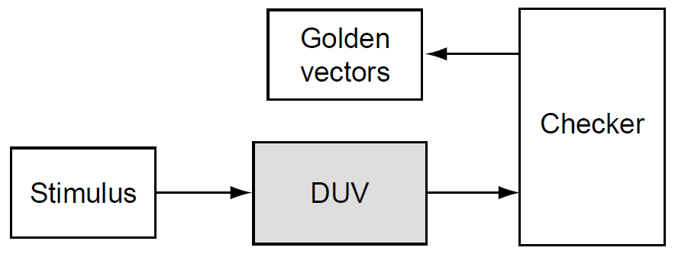
Golden Vectors
A golden vectors environment is a simple environment in which some knowledge base of valid output vectors is stored in the scoreboard.
The checking component compares the DUV results to this knowledge base by calling the scoreboard and requesting the expected vectors.
In most cases, the scoreboard is loaded at the beginning of the test with a known set of valid expect traces.
The advantage to this mechanism of checking is that the verification engineer can check all of the predicted result traces before running the simulation.
A disadvantage to this type of verification is twofold: the creation and the maintenance of the golden vectors.
Notes:
A golden vectors environment is a simple environment in which some knowledge base of valid output vectors is stored in the scoreboard. The checking component compares the DUV results to this knowledge base by calling the scoreboard and requesting the expected vectors. This can be done either for every cycle or for every transaction (based on the functions). In most cases, the scoreboard is loaded (via a file or some other mechanism) at the beginning of the test with a known set of valid expect traces that correspond to what the stimulus will be generating. The output checker compares the actual DUV results to the golden vector predicted results. The verification engineer either generates these valid traces manually or generates them by using an external program. Figure shows a diagram of this type of environment.
The advantage to this mechanism of checking is that the verification engineer can check all of the predicted result traces before running the simulation. Another advantage is that when the verification team runs a regression, all the vectors that need to be verified already exist.
A disadvantage to this type of verification is twofold: the creation and the maintenance of the golden vectors. Manual creation of golden vectors is tedious. If a program creates the golden vectors, then that program will require knowledge about the DUV. (The reference model environment explained next tackles this by placing the knowledge directly into the simulation environment). The maintenance challenge is keeping the golden vectors and stimulus generation synchronized. If the DUV rules change, the verification team must update all of the test cases and golden vectors to reflect the change.
Golden vector checking is best suited for DUVs that have sporadic outputs that correspond closely to the inputs. DUVs that handle just one concurrent command are ripe for golden vector checking as the output is usually easy to predict.

Slide 75
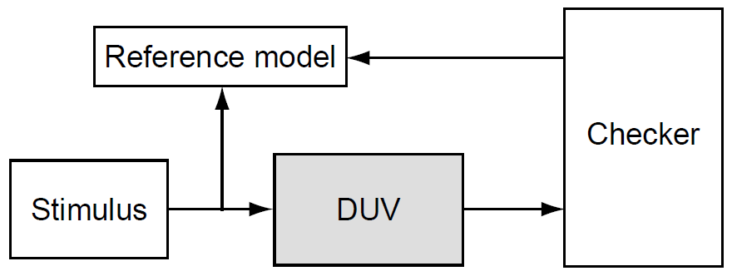
Reference Model
The reference model calculates all expected outputs based on the input stimulus.
The reference model re-implements the function of the DUV, usually in a high level programming language or an HVL.
Because the reference model calculates the results for each cycle, it is also known as a cycle accurate model.
The main advantage to the reference model is the level of checking accuracy. Once the reference model is correct (and debugged), the verification team knows that the DUV is correct for every cycle.
This comes at a price, as this method has a maintenance overhead. The reference model must know the exact internal timing implementation of the DUV, which is very similar to white box verification except that the reference model has no probes into the design.
Notes:
The reference model calculates all expected outputs based on the input stimulus. The reference model re-implements the function of the DUV, usually in a high level programming language or an HVL. Because the reference model calculates the results for each cycle, it is also known as a cycle accurate model.
Unlike the golden vectors approach, the checker component does not request information from the reference model. Instead, the reference model sends information to the checker every cycle based on the program calculations. It is the checker’s job to compare this information to the DUV outputs and decide if the output signals match the expected results.
The main advantage to the reference model is the level of checking accuracy. Once the reference model is correct (and debugged), the verification team knows that the DUV is correct for every cycle. This comes at a price, as this method has a maintenance overhead. The reference model must know the exact internal timing implementation of the DUV, which is very similar to white box verification except that the reference model has no probes into the design.
Verification teams should chose reference models for checking DUVs that have high activity on the outputs. DUVs with multiple concurrent inputs or internal priority logic to process stimulus are candidates for reference model checking because the prediction of the outputs depends highly on the stimulus sequence. Furthermore, if the internal timings of the DUV changes, it is easier to update the reference model once than to edit all of the golden vector test cases.
A variation of the reference model checker is one that is not accurate for every cycle but instead is checked at key points in time. For example, consider an ALU that contains a pipeline with a depth of five. Five cycles after receiving input stimulus to the ALU, the reference model sends predicted outputs to the checker component. This also helps alleviate potential performance disadvantages because the reference model does not have to keep up with all the details, but the reference model does have to know that the pipeline depth is five.

Slide 76
Transaction Based
A transaction-based environment is used for DUVs that have identifiable transactions in which commands and data are acted on and forwarded to appropriate output signals. Many input/output (IO) protocol devices (such as Ethernet and PCI) that forward and route packets of data should use transaction-based checking.
The scoreboard keeps a record of all “current” transactions that have entered the DUV but have not been completed (or forwarded). The scoreboard must also perform any data reformatting.
On observing output signals, the checker component queries the scoreboard, usually with a transaction identifier, and receives the expected data.
The checker flags an error if the identifier does not match an outstanding transaction or if the command or data are not as predicted by the scoreboard.
Notes:
A transaction-based environment is used for DUVs that have identifiable transactions in which commands and data are acted on and forwarded to appropriate output signals. This allows the verification engineer to structure the environment based on the transaction nature of the DUV. Caches, which act on commands and data, are one example. Many input/output (IO) protocol devices (such as Ethernet and PCI) that forward and route packets of data should use transaction-based checking.
This type of checking environment uses a scoreboard to track commands and data driven on the inputs of the DUV. In this environment, the DUV processes the commands and associated data before forwarding the transactions on the outputs. The DUV may reformat the command and data before forwarding it. Figure shows the transaction-based environment.
The scoreboard keeps a record of all “current” transactions that have entered the DUV but have not been completed (or forwarded). The scoreboard must also perform any data reformatting. On observing output signals, the checker component queries the scoreboard, usually with a transaction identifier, and receives the expected data. The checker flags an error if the identifier does not match an outstanding transaction or if the command or data are not as predicted by the scoreboard.
The key in the transaction-based environment is the abstraction level of the command and data. Often, this is simple, as in the Ethernet packet protocol or PCI bus commands. However, DUVs may allow transactions to be spread across many cycles or have other transactions intermixed. It is the scoreboard’s job to package the abstracted transactions into predictable outputs.
The only disadvantage and difficulty to this type of environment is deciding the correct level of abstraction, which is an important decision as it influences both the effectiveness and efficiency of the verification environment. The team should base this decision on the functional stimulus injected into the DUV. When the team defines the right level of abstraction, it becomes easy to define interesting test cases by using sequences of these abstract items, as well as to generate meaningful tests, and it is easier to analyze the test results by looking at the abstract items for debug.

