Slide 1
Funkcionalna verifikacija hardvera
Predavanje I-II

Slide 2
Sadržaj lekcije
Uvod u verifikaciju
  Izazovi prilikom verifikacije dizajna
  Misija i ciljevi verifikacije
  Cena neotkrivenih bagova u dizajnu
  Verifikacioni ciklus
Tok verifikacije
  Verifikaciona hijerarhija
  Strategije verifikacije
Osnovne komponente verifikacionog okruženja baziranog na simulaciji
  Osnovno verifikaciono okruženje: testno okruženje (eng. Testbench)
  Tačke opservacije
  Testna okruženja i strategije testiranja

Slide 3
Uvod u verifikaciju

Slide 4
Uvod u funkcionalnu verifikaciju I
Funkcionalna verifikacija je postala veliki izazov u ​​oblasti dizajna čipova i sistema
Kako se, vremenom, sve više funkcionalnosti implementira u sve gušćim čipovima, bilo je neophodno da adekvatno napreduje i disciplina potrebna za uspešnu verifikaciju čipova i sistema
Kao rezultat toga, verifikacioni inženjer, pozicija koja je bila gotovo nepoznata pre 10-tak godina, postao je nezamenjivi član dizajn tima
Notes:
Silicon chip technology powers many of today’s innovations and newest products. Rapid technology advancement fuels ever-increasing chip complexity, which in turn enables the latest round of amazing products. These chips touch many aspects of our everyday life, from the pocket-sized combination cell phone, pager, and digital camera to the high-end server that searches an online bookseller’s database, verifies credit card funds, and sends the order to the warehouse for immediate delivery. Expectations for these chips grow at an equal rate, despite the additional complexity. For example, consumers do not expect the chips that monitor safety processes in our cars to fail during the normal life of the vehicle. Nor is it acceptable to be denied access to our on-line brokerage accounts because the server is down. Thus, it has become a major engineering feat to design these silicon chips correctly.
An enormous amount of engineering goes into each of these chips, whether it is a microprocessor, memory device, or entire system on a chip (SoC). All types of chips have a set of challenges that the engineers must solve for the final product to be successful in the marketplace.

Slide 5
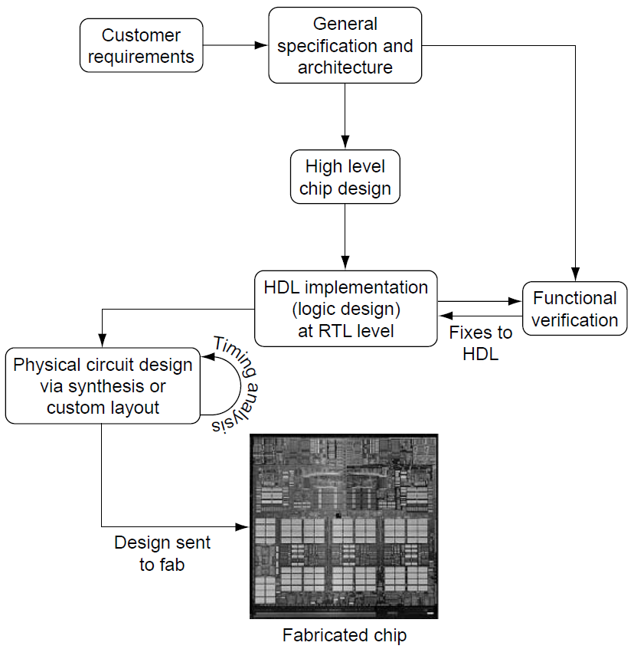
Uvod u funkcionalnu verifikaciju II
Proces projektovanja čipa je prikazan na slici
desno
Svako projektovanje počinje zahtevima kupca,
koji predstavljaju polaznu tačku za specifikaciju i arhitekturu
Komponente čipa zatim nastaju tokom
faze projektovanja na visokom nivou, nakon čega sledi RTL implementacija u jeziku za opis hardvera (HDL - tipično Verilog ili VHDL)
Projektovanje kola i vremenske analize zasnivaju se na HDL modelu, dok funkcionalna verifikacija istražuje logički prostor stanja dizajna kako bi se uporedila implementacija sa specifikacijom i željenom funkcionalnošću
Notes:
Figure shows a chip’s design flow, which starts with the customer’s requirements. Those requirements include (but are not limited to) function, chip size, chip power consumption, and processing speed. Requirements are compiled and prioritized during the concept and high-level design phase, in which designers architect the chip’s main internal components and goals. As the chip design process progresses, engineers face challenges to balance goals that often conflict: higher chip performance may require faster cycle times, but that will raise power consumption; faster cycle times may require adding more stages in the logic, but that increases chip complexity and area.
Throughout the chip design process, design automation (DA) tools accurately predict chip area, timing, and power aid the engineers. After an engineer creates logic, written in a hardware description language (HDL), DA tools can synthesize that logic into appropriate gates that correspond to the original design. Verilog and VHDL are the two most common HDLs. But two questions remain: (1) what if the HDL did not express the correct function in the first place, and (2) what if the designer missed a critical corner condition? Detecting incorrect function has become one of the trickiest challenges in the entire chip design process. This is the challenge of functional verification.
Functional verification ensures that the design performs the tasks as intended by the overall system architecture. It differs from circuit level validation in multiple ways. First, verification engineers work predominantly on the register transfer level (RTL) of the design rather than on the gate level. RTL is a more abstract way to specify the logic design than are the low-level ANDs and ORs of the gate level. RTL languages (HDLs) allow the designer to specify the behavior by using higher-level constructs such as Boolean equations and IF-THEN-ELSE structures. Second, although the main challenge for the circuit designers is to fit the gates into the available chip area and ensure that timing goals are met, it is the verification engineer’s role to ensure that the design is functionally correct in the first place.

Slide 6
Uvod u verifikaciju
Izazovi prilikom verifikacije dizajna

Slide 7
Izazovi prilikom verifikacije dizajna
Dizajn složenih čipova danas se, tipično, sastoji od stotina hiljada linija HDL koda
Posao inženjera za verifikaciju je da traži greške u HDL implementaciji, pronalazeći scenarije u kojima se HDL model ne ponaša u skladu sa specifikacijama
Inženjer za verifikaciju otkriva ove greške pokretanjem složenih simulacija na dizajnu, pri čemu se susreće sa dva osnovna izazova
  Suočavanje sa ogromnim prostorom stanja u kojima se može naći dizajn
  Detektovanje nekorektnog ponašanja

Slide 8
Izazov "eksplozije" prostora stanja I
Tipično, HDL model sadrži hiljade lečeva i ostalih memorijskih elemenata, kao i kombinatorne logike koji svi zajedno kontrolišu i definišu ponašanje čipa
U datom trenutku, čip se može nalaziti u bilo kom od brojnih stanja
Da bi iscrpno proverio da li je čip funkcionalno ispravan, verifikacioni inženjer ima neverovatno težak zadatak da proveri da li svako moguće trenutno stanje i svaka moguća kombinacija ulaznih signala vode ka ispravnom sledećem stanju
Notes:
The scale of the state space is the first verification challenge. Typically, HDL contains thousands of latches, large arrays (RAM), and combinatorial logic, all of which control the behavior of the chip. The chip inputs manipulate the internal logic, causing it to act on the applied stimulus. These inputs transform the current state of the chip, defined by the stored values in the latches and arrays, into the next and future states of the chip. At a given point in time, a chip can be in any one of an enormous number of possible current states (The number of possible states is 2^{n}, where n is the total number of bits of latches and arrays.). Furthermore, the next state of the chip, determined by the current state and the current inputs, can be any of the possible states. To verify exhaustively that a chip is functionally correct, the verification engineer would have the daunting task of checking that each possible current state and each possible input combination yields the correct next state.
To combat state space explosion, verification engineers break the problem down into smaller pieces. A typical chip may have 100,000 latches, imbedded arrays, and hundreds of input pins. Rather than verify the entire chip at once, the verification team will carve out subcomponents of the design and verify these pieces separately. Once the smaller, more manageable pieces are verified, the team stitches the chip subcomponents back together and ensures that they work.
Furthermore, many of the possible states of the chip and many of the possible input combinations are defined as illegal based on design specifications. An illegal state is a state that the design should never enter. Illegal states cut down the size of the current states that must be evaluated by the verification engineer.
But, the verification engineers cannot ignore illegal states in certain chip designs, specifically those chips that must be tolerant of errors. Illegal states can occur because of many factors, including erroneous input, alpha particles flipping a latch, or circuit failures. The verification task may require ensuring that the hardware can recover from these unexpected conditions.

Slide 9
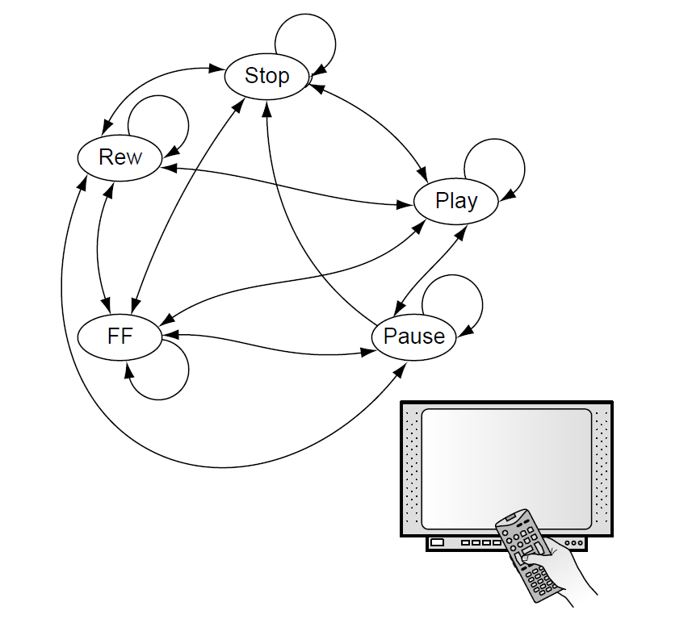
Izazov "eksplozije" prostora stanja II
Primer: STB i daljinski upravljač sa 6 tastera (ništa pritisnuto, play, stop, pause, premotaj unapred i premotaj unazad)
Recimo da, interno, takav sistem koristi 5 stanja : pusti normalnom brzinom, pauziraj, premotaj unapred brzinom 2x, premotaj unazad brzinom 2x i zaustavi
Međutim, odgovarajuće poruke moraju biti prikazane na TV-u za svaki pritisnut taster, što, za rezoluciju "true color" 1024x768 (32-bita po pikselu) daje ukupno:
  (1024 x 768) x 5 x 2³² = 16,888,498,602,639,360 trenutnih stanja
  (1024 x 768) x 2³² x 6= 20, 266,198,323,167,232 narednih stanja
Za iscrpnu verifikaciju čipa, sve tranzicije iz svih trenutnih stanja moraju biti proverene što vodi ka broju provera 3.4 x 10³²
Pod pretpostavkom da se koristi simulator koji može da izvrši do 1000000 tranzicija svake sekunde, za takvu proveru bilo bi potrebno 10,853,172,947,159,498,300 godina
Notes:
The scale of the state space is the first verification challenge. Typically, HDL contains thousands of latches, large arrays (RAM), and combinatorial logic, all of which control the behavior of the chip. The chip inputs manipulate the internal logic, causing it to act on the applied stimulus. These inputs transform the current state of the chip, defined by the stored values in the latches and arrays, into the next and future states of the chip. At a given point in time, a chip can be in any one of an enormous number of possible current states (The number of possible states is 2^{n}, where n is the total number of bits of latches and arrays.). Furthermore, the next state of the chip, determined by the current state and the current inputs, can be any of the possible states. To verify exhaustively that a chip is functionally correct, the verification engineer would have the daunting task of checking that each possible current state and each possible input combination yields the correct next state.
To combat state space explosion, verification engineers break the problem down into smaller pieces. A typical chip may have 100,000 latches, imbedded arrays, and hundreds of input pins. Rather than verify the entire chip at once, the verification team will carve out subcomponents of the design and verify these pieces separately. Once the smaller, more manageable pieces are verified, the team stitches the chip subcomponents back together and ensures that they work.
Furthermore, many of the possible states of the chip and many of the possible input combinations are defined as illegal based on design specifications. An illegal state is a state that the design should never enter. Illegal states cut down the size of the current states that must be evaluated by the verification engineer.
But, the verification engineers cannot ignore illegal states in certain chip designs, specifically those chips that must be tolerant of errors. Illegal states can occur because of many factors, including erroneous input, alpha particles flipping a latch, or circuit failures. The verification task may require ensuring that the hardware can recover from these unexpected conditions.

Slide 10
Izazov "eksplozije" prostora stanja III
Da bi se izborio sa takvom eksplozijom prostora stanja, verifikacioni inženjer "razbija" problem na niz manjih problema sa kojima će moći da se nosi
Naime, umesto verifikacije kompletnog čipa odjednom, verifikacioni tim će prepoznati sve komponente dizajna i verifikovati svaku od njih pojedinačno
Tek kada su ti manji blokovi, adekvatniji za verifikaciju, detaljno testirani, verifikacioni tim ponovo sastavlja čip koristeći njegove verifikovane pod-komponente i proverava da i dalje sve funkcioniše kako treba
Notes:
The scale of the state space is the first verification challenge. Typically, HDL contains thousands of latches, large arrays (RAM), and combinatorial logic, all of which control the behavior of the chip. The chip inputs manipulate the internal logic, causing it to act on the applied stimulus. These inputs transform the current state of the chip, defined by the stored values in the latches and arrays, into the next and future states of the chip. At a given point in time, a chip can be in any one of an enormous number of possible current states (The number of possible states is 2^{n}, where n is the total number of bits of latches and arrays.). Furthermore, the next state of the chip, determined by the current state and the current inputs, can be any of the possible states. To verify exhaustively that a chip is functionally correct, the verification engineer would have the daunting task of checking that each possible current state and each possible input combination yields the correct next state.
To combat state space explosion, verification engineers break the problem down into smaller pieces. A typical chip may have 100,000 latches, imbedded arrays, and hundreds of input pins. Rather than verify the entire chip at once, the verification team will carve out subcomponents of the design and verify these pieces separately. Once the smaller, more manageable pieces are verified, the team stitches the chip subcomponents back together and ensures that they work.
Furthermore, many of the possible states of the chip and many of the possible input combinations are defined as illegal based on design specifications. An illegal state is a state that the design should never enter. Illegal states cut down the size of the current states that must be evaluated by the verification engineer.
But, the verification engineers cannot ignore illegal states in certain chip designs, specifically those chips that must be tolerant of errors. Illegal states can occur because of many factors, including erroneous input, alpha particles flipping a latch, or circuit failures. The verification task may require ensuring that the hardware can recover from these unexpected conditions.

Slide 11
Detektovanje nekorektnog ponašanja
Drugi izazov se odnosi na samo detektovanje situacije u kojoj ponašanje dizajna odstupa od očekivanog ponašanja, predviđenog specifikacijom
Sa svim mogućim tranzicijama iz trenutnog stanja u naredno, verifikacioni inženjer mora biti u stanju da identifikuje da li se dizajn ponaša adekvatno za dato trenutno stanje i trenutne ulaze sistema
U najjednostavnijoj formi, dakle, verifikacioni izazov se svodi na dva elementa:
  Obezbedi odgovarajuće tranzicije stanja i adekvatne ulazne scenarije
  Prepoznaj i označi sva nekorentna ponašanja od strane dizajna
Verifikacioni inženjeri nose se sa ovim izazovom kroz dve fundamentalne metode:
  Verifikacija bazirana na simulaciji i
  Formalna verifikacija
Notes:
The second verification challenge is detecting when the design violates the expected behavior or specification. With all of the possible transitions from one state to the next, the verification engineer must be able to identify whether or not the design acted correctly based on the current state and input.
Rather than focusing on each of the possible states of the hardware, verification engineers validate the logic at a higher level of abstraction: inputs are grouped into valid command and data sets, and the verification engineer concentrates on the behavior of the design based on the functional input stimulus.
In simplest terms, then, the verification challenge comes down to two fundamentals:
1. Drive the state transitions and input scenarios
2. Flag any incorrect behavior exhibited by the design
Verification engineers attack the challenge by using two fundamental methods: (1) simulation-based verification and (2) formal verification, or verifying the design adheres to protocols by using formal proof engines.
In simulation-based verification, the verification engineer applies stimulus to a software model of the design. The sim model runs in conjunction with a simulation engine, which accurately reflects the behavior of the design. As inputs are applied, the simulation engine evaluates the design’s reaction to the specific inputs on the current state, and updates the internal state of the design accordingly. The simulation engine is often run on a desk-side workstation (a general purpose computer), and the verification engineer uses the user interface to query the behavior of the model to check for results and to flag incorrect behavior.
Formal verification, a newer technique, is a great complement to simulation. Rather than verifying possible input sequences and internal-state machine values individually or in sequence, formal verification proves that a protocol, assertion, or design rule holds true for all possible cases in the design. The major drawback of formal verification is that it can only verify a limited size design. Because all possible values in a design are checked, formal verification engines can consume enormous amounts of computer resources, even on small designs. For this reason, formal verification most often is applied to portions of the entire design rather than the whole so the engine can digest the design and return results in a reasonable timeframe.

Slide 12
Uvod u verifikaciju
Misija i ciljevi verifikacije
1

Slide 13
Misija i ciljevi verifikacije
Dizajnerski timovi upravljaju procesom razvoja
hardvera balansirajući ograničenja na tri polja:
  Raspored: Uspeh proizvoda u poluprovodničkoj industriji umnogome zavisi od pojavljivanja na tržištu u pravom trenutku
  Troškovi: Istovremeno, kompanija mora nastojati da
  maksimizira profit u tom procesu, a ključna stavka u vezi profita je da se troškovi proizvodnje i razvoja proizvoda održe na minimumu
  Kvalitet: Budući kupci očekuju da će isporučeni proizvodi ispunjavati odgovarajuće standarde kvaliteta
Pronalaženje zadovoljavajuće ravnoteže između rasporeda, troškova i kvaliteta zavisiće od proizvoda do proizvoda
Ipak, samo balansiranje je problematično jer optimizacija u dva pravca uvek negativno utiče u pravcu trećeg - na primer: poboljšanje kvaliteta uz skraćenje rokova tipično znatno podiže cenu proizvoda i troškove
Notes:
Design teams manage the process of developing computer hardware by balancing the triple constraints:
Schedule: Computer product success depends heavily on hitting the marketplace at the right time. Delays in getting products to market can be deadly for a company, as, more than in any other industry, a disproportionate amount of revenue goes to the product that gets to market first.
Cost: At the same time, a company must endeavor to maximize the profit created by a digital hardware product. A key profit lever is to keep the manufacturing and development expense for a product at a minimum. An expanded look at the verification cycle, as pictured in the figure, shows that after silicon fabrication, engineers perform testing on the entire system using fabricated hardware running end-user applications. Frequently, bugs missed by verification are discovered by engineers during this systems testing, causing design updates and re-fabrication of the hardware. These changes costs money and time, as fabrication facilities charge additional money for re-doing a chip, and some chips, depending on the technology used, may take up to 2 months to process. After a completed systems test, the company manufactures the product and ships it to customers. Customers provide the company with feedback about the product, which, in turn, feeds the requirements for follow-up products. Examples of customer feedback include requests for new features or higher quality.
Quality: Customers expect that delivered products will meet quality standards. Component failures invoke warranty costs, which affect the company’s bottom-line. Furthermore, if the marketplace perceives that a product is of poor quality, it can have a devastating effect on the company.
Finding the correct balance of schedule, cost, and quality will depend on the product. However, the balancing act is tricky, as optimizing for two of the constraints will often hurt the third. For example, maximizing quality while minimizing schedule often inflates product cost.

Slide 14
Uvod u verifikaciju
Cena neotkrivenih bagova

Slide 15
Cena neotkrivenih bagova u dizajnu
Slika desno ilustruje kako se cena neotrkrivenog baga uvećava tokom vremena
Ukoliko je bag primećen rano tokom verifikacije, njegovo otklanjanje je veoma "jeftino": dizajner ispravlja HDL model, nakon čega verifikacioni tim potvrđuje da originalni problem više ne postoji
Bag pronađen tokom sistemskih testova, sa druge strane, može koštati i nekoliko stotina hiljada dolara: hardver se mora ponovo fabrikovati što prouzrokuje dodatno kašnjenje izlaska proizvoda na tržište (tzv. Time-to-market)
Konačno, najskuplji scenario se dešava kada klijent otkrije bag: u tom slučaju problem ne predstavlja samo garancija koja rezultuje zamenom ili ažuriranjem proizvoda, već se dodatno urušava ugled kompanije i brenda što je udarac od koga se sama kompanija možda nikada neće oporaviti
Notes:
Figure shows how the costs of undetected bugs grow over time. If a bug is uncovered early during verification, it costs little to fix: the designer reworks the HDL and the verification team shows that the update fixed the original problem. A bug found in a systems test, however, may cost hundreds of thousands of dollars: hardware must be re-fabricated and there is additional time-to-market. Finally, and most costly, a customer discovering a bug not only invokes warranty replacement or upgrades but may tarnish the image of the company or brand of products - a problem from which the company may never recover.
Verification is the single biggest lever that affects all three of the triple constraints. A chip can be fabricated sooner rather than later if the verification team is able to remove errors quickly and efficiently. Furthermore, costs of re-fabricating a chip multiple times (“re-spins”) can drive development expenses to an unacceptable level and negatively affect the product schedule. A solid verification effort reduces the number of re-spins and removes latent problems, which, if not discovered by verification and a systems test, can show up in customer environments and cause quality problems.

Slide 16
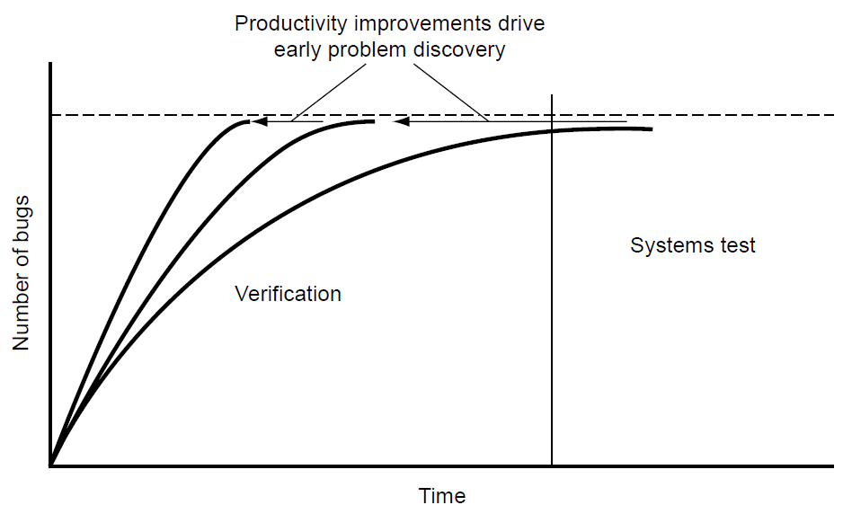
Poboljšanje verifikacione produktivnosti
Pošto verifikacija ima tako jak uticaj na
rokove, troškove i kvalitet, neophodno je pratiti produktivnost verifikacionog procesa
Metrika koju dizajn tim koristi u tu svrhu uzima u obzir dva faktora:
  Raspored i
  Kvalitet otkrivenih bagova
Poboljšanje verifikacione produktivnosti vodi ka skraćenju rokova i smanjenju troškova. Slika sa strane prikazuje tri moguće "krive otkrića bagova”
Najduža kriva se proteže u region sistemskih testova, kada inženjeri pronalaze poslednje bagove u hardveru
Poboljšanje verifikacije, prikazano na druge dve krive, rezultuje otkrivanjem bagova ranije, što će pozitivno uticati na rokove, troškove (i samim tim zaradu)
Notes:
Because verification has such a strong effect on the triple constraints, it is prudent to track verification productivity. The design team measures verification productivity by two factors: schedule time and quality of bugs found.
Project teams track productivity with respect to schedule time by measuring the steepness of the “bug curve”, as shown in the figure. An efficient verification team with a robust process will remove bugs at a faster pace than will a less effective team and process. Therefore, it is a good practice to maintain a history of bug curve rates from each project to track improvements in verification productivity.
The second measure of verification productivity, quality of bugs found, is a more qualitative evaluation than is measuring bug curve rates. The verification team measures the quality of a bug by analyzing the scenario and test case that uncovered the design flaw: the more difficult, esoteric, or complex the scenario, the higher the quality of bug. A productive verification team should find any “easy” or low-quality bugs early in the verification schedule. Throughout the process, the average complexity of the design flaws that the verification team uncovers should grow. Simple bugs found late in the verification cycle signal that the verification environment and test plans need to be analyzed.

Slide 17
Verifikacioni inženjer “MORA”
Jak tim za verifikaciju je neprocenjiva prednost za kompaniju koja
razvija hardver
Misija tima za verifikaciju je da što brže otkloni sve funkcionalne
probleme u dizajnu
Da bi u tome bili uspešni, verifikacioni inženjeri moraju steći specifične veštine:
  Moraju razumevati dizajn (na nivou specifikacije, ali i implementacije),
  Moraju biti u stanju da usko sarađuju sa dizajnerima,
  Moraju razumeti prednosti i mane različitih verifikacionih metoda i alata koji omogućavaju praćenje pokrivenosti prostora stanja od strane testova, i
  Moraju biti u stanju da koriste te alate efikasno kako bi razvili verifikaciono okruženje, obezbedili da se dešavaju zahtevani test scenariji, ali i adekvatna provera rezultata i funkcionalnosti dizajna
Notes:
Verification requires detailed knowledge of the design that is being verified (the design under verification, or DUV). Understanding of the design comes at two levels: the specification level and the implementation level.
The specification dictates the overall function of the design. It includes the architecture, the inputs and outputs, and the performance requirements. The architecture is the main specification of the device: for a microprocessor, this is the instruction set and definitions; for an I/O device, this is the protocols. The architecture is well documented and often globally published. The inputs and outputs of the DUV define the chip or system pins and include the required timings and protocols. The performance requirements of the DUV include the desired throughput of the design, processing speed, and bandwidth, as well as associative cache size and cache.
The implementation of the design deals with the internal constructs used to perform the specification. This is known as the microarchitecture of the design. Implementation components include the following:
Queues and buffers that hold data and commands
Internal state machines
Pipelines
Data and control flows
Designers or system-level architects (in the company or in industry) write the specifications of the design, documents that are available for the verification engineer to study and are the arbiter when design questions arise. Less formal documentation exists for implementation details, and this information must come from the designers. If necessary, verification engineers must extract the implementation details by interviewing the designers. These implementation details are needed so appropriate verification tests that stress the many structures within the design can be created.
Throughout a project, the verification engineer must have a strong relationship with the designer team. This does take some finesse, as it is the verification engineer’s role to find a designer’s mistakes and oversights.
With the wealth of techniques available for verification, it is important for a verification engineer to understand the strengths and weaknesses of each method. Some methods may be very effective on small portions of the design but not on large chips (e.g., formal verification). Other methods might require long lead times to create the code necessary for the environment. A verification engineer must also understand the tools that assist in gauging the state space covered by the testing. Each of these tools must be evaluated for
Effectiveness of approach for this design implementation
Effect of the approach on simulation throughput
Amount of time required to create the verification environment
Finally, when a verification approach is selected, the verification engineer must be able to create the verification environment, ensuring that the required functional test scenarios occur and that the checking is complete. This requires proficiency in multiple verification techniques, all of which rely on the verification engineer’s knack for sniffing out bugs in the design.

Slide 18
Uvod u verifikaciju
Cena verifikacije

Slide 19
Cena verifikacije
Funkcionalna verifikacija je neophodna za proces dizajniranja hardvera
Kako razvojni tim procenjuje koliko resursa treba uložiti u verifikaciju?
Uz premalo resursa, hardver će zahtevati nekoliko prolaza kroz proces fabrikacije,
što je znatno skuplje kako u pogledu troškova samog procesa, a posebno u pogledu time-to-market gubitaka, u poređenju sa alokacijom dovoljnih resursa za verifikaciju
Istovremeno, dizajnerski tim ne želi da previše investira ni u jednu oblast, uključujući
verifikaciju, jer bi prekomerno investiranje vodilo ka redundantnim troškovima
Stoga, razvojni tim teži balansiranju svih troškova koji se mogu smestiti u tri kategorije:
  Inženjerski troškovi (odvojen verifikacioni tim, ali dizajneri takođe vrše inicijalne testove, odnos dizajnera i verifikacionih inženjera 1:1 do 1:4)
  Alati (simulatori, alati za formalnu verifikaciju, pokrivenost, "trace viewers", ...), i
  Vreme (posvećenost kao ključni element uspešne verifikacije).
Uspešna verifikacija podrazumeva odgovarajuće investiranje u sve tri kategorije od gore
Notes:
Verification engineering cost is a measure of the number of people performing verification. Some design teams employ separate verification engineers, whereas other teams use their logic designers to perform verification after writing their HDL. However, there are clear advantages to using an independent verification team and not having the design team play a dual role. Some of these advantages are listed here.
Verification is a separate vocation that requires different skills than does logic design. The ability to create the scenarios and checkers needed to find bugs is detective work unlike the skills needed to create HDL that meets logical and physical requirements. A second reason for an independent verification team is these verification engineers will not be biased by the thought process that goes into the design. If a designer overlooked a case while creating the logic, the same designer should not be expected to write a test scenario for that missed case. Finally, when creating logic, a designer makes assumptions about the design. It is the verification engineer’s job to judge separately the verification environment requirements without the bias of the designer’s assumptions.
However, for many reasons, the design team is crucial to the verification effort. First, designers are the initial line of defense against bugs. Designers should perform a suite of verification tests that ensures a level of quality before delivering HDL to the verification team. Designers also have keen insight into tricky areas of the logic. The designer should highlight these areas of the design to the verification team as potential sources of bugs. A final key element for designers to assist in the verification effort is through accurate and timely documentation. This information guides the verification team in creating complete test plans and executing their work.
The basic building blocks of DA tools for verification are simulation engines and formal verification engines. Other DA tools build on the two basic engines. Software includes: “Coverage” tools that assist in evaluating the effectiveness of the scenarios driven into the logic during simulation; Trace viewers that show graphical (waveform) representations of the scenarios and the values of the latches, arrays, and wires in the HDL; High-level verification languages that assist the verification engineer in writing complex simulation environments; Test case generation software that can create multiple simulation test cases based on abstract templates; Simulation farm control software that allows simulation jobs to be run across multiple workstations simultaneously and collects the test scenario results; Assertion-based tools that assist in debug, allowing a bug to be flagged at the moment it occurs and enabling the engineer to know exactly where the HDL failed. Electronic DA (EDA) vendors supply these tools to the industry. DA software costs generally are based on licensing fees.
The amount of time spent on verification is key in the overall cost equation. Design teams must balance engineering costs and DA software licensing with schedule time. If a design team has an aggressive schedule (based on fabrication passes, experience, and industry benchmarks), then more verification skills and software will be required to meet the goals. If the verification team is not allocated enough resources for the allotted schedule, either the schedule will slip or the results seen in the fabricated hardware will be poor. Time is money in the equation.

Slide 20
Uvod u verifikaciju
Verifikacioni ciklus
2

Slide 21
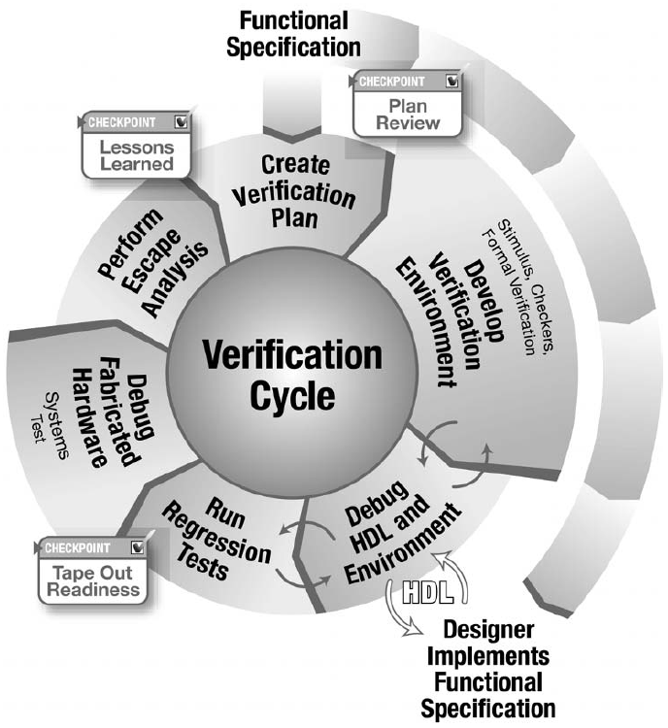
Verifikacioni ciklus
Verifikacioni ciklus se odvija u smeru kazaljke na satu, počevši od funkcionalne
specifikacije, ključne isporuke kako timu za dizajn
tako i timu za verifikaciju
Nakon završetka verifikacionog plana na osnovu specifikacije, ceo inženjerski tim pregleda plan kako bi pronašao eventualna poboljšanja
Dve faze u ciklusu pružaju povratne informacije prethodnim fazama: faza debagovanja i faza regresije - u njima tim za verifikaciju detektuje probleme ili u HDL-u ili u svom kodu verifikacionog okruženja
Nakon regresije, ciklus se nastavlja kroz fabrikaciju čipa i sistemske testove
Nakon što tim dobije fabrikovani čip, evaluira se kvalitet verifikacije kroz tzv analizu propusta (eng. escape analysis), koja daje povratne informacije pomoću kojih bi se trebalo poboljšati verifikaciono okruženje
Notes:
Structure is necessary in any complex field. In verification, structure comes from a well-defined process. The verification process identifies the required steps toward developing a bug-free chip release. Because the verification team enhances their environment based on previous experiences, the process is called the verification cycle.
Generally, verification teams stay together across multiple products. The verification cycle shadows the product cycle, allowing verification engineers to incorporate enhancements into the methodology continuously. Verification engineers gain experience through multiple passes of this cycle.
Figure shows the stages of the verification cycle. The cycle proceeds in a clockwise direction, starting from the functional specification, a key delivery to both the design and verification teams. As the team starts development of the verification environment, they reach the first checkpoint. After completing the verification plan based on the specifications, the entire engineering team reviews the plan to look for enhancements.
Two stages in the process provide feedback to previous stages. These stages are the debug and regression stages in which the verification team detects problems either in the HDL or in their environment code. As regression winds down, the team prepares the product for fabrication. This is the second checkpoint in the cycle, when the design and verification teams review all of the verification work against the tape-out criteria.
The cycle proceeds through the manufacturing and systems test. Once the team receives fabricated hardware, they evaluate the quality of their verification effort through escape analysis, which provides feedback into the process to plug holes in the verification environment. The final checkpoint in the cycle, lessons learned, uses escape analysis and the entire verification cycle experience to compile a list of items to improve on as they start the cycle again.

Slide 22
Funkcionalna specifikacija
Funkcionalna specifikacija opisuje željeni proizvod. Sadrži specifikaciju interfejsa putem kojih se komunicira, funkciju koju uređaj mora da obavlja i sve uslove koji utiču na dizajn
Sistemski arhitekta pravi funkcionalnu specifikaciju i ona je osnova verifikacionog ciklusa
Dok dizajneri implementiraju funkcionalnu specifikaciju u HDL-u, verifikacioni inženjeri razvijaju okruženje za verifikaciju u skladu sa funkcionalnom specifikacijom
Ovo može izgledati suvišno, ali ovo zapravo čini osnovu procesa verifikacije
Paralelna implementacija funkcionalne specifikacije u sklopu verifikacionog okruženja omogućava kontrolnu tačku u verifikacionom ciklusu (poređenje sa impl. kroz dizajn)
Ova redundantnost obezbeđuje da se dizajnerove pretpostavke i implementacija podudaraju sa namerama sistemskog arhitekte, definisanim kroz funkcionalnu specifikaciju

Slide 23
Pravljenje verifikacionog plana
Plan verifikacije je ključan jer predstavlja detaljan opis verifikacionih aktivnosti. On odgovara na pitanja „šta verifikujem?“ i „kako ću to verifikovati?“
Planovi verifikacije uključuju sledeće elemente:
  Specifični testovi i metode - definišu tip okruženja koje će verifikacioni inženjeri kreirati
  Potrebni alati - definišu softver neophodan za podršku opisanom okruženju. Ova stavka se odnosi kako na nabavku softvera, tako i na formiranje tima za razvoj softvera
  Kriterijumi za završetak - definišu metriku koja ukazuju na to da je verifikacija završena
  Potrebni resursi (ljudi, hardver i softver) i detalji rasporeda - povezuju plan sa menadžmentom kroz procenu troškova verifikacije
  Funkcije koje se verifikuju - lista svih funkcionalnosti koje će biti verifikovane na datom verifikacionom nivou
  Funkcije koje nisu obuhvaćene - opisuje sve funkcije koje moraju biti verifikovane na drugom nivou verifikacione hijerarhije. Verifikacija ovih funkcija biće navedena u drugom odeljku verifikacionog plana
Notes:
A verification plan is crucial because it presents a detailed description of the verification effort. It answers the questions “what am I verifying?” and “how am I going to verify it?”
The verification leaders write the verification plan, using the logic designers and system architects as consultants during the process.
Unless the design is simple, a hierarchical approach to verification is required. This approach allows the verification engineer to work on smaller components before building up to the system level. The verification plan contains sections for each component at each level of the hierarchy.
Verification plans include many of the following elements:
Specific tests and methods—define the type of environment that the verification engineers will create.
Required tools—list the software necessary to support the described environment. This list may drive requirements on the software procurement team or on internal software development teams.
Completion criteria—define the measurements that indicate that verification is complete.
Resources (people, hardware, and software) required and schedule details—tie plan to program management by estimating the cost of verification.
Functions to be verified—list the functions that will be verified at this level of verification.
Functions not covered—describe any functions that must be verified at a different level of the hierarchy. The verification of these functions will be specified in a different section of the verification plan.
The team reviews the final verification plans with the architects and designers. This is the first checkpoint in the cycle. The designers and architects compare the verification plans with the design specification and internal structures, suggesting enhancements and modifications to the verification environment plans.

Slide 24
Razvoj okruženja
Kada je verifikacioni plan uspostavljen, počinje razvoj okruženja za verifikaciju
Glavne komponente u verifikacionom okruženju su stimulusi i provera (checking)
Verifikaciono okruženje je skup softverskog koda i alata koji omogućavaju verifikacionom inženjeru da identifikuje nedostatke u dizajnu
Softverski kod je obično specifičan za dizajn, dok su alati tipično generički i koriste se kroz više projekata verifikacije
Postoji više različitih tipova verifikacionog okruženja:
  Deterministička,
  Randomizovana (bazirana na slučajnim vrednostima),
  Formalna, i
  Generatori test slučajeva
Svako od ovih okruženja ima različite mehanizme za kreiranje stimulusa i proveru rezultata u odnosu na DUV (Design Under Verification)
Notes:
Once the verification plan is in place, construction of the verification environment begins. Verification engineers spend the majority of their time on this stage of the cycle. As such, much of this course describes methods for developing verification environments. Major components in the verification environment are stimuli and checking for simulation-based environments, as well as rules generation for formal verification environments.
The verification environment is the set of software code and tools that enable the verification engineer to identify flaws in the design. The software code tends to be specific to the design, whereas the tools are more generic and are used across multiple verification projects.
There are many different types of environments, including deterministic, random based, formal based, and test case generators. Each of these environments has different mechanisms to create stimuli and check results against the DUV. In all cases, a reference model cross-checks the behavior against the design intent. The verification team creates the reference model to implement independently the design specification. A reference model makes a prediction of the test case results based on the test case stimulus. The verification team builds the knowledge of the function and design into the reference model. The reference model provides the checking components with the predicted data. The checking components compare the predicted data to the actual data from the DUV.
The environment is continually refined throughout the verification cycle. Refinements include fixes and additions to the software code.

Slide 25
Debugovanje HDL-a i verifikacionog okruženja
Sledeći korak verifikacionog ciklusa integriše verifikaciono okruženje sa HDL-om
U njemu verifikacioni inženjeri otklanjaju greške u hardveru pokretanjem testova
Dok se testovi izvršavaju, verifikacioni inženjeri pronalaze anomalije i ispituju ih
Ispitivanje otkriva izvor greške, koja će biti ili u verifikacionom okruženju ili u HDL dizajnu. Anomalija se javlja jer je verifikaciono okruženje predvidelo drugačije ponašanje od HDL-a.
Na ovaj način se isplaćuje redundantna putanja u verifikacionom ciklusu
Notes:
The next step of the verification cycle integrates the verification environment with the HDL. This is when verification engineers begin to debug the hardware by running tests. As these tests run, verification engineers find anomalies and examine them. Examination reveals the failure source, which will be either in the verification environment or in the HDL design. The anomaly occurs because the verification environment has predicted different behavior than has the HDL. This is the payoff of the redundant path in the cycle.
If the error is in the verification environment, the verification engineer updates the software to correct the predicted behavior. Otherwise, the HDL has a bug that the design team must correct. Once fixed, the verification engineer reruns the exact same test. This ensures that the update corrects the original anomaly and does not introduce new ones. The team applies this iterative approach until all tests pass.

Slide 26
Regresija
Regresija je kontinuirano izvršavanje testova definisanih kroz verifikacioni plan
Ovo je neophodan korak u ciklusu verifikacije iz dva glavna razloga:
  Prvi razlog je taj što verifikaciona okruženja tipično imaju elemente randomizacije, koji pokreću različite scenarije ulaza svaki put kada se pokrene test
  Drugi razlog je taj što je neophodno ponoviti sve testove nakon što su ispravke primenjene na dizajn (osim potvrde da je popravka uspešna, proveriti da se slučajno nije pojavio neki novi problem)
Stopa pojave grešaka opada kako verifikacioni ciklus dostiže fazu regresije
Da bi otkrili teško pronalažljive greške, timovi za verifikaciju koriste skupove radnih stanica (eng. Workstation pool), tzv „farme“, da bi pokrenuli što veći broj verifikacionih testova
Randomizacija ugrađena u okruženje omogućava nove scenarije testiranja na svakom od testova
Notes:
Regression is the continuous running of the tests defined in the verification plan. This is a required step in the verification cycle for two main reasons. The first reason is that verification environments often have elements of randomization, which drive different input scenarios each time the team runs the test. The second reason is that the team must repeat all tests after fixes have been applied to the design.
The failure occurrence rate drops as the verification cycle reaches the regression stage. To uncover hard-to-find bugs, verification teams leverage large workstation pools, or “farms,” to run an ever-increasing number of verification jobs. The randomization built into the environment enables new test scenarios on each of the jobs.
When the team finds a bug during regression, they use the same process as during HDL and environment debug. The bug is isolated and fixed, and then the verification team re-runs the exact same test.
With chip fabrication on the horizon, the verification team must reflect on the environment to ensure that they have applied all valid scenarios to the design and performed all pertinent checks. This is the tape-out readiness checkpoint.

Slide 27
Fabrikacija hardvera
Tim za dizajn pušta hardver na fabrikaciju kada se ispune svi kriterijumi za proizvodnju
Slanje čipa na fabrikaciju, poznato je i kao „tape-out“, što je termin iz prošlosti kada je dizajn tim čuvao informacije o fizičkom dizajnu čipa na magnetnim trakama koje su se slale u proizvodni pogon
Tim za dizajn čipa se oslanja na listu stavki koje treba zadovoljiti, tzv kriterijum slanja na fabrikaciju, za praćenje fizičkih i logičkih zahteva, koji moraju biti ispunjeni pre slanja dizajna u proizvodnju
Verifikacija je glavna komponenta ovog kriterijuma, obzirom na činjenicu da predstavlja nezavisnog sudiju koji objektivno procenjuje funkcionalnost čipa
Verifikacioni tim kreira i održava svoj deo kriterijuma za slanje na fabrikaciju, zasnivajući ga na planu testiranja. Ovaj kriterijum za fabrikaciju predstavlja formalizaciju zahteva za verifikacioni ciklus
Notes:
At this point, the failure occurrence rate in the regression stage has dropped to near zero, indicating that the verification environments have exhausted their bug-finding capability. However, environments that include randomization parameters continue in the regression stage after the design is sent to manufacturing. During the time between tape-out and receiving parts back from manufacturing (about 2 months’ duration), continued regression using randomization parameters may uncover further logical bugs. In complex designs, random-based verification environments continually create logical states in the design or scenarios that were never encountered before tape-out. Occasionally, one of these new states yields a bug, making the continued regression worthwhile. Designers integrate fixes for bugs found after the initial tape-out into revised HDL code, which will also contain fixes for any problems found during the hardware debug of the systems test.

Slide 28
Debagovanje fabrikovanog hardvera
Dizajnerski tim dobija hardver nakon što se izradi čip i završi proizvodni test čipa, eng. Production test (koji potvrđuje da nema fizičkih defekata koji mogu uticati na funkcionalnost)
Hardver se zatim postavlja u testno okruženje ili u sisteme za koje je čip namenjen
Zatim, tim za otklanjanje grešaka u hardveru (koji se sastoji od dizajnera i verifikacionih inženjera) vrši testiranje hardvera.
Tokom testiranja hardvera, mogu se pojaviti nove anomalije
Glavni cilj verifikacije je da se izbegne pronalaženje grešaka na hardveru, jer je to veoma skupo (znatno povećava troškove proizvodnje, kao što smo ranije već naglasili)
Notes:
Again, the design and verification teams must investigate these anomalies. The overall verification goal is to avoid finding bugs on the real hardware, as it is very expensive. Debugging on the real hardware is much more difficult than in a verification environment, mainly because the real hardware does not provide the full tracing capabilities of the verification environment. If an anomaly is determined to be a functional bug, the design team must fix it. There may be multiple options for fixing the bug, which include using system microcode to avoid the failing condition. However, if the fix must be made in the hardware, re-fabrication is required.

Slide 29
Analiza propusta
Ako se greške otkriju tokom testiranja hardvera, tim za verifikaciju mora da izvrši analizu propusta (eng. Escape analysis)
Ovaj, često zanemaren, ali kritičan deo ciklusa verifikacije osigurava da tim za verifikaciju u potpunosti razume grešku i razloge zašto ona nije otkrivena već u verifikacionom okruženju
Tim za verifikaciju mora da reprodukuje grešku u simulacionom okruženju, ako je moguće, kako bi potvrdio da razume grešku i razume kako se greška "provukla" kroz fazu verifikacije i došla do hardvera
Tim ne može da tvrdi da je ispravka greške ispravna bez reprodukcije originalne greške verifikacionom okruženju
Rezultati analize propusta su važna povratna informacija za sam početak verifikacionog ciklusa, jer omogućava verifikacionom timu da "uči iz prethodnih grešaka"
Razvoj budućeg hardvera ima koristi od ovog učenja, jer ono omogućava da se verifikacioni planovi i verifikaciona okruženja kontinuirano poboljšavaju

Slide 30
Tok verifikacije
Verifikaciona hijerarhija
3

Slide 31
Uvod
Tim za verifikaciju provodi većinu svog vremena u dve faze ciklusa verifikacije:
  razvoj okruženja za verifikaciju i
  otklanjanje grešaka u jeziku za dizajn hardvera (HDL) i okruženju
Ove dve faze predstavljaju srž verifikacije, a u njihovoj osnovi su verifikaciona hijerarhija i strategije za stimulisanje i proveru dizajna koji se verifikuje (DUV)
Osnovna praksa kod rešavanja složenog problema je razbijanje velikog problema na manje, podprobleme koji se lakše rešavaju. U verifikaciji se to postiže korišćenjem postojeće hijerarhijske strukture dizajna - umesto da verifikuje ceo sistem od početka, tim za verifikaciju će prvo napasti manje gradivne blokove sistema pre nego što pređe na veće delove
Bez obzira na kom hijerarhijskom nivou se verifikacioni inženjer nalazi, strategija generisanja stimulusa i otkrivanja grešaka je od vitalnog značaja za verifikaciju.

Slide 32
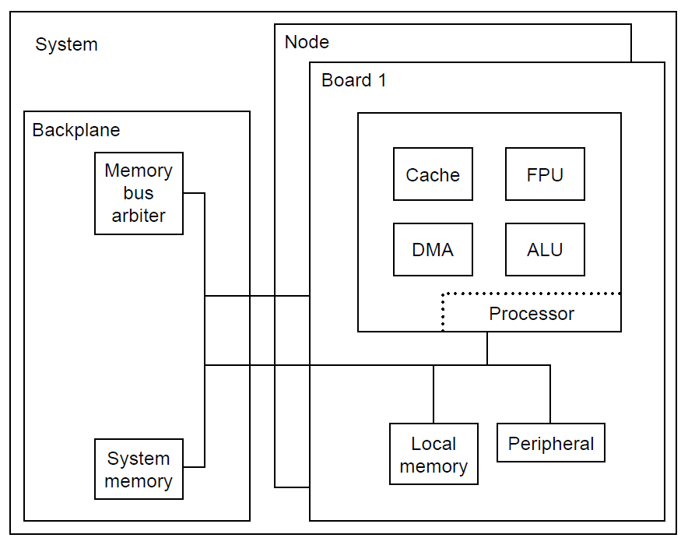
Verifikaciona hijerarhija
Dizajneri današnjih složenih čipova ne kreiraju HDL na jednom nivou (flat HDL). Umesto toga, dizajneri dele sistem i čipove na logičke jedinice. Ove logičke jedinice obično, ali ne obavezno, prate arhitekturu sistema i čipa
Ova uobičajena praksa se naziva hijerarhijski dizajn
Hijerarhijski dizajn omogućava dizajneru da podeli složeni problem na blokove kojima se lakše upravlja. Tim dizajnera kombinuje ove blokove kojima se lakše upravlja da bi formirao veće blokove; ovi blokovi se spajaju dok čip ili sistem nisu završeni. Slika desno prikazuje primer velikog, složenog sistema.
Da li verifikacija može da iskoristi ovaj stil razvoja dizajna? Odgovor je „apsolutno!“
Isti faktori koji pokreću tim dizajnera da razbije složeni čip na jednostavnije komponente takođe sugerišu da timovi za verifikaciju koriste prednosti hijerarhijskog pristupa rešavanju problema
Blok dijagram prikazuje više komponenti u jednom složenom sistemu. Ovaj sistem sadrži nekoliko procesorskih ploča, ili čvorova, povezanih magistralom međusobno i sa sistemskom memorijom

Slide 33
Hijerarhijski nivoi
Kao što dizajneri dele logiku na hijerarhijske komponente, verifikacija koristi prednost istih principa i hijerarhijskih „nivoa“.
Može postojati mnogo nivoa verifikacije. Dole su predstavljeni neki tipični nivoi, ali stvarne implementacije mogu imati više ili manje nivoa u zavisnosti od složenosti dizajna
Sledeća lista predstavlja neke potencijalne verifikacione nivoe, od najnižeg do najvišeg:
  1. Dizajner
  2. Jedinica (Unit)
  3. Jezgro (Core)
  4. Čip
  5. Ploča i sistem
  6. Ko-verifikacija hadrvera i softvera
Slika desno prikazuje kako gore navedeni hijerarhijski nivoi verifikacije odgovaraju velikom, složenom sistemu prikazanom na prethodnom slajdu
Hijerarhijski dijagram sistema sa više čvorova sa prethodnog
slajda koji prikazuje sistem izgrađen od komponenti nižeg nivoa.
Nivo dizajnera sadrži gradivne blokove HDL-a. Zbog manjka prostora, slika prikazuje samo najniži nivo keš jedinice.
Međutim, svaki čip ima jedinice, a svaka jedinica ima HDL na dizajner nivou.Svaki od sledećih nivoa - jedinica, čip, ploča i sistem, spajaju više blokova sa nižeg nivoa hijerarhije
Notes:
Each of these levels of verification has strengths and weaknesses. Although most projects do not require all of these levels, complex designs need at least two levels of verification. Verification teams choose levels based on their unique design features and the complexity of the logic within the hierarchy.

Slide 34
Verifikacija na "dizajner nivou"
Nivo dizajnera (takođe nazvan makro) je najniži nivo, koji često verifikuje sam dizajner -otuda i njegovo ime. Ovaj nivo može biti jednostavni tzv „smoke test“ kojim dizajner samo proverava da je dizajn upotrebljiv u okviru „stvarnog“ verifikacionog okruženja
Dizajner nivo verifikacije osigurava da će se dizajn učitati u simulacionom okruženju i da su osnovne funkcije ispravne
Nivo dizajnera je obično veoma dinamičan, posebno na početku projekta: na ovom nivou, interfejsi i funkcionalnost se često menjaju. Tokom faze dizajniranja, inženjeri često otkrivaju probleme koji zahtevaju izmenu ili izmeštanje funkcionalnosti preko HDL makro granica, što, zauzvrat, dovodi do promene interfejsa
Zbog velikog broja blokova na nivou dizajnera u sistemu, nije izvodljivo da verifikacioni inženjer verifikuje svaki blok nezavisno. Sa druge strane, zahvaljujući maloj veličini ovih blokova, verifikacioni inženjeri često koriste formalnu verifikaciju na ovom nivou hijerarhije
Međutim, blokovi koji su najviše izloženi riziku trebali bi svakako da imaju nezavisnu verifikaciju

Slide 35
Verifikacija na nivou jedinice (Unit-level)
Kod velikih i složenih dizajna, potrebna je verifikacija na nivou jedinica. Iz prethodnog primera, DMA, ALU, FPU i keš blokovi su jedinice koje se zasebno verifikuju
Jedinica sadrži više delova HDL-a sa nivoa dizajnera koji su spojeni u jedinice. Interfejsi i funkcije su stabilniji nego na nivou dizajnera, jer jedinice tipično imaju formalizovane specifikacije i fizičke ili vremenske zahteve kojih se dizajneri pridržavaju
Pošto su interfejsi i specifikacije stabilniji, tim za verifikaciju može da kreira naprednije okruženje (koristeći randomizovane stimuluse i autonomnu proveru)
Radi olakšavanja verifikacije, dizajn treba da bude podeljen tako da potpune funkcionalnosti budu sadržane u okviru jedinice. Ovi zahtevi za verifikaciju u sinergiji sa hijerarhijskom strukturom dizajna, olakšavaju projektovanje složenih dizajna
Iako je svrha nivoa jedinice da se u potpunosti proveri funkcionalnost jedinice, mogu postojati određene funkcionalnosti koje tim za verifikaciju ne može na tom nivou da proveri, kao što je funkcionalnost raspoređena na više jedinica
Kada se verifikuje nivo jedinice, verifikacioni inženjer može da pređe na više nivoe verifikacije, znajući da je osnovna funkcionalnost jedinice ispravna Viši nivoi zatim moraju da provere da li su interfejsi ka i od jedinice ispravni i u skladu sa protokolom

Slide 36
Verifikacija na nivou jezgra (Core-level)
Jezgro je posebna, ponovo upotrebljiva (reusable) jedinica koja zahteva kompletnu funkcionalnu specifikaciju sa stabilnim interfejsima. Dizajneri mogu koristiti jezgro više puta unutar sistema i na više sistema. Mogu kreirati jezgro interno ili ga dobiti iz eksternog izvora.
Verifikacija jezgra je mač sa dve oštrice. Pozitivno je to što kad je jednom verifikovano, ponovna verifikacija jezgra bi trebala da bude minimalna, ako je uopšte bude
Nedostatak verifikacije na nivou jezgra je taj što, pošto dizajneri mogu koristiti jezgra u mnogim različitim aplikacijama na datom sistemu ili više sistema, upotreba svake instance jezgra može biti drugačija
Ovo može otežati verifikaciju jer tim za verifikaciju možda ne zna sve stvarne parametre interfejsa i aplikacije u kojima će tim za dizajn koristiti dato jezgro
Verifikacioni ciklus za ponovo upotrebljivo jezgro uključuje skup regresionih testova, dobro dokumentovanu specifikaciju (funkcionalnosti i interfejsa), detalje o pokrivenosti (da bi se imao jasan pregled šta je verifikovano) i, po mogućstvu, scenarije verifikacije (ovi scenariji su oni navedeni u skupu regresionih testova)
Notes:
A core is a special, reusable unit which requires a complete functional specification with stable interfaces. Designers may use a core multiple times within a system and across multiple systems. They may create the core internally, or obtain it from an external source.
The verification of a core is a double-edged sword. The positive is that once verified, reusing a core should not add a burden to the verification effort. For example, a core that the engineering team reuses 10 times in a design needs just one strong verification effort, saving the need to verify it nine other times. The drawback to core-level verification is that because designers may use cores in many different applications across a system or multiple systems, the usage of each instance may be different. This drives a broader verification effort because the verification team may not know all of the actual interface and application parameters in which the design team will place the core. Engineers can be very creative when it comes to using a core, exercising it in ways different from the primary intentions. Therefore, the verification team must think outside the box when verifying a core, allowing for a broader range of input scenarios than the core’s initial use. Thus, the bounds in which the verification team works on a core are less defined and put a bigger burden on the team to verify the core in a more aggressive manner, as they must dream of “weird” scenarios.
When the core will be used by outside design teams, the verification team must employ a well-defined process, as engineers shy away from cores they do not trust. The key question when designing and verifying a core that other design teams will use is, “How do I gain my customers’ confidence?” This is where a well-defined process helps. The verification cycle for a reusable core includes a regression suite, well-documented specification (functions and interfaces), coverage items (to help indicate what has been verified), and possibly verification scenarios (these scenarios are the ones in the regression suite). The well-documented specification teaches the end-user about the core, and the verification scenarios indicate the bounds and depth of the core verification effort. The regression suite exists for when designers make changes to the core. When this occurs, the verification team runs this suite of verification tests to ensure that this fix or enhancement did not cause any other problems within the core.

Slide 37
Verifikacija na nivou čipa (Chip-level)
Nivo čipa se sastoji od više jedinica, a na ovom nivou postoje veoma dobro definisane granice interfejsa
Svrha ove verifikacije je da se osigura da su jedinice pravilno povezane i da dizajn poštuje sve protokole interfejsa jedinice
Međutim, mogu postojati i funkcionalnosti koje se ne mogu verifikovati na nivou jedinice; ove funkcionalnosti zahtevaju potpuno testiranje na nivou čipa
Dobro definisan interfejs čipa stvara ogromnu prednost za tim za verifikaciju na ovom nivou
Dizajneri se moraju usaglasiti u vezi sa fizičkim definicijama pinova čipa rano u procesu dizajniranja, dajući timu za verifikaciju stabilnu osnovu na kojoj mogu da kreiraju test pakete na nivou čipa
Iako se okruženja i dizajni nižeg nivoa razvijaju i intenzivno menjaju tokom projekta, verifikacija na nivou čipa zahteva manje održavanja

Slide 38
Verifikacija na nivou ploče i sistema
Ploča je skup čipova koji mogu da sadrže i neku diskretnu logiku za povezivanje (I kapije, ILI kapije itd.)
Svrha ovog nivoa verifikacije je da se validira međusobna povezanost čipova, njihova integracija i dizajn kompletne ploče
Fokus verifikacije na nivou sistema je na interakciji, a ne na određenim funkcionalnostima implementiranim unutar čipa ili jedinice
Kao rezultat toga, tim za verifikaciju koji radi na velikom ASIC-u ili FPGA-u radi sa pretpostavkom da je prethodno specificiran, dobro dokumentovan i potpuno verifikovan dizajn na nivoima koji se nalaze ispod sistemskog nivoa
Pošto je fokus na interakciji komponenti, verifikacioni inženjer na ovom nivou pretpostavlja da su pojedinačni čipovi, jezgra ili jedinice funkcionalno ispravni

Slide 39
Koji nivo odabrati?
Odabrati koji nivo verifikacije odabrati, ipak, nije toliko jednostavan zadatak kao što izgleda
Iako smo šest nivoa verifikacije opisali prethodno, većina projekata će sadržati neki podskup gore definisanih hijerarhijskih nivoa, a u skladu sa detaljima konkretnog dizajna
Postoje tehnički faktori koji pomažu timu da odabere koje nivoe da odabere za dati dizajn:
  Uvek odabiraj najniži nivo koji u potpunosti sadrži ciljanu funkcionalnost koja se verifikuje
  Svaki deo koji se verifikuje mora imati svoj supstveni dokument sa specifikacijom
  Nove ili kompleksne komponente zahtevaju fokus (verifikuju se zasebno)
  Odgovarajući nivo kontrole i opservabilnosti utiču na odluku u vezi sa verifikacionim nivoima koji će se koristiti
  Funkcionalnost može diktirati verifikacione nivoe
Notes:
Choosing which verification levels to use is not as easy as it may seem. Although six levels of hardware verification were described above, most verification projects will use an appropriate subset of these levels based on the design details. A single system on chip (SoC) may need unit-level verification on certain new blocks, followed by a chip/system-level effort. On the other hand, a complex server would need verification at the designer, unit, chip, system, and coverification levels.
There are technical factors that help teams decide which levels to choose for a given design. These factors are highlighted here.
Always choose the lowest level that completely contains the targeted function. The smaller the model, the more direct control the verification engineer has over creating the required test scenarios. A test that exercises the board in the previous does not need a system-level model containing the node and the backplane. These extra design pieces have a negative effect on simulation engine performance without providing any benefit to the test.
Each verifiable piece should have its own specification document. This helps keep interfaces and the function more stable, as well as allows everyone on the team to be “reading from the same sheet of music.” If functions and interfaces change often, then verification environments must change as well (with recoding each time).
New or complex components need focus. If a portion of function is new (versus function inherited from previous designs) or complex, then the verification team should isolate this function and create an environment to test it. Complex functions often have arbitration logic or multiple requestors vying for a single resource. This type of function lends itself to creation of robust, focused verification environments.
The appropriate level of control and observability drives decisions on which levels to verify. The lower the verification level, the more control the verification engineer has on the interface inputs, and the more observability on the outputs. This comes at a price of additional effort. Robust designer-level verification on all macrocomponents in a large system is not realistic, as more effort is required to construct each environment for each macro. Instead, only the complex macros have individual verification, leaving the less risky components to the higher levels. When dealing with higher levels of verification (chip, board, system), the team implicitly verifies the smaller components at the cost of lower control and observability.
Function may dictate verification levels. Verification engineers cannot verify certain functions at the lower levels. Often, this is because a function spans multiple components. Although the verification environment can test each component individually, the environment can prove only portions of the whole function. At a higher level, the team assembles all of the components and verifies the entire function.

Slide 40
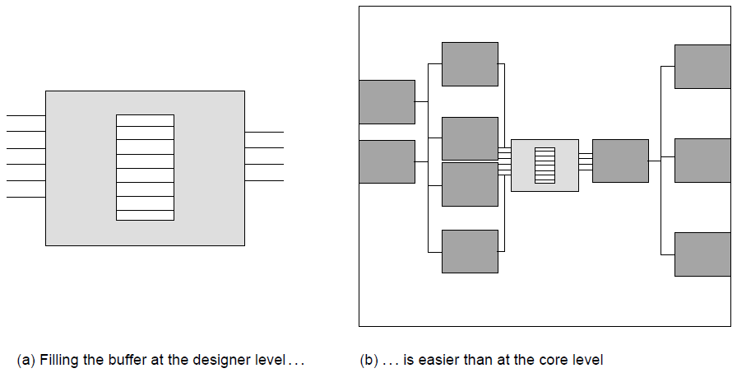
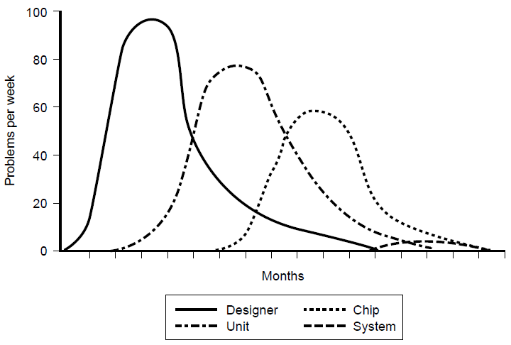
Stopa detekcije grešaka i nivoi na kojima su pronađene
Količina kontrolabilnosti i opservabilnosti koje verifikacioni inženjer ima je u direktnoj korelaciji sa mogućnošću pronalaženja grešaka u dizajnu
Kontrolabilnost pokazuje koliko je jednostavno verifikacionom inženjeru da kreira specifične testove koji su od interesa i ona je u direktnoj vezi sa nivoom verifikacione hijerarhije koji se koristi, kao što se može videti na gornjoj slici sa desne strane.
Opservabilnost pokazuje koliko je jednostavno verifikacionom inženjeru da prepozna kada se dizajn ponaša u skladu sa očekivanjima, a kada ne
Povećana mogućnost pronalaženja grešaka na niskom nivou takođe se poklada sa ciklusom razvoja dizajna
Dobra je praksa prelaziti na više nivoe verifikacione hijerarhije, u skladu sa stopom detekcije grešaka kao što je prikazano na donjoj slici
Notes:
The amount of controllability and observability that the verification engineer has directly correlates to the ability to find bugs in the design. Controllability indicates the ease at which the verification engineer creates the specific scenarios that are of interest. If a design contains a bug but the input scenario conditions that create the bug never occur, the verification engineer will not discover the bug in simulation. Controllability and the verification level of hierarchy are closely related. The higher the level of the hierarchy, the less controllability the verification engineer has. Verification engineers have greater controllability at lower levels because there are fewer dependencies on the surrounding units to cause the scenario.
As an example, a verification engineer wants to create a buffer-full condition in a macro within a core. If the level of hierarchy is the designer level, in which just the macro exists in the simulation environment, the verification engineer simply controls the input signals by pushing data into the buffer without ever popping the data. However, at the higher core level of verification, it is much harder to create this condition because the core level inputs are further from the buffer, and the behavior of the surrounding macros and units may continuously pop data from the buffer unless a very specific core level event occurs. This makes it difficult to fill the buffer. Top figure depicts these two cases: in Figure (a), the verification engineer can directly control the state of the buffer; in Figure (b), the control is indirect because of all of the surrounding logic.
Observability is the other aspect in discovering bugs. Observability indicates the ease with which the verification engineer can identify when the design acts appropriately versus when it demonstrates incorrect behavior. Lower levels of verification are conducive to observability because bugs are more likely to manifest themselves on the outputs. At the higher levels, it is often harder to observe interesting bugs without internal observation points.
The increased ability to find bugs at the lower levels fit nicely with the design cycle as well. Each designer on the team works at a different rate and pace. Therefore, not all macros in a project are ready for verification simultaneously. Designer- or unit-level verification may be available on early blocks long before an entire chip is ready for verification. As a result, it is good practice to progress the verification focus from the lower levels to the higher levels over time. This practice typically yields bug rates and trends as shown in the bottom figure. It is an efficient practice to wait until the bug rate begins to drop in a lower level before moving to the next level.
Cost of Bugs
A bug found at the designer level has little cost. The designer has the algorithms and decision process of the HDL fresh in his or her mind, and finding a bug quickly may drive the designer to implement the function differently, long before physical design or timing of the macro occurs. That same bug found at chip or system level has moderate cost because it will require more problem isolation and debug time. Furthermore, the designer may no longer be able to re-implement the function in a more effective manner because the required rework of physical design on this and other macros would break the schedule.

Slide 41
Tok verifikacije
Strategije verifikacije
4

Slide 42
Strategija verifikacije
Prethodna diskusija u vezi sa kontrolabilnošću I opservabilnošću upućuje na to da verifikacioni inženjer ima dva osnovna zadatka:
  pobuda (kontrolabilnost) i
  provera (opservabilnost) dizajna koji se verifikuje
Ova dve aktivnosti odgovaraju pitanjima koje verifikacioni inženjer mora da postavlja sebi:
  1. Da li sam pobuđivao dizajn u skladu sa svim mogućim ulaznim scenarijima?
  2. Kako da znam kada se desila greška?
Ova dva zadataka jesu nezavisni, ali se moraju obavljati istovremeno da bi doveli do uspeha. Verifikacioni inženjer će uhvatiti grešku u dizajnu ako je pobuda na ulazima dovela dizajn u stanje u kojem se greška može prepoznati i ako se ona prepozna adekvatno. Ako jedan od zadataka ne bude uspešan, neće ni kompletan proces
Pobuđivanje dizajna svim mogućim kombinacijama ulaza neće dovesti do detektovanja greške ako provera zakaže. Slično, idealna provera će biti neuspešna ako pobuda ne stimuliše "kritičan" scenario. Pobuda I provera su jin i jang verifikacije

Slide 43
Principi pobudjivanja I
Kada je zadužen za verifikaciju dela dizajna, verifikacioni inženjer treba prvo da pročita svu dokumentaciju koja postoji za taj dizajn. Prvi zadatak je da razume sve ulazne i izlazne linije, a zatim mora da razume funkcionalnost dizajna kako bi bio u stanju da predvidi izlaze na osnovu ulaza. Važno je da verifikacioni inženjer dobije opise ulaza od izvora koji nije autor HDL-a koji se testira
Sa razumevanjem definicija ulaza, verifikacioni inženjer počinje da planira strategiju stimulacije. On će, najpre, grupisati više signala zajedno na osnovu njihove logičke funkcije. Ovo je važno jer će se razviti odvojene strategije upravljanja za svaki skup grupisanih ulaznih signala
Prilikom razvoja strategije stimulacije, verifikacioni inženjer mora uvek imati na umu da je cilj zapravo maksimizovati broj scenarija koje verifikaciono okruženje stvara
Za kontrolne signale, to znači osigurati da okruženje koristi sve moguće komande i modifikatore. Za magistrale podataka, okruženje treba da kreira širok spektar mogućih vrednosti podataka. Posebno je važno za okruženje da testira granične slučajeve kada se biraju podaci koji će se koristiti u ovu svrhu
Notes:
What does it mean to “drive all possible input scenarios”? Although driving all possible input scenarios is trivial with a two-latch design, it is very hard to gauge completeness of input scenarios in a complex design. And what does it mean to “know when it fails”? How can we know if a complete set of checkers are in place?
To analyze these questions, first look at the “black box”. The black box is a piece of HDL, which is called a black box because verification engineers do not look inside the design implementation. The verification engineer does look at its inputs and outputs, their definitions, and their functions. The actual behavior of the black box and its outputs will depend on the inputs supplied to it over time and the function it performs. Given a set of input stimuli, the function of the black box will yield specific, predictable values over one or more machine cycles.
The black box may have complete documentation, or not. The amount of documentation required and the quality of documentation varies by the designer, the company policy, and the size of the black box. Larger pieces of design (which are higher in the design’s hierarchy) tend to have more documentation. Smaller portions of HDL (lowest levels of the hierarchy) tend to have embedded documentation but not separate functional descriptions.
When charged with verifying a piece of design, the verification engineer should first read whatever documentation exists for that design. The first task is to understand all input and output lines. The verification engineer must then understand the design’s function and thereby be able to predict the outputs based on the inputs. This is the design’s specification.
It is important that the verification engineer obtain the input descriptions from a source other than the author of the HDL under test. This source might be an industry standard specification (such as a Peripheral Component Interconnect (PCI) protocol) or another designer whose HDL outputs are the inputs to the HDL under test. This is significant because the verification engineer must maintain independence in understanding the design inputs in order to break the redundancy path. If the DUV designer authors the input specification, the verification engineer would duplicate any incorrect input understanding that the DUV designer has and bugs may be missed. If the interface specification must come from the designer whose logic is under test, the verification engineer should ensure that other designers sign off on the contents as matching their expectations of what their logic will drive into the DUV.
With the input definitions understood, the verification engineer begins to plan a stimulus strategy. Often, a design has a large number of input signals. In this case, the verification engineer will group multiple signals together based on their logical function. For example, a memory design’s command and address busses function hand in hand to access or store data at the intended memory location. Other memory DUV input signals might support different functions such as resetting the design. Grouping signals and busses together is important because the verification engineer will develop separate driving strategies for each set of grouped input signals.
In developing a stimulus strategy, the verification engineer must always remember the goal is to maximize the scenarios that the verification environment creates. For control signals, this means ensuring that the environment exercises all possible commands and modifiers. For data busses, the environment should create a wide assortment of possible data patterns. It is especially important for the environment to exercise edge cases when data patterns are choosen. Edge cases create odd, exception, or end conditions in the design such as storing to the last address in memory or causing an overflow in an adder.

Slide 44
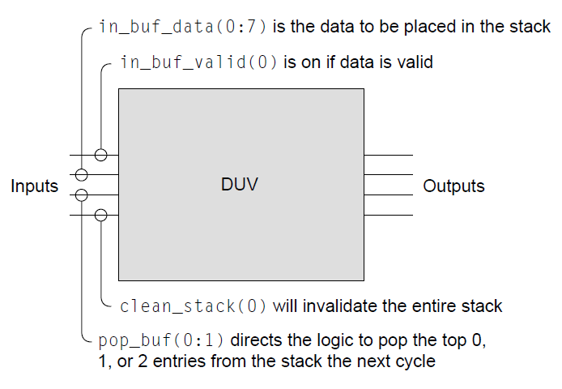
Principi pobudjivanja II
Zamislimo crnu kutiju sa skromnim opisom četiri ulazne linije
Iz datih podataka, možemo zaključiti:
  Postoji stek u okviru dizajna
  Stek je minimalne dubine 2
  Stek je širine 8 bita
  Samo jedan ulaz je moguć u datom trenutku
I dalje ima dosta nepoznatih u vezi dizajna:
  Da li je stek tipa LIFO ili FIFO?
  Kolika je dubina steka?
  Koji uslov treba da bude ispunjen da bi stek bio pun?
  Kada sadržaj steka postaje validan?
  Koje je ponašanje ako se upis i čitanje dese u istom ciklusu? Da li je ovo dozvoljeno uopšte?
  Koliko je vremena potrebno da se obriše sadržaj steka?
  Da li se tada upisi postavljaju na nulu ili samo označavaju kao ne-validni?
  Šta se dešava ako se operacija čitanja pozove na praznom steku?
  U slučaju čitanja dva podatka, kako su oni vraćeni? Istovremeno ili jedan za drugim?
  Šta se dešava ako se pop_buf(0:1) postavi na "11"b (tri čitanja)?
Notes:
What does it mean to “drive all possible input scenarios”? Although driving all possible input scenarios is trivial with a two-latch design, it is very hard to gauge completeness of input scenarios in a complex design. And what does it mean to “know when it fails”? How can we know if a complete set of checkers are in place?
To analyze these questions, first look at the “black box”. The black box is a piece of HDL, which is called a black box because verification engineers do not look inside the design implementation. The verification engineer does look at its inputs and outputs, their definitions, and their functions. The actual behavior of the black box and its outputs will depend on the inputs supplied to it over time and the function it performs. Given a set of input stimuli, the function of the black box will yield specific, predictable values over one or more machine cycles.
The black box may have complete documentation, or not. The amount of documentation required and the quality of documentation varies by the designer, the company policy, and the size of the black box. Larger pieces of design (which are higher in the design’s hierarchy) tend to have more documentation. Smaller portions of HDL (lowest levels of the hierarchy) tend to have embedded documentation but not separate functional descriptions.
When charged with verifying a piece of design, the verification engineer should first read whatever documentation exists for that design. The first task is to understand all input and output lines. The verification engineer must then understand the design’s function and thereby be able to predict the outputs based on the inputs. This is the design’s specification.
It is important that the verification engineer obtain the input descriptions from a source other than the author of the HDL under test. This source might be an industry standard specification (such as a Peripheral Component Interconnect (PCI) protocol) or another designer whose HDL outputs are the inputs to the HDL under test. This is significant because the verification engineer must maintain independence in understanding the design inputs in order to break the redundancy path. If the DUV designer authors the input specification, the verification engineer would duplicate any incorrect input understanding that the DUV designer has and bugs may be missed. If the interface specification must come from the designer whose logic is under test, the verification engineer should ensure that other designers sign off on the contents as matching their expectations of what their logic will drive into the DUV.
With the input definitions understood, the verification engineer begins to plan a stimulus strategy. Often, a design has a large number of input signals. In this case, the verification engineer will group multiple signals together based on their logical function. For example, a memory design’s command and address busses function hand in hand to access or store data at the intended memory location. Other memory DUV input signals might support different functions such as resetting the design. Grouping signals and busses together is important because the verification engineer will develop separate driving strategies for each set of grouped input signals.
In developing a stimulus strategy, the verification engineer must always remember the goal is to maximize the scenarios that the verification environment creates. For control signals, this means ensuring that the environment exercises all possible commands and modifiers. For data busses, the environment should create a wide assortment of possible data patterns. It is especially important for the environment to exercise edge cases when data patterns are choosen. Edge cases create odd, exception, or end conditions in the design such as storing to the last address in memory or causing an overflow in an adder.

Slide 45
Principi pobudjivanja III – koji testovi su potrebni?
Stimulus | Opis
Upisivanja i ne upisivanje | Upisivanje u stek je očigledno. Ipak, testovi treba da pokriju scenario u kojem se upis u stek ne dešava nekoliko ciklusa
Upis i čitanje | Na osnovu datog interfejsa, deluje da je moguće istovremeno upisivati u stek i čitati sa steka
Sva tri čitanja | Postoje tri različite vrednosti koje se mogu dovesti na pop_buff ulaz i treba sve proveriti
Upis kada je stek pun | Iako dubina steka niti ponašanje prilikom upisa u pun stek nisu definisani, ovaj test scenario mora biti pokriven, takođe
Istovremeno čitanje i resetovanje steka | Konkurentne konfliktne operacije kao ova često vode ka greškama u dizajnu
Notes:
What does it mean to “drive all possible input scenarios”? Although driving all possible input scenarios is trivial with a two-latch design, it is very hard to gauge completeness of input scenarios in a complex design. And what does it mean to “know when it fails”? How can we know if a complete set of checkers are in place?
To analyze these questions, first look at the “black box”. The black box is a piece of HDL, which is called a black box because verification engineers do not look inside the design implementation. The verification engineer does look at its inputs and outputs, their definitions, and their functions. The actual behavior of the black box and its outputs will depend on the inputs supplied to it over time and the function it performs. Given a set of input stimuli, the function of the black box will yield specific, predictable values over one or more machine cycles.
The black box may have complete documentation, or not. The amount of documentation required and the quality of documentation varies by the designer, the company policy, and the size of the black box. Larger pieces of design (which are higher in the design’s hierarchy) tend to have more documentation. Smaller portions of HDL (lowest levels of the hierarchy) tend to have embedded documentation but not separate functional descriptions.
When charged with verifying a piece of design, the verification engineer should first read whatever documentation exists for that design. The first task is to understand all input and output lines. The verification engineer must then understand the design’s function and thereby be able to predict the outputs based on the inputs. This is the design’s specification.
It is important that the verification engineer obtain the input descriptions from a source other than the author of the HDL under test. This source might be an industry standard specification (such as a Peripheral Component Interconnect (PCI) protocol) or another designer whose HDL outputs are the inputs to the HDL under test. This is significant because the verification engineer must maintain independence in understanding the design inputs in order to break the redundancy path. If the DUV designer authors the input specification, the verification engineer would duplicate any incorrect input understanding that the DUV designer has and bugs may be missed. If the interface specification must come from the designer whose logic is under test, the verification engineer should ensure that other designers sign off on the contents as matching their expectations of what their logic will drive into the DUV.
With the input definitions understood, the verification engineer begins to plan a stimulus strategy. Often, a design has a large number of input signals. In this case, the verification engineer will group multiple signals together based on their logical function. For example, a memory design’s command and address busses function hand in hand to access or store data at the intended memory location. Other memory DUV input signals might support different functions such as resetting the design. Grouping signals and busses together is important because the verification engineer will develop separate driving strategies for each set of grouped input signals.
In developing a stimulus strategy, the verification engineer must always remember the goal is to maximize the scenarios that the verification environment creates. For control signals, this means ensuring that the environment exercises all possible commands and modifiers. For data busses, the environment should create a wide assortment of possible data patterns. It is especially important for the environment to exercise edge cases when data patterns are choosen. Edge cases create odd, exception, or end conditions in the design such as storing to the last address in memory or causing an overflow in an adder.

Slide 46
Principi pobudjivanja IV – koji testovi su potrebni?
Stimulus | Opis
Istovremeni upis i resetovanje steka | Takođe, kao i prethodni, i ovaj potencijalno problematičan scenario treba biti pokriven
Svi bitovi podataka | Test plan treba da obuhvati verifikaciju da svaki bit u sklopu 8-bitnog podatka koji se upisuje može biti 0 ili 1, kao i da svaka linija steka korektno skladišti upisani podatak
Temporalne zavisnosti kao na primer dvostruku upis jedan sa drugim, uz istovremeno dvostruko čitanje tokom prvog upisa (počevši sa praznim stekom) | Temporalno zavisni stimulusi, koji se protežu na više od jednog ciklusa su, tipično, najteži za generisanje, ali, sa druge strane, najčešće vode ka pronalaženju grešaka u sistemu
Notes:
What does it mean to “drive all possible input scenarios”? Although driving all possible input scenarios is trivial with a two-latch design, it is very hard to gauge completeness of input scenarios in a complex design. And what does it mean to “know when it fails”? How can we know if a complete set of checkers are in place?
To analyze these questions, first look at the “black box”. The black box is a piece of HDL, which is called a black box because verification engineers do not look inside the design implementation. The verification engineer does look at its inputs and outputs, their definitions, and their functions. The actual behavior of the black box and its outputs will depend on the inputs supplied to it over time and the function it performs. Given a set of input stimuli, the function of the black box will yield specific, predictable values over one or more machine cycles.
The black box may have complete documentation, or not. The amount of documentation required and the quality of documentation varies by the designer, the company policy, and the size of the black box. Larger pieces of design (which are higher in the design’s hierarchy) tend to have more documentation. Smaller portions of HDL (lowest levels of the hierarchy) tend to have embedded documentation but not separate functional descriptions.
When charged with verifying a piece of design, the verification engineer should first read whatever documentation exists for that design. The first task is to understand all input and output lines. The verification engineer must then understand the design’s function and thereby be able to predict the outputs based on the inputs. This is the design’s specification.
It is important that the verification engineer obtain the input descriptions from a source other than the author of the HDL under test. This source might be an industry standard specification (such as a Peripheral Component Interconnect (PCI) protocol) or another designer whose HDL outputs are the inputs to the HDL under test. This is significant because the verification engineer must maintain independence in understanding the design inputs in order to break the redundancy path. If the DUV designer authors the input specification, the verification engineer would duplicate any incorrect input understanding that the DUV designer has and bugs may be missed. If the interface specification must come from the designer whose logic is under test, the verification engineer should ensure that other designers sign off on the contents as matching their expectations of what their logic will drive into the DUV.
With the input definitions understood, the verification engineer begins to plan a stimulus strategy. Often, a design has a large number of input signals. In this case, the verification engineer will group multiple signals together based on their logical function. For example, a memory design’s command and address busses function hand in hand to access or store data at the intended memory location. Other memory DUV input signals might support different functions such as resetting the design. Grouping signals and busses together is important because the verification engineer will develop separate driving strategies for each set of grouped input signals.
In developing a stimulus strategy, the verification engineer must always remember the goal is to maximize the scenarios that the verification environment creates. For control signals, this means ensuring that the environment exercises all possible commands and modifiers. For data busses, the environment should create a wide assortment of possible data patterns. It is especially important for the environment to exercise edge cases when data patterns are choosen. Edge cases create odd, exception, or end conditions in the design such as storing to the last address in memory or causing an overflow in an adder.

Slide 47
Strategije provere
Pobuda i provera su usko povezani. Dok se stimulus generatori u okviru okruženja koriste za pobudu ulaza dizajna koji se verifikuje, uloga komponente za proveru (checker) je da ispita da li se DUV ponaša ispravno u skladu sa generisanim ulazima
DUV će se ponašati ispravno ako radi u skladu sa specifikacijom dizajna i željenom funkcionalnosti
Postoje četiri glavna izvora za komponente za proveru. Timovi zaduženi za dizajn i arhitekturu dokumentuju te izvore u različitim specifikacijama, dok verifikacioni inženjer mora da razume svaki od tih izvora i da kreira okruženje koje sadrži kompletnu proveru
Četiri izvora komponente za proveru su:
  Ulazi i izlazi dizajna
  Kontekst dizajna
  Mikroarhitekturna pravila dizajna
  Arhitektura dizajna
Notes:
A fundamental source of checkers is the outputs of the DUV because any bug in the design will at some point manifest itself at the outputs of the design. With robust drivers, most bugs will show up as a miscompare on an output of the design. A miscompare occurs when the actual DUV data does not match the expected data from the checker.
When verifying HDL at the lower levels of the design hierarchy, it is important for the verification engineer to understand the design’s higher level functionality, or design context. A verification engineer must understand the big picture, even when focusing on a specific portion of the design.
Verification teams derive many checkers from properties based on the microarchitecture, or internal structures of the design, so verification engineers must understand the internals of the design.
Most verification checkers have their roots in the design architecture. Although the microarchitecture defines the structures that compose the design, the architecture dictates how the design must act. Industry standards groups and companies publish architecture specifications for public protocols, programmable processing units, and system structures. Hardware designs must abide by these specifications. The architecture lends itself to being the verification engineer’s main source of checkers because of the strict requirements on documenting the architecture.

Slide 48
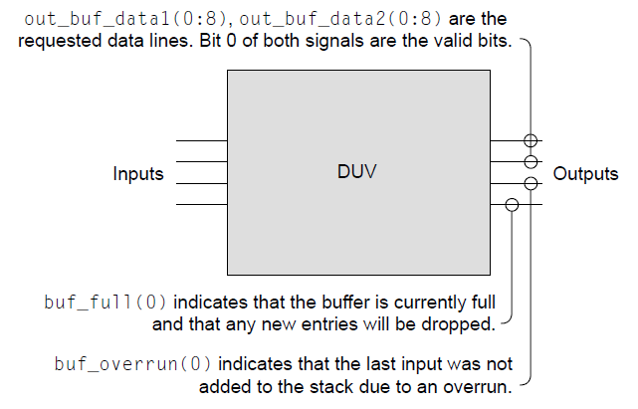
Komponenta za proveru crne kutije I
Uz kratke opise izlaza, neka od pitanja su dobila odgovore:
  U slučaju dvostrukog čitanja, izlazi se dobiju istovremeno
  Logika unutar crne kutije daje indikaciju kada je stek pun
  Generator ulaznog stimulusa mora ponoviti transakciju kada se desi prekoračenje, pošto će podaci biti odbačeni
Tim za dizajn i arhitekturu isporučuju specifkaciju koje otkriva sledeće:
  Stek je dubine 7
  Novi upis na stek je validan za čitanje u sledećem ciklusu
  Stek reset se završava u sledećem ciklusu nakon clean komande, dok dizajn ignoriše ulaze koji stižu istovremeno sa clean komandom
  Clean komanda postavlja valid bit na 0 za svih sedam upisa u steku
  Nema vraćenih podataka kada se čitanje izvrši na steku koji je prazan
  Stek je tipa FIFO
  Buff_full i buff_overrun izlazi su oba neophodna jer buf_full postaje aktivan jedan ciklus nakon što se primi podatak koji će popuniti stek
Notes:
A fundamental source of checkers is the outputs of the DUV because any bug in the design will at some point manifest itself at the outputs of the design. With robust drivers, most bugs will show up as a miscompare on an output of the design. A miscompare occurs when the actual DUV data does not match the expected data from the checker.
When verifying HDL at the lower levels of the design hierarchy, it is important for the verification engineer to understand the design’s higher level functionality, or design context. A verification engineer must understand the big picture, even when focusing on a specific portion of the design.
Verification teams derive many checkers from properties based on the microarchitecture, or internal structures of the design, so verification engineers must understand the internals of the design.
Most verification checkers have their roots in the design architecture. Although the microarchitecture defines the structures that compose the design, the architecture dictates how the design must act. Industry standards groups and companies publish architecture specifications for public protocols, programmable processing units, and system structures. Hardware designs must abide by these specifications. The architecture lends itself to being the verification engineer’s main source of checkers because of the strict requirements on documenting the architecture.

Slide 49
Komponenta za proveru crne kutije II – test plan
Čeker | Izvor | Opis
Dizajn vraća korektne rezultate | Ulazi i izlazi, arhitektura | Fundamentalna provera koja potvrđuje da se podaci na izlazu slažu sa podacima dovedenim na ulaze. Verifikacioni kod mora čuvati sve prethodne upise kako bi proverio redosled čitanja sa steka
Prekoračenje bafera | Mikroarhitektura | Verifikacioni kod mora čivati broj upisa u stek, kako bi proverio pojavljivanje izlaznih signala buff_full i buff_overrun
Notes:
What does it mean to “drive all possible input scenarios”? Although driving all possible input scenarios is trivial with a two-latch design, it is very hard to gauge completeness of input scenarios in a complex design. And what does it mean to “know when it fails”? How can we know if a complete set of checkers are in place?
To analyze these questions, first look at the “black box”. The black box is a piece of HDL, which is called a black box because verification engineers do not look inside the design implementation. The verification engineer does look at its inputs and outputs, their definitions, and their functions. The actual behavior of the black box and its outputs will depend on the inputs supplied to it over time and the function it performs. Given a set of input stimuli, the function of the black box will yield specific, predictable values over one or more machine cycles.
The black box may have complete documentation, or not. The amount of documentation required and the quality of documentation varies by the designer, the company policy, and the size of the black box. Larger pieces of design (which are higher in the design’s hierarchy) tend to have more documentation. Smaller portions of HDL (lowest levels of the hierarchy) tend to have embedded documentation but not separate functional descriptions.
When charged with verifying a piece of design, the verification engineer should first read whatever documentation exists for that design. The first task is to understand all input and output lines. The verification engineer must then understand the design’s function and thereby be able to predict the outputs based on the inputs. This is the design’s specification.
It is important that the verification engineer obtain the input descriptions from a source other than the author of the HDL under test. This source might be an industry standard specification (such as a Peripheral Component Interconnect (PCI) protocol) or another designer whose HDL outputs are the inputs to the HDL under test. This is significant because the verification engineer must maintain independence in understanding the design inputs in order to break the redundancy path. If the DUV designer authors the input specification, the verification engineer would duplicate any incorrect input understanding that the DUV designer has and bugs may be missed. If the interface specification must come from the designer whose logic is under test, the verification engineer should ensure that other designers sign off on the contents as matching their expectations of what their logic will drive into the DUV.
With the input definitions understood, the verification engineer begins to plan a stimulus strategy. Often, a design has a large number of input signals. In this case, the verification engineer will group multiple signals together based on their logical function. For example, a memory design’s command and address busses function hand in hand to access or store data at the intended memory location. Other memory DUV input signals might support different functions such as resetting the design. Grouping signals and busses together is important because the verification engineer will develop separate driving strategies for each set of grouped input signals.
In developing a stimulus strategy, the verification engineer must always remember the goal is to maximize the scenarios that the verification environment creates. For control signals, this means ensuring that the environment exercises all possible commands and modifiers. For data busses, the environment should create a wide assortment of possible data patterns. It is especially important for the environment to exercise edge cases when data patterns are choosen. Edge cases create odd, exception, or end conditions in the design such as storing to the last address in memory or causing an overflow in an adder.

Slide 50
Komponenta za proveru crne kutije III – test plan
Čeker | Izvor | Opis
Stek postaje validan u pravom trenutku | Mikrorarhitektura | Na osnovu specifikacije, podaci u steku su dostupni jedan ciklus nakon što su upisani u stek. Čeker onda mora da potvrdi da podaci nisu dostupni pre nego što treba (u istom ciklusu kad se desio upis) i da su dostupni jedan ciklus posle upisa
Proveri sve izlaze u svakom trenutku | Kontekst dizajna | Nije dovoljno samo proveriti podatke nakon čitanja sa steka, potrebno je proveriti da se na linijama out_buf_data1 I out_buf_data_2 ne pojavljuju podaci osim ako je na ulazima inicirano čitanje i ako ima podataka upisanih na steku. Takođe, buff_full i buff_overrun signali ne trebaju biti aktivni osim kada je čeker predvideo da su ispunjeni odgovarajući uslovi za njihovo pojavljivanje
Notes:
What does it mean to “drive all possible input scenarios”? Although driving all possible input scenarios is trivial with a two-latch design, it is very hard to gauge completeness of input scenarios in a complex design. And what does it mean to “know when it fails”? How can we know if a complete set of checkers are in place?
To analyze these questions, first look at the “black box”. The black box is a piece of HDL, which is called a black box because verification engineers do not look inside the design implementation. The verification engineer does look at its inputs and outputs, their definitions, and their functions. The actual behavior of the black box and its outputs will depend on the inputs supplied to it over time and the function it performs. Given a set of input stimuli, the function of the black box will yield specific, predictable values over one or more machine cycles.
The black box may have complete documentation, or not. The amount of documentation required and the quality of documentation varies by the designer, the company policy, and the size of the black box. Larger pieces of design (which are higher in the design’s hierarchy) tend to have more documentation. Smaller portions of HDL (lowest levels of the hierarchy) tend to have embedded documentation but not separate functional descriptions.
When charged with verifying a piece of design, the verification engineer should first read whatever documentation exists for that design. The first task is to understand all input and output lines. The verification engineer must then understand the design’s function and thereby be able to predict the outputs based on the inputs. This is the design’s specification.
It is important that the verification engineer obtain the input descriptions from a source other than the author of the HDL under test. This source might be an industry standard specification (such as a Peripheral Component Interconnect (PCI) protocol) or another designer whose HDL outputs are the inputs to the HDL under test. This is significant because the verification engineer must maintain independence in understanding the design inputs in order to break the redundancy path. If the DUV designer authors the input specification, the verification engineer would duplicate any incorrect input understanding that the DUV designer has and bugs may be missed. If the interface specification must come from the designer whose logic is under test, the verification engineer should ensure that other designers sign off on the contents as matching their expectations of what their logic will drive into the DUV.
With the input definitions understood, the verification engineer begins to plan a stimulus strategy. Often, a design has a large number of input signals. In this case, the verification engineer will group multiple signals together based on their logical function. For example, a memory design’s command and address busses function hand in hand to access or store data at the intended memory location. Other memory DUV input signals might support different functions such as resetting the design. Grouping signals and busses together is important because the verification engineer will develop separate driving strategies for each set of grouped input signals.
In developing a stimulus strategy, the verification engineer must always remember the goal is to maximize the scenarios that the verification environment creates. For control signals, this means ensuring that the environment exercises all possible commands and modifiers. For data busses, the environment should create a wide assortment of possible data patterns. It is especially important for the environment to exercise edge cases when data patterns are choosen. Edge cases create odd, exception, or end conditions in the design such as storing to the last address in memory or causing an overflow in an adder.

Slide 51
Provera u verifikaciji ne treba da re-implementira dizajn I
Verifikacioni inženjer mora ostati nezavisan, a istovremeno održavati blisku saradnju sa dizajnerskim timom.
Ovo je posebno važno kada se kreira kod za proveru radi verifikacije
Iako je inženjeru za verifikaciju dozvoljeno da zna implementaciju dizajna, kod za proveru ne bi trebalo da odražava algoritam dizajna
Inženjer za verifikaciju uvek mora početi sa pretpostavkom da je implementacija dizajna pogrešna
Ako kod za proveru verodostojno odražava dizajn, postoji mogućnost da komponenta za proveru implementira grešku na isti način kao što je to učinio dizajn
Ovo prekida putanju redundantnosti i uzrokovalo bi da greška ostane neotkrivena, jer se i rezultati dizajna i rezultati komponente za proveru podudaraju

Slide 52
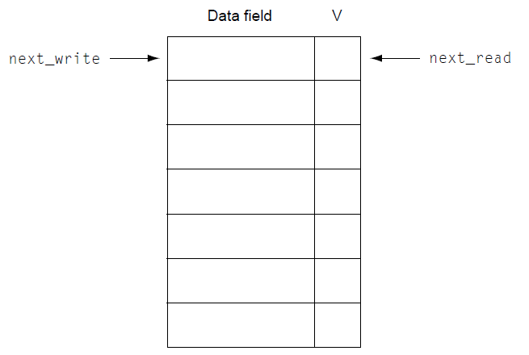
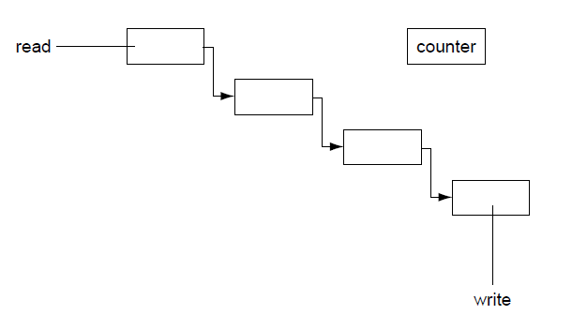
Provera u verifikaciji ne treba da re-implementira dizajn II
Kao primer, uzmimo implementaciju steka kao crne kutije:
  Next_read pokazivač pokazuje na poziciju sa koje se čita tokom naredne read komande
  Next_write pokazivač pokazuje na koju poziciju se smešta sledeći podatak koji se upisuje na stek
  V je valid bit za svaki upis na steku
  Kada su pokazivači isti stek je ili pun ili prazan, zavisnosti od vrednosti V
Verifikacioni kod može da:
  Napravi stek dubine 7 i koristi pointere na isti način kao što se koriste u dizajnu, ili
  Napravi povezanu listu, strukturu za proveru sa različitom i nezavisnom implementacijom (uz dodatni brojač koji se inkrementira kod svakog upisa ili dekrementira kod svakog čitanja)

Slide 53
Sve prethodno rečeno – primer kompleksne greške I
Razmotrimo sledeći scenario greške:
  Specifikacija dizajna navodi da postavljanje clean_stack na "1" rezultuje brisanjem svih valid bita na steku
  Pokazivači next_read i next_write biće postavljeni na vrh steka
  Ako stimulus generator postavi in_buf_valid na "1" sa podacima u istom ciklusu kad se postavi i clean_stack, logika resetuje pokazivače kao što je predviđeno ali greškom takođe postavlja poslednji podatak na stek
  Ovaj slučaj se jedino dešava kada stek ima 6 validnih upisanih podataka u trenutku kada se clean_stack i in_buf_valid setuju, pošto se bag nalazi u logici koja pokušava da setuje buf_full izlaz
Da bi detektovao ovaj bag, verifikacioni inženjer mora da:
  Upiše dovoljno podataka na stek kako bi obezbedio da je 6 validnih podataka prisutno
  Test mora postaviti istovremeno clean_stack i in_buf_valid na "1"
  U tom trenutku stek ima upisanu pogrešnu vrednost, ali bag se neće nikako manifestovati na izlazu
  Ako se još jedan clean_stack desi tokom sledećih nekoliko ciklusa dizajn će očistiti pogrešan podatak I bag će se "provući" neopažen
Notes:
A fundamental source of checkers is the outputs of the DUV because any bug in the design will at some point manifest itself at the outputs of the design. With robust drivers, most bugs will show up as a miscompare on an output of the design. A miscompare occurs when the actual DUV data does not match the expected data from the checker.
When verifying HDL at the lower levels of the design hierarchy, it is important for the verification engineer to understand the design’s higher level functionality, or design context. A verification engineer must understand the big picture, even when focusing on a specific portion of the design.
Verification teams derive many checkers from properties based on the microarchitecture, or internal structures of the design, so verification engineers must understand the internals of the design.
Most verification checkers have their roots in the design architecture. Although the microarchitecture defines the structures that compose the design, the architecture dictates how the design must act. Industry standards groups and companies publish architecture specifications for public protocols, programmable processing units, and system structures. Hardware designs must abide by these specifications. The architecture lends itself to being the verification engineer’s main source of checkers because of the strict requirements on documenting the architecture.

Slide 54
Sve prethodno rečeno – primer kompleksne greške II
Da bi se greška detektovala, komponenta za proveru je podjednako važna kao i stimulus generator
Greška će se pojaviti u jednom od sledeća tri slučaja:
  Prvi se odnosi na pogrešnim vrednostima buf_full izlaza: buf_full je postavljen na "1" jer next_write pokazuje naunos označen kao validan kad on ne bi trebao biti validan: pošto čeker pretpostavlja da je samo šest upisa na stek obavljeno kod steka dubine 7, čeker će prijaviti grešku
  Drugi se dešava kada se pogrešni podaci pojave na out_buf_data1 ili out_buf_data2, što se dešava kada HDL odgovara na read komandu slanjem podatak sa stek pozicije na kojoj se nalazi greškom postavljen valid bit: čeker predviđa da se na izlazu pojave podaci koji odgovaraju prvom upisu nakon što se clean_stack pojavio, ali HDL vraća drugačije podatke te verifikaciono okruženje raportira grešku
  Poslednji je scenario u kome čeker otkriva bag kada HDL postavlja buf_overrun izlaz prerano: pokazivač koji se koristi kod upisa detektuje da pokazuje na validan upis u momentu kada stigne zahtev za novim upisom, a nakon što je samo 6 upisa na stek izvršeno, ali svih sedam lokacija u steku imaju postavljen valid bit
Notes:
A fundamental source of checkers is the outputs of the DUV because any bug in the design will at some point manifest itself at the outputs of the design. With robust drivers, most bugs will show up as a miscompare on an output of the design. A miscompare occurs when the actual DUV data does not match the expected data from the checker.
When verifying HDL at the lower levels of the design hierarchy, it is important for the verification engineer to understand the design’s higher level functionality, or design context. A verification engineer must understand the big picture, even when focusing on a specific portion of the design.
Verification teams derive many checkers from properties based on the microarchitecture, or internal structures of the design, so verification engineers must understand the internals of the design.
Most verification checkers have their roots in the design architecture. Although the microarchitecture defines the structures that compose the design, the architecture dictates how the design must act. Industry standards groups and companies publish architecture specifications for public protocols, programmable processing units, and system structures. Hardware designs must abide by these specifications. The architecture lends itself to being the verification engineer’s main source of checkers because of the strict requirements on documenting the architecture.

Slide 55
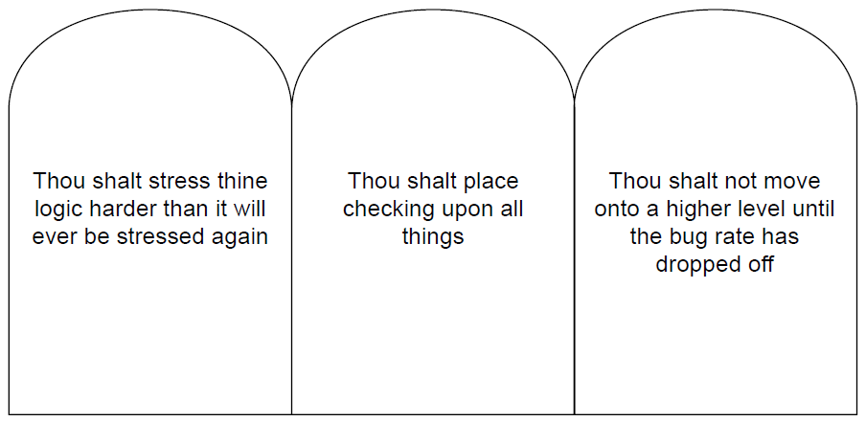
Sumirano – tri postulata simulacije
Suština verifikacije leži u fundamentalnoj kompletnosti komponenti za generisanje stimulusa i za proveru, kao i upotrebi ovih komponenti na svim nivoima verifikacije
U skladu sa tim, mogu se definisati tri osnovna postulata u vezi sa verifikacijom baziranom na simulaciji, kao što je prikazano na slici
Prva dva postulata zahtevaju najviši kvalitet komponenti stimulusa i provere, dok treći definiše odgovarajući trenutak za prelazak sa jednog nivoa verifikacije na drugi

Slide 56
Osnove verifikacije bazirane na simulaciji
Osnovno verifikaciono okruženje: Testno okruženje
5

Slide 57
Osnovno verifikaciono okruženje: Testno okruženje
Uloga verifikacionog okruženja jeste da modeluje kompletan "univerzum" dizajna i mora da podrži sve aktivnosti koje se mogu desiti u njegovoj okolini
Osnovno okruženje, prikazano na slici, sastoji se od logike ili dizajna koji se verifikuje, stimulus komponenti, monitora, komponenti za proveru i tabele rezultata
Ovo okruženje, koje zovemo testno okruženje, zapravo je softversko okruženje koje služi da se kreira, deterministička ulazna sekvenca za dizajn, a
nadgleda i proverava kompletno njegovo ponašanje
Testno okruženje je zatvoren sistem, što znači da najviši nivo (top level) nema ulaze ni izlaze. Funkcionalno, on je zapravo taj "univerzum" sa stanovišta dizajna koji se verifikuje
Svako komponentu testnog okruženja ćemo posebno razmotriti
Notes:
The verification environment models the universe for the design and must support all actions that can happen to the design. The basic environment consists of the design or logic that is being verified, stimulus components, monitor components, checking components, and scoreboard components (some environments may not include a scoreboard). Figure on the right shows a diagram of a basic verification environment.
This environment is referred to as a test bench. In general, a test bench is all the code used to create, observe, and check a pre-determined (“deterministic”) input sequence to the design. This pre-determined input sequence may be generated in a direct approach or by a random method. The test bench, or environment, is a closed system, meaning that the top level of the test bench has no inputs or outputs. It is effectively a model of the universe from the design-under-verification (DUV) standpoint.
The verification engineer must create the code for the components of this test bench universe, and the logic designer creates the hardware description language (HDL) for the DUV. These components can be written in the HDL itself, in a language that was designed for verification (HVL, a high-level verification language), or in a general-purpose programming language such as C/C++. In the case of an HVL or programming language, the code communicates to the simulation engine through an application programming interface (API). Occasionally, it is necessary to mix and match the languages in which the components are written. An outside customer’s model may even be required in the verification environment.
The challenge for a verification engineer is to create a test bench that stimulates the design with interesting input patterns (ideally, these patterns should cover all the functionality of the design if possible, or at least as much as possible) and calculates the expected responses for the outputs based on those input patterns. The design can be said to be functioning as intended by exercising all the functionality and by predicting and checking all responses.

Slide 58
Stimulus komponenta
Stimulus komponenta manipuliše ulazima DUV-a
Tipično, ova komponenta mimikuje ponašanje susednih komponenti iz sistema u kojem će se (ili u kojem se može) naći DUV
Prilikom kreiranja stimulus komponente, verifikacioni inženjer ne treba da modeluje kompletno ponašanje susednih komponenti – umesto toga, stimulus komponenta treba samo da mimikuje ulaze definisane interfejsom DUV-a
Važno je da generator stimulusa prilikom pobuđivanja DUV-a generiše sve sekvence koje mogu uticati na ponašanje DUV-a, a ne da se ograničava samo na sekvence koje će stvarne komponente iz okruženja eventualno slati
Ovo omogućava verifikacionom inženjeru da maksimalno "stresira" DUV, po mogućstvu i više nego što će to ikada biti slučaj u okruženjima u kojima će se DUT nalaziti
Prekoračivanjem granica dizajna, povećava se verovatnoća da će se verifikacioni inženjer susresti sa retkim pojavama, poznatim kao granični slučajevi (corner cases) DUV-a. U suprotnom, iako mogu biti izuzetno značajni, moguće je da se oni ne bi pojavili ni nakon enormno velikog broja ciklusa prilikom testiranja hardvera
Notes:
The stimulus component manipulates inputs to the DUV. Stimulus models are also known as drivers, behaviorals, agitators, irritators, or generators. Typically, the stimulus component code mimics the behavior of a neighboring design entity or entities. In creating the stimulus component, the verification engineer should not model the entire behavior of the neighboring design component; instead, the stimulus component should only mimic the interface inputs to the DUV. This not only makes the simulation code easier to maintain but also allows the stimulus engine to drive the interfaces free of the burden of the realities of the neighboring design component it is mimicking. The stimulus component only needs to concern itself with the behavior of the inputs that affect the DUV.
For example, the real design component may have an eight-deep queue that, when full, inhibits sending a control signal to the DUV, even if the DUV could accept the control signal. The stimulus component only concerns itself with the availability of the DUV to accept the control signal, not whether the real design component’s queue is full.
This is a key concept in verification. The stimulus engine must drive what the DUV is capable of accepting and not restrict itself to what the real neighboring design component might send. This allows the verification engineer to exert a maximum amount of stress on the DUV. If possible, this stress level should exceed that which will ever occur in a customer environment. By exceeding the limits of the design, the verification engineer is more likely to encounter seldom seen occurrences, called corner cases, in the DUV. These corner cases otherwise might never be seen until hundreds of trillions of cycles of hardware test. This concept of “over-stressing” the DUV allows the verification engineer to compete with the relatively infinite number of cycles run in fabricated hardware.
All stimulus components must understand the complete interface protocol; that is, they must be capable of mimicking all possible variations of the protocol. This must occur so that the DUV is stimulated in all possible ways. Without full protocol stimulus capability, the model is incomplete.
Sometimes these verification components have configuration settings that allow the model to work in different environments or levels. These settings indicate to the stimulus component how it should behave.
It is also interesting to place a model in a mode in which all it does is generate bus traffic that is not used. This just irritates the system with “noise.” Then when real bus commands are performed, different results occur because the irritator is running.
A final job of the stimulus component is to track its activity for possible post-simulation analysis of the test case. The stimulus components should record events into a file used for initial test case debugging.

Slide 59
Odlučivanje šta želimo da modelujemo
Prilikom odabira šta će se modelovati, sa stanovišta ponašanja, verifikacioni inženjer treba da se oslanja na specifikaciju dizajna
Ako ne postoji specifikacija DUV-a, bilo bi poželjno da se informacije dobiju od dizajnera susednih komponenti komponente koja se verifikuje, kako bi se razumeli komunikacioni protokoli
Informacije u vezi sa specifikacijom protokola nikako ne bi trebale biti sakupljene od DUV dizajnera, jer se na taj način prekida ciljano uspostavljena redundantna putanja verifikacionog ciklusa
Postoje dve vrste stimulus modela:
  Inicijatori i
  Odzivnici (Responders)
Notes:
The verification engineer should use the design specification when deciding on what to model from a behavioral standpoint. If the DUV does not have a specification, the verification engineer should interview the designer of the neighboring design component to understand the protocols. This provides a cross-check of the DUV designer’s assumptions. At this level, the verification team should find miscommunications between designers.
The verification engineer should not rely on the DUV designer for interface protocol specification because this breaks the redundancy model built into the verification cycle. The designer could misunderstand a part of the agreed on communications scheme and thus bias the stimulus model such that both the HDL and the stimulus component code the incorrect or incomplete behavior. A second concern with receiving input definitions from the designer of the DUV is that the designer may bias the verification engineer about what will occur on the interface. This could lead the verification engineer to miss stimulating certain boundary conditions.
The deterministic test bench stimulus component mainly has outputs that drive the DUV. The only inputs to these stimulus components will be those necessary for their behavior, such as a clock or reset signal. However, more complex stimulus generation components will have inputs that control the stimulus generation.
There are two types of stimulus models: initiators and responders. An initiator is a stimulus model that will initiate a transaction or transactions to the DUV; a responder reacts to outputs from the DUV and feeds stimulus back into the DUV.

Slide 60
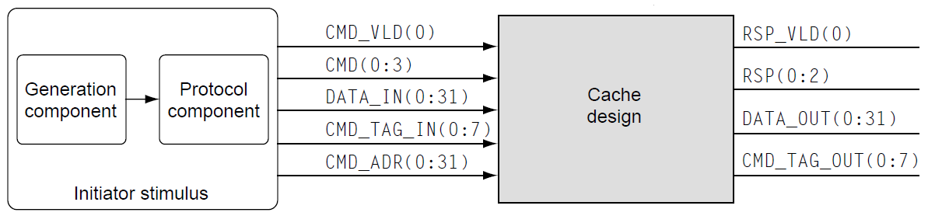
Inicijatori I
Inicijator je stimulus model koji inicira transakciju ili transakcije ka DUV-u
Tipično, inicijator se sastoji od dve komponente:
  protokol komponenta, koja vodi računa o manipulacijama bita na niskom nivou ulaza DUV-a i
  generator komponenta, koja obezbeđuje detalje transakcije na visokom nivou apstrakcije
Ova podela na protokol i generator komponentu je važna iz dva razloga:
  Zasebna protokol komponenta omogućava onome ko piše test slučajeve da razmišlja na nivou transaksije, bez fokusiranja na manipulacije pojedinačnih bita neophodne da bi se ta transakcija zapravo izvršila, i
  Dobro definisan interfejs između protokol i generator komponenti omogućava jednostavnu zamenu generator komponente
Notes:
An initiator is a stimulus model that will initiate a transaction or transactions to the DUV.
All verification environments, simple simulation based or advanced, require driving the bit-level stimulus into the DUV as defined by the protocols. This portion of the environment requires the verification engineer to have detailed knowledge of the complete interface definition. This is the protocol component of the initiator. The protocol component acts as a slave to the generation component. Although the protocol component handles low-level bit manipulation into the DUV, it is the role of the generation component to supply the higher-level request. As an example, let us consider the cache design that needs to be verified. Figure on the bottom shows that the protocol component needs to drive five separate signals and buses comprising 77 total bits.
The microarchitecture of the DUV will dictate how the generation component knows when it is legal to supply a new command to the DUV. Invariably there are two ways that any design communicates availability of its resources to a requestor. The two choices are as follows:
1. The requestor knows the depth of the resource and keeps track of it.
2. The owner of the resource supplies an “available” signal to the requestor.
To illustrate this, suppose that the microarchitecture of the cache example contains a buffer than can hold up to eight fetch requests concurrently. If at any time during the test case, the generation component (requestor) sends a request to the DUV such that the cache had nine outstanding fetch requests, then an illegal test case with an overwrite condition occurs. Therefore, the generation component must implement the same resource availability determination as the microarchitecture. Either the generation component must keep count of the number of outstanding fetches in the cache (number of fetches sent minus the number of fetches completed), or the cache must supply a signal indicating that the buffer is full.
The separation of the generation and protocol components is important. Most interfaces are not as trivial as this cache example and have multiple concurrent or overlapping interactions and many more control and data signals. Breaking these components apart simplifies the coding of the environment. This structure has other benefits as well: a separate protocol component allows the test case writer to think more about the transactions rather than focus on the bit-level manipulations, and furthermore, a well-defined interface between the generation component and the protocol component allows for substitution of generation components. Simple test bench environments often precede complex random environments. The verification team avoids redundant work by creating stand-alone protocol components, allowing current and future generation components to plug into them. The stand-alone protocol component is also referred to as a Bus Functional Model (BFM), a model that performs the bus function.
This type of stimulation of the DUV is called “transaction-based” verification. The basis for the simulation is all types of transactions, generated in a random or directed fashion.

Slide 61
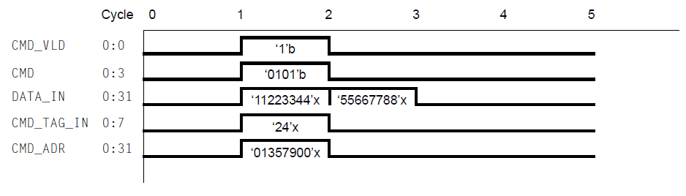
Inicijatori II (komunikacija sa Cache kontrolerom)
CMD (komanda) za skladištenje 64-bitne reči je 0x5
Bit validnosti CMD_VLD mora da prati zahtev zajedno sa odgovarajućim tagom, adresom i prvih 32 bita podataka
Sledeće 32 bita se prosleđuju u narednom ciklusu takta
Protokol komponenta mora biti u stanju da razume i adekvatno dekoduje vrednosti i vremenske zahteve od strane keš memorije kako bi se inicirao validan zahtev
Iako protokol komponenta vodi računa o ovim detaljima transakcije na niskom nivou, uloga generator komponente je da obezbedi zahtev na visokom nivou transakcije
U ovom primeru keš kontrolera, generator komponenta šalje protokol komponenti zahtev za slanje 64-bitnog podatka 0x1122334455667788 na adresu 0x01357900
Notes:
An initiator is a stimulus model that will initiate a transaction or transactions to the DUV.
All verification environments, simple simulation based or advanced, require driving the bit-level stimulus into the DUV as defined by the protocols. This portion of the environment requires the verification engineer to have detailed knowledge of the complete interface definition. This is the protocol component of the initiator. The protocol component acts as a slave to the generation component. Although the protocol component handles low-level bit manipulation into the DUV, it is the role of the generation component to supply the higher-level request. As an example, let us consider the cache design that needs to be verified. Figure on the bottom shows that the protocol component needs to drive five separate signals and buses comprising 77 total bits.
The microarchitecture of the DUV will dictate how the generation component knows when it is legal to supply a new command to the DUV. Invariably there are two ways that any design communicates availability of its resources to a requestor. The two choices are as follows:
1. The requestor knows the depth of the resource and keeps track of it.
2. The owner of the resource supplies an “available” signal to the requestor.
To illustrate this, suppose that the microarchitecture of the cache example contains a buffer than can hold up to eight fetch requests concurrently. If at any time during the test case, the generation component (requestor) sends a request to the DUV such that the cache had nine outstanding fetch requests, then an illegal test case with an overwrite condition occurs. Therefore, the generation component must implement the same resource availability determination as the microarchitecture. Either the generation component must keep count of the number of outstanding fetches in the cache (number of fetches sent minus the number of fetches completed), or the cache must supply a signal indicating that the buffer is full.
The separation of the generation and protocol components is important. Most interfaces are not as trivial as this cache example and have multiple concurrent or overlapping interactions and many more control and data signals. Breaking these components apart simplifies the coding of the environment. This structure has other benefits as well: a separate protocol component allows the test case writer to think more about the transactions rather than focus on the bit-level manipulations, and furthermore, a well-defined interface between the generation component and the protocol component allows for substitution of generation components. Simple test bench environments often precede complex random environments. The verification team avoids redundant work by creating stand-alone protocol components, allowing current and future generation components to plug into them. The stand-alone protocol component is also referred to as a Bus Functional Model (BFM), a model that performs the bus function.
This type of stimulation of the DUV is called “transaction-based” verification. The basis for the simulation is all types of transactions, generated in a random or directed fashion.

Slide 62
Odzivnici
Drugi tip stimulus komponente je odzivnik, koji reaguje na izlaze DUV-a i vraća odgovor nazad ka DUV-u
Razlika između inicijatora i odzivnika je u tome da se odzivnik ponaša kao "slave" DUV komponente
To znači da će odzivnik slati stimulus ka DUV-u jedino kao posledica zahteva ili komande pristigle od strane DUV-a (u primeru ispod, odzivnik mimikuje ponašanje sistemske memorije koja šalje podatke ka keš kontroleru jedino u slučaju da ih on zatraži, npr. nakon keš promašaja)
Notes:
The second type of stimulus component, responders, reacts to outputs from the DUV and feeds stimulus back into the DUV. The difference between an initiator and a responder is that the responder acts as a slave to the DUV. It will only send stimulus back into the DUV as a result of a request, command, or other demand from the DUV.
Continuing with the cache example, figure below shows a main storage memory component that communicates with the cache. The memory receives either a store or fetch command from the cache and must act on that request. The memory itself never initiates communication. For verification of the cache, the memory is replaced by a main store responder stimulus component. When receiving a store command along with an address and data, the main store will react at the appropriate time with a response. For a fetch command, the main store component will return both a response and the requested data.
Variability is allowed in the sequence with the responder. In the cache to main store example, there can be variability in the response (successful completion or failure) and in the number of cycles between command and response (if the timing is not fixed allows). However, in simple simulation environments, the test case writer pre-determines the timings and values.

Slide 63
Monitor
Monitor je model koji nadgleda različite aspekte u okviru okruženja. Oni su samostalne komponente koje prate:
  Izlaze DUV-a kako bi proverili da li su oni saglasni sa zahtevanim protokolom
  Ulaze DUV-a zbog analize funkcionalne pokrivenosti i ažuriranja tabele rezultata
  Interne signale u okviru DUV-a kako bi se detektovali događaji od interesa za okruženje
Ako ništa drugo, uloga monitora je da nadgleda izlaze DUV-a. Ako oni nisu u skladu sa protokolom, monitor mora signalizirati grešku u sistemu
Monitor može da koristi prikupljene informacije kako bi omogućio praćenje funkcionalne pokrivenosti. Stimulus komponente mogu onda da koriste ove informacije kako bi prilagodile stimulus u cilju da pokriju ulazne sekvence koje do sad nisu testirane
Konačno, uloga monitora je da obezbedi informacije za obradu nakon simulacije. Monitor u tu svrhu može da skladišti zapise o događajima na interfejsu u zasebnim datotekama, što kasnije može pomoći prilikom debagovanja
Notes:
A monitor is a model that observes different aspects of the environment. Monitors are self-contained components that observe
Outputs of the DUV for protocol adherence
Inputs to the DUV for functional coverage analysis and scoreboard updates
Internals of the DUV for events of interest to the environment
At a minimum, the monitor must observe the outputs of the DUV. If the DUV does not adhere to the protocol, then the monitor must return an error. The monitor does not drive any signals or wires into the DUV; it only receives inputs and/or callbacks to it. By developing a monitor in this fashion, the verification engineer ensures it is reusable at other levels.
Figure shows the monitor added to the cache environment. The monitor verifies that the DUV obeys the output protocols at all times. In this case, the monitor must check the following:
RSP_VLD(0) (the response valid signal) always accompanies a valid response.
The RSP(0:2) signal, when accompanied by the valid signal, has legal values (e.g., 001 = success; 010 = parity error; 011 = retry due to busy; 100 = illegal command sent; all others are illegal response decodes).
In addition, the monitor may check for the following, depending on the environment and protocols:
The RSP(0:2) signal never is on in the absence of the RSP_VLD(0) signal. Depending on the protocol, the outputs may be required to be zero unless a valid response is being sent.
The tag is correct; that is, it matches with a tag sent previously by the initiator component.
When deciding on how to monitor the outputs for protocol adherence, the verification engineer should refer to the specification. Similar to the stimulus model, if the DUV does not have a specification, then at a minimum, the verification engineer should communicate with the architect and the designer of the piece of logic on the receiving side of the DUV. The independence of the verification engineer is lost if information on how the monitor should work is obtained from the designer, who could misunderstand a part of the correct communication and protocol scheme and thus bias the verification checking.
However, the monitor may need to probe internals of the DUV to collect information to pass on to the checker or scoreboard components. In this case, the verification engineer should limit the internal probes and beware of breaking the redundancy path by relying on the design for too much information.
In all the above scenarios, the monitor can use this information to generate functional coverage data. In sophisticated environments, the stimulus components may use coverage information (either from internal DUV probes or from DUV inputs) collected by the monitor to adapt the stimulus for a more stressful or diverse DUV simulation. This is called coverage directed generation.
A final job of the monitor is to provide post-simulation information to the verification engineer. The monitor should be able to record interface events to a runtime file, formatting it for readability and debugging assistance.

Slide 64
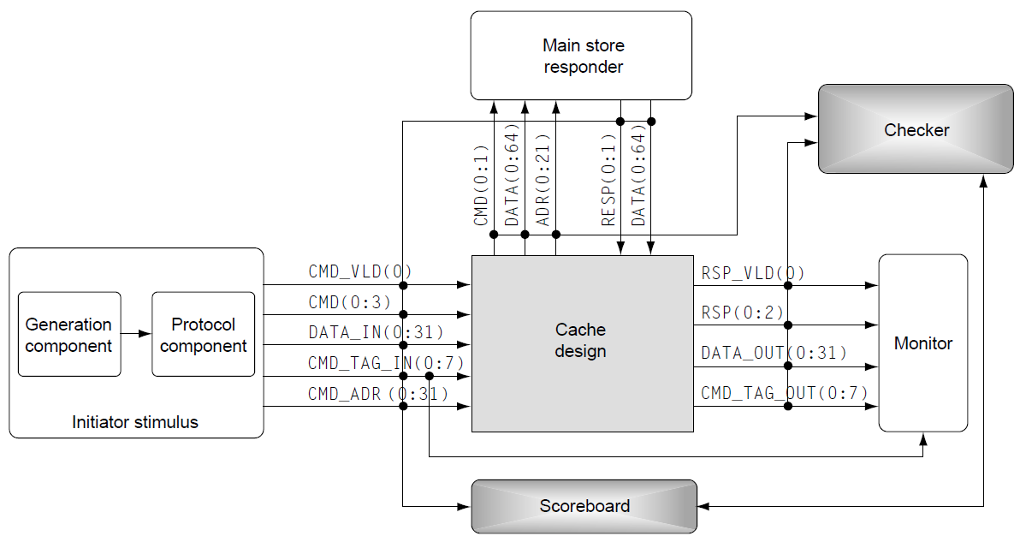
Komponenta provere
Komponenta provere (checker) je specijalan tip monitora koji jedino nadgleda izlaze DUV-a. Međutim, on ima ulogu da proverava da li se dizajn ponaša očekivano sa stanovišta željene funkcionalnosti, a ne u pogledu zadovoljenja komunikacionih protokola. Da bi obavio uspešno svoj posao, ova komponenta koristi dodatne informacije koje dobija od monitora ili tabele rezultata
Kod komponente provere poredi očekivane izlaze sa konkretnim podacima detektovanim na izlazu DUV-a. Ako se oni poklapaju, test se nastavlja ili se uspešno završava. Međutim, ako se ne poklapaju, komponenta provere tipično upisuje relevantne podatke u datoteku koja će pomoći kod debagovanja: očekivan izlaz, stvarni izlaz, kao i sve dodatne informacije koji će kasnije pomoći da se shvati uzrok greške
Komponente provere prate različite tipove grešaka:
  Svi zahtevi dobijaju odgovore (nema gubitka podataka, komandi, paketa, itd.)
  Svi izlazi se poklapaju sa očekivanim vrednostima (podaci, paketi, response code, itd.)
  Nema suvišnih izlaznih aktivnosti (izlaza koji nisu inicirani nekom od ulaznih pobudnih sekvenci)
Notes:
A checker is a special type of monitor that only collects DUV outputs. However, it validates that the design is working as intended from a functional standpoint, not just from a protocol standpoint.
The checker tends to be one of the harder components in the environment to get correct, as the verification engineer must implement many functional checks within the component. It is not only challenging to get individual checkers working correctly for all cases but also imperative that the verification engineer conceive of all the required checking. This is fundamental to the question, “How will I know if the design has a flaw?”
In the past, verification engineers performed the functional checking by reviewing the test case traces by hand and looking for specific results on the DUV outputs. Often, the reference model for the DUV was in the verification engineer’s head. Although this was an arduous process, the designs were simpler and contained fewer corner conditions and complex interactions. As design complexity increased, verification engineers transferred the intelligence behind the checking from their own knowledge to automated software checker components.
The checker may need knowledge from a monitor or scoreboard to accomplish its task. The checker needs to understand what stimulus has occurred in order to independently predict functional results. Because there may be multiple requests and interaction stimulus in a single test case, the checker needs to correlate input requests with output responses. The checker code compares these expected results against actual outputs of the DUV. If the results match, the test case continues or completes successfully. If the results miscompare, the checker will write a failure message to a debug file, noting the actual and expected results along with other information needed to understand the failure.
Checkers monitor for various types of error types:
All requests receive responses (no lost data, commands, packets, etc.)
All outputs match predicted values (response codes, data, packets, etc.)
No superfluous output activity (outputs that do not correspond to any stimulus)
Remember, the monitor component performs checks that are more mundane:
Parity and check-bit correctness
Actual data transfer length corresponds to header transfer length
Other checking that does not require knowledge from the stimulus components

Slide 65
Tabela rezultata
Pojednostavljeno, tabela rezultata (scoreboard) služi za privremeno skladištenje podataka koje će trebati komponenti provere
Komponenta provere koristi tabelu rezultata na dva načina. Osnovna razlika se odnosi na to koja komponenta vrši translaciju ulaznih podataka u očekivane izlazne podatke. Komponenta koja obavlja ovu funkciju zove se referentni model DUV-a i u njoj je zapravo sadržana inteligencija koja vrši proveru
U prvoj metodi, komponenta provere sadrži referentni model. Uloga tabele rezultata je da nagleda ulaze koji su inicirali transakciju, čuva značajne informacije i skladišti ih za kasniju upotrebu
U drugoj metodi, referentni model se nalazi u tabeli rezultata i u okviru nje se vrši računanje očekivanog izlaza za dati ulazni stimulus koji se nadgleda. Kad komponenta provere primeti ciljani događaj na izlazima DUV-a, ona pošalje upit tabeli rezultata kako bi dobila željene rezultate i obavlja poređenje nakon toga
Bilo koja podela posla između ove dve komponente opisana iznad je prihvatljiva. Međutim, kada se jednom odabere pristup, važno je da se referentni model postavlja na konzistentan način za svaku proveru u datom verifikacionom okruženju (uvek na istu lokaciju)
Notes:
A scoreboard is a relatively new term, although the concept has been around for a long time. In the simplest terms, a scoreboard is a temporary holding location for information the checker will require.
A checker can use a scoreboard in two ways. The main difference between the two methods centers on which component does the translation from inputs and expected outputs. The component that performs this function acts as the DUV reference model and contains the checking intelligence.
In the first method, the checker component contains the reference model. The scoreboard’s role is to examine the inputs for transactions to occur, capture pertinent information, and store the information for later use. Then when the checker observes some condition on the outputs of the DUV, it makes a call to the scoreboard to get the data (referred to as a callback).
The scoreboard implementation depends on the functionality that is contained in the DUV. If the DUV has a simple first in, first out (FIFO) protocol, then the scoreboard would also contain a simple FIFO, and the data returned would be from a callback such as “pop expect from port 1.” Or if the DUV had a complex queuing algorithm, then a much more complex function such as a search based on port number would need to be performed in the scoreboard in order to return the correct data. Once the scoreboard returns the data, the reference model in the checker “transforms the data” into expected results and then compares those results to the actual DUV output signals.
In the second method, the scoreboard is the reference model and does the expected result calculation based on the input stimulus it observes. When the checker observes DUV output events, it then queries the scoreboard for the expected data and performs the compare.
Either of the above divisions of work between scoreboard and checker is acceptable. However, it is important that the choice of reference model placement remains consistent. The same paradigm should be followed for all DUV checking throughout the environment.

Slide 66
Dizajn koji se verifikuje
Poslednja komponenta, DUV, je zapravo u središtu verifikacionog okruženja i takođe je poznata i kao unit under test (UUT) ili device under test (DUT).
Većina ostalih komponenti okruženja interaguje sa DUV-om. Ako postoji bag u okviru DUV-a, zadatak komponenti unutar verifikacionog okruženja jeste da ga prepoznaju
Izvorni kod DUV-a je HDL model. On se interpretira ili kompajlira u DUV model (u zavisnosti od alata i korišćenog HDL modela), koji verifikacioni tim onda koristi u simulacijama
DUV može da predstavlja makro na dizajner nivou, logičku jedinicu, čip, ili kompletan sistem. Nezavisno od nivoa, verifikacioni inženjer mora da prilagodi stimulus, komponente provere, tabelu rezultata i monitore kako bi se adekvatno ispitalo ponašanje konkretnog DUV-a
Nivo apstrakcije na kojem je DUV opisan takođe se može razlikovati. Izvorni HDL može opisivati funkcionalnost na RTL nivou, nivou kapija (gate level), tranzistora (transistor level), ili čak na bihevioralnom nivou koji uopšte nije sintetizabilan
Notes:
The last component, the DUV, is the center of the verification environment and is also known as the unit under test (UUT) or the device under test (DUT). Most of the other components interact with the DUV. If there are bugs in the DUV, the verification team must find them.
The DUV source is the HDL itself. Whether running a simulation or formal verification, the source HDL gets interpreted or compiled into the DUV model (depending on the tools and HDL source used), which the verification team uses for its simulation. The specific interpreter or compiler differs depending on the electronic design automation vendor, but in all cases, the DUV is an accurate representation of the HDL.
The DUV can be from any level of the hierarchy. The DUV in the previous figures can represent a sole designer macro, a logical unit, a chip, or an entire system. Regardless of the level, the verification engineer must customize stimulus and checking components, scoreboards, and monitors to exercise and validate the particular DUV.
The abstraction level at which the DUV is described can be different as well. The source HDL may describe the function at the RTL level, gate level, transistor level, or even behavioral level (non-synthesisable).
The DUV interacts directly with the stimulus and checking components. The stimulus component manipulates the DUV’s inputs, and the monitor and checking components observe its outputs. In some situations, monitors and checkers may reside inside the DUV, which could be attributed to the need for additional observation or checking points.

Slide 67
Osnove verifikacije baziranena simulaciji
Tačke opservacije

Slide 68
Crna kutija
Kada je ceo verifikacioni kod ograničen na povezivanje sa spoljnim interfejsima DUV-a, ovo je poznato kao verifikacija crne kutije, jer je okruženje za verifikaciju „u mraku“ u vezi sa unutrašnjim detaljima DUV-a
Ključ za verifikaciju crne kutije je sposobnost predviđanja izlaza na osnovu ulaza. Da bi se to postiglo, specifikacija mora jasno objasniti funkcionalnost DUV-a
Okruženje crne kutije ima prednosti i mane:
  Dobre strane su da strukturne promene unutar DUV-a imaju mali uticaj na verifikacioni kod, jer je funkcionalnost nezavisna od implementacije
  Štaviše, sposobnost predviđanja funkcionalnih rezultata samo na osnovu ulaza osigurava da referentni model ostane nezavisan od DUV algoritama
  S druge strane, pošto okruženje crne kutije može samo da kontroliše ulaze i posmatra izlaze, nedostaju mu kontrolne tačke i tačke opservacije
Notes:
When all of the verification code is restricted to interfacing with external interfaces of the DUV, this is known as black box verification, because the verification environment is “in the dark” about internal details of the DUV.
Most simulation-based environments begin as black box environments. The verification engineers begin reading a specification of the DUV that contains the function and the definition of the external interfaces. As the team writes the verification code, the drivers, monitors, checkers, and scoreboard use only the external interfaces as defined by the specification. The internal signals and constructs remain in the dark.
The key to black box verification is the ability to predict the outputs based on the inputs. To do this, the specification must clearly explain the function of the DUV.
The black box environment has pros and cons. The good points are that structural changes inside the DUV have little impact on the verification code, as the function is independent of implementation. If an internal pipeline had to change because of a timing constraint, there is little to no impact on the verification environment. Furthermore, the ability to predict functional results based on inputs alone ensures that the reference model remains independent from the DUV algorithms.
On the other hand, because the black box environment can only control the inputs and observe the outputs, it lacks control and observation points. There are many cases in which a verification environment can be more robust just by keying off internal signals in the DUV. Similarly, checking ambiguous cases becomes trivial if the scoreboard component monitors internal signals. By using internal signals, the verification engineers can shed some light on the black box.

Slide 69
Bela kutija
Prednosti i mane testiranja crne su suprotne u slučaju testiranja u okruženju bele kutije, koje pruža potpunir uvid u unutrašnje strukture DUV-a
Verifikacioni inženjer ima mogućnost da posmatra i postavlja čekere na interne signale, kao i da modeluje i predviđa ponašanje internih redova, mašina stanja i drugih delova mikroarhitekture
U okruženje sa belom kutijom greška može biti detektovana direktno na izvornom mestu, dok okruženje crne kutije indirektno registruje pojavu greške čiji se simptomi pojavljuju na izlazu DUV-a
Verifikacija bele kutije ima svoje nedostatke u smislu održavanja koda u skladu sa promenama okruženja
Verifikaciona okruženja koja koriste paradigmu bele kutije moraju, takođe, voditi računa da ostanu nezavisna od samog DUV-a
Notes:
The advantages and disadvantages of black box testing are reversed in the white box environment, which provides a full understanding of the internal structures of the DUV. The verification engineer observes and places checking on internal signals, as well as models and predicts the behavior of internal queues, pipelines, state machines, and other portions of the microarchitecture.
The white box environment contrasts with the black box environment through its direct measurement of the DUV. A white box environment will flag a bug at its source, whereas the black box environment captures a failure indirectly as its symptoms appear on the DUV output. More details of the cache design described above can illustrate the white box methods.
Figure shows that the incoming command, tag, and address are placed into an eight-deep command queue. In the white box environment, the verification engineer might keep a reference model of the command queue and use that model to constantly check the contents of the queue. If the design has a bug such that a valid entry in the queue was dropped or overwritten, the white box environment checker would immediately flag the flaw. This is a direct capture of the failure where valid data is destroyed. The black box environment would also flag this bug, as the cache design would never give a response to a command that was recorded in the scoreboard. In this case, the checker is indirect, detecting the symptoms (a lost command). Both paradigms are successful.
White box verification has its drawbacks in the amount of maintenance required on the environment. The problem is that the environment is tightly integrated with the implementation: if a signal name changes, the white box checker component must change as well, which can become a maintenance nightmare. Therefore, this type of verification is typically done only at the low levels of the hierarchy.
Verification environments coded in a white box paradigm must also take care to remain independent of the DUV. Despite knowledge of the internal microarchitecture, the verification engineer must not use the HDL algorithms as a source of checking. This would break the redundancy path required to find bugs in the design.

Slide 70
Siva kutija
Verifikacija Sive kutije je kombinacija prethodne dve
U okruženju sive kutije, verifikacioni inženjer prati ili posmatra neke interne signale, koji pomažu u validaciji funkcionalne specifikacije na nivou crne kutije, dok ostatak DUV-a ostaje „u mraku“
Siva kutija je tipično model koji se koristi za većinu okruženja, uglavnom zato što je bilo kakvo predviđanje rezultata na nivou interfejsa gotovo nemoguće bez posmatranja nekog internog signala
Postoje i određeni scenariji testiranja koji su poželjni, ali ih je gotovo nemoguće sprovesti bez verifikacije koja zadire u unutrašnju struktura DUV-a
Na primer, često dizajni koriste brojače koji služe za repetitivno izvršavanje određene funkcionalnosti. U mnogim slučajevima, dolazi do prekoračenja opsega ovih brojača nakon nekoliko hiljada ili čak miliona mašinskih ciklusa. Iako ovo može biti samo milisekunde na stvarnom hardveru, u simulacionim ciklusima ovaj period je čitava večnost. Da bi izazvao događaj koji je doveo do prekoračenja brojača više puta u jednom test slučaju, verifikacioni inženjer menja vrednost brojača na vrednost blizu njegove granice, što bi bilo nemoguće uraditi bez korišćenja metode verifikacije sive kutije

Slide 71
Osnove verifikacije baziranena simulaciji
Testna okruženja i strategije testiranja
7

Slide 72
Testna okruženja
Nakon definisanja testnih okruženja i potrebnih komponenti, fokus prelazi na same test slučajeve (test cases)
Test slučaj ograničava stimulus komponente tako da se testiraju specifične funkcionalnosti (ili skup njih) u okviru DUV-a
Ovo takođe nazivamo i determinističko testiranje, ili determinističko testno okruženje, jer je ciljana funkcionalnost predodređena još pre nego što se počne sa testom
Postoje takođe i samo-proveriva (self-checking) testna okruženja kod kojih se vrši provera nezavisno od primenjenog stimulusa
Ovo omogućava da se funkcionalnost DUV-a proverava samostalno za svaki dati testi slučaj

Slide 73
Deterministička testna okruženja I
Verifikacioni tim koristi determinističke test slučajeve predominantno u ranoj fazi verifikacije, sa ciljem da se proveri osnovna DUV functionalnost
Primer sa determinističkim test slučajem kod keš kontrolera bio bi onaj koji proverava da li je koherentnost podataka zadovoljena za datu sekvencu operacija
Koherentnost podrazumeva da onaj koji traži podatke uvek dobije trenutne, nezastarele vrednosti podataka. Ovo inherentno implicira da, za svaku adresu u sistemu, postoji tačno jedna vrednost podatka koji se odnosi na tu adresu
U slučaju keš kontrolera, operacija čitanja ne sme rezultovati podatkom koji nije poslednji upisan na tu adresu
Verifikacioni inženjer može osmisliti mnoštvo determinističkih test slučajeva koji testiraju ovakvu koherentnost podataka
Notes:
Verification teams use deterministic test cases predominantly early in the verification cycle to prove basic DUV functionality. Here, the verification engineer looks to the specification for guidance on the basic commands and protocols to test and monitor, creates deterministic test cases to pinpoint specific points of contention in the DUV specification, and relies in part on the design engineers for advice on scenarios to exercise.
A very simple example is a “two-input AND gate.” There are four deterministic tests for the DUV. A verification engineer charged with verifying this two-input AND gate could create four individual deterministic test cases. Alternatively, the verification engineer could decide that the four scenarios are simplistic enough to merge into a single deterministic test case that drives the four scenarios in sequence.
A more interesting deterministic test case involving the cache design would be to ensure that particular sequences of operations maintain data coherency. Coherency dictates that data requestors always get the latest copy of the data. This inherently implies that for every address in the system, there is only one current data value associated with that address. In this cache design, a fetch cannot return data that does not represent the latest value for that address. A verification engineer could write many deterministic test cases to verify coherency. One such case is described here.
Figure shows a decode mux in front of separate store and fetch queues in the cache design. As commands enter the cache DUV, the design directs the address, tag, and the data (for stores) toward the appropriate logic based on the type of command.
A deterministic sequence to verify coherency might consist of the following inputs:
Three store commands to various addresses are sent. These commands initially fill three of the four positions in the store queue.
A fourth store request to address X is sent. This store request is the last in line to be executed
A fetch request to address X is sent.
Because the fetch request is at the top of the queue and a previous store request is buried in the store queue, this test case is designed to uncover a design flaw that would return fetch data other than that in the store queue. Coherency requires that the fetch request return the latest data, which may be in the store queue rather than in the cache or main memory. The cache design must deal with this case by one of these means:
Give stores higher priority than that of fetches, allowing the store queue to drain before processing fetches.
Do an address comparison of all stores addresses pending based on the fetch address and block the fetch.
Do an address comparison of all stores addresses pending based on the fetch address and provide a cache and main store bypass by the store queue data that would feed the fetch response data.

Slide 74
Deterministička testna okruženja II
Jedan takav bi mogao biti:
  Tri zahteva za operaciju upisa na različite adrese su poslati. Ove komande inicijalno popune tri od četiri lokacije u internom redu operacije upisa (store)
  Četvrti zahtev za upis na adresu X se šalje i on bi trebao biti poslednji koji će biti obrađen
  Šalje se zahtev za čitanje sa adrese X
Koherentnost podrazumeva da će zahtev za čitanje rezultovati "najsvežijim" podacima, koji se možda nalaze i dalje u redu za opsluživanje operacija upisa, a ne u samoj keš memoriji ili osnovnoj memoriji
Keš kontroler mora da se nosi sa ovakvom situacijom na jedan od sledećih načina:
  Prioritizuje operacije upisa u odnosu na operacije čitanja, što rezultuje time da se sve operacije upisa izvrše pre nego što se opsluže operacije iz reda čekanja na upis (Fetch CMD queue)
  Vrši komparaciju adresa kod zakazanih operacija u redu za upis sa adresama koje su referencirane u redu za čitanje i blokira čitanje ako dođe do poklapanja
  Poredi adrese kao iznad, ali u slučaju poklapanja vraća podatke iz reda čekanja na upis, kao "bajpas" čitanja iz keš memorije ili osnovne memorije
Notes:
Verification teams use deterministic test cases predominantly early in the verification cycle to prove basic DUV functionality. Here, the verification engineer looks to the specification for guidance on the basic commands and protocols to test and monitor, creates deterministic test cases to pinpoint specific points of contention in the DUV specification, and relies in part on the design engineers for advice on scenarios to exercise.
A very simple example is a “two-input AND gate.” There are four deterministic tests for the DUV. A verification engineer charged with verifying this two-input AND gate could create four individual deterministic test cases. Alternatively, the verification engineer could decide that the four scenarios are simplistic enough to merge into a single deterministic test case that drives the four scenarios in sequence.
A more interesting deterministic test case involving the cache design would be to ensure that particular sequences of operations maintain data coherency. Coherency dictates that data requestors always get the latest copy of the data. This inherently implies that for every address in the system, there is only one current data value associated with that address. In this cache design, a fetch cannot return data that does not represent the latest value for that address. A verification engineer could write many deterministic test cases to verify coherency. One such case is described here.
Figure shows a decode mux in front of separate store and fetch queues in the cache design. As commands enter the cache DUV, the design directs the address, tag, and the data (for stores) toward the appropriate logic based on the type of command.
A deterministic sequence to verify coherency might consist of the following inputs:
Three store commands to various addresses are sent. These commands initially fill three of the four positions in the store queue.
A fourth store request to address X is sent. This store request is the last in line to be executed
A fetch request to address X is sent.
Because the fetch request is at the top of the queue and a previous store request is buried in the store queue, this test case is designed to uncover a design flaw that would return fetch data other than that in the store queue. Coherency requires that the fetch request return the latest data, which may be in the store queue rather than in the cache or main memory. The cache design must deal with this case by one of these means:
Give stores higher priority than that of fetches, allowing the store queue to drain before processing fetches.
Do an address comparison of all stores addresses pending based on the fetch address and block the fetch.
Do an address comparison of all stores addresses pending based on the fetch address and provide a cache and main store bypass by the store queue data that would feed the fetch response data.

Slide 75
Samo-proveriva testna okruženja
Umetanje znanja u vezi funkcionalnosti DUV-a u testno okruženje ima značajne prednosti jer omogućava automatizaciju, inače zamornog, manualnog proveravanja funkcionalnosti
Pošto testno okruženje predstavlja čitav “univerzum” DUV-a, svo neophodno znanje zapravo mora biti sadržano u okviru njega
Verifikacioni inženjer ugrađuje to znanje u komponente provere i tabelu rezultata, kako bi omogućio da okruženje bude samo-proverivo
Postoje tri tipa samo-proverivih testbenčeva:
  Zlanti vektori
  Referentni model
  Testno okruženje bazirano na transakcijama

Slide 76
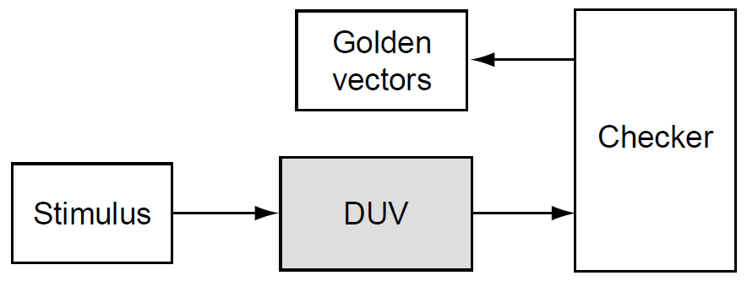
Zlatni vektori
Okruženje zlatnih vektora je jednostavno okruženje u kome se validni izlazni vektori čuvaju u tabeli rezultata
Komponenta za proveru upoređuje rezultate DUV-a sa tabelom rezultata iz koje dobija očekivane vektore
U većini slučajeva, ova tabela rezultata se upisuje u tabelu rezultata na početku testa na osnovu unapred poznatog skupa validnih očekivanih izlaznih vrednosti
Prednost ovog mehanizma provere je u tome što verifikacioni inženjer može da proveri sve predviđene rezultate čak i pre pokretanja simulacije
Nedostatak ove vrste verifikacije je dvostruk: kreiranje i održavanje zlatnih vektora
Notes:
A golden vectors environment is a simple environment in which some knowledge base of valid output vectors is stored in the scoreboard. The checking component compares the DUV results to this knowledge base by calling the scoreboard and requesting the expected vectors. This can be done either for every cycle or for every transaction (based on the functions). In most cases, the scoreboard is loaded (via a file or some other mechanism) at the beginning of the test with a known set of valid expect traces that correspond to what the stimulus will be generating. The output checker compares the actual DUV results to the golden vector predicted results. The verification engineer either generates these valid traces manually or generates them by using an external program. Figure shows a diagram of this type of environment.
The advantage to this mechanism of checking is that the verification engineer can check all of the predicted result traces before running the simulation. Another advantage is that when the verification team runs a regression, all the vectors that need to be verified already exist.
A disadvantage to this type of verification is twofold: the creation and the maintenance of the golden vectors. Manual creation of golden vectors is tedious. If a program creates the golden vectors, then that program will require knowledge about the DUV. (The reference model environment explained next tackles this by placing the knowledge directly into the simulation environment). The maintenance challenge is keeping the golden vectors and stimulus generation synchronized. If the DUV rules change, the verification team must update all of the test cases and golden vectors to reflect the change.
Golden vector checking is best suited for DUVs that have sporadic outputs that correspond closely to the inputs. DUVs that handle just one concurrent command are ripe for golden vector checking as the output is usually easy to predict.

Slide 77
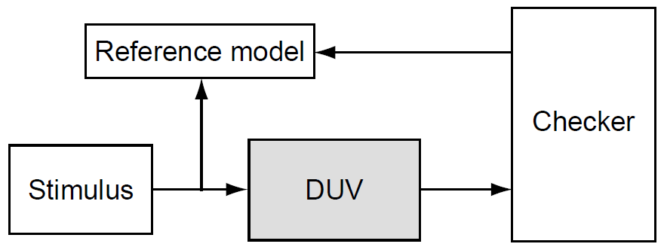
Referentni model
Referentni model računa sve očekivane izlaze bazirano na ulaznom stimulusu
On re-implementira funkcionalnost DUV-a, tipično korišćenjem programskog jezika visokog nivoa ili jezika za verifikaciju hardvera (HVL, Hardware Verification Language)
Obzirom na to da referentni model računa rezultate u svakom ciklusu takta, često se naziva i model tačan na nivou ciklusa (cycle accurate model)
Glavna prednost referentnog modela je nivo tačnosti provere. Kada je referentni model ispravan (i debagovanje završeno), tim za verifikaciju zna da se DUV ponaša ispravno u svakom ciklusu takta
Ovo ima svoju cenu, jer ova metoda je skupa u smislu održavanja. Referentni model mora biti potpuno usklađen sa internim vremenskim aspektima implementacije DUV-a, što je veoma slično verifikaciji bele kutije, osim što referentni model nema nikakav pristup tačkama opservacije unutar dizajna
Notes:
The reference model calculates all expected outputs based on the input stimulus. The reference model re-implements the function of the DUV, usually in a high level programming language or an HVL. Because the reference model calculates the results for each cycle, it is also known as a cycle accurate model.
Unlike the golden vectors approach, the checker component does not request information from the reference model. Instead, the reference model sends information to the checker every cycle based on the program calculations. It is the checker’s job to compare this information to the DUV outputs and decide if the output signals match the expected results.
The main advantage to the reference model is the level of checking accuracy. Once the reference model is correct (and debugged), the verification team knows that the DUV is correct for every cycle. This comes at a price, as this method has a maintenance overhead. The reference model must know the exact internal timing implementation of the DUV, which is very similar to white box verification except that the reference model has no probes into the design.
Verification teams should chose reference models for checking DUVs that have high activity on the outputs. DUVs with multiple concurrent inputs or internal priority logic to process stimulus are candidates for reference model checking because the prediction of the outputs depends highly on the stimulus sequence. Furthermore, if the internal timings of the DUV changes, it is easier to update the reference model once than to edit all of the golden vector test cases.
A variation of the reference model checker is one that is not accurate for every cycle but instead is checked at key points in time. For example, consider an ALU that contains a pipeline with a depth of five. Five cycles after receiving input stimulus to the ALU, the reference model sends predicted outputs to the checker component. This also helps alleviate potential performance disadvantages because the reference model does not have to keep up with all the details, but the reference model does have to know that the pipeline depth is five.

Slide 78
Testno okruženje bazirano na transakcijama
Okruženje zasnovano na transakcijama se koristi za DUV-ove koji imaju identifikovane transakcije u kojima se komande i podaci obrađuju kroz ulazne i prosleđuju odgovarajućim izlaznim signalima. Mnogi uređaji sa ulazno/izlaznim (IO) protokolom (kao što su Ethernet i PCI) koji prosleđuju i usmeravaju pakete podataka trebalo bi da koriste ovakvu proveru baziranu na transakcijama
Tabela rezultata vodi evidenciju svih „trenutnih“ transakcija koje su ušle u DUV, ali nisu obrađene (ili prosleđene). Tabela rezultata, takođe, mora da izvrši promenu formata podataka, ako je to potrebno
Prilikom proveravanja izlaznih signala, komponenta za proveru šalje upit ka tabeli razultata, tipično sa identifikatorom transakcije, i dobija nazad očekivane podatke
Komponenta provere signalizira grešku ako identifikator ne odgovara transakciji koja je primljena na ulazu ali nije obrađena, ili ako komanda (ili podaci) nisu onakvi kakvi su predviđeni tabelom rezulata
8
Notes:
A transaction-based environment is used for DUVs that have identifiable transactions in which commands and data are acted on and forwarded to appropriate output signals. This allows the verification engineer to structure the environment based on the transaction nature of the DUV. Caches, which act on commands and data, are one example. Many input/output (IO) protocol devices (such as Ethernet and PCI) that forward and route packets of data should use transaction-based checking.
This type of checking environment uses a scoreboard to track commands and data driven on the inputs of the DUV. In this environment, the DUV processes the commands and associated data before forwarding the transactions on the outputs. The DUV may reformat the command and data before forwarding it. Figure shows the transaction-based environment.
The scoreboard keeps a record of all “current” transactions that have entered the DUV but have not been completed (or forwarded). The scoreboard must also perform any data reformatting. On observing output signals, the checker component queries the scoreboard, usually with a transaction identifier, and receives the expected data. The checker flags an error if the identifier does not match an outstanding transaction or if the command or data are not as predicted by the scoreboard.
The key in the transaction-based environment is the abstraction level of the command and data. Often, this is simple, as in the Ethernet packet protocol or PCI bus commands. However, DUVs may allow transactions to be spread across many cycles or have other transactions intermixed. It is the scoreboard’s job to package the abstracted transactions into predictable outputs.
The only disadvantage and difficulty to this type of environment is deciding the correct level of abstraction, which is an important decision as it influences both the effectiveness and efficiency of the verification environment. The team should base this decision on the functional stimulus injected into the DUV. When the team defines the right level of abstraction, it becomes easy to define interesting test cases by using sequences of these abstract items, as well as to generate meaningful tests, and it is easier to analyze the test results by looking at the abstract items for debug.

