Slide 1
Funkcionalna verifikacija hardvera
Predavanje X-XI

Slide 2
Lecture Content
Monitoring the Verification Flow
  Verification coverage overview
  Structural (code) coverage
  Functional coverage
  The right coverage analysis strategy

Slide 3
Monitoring the Verification Flow
Verification Coverage Overview

Slide 4
Verification Coverage Overview I
The verification team needs metrics for the quality and completeness of their work as the project proceeds over time.
There are obvious completeness criteria the verification team can derive from the discussions of the verification plan.
Keeping track of the status of different verification tasks is a fundamental piece of information about how well a project is progressing.
Knowledge about which tests the verification engineers have indeed exercised from the test plan provides a necessary metric.
Watching the bug rate is certainly a key piece of scorekeeping that guides a project.
Still, the central question for the verification team remains: “When is verification complete?”
Once the team has finished all planned verification tasks, run all tests, and the bug rate has dropped to zero, is it time to declare success?

Slide 5
Verification Coverage Overview II
Exhaustive simulation of even small designs is not possible.
The following example shows the combinatorial explosion that makes verification such a daunting task.
Let the DUV be a 16-bit adder. Simulating all combinatorial possibilities of the adder takes 4 billion simulation cycles, assuming that this circuit does not have state-holding elements.
If the project uses a simulation engine that is able to run 1,000 cycles per second, the team still needs around 50 days to simulate this trivial DUV exhaustively.
When does the verification team stop simulation?
Is it good enough to continue until the simulation has been bug-free for 3 days?
How do they know that another day of simulation would not yield yet another bug?
Furthermore, is it truly necessary to simulate the adder DUV exhaustively to make a convincing case of verification completeness?

Slide 6
Verification Coverage Overview III
It is the task of verification coverage analysis to convince the verification team that they have done sufficient verification, not exhaustive verification, to satisfy defined quality criteria.
Verification coverage is the measurement of state space that simulation-based verification has touched in the entire environment.
Coverage can measure DUV internal states, queues, and activities, as well as DUV inputs and even states of the verification environment components.
Fundamentally, coverage is a measurement of how well the stimulus components have exercised the DUV.
Coverage cannot make a statement on the quality or robustness of the checking components.

Slide 7
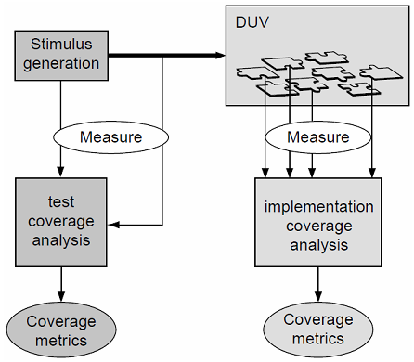
Verification Coverage Target Areas I
There are two completely complementary sides of the verification coverage task.
First, there is coverage of the verification environment.
Here, the objective is to measure how well the verification stimulus environment covers the specification of the design.
This coverage aspect is called verification test coverage.
Second, there is coverage of the function implemented in the DUV.
This metric seeks to measure how well the verification stimulus activates or exercises the implementation of the specification in the concrete design.
This coverage task is called implementation coverage.
Figure on the right shows the two areas of coverage analysis side by side.

Slide 8
Verification Coverage Target Areas II
The base activity that precedes any type of coverage analysis is the collection of coverage measurements.
The verification team collects the measures for test coverage from the stimulus initiator component, the test case, or the interface into the DUV.
Implementation coverage analysis relies on measurements of activities inside the DUV by inspection into the HDL model during simulation.
Throughout the measurement and analysis activity, the verification team must never forget that the ultimate goal of coverage analysis is to guide the verification process, and not to prove its completeness.
Completeness is an elusive goal that is unreachable anyway.

Slide 9
Verification Coverage Goals I
A seemingly simple coverage goal would be the combinatorial space spanned by the enumeration of all possible patterns on the DUV inputs, all possible states internal to the DUV, and all possible output patterns on the outputs of the DUV.
Although this coverage metric is trivial to define, it is also completely useless to guide the verification process, because it is unachievable.
Then, toward which targets should coverage analysis drive the verification process?
Coverage analysis could be defined as the task to maximize the probability of stimulating and detecting bugs, at minimum cost (in time, labor, and computation).
In the end, not very surprisingly, detection of hidden bugs is the main objective of the verification process.

Slide 10
Verification Coverage Goals II
Figure on the right illustrates how coverage information can guide the simulation through the state space of a DUV to find the hidden bugs.
The generated stimulus drives the simulation through the state space in a meandering path.
The task of coverage guidance is to influence the direction of the traversal to hit areas that are prone to hidden bugs.
In summary, the amount of hidden bugs found measures the quality of the coverage analysis effort.
Coverage is a tool that helps the verification team to find bugs, and it is only a means to an end.
A coverage measure that the verification team meets without finding bugs has only a limited value.
Several times it has been said that it is impossible to cover all parts of a design with simulation.
Therefore, coverage must focus on error prone areas.
In this sense, a good coverage metric needs to have a predictive component; it needs to be able to measure bug coverage.
Verification coverage guidance to the hidden bugs. The overall rectangle represents the state space of a design under verification (DUV). Simulation traverses through this state space along a zig-zag trajectory. The hidden bugs in the DUV are shown as shaded circles. Influence of coverage guidance is shown by arrows that cause the simulation traversal to change in a different direction, hopefully closer to a hidden bug.

Slide 11
Verification Coverage Models
Figure on Slide 7 distinguishes coverage efforts by their target areas - test coverage versus implementation coverage.
Developers and researchers have evolved different successful schemes to specify coverage metrics for both applications.
These schemes are referred to as coverage models.
It is possible to classify coverage models as either structural (code) or functional. Both classes apply to verification test coverage or implementation coverage.
Functional coverage models focus on the semantics of either the test or the design implementation.
For example, did the test cover all possible commands or did the simulation ever trigger a first in, first out (FIFO) buffer overflow?
Structural (code) coverage models, on the other hand, tie into the representation of the domain to be covered.
A good example for a structural coverage model is line coverage, a measure of whether all source lines in the stimulus generator program or the DUV HDL have been visited during simulation.

Slide 12
Monitoring the Verification Flow
Structural (Code) Coverage

Slide 13
Structural (Code) Coverage
The application for structural coverage models is largely implementation coverage analysis.
These models always tie into a structural aspect of the implementation of the test generation, the DUV, or the representation of the design HDL.
We will review the most common structural coverage measures:
  toggle,
  line‚
  statement‚
  branch‚
  path,
  condition and
  FSM coverage.

Slide 14
Toggle Coverage
Toggle coverage measures how many times the signals and latches (facilities) in the HDL model have changed their logic value during simulation.
The absence of signal change activity in an area of the DUV indicates that the stimuli did not target this area at all.
The advantage of toggle coverage is that it is a very simple, easy-to-understand model.
Its drawback is, however, that it yields massive amounts of data, and the statement that 100% of all signals in a DUV have toggled does not yield any insight into the functional significance of the testing done.
Example of the toggle coverage for the 11-bit reg signal is shown on the figure to the right.
Some code coverage tools report not only zero-to-one and one-to-zero transitions‚ but also transitions to and from undefined (“X”) and tristate (“Z”).
Toggle Coverage Example

Slide 15
Line Coverage
Line coverage takes the syntactical structure of the HDL specification and measures which HDL lines were executed by the simulation run.
Similar to toggle coverage, this coverage model is easy to comprehend, and the absence of activity in areas of the HDL model highlights omissions in the tests.
The limitation of line coverage is the missing semantic insight.
The fact that an HDL statement has been executed results in no knowledge about the correctness of the content of the statement.
Line Coverage Example
Notes:
A related coverage metric reported by some tools‚ block coverage‚ defines a sequence of statements with no branches to be a block. (A branch is introduced by any control flow statement such as an “if” or “while” statement). If the first statement of the block is executed‚ all of the statements in the block are executed. Although block coverage offers the same visibility into RTL execution as line coverage‚ less overhead is introduced during simulation because only one counter is inserted per block.

Slide 16
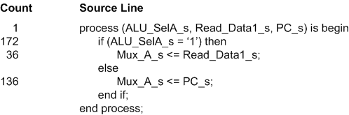
Statement Coverage
Statement coverage reports which RTL statements have and have not been executed.
This metric is more precise than line coverage because statements may span multiple lines and more than one statement may occupy a single line.
Statement Coverage Example

Slide 17
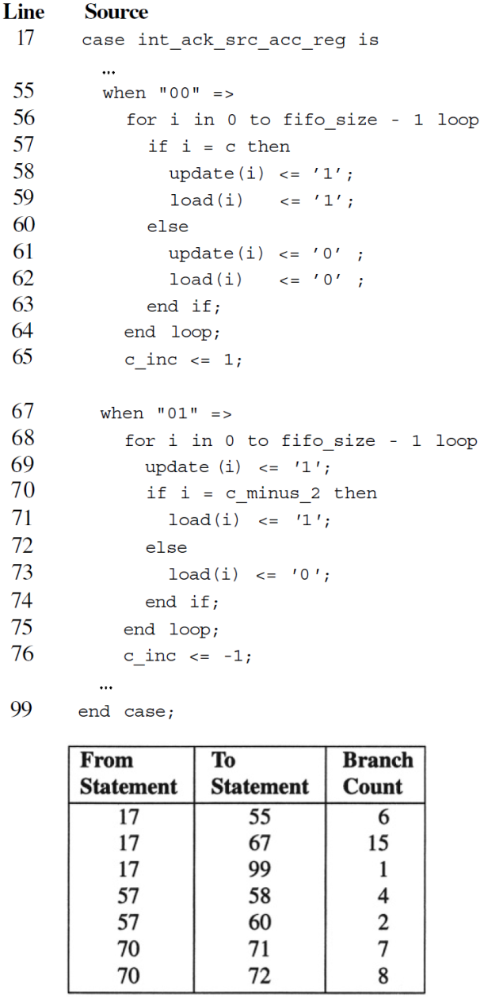
Branch Coverage
Branch coverage or conditional coverage looks at conditional statements (if‚ case‚ while‚ repeat‚ forever‚ for and loop) in the HDL and keeps track of which conditions the simulation encounters and which it does not.
This model assumes that there is semantic meaning in the condition that the designer expressed in HDL.
Decision points in the HDL specification are typically representative of different conditions to which the design needs to react.
Therefore, the lack of exercising a decision in all possible, anticipated ways clearly indicates a lack of testing.
Branch Coverage Example

Slide 18
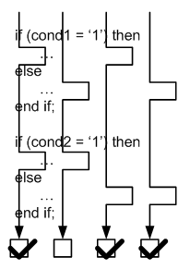
Path Coverage
Path coverage is a refinement of branch coverage. Path coverage reports the number of times every possible path through the code was executed.
Rather than looking at single conditional decisions in isolation, path coverage does an execution flow analysis of the HDL and identifies combinations of subsequent decisions into execution paths.
Figure to the right shows the automatic inference of four possible execution paths on a given HDL with if/then/else structure.
If branch coverage would have been used, it would indicate that all branches were taken.
But, only the path coverage could reveal that one of the possible paths through the structure has not been taken, which could be significant indication for the verification team.
Path Coverage Example

Slide 19
Condition Coverage
Condition coverage records the number of times each permutation of the terms of a Boolean expression cause the complete expression to evaluate to true or false.
Consider the expression (A && B) || C || D. This expression evaluates to true under three conditions:
  1. A && B
  2. C
  3. D
and to false under two conditions:
  1. !A && !C && !D
  2. !B && !C && !D
A stricter form of condition coverage - exclusive condition coverage - is sometimes available that requires each term to be the controlling term (i.e. sole reason) for an expression to evaluate true or false.
For the example above, the expression evaluates to true for these five exclusive conditions. The controlling term is in boldface below:
  1. A && B && !C && !D
  2. !A && B && C && !D
  3. A && !B && C && !D
  4. !A && B && !C && D
  5. A && !B && !C && D

Slide 20
FSM Coverage
Modern code coverage tools identify and extract finite state machines from RTL.
There are several FSM metrics of interest to the verification engineer:
  The most basic is state coverage: how many times was each state of a state machine entered?
  Another is arc coverage: how many times did the FSM transition from one state to each of its neighboring states? Arc coverage should be reported for the sub-expressions of each next state equation as we saw for condition coverage.
  A third FSM metric is sequential arc coverage‚ often called transition coverage. Sequential arc coverage identifies state visitation sequences of various lengths and records the number of times each sequence was traversed.

Slide 21
FSM Coverage Example – State Coverage
Consider the following FSM composed of five states and nine arcs shown on the figure to the left. Next to each arc is its next-state equation.
State coverage for this FSM might be reported as in figure to the right.
State Coverage

Slide 22
FSM Coverage Example – Arc Coverage
Arc coverage for the same FSM might be reported as in figure to the right.
Arc Coverage

Slide 23
FSM Coverage Example – Sequential Arc Coverage
Lastly, sequential arc coverage, for two-arc transitions beginning at state S1, for the same FSM might be reported as in figure to the right.
Sequential Arc Coverage

Slide 24
Controlled and Observed Coverage
So far we have discussed the coverage metrics commonly available from code coverage programs.
Each metric was considered within the context of its associated RTL‚ with no consideration for the effect a recorded metric had on the running simulation.
We may observe the execution of a statement‚ perhaps an assignment statement. What if the assigned value never propagates to an observation interface for checking?
What if that statement is only executed one time in all of the regression runs and the value is never propagated?
A potentially erroneous assignment is never checked‚ but recorded as observed.
The code coverage program must provide a means of sensitizing the recording of code coverage metrics to a defined observation interface‚ generally a monitor of the verification environment checking aspect.
For each metric - line‚ statement‚ branch‚ condition‚ toggle and FSM - the program must be able to trace the effect of the observed metric to a selected observation point through the RTL hierarchy.
Notes:
To illustrate the need for observing the coverage, consider a problem of verifying a superscalar‚ 3-issue IA-32 microprocessor. Since the management hasn’t been convinced to invest in the development or purchase of an automated generation environment‚ the verification team had manually written hundreds of assembly language tests to verify the instruction set architecture (ISA). Nevertheless‚ they employed a coverage-driven verification methodology to achieve 100% coverage on the ISA functional coverage models. Despite employing a rigorous CDV methodology‚ in first silicon a bug has been discovered in one of the branch instructions. The verification team has measured 100% branch coverage and the self-checking branch tests had been thoroughly reviewed. How did this bug escape?
Two groups of tests the verification team has developed were the floating point tests and the branch instruction tests. Unbeknown to them‚ the single occurrence of a particular branch instruction scenario was coded in one of the floating point tests. The floating point test‚ not responsible for branch instruction verification‚ was insensitive to the misbehavior of the branch instruction. The branch instruction test suite mistakenly excluded this particular branch scenario. When the verification team functionally graded the full test suite‚ there were no reported branch coverage holes. At the same time‚ all tests - including the branch tests - passed without error.
The problem was now apparent: the verification team has not restricted the measurement of branch instruction functional coverage to the branch tests. More generally‚ coverage was measured in one set of stimuli but not correlated to response checking in the same stimuli. Branch coverage controlled test execution but it was not observed by branch behavior checking code.
The lesson for functional coverage is to make sure each functional coverage model has corresponding - and concurrently active - data and temporal checking code.

Slide 25
Code Coverage Use Model
Code coverage reports how well the RTL implementation of the device has been exercised from the perspective of each of the metrics discussed earlier.
Since the RTL is quite volatile during the early stages of design‚ our interest in how well it has been exercised peaks later in the design cycle.
Let’s walk through each step of the code coverage process:
  instrumentation‚
  metric recording and
  analysis.

Slide 26
Instrument Code
The first step for using code coverage is to instrument the RTL.
We should select the code modules‚ hierarchies or instances we want to observe.
Next‚ we should select the metrics we want to record.
The amount of code instrumented and number of metrics measured will determine how much your simulation rate is degraded.
We should restrict these to what is required to meet our coverage goals.
The last instrumentation step depends upon the particular tool we are using:
  Some tools require no further action before simulation to begin recording metrics.
  Others require an instrumentation/compilation step wherein they insert code into the RTL which defines counters and increments them.
Code coverage tool documentation should be consulted for the details on creating an instrumented‚ ready-to-simulate design database.

Slide 27
Record Metrics
The second step in the application of code coverage is recording metrics.
The actual recording of metrics is performed by the simulator during simulation.
However‚ the recorded data needs to be organized for subsequent analysis.
Each of the recorded metrics has an associated threshold or hit count.
The default value is usually one. In high-risk areas of the RTL‚ with perhaps an unusual amount of complexity‚ one should consider increasing the threshold for the metrics recorded in these areas. This “over-sampling” will mitigate the risk of observing a statement‚ sub-expression or FSM arc at a time the device is relatively quiescent.
Each simulation is usually identified by one or more unique identifiers.
If an autonomous verification environment is used‚ the only attribute distinguishing one simulation from the next is the random seed.
If a test-driven environment is used‚ a test number or id‚ in addition to a possible random seed‚ identifies a simulation.
For a given snapshot of the RTL‚ code coverage should be accumulated for all of its simulations.
After code coverage has been measured for an RTL release‚ it must be analyzed.

Slide 28
Analyze Measurements
The third step in using code coverage is analyzing the measurements.
Irrelevant data need to be excluded from analysis and focus should be placed on the meaning of recorded metrics.
Before examining how to interpret recorded metrics‚ keep in mind that code coverage cannot reveal necessary‚ but missing‚ RTL.
If RTL required to implement a device requirement has not been written‚ it can only be identified by functional, not by code coverage.
Often‚ verification engineer may be overwhelmed with the amount of information presented by the coverage tool.
Data filtering addresses this‚ the topic discussed next.

Slide 29
Filtering Measurements I
When code coverage is first enabled and metrics selected‚ the amount of reported information may be daunting.
The reported results must be filtered to exclude:
  known illegal conditions‚
  known unused logic and
  low-priority code coverage holes.
Known illegal conditions are “else” clauses of “if” statements and unused case default statements for conditions that should not happen.
The designer may have logic to handle the expected values zero‚ one and two from a 2-bit bus. If the bus returns the value three‚ a default case or “else” clause if often included to report an error through a displayed message. This logic is not expected to be executed‚ so it should be filtered.
A good code coverage tool allows filtering at the level of most of the metrics: line‚ statement‚ FSM state‚ etc. Some provide pragmas that may be inserted in the RTL for the designer to tag logic as unused.

Slide 30
Filtering Measurements II
Another reason for filtering results is known unused logic.
A module may be used twice in the design‚ but configured differently for each instance.
The configuration often deactivates a subset of the module logic‚ preventing it from ever being used in a given instance.
That logic should be tagged as unused‚ either in the RTL or using the user interface or configuration file(s) of the code coverage program.
Unless expected unused (or unexercised) logic is excluded from reported results‚ the code coverage measurements will be misleadingly low.
Take the time to construct filter files and instrument the RTL with pragmas before wading through these coverage results.
Finally‚ there may be coverage holes you choose not to fill.
These coverage holes correspond to RTL that is rarely exercised or low-risk or both.
If a particular set of metrics are only observed under rare operational conditions and these conditions are also difficult to reproduce during verification‚ you may choose to filter them.
Also‚ if a coverage hole corresponds to RTL with little‚ if any‚ complexity‚ you may also choose to spend scarce resources filling higher risk holes.

Slide 31
Toggle Coverage Analysis
Toggle coverage records transitions between values of bits in registers and wires.
While the toggle coverage of a data register may yield little value‚ toggle coverage of a one-hot mux select bus will tell us whether or not all of the mux paths have been exercised.
Toggle coverage of an address bus or other‚ control-oriented bus‚ will indicate whether or not basic activity was observed.
In general‚ toggle coverage serves as a general “liveness” or activity indicator.
It provides a very coarse view of signal activity but associates no semantic meaning to recorded results.

Slide 32
Line Coverage and Statement Coverage Analysis
Line coverage‚ indicates which RTL lines have been executed.
A line may contain a partial statement‚ a full statement or multiple statements.
If a line contains a partial statement‚ it must be examined along with the other lines which define it.
If a line contains a complete statement but the line is reported as not executed‚ there are a couple of possible reasons:
  One possibility is that the line cannot be executed because the data and control flow of the code prevent it.
  Another is that the condition required to execute the line is rare but it has not yet been created.
  If an random-based verification environment is used‚ the probability of creating this condition may need to be increased.
If a directed tests are driving the environment‚ they may not contain the necessary stimuli to create the condition.
Returning to the third line/statement relationship‚ multiple statements may be defined on a single line. If so and the line is reported as not executed‚ the same analysis used for a single statement on a line should be applied to each statement.
Statement coverage reports which RTL statements have and have not been executed.
For each statement which has not been executed‚ the analysis described above for statements in lines should be applied.

Slide 33
Branch Coverage Analysis I
Branch coverage reports control flow transfers between RTL statements. Let’s consider each type of branch statement in turn.
An if statement has two possible branches:
  the if (true condition) branch and
  an optional else (false condition) branch.
If either branch has not been executed‚ the if conditional expression should be examined to determine if the expression may‚ in fact‚ assume both true and false values.
The case statement is quite analogous to the if statement‚ except that it may have more than two branches.
If one or more branches are reported as not executed‚ the case statement expression must be examined to make sure it may evaluate to each of the case label values.

Slide 34
Branch Coverage Analysis II
The VHDL loop statement is used to construct an unconditional loop‚ while loop or for loop. Each of these is characterized by a reverse control flow transfer‚ either conditional or unconditional.
The while loop has three branches:
  one bypassing the body of the loop when the while condition is false‚
  a second sequential transfer from the while test into the body and
  a third unconditional branch from the end of the body back to the conditional expression.
If either of the first two branches are never taken‚ the while condition must be examined to make sure both the first and subsequent evaluations of the expression may evaluate to true and false.
The third unconditional reverse branch must be observed if the sequential transfer into the loop body is recorded.
Uncoditional loop is not very interesting because‚ if the statement itself is encountered‚ both of its branches (sequential transfer into loop body and reverse transfer to top of body) will always be executed.
For loop is essentially a repackaged while loop in which the initialization assignment and iteration variable increment are specified in the for expression itself.
It should be analyzed just like the while loop.
As said earlier, path coverage is an refinement of the branch coverage metric, and it should be analyzed similarly.

Slide 35
Condition Coverage Analysis
Condition coverage records how extensively the terms of expressions have been evaluated.
Considering the example we used earlier‚ (A && B) || C || D‚ it has four Boolean terms: A‚ B‚ C and D.
If the coverage program reports that any of these terms have not been observed evaluating to true or false‚ the constituent signal and register operands from which it is composed must be examined to determine why this is the case.
For example‚ a mutually exclusive relationship between A and B (A = !B) would prevent the term (A && B) from ever being true.
Likewise‚ if C is defined to always be the inverted value of D (C = !D)‚ the two false conditions will always be observed‚ independent of the values of A‚ B‚ C and D:
    (!A && !C && !D) = (!A && !C && !(!C)) = (!A && !C && C) = (!A && 0) = 0
    (!B && !C && !D) = (!B && !C && !(!C)) = (!B && !C && C) = (!B && 0) = 0

Slide 36
FSM Coverage Analysis
FSM coverage records visits to states and single and sequential arc traversals.
Assuming an FSM has been optimized to reduce its state count to a minimum‚ each state must be visited at least once.
Likewise‚ each arc must be traversed at least one time and‚ in addition‚ it must be traversed for each controlling term of its next-state equation.
This means that full next-state condition coverage is necessary for full FSM coverage.
The matter of sequential arc coverage - two‚ three or more arc traversal permutations - is more complex.
In order to understand the necessary sequential arc depth and which arc permutations must be observed‚ it is necessary to understand what specified functionality and implemented device logic is only exercised under particular sequential scenarios.
This understanding is only acquired through detailed analysis of the functional and design specifications and the RTL.
If you were to choose to capture FSM behavior using a functional coverage model‚ you would have to invest in the same analysis to design the model. However‚ you would be relieved of the back-end analysis required of code coverage FSM extraction.
This is the reason why the FSM behavior is typically captured using the functional coverage model approach.

Slide 37
Discussion of Structural Coverage Models I
So far, we discussed structural coverage only in the context of the design and its HDL representation.
Structural coverage plays a lesser role for the verification environment.
Of course, it is possible to apply line, branch, and path coverage to any type of sequential code. Why would this not work for verification code?
Indeed, it is possible to instrument the code of checkers or monitor component.
A checker or monitor has to inspect the HDL model over time and compare these observations against the specification.
As the verification follows events in the model, it naturally assembles scenarios and transactions.
All these abstractions are relevant to coverage analysis, and in some cases, the environment code might be the source of more effective coverage models.
It is very practical to measure which conditions a checker or monitor had to compare against the specification and which scenarios it never encountered.

Slide 38
Discussion of Structural Coverage Models II
Structural coverage, especially the more sophisticated forms, can clearly improve the verification quality.
The strength of structural coverage analysis, aside from its easy implementation, is its ability to point out holes of uncovered areas in the design.
However, as discussed above, it is clear that for any nontrivial design there will be areas that simulation will not cover.
The real problem is deciding which areas are safe for the verification team to leave uncovered. This is the common drawback of structural coverage.
The indication of absence of coverage is its value.
However, that is only the start of a reasoning process, which decides whether this result is relevant or not for the verification of the design.
Structural coverage models have no ability to predict bugs; bug coverage model they are not.
Notes:
Most EDA companies have embraced structural coverage measurement with vigor. This should not be a surprise, because it is straightforward to add and integrate most of the data collection for the structural models into the HDL processing tools that the vendors already provide. It is also much more runtime-efficient to evaluate the instrumentation embedded inside the HDL simulation compared with retrieving this data out of the model and processing them in the test bench.
All these advantages of embedded structural instrumentation have made structural coverage an important feature of HDL simulation engines.

Slide 39
Monitoring the Verification Flow
Functional Coverage

Slide 40
Functional Coverage I
The purpose of measuring functional coverage is to measure verification progress from the perspective of the functional requirements of the device.
The functional requirements are imposed on both the inputs and outputs of the device - and their interrelationships - by the device specifications (functional specification and design (microarchitecture) specification).
The input requirements dictate the full data and temporal scope of input stimuli to be processed by the device.
The output requirements specify the complete set of data and temporal responses to be observed.
The input/output requirements specify all stimulus/response permutations which must be observed to meet black-box device requirements.
Since the full behavior of a device may be defined by these input, output and input/output requirements, a functional coverage space which captures these requirements is referred to as a coverage model.
The degree to which a coverage model captures these requirements is defined to be its fidelity.
The fidelity of a model determines how closely the model defines the actual behavioral requirements of the device. This is the abstraction gap between the coverage model and the device.
Notes:
For example, if we are modeling a control register having 18 specified values and the coverage model defines all 18 values, their is no abstraction gap so this is a high fidelity model. However, if a 32-bit address bus defines all 2³² values and an associated coverage model groups those values into 16 ranges, a substantial abstraction gap is introduced. Hence, this would be a lower fidelity model.
In addition to the abstraction gap between the coverage model and the device, another source of fidelity loss is omitting functional relationships from the model. For example, if two bits, such as CR3 and CR7 of the control register, have a dependency such as “CR3 may only be one if CR7 is one”, yet this dependency is not reflected in an associated coverage model, that model is of a lower fidelity than a model that captures this relationship.

Slide 41
Functional Coverage II
Unlike structural coverage, there is no automated way to create functional coverage models.
Functional coverage targets semantic aspects of the test generation or design implementation.
Underlying all functional coverage activities there is the acknowledgement that it is necessary to choose which functional areas of the design need to be tested.
Insight into the design semantics drives these choices, and they must come from the designer or the verification engineer.
A very important component of this insight is the knowledge of design complexity, of areas that are prone to bugs.
The predictive bug coverage component of functional coverage models must come from the experience of the engineers.
There is no set of complex automation tools available to define functional coverage models.
The tool support focuses mostly on the implementation of the coverage model and the efficient collection of the data during runtime. After the data are collected, the tools provide GUI support to help in the traversal of the results.

Slide 42
Functional Coverage Model Designing Steps
Functional coverage model design steps include:
  describing the semantics of the model,
  identifying the coverage attributes (events) and
  specifying the relationships among these attributes which characterize the device and time when to correlate them.
The semantics of the model is an English description of what is modeled, sometimes called a story.
An example for an input coverage model is:
  The instruction decoder must decode every opcode, in every addressing mode with all permutations of operand registers.
An output model example is:
  We must observe the packet processor write a sequence of packets of the same priority, where the sequence length varies from one to 255.
Once the semantic description is written, the second step in designing a coverage model is identifying attributes, or as it is sometimes called, coverage events. But first, what is meant by an attribute?
An attribute specifies an event in the model or the test bench, which is important enough that the verification environment must note and log its occurrence.
An attribute identified from one of the device specifications is a parameter of the device such as configuration mode, instruction opcode, control field value or packet length.

Slide 43
Attribute Identification
The second step in designing a coverage model includes:
  identifying attributes,
  identifying possible values of the attributes and
  identifying the times they should be sampled.
The most effective way to identify attributes and their possible values is in a brainstorming session among several verification engineers and designers familiar with the device specifications.
The last concern we have with attribute identification is selecting the sampling time for each attribute.
An attribute may be sampled at a variety of times: each time its value is changed, on every cycle or in conjunction with another event. How do we decide when and how often it should be sampled?
There are several things to consider when choosing an attribute sampling time:
  First of all, a value should be sampled no more frequently than it is updated.
    A system control register bit, for example, may only be written when an associated control register write instruction is executed. If the monitor sampling the register has access to the execute stage of the processor, it could read the control register bit only when the write instruction is executed. It may also have direct access to the control register write logic in which case it could simply watch the register write enable line.
  An attribute should also be sampled no more frequently than the frequency at which it interacts with other attributes.
    This “interaction frequency” is the inverse of the attribute correlation time. Because attributes interact with others, they create attribute relationships. Attribute correlation times and attribute relationships are discussed next.

Slide 44
Attribute Relationships
Attribute relationships should reflect attribute interactions, dependencies and device behavior specified by combinations of attributes.
Each of these behavioral relationships are reflected in device logic purposefully designed to meet these requirements or in particular scenarios described in the device specifications.
Associated with each attribute relationship is a correlation time.
The correlation time is a moment two or more attributes participate in decision logic of the device.
The structure of the relationship may be of one of three types:
  matrix,
  hierarchical or
  hybrid.

Slide 45
Matrix Coverage Model
A matrix model considers each attribute to be a dimension of a matrix, where the number of dimensions is defined by the number of attributes.
The values along each axis are the values of the corresponding attribute.
Figure to the right illustrates a two dimensional matrix model.
The two attributes are labeled “Attribute A” and “Attribute B.”
Attribute A has twelve values, A0 through A11 while attribute B has eight values, B0 through B7.
An attribute pair, (A_{n}, B_{m}), defines a point within this two dimensional coverage space.
This matrix model defines 96 points.
Matrix Coverage Model

Slide 46
Hierarchical Coverage Model
A hierarchical model is structured like an inverted tree with its root at the top.
It is a directed graph whose nodes are attribute values and whose edges indicate a relationship between one attribute value and another.
One attribute is represented at each level in the tree, with the primary controlling attribute at the root and each successive attribute one level lower.
Figure to the right illustrates a hierarchical coverage model defined by three attributes: “Attribute A,” “Attribute B” and “Attribute C.”
Attribute A is the primary controlling attribute and has four values, A0 through A3.
Attribute B is a secondary attribute and has three values, B0, B1 and B2.
Attribute C is a tertiary attribute having four values, C0 through C3.
In this model, an attribute 3-tuple, (A_{n} , B_{m} , C_{k}), defines one of the ten points in the coverage space.
For example, p₇ is defined by (A2, B0, C2), the path to this point.
Hierarchical Coverage Model

Slide 47
Hybrid Coverage Model
A hybrid model is composed of a blend of matrix and hierarchical regions, where fully permuted attribute combinations are structured as a matrix and irregular attribute relationships are structured hierarchically.
The matrix subregions may be leaf nodes of a base hierarchical model or hierarchical subregions may occupy nodes within a base matrix model.
Figure on the right illustrates a hybrid model of the first type, matrix subregions are leaf nodes of a base hierarchical model.
Attributes A, B and C are defined the same as the previous hierarchical model, having four, three and four values respectively.
Attribute D has three values, D0, D1, and D2 and attribute E has six values, E0 through E5. These two attributes define a three by six matrix subregion of the hierarchical model.
Attributes F and G likewise define a five by four matrix subregion.
This model defines a total of 46 points: 8 leaf nodes (p₁, p₃, p₄, p₅, p₆, p₇, p₈, p₉), 18 points in the attribute D/E matrix and 20 points in the attribute F/G matrix.
Hybrid Coverage Model

Slide 48
Pros and Cons of Each Model I
Although the structure of the coverage model should reflect the underlying relationships among the attributes from which it is composed, there are times when the relationships may be modeled using more than one of these model structures.
What are the pros and cons of each structure in terms of model fidelity and implementation effort?
The matrix model requires the least effort to design and implement because of its symmetry. Each of the interacting attributes is specified, along with its corresponding values.
Because the matrix model is so easy to build, engineers often choose it as the path of least resistance even though another model is more applicable.
If the full size of a model, structured as a matrix, is relatively small (1,000 points or less) and the most of the coverage points are not invalid or impossible to reach, the time saved over designing a more precise hierarchical or hybrid model is worth the loss of fidelity.
However, if the matrix model would be quite large (100,000 or more points) or it would define many invalid points, a hierarchical or hybrid model should be chosen instead.

Slide 49
Pros and Cons of Each Model II
The hierarchical model requires more effort to design because, not only must the attributes and their values be specified, specific relationships among attributes must also be defined.
These relationships are often quite irregular and complex, requiring many lines to enumerate.
Nonetheless, the complexity reflected in the hierarchical model is inherent in the attribute relationships described by the device specification or reflected in the RTL implementation. Although it may be simplified using a lower fidelity model, it cannot be avoided.
The strength of the hierarchical model is that it can precisely define attribute relationships, dramatically reducing the size of a coverage model and providing deeper insight into observed device behaviors.

Slide 50
Pros and Cons of Each Model III
The hybrid model requires a design effort comparable to the hierarchical model.
Again, attributes, values and individual relationships must be enumerated.
However, some regions of a hybrid model are quite regular and are represented by a matrix structure.
The hybrid model usually reflects the most precise input, output or internal device behavior because of the nature of designs.
They are a blend of symmetric values with a few exceptions tossed in.

Slide 51
Detailed Design
Detailed design concerns itself with mapping the coverage model design to the verification environment.
In other words, how must the design be architected so that it may be implemented in VHDL?
In order to answer the question, three specific questions must be answered:
  1. What must be sampled for the attribute values?
  2. Where in the verification environment should we sample?
  3. When should the data be sampled and correlated?
The answer to the first question maps verification environment fields and variables, or device signals and registers, to attributes.
The answer to the second question determines where in the verification environment data sampling will be performed.
The answer to the third question maps the sampling and correlation times to specific events in the environment.

Slide 52
What to Sample
The data to be captured for each of the attributes defined during functional coverage model design must be associated with a data source in the environment, either in the verification environment or in the device under verification.
For example, the attributes of an input coverage model will be sampled from data injected into the device.
The attributes of output coverage model will be sampled from data captured on device outputs.
Some coverage models may require attributes that may only be captured from within the DUV or may compose attributes from all three sources.

Slide 53
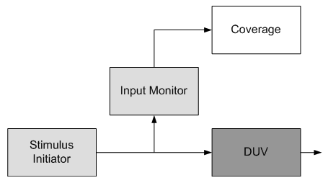
Sampling Input Attributes
Input attributes should be sampled by a monitor that has access to the primary inputs to the device.
The monitor should sample data from input signals at valid times specified by the device specification.
The monitor should not retrieve its data from a stimulus generator because creating such a dependency would compromise the ability to reuse the monitor for recording coverage at a subsequent integration level. This will be discussed later in the course.
The figure on the right depicts a monitor sampling data from a device’s primary inputs.
The block labeled “Coverage” is a distinct aspect from the “Input Monitor” block because it has a particular responsibility whereas the monitor is more general-purpose.
The coverage block is solely responsible for recording functional coverage data.
The monitor block is a generic data capture facility, used by both coverage and checking aspects.
Sampling Input Attributes

Slide 54
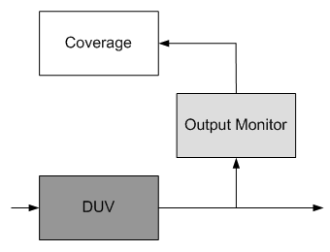
Sampling Output Attributes
Output attributes should also be sampled by a monitor but, of course, from the primary outputs of the device.
The monitor should sample data at valid times specified by the device specification.
The figure on the right depicts a monitor sampling data from a device’s primary outputs.
Sampling Output Attributes

Slide 55
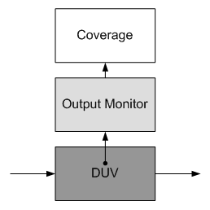
Sampling Internal Attributes
Device internal attributes also have an associated monitor, responsible for capturing internal signal and register values.
Unlike the input and output interfaces of the device, internal signals are not as well specified (if they are specified at all).
Sampling of such internal signals must be coordinated with the design team in order to minimize volatility.
Because internal signals may be quite volatile and are frequently unspecified, the use of internal attributes for coverage model design should be minimized.
They impose an additional maintenance burden on the verification team, once implemented, because the monitor and coverage must continually track design changes.
One strategy that was successfully employed to address this is defining a set of fixed signals and registers for verification use.
The verification team identifies internal signals and registers required for coverage measurement and the design team agrees to minimize their changes.
This “verification interface” is treated the same as an external device interface because it is specified and (nearly) frozen.
The bottom figure depicts a monitor sampling data from the DUV’s internal signals and registers.
Sampling Internal Attributes

Slide 56
Where to Sample
A dynamic verification environment is composed of three aspects: coverage measurement, stimulus generation and response checking.
The coverage measurement aspect will be implemented in a set of monitors responsible for monitoring input, output and internal interfaces of the DUV.
Typically, if we are measuring output coverage, a monitor on an output interface of the device will capture data used by a data checker - such as a scoreboard - as well as by a coverage model.
If attributes are required from device inputs, they should be captured from a monitor on the device inputs.
It may be tempting to place input data capture in the generation aspect of the environment, but what happens when this aspect is reconfigured or removed in the verification environment of a subsequent integration of the device? Input coverage could no longer be measured on that interface.

Slide 57
Coverage Model Example – Calc1 Design
During the verification of the Calc1 the driver should generate all commands, including illegal ones, at least once for every port. To monitor this we can design the following coverage model.
First we must identify the coverage attributes (events). Our coverage model will have two attributes:
  First attribute is the port to which the command is issued. Possible values for this attribute are 1, 2, 3 and 4.
  Second attribute is the command type with the possible values “No operation”, “Add”, “Subtract”, “Shift left”, “Shift right”, “Illegal”, as defined in the Lecture 9, Slide 18, Table 1.
Since all attribute combinations are legal, we will use the matrix coverage model, as shown on the figure below shows.
Sampling times for both attributes equal the system clock period. Correlation time should be equal to the system clock period also.
The goal to cover all cells of the cross-product is equivalent to the statement that the driver generated all commands, including illegal ones, at least once for every port.
Matrix coverage model for Calc1 stimulus.
The two dimensions of the matrix are operations and ports. The coverage model gives insight into which operation/port combinations were not simulated versus which ones were and how many times they were simulated.

Slide 58
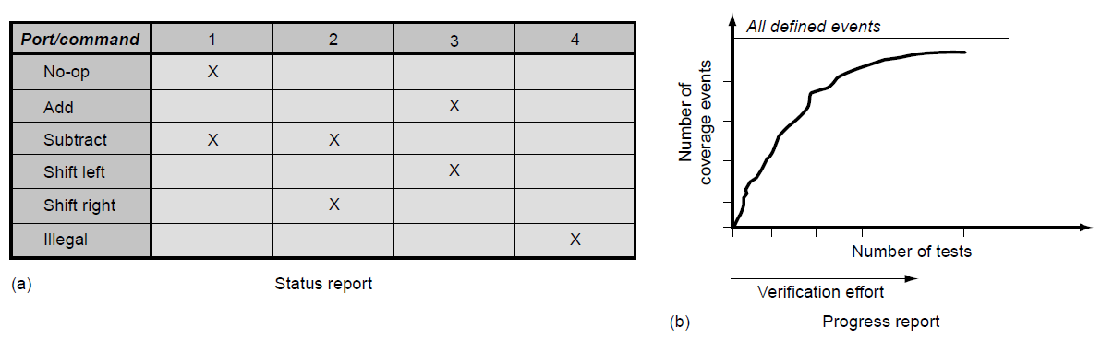
Analyzing the Collected Coverage
It is possible to analyze the collected coverage data per test case. Alternatively, the coverage collection tool can tabulate many test case results into one result.
Coverage tools typically provide two types of reports: status reports and progress reports.
The status report, Figure (a), shows the current overall encountered coverage events in a snapshot diagram, whereas the progress reports, Figure (b) display a curve of the increasing sum of encountered events over the process of test case simulation.
The typical shape of the progress is asymptotical toward the goal of reaching all events, with a sharp increase in the beginning of the process.
The early events are typically the easy ones to hit, whereas the events encountered later need much more effort from the verification team, tuning the stimulus generation.
Coverage reports.
(a) Status report showing the summary of all coverage data up to a point in time.
(b) Coverage results tabulated over time.

Slide 59
Monitoring the Verification Flow
The Right Coverage Analysis Strategy

Slide 60
The Right Coverage Analysis Strategy I
The overall discussion in this lecture should highlight that coverage analysis is one of the harder problems for a verification team.
Although there are many automatic tools that promise a quick fix for the coverage quandary, all of them have significant drawbacks.
On the other hand, neither industry nor academia has so far found coverage metrics with the right necessary predictive capability to guide simulation into those areas of the state space where the hidden bugs are.
This leaves a verification team with a range of necessary incomplete alternatives to select the right coverage strategy for their specific project.
However, the discussion leaves us with useful guidelines that will result in a better use of coverage technologies and an overall better verification methodology.

Slide 61
The Right Coverage Analysis Strategy II
Use coverage analysis. Especially with random-biased stimulus generation, the verification is blind without the coverage feedback.
Use coverage as a method that provides insight into verification progress, not as a tool that provides a set of absolute numbers. The verification team should not confuse reaching 100% of the coverage with a guaranteed bug-free design under verification (DUV). Coverage numbers are only useful with careful interpretation.
The more insight it takes to create a coverage model, the more insightful the coverage feedback information will be.
Use structural coverage feedback mainly as an indicator for holes in the simulation coverage. Because automatic metrics take not much insight, the value of their positive feedback (events have been hit) is limited. Missing events, however, provide unambiguous feedback of missing verification in the areas specific to the metric used.
Limit structural coverage feedback to the amount of data the simulation infrastructure can support. Low-level structural coverage collection often easily overwhelms a project.

Slide 62
The Right Coverage Analysis Strategy III
Use as much manually instrumented functional coverage data collection as possible. Manual instrumentation of the simulation process requires insight and effort. The insight provides useful coverage information; the effort limits the instrumentation to mostly useful coverage information.
Instrument corner conditions in the DUV for coverage analysis. Corner conditions are naturally more error-prone. Examples of corner conditions are maximum and minimum resource allocations or rare collisions of events that need special treatment in the DUV implementation.
Select the dimensions of matrix coverage model carefully. A matrix model that is too large likely provides not enough insight. Similar to the DUV state space, matrix model tend to blow up easily in size and simulation cannot cover all the events specified.
Use broad coverage analysis at the level of functional unit simulation. Prioritize and review coverage goals at the higher level of the hierarchy.
The unit-level simulation provides the broadest amount of functional coverage. Levels above unit simulation by intent will not reach all coverage measures that are in place for a unit.
A selection of prioritized measures from the units and new measures should constitute the coverage goals for a higher verification level (e.g., chip level).

