Slide 1
Funkcionalna verifikacija hardvera
Predavanje III

Slide 2
Sadržaj lekcije
Verifikacioni plan
Sadržaj verifikacionog plana
Primer verifikacionog plana

Slide 3
Verifikacioni plan
Uvod

Slide 4
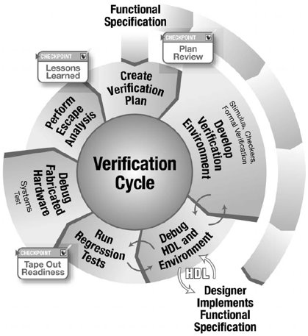
Verifikacioni plan
Verifikacioni plan je odlučujući faktor za uspeh kompletnog procesa verifikacije
On definiše ne samo aktivnosti koje će verifikacioni tim da preduzme, već opisuje i način na koji će to da se uradi
Pošto je to prvi korak u verifikacionom ciklusu, svi naredni koraci bazirani su na ovom dokumentu
Ovaj dokument je "živ" dokument u smislu da je podložan izmenama, a za njega je zadužen ceo dizajn i verifikacioni tim

Slide 5
Funkcionalna specifikacija I
Funkcionalna specifikacija služi kao izvor za izradu verifikacionog plana
Verifikacioni inženjer mora najpre da potpuno razume dizajn koji se verifikuje (DUV) pre nego što odluči kako da ga verifikuje
Uloga specifikacije je značajna u celom procesu jer ona zapravo razrešava sve dileme na koje se može naići
Naime, često se dešavaju neslaganja između tima za verifikaciju i dizajn - ona se manifestuju kao pogrešna poređenja u okviru test slučajeva
U tim slučajevima, timovi će se pozivati na specifikaciju kako bi ustanovili koje je ispravno tumačenje
Notes:
The source of the plan is the functional intent and specification. The verification engineer must first understand the design under verification (DUV) before determining how to verify it. The specification is the driving vehicle for this; it becomes the “law.” Many times, discrepancies arise between verification and design (these manifest themselves as testcase miscompares). In these cases, the team will refer to the specification for the correct behavior.
However, discrepancies can often occur when the specification is unclear or ambiguous on a technical matter. If two people read the same specification issue and interpret it differently, then the specification has a problem. Because the specification is the law, the team must settle the discrepancy. It is a simple matter of going back to the architect and having the intent clarified.
The specification and verification plan are not “gentleman’s agreements,” as both items must exist in written form and apply to the current project. It is not acceptable to use a previous version of the verification plan and specification on a new version of a design. These documents must evolve with the design: if the project is important enough to create another version, then it is important enough to update both the specification and verification plan to reflect the current changes.
However, the reality is not always so black and white. Often the final specification is not complete until the chip ships to manufacturing or even to the customer. The verification team must use the evolving document as the basis of the plan. Other times, designers have workbooks that evolve into the specification. If this is the current specification, then these workbooks are the basis for the verification plan. However, technical insights that affect the system or chip, such as power-on-reset sequences or chip configuration initializations, may be missing from the workbooks. In these cases, the architect must have input on the function of the design. These cases are suboptimal, but do occur in industry.

Slide 6
Funkcionalna specifikacija II
Međutim, neslaganja se često mogu javiti kada je specifikacija nejasna ili dvosmislena u vezi sa nekim tehničkim pitanjem
Ako dve osobe različito tumače neku stavku specifikacije, onda je problem zapravo u specifikaciji. Na primer:
Odgovor R će se pojaviti kada se A pojavi posle B ili C
U ovom slučaju, specifikacija je bila nejasna (A posle B ili posle C, naspram A posle [B logičko ILI C]). Pošto je specifikacija zakon, tim mora da razreši neslaganje
Ovo podrazumeva konsultovanje sistem arhitekte koji treba da razjasni svoju nameru nakon čega bi trebalo da bude jasno kako specifikacija treba da se tumači
Notes:
The source of the plan is the functional intent and specification. The verification engineer must first understand the design under verification (DUV) before determining how to verify it. The specification is the driving vehicle for this; it becomes the “law.” Many times, discrepancies arise between verification and design (these manifest themselves as testcase miscompares). In these cases, the team will refer to the specification for the correct behavior.
However, discrepancies can often occur when the specification is unclear or ambiguous on a technical matter. If two people read the same specification issue and interpret it differently, then the specification has a problem. Because the specification is the law, the team must settle the discrepancy. It is a simple matter of going back to the architect and having the intent clarified.
The specification and verification plan are not “gentleman’s agreements,” as both items must exist in written form and apply to the current project. It is not acceptable to use a previous version of the verification plan and specification on a new version of a design. These documents must evolve with the design: if the project is important enough to create another version, then it is important enough to update both the specification and verification plan to reflect the current changes.
However, the reality is not always so black and white. Often the final specification is not complete until the chip ships to manufacturing or even to the customer. The verification team must use the evolving document as the basis of the plan. Other times, designers have workbooks that evolve into the specification. If this is the current specification, then these workbooks are the basis for the verification plan. However, technical insights that affect the system or chip, such as power-on-reset sequences or chip configuration initializations, may be missing from the workbooks. In these cases, the architect must have input on the function of the design. These cases are suboptimal, but do occur in industry.

Slide 7
Verifikacioni plan
Sadržaj verifikacionog plana

Slide 8
Sadržaj verifikacionog plana
Verifikacioni plan se sastoji od nekolicine sekcija od kojih svaka artikuliše kritičnu komponentu samog procesa verifikacije. Ove sekcije opisuju kako tehničke zahteve u vezi verifikacionog okruženja, tako i zahteve u vezi sa vođenjem projekta (project management)
Tehnički zahtevi u sklopu verifikacionog plana su sledeći:
opis verifikacionih nivoa,
funkcije koje se verifikuju,
specifični testovi metode,
zahtevi u vezi pokrevenosti i
test scenariji (matrica).
Ove sekcije detaljno opisuju strategiju i samu konstrukciju verifikacionog okruženja
Sekcije u vezi sa vođenjem projekta su:
zahtevani alati,
rizici i međuzavisnosti,
zahtevi za resursima i
detalji u vezi rasporeda
Ove sekcije definišu softver, računarske i ljudske resurse koji su neophodni kako bi se projekat završio u predviđenom roku

Slide 9
Opis hijerarhijskih nivoa verifikacije
Prva odluka tima za verifikaciju prilikom verifikacije dizajna jeste da odluči koji hijerarhijski nivoi verifikacije će se koristiti
U zavisnosti od složenosti svakog nivoa, tim za verifikaciju mora da izabere da li će nivoe verifikovati nezavisno ili grupisati nivoe u funkcionalne komponente koje će se verifikovati. Ova odluka se zasniva na dva faktora:
Kompleksnost individualnih komponenti – kompleksi delovi unutar DUV-a zahtevaju sopstvenu verifikaciju
Postojanje jasno definisanih interfejsa i specifikacije - kako bi se pristupalo komponenti. Mogućnost da se pobuđuje komponenta i proveravaju rezultati u skladu sa protokolom interfejsa je ključ za verifikaciju i zahteva stabilan, dobro dokumentovan interfejs
Nakon definisanja verifikacionih nivoa koji će se koristiti, verifikacioni tim kreira verifikacioni plan za svaki od tih nivoa
Na narednim slajdovima će biti opisane komponente verifikacionog plana neophodne za svaki od nivoa, ali prvo ćemo predstaviti dizajn koji ćemo koristiti u nastavku kao primer
Notes:
The verification team’s first decision in verifying a design is to articulate the verification levels. As described earlier, a system may contain multiple levels of design hierarchy. Depending on the complexity of each level, the verification team must choose to verify levels independently or group levels together into functional components.
The verification team bases their decision to group components together or to first verify some (or each) components independently on two factors. The first factor is the complexity of the individual component. Complex portions of the DUV require their own verification. Proper verification on complex functions usually requires a high level of control and observability. Conversely, the verification team may fold simpler macros that do not require this high level of control and observability into the next level of verification with little risk.
The second factor in grouping components is the existence of a clean interface and specification to drive the component. The ability to properly drive interface protocol and check for results is the key to verification and requires a stable, documented interface. If the interface is “a moving target,” then the volatility in the design and verification environment should be expected. If it is feasible to verify blocks with unwieldy or unstable interfaces at a higher level, then this may be an appropriate trade-off.
After defining the verification levels, the verification team will create verification plans for each level. The following slides describe the components of a verification plan needed for each level.

Slide 10
Primer dizajna za demonstraciju v. plana
Calc1
1

Slide 11
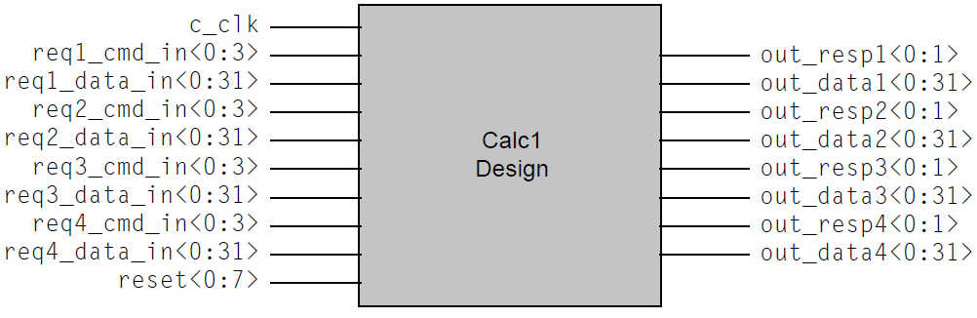
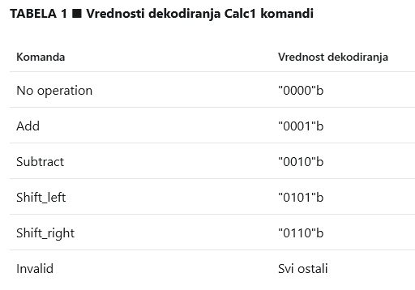
Specifikacija dizajna I
Calc1 je implementacija RTL dizajna kalkulatora četiri operacije. On može da prihvati do 4 operacije istovremeno, korišćenjem svoja četiri porta
Svaki zahtev koristi jedan od četiri porta za slanje komande i podataka. Četiri porta mogu da obrađuje svaki po jednu komandu u paraleli
Svaka komanda dobija odgovor od strane Calc1 dizajna, osim u slučaju nastanka greške, odgovor će sadržati rezultat komandom zahtevane operacije
Slika sa strane prikazuje ulazne i izlazne signale Calc1
Svaki od četiri porta Calc1 ima dve odvojene ulazne magistrale i dve izlazne magistrale
Tabela 1 pokazuje komande za 4-bitnu magistralu komandi
Notes:
Calc1 is a register transfer level (RTL) design implementation of a four-operation calculator. The four operators are Add, Subtract, Shift_left, and Shift_right. The RTL can accept up to four simultaneous operators from its four ports. A single port request sends an operator into the calculator on the command input bus, accompanied by operand data. Each request uses one of four input ports to send the command and operand data. The four ports can each handle a single command in parallel.
Each command will receive a response from the calculator design. Except in the case of an error condition, the response will include the result of the operation.
Top figure shows the input and output signals for Calc1. As with all designs, the RTL must generate or receive a clock signal input. For Calc1, the RTL receives the clock signal on c_clk.
Each of the four Calc1 ports has two separate input busses and two output busses. The first input bus, reqX_cmd_in(0:3) (where X is replaced by port numbers 1, 2, 3, or 4) is a 4-bit bus used to transmit the command to the Calc design. Table 1 shows the command and decode values for the 4-bit command bus.
The second input bus, reqX_data_in(0: 31), is the operand data bus. Each of the four operation types requires two operands. The requestor ports send operand1 data and operand2 data on sequential cycles, with operand1 data concurrent with the command. Therefore, it takes two cycles to send a complete command and data sequence.
Table 2 shows how the Calc1 design operates on the two operands.
The two output lines for each port are the response bus, out_respX (0 : 1), and result data bus, out_dataX(0 : 31). The response bus goes active for one cycle when the Calc1 design completes the computation for the port. The number of cycles that it takes to complete an operation depends on amount of activity on the three other ports but will always be at least three cycles.
Table 3 shows the possible responses for a given operation.
The output data bus, out_dataX(0 :31), should only be sampled when out_respX(0: 1) contains the successful response decode value (“01”b). At that time, the value on the output bus will contain the result of the operation for that port.

Slide 12
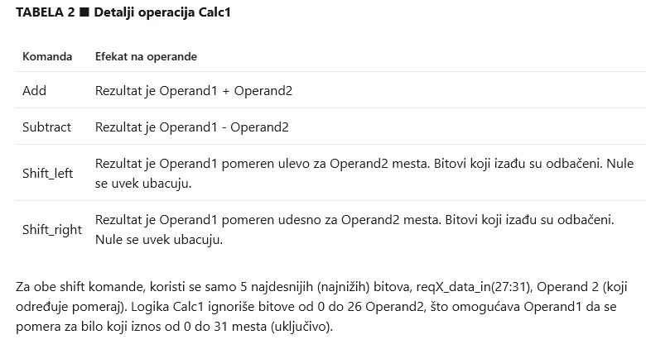
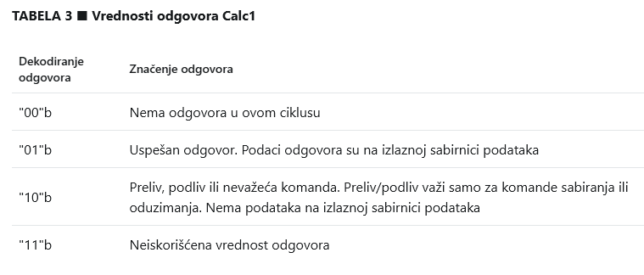
Specifikacija dizajna II
Tabela 2 pokazuje kako Calc1 dizajn koristi dva operanda
Tabela 3 prikazuje moguće odgovore na datu operaciju
Notes:
Calc1 is a register transfer level (RTL) design implementation of a four-operation calculator. The four operators are Add, Subtract, Shift_left, and Shift_right. The RTL can accept up to four simultaneous operators from its four ports. A single port request sends an operator into the calculator on the command input bus, accompanied by operand data. Each request uses one of four input ports to send the command and operand data. The four ports can each handle a single command in parallel.
Each command will receive a response from the calculator design. Except in the case of an error condition, the response will include the result of the operation.
Top figure shows the input and output signals for Calc1. As with all designs, the RTL must generate or receive a clock signal input. For Calc1, the RTL receives the clock signal on c_clk.
Each of the four Calc1 ports has two separate input busses and two output busses. The first input bus, reqX_cmd_in(0:3) (where X is replaced by port numbers 1, 2, 3, or 4) is a 4-bit bus used to transmit the command to the Calc design. Table 1 shows the command and decode values for the 4-bit command bus.
The second input bus, reqX_data_in(0: 31), is the operand data bus. Each of the four operation types requires two operands. The requestor ports send operand1 data and operand2 data on sequential cycles, with operand1 data concurrent with the command. Therefore, it takes two cycles to send a complete command and data sequence.
Table 2 shows how the Calc1 design operates on the two operands.
The two output lines for each port are the response bus, out_respX (0 : 1), and result data bus, out_dataX(0 : 31). The response bus goes active for one cycle when the Calc1 design completes the computation for the port. The number of cycles that it takes to complete an operation depends on amount of activity on the three other ports but will always be at least three cycles.
Table 3 shows the possible responses for a given operation.
The output data bus, out_dataX(0 :31), should only be sampled when out_respX(0: 1) contains the successful response decode value (“01”b). At that time, the value on the output bus will contain the result of the operation for that port.

Slide 13
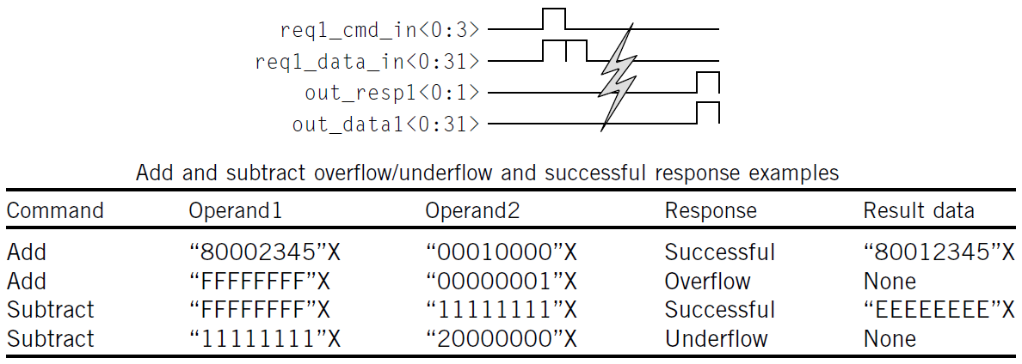
Specifikacija dizajna III
Slika ispod prikazuje vremenski dijagram za sekvencu komande i odgovora na primeru jedne uspešno izvršene komande sa porta 1. Komanda i prvi operand prosleđeni su u prvom ciklusu sekvence, dok je drugi operand prosleđen u narednom ciklusu. Nekoliko ciklusa kasnije, odgovor se pojavljuje na izlazu dizajna, zajedno sa rezultatom
Na svakom portu, jedna komanda može da se izvršava u jednom trenutku. Kada se na portu pošalje komanda, nije moguće slati novu komandu dok se ne dobije odgovor na prethodnu
Svaki port je nezavisan od drugih portova: na sva četiri porta je moguće slati komande istovremeno, ili bilo kakvu kombinaciju komandi u nekoliko ciklusa
Dizajn sadrži jednu ALU za operacije sabiranja i oduzimanja, a drugu za komande pomeranja. Interno, u dizajnu, postoji logika koja šalje komande jednoj ili drugoj ALU, u zavisnosti od dekodovane komande. Calc1 opslužuje komande u maniru first-come, first-served. Calc1 može opsluživati komande koje stižu u istom ciklusu u bilo kom, proizvoljnom, redosledu.
Notes:
Figure shows a timing diagram of the command and response sequence for a single successful command on Port 1. The command and first operand of data appear on the first cycle of the sequence, and the second operand data follows on the second cycle. A few cycles pass, and the response appears on the output of the design, accompanied by the result data.
Each port may have one operation ongoing at a time. Once a port sends a command, it may not send another command until it receives a response for the preceding command. The protocols do not require that a requestor port send a new command whenever the preceding command completes; the port may be idle for any number of cycles in between commands.
Each port is independent of the others: all four ports may send commands concurrently or any combination of commands across cycles (with the stated restriction of only one outstanding command per port). Therefore, at any given point, the Calc1 design may work on any number of commands, up to a maximum of four.
If all four ports send commands concurrently, the responses will not be concurrent. Although each port has equal priority, there are limited resources inside the design. Specifically, there is one ALU for adds and subtracts, and a second ALU for shift commands. Hence, if all four ports sent concurrent add commands, the Calc1 logic would serialize the responses, as only one add command could be processed by the ALU at a time¹.
Internal to the design is a priority logic scheme that sends commands to one ALU or the other, depending on the command decode. Calc1 services commands on a first-come, first-serve basis. Calc1 may service commands that arrive on the same cycle in any order.
The design has a reset bus input used to clear the internal state of the design. During verification, the test case initially should activate the reset to put the design in a cleared state. Setting the reset line, reset(0:7), to “11111111”b activates the reset. This input value needs to be held for seven consecutive cycles in order for the reset to propagate through the design. The test case should set to zero all other input busses except the c_clk while resetting the Calc1 DUV².
Calc1 treats arithmetic operands as unsigned data. The most significant (leftmost) bit, bit 0, is a data bit, not a sign bit. An overflow occurs on an add operation when the high-order bit (bit 0) has a carryout, and an underflow occurs on a subtract operation when a larger number is subtracted from a smaller number. Supplied table shows some examples of this.
---------------------------------------------------------------------------------------------------------------------------------------------
¹ This is microarchitectural information describing the internals of Calc1. The verification engineer may not need this information to drive inputs, but checking components, such as reference models, do require this information. The more a verification engineer understands how the design functions, the better the environment.
² The test case must drive the c_clk. However, the value of the c_clk input depends on the type of simulation engine. For event simulation, the stimulus component must toggle c_clk every cycle. For cycle simulation engines, the stimulus component should stick c_clk to “1”b.

Slide 14
Pravljenje plana verifikacije za Calc1 – Opis verifikacionih nivoa
Calc1 je jednostavan dizajn koji se koristi za upoznavanje sa verifikacijom baziranom na simulacijama
Pored toga, specifikacija opisuje dizajn na nivou interfejsa sa ovog najvišeg nivoa hijerarhije
Samim tim, ovakav dizajn zahteva verifikaciju samo na najvišem nivou hijerarhije (top-level).
Verifikacija na nižim nivoima hijerarhije (npr. ALU), zahtevala bi dodatne opise ulaza i izlaza tih pojedinačnih modula
Međutim, ukoliko ljudski resursi dozvoljavaju, uz dodatnu specifikaciju, mogla bi se sprovesti verifikacija na nivou jedinice, detaljno analizirajući ALU i logiku za prioritizaciju operacija, što omogućava bolju kontrolu i dodatno „stresiranje“ dizajna
Pored toga, kod „realnog“ dizajna, tipično je da su neki moduli dostupni pre ostalih. Ukoliko bi logika za prioritizaciju operacija bila dostupna pre ALU, njena verifikacija na nivou jedinice bi mogla da počne bez potrebe da se čeka na dostupnost kompletnog čipa
Sa druge strane, ovaj dodatni nivo verifikacije bi dodao dizajn timu zavisnost od dokumentovanja interfejsa na nivou jedinice

Slide 15
Funkcije koje se verifikuju I
Ovaj odeljak navodi specifične funkcije DUV-a koje će verifikacioni tim verifikovati
Ova sekcija identifikuje svu funkcionalnost koju će tim verifikovati
Osnovni izvor liste funkcija je specifikacija – svaka funkcija treba da ima kratak opis i odgovarajuću referencu na specifikaciju
Lista funkcija koje treba verifikovati mora da sadrži fundamentalne funkcije, tj funkcije prisutne u okviru svakog projekta (resetovanje sistema, rukovanje greškama ili debagovanje sistema), kao i pod kojim uslovima će tim verifikovati ove funkcije
Lista dalje može da se podeli na sledeće podliste:
Kritične funkcije
Sekundarne funkcije
Funkcije koje se neće verifikovati (na trenutnom nivou verifikacije)
2
Notes:
This section lists the specific functions of the DUV that the verification team will exercise. Because the plan is crucial in determining success, this is where the verification team articulates the functional requirements. This section identifies everything that the team will verify. Any functions omitted (intentionally or inadvertently) may not be verified. During the initial review, it is equally important for the design team to focus on the listed functions as it is to brainstorm on what might be missing. The verification team creates this section of the plan for each level of verification.
The main source of the list of functions is the specification. Each function should have a short description about it, and the team can cross-reference these functions to the specification to help determine if the plan covers all functions in the specification. This list of functions can also be of assistance when disputes arise on the function of something that is being tested, as the team has a quick reference back to the specification for clarification on a function.
The list of functions to be verified must include pervasive functions, operations other than those that may occur under normal running conditions. Pervasive functions include system resets, error handling, and system debug. The verification team often devotes an entire section of the verification plan toward pervasive function.
This section also describes under what conditions the team will verify all the functions. This is crucial in that it helps define the functions that the verification components need to support. If a component cannot produce the stimulus, then the verification engineer cannot check that function. Even if a check exists, the environment will never exercise the checker because the stimulus is constrained in an inappropriate fashion.
The other purpose of the list of functions is to provide an order of priority. The list should be broken down into different areas:
Critical functions
Secondary functions
Non-verified functions at this level
The critical functions are those that the team must verify before using the design elsewhere. Typically, the functions listed here are the things that will render the chip dead if not met.
The secondary functions include performance-related issues, functions that the designers will enable in later versions of the chip, or function that has software backup. If any one of these functions is broken, the design is not “dead”.
Non-verified functions indicate functions that the verification team will not exercise at this particular level of verification. There are two reasons to ignore function at a particular level: the first is that the team fully verified the function at a lower level and there will be further verification (for a sanity check) in simulation at a higher level, and the second is that the function is not applicable at this level of verification.

Slide 16
Funkcije koje se verifikuju II
Kritične funkcije su one koje tim mora da verifikuje – "linija koja ne može da se pređe", ako verifikovanje ovih funkcija bude neuspešno, uređaj se smatra "mrtvim"
Sekundarne funkcije uključuju
one koje nisu kritične za tape-out: problemi u vezi sa performansama, funkcije koje će dizajner aktivirati u nekoj narednoj verziji čipa ili funkcionalnosti koje mogu da se implementiraju u softveru
ne-kritične za naredni nivo verifikacije: nasuprot idealnom scenariju, tim tipično mora da odabere kritične funkcionalnosti pre nego što pređe na viši nivo verifikacione hijerarhije
Ne-verifikovane funkcije predstavljaju funkcije koje verifikacioni tim neće verifikovati na trenutnom nivou verifikacije. Postoje dva razloga za ovakvu odluku:
Tim je već detaljno verifikovao datu funkcionalnost na nižim nivoima verifikacije, a takođe će biti daljnjeg testiranja u simulacijama na višem nivou i
Funkcija nije uopšte dostupna (primenjiva) na trenutnom nivou verifikacije
Notes:
This section lists the specific functions of the DUV that the verification team will exercise. Because the plan is crucial in determining success, this is where the verification team articulates the functional requirements. This section identifies everything that the team will verify. Any functions omitted (intentionally or inadvertently) may not be verified. During the initial review, it is equally important for the design team to focus on the listed functions as it is to brainstorm on what might be missing. The verification team creates this section of the plan for each level of verification.
The main source of the list of functions is the specification. Each function should have a short description about it, and the team can cross-reference these functions to the specification to help determine if the plan covers all functions in the specification. This list of functions can also be of assistance when disputes arise on the function of something that is being tested, as the team has a quick reference back to the specification for clarification on a function.
The list of functions to be verified must include pervasive functions, operations other than those that may occur under normal running conditions. Pervasive functions include system resets, error handling, and system debug. The verification team often devotes an entire section of the verification plan toward pervasive function.
This section also describes under what conditions the team will verify all the functions. This is crucial in that it helps define the functions that the verification components need to support. If a component cannot produce the stimulus, then the verification engineer cannot check that function. Even if a check exists, the environment will never exercise the checker because the stimulus is constrained in an inappropriate fashion.
The other purpose of the list of functions is to provide an order of priority. The list should be broken down into different areas:
Critical functions
Secondary functions
Non-verified functions at this level
The critical functions are those that the team must verify before using the design elsewhere. Typically, the functions listed here are the things that will render the chip dead if not met.
The secondary functions include performance-related issues, functions that the designers will enable in later versions of the chip, or function that has software backup. If any one of these functions is broken, the design is not “dead”.
Non-verified functions indicate functions that the verification team will not exercise at this particular level of verification. There are two reasons to ignore function at a particular level: the first is that the team fully verified the function at a lower level and there will be further verification (for a sanity check) in simulation at a higher level, and the second is that the function is not applicable at this level of verification.

Slide 17
Test scenariji: matrica test slučajeva
Dobar verifikacioni plan bi trebao da sadrži listu svih interesantnih test scenarija koji će obezbediti bolju verifikaciju dizajna. Ova lista se često naziva matrica test slučajeva
Definisanje inicijalne matrice je neophodno i pre nego što se uopšte krene sa kreiranjem i modelovanjem verifikacionog okruženja, kako bi se obezbedilo da nijedan potencijalno važan test ne bude izostavljen
U samoj matrici test slučajeva, verifikacioni plan treba da navede oznaku svakog testa, obezbedi kratak opis testa i reference na odgovarajuće funkcionalnosti i stavke pokrivenosti
U sklopu definicije verifikacionog plana, tim treba da specificira sve validne i ne-validne vrednosti, kao i granične slučajeve za svaki ulazni podatak koji će se generisati
Kada se kreira matrica test slučajeva, o sledećem se treba voditi računa:
konfiguracije koje se verifikuju,
varijacije podataka u okviru okruženja (zavisi od nivoa apstrakcije),
atributima od značaja za svaki od podataka,
interesantnim sekvencama za svaki ulazni port DUV-a,
uslovima pod kojima nastaju greške (error conditions) i
graničnim slučajevima (corner cases).
Granični slučajevi zaslužuju zasebnu sekciju u matrici test slučajeva
Notes:
A good verification plan should list all of the interesting test scenarios that will serve to verify the design. This list is the test case matrix. Defining a preliminary matrix is necessary before starting the design and modeling of the verification environment because every potentially valuable test should be enabled. Within the matrix, the verification plan should label each test, give a short description, and contain a cross-reference to the function and coverage lists.
The matrix starts with the basic required tests and then builds on them. The plan groups tests with similar features to form test scenarios, which may have the same configuration, granularity, or verification strategy. The descriptions of the scenario designate the targeted function. The last item on the matrix is a cross-reference to the functional requirements and coverage goals.
This section can produce a huge matrix of tests. Often, the matrix size can explode when there are multiple DUV configurations. If a DUV has 10 basic functional tests and each one is valid in one of three modes (e.g., bus frequency), then the net result is that the matrix will have 30 tests.
A random coverage-based matrix begins with a listing of the targeted functions. The initial description states how the team will constrain the environment to achieve the goals. In a random environment, this translates to driving certain inputs with specific values while leaving other inputs unconstrained (randomly generated values). This set of constraints then determines the scenario.
The test matrix grows as the implementation continues. For complex DUVs, the team cannot define all tests at the start; instead, they add to the test matrix as they determine new scenarios, through either DUV discovery or coverage holes. It is critical to document these new tests in the verification plan, as the team needs to include these tests in the future.
As part of defining a verification plan, the verification team needs to specify the legal values, illegal values, and corner cases of each input data element they want to generate. The following should be kept in mind when creating the matrix: configurations to verify, variations of the data items in the environment (this ties to the abstraction level), important attributes of each data item, interesting sequences for every DUV input port, error conditions, and corner cases.
Corner cases deserve their own section in the test case matrix. The verification team must pay special attention to many out-of-the-ordinary cases, which include the smallest and the largest data elements such as an empty and full queue or first in, first out (FIFO), extreme values such as the largest and smallest packet lengths, and unique time relations such as bus collisions and interrupts during instruction streams.
As the above test scenarios listed, the team should define the range of values for each generated data item, thus helping to define the verification plan and model the input data.

Slide 18
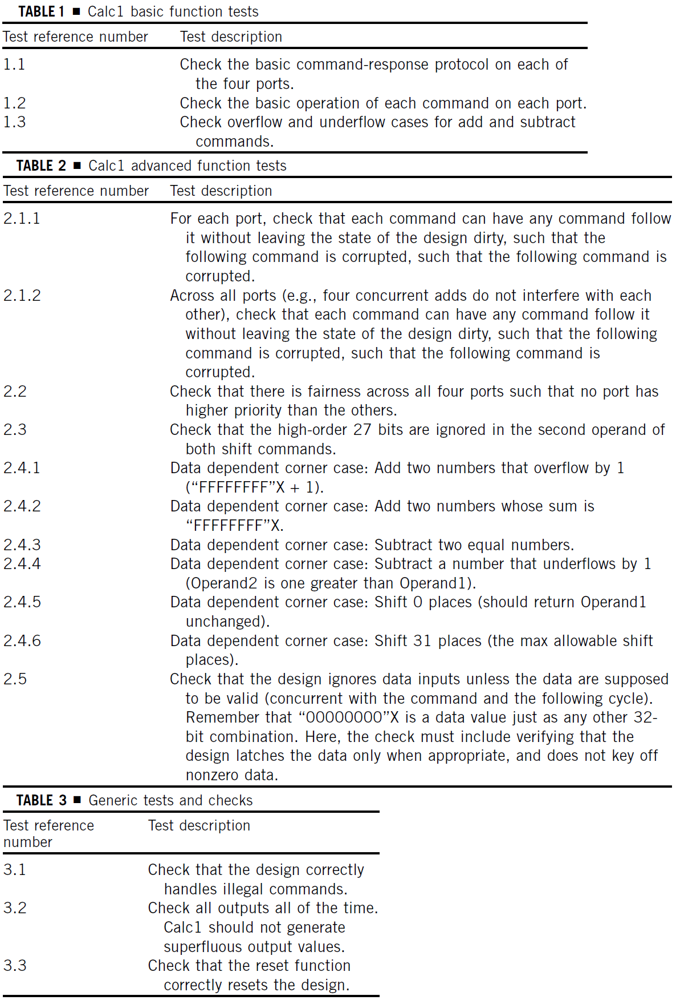
Calc 1: Funkcije za verifikaciju/matrica test slučajeva
Obzirom na jednostavnost Calc1, zajedno ćemo prikazati funkcije koje se verifikuju i test scenarije (matricu test slučajeva), inače odvojene sekcije plana verifikacije
Navodimo detalje u tabeli sa odgovarajućim brojevima referenci koji će se koristiti za referenciranje u planu verifikacije
Već iz opisa Calc1 dizajna, očito je da su neophodni osnovni testovi navedeni u tabeli sa strane
Nakon osnovnih funkcija iz Tabele 1, sledi niz testova sa kompleksnijim scenarijima (Tabela 2)
Konačno, generički testovi i provere koji se mogu naći u sklopu svakog plana verifikacije prikazani su u tabeli 3

Slide 19
Specifični testovi i metode: Okruženje I
Ovaj odeljak pruža detalje u vezi verifikacionih okruženja za svaki nivo verifikacije
Često je korisno dodati i blok dijagram koji prikazuje "univerzum" DUV-a, što predstavlja jednostavan način da se naznače potrebne komponente u okruženju
Opisuje da li će okruženje tretirati DUV kao crnu kutiju, belu kutiju ili sivu kutiju
Takođe pruža specifičnosti u vezi sa strategijom verifikacije, uključujući količinu slučajnosti ili determinizma u simulacionom okruženju
Pored toga, ovaj sekcija verifikacionog plana opisuje i strategiju za proveru
Tim, takođe, treba da dokumentuje kriterijume za izbor između zlatnih vektora, referentnog modela i modela zasnovanog na transakcijama
3

Slide 20
Specifični testovi i metode: Okruženje II (Tipovi verifikacije)
U ovoj sekciji se definiše odabir tretiranja DUV-a kao crne, bele ili sive kutije
Tim bazira svoju odluku na sledećem:
Funkcije koje se verifikuju
Kako je najbolje proveriti interne strukture
Kako se greške mogu manifestovati
Održavanje odabranog modela verifikacije (zapamtiti da pristup "bele kutije" zahteva mnogo više posla, ali će takođe biti u stanju da otkrije veći broj bagova)
Najveći broj okruženja je baziran na "sivoj kutiji", pošto verifikacioni tim najčešće postavlja tačke opservacije u okviru DUV-a kako bi obezbedio posmatranje interesantnih događaja koji mogu nastati tokom simulacije

Slide 21
Specifični testovi i metode: Okruženje III (Strategija verifikacije)
Odabir između determinističke simulacije, bazirana na slučajnim vrednostima (random based) simulacije, ili formalne verifikacije određuje i drugačije zahteve za komponentama verifikacionog okruženja
Verifikacioni tim donosi odluke na osnovu funkcionalnosti DUV-a i dostupnih resursa:
Za jednostavan dizajn sa skromnom funkcionalnošću najbolji je odabir determinističkih testova
Kompleksna funkcionalnost zahteva randomizaciju, jer verifikacioni tim gotovo izvesno ne može prediveti sve permutacije ulaza od značaja
Tim će se opredeliti za formalnu verifikaciju u slučaju malih ali kompleksnih blokova dizajna
Osnovni kriterijum za odluku između simulacije bazirane na slučajnim vrednostima i formalne verifikacije jeste veličina komponente koja se verifikuje (ako može, koristi se formalna verifikacija)
Dok deterministički test pokriva jedan, legalan događaj, kod slučajnih i formalnih pristupa u verifikaciji neophodno je da verifikacioni inženjer eksplicitno onemogući ilegalne stimuluse, a dozvoli sve ostalo

Slide 22
Specifični testovi i metode: Okruženje IV (Randomizacija)
Nekontrolisana randomizacija nije korisna jer na taj način testovi možda neće "pogoditi" interesantne test slučajeve i, kao rezultat, mogu rezultovati detekcijom nepostojećih grešaka u dizajnu
Sa druge strane, nedostatak randomizacije može sprečiti "pogađanje" svih interesantnih test slučajeva
Stoga, najkorisnija je, zapravo, kontrolisana i adekvatno ograničena randomizacija, eventualno sa mogućnošću kompletnog isključenja randomizacije, po potrebi
Nasumična okruženja mogu zahtevati dodatne specijalizovane tzv. mikro-modove kako bi se izbegle greške vezane za arhitekturu ili kako bi se kreirao neki poznat scenario
Takav mikro-mod bi omogućio verifikacionom inženjeru da umetne determinističke sekvence u okviru inače randomizovanog okruženja (npr jedan od validnih kodova operacije u okviru randomizovane instrukcije)

Slide 23
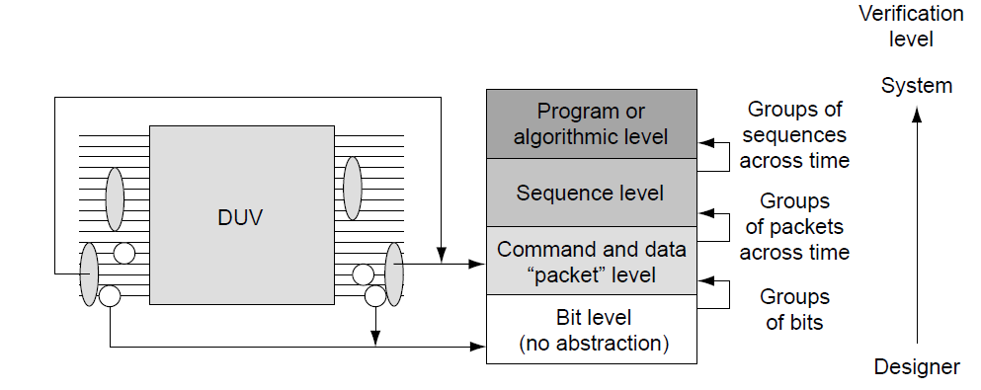
Specifični testovi i metode: Okruženje V (Nivo abstrakcije)
Nivo abstrakcije diktira kako verifikaciono okruženje upravlja tokovima kontrolnih bita i bita podataka
Na slici desno su prikazani različiti nivoi apstrakcije
Iznad nivoa bita, ulazi i izlazi se "grupišu" kako bi sačinjavali smislene komande ili pakete podataka
Komponente kreiraju sekvence spajanjem više paketa zajedno kako bi sačinjavali funkciju
Nekoliko sekvenci čine program ili implementaciju algoritma
Često, izbor nivoa abstrakcije je usaglašen sa trenutnim verifikacionim nivoom
Na nivou dizajnera koriste se tokovi bita za verifikaciju jednostavnih blokova
Na nivou jedinice ili čipa, verifikacioni inženjeri tipično koriste pakete ili sekvence kao nivo apstrakcije
Apstrakcija na nivou programa se retko koristi na nivoima nižim od nivoa sistema

Slide 24
Specifični testovi i metode: Okruženje VI (Provera)
Strategija provere se određuje na osnovu izbora tipa verifikacije (crna kutija, bela kutija, siva kutija), strategije generisanja stimulusa tokom verifikacije i korišćenog nivoa apstrakcije
Vrsta stimulusa (deterministički naspram slučajno generisanog) određuje izbor između zlatnih vektora (det.) i referentnog modela ili provere zasnovane na transakcijama (sluč.)
Raspoloživost resursa će takođe uticati na odluku, posebno ako se bira između referentnog modela tačnog na nivou ciklusa i provere zasnovane na transakcijama
Verifikacioni tim može detaljno opisati i podatke sadržane u okviru tabele rezultate u ovoj sekciji verifikacionog plana
Neophodno je razumeti koje informacije će se pratiti globalno, širom okruženja, a koje će se pratiti korišćenjem lokalnih monitor komponenti

Slide 25
Calc1: Okruženje I
Tip verifikacije: Crna, bela ili siva kutija
Verifikacioni inženjer može verifikovati sve funkcionalnosti navedene ranije dovođenjem odgovarajuće pobude na ulazima i proverom odgovarajućih izlaza. Ovo daje indikaciju da je pristup crne kutije adekvatan za verifikaciju Calc1 modula
Ipak, komponente za proveru postavljene na odgovarajućim internim funkcionalnostima mogu da dovedu do bržeg pronalaska greške. Ovo bi, na primer, bila provera koja prati rad internog reda (ili steka) bloka za prioritizaciju. Na ovaj način bi se moglo proveriti da je svaka komanda korektno tretirana od strane dizajna (stavke 2.1 sa liste funkcija koje treba verifikovati)
Dodatno, okruženje bi trebalo da proveri fer prioritizaciju komandi od strane bloka za prioritizaciju operacija (stavka 2.2 sa liste funkcija koje treba verifikovati).
Ove komponente provere daju indikaciju da bi pristup baziran na sivoj kutiji bio adekvatniji
Dakle, sve stimulus komponente će pobuđivati ulaze dizajna, a većina monitora će pratiti signale na izlazima čipa, dok će određeni broj komponenti za proveru biti postavljen na internoj logici

Slide 26
Specifični testovi i metode: Okruženje II
Strategija verifikacije
Deterministički, randomizovani testovi i formalna verifikacija dolaze u obzir za Calc1
Međutim, formalna verifikacija bi mogla imati problem sa proverom korektnih 32-bitnih ALU rezultata
Kompletno randomizovano okruženje je verovatno nepotrebno za ovako jednostavan dizajn, obzirom na činjenicu da je broj potrebnih test slučajeva potrebnih za verifikaciju funkcionalnosti ograničen
Stoga, za Calc1 dizajn, biće korišćena deterministička verifikacija
Kontrola randomizacije
Obzirom na to da se koriste deterministički testovi, ovo postaje irelevantno
Prilikom kreiranja test slučajeva, ulazni podaci i očekivani izlazi se upisuju direktno u test

Slide 27
Specifični testovi i metode: Okruženje III
Nivo apstrakcije
Nivo apstrakcije zavisi od jezika u kojem se kreira test slučaj
Ako infrastruktura omogućava, pobuđivanje Calc1 korišćenjem paketa je optimalno za brzo kodiranje test slučajeva
Slika dole prikazuje primer test slučaja u kojem je korišćena sintaksa na nivou paketa
U ovoj sintaksi, okruženje obavlja više zadataka:
Prvi je translacija komande u odgovarajuće bite (npr ADD = “0001”b).
Sledeći zadatak je pobuđivanje ulaznih signala na bit-nivou na ulazima Calc1 dizajna
Takođe, potrebno je sačekati validan odgovor od strane dizajna pre nego što se pošalje nova komanda na isti port
Na kraju, potrebno je voditi računa o reset logici i dovođenju odgovarajućeg takt signala
Napredno Calc1 verifikaciono okruženje bi omogućilo i predviđanje očekivanih rezultata. Ukoliko se koristi referentni model koji predviđa odgovor i rezultate, inženjer koji kreira testove ne mora „ručno“ da računa izlaze za date ulaze
4
Notes:
The syntax in the figure is very convenient, as the infrastructure that reads and manages the test case handles many mundane tasks, allowing the test case writer to focus on the intent of the test case. In the syntax, the infrastructure environment manages multiple tasks for the test case writer. The first task for the infrastructure is translating the actual command decode values to bits (e.g., ADD = “0001”b). This has a potentially huge added benefit: if the designer ever changes the decode value of the ADD operand (e.g., ADD = “1001”b), all that is required in the environment is a simple modification to the infrastructure. If, instead, the verification engineer codes the operand decode values in the test case itself, then the team must change every test case with the ADD command. The same is true for the encoding of the response value.
The next task for the infrastructure is driving the bit-level values into the Calc1 design. The infrastructure knows to place the operand1 data value on the bus concurrent with the command and to send operand2 data the next cycle.
The infrastructure design also waits for the valid response. The test case writer cannot predict when the response will come back, so the infrastructure waits for the response event and checks the value when it finally appears on the outputs. This enables the next infrastructure task to send the next command to the port when the port becomes available. In the sample test case of bottom figure, there are two commands destined for Port 1. The protocol states that only one command may be outstanding at a time on a given port. Therefore, the infrastructure can send the first two commands concurrently (to Port1 and Port2) but must wait for the ADD on Port 1 to finish before initiating the SUB. Without an infrastructure, sending multiple commands to the same port is a very tedious task involving trial and error.
The infrastructure will also take care of resetting the logic and driving the clocks. The infrastructure automatically raises the reset line for seven cycles as required at the beginning of every test case, thus circumventing the need to articulate the reset in every test case. The infrastructure also drives the clocks to the correct values. An even more robust infrastructure might further simplify the test case writing task by including other advanced aspects of verification stimulus generation and checking.
An advanced Calc1 verification environment would include data prediction. If the infrastructure included a golden model that predicts the result and response fields, it frees the test case writer from having to “do the math.”
Further functions in an advanced verification environment include generation of random operand data. If desired, the syntax of the test case allows the writer to replace an operand data value with the keyword “random,” which tells the packet generator to pick a random number value. This requires data prediction capabilities in the infrastructure. The test case writer maintains deterministic control over the command selection and flow of the test case, but optionally can allow the infrastructure to choose values.

Slide 28
Zahtevi u vezi pokrivenosti
Pokrivenost je mehanizam povratnih informacija koje procenjuju kvalitet komponenti za generisanje stimulusa u verifikacionom okruženju. Kao što verifikaciono okruženje vrši „kontrolu kvaliteta“ DUV-a, pokrivenost vrši kontrolu kvaliteta verifikacionog okruženja
Ovaj odeljak verifikacionog plana opisuje predviđene ciljeve stimulusa komponenti. Ciljevi treba da pokriju sve funkcionalne zahteve u vezi stimulusa i da osiguraju da stimulus generatori u okruženju rade upravo ono što je potrebno
Ciljevi pokrivenosti mogu uključivati sledeće:
Okruženje je proverilo sve vrste komandi i transakcija
Stimulus je kreirao specifične ili podataka iz šireg opsega
Okruženje ima podršku za višestruki konkrurentni stimulus (sve dok je on legalan)
Inicijatori i odzivnici su namerno injektovali greške u DUV
Takođe, dobra praksa je da se obezbedi povratna informacija u vezi pokrivenosti svih komponenti provere u okruženju, kako bi se verifikovalo da su se sve provere izvršile (% izvršenog koda komponenti provere)
Svaka neizvršena provera ukazuje na nedostatak ili u stimulus komponentama ili u samom verifikacionom planu

Slide 29
Potrebni alati
Ova sekcija sadrži listu softverskih alata (po potrebi i hardverskih mašina za simulaciju) neophodih za ispunjenje plana. Neki od primera bi bili:
Simulacioni alati bazirani na događajima za jedinice
Simulacioni alati na nivou ciklusa za čipove
Alati za formalnu verifikaciju
Alati za rad sa tvrdnjama (assertions)
Debageri
Hardver za emulaciju
Hardver za akceleraciju
Softver za ko-simulaciju
Verifikacioni jezici visokog nivoa (High-level verification languages HVLs)
Biblioteka funkcija
Dobro predviđanje potrebnih alata je značajno jer ono ima značajan uticaj na resurse i, generalno, trošak
Novi ili drugačiji alati zahtevaju više resursa ili vode ka probijanju rokova planiranog rasporeda, obzirom na to da tim zahteva vreme kako bi ovladao njima
Navođenje alata u planu takođe je važno i zbog eventualnih potreba za nabavkom od EDA (Electronic Design Automation) dobavljača, kao i procene troška korišćenih simulatora
Notes:
In some companies, a concrete verification methodology exists, and this section is predetermined. In these cases, the verification plan follows the current methodology, including the default toolset.
There are instances in which a deviation is required from the default toolset. For example, if a system-level simulation environment involves a chip verified separately under a different methodology or toolset, the team may need additional tools to bridge the environments. It might follow then that the team needs a co-simulation environment. Co-simulation occurs when the team verifies diverse source code or methodologies at once. This could be between VHDL and Verilog, or it might be between two different HVLs - Specman e, SystemC, and/or Vera.

Slide 30
Rizici i zavisnosti I
Ovaj odeljak verifikacionog plana identifikuje kritične rizike i zahteve za isporuku koje menadžment projekta mora da prati do njegovog završetka
Složenost današnjih dizajna sama po sebi sadrži rizike verifikacije. Tim za verifikaciju zavisi od drugih timova koji mu isporučuju informacije, alate, specifikaciju funkcionalnosti i intelektualnu svojinu kako bi se postigao uspeh. Uloga ovog odeljka je da artikuliše ove stavke
Tim za verifikaciju upravlja rizicima fokusirajući se na njihovo izbegavanje i kreirajući planove za nepredviđene situacije. Na primer, postoje rizici povezani sa zavisnošću od novog alata:
kašnjenja u isporuci i pokretanju (npr. kašnjenje prilikom isporuke ili neispravna funkcionalnost),
Integracija sa postojećim alatima,
Izazovi u vezi sa edukacijom,
Plan za nepredviđene situacije može da sadrži alate za bekapovanje ili rani test prihvatljivosti koji određuje da li će se novi alat uopšte koristiti
Notes:
This section of the verification plan identifies critical threats to success and delivery requirements that project management needs to track to closure. The complexity of today’s designs inherently contains verification risks. The verification team depends on other teams to deliver information, tools, function, and intellectual property in order to achieve success. This section articulates these items.
The verification team manages risk through focusing on avoidance and by creating contingency plans. For instance, there are risks associated with dependence on a new tool: delivery and start-up delays (e.g., late delivery or nonworking functions), integration with established tools, and educational challenges. Contingency plans might consist of using a backup tool or creating an early acceptance test for the tool.
Dependencies range from on-time HDL deliveries to availability of tools and technology. HDL deliveries may come in regularly scheduled packages, in which the design team delivers basic function first, followed by further, more complex functions. The verification team must plan their work based on these deliveries, so the plan must articulate this dependency.
The verification team should highlight the dependency and risks during the initial plan review, thus driving overall acknowledgement of these items and discussion of possible risk mitigation actions.
In a complex design project, there are common risks and dependencies. One of the most common risks in a large design project is the reliance on a separate verification team, such as a local team or an intellectual property (IP) vendor (in a system-on-a-chip design), to pre-verify a lower-level core before chip- or system-level verification. Receiving a release of a poorly verified core likely leads to debugging a unit-level bug at the system level. In these situations, pinpointing the bug is much more difficult or even impossible.
As mentioned above, new tools and new versions of current tools add risk to a project. Problems include occasions when the tool is not available when promised, when quality defects in the tool slow the pace of the verification effort, or when the promised functionality of the tool is not delivered. Worse yet, a new tool, advertised as a seamless integration effort, might end up requiring months of environment changes. Many groups have a tool freeze within a project. This is a point after which the team will not entertain new tools (or revisions of tools) because of the risk associated with changes.
Architecture closure is a common risk and dependency item. As mentioned before, the design team rarely supplies the complete and final specification before the start of verification. This is both a dependency and a risk. The team requires closure of architectural items by specific dates in order to meet the schedule. However, the team also runs the risk that they need to overhaul their verification environment because the early assumptions prove to be invalid.
A final common risk and dependency is having the available resources to complete the work on schedule. There may be a unique resource requirement that needs to be listed (e.g., people, machines, licenses). For instance, there may be contention among multiple projects for specific simulation hardware such as emulators. In another case, the verification plan will assume a certain daily simulation cycle throughput during the early phases of the design right through the regression phase. The simulation engines and licenses must be available to meet this throughput.

Slide 31
Rizici i zavisnosti II
Kada govorimo o zavisnostima, one se mogu odnositi na zavisnost od isporuke HDL modela na vreme ili dostupnost potrebnih alata i tehnologija
Isporuka HDL modela se tipično vrši u skladu sa unapred zakazanim terminima, u kojima dizajn tim najpre isporučuje modele koji sadrže osnovnu funkcionalnost, a kasnije složenije i složenije funkcionalnosti
Verifikacioni tim mora da planira svoje aktivnosti u skladu sa tim isporukama, tako da sve te zavisnosti moraju jasno biti artikulisane u verifikacionom planu
Tipične zavisnosti i rizici su:
Oslanjanje na zaseban verifikacioni tim, bilo da je u pitanju drugi interni tim, ili od dostavljača intelektualne svojine (IP) kako bi se obavila verifikacija na nivou jezgra pre nego što se pređe na verifikaciju čipa ili sistema
Problemi sa novim alatima: isporuka i kašnjenje pri pokretanju alata, integracija sa postojećim alatima --→ zamrzavanje alata“ (tool freeze) u okviru projekta, izazovi u vezi sa edukacijom → Obuka i podrška
Zatvaranje arhitekture (Architecture closure) – dizajn tim retko obezbeđuje kompletnu i finalnu specifikaciju pre starta verifikacije, što je istovremeno i zavisnost i rizik
Dostupnost resursa kako bi se posao završio na vreme
Notes:
This section of the verification plan identifies critical threats to success and delivery requirements that project management needs to track to closure. The complexity of today’s designs inherently contains verification risks. The verification team depends on other teams to deliver information, tools, function, and intellectual property in order to achieve success. This section articulates these items.
The verification team manages risk through focusing on avoidance and by creating contingency plans. For instance, there are risks associated with dependence on a new tool: delivery and start-up delays (e.g., late delivery or nonworking functions), integration with established tools, and educational challenges. Contingency plans might consist of using a backup tool or creating an early acceptance test for the tool.
Dependencies range from on-time HDL deliveries to availability of tools and technology. HDL deliveries may come in regularly scheduled packages, in which the design team delivers basic function first, followed by further, more complex functions. The verification team must plan their work based on these deliveries, so the plan must articulate this dependency.
The verification team should highlight the dependency and risks during the initial plan review, thus driving overall acknowledgement of these items and discussion of possible risk mitigation actions.
In a complex design project, there are common risks and dependencies. One of the most common risks in a large design project is the reliance on a separate verification team, such as a local team or an intellectual property (IP) vendor (in a system-on-a-chip design), to pre-verify a lower-level core before chip- or system-level verification. Receiving a release of a poorly verified core likely leads to debugging a unit-level bug at the system level. In these situations, pinpointing the bug is much more difficult or even impossible.
As mentioned above, new tools and new versions of current tools add risk to a project. Problems include occasions when the tool is not available when promised, when quality defects in the tool slow the pace of the verification effort, or when the promised functionality of the tool is not delivered. Worse yet, a new tool, advertised as a seamless integration effort, might end up requiring months of environment changes. Many groups have a tool freeze within a project. This is a point after which the team will not entertain new tools (or revisions of tools) because of the risk associated with changes.
Architecture closure is a common risk and dependency item. As mentioned before, the design team rarely supplies the complete and final specification before the start of verification. This is both a dependency and a risk. The team requires closure of architectural items by specific dates in order to meet the schedule. However, the team also runs the risk that they need to overhaul their verification environment because the early assumptions prove to be invalid.
A final common risk and dependency is having the available resources to complete the work on schedule. There may be a unique resource requirement that needs to be listed (e.g., people, machines, licenses). For instance, there may be contention among multiple projects for specific simulation hardware such as emulators. In another case, the verification plan will assume a certain daily simulation cycle throughput during the early phases of the design right through the regression phase. The simulation engines and licenses must be available to meet this throughput.

Slide 32
Zahtevi za resursima I
Sa postavljenim arhitekturom okruženja i scenarijima testiranja, tim može da proceni svoje potrebe za resursima
Procena ljudskih resursa varira u zavisnosti od tipa okruženja i iskustva pojedinaca:
Okruženje sa komponentama provere baziranim na referentnim modelima zahteva više ljudi za implementaciju, ali njihova preciznost i poboljšane mogućnosti za provere opravdavaju ulaganje
Ipak, rešenja koja su manje zahtevna u pogledu resursa, kao npr. provera sa modelima na bazi transakcija može biti takođe adekvatna
Iskusni verifikacioni inženjer će trebati manje vremena ne samo za kodovanje, već i za debagovanje okruženja
Vođe timova za verifikaciju alociraju resurse po svim nivoima verifikacione hijerarhije, počevši od najnižih nivoa definisanih planom:
Više okruženja postoji na nižim nivoima verifikacije, a manje resursa se alocira po okruženju na tim nižim nivoima
Manje ljudskih resursa je potrebno za verifikaciju na nivou jedinica nasuprot verifikaciji na nivou sistema
Tipično, jedan verifikacioni inženjer će razvijati sve stimulus komponente na nivou jedinica, dok će drugi inženjer biti zadužen za razvoj čekera za tu jedinicu
Za kompleksne čipove ili sisteme, preveliki je broj interfejsa za jednog verifikacionog inženjera koji bi razvijao bilo stimulus komponente bilo čekere. Stoga, tim će podeliti njihov razvoj na više inženjera, na razuman način
Notes:
People resource estimates vary based on the type of environment and the experience of the individuals. Reference model checking environments will require more people to implement, but their accuracy and checking capabilities are often worth the investment. However, less resource-intensive solutions such as transaction-based checking may be adequate. Experienced verification engineers will require less time to code and debug the environment. Time should be planned for review of the verification components for all portions of the code, paying special attention to the code of inexperienced verification engineers.

Slide 33
Zahtevi za resursima II
Potrebni resursi uključuju ne samo ljude, već i računarske resurse i licence
Procena potrebnih računarskih resursa vrši se na osnovu trajanja jednog test scenarija i procenjenog broja testova koji će se pokrenuti tokom celog ciklusa verifikacije
Ovi brojevi treba da budu u skladu sa vremenom i računarskim resursima dostupnim za projekat (ograničavajući faktor mogu biti centralne procesorske jedinice ili licence dostupne na projektu), što može dovesti do zahteva za dodatnim računarskim resursima ili licencama
Prilikom odlučivanja o dužini testova, treba imati na umu da dugi testovi mogu pokriti zanimljivije DUV scenarije, ali ih je teže debagovati u slučaju da dođe do greške
U tom smislu, može biti korisnije imati više manjih testova, fokusiranih i jednostavnijih za debagovanje, umesto nekoliko dugačkih
Notes:
People resource estimates vary based on the type of environment and the experience of the individuals. Reference model checking environments will require more people to implement, but their accuracy and checking capabilities are often worth the investment. However, less resource-intensive solutions such as transaction-based checking may be adequate. Experienced verification engineers will require less time to code and debug the environment. Time should be planned for review of the verification components for all portions of the code, paying special attention to the code of inexperienced verification engineers.

Slide 34
Detalji rasporeda I
Poslednji deo planiranja verifikacije odnosi se na dokumentovanje vremenskih rokova za svaku od verifikacionih aktivnosti
Prvi korak je kreiranje rasporeda na visokom nivou, pre nego što se popune detalji. To podrazumeva isporučivanje specifikacije na početku i završava se sa isporučivanjem čipa na proizvodnju
Za svaki nivo hijerarhije, ovaj raspored na visokom nivou treba da sadrži razvoj verifikacionog okruženja, debagovanje HDL-a i fazu regresije
Ključna stavka u rasporedu je prva isporuka HDL-a verifikacionom timu
HDL isporuka sadrži dovoljno HDL-a koji izvršava specifične DUV funkcionalnosti
Tipično, postojaće više ovakvih HDL isporuka tokom razvojnog ciklusa: ovo omogućava verifikacionom timu da napreduje sa osnovnim funkcijama dok HDL dizajneri rade na kompleksnim i sekundarnim funkcionalnostima
Ovaj paralelizam može skratiti vremenske rokova
Ali, sa druge strane, on zahteva od HDL dizajnera da balansiraju svoje vreme između razvoja novog HDL-a i ispravljanja novo otkrivenih verifikacionih bagova prethodno isporučenog koda
Notes:
Previous sections of the plan cover the verification of the many different levels of hierarchy and the proposed environments for each. The final portion of verification planning is to document the timeline for each of the verification activities.
As the team creates the schedule details, they must consider all of the other sections of the verification plan. However, the resource section is the most tightly coupled to the schedule details section because the available resources have a direct and obvious impact on schedule. More resources will improve the schedule, and less resources will extend the schedule.
The schedule includes both deliveries to the verification team and verification work items. The first step is to create a high-level schedule before filling in the details. The high-level schedule follows the first half of the verification cycle. It starts with a delivery of the specification and completes with chip release(s) to manufacturing. For each level of the hierarchy, the high-level schedule includes the development of verification environments, the debugging of the HDL, and the regression stage.
A key delivery in the schedule is the first drop of HDL to the verification team. An HDL drop consists of enough HDL to perform specific DUV functions. Often, there are multiple drops of HDL in the development cycle. Staggering the drops allows the verification team to make progress on basic functions while the HDL designers work on complex and secondary functions. This parallelization can streamline the schedule; however, it will force the HDL designers to balance their time between creating new HDL and fixing newly discovered verification bugs in previous drops.
The verification leaders must estimate how long it will take to create the basic verification environment. In most cases, this time is closely aligned with how long it takes the designers to create the first HDL delivery. The second time estimate is the duration of the debug portion of the schedule, which begins after the initial delivery of environment and HDL. The estimated duration of this portion of the schedule is based on how long it should take to run through the test matrix. The estimate must account for further HDL delivery dates as well. The remaining timeframe before the chip release to manufacturing is set aside for regression.
Top figure shows the format of the high-level schedule. In this example, the team chose to execute three levels of functional verification: unit, chip, and system. Verification engineers have singled out four units across three chips for unit simulation environments.
Verification proceeds from the lowest level of the hierarchy (in this case, unit level) to the highest. Unit verification precedes chip level, which then precedes system level. Chip-level verification should not start until after the verification of substantial function at unit level. Similarly, system level cannot begin until all three chips have demonstrated solid functionality.
The schedule must allow enough time for each level of hierarchy to test the function before the next level starts. This ensures that the verification team will find bugs at the lowest level possible, easing the debugging burden and capturing bugs at the earliest point in the schedule. A good practice is to start the next level of verification when the bug rate from the lower level has dropped. This ensures that the resources stay focused on the most productive verification level. Bottom figure shows a sample bug curve that results when the team follows the schedule guidelines.

Slide 35
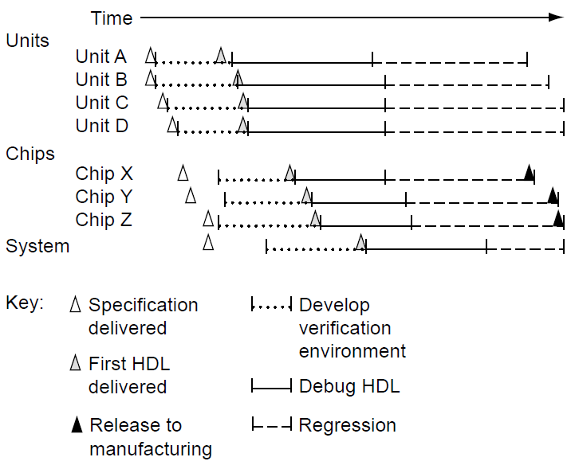
Detalji rasporeda II
Vođe tima estimiraju koliko vremena je potrebno da se razvije osnovno verifikaciono okruženje. Najčešće, ovo vreme je direktno zavisno od toga koliko je vremena potrebno dizajnerima za prvu HDL isporuku
Druga procena vremena se odnosi na trajanje debagovanja, aktivnosti koja počinje čim su dostupni verifikaciono okruženje i HDL
Procenjeno trajanje ovog dela rasporeda se bazira na tome koliko vremena je potrebno da se prođe kroz kompletnu matricu test slučajeva, ali ono mora da uzima u obzir i trenutke isporuke preostalog HDL-a
Svo preostalo vreme pre predaje čipa proizvodnji se ostavlja za regresione testove
Raspored mora ostaviti dovoljno vremena za testiranje funkcionalnosti na svakom od nivoa verifikacione hijerarhije, pre nego što započne testiranje na narednom nivou
Dobra je praksa da se krene sa narednim nivoom verifikacije onog trenutka kada stopa detekcije bagova na prethodnom krene da opada. Ovo omogućava da fokus svih resursa ostane na najproduktivnijem verifikacionom nivou
Raspored na visokom nivou pokazuje prvu polovinu verifikacionog ciklusa. Glavne kontrolne tačke su isporuka dizajna, razvoj okruženja, debagovanje i regresija
Notes:
Previous sections of the plan cover the verification of the many different levels of hierarchy and the proposed environments for each. The final portion of verification planning is to document the timeline for each of the verification activities.
As the team creates the schedule details, they must consider all of the other sections of the verification plan. However, the resource section is the most tightly coupled to the schedule details section because the available resources have a direct and obvious impact on schedule. More resources will improve the schedule, and less resources will extend the schedule.
The schedule includes both deliveries to the verification team and verification work items. The first step is to create a high-level schedule before filling in the details. The high-level schedule follows the first half of the verification cycle. It starts with a delivery of the specification and completes with chip release(s) to manufacturing. For each level of the hierarchy, the high-level schedule includes the development of verification environments, the debugging of the HDL, and the regression stage.
A key delivery in the schedule is the first drop of HDL to the verification team. An HDL drop consists of enough HDL to perform specific DUV functions. Often, there are multiple drops of HDL in the development cycle. Staggering the drops allows the verification team to make progress on basic functions while the HDL designers work on complex and secondary functions. This parallelization can streamline the schedule; however, it will force the HDL designers to balance their time between creating new HDL and fixing newly discovered verification bugs in previous drops.
The verification leaders must estimate how long it will take to create the basic verification environment. In most cases, this time is closely aligned with how long it takes the designers to create the first HDL delivery. The second time estimate is the duration of the debug portion of the schedule, which begins after the initial delivery of environment and HDL. The estimated duration of this portion of the schedule is based on how long it should take to run through the test matrix. The estimate must account for further HDL delivery dates as well. The remaining timeframe before the chip release to manufacturing is set aside for regression.
Top figure shows the format of the high-level schedule. In this example, the team chose to execute three levels of functional verification: unit, chip, and system. Verification engineers have singled out four units across three chips for unit simulation environments.
Verification proceeds from the lowest level of the hierarchy (in this case, unit level) to the highest. Unit verification precedes chip level, which then precedes system level. Chip-level verification should not start until after the verification of substantial function at unit level. Similarly, system level cannot begin until all three chips have demonstrated solid functionality.
The schedule must allow enough time for each level of hierarchy to test the function before the next level starts. This ensures that the verification team will find bugs at the lowest level possible, easing the debugging burden and capturing bugs at the earliest point in the schedule. A good practice is to start the next level of verification when the bug rate from the lower level has dropped. This ensures that the resources stay focused on the most productive verification level. Bottom figure shows a sample bug curve that results when the team follows the schedule guidelines.

Slide 36
Calc1: Potrebni alati, rizici i zavisnosti
Od alata, za verifikaciju Calc1 potreban je jedan simulator (sa odgovarajućom licencom) i softver sa mogućnošću prikaza vremenskih dijagrama (waveform viewer), kao i dostupnost jezika ili infrastrukture u kojima se mogu opisivati test slučajevi
Oni moraju komunicirati sa simulatorom, u smislu pobuđivanja ulaza, provere izlaza i taktovanja dizajna koji se simulira
Ovaj jednostavan primer nema rizike koje bi trebalo posebno razmatrati
Notes:
In a larger project with a more complex design, there might be risks inherent in the delivery of the specification of esoteric operations (e.g., binary floating point) or in the ability to verify the design in a short schedule.
If Calc1 were part of a large system, this section would detail schedule integration factors. The system-level verification cycle depends on the correctness of the Calc1 function so that broader system integration verification can occur without being concerned with the quality of the add, subtract, or shift functions.
The Calc1 exercise also depends on the delivery of the specification (which was delivered above) and availability of the required tools. To perform this exercise, you will need the required tools as documented in the previous section of the verification plan.

Slide 37
Calc1: Blok dijagram okruženja
Parser test slučajeva čita komande u tekstualnom obliku i konvertuje ih u pakete koje će koristiti stimulus inicijator
Inicijator prosleđuje pakete modelu, na odgovarajućem portu, vršeći konverziju apstraktnih paketa u niz bita koji se prosleđuju dizajnu
Kada inicijator pošalje paket sa podacima, ista ta komanda se prosleđuje i tabeli rezultata, koja vodi računa o komandama koje se trenutno izvršavaju od strane Calc1 simulacionog modela.
Kako Calc1 simulacioni model završi komandu, izlazna komponenta provere preuzima očekivani odgovor od strane tabele rezultata kako bi uporedila primljeni i očekivani odgovor
Ukoliko se bilo odgovor, bilo rezultati, ne podudaraju, izvršavanje testa se prekida, a komponenta provere raportira grešku, očekivane i dobijene podatke
Notes:
Figure on the right shows the high-level view of the components in the infrastructure. The test case parser reads the text-based commands from the test case and converts them into packet structures for the stimulus initiator.
The initiator passes the packets into the model on the designated port, performing the packet to bit-stream conversion. Each command packet requires two cycles to transmit into the Calc1 simulation model as dictated by the design’s specification. The stimulus initiator can multiplex across all four ports, sending simultaneous or staggered commands based on the test case. When the interface driver transmits a command packet, it also posts the command to a scoreboard, which keeps track of commands currently under execution by the Calc1 simulation model. As the Calc1 simulation model completes commands, the output checker pulls the expected response and expected data from the scoreboard for comparison to the actual response. If there is a response or data mismatch, the test case execution ceases and the output checker records both the error and the actual versus expected data. Otherwise, the output checker removes the command from the scoreboard, indicating that the stimulus initiator may dispatch a new packet to that port. When the stimulus initiator transmits all of the test case packets and the checker receives all responses, the test case ends successfully. The infrastructure also takes care of the seven-cycle reset sequence as well as driving the clocks into the model.

Slide 38
Calc1: Pokrivenost, zahtevi za resursima, detalji rasporeda
Cilj u vezi pokrivenosti za Calc1 je baziran na funkcijama koje se verifikuju (opisane zasebnom sekcijom), a cilj je da razvijeni testovi kreiraju sve opisane test slučajeve
Ovi ciljevi su jednostavni jer su svi test scenariji koji su planirani potpuno definisani i uobličeni. Međutim, kod robusnih dizajnova, ciljevi u vezi pokrivenosti zahtevaju znatno više napora i znatno su strožiji
Za Calc1, zahtevi za resursima svode se na jednog verifikacionog inženjera. Osim toga, potrebna je jedna radna stanica na kojoj će se pokretati simulacija
Što se tiče rokova za Calc1 oni su prilično predvidivi
U slučaju korišćenja apstrakcije na nivou paketa, Calc1 verifikacioni inženjer zavisi od postojanja kvalitetne infrastrukture koja će podržati takav nivo apstrakcije
Pod uslovom da ona postoji, verifikacioni inženjer bi trebao da završi kompletnu verifikaciju Calc1 dizajna za jedan radni dan
Tipično, ipak, on mora da kreira odgovarajuću infrastrukturu, ili da barem prilagodi već postojeću u skladu sa dizajnom koji se verifikuje. U tom slučaju, dodatno vreme se mora uzeti u obzir prilikom kreiranja plana
Notes:
Although there is a detailed explanation of coverage and coverage tools in one of upcoming lectures, the fundamental notion of coverage is to provide feedback and confirmation of what the verification environment has exercised in the DUV. Coverage feedback provides the verification engineer with insight into the actual data of what the test case has done. This data will show either that the test case has met its intent or that the test case failed to exercise the intended function or scenario within the design. For example, in the functions to be verified section of the verification plan, test reference number 2.1.1 calls for tests that verify that each command can follow any other command on each port. This statement stipulates a series of 16 pairs of commands on each port for a total of 64 different test scenarios. Coverage feedback will track which of the 64 sequences the test cases have completed.

Slide 39
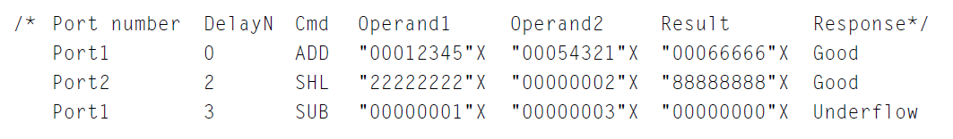
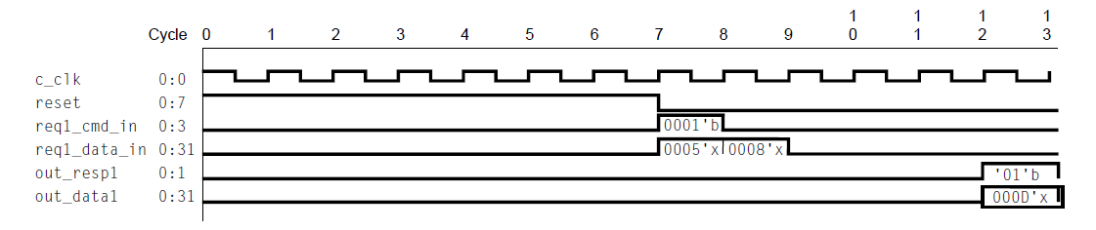
Ažurirana sintaksa test slučajeva i vremenski dijagram test slučaja 1.1.1

Slide 40
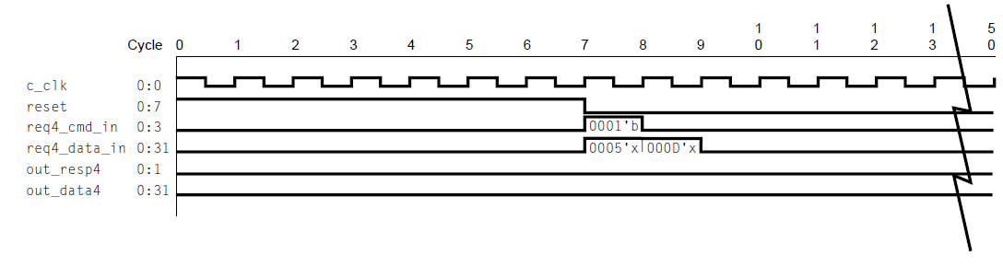
Test slučaj 1.1.4 sa greškom (ADD komanda na portu 4)

Slide 41
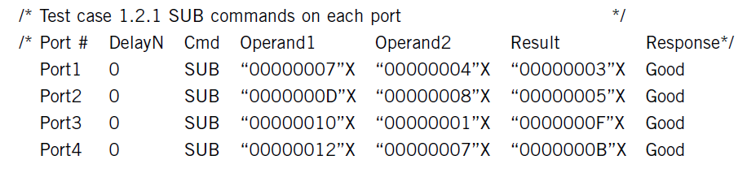
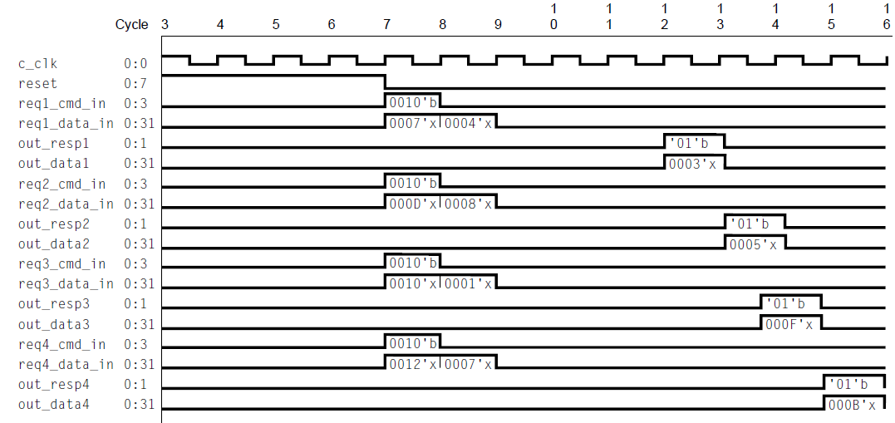
Test slučaj 1.2.1 (SUB komanda na svakom portu)

Slide 42
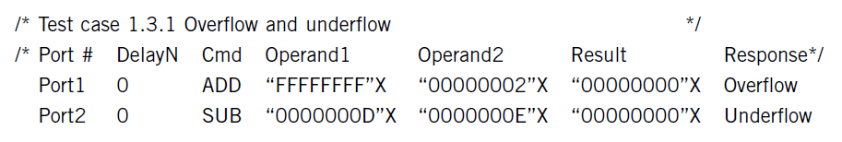
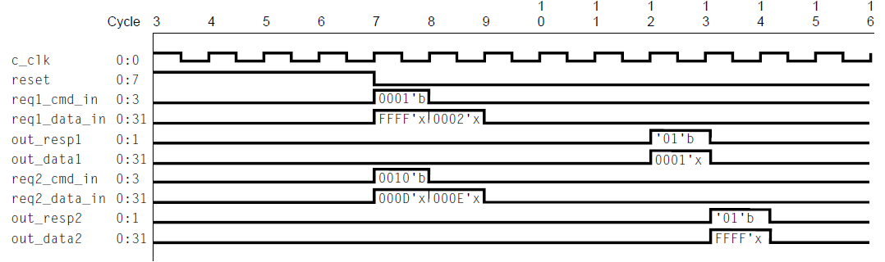
Test slučaj 1.3.1 sa greškom (over/underflow)
5

