Slide 1
Funkcionalna verifikacija hardvera
Predavanje III

Slide 2
Lecture Content
The Verification Plan
  Contents of the verification plan
  Verification plan example

Slide 3
The Verification Plan
Introduction

Slide 4
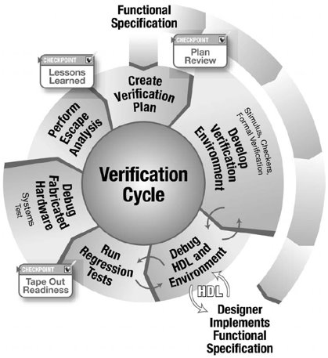
The Verification Plan
The verification plan is a decisive factor for success.
It defines both the functions that the verification team must attack and how they will do their work.
As the first step in the verification cycle, the team derives the entire verification effort from this document.
This document is a living document, owned by the entire design team, not by any one person and not by the verification team alone.

Slide 5
The Functional Specification I
The source of the plan is the functional intent and specification.
The verification engineer must first understand the design under verification (DUV) before determining how to verify it.
The specification is the driving vehicle for this; it becomes the “law”.
Many times, discrepancies arise between verification and design (these manifest themselves as testcase miscompares).
In these cases, the team will refer to the specification for the correct behavior.
Notes:
The source of the plan is the functional intent and specification. The verification engineer must first understand the design under verification (DUV) before determining how to verify it. The specification is the driving vehicle for this; it becomes the “law.” Many times, discrepancies arise between verification and design (these manifest themselves as testcase miscompares). In these cases, the team will refer to the specification for the correct behavior.
However, discrepancies can often occur when the specification is unclear or ambiguous on a technical matter. If two people read the same specification issue and interpret it differently, then the specification has a problem. Because the specification is the law, the team must settle the discrepancy. It is a simple matter of going back to the architect and having the intent clarified.
The specification and verification plan are not “gentleman’s agreements,” as both items must exist in written form and apply to the current project. It is not acceptable to use a previous version of the verification plan and specification on a new version of a design. These documents must evolve with the design: if the project is important enough to create another version, then it is important enough to update both the specification and verification plan to reflect the current changes.
However, the reality is not always so black and white. Often the final specification is not complete until the chip ships to manufacturing or even to the customer. The verification team must use the evolving document as the basis of the plan. Other times, designers have workbooks that evolve into the specification. If this is the current specification, then these workbooks are the basis for the verification plan. However, technical insights that affect the system or chip, such as power-on-reset sequences or chip configuration initializations, may be missing from the workbooks. In these cases, the architect must have input on the function of the design. These cases are suboptimal, but do occur in industry.

Slide 6
The Functional Specification II
But discrepancies can often occur when the specification is unclear or ambiguous on a technical matter
If two people read the same specification issue and interpret it differently, then the specification has a problem. For example:
A response, R, shall occur when A occurs after B or C.
In this case, the specification was unclear. Because the specification is the law, the team must settle the discrepancy
It is a simple matter of going back to the architect and having the intent clarified
Notes:
The source of the plan is the functional intent and specification. The verification engineer must first understand the design under verification (DUV) before determining how to verify it. The specification is the driving vehicle for this; it becomes the “law.” Many times, discrepancies arise between verification and design (these manifest themselves as testcase miscompares). In these cases, the team will refer to the specification for the correct behavior.
However, discrepancies can often occur when the specification is unclear or ambiguous on a technical matter. If two people read the same specification issue and interpret it differently, then the specification has a problem. Because the specification is the law, the team must settle the discrepancy. It is a simple matter of going back to the architect and having the intent clarified.
The specification and verification plan are not “gentleman’s agreements,” as both items must exist in written form and apply to the current project. It is not acceptable to use a previous version of the verification plan and specification on a new version of a design. These documents must evolve with the design: if the project is important enough to create another version, then it is important enough to update both the specification and verification plan to reflect the current changes.
However, the reality is not always so black and white. Often the final specification is not complete until the chip ships to manufacturing or even to the customer. The verification team must use the evolving document as the basis of the plan. Other times, designers have workbooks that evolve into the specification. If this is the current specification, then these workbooks are the basis for the verification plan. However, technical insights that affect the system or chip, such as power-on-reset sequences or chip configuration initializations, may be missing from the workbooks. In these cases, the architect must have input on the function of the design. These cases are suboptimal, but do occur in industry.

Slide 7
The Verification Plan
Contents of the Verification Plan

Slide 8
Contents of the Verification Plan
The verification plan consists of multiple sections, each articulating a critical component of the verification workload. These sections describe both the technical requirements for the verification environments and the project management needs.
The technical requirements of the verification plan fall into the following major headings:
  description of verification levels,
  functions to be verified,
  specific tests and methods,
  coverage requirements, and
  test scenarios (matrix).
These sections describe, in detail, the strategy and construction of the verification environments for the project.
The project management sections of the plan have these major headings:
  required tools,
  risks and dependencies,
  resources requirements, and
  schedule details.
These sections articulate the software, compute hardware, and personnel required to complete the project on the required schedule.

Slide 9
Description of Verification Levels
The verification team’s first decision in verifying a design is to articulate the verification levels.
Depending on the complexity of each level, the verification team must choose to verify levels independently or group levels together into functional components. This decision is based on two factors.
  The first factor is the complexity of the individual component. Complex portions of the DUV require their own verification.
  The second factor is the existence of a clean interface and specification to drive the component. The ability to properly drive interface protocol and check for results is the key to verification and requires a stable, documented interface.
After defining the verification levels, the verification team will create verification plans for each level.
The following slides describe the components of a verification plan needed for each level.
Notes:
The verification team’s first decision in verifying a design is to articulate the verification levels. As described earlier, a system may contain multiple levels of design hierarchy. Depending on the complexity of each level, the verification team must choose to verify levels independently or group levels together into functional components.
The verification team bases their decision to group components together or to first verify some (or each) components independently on two factors. The first factor is the complexity of the individual component. Complex portions of the DUV require their own verification. Proper verification on complex functions usually requires a high level of control and observability. Conversely, the verification team may fold simpler macros that do not require this high level of control and observability into the next level of verification with little risk.
The second factor in grouping components is the existence of a clean interface and specification to drive the component. The ability to properly drive interface protocol and check for results is the key to verification and requires a stable, documented interface. If the interface is “a moving target,” then the volatility in the design and verification environment should be expected. If it is feasible to verify blocks with unwieldy or unstable interfaces at a higher level, then this may be an appropriate trade-off.
After defining the verification levels, the verification team will create verification plans for each level. The following slides describe the components of a verification plan needed for each level.

Slide 10
Functions to be Verified I
This section lists the specific functions of the DUV that the verification team will exercise.
This section identifies everything that the team will verify.
The main source of the list of function is the specification – each function should have a short description and a cross-reference to the specification
The list of functions to be verified must include pervasive functions (system resets, error handling or system debug), as well as under what conditions the team will verify all the functions (if a component cannot produce the stimulus, then the verification engineer cannot check that function)
The list should be broken down into different areas:
  Critical functions
  Secondary functions
  Non-verified functions at this level
Notes:
This section lists the specific functions of the DUV that the verification team will exercise. Because the plan is crucial in determining success, this is where the verification team articulates the functional requirements. This section identifies everything that the team will verify. Any functions omitted (intentionally or inadvertently) may not be verified. During the initial review, it is equally important for the design team to focus on the listed functions as it is to brainstorm on what might be missing. The verification team creates this section of the plan for each level of verification.
The main source of the list of functions is the specification. Each function should have a short description about it, and the team can cross-reference these functions to the specification to help determine if the plan covers all functions in the specification. This list of functions can also be of assistance when disputes arise on the function of something that is being tested, as the team has a quick reference back to the specification for clarification on a function.
The list of functions to be verified must include pervasive functions, operations other than those that may occur under normal running conditions. Pervasive functions include system resets, error handling, and system debug. The verification team often devotes an entire section of the verification plan toward pervasive function.
This section also describes under what conditions the team will verify all the functions. This is crucial in that it helps define the functions that the verification components need to support. If a component cannot produce the stimulus, then the verification engineer cannot check that function. Even if a check exists, the environment will never exercise the checker because the stimulus is constrained in an inappropriate fashion.
The other purpose of the list of functions is to provide an order of priority. The list should be broken down into different areas:
Critical functions
Secondary functions
Non-verified functions at this level
The critical functions are those that the team must verify before using the design elsewhere. Typically, the functions listed here are the things that will render the chip dead if not met.
The secondary functions include performance-related issues, functions that the designers will enable in later versions of the chip, or function that has software backup. If any one of these functions is broken, the design is not “dead”.
Non-verified functions indicate functions that the verification team will not exercise at this particular level of verification. There are two reasons to ignore function at a particular level: the first is that the team fully verified the function at a lower level and there will be further verification (for a sanity check) in simulation at a higher level, and the second is that the function is not applicable at this level of verification.

Slide 11
Functions to be Verified II
The critical functions are those that the team must verify before using the design elsewhere – a "line that cannot be crossed", if failing design is considered as "dead"
The secondary functions include
  non-critical to tape-out: performance-related issues, functions that the designers will enable in later versions of the chip, or function that has software backup
  non-critical to the next level of verification: opposite from ideal scenario, the team may choose to verify only the critical functions before beginning the next level of verification
Non-verified functions indicate functions that the verification team will not exercise at this particular level of verification. There are two reasons to ignore function at a particular level:
  The team has fully verified the function at a lower level and there will be further verification (for a sanity check) in simulation at a higher level, and
  The function is not applicable at this level of verification.
Notes:
This section lists the specific functions of the DUV that the verification team will exercise. Because the plan is crucial in determining success, this is where the verification team articulates the functional requirements. This section identifies everything that the team will verify. Any functions omitted (intentionally or inadvertently) may not be verified. During the initial review, it is equally important for the design team to focus on the listed functions as it is to brainstorm on what might be missing. The verification team creates this section of the plan for each level of verification.
The main source of the list of functions is the specification. Each function should have a short description about it, and the team can cross-reference these functions to the specification to help determine if the plan covers all functions in the specification. This list of functions can also be of assistance when disputes arise on the function of something that is being tested, as the team has a quick reference back to the specification for clarification on a function.
The list of functions to be verified must include pervasive functions, operations other than those that may occur under normal running conditions. Pervasive functions include system resets, error handling, and system debug. The verification team often devotes an entire section of the verification plan toward pervasive function.
This section also describes under what conditions the team will verify all the functions. This is crucial in that it helps define the functions that the verification components need to support. If a component cannot produce the stimulus, then the verification engineer cannot check that function. Even if a check exists, the environment will never exercise the checker because the stimulus is constrained in an inappropriate fashion.
The other purpose of the list of functions is to provide an order of priority. The list should be broken down into different areas:
Critical functions
Secondary functions
Non-verified functions at this level
The critical functions are those that the team must verify before using the design elsewhere. Typically, the functions listed here are the things that will render the chip dead if not met.
The secondary functions include performance-related issues, functions that the designers will enable in later versions of the chip, or function that has software backup. If any one of these functions is broken, the design is not “dead”.
Non-verified functions indicate functions that the verification team will not exercise at this particular level of verification. There are two reasons to ignore function at a particular level: the first is that the team fully verified the function at a lower level and there will be further verification (for a sanity check) in simulation at a higher level, and the second is that the function is not applicable at this level of verification.

Slide 12
Specific Tests and Methods: Environment I
This section provides the details of the verification environments for each level of verification.
It is often helpful to include a block diagram showing the universe for the DUV, which is an easy way to indicate the required components in the environment.
It describes if the environment will treat the DUV as a black box, white box, or grey box.
It also provides specifics on the verification strategy, including the amount of randomness or determinism in a simulation environment.
In addition, this section of the verification plan describes the checking strategy.
The team needs to document the choice among golden vectors, reference model, and transaction-based strategies.

Slide 13
Specific Tests and Methods: Environment II (Type of verification)
This section states the choice of black box, white box, or grey box verification
The team bases their choice on the following:
  The function to be verified
  How to best exercise the internal structures
  How errors may manifest themselves
  The availability of resources for maintenance (remember, white box style will require more work but may also uncover more bugs)
Most environments are grey box, as the verification team decides to create observation points within the DUV to ensure the handful of interesting aspects occur during simulation

Slide 14
Specific Tests and Methods: Environment III (Verification stategy)
The choice of deterministic simulation, random-based simulation, or formal verification drives divergent environment components
The verification team bases the choice on the function of the DUV and the available resources:
  Simple designs with straightforward functionality lend themselves to deterministic test approaches
  Complex functions require randomization, because the verification team cannot envision all of the input permutations
  The team chooses formal verification for small, complex blocks of design for which many permutations exist
The key trade-off between simulation-based randomization and formal verification is that the team will employ formal verification if the formal verification engine can manage the block size
Although deterministic testing drives a single, legal event, random and formal verification approaches require that the verification engineer explicitly disables illegal stimulus and allow everything else

Slide 15
Specific Tests and Methods: Environment IV (Random aspects)
Too much randomness can prevent problems from being uncovered, as the tests may not hit interesting cases, and may drive false failures
Conversely, not enough randomness will prohibit the creation of all the interesting tests
A user wants controlled and properly constrained randomness possibly with “unrandomizing” controls built in
The random environment may require further specialized micromodes to get around an architecture fault or to create a known scenario
A micromode allows the verification engineer to inject a deterministic sequence into the random environment

Slide 16
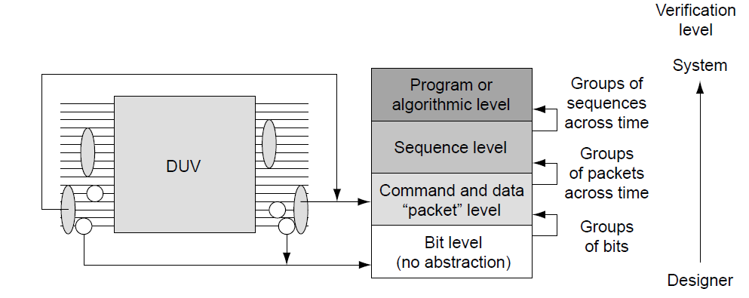
Specific Tests and Methods: Environment V (Abstraction level)
The abstraction level dictates how the verification environment views streams of control and data bits
Figure on the right shows various abstraction level choices
  Above the bit-level, inputs and outputs join to make meaningful command and data packets
  Components create sequences by joining multiple packets together to form a function
  Multiple sequences create a program or implement an algorithm
Often, the choice of abstraction level parallels the verification level
  Designer-level verification uses bit streams to verify simple blocks
  For the unit and chip levels, verification engineers choose the packet or sequence level of abstraction
  Program-level abstraction rarely occurs below the system level

Slide 17
Specific Tests and Methods: Environment VI (Checking)
The checking strategy falls into place based on the choice of verification type (black box, white box, grey box), the verification stimulus strategy, and the level of abstraction
The type of stimulus (deterministic versus random) guides the choice between golden vectors and the reference model or transaction-based checking
The available staffing will also drive the decision, especially between a cycle-accurate reference model and the transaction-based checking
The verification team can include details such as the data contents of the scoreboard in this section of the verification plan
The team must understand what information they will track globally within the environment, as well as what data they must check in local output monitor components

Slide 18
Coverage Requirements
Coverage is the feedback mechanism that evaluates the quality of the verification environment’s stimulus generation components. The verification environment provides “quality control” on the DUV; coverage provides quality control on the verification environment
This section of the verification plan describes the intended stimulus goals for the environment. The goals should cover all of the functional stimulus requirements and ensure that the stimulus components in the environment do what they should
The coverage goals may include the following:
  The environment has exercised all types of commands and transactions
  The stimulus has created a specific or varying range of data types
  The environment has driven varying degrees of legal concurrent stimulus
  The initiator and responder components have driven errors into the DUV
Another good practice is to have coverage feedback for all environment checkers to verify that the stimulus exercises all of the checking code
Unexercised individual checks indicate that there is a hole somewhere in the stimulus components or in the plan.

Slide 19
Test Case Scenario: Matrix
A good verification plan should list all of the interesting test scenarios that will serve to verify the design. This list is the test case matrix
Defining a preliminary matrix is necessary before starting the design and modeling of the verification environment because every potentially valuable test should be enabled
Within the matrix, the verification plan should label each test, give a short description, and contain a cross-reference to the function and coverage lists
As part of defining a verification plan, the verification team needs to specify the legal values, illegal values, and corner cases of each input data element they want to generate
The following should be kept in mind when creating the matrix:
  configurations to verify,
  variations of the data items in the environment (this ties to the abstraction level),
  important attributes of each data item,
  interesting sequences for every DUV input port,
  error conditions, and
  corner cases.
Corner cases deserve their own section in the test case matrix
Notes:
A good verification plan should list all of the interesting test scenarios that will serve to verify the design. This list is the test case matrix. Defining a preliminary matrix is necessary before starting the design and modeling of the verification environment because every potentially valuable test should be enabled. Within the matrix, the verification plan should label each test, give a short description, and contain a cross-reference to the function and coverage lists.
The matrix starts with the basic required tests and then builds on them. The plan groups tests with similar features to form test scenarios, which may have the same configuration, granularity, or verification strategy. The descriptions of the scenario designate the targeted function. The last item on the matrix is a cross-reference to the functional requirements and coverage goals.
This section can produce a huge matrix of tests. Often, the matrix size can explode when there are multiple DUV configurations. If a DUV has 10 basic functional tests and each one is valid in one of three modes (e.g., bus frequency), then the net result is that the matrix will have 30 tests.
A random coverage-based matrix begins with a listing of the targeted functions. The initial description states how the team will constrain the environment to achieve the goals. In a random environment, this translates to driving certain inputs with specific values while leaving other inputs unconstrained (randomly generated values). This set of constraints then determines the scenario.
The test matrix grows as the implementation continues. For complex DUVs, the team cannot define all tests at the start; instead, they add to the test matrix as they determine new scenarios, through either DUV discovery or coverage holes. It is critical to document these new tests in the verification plan, as the team needs to include these tests in the future.
As part of defining a verification plan, the verification team needs to specify the legal values, illegal values, and corner cases of each input data element they want to generate. The following should be kept in mind when creating the matrix: configurations to verify, variations of the data items in the environment (this ties to the abstraction level), important attributes of each data item, interesting sequences for every DUV input port, error conditions, and corner cases.
Corner cases deserve their own section in the test case matrix. The verification team must pay special attention to many out-of-the-ordinary cases, which include the smallest and the largest data elements such as an empty and full queue or first in, first out (FIFO), extreme values such as the largest and smallest packet lengths, and unique time relations such as bus collisions and interrupts during instruction streams.
As the above test scenarios listed, the team should define the range of values for each generated data item, thus helping to define the verification plan and model the input data.

Slide 20
Required Tools
The required tools section contains the specification and list of the verification toolset, describing the software (and potentially hardware simulation machines) needed to perform the plan. Some examples of this are as follows:
  Event simulation tools for units
  Cycle simulation tools for chip (for performance reasons)
  Formal verification tools
  Assertion-based tools
  Debuggers
  Emulation hardware
  Acceleration hardware
  Co-simulation software
  High-level verification languages (HVLs)
  Libraries of functions
Articulating the required tools is important because they could have a resource or monetary impact
New or different tools will drive more resources or inflate the schedule as the team learns the appropriate usages
Inclusion of tools in the plan also serves to document software purchase requirements from electronic design automation (EDA) vendors, as well as simulation engine estimates
Notes:
In some companies, a concrete verification methodology exists, and this section is predetermined. In these cases, the verification plan follows the current methodology, including the default toolset.
There are instances in which a deviation is required from the default toolset. For example, if a system-level simulation environment involves a chip verified separately under a different methodology or toolset, the team may need additional tools to bridge the environments. It might follow then that the team needs a co-simulation environment. Co-simulation occurs when the team verifies diverse source code or methodologies at once. This could be between VHDL and Verilog, or it might be between two different HVLs - Specman e, SystemC, and/or Vera.

Slide 21
Risks and Dependencies I
This section of the verification plan identifies critical threats to success and delivery requirements that project management needs to track to closure
The complexity of today’s designs inherently contains verification risks. The verification team depends on other teams to deliver information, tools, function, and intellectual property in order to achieve success. This section articulates these items
The verification team manages risk through focusing on avoidance and by creating contingency plans. For instance, there are risks associated with dependence on a new tool:
  delivery and start-up delays (e.g., late delivery or nonworking functions),
  integration with established tools, and
  educational challenges
  Contingency plans might consist of using a backup tool or creating an early acceptance test for the tool
Notes:
This section of the verification plan identifies critical threats to success and delivery requirements that project management needs to track to closure. The complexity of today’s designs inherently contains verification risks. The verification team depends on other teams to deliver information, tools, function, and intellectual property in order to achieve success. This section articulates these items.
The verification team manages risk through focusing on avoidance and by creating contingency plans. For instance, there are risks associated with dependence on a new tool: delivery and start-up delays (e.g., late delivery or nonworking functions), integration with established tools, and educational challenges. Contingency plans might consist of using a backup tool or creating an early acceptance test for the tool.
Dependencies range from on-time HDL deliveries to availability of tools and technology. HDL deliveries may come in regularly scheduled packages, in which the design team delivers basic function first, followed by further, more complex functions. The verification team must plan their work based on these deliveries, so the plan must articulate this dependency.
The verification team should highlight the dependency and risks during the initial plan review, thus driving overall acknowledgement of these items and discussion of possible risk mitigation actions.
In a complex design project, there are common risks and dependencies. One of the most common risks in a large design project is the reliance on a separate verification team, such as a local team or an intellectual property (IP) vendor (in a system-on-a-chip design), to pre-verify a lower-level core before chip- or system-level verification. Receiving a release of a poorly verified core likely leads to debugging a unit-level bug at the system level. In these situations, pinpointing the bug is much more difficult or even impossible.
As mentioned above, new tools and new versions of current tools add risk to a project. Problems include occasions when the tool is not available when promised, when quality defects in the tool slow the pace of the verification effort, or when the promised functionality of the tool is not delivered. Worse yet, a new tool, advertised as a seamless integration effort, might end up requiring months of environment changes. Many groups have a tool freeze within a project. This is a point after which the team will not entertain new tools (or revisions of tools) because of the risk associated with changes.
Architecture closure is a common risk and dependency item. As mentioned before, the design team rarely supplies the complete and final specification before the start of verification. This is both a dependency and a risk. The team requires closure of architectural items by specific dates in order to meet the schedule. However, the team also runs the risk that they need to overhaul their verification environment because the early assumptions prove to be invalid.
A final common risk and dependency is having the available resources to complete the work on schedule. There may be a unique resource requirement that needs to be listed (e.g., people, machines, licenses). For instance, there may be contention among multiple projects for specific simulation hardware such as emulators. In another case, the verification plan will assume a certain daily simulation cycle throughput during the early phases of the design right through the regression phase. The simulation engines and licenses must be available to meet this throughput.

Slide 22
Risks and Dependencies II
Dependencies range from on-time HDL deliveries to availability of tools and technology
HDL deliveries may come in regularly scheduled packages, in which the design team delivers basic function first, followed by further, more complex functions
The verification team must plan their work based on these deliveries, so the plan must articulate this dependency
Some common dependencies and risks are:
  Reliance on a separate verification team, such as a local team or an intellectual property (IP) vendor, to pre-verify a lower-level core before chip- or system-level verification.
  Problems with new tools: delivery and start-up delays, integration with established tools -> tool freeze within a project, and educational challenges -> Classes and on-site support
  Architecture closure - the design team rarely supplies the complete and final specification before the start of verification. This is both a dependency and a risk
  Having the available resources to complete the work on schedule.
Notes:
This section of the verification plan identifies critical threats to success and delivery requirements that project management needs to track to closure. The complexity of today’s designs inherently contains verification risks. The verification team depends on other teams to deliver information, tools, function, and intellectual property in order to achieve success. This section articulates these items.
The verification team manages risk through focusing on avoidance and by creating contingency plans. For instance, there are risks associated with dependence on a new tool: delivery and start-up delays (e.g., late delivery or nonworking functions), integration with established tools, and educational challenges. Contingency plans might consist of using a backup tool or creating an early acceptance test for the tool.
Dependencies range from on-time HDL deliveries to availability of tools and technology. HDL deliveries may come in regularly scheduled packages, in which the design team delivers basic function first, followed by further, more complex functions. The verification team must plan their work based on these deliveries, so the plan must articulate this dependency.
The verification team should highlight the dependency and risks during the initial plan review, thus driving overall acknowledgement of these items and discussion of possible risk mitigation actions.
In a complex design project, there are common risks and dependencies. One of the most common risks in a large design project is the reliance on a separate verification team, such as a local team or an intellectual property (IP) vendor (in a system-on-a-chip design), to pre-verify a lower-level core before chip- or system-level verification. Receiving a release of a poorly verified core likely leads to debugging a unit-level bug at the system level. In these situations, pinpointing the bug is much more difficult or even impossible.
As mentioned above, new tools and new versions of current tools add risk to a project. Problems include occasions when the tool is not available when promised, when quality defects in the tool slow the pace of the verification effort, or when the promised functionality of the tool is not delivered. Worse yet, a new tool, advertised as a seamless integration effort, might end up requiring months of environment changes. Many groups have a tool freeze within a project. This is a point after which the team will not entertain new tools (or revisions of tools) because of the risk associated with changes.
Architecture closure is a common risk and dependency item. As mentioned before, the design team rarely supplies the complete and final specification before the start of verification. This is both a dependency and a risk. The team requires closure of architectural items by specific dates in order to meet the schedule. However, the team also runs the risk that they need to overhaul their verification environment because the early assumptions prove to be invalid.
A final common risk and dependency is having the available resources to complete the work on schedule. There may be a unique resource requirement that needs to be listed (e.g., people, machines, licenses). For instance, there may be contention among multiple projects for specific simulation hardware such as emulators. In another case, the verification plan will assume a certain daily simulation cycle throughput during the early phases of the design right through the regression phase. The simulation engines and licenses must be available to meet this throughput.

Slide 23
Resource Requirements I
With the environment architecture and test scenarios in place, the team can estimate its resource requirements
People resource estimates vary based on the type of environment and the experience of the individuals:
  Reference model checking environments will require more people to implement, but their accuracy and checking capabilities are often worth the investment
  However, less resource-intensive solutions such as transaction-based checking may be adequate
  Experienced verification engineers will require less time to code and debug the environment
The verification leaders allocate people resources across the verification hierarchy, starting with the lowest level in the plan:
  there are more total environments at the lower levels
  the resource plan allocates fewer people per environment at the lower levels
  it takes fewer people to execute a unit environment than a system environment
  Typically, a single verification engineer will write all of the stimulus components at a unit level with another verification engineer to create the checking for that unit
  for a complex chip or system, there are too many interfaces for a single verification engineer to write all of the stimulus or checking components, so the team splits the development across multiple people along sensible partitions
Notes:
People resource estimates vary based on the type of environment and the experience of the individuals. Reference model checking environments will require more people to implement, but their accuracy and checking capabilities are often worth the investment. However, less resource-intensive solutions such as transaction-based checking may be adequate. Experienced verification engineers will require less time to code and debug the environment. Time should be planned for review of the verification components for all portions of the code, paying special attention to the code of inexperienced verification engineers.

Slide 24
Resource Requirements II
Resource requirements include not only people but also compute and license resources
Estimate of the required compute resources is calculated based on the length of one test scenario and the estimated number of tests to run during the whole verification cycle
These numbers should be consistent with the time and computing resources available for the project (the limiting factor could be central processing units or licenses available to the project), which may drive requests for additional compute or license resources
When deciding on the length of tests, keep in mind that long tests might reach more interesting DUV scenarios, but they are harder to debug when they fail
It may be more beneficial to have many smaller (more focused and easier-to-debug) tests than a few long ones
Notes:
People resource estimates vary based on the type of environment and the experience of the individuals. Reference model checking environments will require more people to implement, but their accuracy and checking capabilities are often worth the investment. However, less resource-intensive solutions such as transaction-based checking may be adequate. Experienced verification engineers will require less time to code and debug the environment. Time should be planned for review of the verification components for all portions of the code, paying special attention to the code of inexperienced verification engineers.

Slide 25
Schedule Details I
The final portion of verification planning is to document the timeline for each of the verification activities
The first step is to create a high-level schedule before filling in the details. It starts with a delivery of the specification and completes with chip release(s) to manufacturing
For each level of the hierarchy, the high-level schedule includes the development of verification environments, the debugging of the HDL, and the regression stage
A key delivery in the schedule is the first drop of HDL to the verification team
  An HDL drop consists of enough HDL to perform specific DUV functions
  Often, there are multiple drops of HDL in the development cycle: this allows the verification team to make progress on basic functions while the HDL designers work on complex and secondary functions
  This parallelization can streamline the schedule -
  however, it will force the HDL designers to balance their time between creating new HDL and fixing newly discovered verification bugs in previous drops
Notes:
Previous sections of the plan cover the verification of the many different levels of hierarchy and the proposed environments for each. The final portion of verification planning is to document the timeline for each of the verification activities.
As the team creates the schedule details, they must consider all of the other sections of the verification plan. However, the resource section is the most tightly coupled to the schedule details section because the available resources have a direct and obvious impact on schedule. More resources will improve the schedule, and less resources will extend the schedule.
The schedule includes both deliveries to the verification team and verification work items. The first step is to create a high-level schedule before filling in the details. The high-level schedule follows the first half of the verification cycle. It starts with a delivery of the specification and completes with chip release(s) to manufacturing. For each level of the hierarchy, the high-level schedule includes the development of verification environments, the debugging of the HDL, and the regression stage.
A key delivery in the schedule is the first drop of HDL to the verification team. An HDL drop consists of enough HDL to perform specific DUV functions. Often, there are multiple drops of HDL in the development cycle. Staggering the drops allows the verification team to make progress on basic functions while the HDL designers work on complex and secondary functions. This parallelization can streamline the schedule; however, it will force the HDL designers to balance their time between creating new HDL and fixing newly discovered verification bugs in previous drops.
The verification leaders must estimate how long it will take to create the basic verification environment. In most cases, this time is closely aligned with how long it takes the designers to create the first HDL delivery. The second time estimate is the duration of the debug portion of the schedule, which begins after the initial delivery of environment and HDL. The estimated duration of this portion of the schedule is based on how long it should take to run through the test matrix. The estimate must account for further HDL delivery dates as well. The remaining timeframe before the chip release to manufacturing is set aside for regression.
Top figure shows the format of the high-level schedule. In this example, the team chose to execute three levels of functional verification: unit, chip, and system. Verification engineers have singled out four units across three chips for unit simulation environments.
Verification proceeds from the lowest level of the hierarchy (in this case, unit level) to the highest. Unit verification precedes chip level, which then precedes system level. Chip-level verification should not start until after the verification of substantial function at unit level. Similarly, system level cannot begin until all three chips have demonstrated solid functionality.
The schedule must allow enough time for each level of hierarchy to test the function before the next level starts. This ensures that the verification team will find bugs at the lowest level possible, easing the debugging burden and capturing bugs at the earliest point in the schedule. A good practice is to start the next level of verification when the bug rate from the lower level has dropped. This ensures that the resources stay focused on the most productive verification level. Bottom figure shows a sample bug curve that results when the team follows the schedule guidelines.

Slide 26
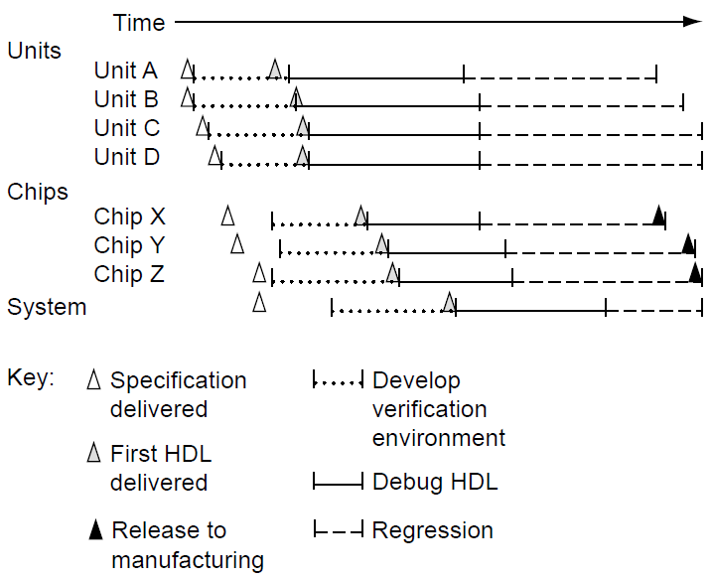
Schedule Details II
The verification leaders must estimate how long it will take to create the basic verification environment. In most cases, this time is closely aligned with how long it takes the designers to create the first HDL delivery
The second time estimate is the duration of the debug portion of the schedule, which begins after the initial delivery of environment and HDL
The estimated duration of this portion of the schedule is based on how long it should take to run through the test matrix, but this estimate must account for further HDL delivery dates as well
The remaining timeframe before the chip release to manufacturing is set aside for regression
The schedule must allow enough time for each level of hierarchy to test the function before the next level starts.
A good practice is to start the next level of verification when the bug rate from the lower level has dropped. This ensures that the resources stay focused on the most productive verification level.
High-level schedule showing the first half of the verification cycle. The major checkpoints include design deliveries, environment development, debug, and regression.
Notes:
Previous sections of the plan cover the verification of the many different levels of hierarchy and the proposed environments for each. The final portion of verification planning is to document the timeline for each of the verification activities.
As the team creates the schedule details, they must consider all of the other sections of the verification plan. However, the resource section is the most tightly coupled to the schedule details section because the available resources have a direct and obvious impact on schedule. More resources will improve the schedule, and less resources will extend the schedule.
The schedule includes both deliveries to the verification team and verification work items. The first step is to create a high-level schedule before filling in the details. The high-level schedule follows the first half of the verification cycle. It starts with a delivery of the specification and completes with chip release(s) to manufacturing. For each level of the hierarchy, the high-level schedule includes the development of verification environments, the debugging of the HDL, and the regression stage.
A key delivery in the schedule is the first drop of HDL to the verification team. An HDL drop consists of enough HDL to perform specific DUV functions. Often, there are multiple drops of HDL in the development cycle. Staggering the drops allows the verification team to make progress on basic functions while the HDL designers work on complex and secondary functions. This parallelization can streamline the schedule; however, it will force the HDL designers to balance their time between creating new HDL and fixing newly discovered verification bugs in previous drops.
The verification leaders must estimate how long it will take to create the basic verification environment. In most cases, this time is closely aligned with how long it takes the designers to create the first HDL delivery. The second time estimate is the duration of the debug portion of the schedule, which begins after the initial delivery of environment and HDL. The estimated duration of this portion of the schedule is based on how long it should take to run through the test matrix. The estimate must account for further HDL delivery dates as well. The remaining timeframe before the chip release to manufacturing is set aside for regression.
Top figure shows the format of the high-level schedule. In this example, the team chose to execute three levels of functional verification: unit, chip, and system. Verification engineers have singled out four units across three chips for unit simulation environments.
Verification proceeds from the lowest level of the hierarchy (in this case, unit level) to the highest. Unit verification precedes chip level, which then precedes system level. Chip-level verification should not start until after the verification of substantial function at unit level. Similarly, system level cannot begin until all three chips have demonstrated solid functionality.
The schedule must allow enough time for each level of hierarchy to test the function before the next level starts. This ensures that the verification team will find bugs at the lowest level possible, easing the debugging burden and capturing bugs at the earliest point in the schedule. A good practice is to start the next level of verification when the bug rate from the lower level has dropped. This ensures that the resources stay focused on the most productive verification level. Bottom figure shows a sample bug curve that results when the team follows the schedule guidelines.

Slide 27
Verification Plan Example
Calc1

Slide 28
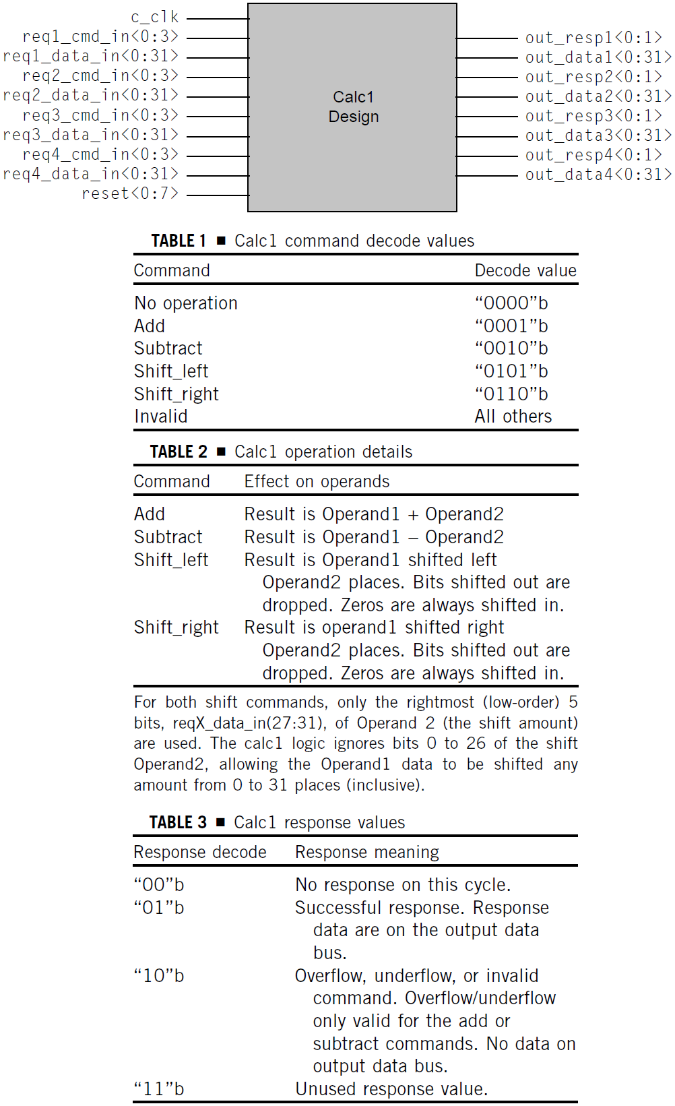
Design Description I
Calc1 is a RTL design implementation of a four-operation calculator. The RTL can accept up to four simultaneous operators from its four ports
Each request uses one of four input ports to send the command and operand data. The four ports can each handle a single command in parallel
Each command will receive a response from the calculator design. Except in the case of an error condition, the response will include the result of the operation
Figure shows the input and output signals for Calc1
Each of the four Calc1 ports has two separate input busses and two output busses.
Table 1 shows the command and decode values for the 4-bit command bus.
Table 2 shows how the Calc1 design operates on the two operands.
Table 3 shows the possible responses for a given operation.
Notes:
Calc1 is a register transfer level (RTL) design implementation of a four-operation calculator. The four operators are Add, Subtract, Shift_left, and Shift_right. The RTL can accept up to four simultaneous operators from its four ports. A single port request sends an operator into the calculator on the command input bus, accompanied by operand data. Each request uses one of four input ports to send the command and operand data. The four ports can each handle a single command in parallel.
Each command will receive a response from the calculator design. Except in the case of an error condition, the response will include the result of the operation.
Top figure shows the input and output signals for Calc1. As with all designs, the RTL must generate or receive a clock signal input. For Calc1, the RTL receives the clock signal on c_clk.
Each of the four Calc1 ports has two separate input busses and two output busses. The first input bus, reqX_cmd_in(0:3) (where X is replaced by port numbers 1, 2, 3, or 4) is a 4-bit bus used to transmit the command to the Calc design. Table 1 shows the command and decode values for the 4-bit command bus.
The second input bus, reqX_data_in(0: 31), is the operand data bus. Each of the four operation types requires two operands. The requestor ports send operand1 data and operand2 data on sequential cycles, with operand1 data concurrent with the command. Therefore, it takes two cycles to send a complete command and data sequence.
Table 2 shows how the Calc1 design operates on the two operands.
The two output lines for each port are the response bus, out_respX (0 : 1), and result data bus, out_dataX(0 : 31). The response bus goes active for one cycle when the Calc1 design completes the computation for the port. The number of cycles that it takes to complete an operation depends on amount of activity on the three other ports but will always be at least three cycles.
Table 3 shows the possible responses for a given operation.
The output data bus, out_dataX(0 :31), should only be sampled when out_respX(0: 1) contains the successful response decode value (“01”b). At that time, the value on the output bus will contain the result of the operation for that port.

Slide 29
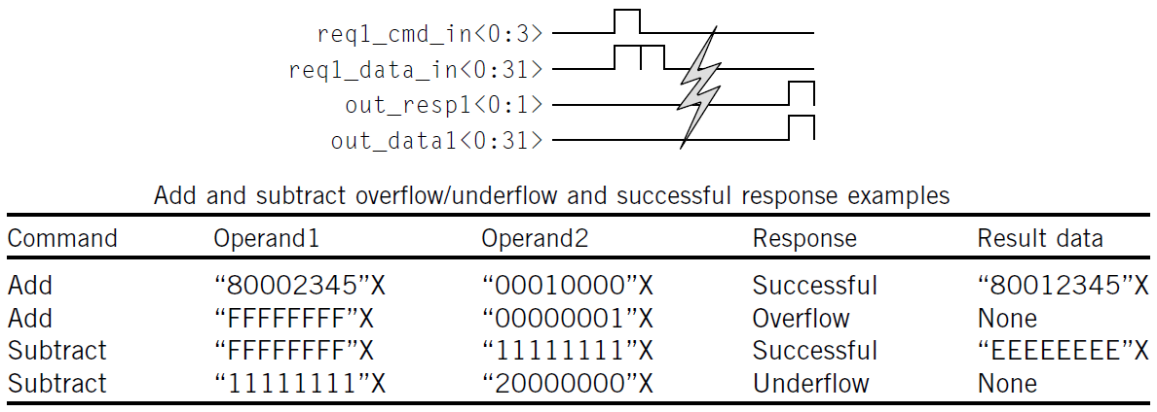
Design Description II
Figure shows a timing diagram of the command and response sequence for a single successful command on Port 1. The command and first operand of data appear on the first cycle of the sequence, and the second operand data follows on the second cycle. A few cycles pass, and the response appears on the output of the design, accompanied by the result data.
Each port may have one operation ongoing at a time. Once a port sends a command, it may not send another command until it receives a response for the preceding command.
Each port is independent of the others: all four ports may send commands concurrently or any combination of commands across cycles.
There is one ALU for adds and subtracts, and a second ALU for shift commands. Internal to the design is a priority logic scheme that sends commands to one ALU or the other, depending on the command decode. Calc1 services commands on a first-come, first-serve basis. Calc1 may service commands that arrive on the same cycle in any order.
Notes:
Figure shows a timing diagram of the command and response sequence for a single successful command on Port 1. The command and first operand of data appear on the first cycle of the sequence, and the second operand data follows on the second cycle. A few cycles pass, and the response appears on the output of the design, accompanied by the result data.
Each port may have one operation ongoing at a time. Once a port sends a command, it may not send another command until it receives a response for the preceding command. The protocols do not require that a requestor port send a new command whenever the preceding command completes; the port may be idle for any number of cycles in between commands.
Each port is independent of the others: all four ports may send commands concurrently or any combination of commands across cycles (with the stated restriction of only one outstanding command per port). Therefore, at any given point, the Calc1 design may work on any number of commands, up to a maximum of four.
If all four ports send commands concurrently, the responses will not be concurrent. Although each port has equal priority, there are limited resources inside the design. Specifically, there is one ALU for adds and subtracts, and a second ALU for shift commands. Hence, if all four ports sent concurrent add commands, the Calc1 logic would serialize the responses, as only one add command could be processed by the ALU at a time¹.
Internal to the design is a priority logic scheme that sends commands to one ALU or the other, depending on the command decode. Calc1 services commands on a first-come, first-serve basis. Calc1 may service commands that arrive on the same cycle in any order.
The design has a reset bus input used to clear the internal state of the design. During verification, the test case initially should activate the reset to put the design in a cleared state. Setting the reset line, reset(0:7), to “11111111”b activates the reset. This input value needs to be held for seven consecutive cycles in order for the reset to propagate through the design. The test case should set to zero all other input busses except the c_clk while resetting the Calc1 DUV².
Calc1 treats arithmetic operands as unsigned data. The most significant (leftmost) bit, bit 0, is a data bit, not a sign bit. An overflow occurs on an add operation when the high-order bit (bit 0) has a carryout, and an underflow occurs on a subtract operation when a larger number is subtracted from a smaller number. Supplied table shows some examples of this.
---------------------------------------------------------------------------------------------------------------------------------------------
¹ This is microarchitectural information describing the internals of Calc1. The verification engineer may not need this information to drive inputs, but checking components, such as reference models, do require this information. The more a verification engineer understands how the design functions, the better the environment.
² The test case must drive the c_clk. However, the value of the c_clk input depends on the type of simulation engine. For event simulation, the stimulus component must toggle c_clk every cycle. For cycle simulation engines, the stimulus component should stick c_clk to “1”b.

Slide 30
Creating the Verification Plan for Calc1 –
Description of Verification Levels
Calc1 is a simple design used as an initial introduction to simulation-based verification.
Therefore, this design requires verification only at the top level of the DUV hierarchy; furthermore, the available specification only describes the top-level interfaces.
Verification at a lower level of hierarchy, such as the ALUs, would require an input and output description of that subunit.
However, if the people resources exist, it is better to do unit-level verification, thus placing the priority logic and ALUs under a microscope of verification and allowing a higher level of control and stress on the design.
Furthermore, in real-world designs, it is common for one designer’s logic to be available before others’ logic. If the priority logic HDL is ready for verification before the ALUs, the priority logic unit-level verification can commence without waiting for the entire chip.
This level of verification would add a dependency on the design team to document the unit interfaces.

Slide 31
Required Tools, Risks and Dependencies
The tools inventory for Calc1 comprises a single software simulation engine (and license to run it) and one workstation, a waveform viewer, and a test case language or infrastructure.
The language or infrastructure must communicate with the simulation engine, which provides the means to drive the inputs, check the outputs, and clock the model of the design, which is simulated by the engine itself.
This exercise does not have risks worthy of documentation.
Notes:
In a larger project with a more complex design, there might be risks inherent in the delivery of the specification of esoteric operations (e.g., binary floating point) or in the ability to verify the design in a short schedule.
If Calc1 were part of a large system, this section would detail schedule integration factors. The system-level verification cycle depends on the correctness of the Calc1 function so that broader system integration verification can occur without being concerned with the quality of the add, subtract, or shift functions.
The Calc1 exercise also depends on the delivery of the specification (which was delivered above) and availability of the required tools. To perform this exercise, you will need the required tools as documented in the previous section of the verification plan.

Slide 32
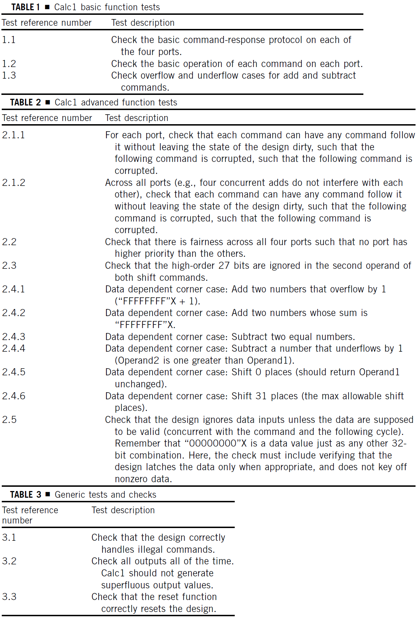
Functions to be Verified and Test Scenarios: Matrix
Because Calc1 is simple, we have combined the functions to be verified and the test case scenarios (matrix) sections of the verification plan.
We list the details here in table format with a reference number for crosschecking tests against the verification plan.
Certain test case requirements jump out at the verification engineer.
From the Calc1 design description, it is clear that the verification engineer must create the following basic tests as shown in Table 1.
Beyond the basic functions described in Table 1 are a series of tests that involve scenarios that are more complex (Table 2).
Finally, there are generic tests and checks that are applicable to all verification plans (Table 3).

Slide 33
Specific Tests and Methods: Environment I
Type of Verification: Black Box, White Box, Grey Box
  A verification engineer can create all of the functions listed under the functions to be verified section by driving the chip inputs and can check most scenarios by monitoring the chip outputs. This would indicate that black box checking is adequate.
  However, checkers placed on certain logic functions internal to the design might flag logic flaws faster. These checkers include checks on internal queues or stacks, especially in the priority logic. This would verify that no command leaves the state of the machine dirty (item 2.1 in the list of functions to be verified).
  In addition, the environment could include checks that verify fairness in the priority logic by monitoring the dispatch of commands to the ALUs (item 2.2 in the list of functions to be verified).
  These checkers indicate that grey box verification is appropriate.
  Therefore, all stimulus will be driven on the chip inputs, and most checkers will monitor the chip outputs. The environment will contain a limited number of checkers on internal logic.

Slide 34
Specific Tests and Methods: Environment II
Verification Strategy
  Deterministic, random, and formal verification are all viable technologies for Calc1.
  However, formal verification could have trouble verifying correct ALU results across all 32 bits simultaneously.
  A full-blown random environment might be overkill for this simple design, as the number of test cases required to verify the functions is limited.
  Therefore, for the Calc1 exercise, the deterministic verification method is chosen.
Randomization Controls
  Given the deterministic test case method, questions such as randomization controls become irrelevant.
  The test case writer will encode the input values and the expected outputs into the test case itself.

Slide 35
Specific Tests and Methods: Environment III
Abstraction Level
  The level of abstraction depends on the test case language.
  If the infrastructure exists, driving the Calc1 at the packet level is optimal for quickly coding test cases.
  Bottom figure shows an example test case with packet-level syntax.
  In the syntax, the infrastructure environment manages multiple tasks for the test case writer:
    The first task for the infrastructure is translating the actual command decode values to bits (e.g., ADD = “0001”b).
    The next task for the infrastructure is driving the bit-level values into the Calc1 design.
    The infrastructure design also waits for the valid response before writing next command to the same port.
    The infrastructure will also take care of resetting the logic and driving the clocks.
  An advanced Calc1 verification environment would include data prediction. If the infrastructure included a golden model that predicts the result and response fields, it frees the test case writer from having to “do the math.”
Notes:
The syntax in the figure is very convenient, as the infrastructure that reads and manages the test case handles many mundane tasks, allowing the test case writer to focus on the intent of the test case. In the syntax, the infrastructure environment manages multiple tasks for the test case writer. The first task for the infrastructure is translating the actual command decode values to bits (e.g., ADD = “0001”b). This has a potentially huge added benefit: if the designer ever changes the decode value of the ADD operand (e.g., ADD = “1001”b), all that is required in the environment is a simple modification to the infrastructure. If, instead, the verification engineer codes the operand decode values in the test case itself, then the team must change every test case with the ADD command. The same is true for the encoding of the response value.
The next task for the infrastructure is driving the bit-level values into the Calc1 design. The infrastructure knows to place the operand1 data value on the bus concurrent with the command and to send operand2 data the next cycle.
The infrastructure design also waits for the valid response. The test case writer cannot predict when the response will come back, so the infrastructure waits for the response event and checks the value when it finally appears on the outputs. This enables the next infrastructure task to send the next command to the port when the port becomes available. In the sample test case of bottom figure, there are two commands destined for Port 1. The protocol states that only one command may be outstanding at a time on a given port. Therefore, the infrastructure can send the first two commands concurrently (to Port1 and Port2) but must wait for the ADD on Port 1 to finish before initiating the SUB. Without an infrastructure, sending multiple commands to the same port is a very tedious task involving trial and error.
The infrastructure will also take care of resetting the logic and driving the clocks. The infrastructure automatically raises the reset line for seven cycles as required at the beginning of every test case, thus circumventing the need to articulate the reset in every test case. The infrastructure also drives the clocks to the correct values. An even more robust infrastructure might further simplify the test case writing task by including other advanced aspects of verification stimulus generation and checking.
An advanced Calc1 verification environment would include data prediction. If the infrastructure included a golden model that predicts the result and response fields, it frees the test case writer from having to “do the math.”
Further functions in an advanced verification environment include generation of random operand data. If desired, the syntax of the test case allows the writer to replace an operand data value with the keyword “random,” which tells the packet generator to pick a random number value. This requires data prediction capabilities in the infrastructure. The test case writer maintains deterministic control over the command selection and flow of the test case, but optionally can allow the infrastructure to choose values.

Slide 36
Block Diagram of the Environment
The test case parser reads the text-based commands from the test case and converts them into packet structures for the stimulus initiator.
The initiator passes the packets into the model on the designated port, performing the packet to bit-stream conversion.
When the interface driver transmits a command packet, it also posts the command to a scoreboard, which keeps track of commands currently under execution by the Calc1 simulation model.
As the Calc1 simulation model completes commands, the output checker pulls the expected response and expected data from the scoreboard for comparison to the actual response.
If there is a response or data mismatch, the test case execution ceases and the output checker records both the error and the actual versus expected data.
Notes:
Figure on the right shows the high-level view of the components in the infrastructure. The test case parser reads the text-based commands from the test case and converts them into packet structures for the stimulus initiator.
The initiator passes the packets into the model on the designated port, performing the packet to bit-stream conversion. Each command packet requires two cycles to transmit into the Calc1 simulation model as dictated by the design’s specification. The stimulus initiator can multiplex across all four ports, sending simultaneous or staggered commands based on the test case. When the interface driver transmits a command packet, it also posts the command to a scoreboard, which keeps track of commands currently under execution by the Calc1 simulation model. As the Calc1 simulation model completes commands, the output checker pulls the expected response and expected data from the scoreboard for comparison to the actual response. If there is a response or data mismatch, the test case execution ceases and the output checker records both the error and the actual versus expected data. Otherwise, the output checker removes the command from the scoreboard, indicating that the stimulus initiator may dispatch a new packet to that port. When the stimulus initiator transmits all of the test case packets and the checker receives all responses, the test case ends successfully. The infrastructure also takes care of the seven-cycle reset sequence as well as driving the clocks into the model.

Slide 37
Coverage Requirements, Resource Requirements,
Schedule Details
Coverage goals for the Calc1 example are based on the tests defined in the functions to be verified section, and the goals require that the verification tests create all of the cases described in that section.
These goals are simple because the test scenarios in this design are able to be articulated. However, in robust designs, coverage goals require greater effort and rigor in the verification cycle.
For the Calc1 exercise, the resource requirements call for a single verification engineer. The compute resources call for a single workstation on which the simulation engine runs.
The schedule details for the Calc1 exercise are straightforward.
In the case of the packet-level abstraction, the Calc1 verification engineer depends on the existence and quality of the infrastructure.
If necessary infrastructure already exists, a verification engineer should expect to complete the Calc1 design example in a single workday.
Usually, the verification engineer must create the infrastructure or at least personalize it for the design under test. If this is the case, extra schedule time is required.
Notes:
Although there is a detailed explanation of coverage and coverage tools in one of upcoming lectures, the fundamental notion of coverage is to provide feedback and confirmation of what the verification environment has exercised in the DUV. Coverage feedback provides the verification engineer with insight into the actual data of what the test case has done. This data will show either that the test case has met its intent or that the test case failed to exercise the intended function or scenario within the design. For example, in the functions to be verified section of the verification plan, test reference number 2.1.1 calls for tests that verify that each command can follow any other command on each port. This statement stipulates a series of 16 pairs of commands on each port for a total of 64 different test scenarios. Coverage feedback will track which of the 64 sequences the test cases have completed.

Slide 38
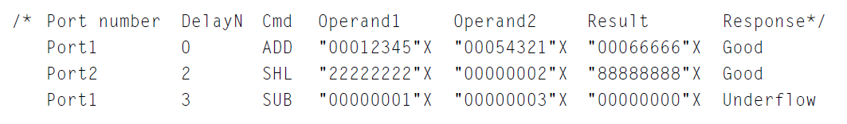
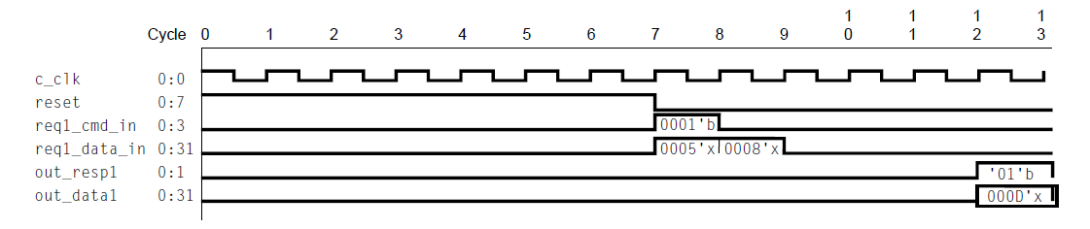
Updated test case syntax and trace of test case 1.1.1

Slide 39
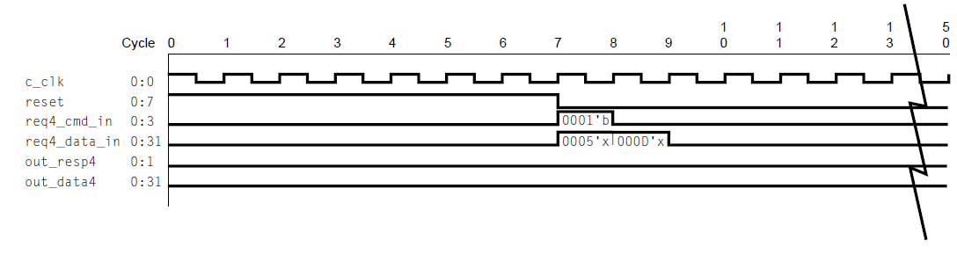
Failing test case 1.1.4 (ADD command on port 4)

Slide 40
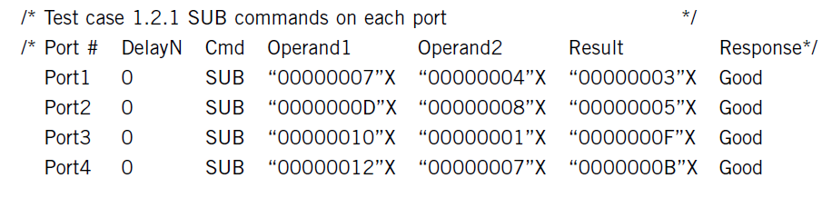
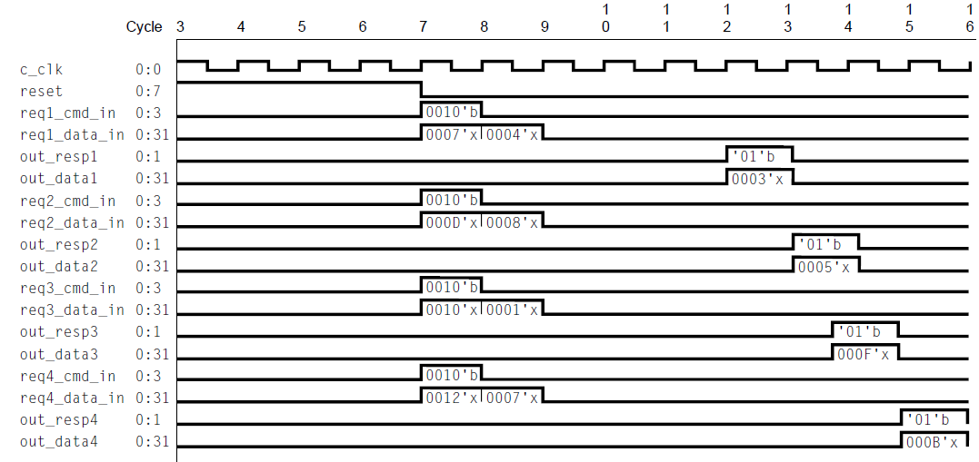
Test case 1.2.1 (SUB command on each port)

Slide 41
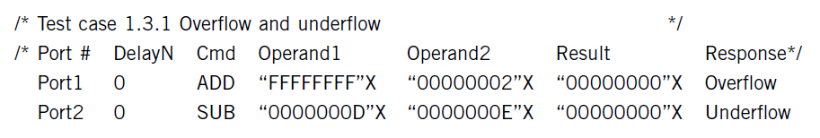
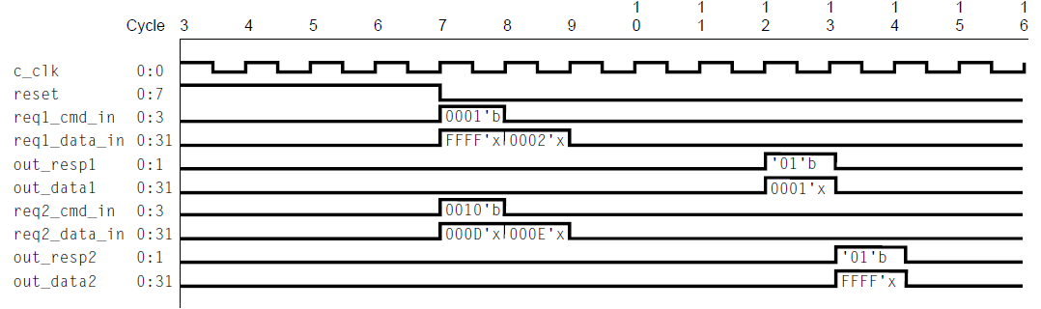
Failing test case 1.3.1 (over/under flow)

