Slide 1
Funkcionalna verifikacija hardvera
Predavanje IV

Slide 2
Lecture Content
HDLs and Simulation Engines
  Hardware description languages
  Simulation engines: introduction
  Event-driven simulation
  Cycle-based simulation
Creating Environments
  Test bench writing using HDLs
  High-level verification languages (HVLs)
  Other test bench tools

Slide 3
HDLs and Simulation Engines
Hardware Description Languages

Slide 4
Introduction
Design engineers normally use an HDL to define the function and the structure of a design under verification (DUV).
Specifying a design in the text format of an HDL, an activity called design entry, allows the engineer to document the DUV unambiguously and later execute it as a model in a simulation engine.
To better support the simulation task, HDLs have features that go beyond the mere description of the design and include the specification of stimulus and checking components, which form an HDL test bench.
There are a variety of algorithms available to build simulation engines. Because the simulation engine plays such a crucial role in the center of the simulation-based flow, typical architectures of such engines are discussed in this lecture.
Overview of major simulation tools. The simulation engine executes the design under verification model as well as a test bench specified in a hardware description language. The verification team can stimulate and check the model in two additional ways: through a test bench external to the simulation engine or by an interactive control user-interface. Shaded rectangles show a set of graphical user interfaces typically provided around these tools to improve verification productivity.
Notes:
Design engineers normally use an HDL to define the function and the structure of a design under verification (DUV). Specifying a design in the text format of an HDL, an activity called design entry, allows the engineer to document the DUV unambiguously and later execute it as a model in a simulation engine. The HDL version of the DUV is also the basis for the physical implementation of the design. To better support the simulation task, HDLs have features that go beyond the mere description of the design and include the specification of stimulus and checking components, which form an HDL test bench. When we characterize the typical elements of HDLs as design specification tools in this lecture, using VHDL as prime example.
There are a variety of algorithms available to build simulation engines. Because the simulation engine plays such a crucial role in the center of the simulation-based flow, typical architectures of such engines are discussed in this lecture. It is important that verification engineers understand the characteristics of such tools at their disposal. Electronic design automation (EDA) developers build tools such as simulation engines around different sets of tradeoffs, many of which select between accuracy and speed. The verification team must choose those tools that are most adequate for their given project.
Many simulation engines offer an interactive graphical user interface (GUI), which lets the user apply individual stimulus and check commands manually in between simulation steps of the model. Such interfaces, which support a detailed debug mode, are effective mainly on smaller models or very specific debug situations. When working with larger-sized DUVs, the verification engineer lets the simulation engine save the results of a simulation run to trace files, which capture simulated model states over time. As also shown in the figure, waveform viewer tools let the user browse through these results files in various ways, for example, forward and backward in simulation time, to inspect and debug the model behavior in detail.
For many verification tasks, the users do not find the test bench features of the HDL sufficient. Therefore, most simulation engines provide open interfaces that support the application of checks and stimuli from a programming or test bench authoring language.
It is already apparent from the figure that many simulation tools present an interactive GUI to the designer. A very common approach is to integrate the different GUI tasks under one single master GUI, which then gives the user the view of a single integrated HDL and verification development environment even if the implementation underneath consists of separate tools.
All major EDA companies offer many of these tools, often integrated into one GUI framework. The benefit of the Institute of Electrical and Electronics Engineers (IEEE) standardization of the HDLs is that many simulation engines are largely interchangeable with each other. The differentiation comes from simulation speed and value-add features such as the integration of the other simulation tasks: coverage, test bench program support, and user-friendliness for debug.

Slide 5
Hardware Description Languages
Hardware description languages are the central tools for design engineers to specify the behavior and the functional and physical partitioning of a piece of hardware design.
The idea of a formal language to specify the behavior of hardware goes back to the 1960s.
Similar to the concept of a programming language, the idea was to use a formal, machine-readable syntax with well-defined semantics to allow the unambiguous specification of a given hardware design.

Slide 6
HDL Modeling Levels I
Aside from the pure specification of the design, the main purpose of using an HDL was always to automatically turn the HDL text into a simulation model.
Figure to the right shows the model build flow from HDL to simulation engine.
A simulation engine runs the model and lets the verification engineer interact with it at various times during the simulation.
The two main hardware description languages used in the industry today are Verilog and VHDL.
The IEEE has defined standards for both (VHDL IEEE 1076, Verilog IEEE 1364), and all major EDA vendors support both languages equally well.
This flow shows how a language-processing program (compiler) reads the hardware description language specification of a design under verification (DUV) and produces a simulation model in the end. The user can execute the compiled model by calling a simulation engine, which loads the model of the DUV and evaluates it.

Slide 7
HDL Modeling Levels II - Modeling Dimensions
The main attributes of a design at the highest modeling level are its inputs and outputs and the behavior of the DUV.
One way to describe the behavior would simply be the specification of the value of input signals and the corresponding value of output signals over time.
Approaching the specification of input/output (I/O) behavior more systematically, the properties of the design block and its I/Os can be described along four different modeling dimensions.
These four modeling dimensions are shown on the figure to the right.
The temporal dimension deals with the timing relationship of DUV behavior. The data abstraction defines the value sets for DUV signals. The specification of the functional relationships between DUV inputs/outputs belongs into the functional dimension. The structural dimension is relevant when the designer specifies a DUV not by functional behavior but by creating a more complex DUV from simpler building blocks.
Notes:
The temporal dimension is necessary to describe behavior over time, which is always observable as change of model state. The values of I/O signals or state-holding variables inside the DUV represent the state of the model. An analog simulation system lets us specify behavior in continuous time, fairly close to the physical model of an electrical circuit. Gate and wire delays are more abstract; they are the first example of discrete time in the list of increasing temporal abstraction shown in figure. They measure the time it takes to propagate changes of signal values through the elements of a model. Every change occurs abruptly at the outputs of these elements. The notion of clock cycle abstracts time further: on this level, we are only interested in sampling signal values at specific periodic, recurring points in time. A DUV specification uses the most abstract notion of time when it views changes of model state only as occurrences of instructions or transactions. The model is still sampled periodically, but the measure of time is the completion of units of work in the model. Finally, the most abstract notion of time knows only abstract events. The only concern at this level is the mere precedence of observed changes of model state. For the purpose of the level of verification discussed in this book, we will limit ourselves to discrete time.
In the dimension of data abstraction, it is useful to distinguish five different levels to describe model state. Again close to the physical model of a circuit is the notion of a continuous value, typically a voltage measure. At a level more abstract, multi-value simulation engines or HDL signal types allow for granular representations of a signal state as a multi-valued “bit”. A multi-valued bit signal or variable can assume values besides the strict binary “0” and “1”. For example, values like “u” or “x” specify the states “un-initialized” or “unknown”, respectively. Other value denotations are useful to distinguish signal strength and are helpful to simulate bus signals with multiple sources. The more abstract binary representation of bit is central to the type of verification discussed here. Abstract values are much better suited than are simple bits and collection of bits to encode the actual intention of the design and the semantic meaning implied by a signal state. However, integer, floating-point, or text string types are equally suited to serve as abstract values. From this more abstract specification, the bit encoding is a question of implementation. Finally, at the end of the list of data abstractions, composite values can package together several abstract values to one structured object, similar to records or C-language like structs, which allow users to refer to complex composite values or states in a very concise way.
For the specification of the behavior of a DUV, we can choose from the different abstraction levels in the functional dimension. Clearly related to the continuous domain in the dimensions of data abstraction and temporal abstraction is the use of continuous mathematical functions such as differential equations. Next, the abstractions of transistors to switch-level elements yield a concise model for detailed custom-circuit simulations. So-called gate-level and register-transfer models (explained below) use Boolean logic as the base for the specification of functional blocks built from Boolean elements. Further abstracted forms of specification use general programmed algorithms to define functionality. For example, a sort algorithm that sorts different key entries in a buffer can concisely use a bubble-sort subroutine regardless of how the real hardware implements the function in Boolean logic later. If our simulation system and HDL support built-in high-level data types and operators, such as matrices and their multiply operators, the behavioral function of a block can be defined most concisely with an abstract mathematical formula.
The fourth and final important dimension of our modeling taxonomy is the structural dimension. We can describe a design as a single amorphous black box without any structural content, for example, a fast Fourier transformation (FFT) design described with abstract mathematical formulas. More typical is the breakdown of a single black box to a set of interconnected functional blocks in a refinement step. Although such simple structural refinement implies at least two levels of hierarchy, the most granular structural partitioning uses potentially many levels of detailed hierarchy, all the way to a library of pre-defined primitive elements.

Slide 8
Coverage of Modeling Dimensions by VHDL and Verilog
VHDL’s focus is decidedly on higher-levels of abstractions with its support for user-defined data-types, programming-language-like function overloading, and the support to define complex composite data types with records.
On the other hand, VHDL supports switch-level and multi-value logic only specified as open-ended user packages without direct language support.
Both languages excel in their flexibility to express structural decomposition and hierarchy as one would expect in an area where an HDL is most fundamentally different from a programming language.
Verilog’s built-in support for abstract events has no counterpart in VHDL, in which the designer has to model the occurrence of an event as a change of a signal value.
Coverage of modeling levels by VHDL
Coverage of modeling levels by Verilog
Notes:
Verilog covers large parts of the non-analog domain in all dimensions. Verilog has direct built-in support for switch-level modeling, which gives it a clear performance edge over VHDL in this area. VHDL’s focus is decidedly on higher-levels of abstractions with its support for user-defined data-types, programming-language-like function overloading, and the support to define complex composite data types with records. On the other hand, VHDL supports switch-level and multi-value logic only specified as open-ended user packages without direct language support versus the built-in but fixed capabilities of Verilog. The trade-offs between the languages are generality and flexibility versus performance.
Both languages excel in their flexibility to express structural decomposition and hierarchy as one would expect in an area where an HDL is most fundamentally different from a programming language. After all, it is a central design technique in hardware design to build more complex hardware modules from simpler building blocks. The definition of modules (Verilog) or entities (VHDL) that represent such re-usable building blocks, their instantiation, and the interconnection of the instances via signals is a basic activity of HDL-based logic design.
It is interesting to note that Verilog’s built-in support for abstract events has no counterpart in VHDL, in which the designer has to model the occurrence of an event as a change of a signal value.
The IEEE standard called VHDL-AMS (IEEE 1076.1) extends VHDL to cover the continuous domains (time and data values).

Slide 9
Verification Aspects of HDLs
The use of HDLs in verification is not limited to the simulation of the hardware design specification (the DUV).
Modern HDLs also include constructs that support verification tasks.
The verification aspects cover two different areas:
  capturing design intent using assertions, and
  HDL features for the creation of test benches.
In this lecture we will discuss only the second area.

Slide 10
HDL Test Benches I
A test bench for a given design has two main tasks (top figure):
  1. Stimulate the primary inputs of a design with drivers.
  2. Check interfaces and internal state of the design.
It is good practice to separate test benches into at least two partitions along the lines of these main tasks.
Reusing the investment made into the checkers on interfaces and design internals is welcomed, as the real designs are connected to the interface of the previously standalone verified design units.
In top figure, the driver was separated from the checker. The larger model in bottom figure still includes the checker for the design units while replacing the drivers with the neighboring real design.
A basic hardware description language test bench is represented by the components stimulus generation and checking.
Hardware description language test bench re-use example. We integrate Design1 and Design2 into a larger design under verification and want to
re-use as much as possible from the simulation environments used to verify Design1 and Design2 standalone. While Design1 replaces the driver component for Design2, all checker components are re-usable in this configuration, as well as the driver component for Design1.

Slide 11
HDL Test Benches II
The HDL coding for drivers and checkers does not need to satisfy any of the non-verification constraints imposed on design HDL. Therefore, the full range of HDL constructs is available.
Test bench components are the area of heavy use of the higher-level, behavioral HDL constructs, which have little or no application in pure design specifications:
  Abstract data types, records, multi-dimensional arrays
  File I/O
  Subprograms, tasks, fork/join
  Dynamic memory allocation (e.g., for scoreboarding)
Most of the language features listed here are very similar to what programming languages offer.
Therefore, a viable alternative to using HDL coding for test benches is the use of a general-purpose programming language that has access to the simulation model via a programming interface to the simulation engine.
Using a programming language outside the simulation engine that accesses the model via an application-programming interface (API) is an alternative to the use of hardware description language testbenches.
Notes:
The HDL coding for drivers and checkers does not need to satisfy any of the non-verification constraints imposed on design HDL. Therefore, the full range of HDL constructs is available. Test bench components are the area of heavy use of the higher-level, behavioral HDL constructs, which have little or no application in pure design specifications:
Abstract data types, records, multi-dimensional arrays
File I/O
Subprograms, tasks, fork/join
Dynamic memory allocation (e.g., for scoreboarding)
Most of the language features listed here are very similar to what programming languages offer. Therefore, a viable alternative to using HDL coding for test benches is the use of a general-purpose programming language that has access to the simulation model via a programming interface to the simulation engine.
As shown in the figure, simulation engines usually offer an application-programming interface (API) that lets test bench code written in programming languages interact with the simulation engine and the model. There are even simulation engine-independent standard definitions of such interfaces. Verilog programming-language interface (PLI) is part of the language’s IEEE standard. A corresponding activity for VHDL is under way.
The availability of standard interfaces to simulation engines and the desire to improve productivity for verification led to the development of special-purpose verification languages (Vera, e, System C languages), which use the available API or PLI of various commercial simulation engines. The focus on the verification task alone in these languages led to the development of innovative features supporting the verification task.
The acceptance of these so-called high-level verification languages (HVLs) in turn created the motivation for HDL developers to add such features directly into hardware description languages. Many extensions over IEEE Verilog found in SystemVerilog are directly verification related.

Slide 12
HDLs and Simulation Engines
Simulation Engines: Introduction

Slide 13
Simulation Engines: Introduction
The task of a simulation engine is to evaluate an HDL model over time and present its state to the user and programs, which the user attaches to the engine’s programming interface.
The HDL language reference manual (LRM) defines the behavior of the simulation engine.
The VHDL LRM in particular prescribes a detailed model of processing to define the correct and unambiguous execution semantics of the language.
Built into the definition of Verilog and VHDL is the concept of event-driven simulation. It provides an algorithm well suited to support both HDLs across all their features.
We will discuss the event-driven simulation scheme in more detail later in this lecture, as well as the different methods to increase simulation throughout, and we finish the overview of simulation engine technology with a view of cycle-based simulation.
Cycle-based simulation is a high-speed alternative to event-driven simulation and relies on a methodology that allows the verification team to accomplish most functional verification on an abstract RTL model.

Slide 14
Speed Versus Accuracy
A simulation engine is a central tool for the verification team, which spends a majority of the effort of the verification cycle running simulation.
This part of the cycle requires the most compute resources, and therefore, it is easy to understand that the optimization of simulation efficiency is a high priority.
It is possible to optimize simulation efficiency from two different angles.
  First, a higher level of abstraction in the HDL specification of the DUV will generally result in faster simulation because the model will contain less detail that the simulation engine has to evaluate.
  The second method to improve simulation performance is, of course, optimizing the simulation engine itself.
There is a fundamental goal conflict in verification between speed and accuracy, as shown on the figure to the right.
The level of abstraction used to model a design under verification (DUV) has a direct impact on simulation runtime and memory requirements. The more detailed and accurate the modeling style with respect to the DUV implementation, the bigger and slower the simulation model becomes. Abstract register transfer level (RTL) simulation can be much more efficient than a detailed timing-aware simulation on the gate-level. The actual performance difference depends much on the given simulation engine and the exact modeling style used, but can reach factors of 5 to 10 times in runtime and model size.
Notes:
A simulation engine is a central tool for the verification team, which spends a majority of the effort of the verification cycle running simulation. This part of the cycle requires the most compute resources, and therefore, it is easy to understand that the optimization of simulation efficiency is a high priority. The performance of the simulation engine is only one factor of the overall efficiency; however, it is a key factor because a verification team that can run models twice as fast can run double the amount of test cases in the same time and likely find DUV bugs faster.
It is possible to optimize simulation efficiency from two different angles. First, a higher level of abstraction in the HDL specification of the DUV will generally result in faster simulation because the model will contain less detail that the simulation engine has to evaluate. The second method to improve simulation performance is, of course, optimizing the simulation engine itself. The optimization of simulation engine performance has been a key differentiator for EDA vendors for the past 10 years, and only recently have the performance gains achieved every year flattened out somewhat, indicating a maturation of the technology.
Both methods to improve simulation speed can work together in synergy. When a design methodology supports a certain abstract style of HDL specification and it is possible to optimize a simulation engine very specifically toward that style, a significant improvement of speed is possible. The cycle-based simulation method discussed later is a classic example of this synergy.
Figure illustrates the basic trade-offs for simulation engine efficiency. Different HDL modeling styles are used to characterize the choice between faster simulation with the RTL abstraction and a DUV model that exhibits a close relationship with the design implementation, down to the delay characteristics of individual gates.
There is a fundamental goal conflict in verification between speed and accuracy. A simulation engine that is able to simulate more test cases per time can simulate a bigger part of the state space of a design. However, abstraction means that less accuracy and detailed design implementation information are contained in the model. For functional verification to rely safely on an abstract model, the design methodology must cover the verification of the implementation details otherwise.
For example, if the design team uses logic synthesis to implement a synchronously clocked design, the verification team may not need delay simulation if a static timing tool guarantees timing verification during logic synthesis, placement, and wiring. Relieving functional simulation from the detailed delay information can lead to better simulation performance because verification can use a more abstract HDL model. However, if the designers add an asynchronous interface, it might be necessary to run at least some amount of dedicated tests against a detailed delay simulation model, which will simulate more slowly. If the verification team simulates the asynchronous interface without the exact delay information, it will likely miss error scenarios in which the hardware interfaces fail to interact correctly. In this case, the emphasis on a fast simulation model leads to the costly escape of design bugs.
This discussion shows that it is not possible to come to a general verdict whether simulation speed or modeling accuracy is more important. It is necessary to make this choice only after a consideration of the design methodology as a whole and not just with the desire to optimize functional verification in isolation.

Slide 15
HDLs and Simulation Engines
Event-Driven Simulation

Slide 16
Introduction
The event-driven simulation scheme is the most popular and broadly known simulation algorithm and reaches far beyond just simulation of digital hardware designs.
Every event-driven model consists of a network of blocks interconnected with each other.
The interconnections, sometimes called channels or signals, transport information between the blocks, flowing from block outputs to inputs of other blocks.
It is the function of each block to process the information presented at its inputs. This may result in the change of the internal state of a block or in the transfer of new information to the block’s outputs. We call such a transfer an event.
The event-driven simulation engine has a structural view of the model: the block/interconnect topology or model network.
By using this view of the model network, the simulation engine activates a block whenever an event occurs on its inputs. In this scheme, the engine takes notice of the events propagating through the network, activating only those blocks affected by the event flow.
This is the essence of the event-driven simulation scheme.
Notes:
The event-driven simulation scheme is the most popular and broadly known simulation algorithm and reaches far beyond just simulation of digital hardware designs. Most simulation systems have used discrete event-driven approaches since the 1960s. This simulation scheme is very general, which explains its wide applicability. Every event-driven model consists of a network of blocks interconnected with each other. The interconnections, sometimes called channels or signals, transport information between the blocks, flowing from block outputs to inputs of other blocks. It is the function of each block to process the information presented at its inputs. This may result in the change of the internal state of a block or in the transfer of new information to the block’s outputs. We call such a transfer an event. The general event-driven scheme does not define how the user specifies the function of a block. This can occur via a special-purpose simulation language, a programming language, or an HDL. The event-driven simulation engine has a structural view of the model: the block/interconnect topology or model network. By using this view of the model network, the simulation engine activates a block whenever an event occurs on its inputs. In this scheme, the engine takes notice of the events propagating through the network, activating only those blocks affected by the event flow. This is the essence of the event-driven simulation scheme. An alternative scheme, for example, could call all blocks of the model network round robin, making sure to activate every block function during every such cycle through the model. The event-driven simulation, on the other hand, activates only those parts of the model that need to process new input data. Skipping the activation of blocks whose inputs show no events promises superior simulation performance, which is the reason why event-driven simulation is so attractive in many areas.
The following slides discuss how the functionality and structure of HDL models map to the event-driven simulation algorithm.

Slide 17
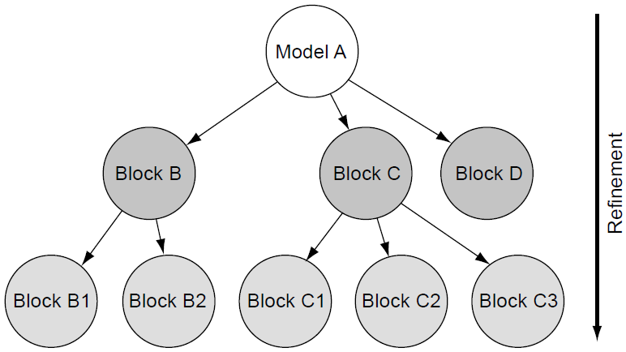
Hierarchical Model Network I
The earlier HDL discussion introduced the top-level view of a simulation model, showing the input/output interfaces and a monolithic block for the DUV model itself.
Only for the simplest models is it possible to specify the behavior of the block also as one monolithic function.
It is more natural to refine the model structurally for one or several levels by replacing the top-level block with a set of interconnected blocks on the next level of hierarchy.
Figure to the right demonstrates the structural refinement process as a hierarchy tree diagram for an example.
A tree structure illustrates on example Model A how HDL specifications can use structural refinement to build from instances of lower level elements. Model A builds on blocks B, C, and D; blocks B and C in turn instantiate components of their own, and block D contains no further structural refinement.
Notes:
Figure demonstrates the structural refinement process as a hierarchy tree diagram for an example. Model A contains blocks B, C, and D on the next level of detail. Blocks B and C themselves are partitioned into two or three sub-blocks, respectively. The top level of the hierarchy is the root; the blocks D, B1, B2, C1, C2, C3 are the leaf-level nodes. By definition, leaf-level nodes have no further structural refinement, and therefore, their functional specification is contained in one VHDL entity/architecture or Verilog module without any instances of lower-level entity/architectures or modules. The root of every sub-hierarchy (A, B, C) contains the instances of the lower levels and potentially functional HDL code.

Slide 18
Hierarchical Model Network II
The blocks of the model interconnected by signals build a network.
Because the signals have a specific direction, as shown by the arrows in the diagram, we say the model forms a directed network.
The signal flow connects the component blocks with each other.
The behavioral HDL specification of each block prescribes the application of the values of the input ports to the block’s internal computation.
The HDL behavior also specifies how output ports, and therefore the connected signals, change as result of such a computation.
The same example Model A used in previous slide shown again as a hierarchical dataflow network. Embedding lower level blocks represents the structural hierarchy. In addition, all components have input and output ports. Signals, illustrated by arrows, connect inputs and outputs of the model components to show the data flow between blocks and through the levels of hierarchy.
Notes:
Figure shows the same model hierarchy, Model A, using a dataflow model network diagram. In addition to the component hierarchy, this representation shows the flow of information, the signal flow between the different model components, and levels of hierarchy. Consider, for example, the first model input i1. It is a primary input, an input port of Model A itself. A signal s1 connects this port to the first input port of block B, which in turn drives signal s2, which connects to the first port of block B1. Inside B1, this port drives signal s3, the only visible signal inside the diagram of that block.

Slide 19
Hierarchical Model Network III
It is the task of the simulation engine to compute the values of the model signals over time.
The direction of the signals implies a natural order of computation.
It is clear that, if signal s1 changes, the signals s2 and s3 should also change to keep the values in the network consistent.
Because s3 is an input to B1, it is intuitive to assume that B1’s behavioral specification needs to be invoked when s3’s value changes.
Because of this computation, it is possible that signals s4, s5, and s6 will subsequently change in value.
The bottom figure shows an example of discrete signal waveforms over time as recorded during an HDL simulation.
Hardware description language (HDL) model signal changes over time recorded as waveforms. HDL signals have discrete values and change at discrete time intervals. The vertical lines in the waveform display help the user to align signal changes visually. The waveforms show bit-signal values simply
by level and illustrate more complex signal values by annotation, like the integer values in the lowest waveform.
Notes:
Changes of signal values designate events in the model. The model time orders events relative to each other; that is, it is important to be able to tell whether a particular event happened before another event or if it caused another event. Therefore, it is possible to look at the discrete time steps in above figure as points at which the simulation engine calculates or samples the model state.

Slide 20
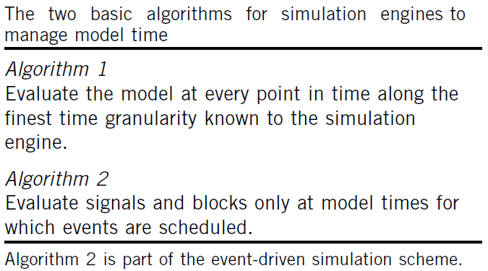

Model Evaluation Over Time
There are two fundamentally different algorithms to control simulation over time as specified in the top figure.
Algorithm 1 is useful only if it is very likely that at every evaluation time there are new values to be calculated.
Algorithm 2 can only function if the simulation engine has knowledge about which events it has to evaluate at the current time or any point in future model time.
The model objects (blocks and signals) need to notify the simulation engine about future changes.
This notification about change or update information is called scheduling.
By using the scheduling information, the simulation engine is able to skip time intervals during which no work is scheduled, a performance advantage for the simulation.
Notes:
There are two fundamentally different algorithms to control simulation over time as specified in the top figure.
Algorithm 1 is useful only if it is very likely that at every evaluation time there are new values to be calculated. Clearly, compute power would be wasted if the model was simply in a steady state at many evaluation points, and the simulation engine had to evaluate the entire model only to find out that no signal update work has to be done.
Algorithm 2 can only function if the simulation engine has knowledge about which events it has to evaluate at the current time or any point in future model time. The model objects (blocks and signals) need to notify the simulation engine about future changes. This notification about change or update information is called scheduling. By using the scheduling information, the simulation engine is able to skip time intervals during which no work is scheduled, a performance advantage for the simulation.
Bottom figure shows a classic example of HDL constructs that contain explicit scheduling information for events the simulation engine has to execute at a future model time. It illustrates a simple sequential process specifying the function of an oscillator block. The behavioral code for process oscillator iterates endlessly between setting the signal clock to “0” and “1”. After each update, the process suspends control to the simulation engine for the specified amount of model time. The HDL model code relinquishes control and delegates the scheduled future action to the simulation engine. It is part of the semantic rules in the LRM of VHDL to support Algorithm 2 in any implementation of a simulation engine.

Slide 21
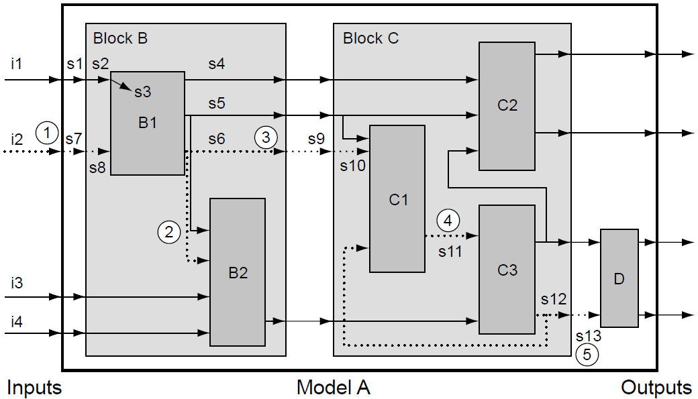
Event-Driven Control of Model Evaluation I
We assume, as an example, that a specific update occurs on the input i2.
Initially, after a series of signal changes (s7, s8), block B1 is activated, which results in a change of signal s6.
This causes a scheduled change, marked as (3), of block B’s output port, the signal connected to it (s9) and the activation of block B2 (2).
The signal change on s9 ripples into block C, causes the call of C1 and a change event on signal s11 (4).
After the activation of C3, the signals s12 and s13 change.
Because s12 is also an input to block C1, this block has to be activated again.
A change of the signal value on input i2 results in a series of updates to Model A. The dashed arrows show how the change propagates over time. The sequence of signal changes and corresponding key model updates are marked by the numbered circles.
The update sequence assuming all zero-delay events. The numbers in the shaded circles refer to the same marked key events in the top figure. The simulation engine orders the events dynamically as they occur on the model.
Notes:
Now that we decided how the engine advances time during a simulation, the next question is how the engine controls the evaluation of model updates.
Going back to the example for a hierarchical network model of Slide 18 (shown here with mark-ups in the top figure), we assume, as an example, that a specific update occurs on the input i2. Several of the key model update events are marked with the numbers 1 to 5 highlighted with shaded circles. The change event of s7 (1) propagates over time in a series of signal changes through the network until it concludes with an output signal change of s13 (5).
Initially, after a series of signal changes (s7, s8), block B1 is activated, which results in a change of signal s6. This causes a scheduled change, marked as (3), of block B’s output port, the signal connected to it (s9) and the activation of block B2 (2). Note that B2’s output does not change at this point because apparently the change on input signal s6 has no effect of B2’s output function. The signal change on s9 ripples into block C, causes the call of C1 and a change event on signal s11 (4). After the activation of C3, the signals s12 and s13 change. Because s12 is also an input to block C1, this block has to be activated again. For this example, we assume that the repeated call to C1 does not cause another output change on s11. Note that the re-activation of C1 results from a topological feedback loop, which could cause repeated calls of the same model blocks. In this example, the second activation of C1 does not cause further signal changes. Similarly, the final update of s13 and the call to block D causes no further update event.
The feedback loop in the topology exhibits how a particular block (C1) can be scheduled and re-scheduled because of a wave of updates. The feedback of the signal change of s12 leads to another evaluation of C1. Although the example assumes no further events after that evaluation, it is possible that the behavior of the model exercises the re-scheduling loop between C1 and C3 more than once. It depends on the behavior of the blocks whether such a topological loop settles at some point or continues to oscillate forever. The simulation engine or an external intervention by the user has to interrupt an uncontrolled model oscillation.
Throughout the example update sequence in the figure, block C2 was never activated, illustrating how the event-driven scheme only evaluates those parts of the DUV model that are affected by changes and successfully avoids the activation of model parts that can be skipped. Still, the topology of the model required massive updates in this case because input i2 affects many model blocks. However, changing input i4, for example, would probably result in only the activation of B2, C3, and D.
Another way to visualize the model updates of the top figure is to line up the sequence of scheduled model events over time. If the HDL for Model A specifies explicit delays for model updates (signals/gate delays or wait statements in behavioral code), the changes will spread out naturally over a range of model time controlled by the DUV specification. The simulation engine itself must order changes dynamically that have no HDL-specified model time delay (zero delay). Assuming the HDL of Model A does not use any explicit delays (zero delay model), we show every successive model event as one discrete step internal to the simulation engine in the bottom figure. Every evaluation creates a resulting update that the simulation engine schedules to occur at the beginning of the next internal step. At several points in the sequence (after the changes of s6 and s12), the simulation engine schedules more than one update in parallel. In a sequential program that simulates this network, it is effectively up to the simulation engine’s random choice to decide in which sequence the two model updates really happen; from a user view, the model actions happen in parallel.

Slide 22
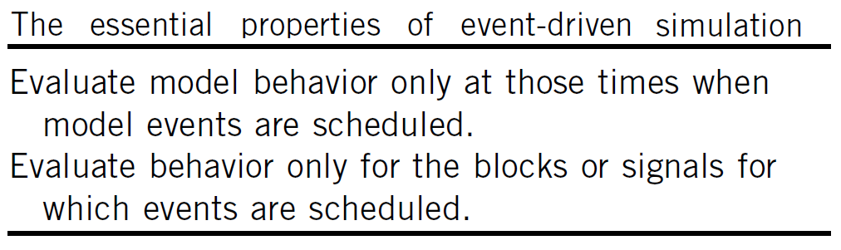
Event-Driven Control of Model Evaluation II
We call the described evaluation strategy event-driven.
Whenever an event occurs, such as the update of a signal, the simulation engine schedules the computation of all the blocks, which are sinks of this signal.
If these blocks update their output signals, the changes propagate further in the same way.
We can now combine the two key aspects of the event-driven simulation approach, shown on the figure to the right.
It appears obvious that event-driven simulation is quite efficient because the strategy implies that the simulation engine only does the work necessary to evaluate model changes.
Extraneous computations do not occur.
Notes:
Although we assumed zero-delay in previous example, the event-driven simulation algorithm is much more general. By using VHDL or Verilog time control constructs, signal updates can have delays of arbitrary amounts of model time. This simply postpones the model evaluation to another discrete model time step instead of all updates happening at the same model time. Hence, it stretches out the event sequence over simulated time but does not change the basic event-driven update mechanism.

Slide 23
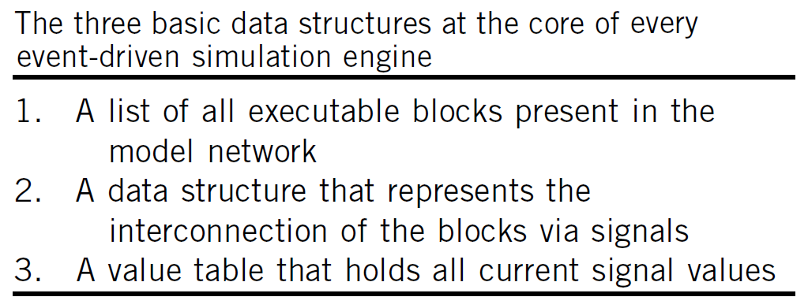
Implementation Sketch of an Event-Driven
Simulation Engine I
The simulation engine needs to maintain the data structures to represent the model network, its interconnect topology, and the current state of the model (top figure).
Conceptual diagram of the central scheduling data structure at the heart of the execution control of an event-driven simulation engine is shown on the bottom figure.
Every model time with scheduled events has a linked to-do list containing information to enable the engine to execute the event.
Every to-do list is anchored at a particular position of the time wheel.
The time wheel is a circular linked list in which every entry maintains a pointer to the to-do list for a given model time, which has scheduled activity.
The data entry current_model_time simply marks the head of the time wheel list for the current model time.
Notes:
The properties of the event-driven simulation approach can now be summarized, with a conceptual description of the basic mechanisms of an event-driven simulation engine.
The simulation engine needs to maintain the following data structures to represent the model network, its interconnect topology, and the current state of the model (top figure).
A central data structure to control activity and time progress in an event simulator is typically the so-called time wheel (bottom figure). The time wheel is a simple linked list that contains entries for every model time, current or future, for which the engine has scheduled an activity. For any such model time, the simulation engine keeps a to-do list of model blocks and signals that are scheduled. The simulation engine always takes the next item from the list for the current time, does the necessary evaluation, and proceeds to the next list item. As we have shown, the result of an evaluation can trigger the addition of list items for the current time (zero-delay) or any future time. Once the list for a current time is empty, the time wheel can “turn” to the next model time for which work is scheduled. As illustrated in the bottom figure, the engine updates the current model time simply by moving the current_model_time reference to the new head of the time wheel list.
For time zero, the start time of simulation, the simulation engine schedules all executable model blocks contained in a model. In VHDL, these are all processes and concurrent assignment statements. This approach makes sure that the simulation properly initializes all model blocks.

Slide 24
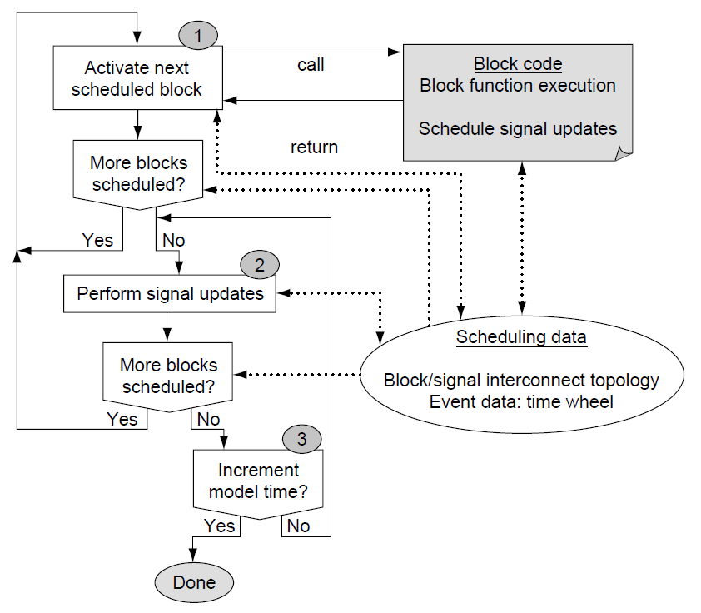
Implementation Sketch of an Event-Driven
Simulation Engine II
Notes:
The properties of the event-driven simulation approach can now be summarized, with a conceptual description of the basic mechanisms of an event-driven simulation engine.
The simulation engine needs to maintain the following data structures to represent the model network, its interconnect topology, and the current state of the model (top figure).
A central data structure to control activity and time progress in an event simulator is typically the so-called time wheel (bottom figure). The time wheel is a simple linked list that contains entries for every model time, current or future, for which the engine has scheduled an activity. For any such model time, the simulation engine keeps a to-do list of model blocks and signals that are scheduled. The simulation engine always takes the next item from the list for the current time, does the necessary evaluation, and proceeds to the next list item. As we have shown, the result of an evaluation can trigger the addition of list items for the current time (zero-delay) or any future time. Once the list for a current time is empty, the time wheel can “turn” to the next model time for which work is scheduled. As illustrated in the bottom figure, the engine updates the current model time simply by moving the current_model_time reference to the new head of the time wheel list.
For time zero, the start time of simulation, the simulation engine schedules all executable model blocks contained in a model. In VHDL, these are all processes and concurrent assignment statements. This approach makes sure that the simulation properly initializes all model blocks.

Slide 25
Improving Simulation Performance
Because event-driven simulation has been so widely used, the optimization of its performance is well understood.
The speed of simulation depends on the granularity of the model and the rate of dynamic model changes.
A model with few monolithic blocks will likely suffer from a large amount of re-scheduling overhead because of topological feedback loops.
The same DUV function modeled with a large number of primitive blocks will degrade in speed because the simulation engine must keep track of a huge amount of scheduling activity.
The optimum performance lies somewhere between these two extremes.
Less dynamic model activity improves simulation speed more in the case of fine model granularity.
Notes:
Figure illustrates the sensitivity of simulation performance in relationship to the granularity of the model. For the case of many small blocks, most time in simulation will be spent on scheduling overhead while the actual block evaluations are trivial. For the cases of large processes (VHDL) or always blocks (Verilog), the model topology will increasingly be fraught with feedback loops. Although the amount of scheduling activity is low compared with the time spent inside the code of the model blocks, the blocks are evaluated multiple times until the model converges to a steady state.
The activity rate of the model is another big factor for the performance of event-driven simulation, and therefore, figure illustrates it as another dimension. Obviously, a low activity rate helps simulation speed. The primary advantage of event-driven simulation is the ability to skip unnecessary model evaluations; however, a model with few monolithic blocks of sequential code can take less advantage of a low activity rate than can a model with finer granularity. Performance gain from low activity is only possible if there are distinct blocks of work that the engine can skip. In contrast, with a model of the finest granularity, the scheduling overhead will again cause loss of efficiency compared with a model that has an optimal balance in model block size.

Slide 26
HDLs and Simulation Engines
Cycle-Based Simulation

Slide 27
Introduction
Cycle-based simulation is a specialized technique to improve simulation efficiency.
The reason for the superior performance of cycle-based simulation engines compared with event-driven simulation is the simplicity of the algorithm and the total optimization toward a specific hardware design style - synchronous design.
Therefore, as always, a tremendous speedup comes with the disadvantage of trading off general-purpose applicability.
The downside of cycle-based simulation is that it puts severe constraints on the HDL style of the DUV.
Pure cycle-based simulation engines do not support or ignore delay controls, limit sequential constructs significantly, and do not allow most test bench-specific features of the HDLs.
Notes:
Cycle-based simulation is a specialized technique to improve simulation efficiency. It has a long history of development and successful application on the largest design and verification projects. The reason for the superior performance of cycle-based simulation engines compared with event-driven simulation is the simplicity of the algorithm and the total optimization toward a specific hardware design style - synchronous design. Therefore, as always, a tremendous speedup comes with the disadvantage of trading off general-purpose applicability.
On designs and projects in which cycle-based simulation applies, the speedup can be large. A speedup of 10 to 20 times and a DUV model size compression of more than 10 times are typically quoted; some sources even put the speedup at 100 times that of traditional event- simulation.
The downside of cycle-based simulation is that it puts severe constraints on the HDL style of the DUV. Pure cycle-based simulation engines do not support or ignore delay controls, limit sequential constructs significantly, and do not allow most test bench-specific features of the HDLs. Projects with large synchronous designs, however, can productively use cycle-based engines to speed up the DUV simulation, while leaving the test bench writing to the use of special-purpose test bench languages outside the realm of HDLs.

Slide 28
Synchronous Design
Synchronous design principle separates state-holding elements (latches, flip-flops, memory arrays) of a design from combinatorial logic.
Combinatorial logic is always “surrounded” by the state-holding elements.
Furthermore, there cannot be any feedback path in the combinational logic.
The main property of the synchronous design is that the timing and functional verification can be separated.
This separation of physical from functional concerns is the foundation for the extreme performance optimization and simplification that cycle-based simulation engines offer.
Fragment of the network model of a synchronous design. The combinational logic between the state-holding elements must be able to propagate updates faster than the clock frequency of the latches or flip-flops. The dashed arrow shows the path with the longest delay–the critical delay path of this part of the design.
Notes:
The foundation of cycle-based simulation rests on a fundamental methodology restriction that applies to many modern designs, the synchronous design principle. If we separate the state-holding elements (latches, flip-flops, memory arrays) of a design from the combinational logic, it becomes clear that the function of the combinational portion is identical to the state transition and output generation function of a FSM.
The clock signal used to update the state-holding elements synchronizes the FSM update and the progression of the design through the state space. In a first approximation, we consider a clock signal that is central and occurs at the same time for all state-holding elements, which we simply call latches. We refer to such a clock signal as a synchronous clock.
The longest delay along any update path through the combinational logic of a design defines the maximum frequency for the clock signal of a synchronous design (see figure). We call the calculation of this maximum frequency under which the design still functions correctly timing verification. The critical delay path is the longest delay path allowed from latch to latch. Any path with a longer delay leads to incorrect functioning of the circuit because the combinational result will not arrive in time to update the target latch correctly. The scheme also implies that combinational feedback loops are not possible.
Therefore, rather than using dynamic techniques that would have to apply all possible combinational input patterns, timing verification can be done with static, pattern-independent techniques. Timing verification tools process the physical netlist topologically as a graph and do not apply Boolean patterns at all. Thus, this process can be separated completely from the discipline of functional verification. Timing verification guarantees that the maximum clock frequency is low enough to enable correct electrical function of the circuit, whereas functional verification can focus exclusively on the functional content of the design.
This separation of physical from functional concerns is the foundation for the extreme performance optimization and simplification that cycle-based simulation engines offer.

Slide 29
The Cycle-Based Simulation Algorithm
The combinational logic description of a cycle-based model is devoid of timing control statements. It is a zero-delay specification and free of combinational feedback loops.
By using the primary inputs and the current values of the state-holding elements as the starting points, as well as the primary outputs and the next values of the state-holding elements as the end points, it is possible to strictly order, or levelize, all blocks of the model network.
Technically speaking the model is a directed acyclic graph (DAG).
The cycle-based simulation engine proceeds from cycle to cycle by evaluating the combinational function graph and calculating the new latch and primary output values.
In comparison to the event-driven algorithm, the cycle-based engine does not need to schedule blocks because it is clear from their position in the graph when their evaluation is necessary.
Model network for a cycle-based simulation. Starting from the network model of design under verification, the model ordering process combines all state-holding elements (marked latches) and levelizes the combinational logic blocks. Levelization starts at level 1 with all blocks that connect to model inputs or latches only. Any subsequent level n contains only blocks whose inputs connect to outputs from blocks of prior levels (maximally level n - 1). This results in an ordered directed acyclic graph as illustrated in magnifying glass view.
Notes:
The separation of timing and functional verification allows the HDL specification to be purely functional. This means that the HDL of a synchronous design needs to specify timing only for the clock signal. Even for this signal, the delay time, or cycle time, is rather arbitrary because the real cycle time can change with any iteration in the physical design process. In fact, for functional simulation all that is needed is the separation from a time at cycle “n” to the time at cycle “n + 1.” Therefore, many cycle-based simulation engines do not reference physical time measures but simply an integer that denotes the current cycle.
It is evident that this abstract view of the DUV has a close affinity to Algorithm 1 shown in Slide 20. A possible cycle-based algorithm can take the cycle as the finest time granularity and simply update the model once per cycle.
The combinational logic description of a cycle-based model is devoid of timing control statements. It is a zero-delay specification and free of combinational feedback loops. By using the primary inputs and the current values of the state-holding elements as the starting points, as well as the primary outputs and the next values of the state-holding elements as the end points, it is possible to strictly order, or levelize, all blocks of the model network. Technically speaking the model is a directed acyclic graph (DAG). Figure illustrates the basic view of this graph. By using simple gates as an example for combinational function, the magnifying glass cut-out in the figure shows the ordering of the graph, which illustrates that if signals A and B are evaluated first, signal C needs to be evaluated once only per evaluation of the state machine function.
The cycle-based simulation engine proceeds from cycle to cycle by evaluating the combinational function graph and calculating the new latch and primary output values.
In comparison to the event-driven algorithm, the cycle-based engine does not need to schedule blocks because it is clear from their position in the graph when their evaluation is necessary. Although it is possible to use an event-driven scheme within the combinational function evaluation, most cycle-based simulation engines have implemented what the literature calls the oblivious simulation algorithm. The oblivious scheme calculates all the combinational function at every simulation cycle and thus foregoes any dynamic event scheduling whatsoever. The algorithm trades off the redundant work of evaluating those parts of the model that do not change from cycle to cycle for the omission of complicated management of the to-do lists and time wheel management that are key to event-driven simulation. The oblivious algorithm is extremely simple and, most importantly, a good basis for further optimization.

Slide 30
Creating Environments
Test Bench Writing Using HDLs

Slide 31
Test Bench Writing Tools
We have already introduced the base concepts of test benches and the principles to structure them so that the resulting simulation environment is flexible and productive.
We will now discuss the tools that are at the disposal of the verification engineer to accomplish this task.
Figure to the right highlights again the relationship between the simulation engine, containing the model of the DUV, and the different forms of test benches.
We will now look more closely at VHDL features that support the actual coding of driver and checker components.
At the end we will briefly turn to test bench writing external to HDLs and simulation engines.
The relationship between the test bench and the simulation engine. A hardware description language test bench is integrated with the model of the DUV, while an external test bench uses the simulation engine’s programming interface to interact with the model.

Slide 32
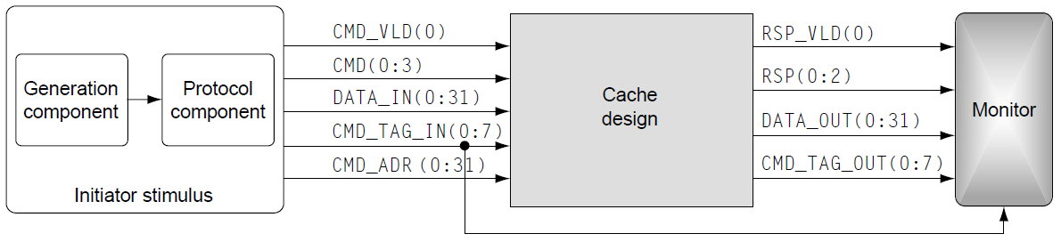
HDL Languages as Test Bench Tool
From the beginning, the creators of HDLs conceived them as simulation languages to support both design and test bench writing.
The following discussion does intend to introduce some of the fundamental concepts.
In an HDL environment, all test bench components - stimulus generators, monitors, checkers, and scoreboards - connect to the DUV structurally via signals.
In addition to the three instances - DUV, monitor, stimulus component, and their interconnecting signals - the test bench code also contains the control of a central clock.
The clk_gen process drives the clock signal with the period of 100 ns.
// Testbench
entity cache_test
end entity;
architecture beh of cache_test is
constant cycle_time_c 100 ns;
signal clk_s, cmd_vld_s, rsp_vld_s: std_logic;
signal rsp_s: std_logic_vector(2 downto 0);
signal cmd_s: std_logic_vector(3 downto 0);
signal cmd_tag_in_s, cmd_tag_out_s: std_logic_vector(7 downto 0);
signal data_in_s, data_out_s, cmd_addr_s: std_logic_vector(31 downto 0);
begin
// Instances of testbench components
stimulus: entity work.stim(beh)
port map (clk => clk_s, cmd_vld_o => cmd_vld_s, cmd_o => cmd_s,
data_in_o => data_in_s, cmd_tag_in_o => cmd_tag_in_s,
cmd_addr_o => cmd_addr_s);
monitor: entity work.mon(beh)
port map (clk => clk_s, rsp_vld_i => rsp_vld_s, rsp_i => rsp_s,
data_o => data_out_s, cmd_tag_o => cmd_tag_out_s);
// Instance of cache design
cache_unit: entity work.cache(rtl)
port map (clk => clk_s, cmd_vld_i => cmd_vld_s, cmd_i => cmd_s,
data_i => data_in_s, cmd_tag_i => cmd_tag_in_s,
cmd_addr_i => cmd_addr_s, rsp_vld_o => rsp_vld_s,
rsp_o => rsp_s, data_o => data_out_s,
cmd_tag_o => cmd_tag_out_s);
// Clock generator
clk_gen: process
begin
clk_s <= '0', '1' after cycle_time_c/2;
wait for cycle_time_c;
end process;
end architecture beh;
Notes:
From the beginning, the creators of HDLs conceived them as simulation languages to support both design and test bench writing. Verilog and VHDL are both very large languages, and at least half of the language definition is devoted to test bench writing. The following discussion does intend to introduce some of the fundamental concepts.
In an HDL environment, all test bench components - stimulus generators, monitors, checkers, and scoreboards - connect to the DUV structurally via signals (VHDL) or wires (Verilog). The explicit specification of the structural connection certainly is a basic capability of any HDL. Returning to the cache design example used earlier, VHDL code shows the implementation of the top level of a VHDL test bench shown on the figure.
In addition to the three instances - DUV, monitor, stimulus component, and their interconnecting signals - the test bench code also contains the control of a central clock. The clk_gen process drives the clock signal with the period of 100 ns. The use of a symbolically defined constant for the cycle time is a simple example of how to create parameters in the HDL with a single point of control for change.

Slide 33
Simple Generation Component
Code on the right implements a simple generator component in VHDL.
At simulation start time, the read_patterns process loads the contents of a text file into a patterns_s array. To do this it uses a procedure Load_Patterns.
The file “cache.patterns” is the actual test case. The file can contain a regression set of golden test vectors, manually written tests, or a test pattern that a generation program creates.
The generator component is prepared to read 1,024 commands and supply them to the stimulus component.
After processing all patterns, the generator waits for 1,000 ns and shuts down the simulation run.
entity generator
port (clk: in std_logic;
request_i: in std_logic;
cmd_o: out std_logic_vector(3 downto 0);
data_o: out std_logic_vector(63 downto 0);
addr_o: out std_logic_vector(31 downto 0);
tag_o: out std_logic_vector(7 downto 0));
end entity generator
architecture beh of generator is
type patterns_t is array (0 to 1023) of std_logic_vector(107 downto 0);
signal patterns_s: patterns_t;
signal ptr_s: integer := 0;
signal n_patt_s: std_logic_vector(107 downto 0);
begin
read_patterns: process
begin
Load_Patterns ("cache.patterns", patterns_s);
wait;
end process;
stim_gen: process
begin
wait until rising_edge(clk);
if (request_i = '1') then
if (ptr_s < 1024) then
n_patt_s <= patterns_s(ptr_s);
ptr_s <= ptr_s + 1;
cmd_o <= n_patt_s(3 downto 0);
data_o <= n_patt_s(67 downto 4);
addr_o <= n_patt_s(99 downto 68);
tag_o <= n_patt_s(107 downto 100);
else
wait for 1000 ns;
report "END OF SIMULATION!"
severity failure;
end if;
end if;
end process;
end architecture beh;
Notes:
This certainly is a very crude form of hard-coded control. What happens if it takes more than these time steps to process commands that might be pending in the DUV? A real production test bench must implement a more appropriate test case control, most likely in the checker component.

Slide 34
Stim Component
Stimulus component for the cache DUV.
Entity stim instantiates the generator component inside the stimulus component.
The protocol_component process inside stim implements the protocol component.
It will take a test pattern or command, newly delivered by generator, and apply it to the output of the stimulus component using the two clock cycles that the input protocol of the cache DUV requires.
The example code shown on three previous slides, illustrates a bare skeleton of a real stimulus test bench component.
The following slides hold descriptions of the additional considerations a verification engineer would include to make this example robust and usable in a production environment.
entity stim
port (clk: in std_logic;
cmd_vld_o: out std_logic;
cmd_o: out std_logic_vector(3 downto 0);
data_in_o: out std_logic_vector(63 downto 0);
cmd_addr_o: out std_logic_vector(31 downto 0);
cmd_tag_in_o: out std_logic_vector(7 downto 0));
end entity stim;
architecture beh of stim is
signal n_cmd_s: std_logic_vector(3 downto 0) := (others => '0');
signal n_data_in_s: std_logic_vector(63 downto 0) := (others => '0');
signal n_addr_s: std_logic_vector(31 downto 0) := (others => '0');
signal n_tag_s: std_logic_vector(7 downto 0) := (others => '0');
signal request_s: std_logic := '1';
begin
gen: entity work.generator(beh)
port map (clk => clk, request_i => request_s, cmd_o => n_cmd_s,
data_o => n_data_in_s, addr_o => n_addr_s,
tag_o => n_tag_s);
protocol_component: process
begin
cmd_vld_o <= '0';
cmd_o <= (others => '0');
data_in_o <= (others => '0');
cmd_addr_o <= (others => '0');
cmd_tag_in_o <= (others => '0');
loop
wait until rising_edge(clk);
cmd_vld_o <= '1';
cmd_o <= n_cmd_s;
data_in_o <= n_data_in_s(31 downto 0);
cmd_addr_o <= n_addr_s;
cmd_tag_in_o <= n_tag_s;
request_s <= '0';
wait until rising_edge(clk);
cmd_vld_o <= '0';
cmd_o <= (others => '0');
data_in_o <= n_data_in_s(63 downto 32);
cmd_addr_o <= (others => '0');
cmd_tag_in_o <= n_tag_s;
request_s <= '1';
end loop;
end process;
end architecture beh;
Notes:
Figure instantiates this generator inside the stimulus component. We explained that it is important to separate the generator and the protocol components. Such a structure reflects the different areas of concern addressed by these components. If the generation process needs to be changed radically, the protocol component should remain untouched and vice versa.

Slide 35
Verilog Test Bench
// Testbench
module cache_test;
`define CYCLE_TIME 100
wire CMD_VLD, [0:3]CMD, [0:31]DATA_IN, [0:7]CMD_TAG_IN, [0:31]CMD_ADDR;
wire RSP_VLD, [0:2]RSP, [0:31]DATA_OUT, [0:7]CMD_TAG_OUT;
reg CLK;
// instances of testbench components
stim STIM (CLK, CMD_VLD, CMD, DATA_IN, CMD_TAG_IN, CMD_ADDR);
mon MON (CLK, RSP_VLD, RSP, DATA_OUT, CMD_TAG_OUT);
// instance of cache design
cache CACHE (CLK, CMD_VLD, CMD, DATA_IN, CMD_TAG_IN, CMD_ADDR,
RSP_VLD, RSP, DATA_OUT, CMD_TAG_OUT);
// clock control
initial begin
forever begin
CLK = 0;
#CYCLE_TIME/2; // this is where the time progress is controlled
CLK = 1;
#CYCLE_TIME/2;
end
end
endmodule
Notes:
From the beginning, the creators of HDLs conceived them as simulation languages to support both design and test bench writing. Verilog and VHDL are both very large languages, and at least half of the language definition is devoted to test bench writing. The following discussion does intend to introduce some of the fundamental concepts.
In an HDL environment, all test bench components - stimulus generators, monitors, checkers, and scoreboards - connect to the DUV structurally via signals (VHDL) or wires (Verilog). The explicit specification of the structural connection certainly is a basic capability of any HDL. Returning to the cache design example used earlier, VHDL code shows the implementation of the top level of a VHDL test bench shown on the figure.
In addition to the three instances - DUV, monitor, stimulus component, and their interconnecting signals - the test bench code also contains the control of a central clock. The clk_gen process drives the clock signal with the period of 100 ns. The use of a symbolically defined constant for the cycle time is a simple example of how to create parameters in the HDL with a single point of control for change.

Slide 36
Verilog Generation Component
// Stimulus Component
module generator(CLK, REQUEST, CMD, DATA, ADDR, TAG)
input CLK, REQUEST;
output [0:3]CMD, [0:63]DATA, [0:31]ADDR, [0:7]TAG;
reg [0:3]CMD, [0:63]DATA, [0:31]ADDR, [0:7]TAG;
reg [0:107] patterns[0:1023], [0:10]ptr;
reg [0:107] n_patt;
intial begin
$readmemh("cache.patterns", patterns); ptr = 0; ready = 1;
end
always @(posedge CLK)
begin
if (REQUEST)
begin
if(ptr < 1024)
begin
n_patt = patterns[ptr]; ptr = ptr + 1;
CMD = n_patt[0:3]; DATA=n_patt[4:67]; ADDR=n_patt[68:99]; TAG=n_patt[100:107];
end
else begin
#1000;
$display("Simulation Done!");
$finish();
end
end
end
endmodule
Notes:
This certainly is a very crude form of hard-coded control. What happens if it takes more than these time steps to process commands that might be pending in the DUV? A real production test bench must implement a more appropriate test case control, most likely in the checker component.

Slide 37
Verilog Stim Component
module stim (CLK, CMD_VLD, CMD, DATA_IN, CMD_TAG_IN, CMD_ADDR) ;
input CLK;
output CMD_VLD, [0:3]CMD, [0:31]DATA_IN, [0:7]CMD_TAG_IN, [0:31]CMD_ADDR;
reg CMD_VLD, [0:3]CMD, [0:31]DATA_IN, [0:7]CMD_TAG_IN, [0:31]CMD_ADDR;
reg [0:3]N_CMD, [0:63]N_DATA_IN, [0:31]N_ADDR, [0:7]N_TAG_IN;
reg REQUEST;
// instantiate generator
generator GENERATOR(REQUEST, N_CMD, N_DATA_IN, N_ADDR, N_TAG_IN);
task write_command; // protocol component
begin
@(posedge CLK);
CMD_VLD = 1; CMD = N_CMD;
DATA_IN = N_DATA_IN[0:31]; CMD_ADDR = N_ADDR; CMD_TAG_IN = N_TAG_IN;
REQUEST = 0;
@(posedge CLK);
CMD_VLD = 0; CMD = 0;
DATA_IN = N_DATA_IN[32:63]; CMD_ADDR = 0; CMD_TAG_IN = N_TAG_IN;
REQUEST = 1;
end
endtask
initial begin
CMD_VLD = 0; CMD = 0; DATA_IN = 0; CMD_TAG_IN = 0; CMD_ADDR = 0;
N_CMD = 0; N_DATA_IN = 0; N_ADDR = 0; N_TAG_IN = 0; REQUEST = 1;
forever begin
write_command(); // apply command using correct protocol
end
end
endmodule
Notes:
Figure instantiates this generator inside the stimulus component. We explained that it is important to separate the generator and the protocol components. Such a structure reflects the different areas of concern addressed by these components. If the generation process needs to be changed radically, the protocol component should remain untouched and vice versa.

Slide 38
Additional Considerations - Parameterization
Separating central decisions from actual code and encoding them as parameters is always helpful to make the test bench easily adaptable to different usage situations.
For example, it would be much better to read in the name of the test case file “cache.patterns” from outside the test bench.
This way a team can keep many different test case files in a single directory of a file system at the same time.
We call such a collection of test cases a test case bucket.

Slide 39
Additional Considerations – Debug Trace File Generation
Both VHDL and Verilog have a number of facilities to write out debug information
For example, the report and write commands lets a user write text and signal values to the console
In Verilog $monitor/$fmonitor with a list of signals, name/value pair will be written on a screen (or in the file) for each change of referenced signals
Using such directed debug trace mechanisms allows a focused diagnosis of test bench problems.
Of course, the verification can always use the trace file data, if the simulation engine supports one natively.

Slide 40
Additional Considerations – Randomization I
The stimulus generation shown is completely deterministic. To fulfill any reasonably complete test plan, the actual tests must vary over a number of properties of the cache design interface:
  Different commands, different sequences of commands.
  Different temporal spacing between the command, i.e., up to eight commands back-to-back in sequence, different dead cycles between back-to-back commands.
  Different and colliding target addresses.
  A wide variation of the data values is probably not important.
With the given test bench, the verification team can only accomplish this variation by creating many different “cache.patterns” files, which cover these cases.
It is possible to move some of the variability into the test bench code itself.
Verilog offers a number of system tasks that support randomization. The most obvious is $random(), which returns a 32-bit random integer value. VHDL has no built-in randomization constructs, but the power of the language supports many different ways to define random number generators. For an example of an elaborate package for random number generation, refer to VHDL Random Number Generation Package
These function support a “seed” parameter whose importance is explained on the next slide.

Slide 41
Additional Considerations – Randomization II
An important aspect of working with randomized testing is that the verification must be able to repeat any simulation run.
If a simulation reveals a design error (or test bench error) it is necessary to rerun the simulation, perhaps many times, to support debug and later the validation of a fix.
For the difficult bugs, it is also desirable to package the conditions that lead to the problem and be able to rerun the exact scenario for regression purposes.
Repeatability is trivial for pre-generated tests if the test files are stored in a file system. However, if runtime randomization is used, it is vital to supply seeds to the random number generation functions. Using the same seed will guarantee that the simulation engine will repeat the generation of a sequence of random numbers in exactly the same way.
If a test bench uses runtime randomization in many different places, explicit random seed management is advisable. This means that the code should collect and set all seeds at one or only a few central places. Such an organization will make it easier to support a controlled exact rerun of a simulation test for debug or regression.
Notes:
Verification engineers can use randomization either to pre-generate deterministic tests or during the runtime of a test bench-driven simulation. In either case, it is important, for the completion of the verification plan, that the project tracks which of the cases the stimulus component actually applied. The methods and techniques of this verification coverage tracking will be discussed in the second half of this chapter.
It is important that test bench writers understand the statistical characteristics of the random distribution they select in their stimulus components. This is even more important if there are holes suspected in the coverage tracking done by the project. HDL test bench implementations whose random distributions are deficient can leave dangerous coverage holes if a project relies on a specific distribution.

Slide 42
Random Number Generators
A pseudorandom number generator (PRNG) is an algorithm for generating a sequence of numbers that approximates the properties of random numbers.
The sequence is not truly random in that it is completely determined by a relatively small set of initial values, called the PRNG's state.
A random seed (or seed state, or just seed) is a number (or vector) used to initialize a pseudorandom number generator.
Typically, random number generators generate random numbers according to the uniform probability distribution.
There are also random number generators that generate random numbers with different probability distributions (normal, exponential, Poisson, etc.)

Slide 43
Creating Environments
High-Level Verification Languages

Slide 44
High-Level Verification Languages (HVLs)
During the past few years, special purpose languages for test bench writing have gained much focus and popularity.
These HVLs are a variety of domain-specific languages. Such languages have built-in functionality targeted for one specific application domain.
The idea is that if the vocabulary of such a language is built directly in terms of the application area, users will learn more easily how to use the language and will be instantly more productive compared with using a general-purpose programming language.
Currently the most popular HVLs are:
  OpenVera and SystemVerilog marketed by Synopsys,
  e language from Verisity (now under Cadence),
  SystemC - a large C++ library that supports high-level hardware design, modeling, simulation, and verification

Slide 45
Features of HVLs
All HVLs usually provide the following basic functionality:
Simulation independence
  is fundamental for any such language. This allows the verification engineer to write a test bench that is portable between simulation engines from different vendors.
Full visibility to all HDL model objects (signal, registers, arrays, etc.)
  is necessary to control all aspects of the DUV. It must be possible to read and write these model facilities.
High-level programming language features
  such as complex data types, object-oriented class definitions, and modularity are another requirement that all popular HVLs share.

Slide 46
Additional Features of HVLs
Temporal Expressions
  The specification of sequences of events over time is at the heart of complex assertion checking. The HVLs have built-in constructs to express such temporal expression concisely.
Constrained Random Generation
  Random generation of stimulus is one of the core capabilities of an efficient test bench. Thus far, the discussion of randomization has been limited to the probabilistic selection of a single value. Interfaces of real-life DUVs will not allow the free randomization of input signals and busses. There are two dimensions for constraints on input interfaces:
    First is the value dependency of between different signals at the same time.
    Second are value dependencies over time.
  HVLs offer built-in features to express constraints, thus making the authors of driver code more productive.
Coverage Collection
  One important measure of the quality of the verification cycle is the quantification of how much of the design functionality the simulation process has covered. HVLs offer built-in mechanisms to express which coverage information to collect over time. These data supply the verification team with information about which goals the test bench has hit during simulation.

Slide 47
Creating Environments
Other Test Bench Tools

Slide 48
Scripting Languages
Before EDA companies focused on verification as a bottleneck for hardware design projects and developed HVLs as productivity aid, verification teams made use of scripting languages to write test benches and generate tests.
In the open source domain, there is a number of scripting languages that support rapid development of software (Perl, TCL, Python).
The advantages of a scripting language are usually:
  Interpreted execution: no compile and link cycle
  Weak type system: no tedious type declarations for data variables
  High-level data types: lists, dictionaries, hash-maps
  Strong support of text processing
  Easy access to operating system services: files, directories, data management systems
However, there is typically a 5 to 10 times performance gap between an interpreted scripting language and a compiled programming language. This strong disadvantage severely limited the success of scripting languages as test bench authoring tools.
Notes:
Simulation runs are usually not standalone activities. There is a need to maintain the HDL and test bench code in source code libraries. Setting up a simulation run is preceded by a checkout of source code, compile, model build, and job distribution to a host simulation machine, and in the end the collection and triage of simulation results. Many of these data management and preparation activities can greatly benefit from the use of the flexible, highly productive scripting languages. Therefore, a verification engineer should be fluent in at least one or two of them.

Slide 49
Waveform Editors
There have been many attempts to use a graphical language to specify test bench behavior.
Waveforms or timing diagrams are a very popular method to convey expected or generated signal changes in documentation of hardware interfaces.
Consequently, waveform editors have been promising approaches for graphical test bench authoring.
One of the limitations of strictly graphical waveforms is that they only specify one scenario.
Once a more complex specification is finished, the daily maintenance of updates, such as signal name and property changes, requires typically more work in a graphical than a textual representation.
Consequently, timing diagrams and waveform editors have been limited to small design block simulation.
Notes:
On the other hand, timing diagrams are a powerful and efficient communication medium between designers and verification engineers. Because of the popularity of waveforms in their informal use with paper and pencil, there remains hope that at some point an effective user interface technology will open timing diagram specification to a wider verification audience.

