Slide 1
Funkcionalna verifikacija hardvera
Predavanje IV

Slide 2
Sadržaj lekcije
Jezici za opis hardvera i simulatori
  Jezici za opis hardvera
  Simulatori: uvod
  Simulacija vođena događajima
  Simulacija na nivou takta
Kreiranje okruženja
  Kreiranje testnih okruženja korišćenjem HDL-a
  Jezici za verifikaciju visokog nivoa (HVL)
  Alati korišćeni u testnom okruženju

Slide 3
HDL i simulatori
Jezici za opis hardvera

Slide 4
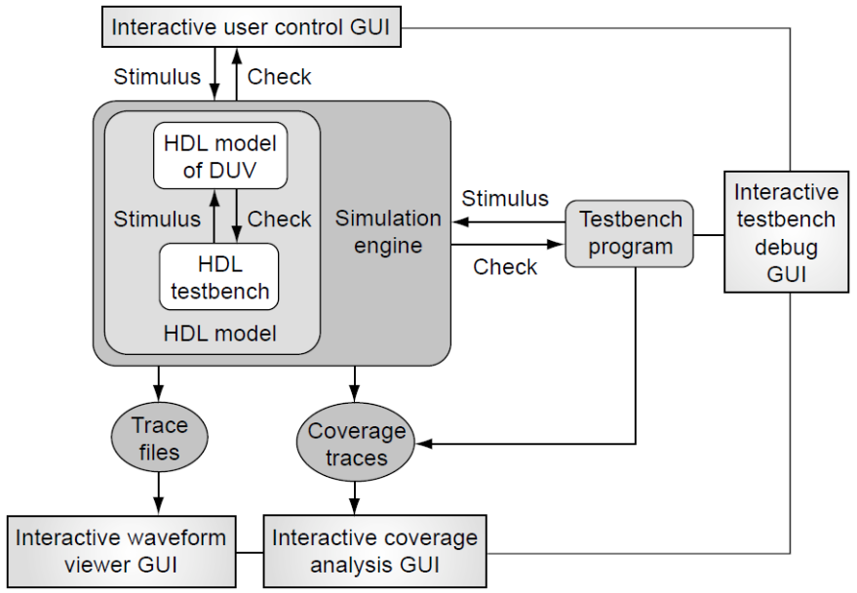
Uvod
Projektanti dizajna uobičajeno koriste HDL jezike kako bi definisali funkciju i strukturu dizajna koji se verifikuje (DUV)
Specifikacija dizajna u tekstualnom HDL formatu, koji se naziva unos dizajna (design entry), omogućava inženjeru da nedvosmisleno opiše DUV i kasnije ga izvršava kao model unutar simulatora
Radi bolje podrške simulacionim zadacima, HDL jezici sadrže funkcionalnosti koje prevazilaze puki opis hardvera i uključuju specifikaciju stimulusa i komponenti za proveru, koji zajedno formiraju testno okruženje
Postoji niz različitih algoritama za razvoj simulatora. Budući da oni igraju ključnu ulogu u toku verifikacije zasnovane na simulaciji, na ovom predavanju će biti reči o njihovim tipičnim arhitekturama.
Pregled glavnih simulacionih alata gde simulator izvršava model dizajna koji se verifikuje (DUV) kao i testno okruženje definisano u jeziku za opis hardvera.Verifikacioni tim može primeniti stimulus i proveravati model na dva dodatna načina: putem eksternog testnog okruženja izvan samog simulatora ili korišćenjem interaktivnog kontrolnog korisničkog interfejsa. Osenčeni pravougaonici predstavljaju skup grafičkih korisničkih interfejsa koji se tipično isporučuju uz ove alate kako bi se povećala produktivnost procesa verifikacije
Notes:
Design engineers normally use an HDL to define the function and the structure of a design under verification (DUV). Specifying a design in the text format of an HDL, an activity called design entry, allows the engineer to document the DUV unambiguously and later execute it as a model in a simulation engine. The HDL version of the DUV is also the basis for the physical implementation of the design. To better support the simulation task, HDLs have features that go beyond the mere description of the design and include the specification of stimulus and checking components, which form an HDL test bench. When we characterize the typical elements of HDLs as design specification tools in this lecture, using VHDL as prime example.
There are a variety of algorithms available to build simulation engines. Because the simulation engine plays such a crucial role in the center of the simulation-based flow, typical architectures of such engines are discussed in this lecture. It is important that verification engineers understand the characteristics of such tools at their disposal. Electronic design automation (EDA) developers build tools such as simulation engines around different sets of tradeoffs, many of which select between accuracy and speed. The verification team must choose those tools that are most adequate for their given project.
Many simulation engines offer an interactive graphical user interface (GUI), which lets the user apply individual stimulus and check commands manually in between simulation steps of the model. Such interfaces, which support a detailed debug mode, are effective mainly on smaller models or very specific debug situations. When working with larger-sized DUVs, the verification engineer lets the simulation engine save the results of a simulation run to trace files, which capture simulated model states over time. As also shown in the figure, waveform viewer tools let the user browse through these results files in various ways, for example, forward and backward in simulation time, to inspect and debug the model behavior in detail.
For many verification tasks, the users do not find the test bench features of the HDL sufficient. Therefore, most simulation engines provide open interfaces that support the application of checks and stimuli from a programming or test bench authoring language.
It is already apparent from the figure that many simulation tools present an interactive GUI to the designer. A very common approach is to integrate the different GUI tasks under one single master GUI, which then gives the user the view of a single integrated HDL and verification development environment even if the implementation underneath consists of separate tools.
All major EDA companies offer many of these tools, often integrated into one GUI framework. The benefit of the Institute of Electrical and Electronics Engineers (IEEE) standardization of the HDLs is that many simulation engines are largely interchangeable with each other. The differentiation comes from simulation speed and value-add features such as the integration of the other simulation tasks: coverage, test bench program support, and user-friendliness for debug.

Slide 5
Jezici za opis hardvera
HDL jezici predstavljaju ključne alate koje projektanti dizajna koriste za specifikaciju ponašanja, kao i funkcionalne i fizičke particije hardverskog dizajna
Ideja o formalnom jeziku za specifikaciju ponašanja hardvera datira još iz 1960-ih godina
Slično konceptu programskih jezika, ideja je bila da se koristi formalna, mašinski čitljiva sintaksa sa jasno definisanom semantikom kako bi se omogućila nedvosmislena specifikacija datog hardverskog dizajna

Slide 6
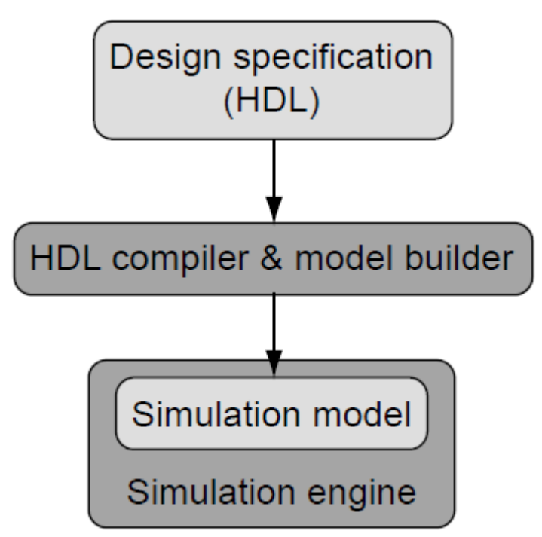
Nivoi modelovanja HDL-a I
Pored same specifikacije dizajna, primarna svrha korišćenja HDL jezika oduvek je bila automatsko prevođenje HDL teksta u simulacioni model
Slika desno prikazuje tok izgradnje modela od HDL opisa do samog simulatora
Simulator izvršava model i omogućava verifikacionom inženjeru interakciju sa njim u različitim trenucima tokom simulacije
Dva glavna jezika za opis hardvera koji se danas koriste u industriji su Verilog i VHDL
IEEE je definisao standarde za oba jezika (VHDL IEEE 1076, Verilog IEEE 1364), a svi vodeći proizvođači EDA alata podjednako podržavaju oba standarda
Ovaj tok pokazuje kako program za obradu jezika (kompajler) čita specifikaciju dizajna koji se verifikuje (DUV) napisanu u jeziku za opis hardvera i na kraju generiše simulacioni model. Korisnik može izvršiti kompajlirani model pozivanjem simulatora, koji učitava model DUV-a i vrši njegovu evaluaciju

Slide 7
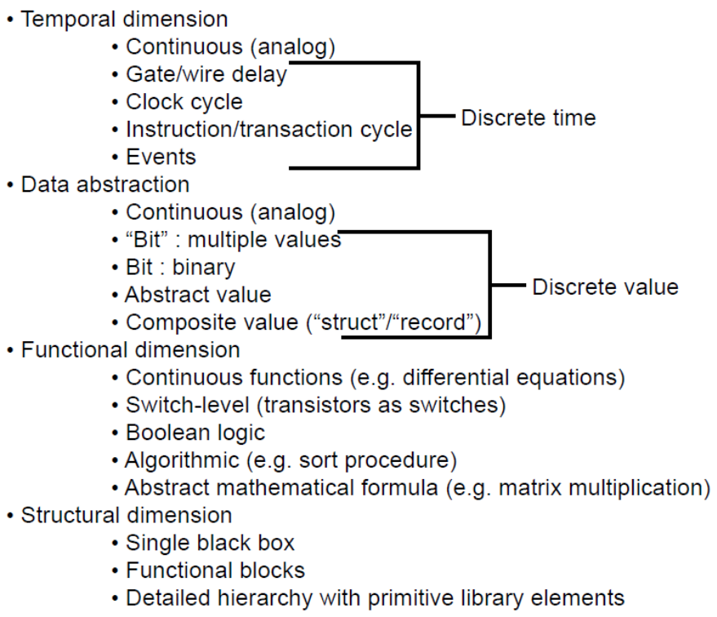
Nivoi modelovanja HDL-a II - Dimenzije modelovanja
Glavni atributi dizajna na najvišem nivou modelovanja su njegovi ulazi i izlazi, kao i samo ponašanje DUV-a
Jedan od načina za opisivanje ponašanja jeste jednostavna specifikacija vrednosti ulaznih signala i odgovarajućih vrednosti izlaznih signala u toku vremena
Sistematičniji pristup specifikaciji ulazno-izlaznog (I/O) ponašanja podrazumeva opis svojstava dizajnerskog bloka i njegovih I/O portova kroz četiri različite dimenzije modelovanja
Ove četiri dimenzije modelovanja prikazane su na slici desno
Vremenska dimenzija se bavi vremenskim odnosima u ponašanju DUV-a
Apstrakcija podataka definiše skupove vrednosti za signale DUV-a
Specifikacija funkcionalnih odnosa između ulaza i izlaza DUV-a pripada funkcionalnoj dimenziji
Strukturna dimenzija je relevantna kada projektanti dizajna ne definišu DUV preko funkcionalnog ponašanja, već kreiranjem složenijeg DUV-a od jednostavnijih gradivnih blokova
Notes:
The temporal dimension is necessary to describe behavior over time, which is always observable as change of model state. The values of I/O signals or state-holding variables inside the DUV represent the state of the model. An analog simulation system lets us specify behavior in continuous time, fairly close to the physical model of an electrical circuit. Gate and wire delays are more abstract; they are the first example of discrete time in the list of increasing temporal abstraction shown in figure. They measure the time it takes to propagate changes of signal values through the elements of a model. Every change occurs abruptly at the outputs of these elements. The notion of clock cycle abstracts time further: on this level, we are only interested in sampling signal values at specific periodic, recurring points in time. A DUV specification uses the most abstract notion of time when it views changes of model state only as occurrences of instructions or transactions. The model is still sampled periodically, but the measure of time is the completion of units of work in the model. Finally, the most abstract notion of time knows only abstract events. The only concern at this level is the mere precedence of observed changes of model state. For the purpose of the level of verification discussed in this book, we will limit ourselves to discrete time.
In the dimension of data abstraction, it is useful to distinguish five different levels to describe model state. Again close to the physical model of a circuit is the notion of a continuous value, typically a voltage measure. At a level more abstract, multi-value simulation engines or HDL signal types allow for granular representations of a signal state as a multi-valued “bit”. A multi-valued bit signal or variable can assume values besides the strict binary “0” and “1”. For example, values like “u” or “x” specify the states “un-initialized” or “unknown”, respectively. Other value denotations are useful to distinguish signal strength and are helpful to simulate bus signals with multiple sources. The more abstract binary representation of bit is central to the type of verification discussed here. Abstract values are much better suited than are simple bits and collection of bits to encode the actual intention of the design and the semantic meaning implied by a signal state. However, integer, floating-point, or text string types are equally suited to serve as abstract values. From this more abstract specification, the bit encoding is a question of implementation. Finally, at the end of the list of data abstractions, composite values can package together several abstract values to one structured object, similar to records or C-language like structs, which allow users to refer to complex composite values or states in a very concise way.
For the specification of the behavior of a DUV, we can choose from the different abstraction levels in the functional dimension. Clearly related to the continuous domain in the dimensions of data abstraction and temporal abstraction is the use of continuous mathematical functions such as differential equations. Next, the abstractions of transistors to switch-level elements yield a concise model for detailed custom-circuit simulations. So-called gate-level and register-transfer models (explained below) use Boolean logic as the base for the specification of functional blocks built from Boolean elements. Further abstracted forms of specification use general programmed algorithms to define functionality. For example, a sort algorithm that sorts different key entries in a buffer can concisely use a bubble-sort subroutine regardless of how the real hardware implements the function in Boolean logic later. If our simulation system and HDL support built-in high-level data types and operators, such as matrices and their multiply operators, the behavioral function of a block can be defined most concisely with an abstract mathematical formula.
The fourth and final important dimension of our modeling taxonomy is the structural dimension. We can describe a design as a single amorphous black box without any structural content, for example, a fast Fourier transformation (FFT) design described with abstract mathematical formulas. More typical is the breakdown of a single black box to a set of interconnected functional blocks in a refinement step. Although such simple structural refinement implies at least two levels of hierarchy, the most granular structural partitioning uses potentially many levels of detailed hierarchy, all the way to a library of pre-defined primitive elements.

Slide 8
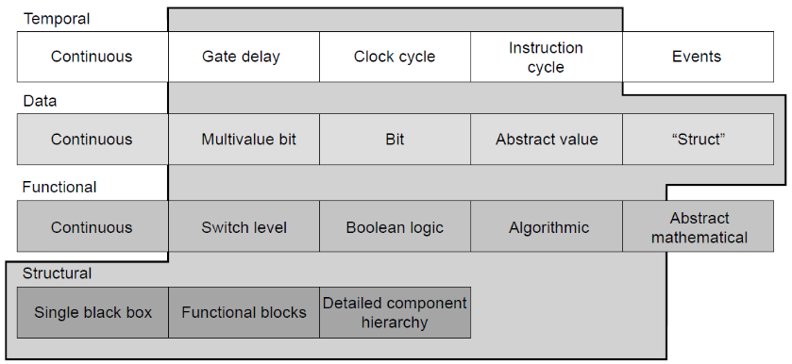
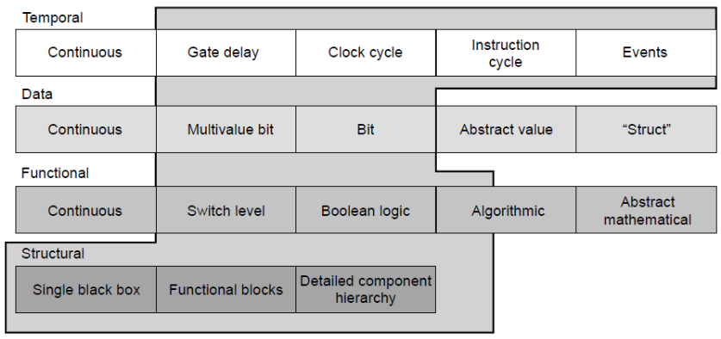
Zastupljenost dimenzija modelovanja u VHDL i Verilog jeziku
Fokus VHDL-a je prevashodno na višim nivoima apstrakcije, što se ogleda u podršci za korisnički definisane tipove podataka, preklapanje funkcija (function overloading) slično programskim jezicima i definisanje složenih kompozitnih tipova podataka putem zapisa (records)
Sa druge strane, VHDL podržava logiku na nivou prekidača (switch-level) i višeznačnu logiku isključivo kroz otvorene korisničke pakete, bez direktne podrške unutar samog jezika
Oba jezika se ističu svojom fleksibilnošću u izražavanju strukturne dekompozicije i hijerarhije, što je i očekivano u oblasti gde se HDL suštinski razlikuje od konvencionalnih programskih jezika
Ugrađena podrška za apstraktne događaje (events) u Verilog-u nema direktan ekvivalent u VHDL-u, gde projektant mora modelovati pojavu događaja kao promenu vrednosti signala
Coverage of modeling levels by VHDL
Coverage of modeling levels by Verilog
Notes:
Verilog covers large parts of the non-analog domain in all dimensions. Verilog has direct built-in support for switch-level modeling, which gives it a clear performance edge over VHDL in this area. VHDL’s focus is decidedly on higher-levels of abstractions with its support for user-defined data-types, programming-language-like function overloading, and the support to define complex composite data types with records. On the other hand, VHDL supports switch-level and multi-value logic only specified as open-ended user packages without direct language support versus the built-in but fixed capabilities of Verilog. The trade-offs between the languages are generality and flexibility versus performance.
Both languages excel in their flexibility to express structural decomposition and hierarchy as one would expect in an area where an HDL is most fundamentally different from a programming language. After all, it is a central design technique in hardware design to build more complex hardware modules from simpler building blocks. The definition of modules (Verilog) or entities (VHDL) that represent such re-usable building blocks, their instantiation, and the interconnection of the instances via signals is a basic activity of HDL-based logic design.
It is interesting to note that Verilog’s built-in support for abstract events has no counterpart in VHDL, in which the designer has to model the occurrence of an event as a change of a signal value.
The IEEE standard called VHDL-AMS (IEEE 1076.1) extends VHDL to cover the continuous domains (time and data values).

Slide 9
Verifikacioni aspekti HDL jezika
Upotreba HDL jezika u verifikaciji nije ograničena samo na simulaciju specifikacije hardverskog dizajna (DUV)
Moderni HDL jezici takođe uključuju konstrukcije koje podržavaju verifikacione zadatke
Aspekti verifikacije pokrivaju dve različite oblasti:
  Zapisivanje namere dizajna (design intent) korišćenjem logičkih tvrdnji (assertions)
  HDL funkcionalnosti za kreiranje testnih okruženja
U okviru ovog predavanja fokusiraćemo se isključivo na drugu oblast

Slide 10
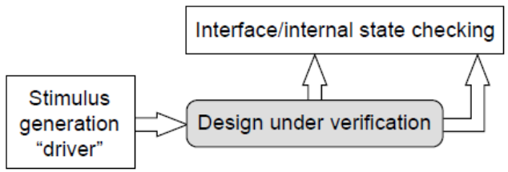
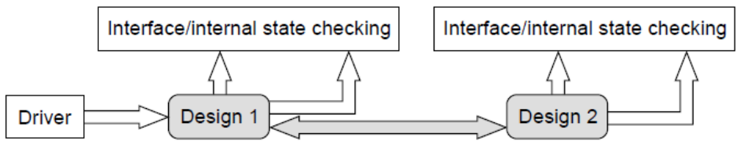
HDL testna okruženja I
Testno okruženje za dati dizajn ima dva osnovna zadatka (gornja slika):
  Generisanje stimulusa na primarnim ulazima dizajna pomoću drajvera (drivers)
  Provera interfejsa i unutrašnjeg stanja dizajna
Dobra je praksa da se testno okruženje podeli na najmanje dve particije u skladu sa ovim osnovnim zadacima
Ponovna upotreba resursa uloženih u komponente za proveru na interfejsima i unutar samog dizajna je veoma poželjna, s obzirom na to da se u realnim sistemima dizajn povezuje sa interfejsima prethodno samostalno verifikovanih jedinica
Na gornjoj slici, drajver je odvojen od komponente za proveru, dok veći model na donjoj slici i dalje sadrži komponente za proveru funkcionalnih jedinica, ali su drajveri zamenjeni susednim realnim delovima dizajna
Osnovno testno okruženje u jeziku za opis hardvera predstavljeno je komponentama za generisanje stimulusa i proveru ispravnosti
Primer ponovne upotrebe testnog okruženja u jeziku za opis hardvera
Integracijom Design1 i Design2 u veći DUV, cilj je ponovna upotreba što većeg dela simulacionog okruženja koje je korišćeno za njihovu pojedinačnu verifikaciju. Dok Design1 zamenjuje drajver komponentu za Design2, sve komponente za proveru ostaju upotrebljive u ovoj konfiguraciji, kao i drajver komponenta za Design1

Slide 11
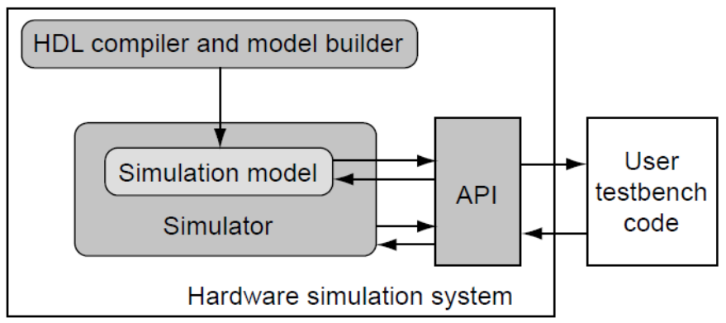
HDL testna okruženja II
HDL kodiranje drajvera i komponenti za proveru ne mora da ispunjava ograničenja koja važe za HDL opis samog dizajna, pa je na raspolaganju pun opseg dostupnih konstrukcija jezika
Komponente testnog okruženja intenzivno koriste HDL konstrukcije visokog nivoa i bihevioralne opise koji imaju malu ili nikakvu primenu u čistoj specifikaciji hardvera:
  Apstraktni tipovi podataka, zapisi (records) i višedimenzionalni nizovi
  Rad sa datotekama (File I/O)
  Podprogrami, taskovi i konkurentno izvršavanje (fork/join)
  Dinamička alokacija memorije (npr. za potrebe tabele rezultata)
Većina navedenih funkcionalnosti jezika veoma je slična onima koje nude konvencionalni programski jezici
Stoga, održiva alternativa HDL kodiranju testnih okruženja jeste upotreba programskih jezika opšte namene koji pristupaju simulacionom modelu preko programskog interfejsa samog simulatora
Upotreba programskog jezika izvan samog simulatora, koji modelu pristupa putem programskog interfejsa aplikacije (API), predstavlja alternativu korišćenju testnih okruženja napisanih u jezicima za opis hardvera
Notes:
The HDL coding for drivers and checkers does not need to satisfy any of the non-verification constraints imposed on design HDL. Therefore, the full range of HDL constructs is available. Test bench components are the area of heavy use of the higher-level, behavioral HDL constructs, which have little or no application in pure design specifications:
Abstract data types, records, multi-dimensional arrays
File I/O
Subprograms, tasks, fork/join
Dynamic memory allocation (e.g., for scoreboarding)
Most of the language features listed here are very similar to what programming languages offer. Therefore, a viable alternative to using HDL coding for test benches is the use of a general-purpose programming language that has access to the simulation model via a programming interface to the simulation engine.
As shown in the figure, simulation engines usually offer an application-programming interface (API) that lets test bench code written in programming languages interact with the simulation engine and the model. There are even simulation engine-independent standard definitions of such interfaces. Verilog programming-language interface (PLI) is part of the language’s IEEE standard. A corresponding activity for VHDL is under way.
The availability of standard interfaces to simulation engines and the desire to improve productivity for verification led to the development of special-purpose verification languages (Vera, e, System C languages), which use the available API or PLI of various commercial simulation engines. The focus on the verification task alone in these languages led to the development of innovative features supporting the verification task.
The acceptance of these so-called high-level verification languages (HVLs) in turn created the motivation for HDL developers to add such features directly into hardware description languages. Many extensions over IEEE Verilog found in SystemVerilog are directly verification related.

Slide 12
Jezici za opis hardvera i simulatori
Simulatori: Uvod
1

Slide 13
Simulatori: Uvod
Zadatak simulatora je da vrši evaluaciju HDL modela kroz vreme i prikazuje njegovo stanje korisniku i programima koji su povezani preko programskog interfejsa
Priručnik za jezik (LRM – Language Reference Manual) definiše ponašanje simulatora
U same definicije Verilog i VHDL jezika ugrađen je koncept simulacije vođene događajima (event-driven simulation), koji nudi algoritam pogodan za podršku svim funkcionalnostima oba HDL-a
U nastavku predavanja detaljnije ćemo analizirati šemu simulacije vođene događajima, kao i različite metode za povećanje propusne moći simulacije
Pregled tehnologija simulatora završićemo analizom simulacije na nivou takta koja predstavlja brzu alternativu simulaciji vođenoj događajima i oslanja se na metodologiju koja verifikacionom timu omogućava obavljanje većeg dela funkcionalne verifikacije na apstraktnom RTL modelu

Slide 14
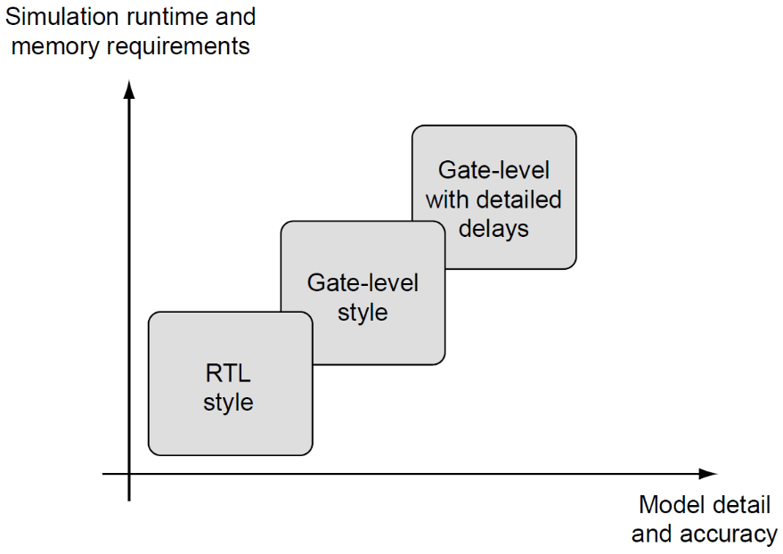
Kompromis između brzine i preciznosti
Simulator predstavlja ključni alat za verifikacioni tim, koji najveći deo napora u ciklusu verifikacije troši upravo na pokretanje simulacija
Ova faza ciklusa zahteva najviše računarskih resursa, zbog čega je optimizacija efikasnosti simulacije prioritet visokog značaja
Efikasnost simulacije je moguće optimizovati iz dva različita ugla
  Prvo, viši nivo apstrakcije u HDL specifikaciji DUV-a generalno rezultuje bržom simulacijom, jer model sadrži manje detalja koje simulator mora da obrađuje
  Drugi metod za poboljšanje performansi je, naravno, optimizacija samog simulatora
U procesu verifikacije postoji fundamentalni konflikt između brzine i preciznosti, što je prikazano na slici desno
Nivo apstrakcije koji se koristi za modelovanje dizajna koji se verifikuje (DUV) ima direktan uticaj na vreme izvršavanja i memorijske zahteve simulatora. Što je stil modelovanja detaljniji i precizniji u odnosu na samu implementaciju DUV-a, to simulacioni model postaje memorijski zahtevniji i sporiji. Apstraktna simulacija na nivou registarskih prenosa (RTL) može biti znatno efikasnija od detaljne simulacije na nivou logičkih kola koja uzima u obzir vremenska kašnjenja (timing-aware simulation)
Stvarna razlika u performansama u velikoj meri zavisi od primenjenog simulatora i preciznog stila modelovanja, ali može dostići faktore od 5 do 10 puta u pogledu vremena izvršavanja i veličine modela
Notes:
A simulation engine is a central tool for the verification team, which spends a majority of the effort of the verification cycle running simulation. This part of the cycle requires the most compute resources, and therefore, it is easy to understand that the optimization of simulation efficiency is a high priority. The performance of the simulation engine is only one factor of the overall efficiency; however, it is a key factor because a verification team that can run models twice as fast can run double the amount of test cases in the same time and likely find DUV bugs faster.
It is possible to optimize simulation efficiency from two different angles. First, a higher level of abstraction in the HDL specification of the DUV will generally result in faster simulation because the model will contain less detail that the simulation engine has to evaluate. The second method to improve simulation performance is, of course, optimizing the simulation engine itself. The optimization of simulation engine performance has been a key differentiator for EDA vendors for the past 10 years, and only recently have the performance gains achieved every year flattened out somewhat, indicating a maturation of the technology.
Both methods to improve simulation speed can work together in synergy. When a design methodology supports a certain abstract style of HDL specification and it is possible to optimize a simulation engine very specifically toward that style, a significant improvement of speed is possible. The cycle-based simulation method discussed later is a classic example of this synergy.
Figure illustrates the basic trade-offs for simulation engine efficiency. Different HDL modeling styles are used to characterize the choice between faster simulation with the RTL abstraction and a DUV model that exhibits a close relationship with the design implementation, down to the delay characteristics of individual gates.
There is a fundamental goal conflict in verification between speed and accuracy. A simulation engine that is able to simulate more test cases per time can simulate a bigger part of the state space of a design. However, abstraction means that less accuracy and detailed design implementation information are contained in the model. For functional verification to rely safely on an abstract model, the design methodology must cover the verification of the implementation details otherwise.
For example, if the design team uses logic synthesis to implement a synchronously clocked design, the verification team may not need delay simulation if a static timing tool guarantees timing verification during logic synthesis, placement, and wiring. Relieving functional simulation from the detailed delay information can lead to better simulation performance because verification can use a more abstract HDL model. However, if the designers add an asynchronous interface, it might be necessary to run at least some amount of dedicated tests against a detailed delay simulation model, which will simulate more slowly. If the verification team simulates the asynchronous interface without the exact delay information, it will likely miss error scenarios in which the hardware interfaces fail to interact correctly. In this case, the emphasis on a fast simulation model leads to the costly escape of design bugs.
This discussion shows that it is not possible to come to a general verdict whether simulation speed or modeling accuracy is more important. It is necessary to make this choice only after a consideration of the design methodology as a whole and not just with the desire to optimize functional verification in isolation.

Slide 15
Jezici za opis hardvera i simulatori
Simulacija vođena događajima

Slide 16
Uvod
Šema simulacije vođene događajima (event-driven simulation) predstavlja najpopularniji i najpoznatiji simulacioni algoritam, čija primena prevazilazi okvire samog projektovanja digitalnog hardvera
Svaki model vođen događajima sastoji se od mreže međusobno povezanih blokova
Međuveze, koje se ponekad nazivaju kanali ili signali, prenose informacije između blokova, krećući se od izlaza jednog bloka ka ulazima drugih blokova
Funkcija svakog bloka je da obradi informacije prisutne na njegovim ulazima, što može rezultovati promenom unutrašnjeg stanja bloka ili prenosom novih informacija na njegove izlaze, a takav prenos nazivamo događajem
Simulator vođen događajima ima strukturni uvid u model, odnosno u topologiju blokova i njihovih međuveza (mrežu modela)
Koristeći ovaj uvid u mrežu modela, simulator aktivira određeni blok kad god se na njegovim ulazima pojavi događaj
U ovoj šemi, simulator prati događaje koji se propagiraju kroz mrežu i aktivira isključivo one blokove na koje taj tok događaja direktno utiče
Ovo predstavlja samu suštinu šeme simulacije vođene događajima
Notes:
The event-driven simulation scheme is the most popular and broadly known simulation algorithm and reaches far beyond just simulation of digital hardware designs. Most simulation systems have used discrete event-driven approaches since the 1960s. This simulation scheme is very general, which explains its wide applicability. Every event-driven model consists of a network of blocks interconnected with each other. The interconnections, sometimes called channels or signals, transport information between the blocks, flowing from block outputs to inputs of other blocks. It is the function of each block to process the information presented at its inputs. This may result in the change of the internal state of a block or in the transfer of new information to the block’s outputs. We call such a transfer an event. The general event-driven scheme does not define how the user specifies the function of a block. This can occur via a special-purpose simulation language, a programming language, or an HDL. The event-driven simulation engine has a structural view of the model: the block/interconnect topology or model network. By using this view of the model network, the simulation engine activates a block whenever an event occurs on its inputs. In this scheme, the engine takes notice of the events propagating through the network, activating only those blocks affected by the event flow. This is the essence of the event-driven simulation scheme. An alternative scheme, for example, could call all blocks of the model network round robin, making sure to activate every block function during every such cycle through the model. The event-driven simulation, on the other hand, activates only those parts of the model that need to process new input data. Skipping the activation of blocks whose inputs show no events promises superior simulation performance, which is the reason why event-driven simulation is so attractive in many areas.
The following slides discuss how the functionality and structure of HDL models map to the event-driven simulation algorithm.

Slide 17
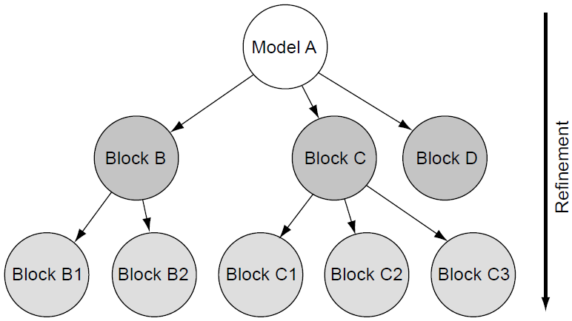
Hijerarhijska mreža modela I
Ranija diskusija o HDL jezicima uvela je prikaz simulacionog modela na najvišem nivou, prikazujući ulazno-izlazne interfejse i monolitni blok samog DUV modela
Samo kod najjednostavnijih modela moguće je specifikovati ponašanje bloka kao jednu monolitnu funkciju
Prirodnije je strukturno raščlaniti model na jedan ili više nivoa, zamenjujući blok najvišeg nivoa skupom međusobno povezanih blokova na sledećem nivou hijerarhije
Slika desno prikazuje proces strukturnog raščlanjivanja putem dijagrama hijerarhijskog stabla za jedan konkretan primer
Struktura stabla na primeru modela A ilustruje kako HDL specifikacije koriste strukturno raščlanjivanje za izgradnju sistema od instanci elemenata nižeg nivoa. Model A se gradi od blokova B, C i D; blokovi B i C sa svoje strane instanciraju sopstvene komponente, dok blok D ne sadrži dalje strukturno raščlanjivanje
Notes:
Figure demonstrates the structural refinement process as a hierarchy tree diagram for an example. Model A contains blocks B, C, and D on the next level of detail. Blocks B and C themselves are partitioned into two or three sub-blocks, respectively. The top level of the hierarchy is the root; the blocks D, B1, B2, C1, C2, C3 are the leaf-level nodes. By definition, leaf-level nodes have no further structural refinement, and therefore, their functional specification is contained in one VHDL entity/architecture or Verilog module without any instances of lower-level entity/architectures or modules. The root of every sub-hierarchy (A, B, C) contains the instances of the lower levels and potentially functional HDL code.

Slide 18
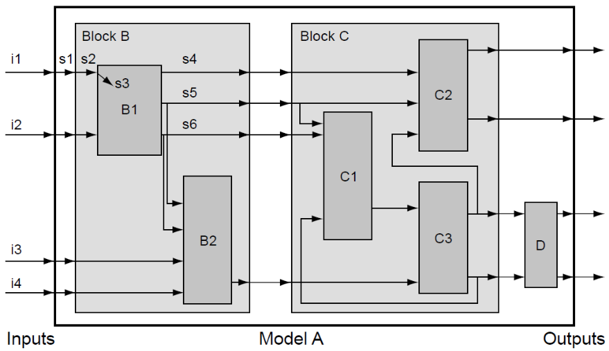
Hijerarhijska mreža modela II
Blokovi modela povezani signalima formiraju mrežu
S obzirom na to da signali imaju specifičan smer, kao što je prikazano strelicama na dijagramu, kažemo da model formira usmerenu mrežu
Tok signala međusobno povezuje komponente unutar blokova
Bihevioralna HDL specifikacija svakog bloka propisuje primenu vrednosti sa ulaznih portova na unutrašnju obradu samog bloka
HDL opis ponašanja takođe definiše kako se izlazni portovi, a samim tim i povezani signali, menjaju kao rezultat takve obrade
Isti primer modela A sa prethodnog slajda, ovoga puta prikazan kao hijerarhijska mreža toka podataka. Ugnježdeni blokovi nižeg nivoa predstavljaju strukturnu hijerarhiju, pri čemu sve komponente poseduju ulazne i izlazne portove. Signali, ilustrovani strelicama, povezuju ulaze i izlaze komponenti modela kako bi prikazali tok podataka između blokova i kroz različite nivoe hijerarhije
Notes:
Figure shows the same model hierarchy, Model A, using a dataflow model network diagram. In addition to the component hierarchy, this representation shows the flow of information, the signal flow between the different model components, and levels of hierarchy. Consider, for example, the first model input i1. It is a primary input, an input port of Model A itself. A signal s1 connects this port to the first input port of block B, which in turn drives signal s2, which connects to the first port of block B1. Inside B1, this port drives signal s3, the only visible signal inside the diagram of that block.

Slide 19
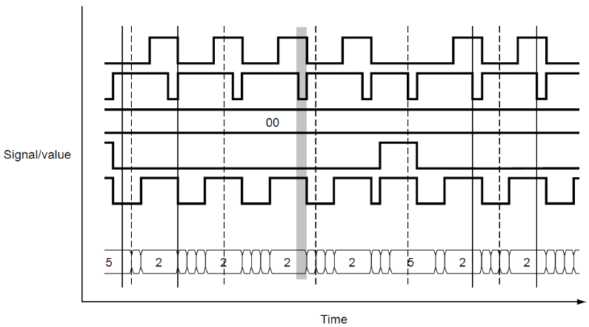
Hijerarhijska mreža modela III
Zadatak simulatora je da izračunava vrednosti signala modela u toku vremena
Smer signala podrazumeva prirodan redosled izračunavanja
Jasno je da, ukoliko se signal s1 promeni, signali s2 i s3 takođe treba da se promene kako bi vrednosti u mreži ostale konzistentne
Budući da je s3 ulaz u blok B1, intuitivno se nameće zaključak da je potrebno pozvati bihevioralnu specifikaciju bloka B1 onog trenutka kada se vrednost signala s3 promeni
Kao rezultat ovog izračunavanja, postoji mogućnost da će signali s4, s5 i s6 naknadno promeniti svoje vrednosti
Donja slika prikazuje primer diskretnih talasnih oblika signala u toku vremena, onako kako su zabeleženi tokom HDL simulacije
Promene signala HDL modela tokom vremena zabeležene u obliku talasnih oblika (waveforms). HDL signali imaju diskretne vrednosti i menjaju se u diskretnim vremenskim intervalima. Vertikalne linije na prikazu talasnih oblika pomažu korisniku da vizuelno poravna promene signala. Talasni oblici prikazuju vrednosti bit-signala putem nivoa napona, dok se složenije vrednosti signala ilustruju anotacijama, kao što su celobrojne (integer) vrednosti u najnižem talasnom obliku
Notes:
Changes of signal values designate events in the model. The model time orders events relative to each other; that is, it is important to be able to tell whether a particular event happened before another event or if it caused another event. Therefore, it is possible to look at the discrete time steps in above figure as points at which the simulation engine calculates or samples the model state.

Slide 20
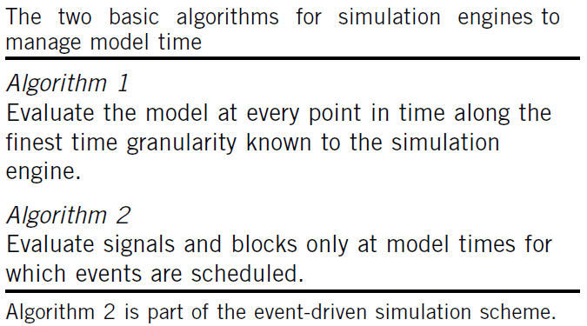
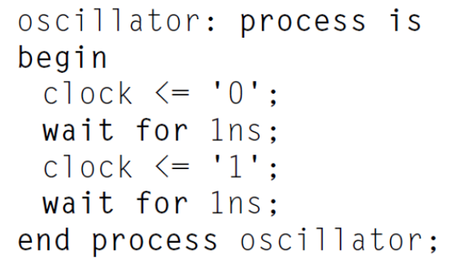

Evaluacija modela u toku vremena
Postoje dva suštinski različita algoritma za kontrolu simulacije kroz vreme, kao što je prikazano na gornjoj slici
Algoritam 1 je koristan samo ako je velika verovatnoća da u svakom trenutku evaluacije postoje nove vrednosti koje treba izračunati
Algoritam 2 može funkcionisati samo ako simulator poseduje informaciju o tome koje događaje treba da obradi u trenutnom ili u bilo kom budućem trenutku simulacionog vremena
Objekti modela (blokovi i signali) moraju da obaveste simulator o predstojećim promenama
Ovo obaveštavanje o promeni ili ažuriranju informacija naziva se zakazivanje (scheduling)
Korišćenjem informacija o zakazivanju, simulator je u mogućnosti da preskoči vremenske intervale u kojima nema zakazanih aktivnosti, što predstavlja značajnu prednost za performanse simulacije
Notes:
There are two fundamentally different algorithms to control simulation over time as specified in the top figure.
Algorithm 1 is useful only if it is very likely that at every evaluation time there are new values to be calculated. Clearly, compute power would be wasted if the model was simply in a steady state at many evaluation points, and the simulation engine had to evaluate the entire model only to find out that no signal update work has to be done.
Algorithm 2 can only function if the simulation engine has knowledge about which events it has to evaluate at the current time or any point in future model time. The model objects (blocks and signals) need to notify the simulation engine about future changes. This notification about change or update information is called scheduling. By using the scheduling information, the simulation engine is able to skip time intervals during which no work is scheduled, a performance advantage for the simulation.
Bottom figure shows a classic example of HDL constructs that contain explicit scheduling information for events the simulation engine has to execute at a future model time. It illustrates a simple sequential process specifying the function of an oscillator block. The behavioral code for process oscillator iterates endlessly between setting the signal clock to “0” and “1”. After each update, the process suspends control to the simulation engine for the specified amount of model time. The HDL model code relinquishes control and delegates the scheduled future action to the simulation engine. It is part of the semantic rules in the LRM of VHDL to support Algorithm 2 in any implementation of a simulation engine.

Slide 21
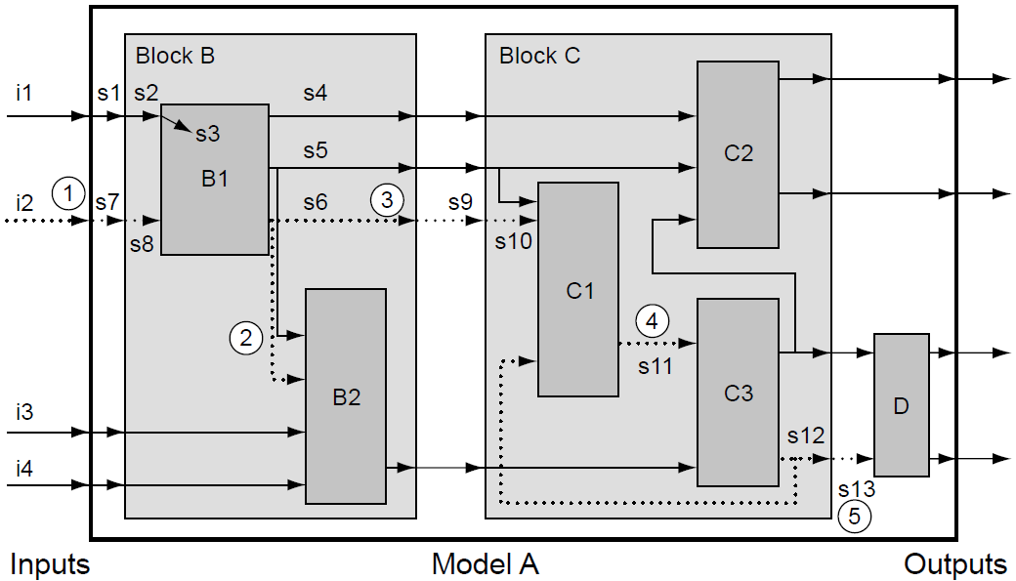
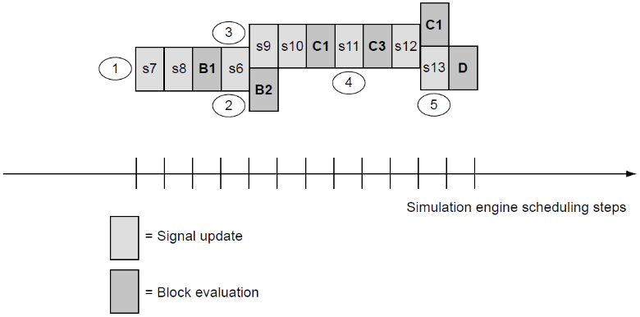
Kontrola evaluacije modela vođena događajima I
2
Pretpostavimo, kao primer, da se specifična promena dogodi na ulazu i2
Inicijalno, nakon serije promena signala (s7, s8), aktivira se blok B1, što rezultuje promenom signala s6
Ovo uzrokuje zakazanu promenu, označenu sa (3), na izlaznom portu bloka B, zatim na signalu koji je na njega povezan (s9), kao i aktivaciju bloka B2 (2)
Promena signala na s9 se dalje prenosi u blok C, uzrokuje poziv bloka C1 i pojavu događaja promene na signalu s11 (4)
Nakon aktivacije bloka C3, dolazi do promene signala s12 i s13
Budući da je s12 istovremeno i ulaz u blok C1, ovaj blok se mora ponovo aktivirati
Promena vrednosti signala na ulazu i2 rezultuje nizom ažuriranja unutar modela A. Isprekidane strelice pokazuju kako se ta promena propagira kroz vreme. Redosled promena signala i odgovarajuća ključna ažuriranja modela označeni su brojevima u krugovima.
Redosled ažuriranja uz pretpostavku da svi događaji imaju nulto kašnjenje (zero-delay). Brojevi u osenčenim krugovima odnose se na iste označene ključne događaje sa gornje slike. Simulator dinamički određuje redosled događaja onako kako se oni pojavljuju u modelu.
Notes:
Now that we decided how the engine advances time during a simulation, the next question is how the engine controls the evaluation of model updates.
Going back to the example for a hierarchical network model of Slide 18 (shown here with mark-ups in the top figure), we assume, as an example, that a specific update occurs on the input i2. Several of the key model update events are marked with the numbers 1 to 5 highlighted with shaded circles. The change event of s7 (1) propagates over time in a series of signal changes through the network until it concludes with an output signal change of s13 (5).
Initially, after a series of signal changes (s7, s8), block B1 is activated, which results in a change of signal s6. This causes a scheduled change, marked as (3), of block B’s output port, the signal connected to it (s9) and the activation of block B2 (2). Note that B2’s output does not change at this point because apparently the change on input signal s6 has no effect of B2’s output function. The signal change on s9 ripples into block C, causes the call of C1 and a change event on signal s11 (4). After the activation of C3, the signals s12 and s13 change. Because s12 is also an input to block C1, this block has to be activated again. For this example, we assume that the repeated call to C1 does not cause another output change on s11. Note that the re-activation of C1 results from a topological feedback loop, which could cause repeated calls of the same model blocks. In this example, the second activation of C1 does not cause further signal changes. Similarly, the final update of s13 and the call to block D causes no further update event.
The feedback loop in the topology exhibits how a particular block (C1) can be scheduled and re-scheduled because of a wave of updates. The feedback of the signal change of s12 leads to another evaluation of C1. Although the example assumes no further events after that evaluation, it is possible that the behavior of the model exercises the re-scheduling loop between C1 and C3 more than once. It depends on the behavior of the blocks whether such a topological loop settles at some point or continues to oscillate forever. The simulation engine or an external intervention by the user has to interrupt an uncontrolled model oscillation.
Throughout the example update sequence in the figure, block C2 was never activated, illustrating how the event-driven scheme only evaluates those parts of the DUV model that are affected by changes and successfully avoids the activation of model parts that can be skipped. Still, the topology of the model required massive updates in this case because input i2 affects many model blocks. However, changing input i4, for example, would probably result in only the activation of B2, C3, and D.
Another way to visualize the model updates of the top figure is to line up the sequence of scheduled model events over time. If the HDL for Model A specifies explicit delays for model updates (signals/gate delays or wait statements in behavioral code), the changes will spread out naturally over a range of model time controlled by the DUV specification. The simulation engine itself must order changes dynamically that have no HDL-specified model time delay (zero delay). Assuming the HDL of Model A does not use any explicit delays (zero delay model), we show every successive model event as one discrete step internal to the simulation engine in the bottom figure. Every evaluation creates a resulting update that the simulation engine schedules to occur at the beginning of the next internal step. At several points in the sequence (after the changes of s6 and s12), the simulation engine schedules more than one update in parallel. In a sequential program that simulates this network, it is effectively up to the simulation engine’s random choice to decide in which sequence the two model updates really happen; from a user view, the model actions happen in parallel.

Slide 22
Kontrola evaluacije modela vođena događajima II
Opisanu strategiju evaluacije nazivamo simulacija vođena događajima
Kada god se dogodi neki događaj, kao što je ažuriranje signala, simulator zakazuje izračunavanje za sve odredišne blokove tog signala
Ukoliko ovi blokovi ažuriraju svoje izlazne signale, promene se dalje propagiraju na isti način
Dakle, dva ključna aspekta pristupa simulacije vođene događajima su:
  Evaluiraj ponašanje modela samo u trenucima u kojima su zakazani događaji
  Evaluiraj ponašanje samo onih blokova ili signala za koje postoje zakazani događaji
Očigledno je da je simulacija vođena događajima veoma efikasna, jer ova strategija podrazumeva da simulator obavlja samo onaj posao koji je neophodan za evaluaciju promena u modelu
Suvišna izračunavanja se ne izvršavaju
Notes:
Although we assumed zero-delay in previous example, the event-driven simulation algorithm is much more general. By using VHDL or Verilog time control constructs, signal updates can have delays of arbitrary amounts of model time. This simply postpones the model evaluation to another discrete model time step instead of all updates happening at the same model time. Hence, it stretches out the event sequence over simulated time but does not change the basic event-driven update mechanism.

Slide 23
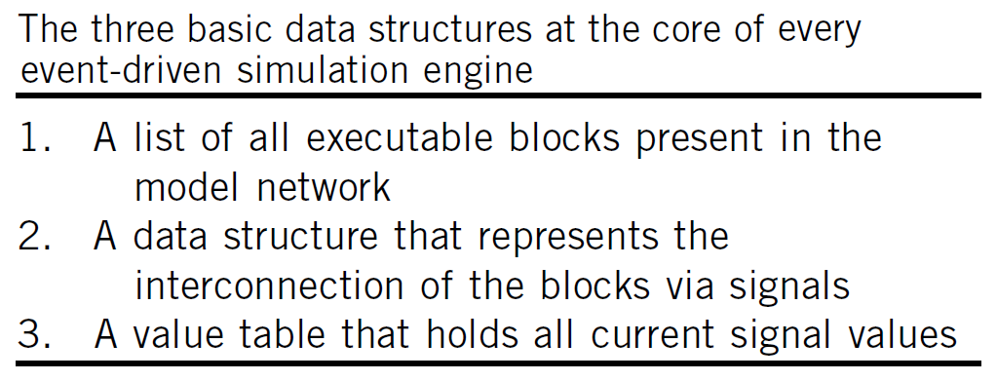
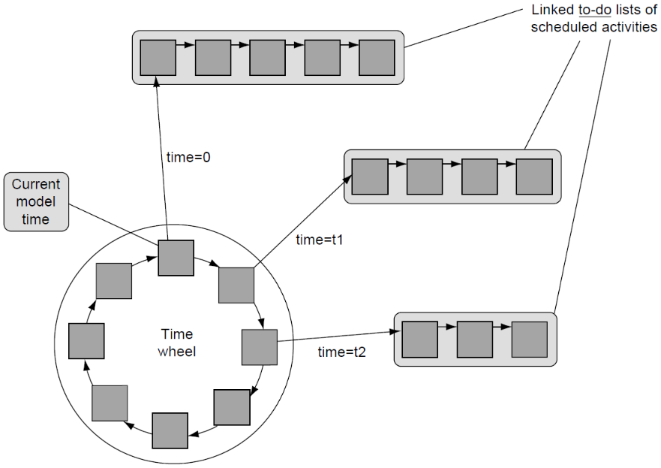
Skica implementacije simulatora vođenog događajima I
Simulator mora da održava strukture podataka koje predstavljaju mrežu modela, topologiju njegovih međuveza i trenutno stanje modela (gornja slika)
Konceptualni dijagram centralne strukture podataka za zakazivanje, koja se nalazi u samom srcu kontrole izvršavanja simulatora vođenog događajima, prikazan je na donjoj slici
Svaki trenutak simulacionog vremena za koji postoje zakazani događaji poseduje povezanu listu zadataka (to-do list) koja sadrži informacije neophodne simulatoru za izvršavanje tih događaja
Svaka lista zadataka je vezana za specifičnu poziciju unutar vremenskog točka (time wheel)
Vremenski točak je kružna povezana lista u kojoj svaki unos sadrži pokazivač na listu zadataka za dato simulaciono vreme u kojem je zakazana aktivnost
Podatak current_model_time jednostavno označava početak liste unutar vremenskog točka za trenutno simulaciono vreme
Notes:
The properties of the event-driven simulation approach can now be summarized, with a conceptual description of the basic mechanisms of an event-driven simulation engine.
The simulation engine needs to maintain the following data structures to represent the model network, its interconnect topology, and the current state of the model (top figure).
A central data structure to control activity and time progress in an event simulator is typically the so-called time wheel (bottom figure). The time wheel is a simple linked list that contains entries for every model time, current or future, for which the engine has scheduled an activity. For any such model time, the simulation engine keeps a to-do list of model blocks and signals that are scheduled. The simulation engine always takes the next item from the list for the current time, does the necessary evaluation, and proceeds to the next list item. As we have shown, the result of an evaluation can trigger the addition of list items for the current time (zero-delay) or any future time. Once the list for a current time is empty, the time wheel can “turn” to the next model time for which work is scheduled. As illustrated in the bottom figure, the engine updates the current model time simply by moving the current_model_time reference to the new head of the time wheel list.
For time zero, the start time of simulation, the simulation engine schedules all executable model blocks contained in a model. In VHDL, these are all processes and concurrent assignment statements. This approach makes sure that the simulation properly initializes all model blocks.

Slide 24
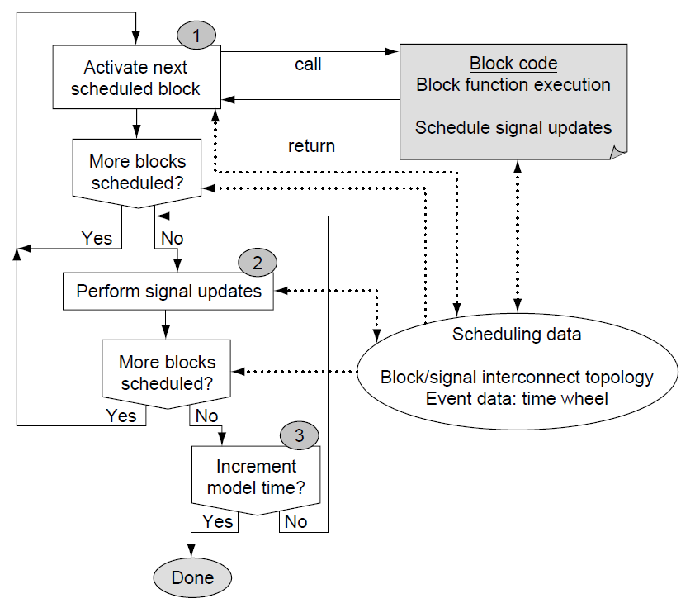
Skica implementacije simulatora vođenog događajima II
Notes:
The properties of the event-driven simulation approach can now be summarized, with a conceptual description of the basic mechanisms of an event-driven simulation engine.
The simulation engine needs to maintain the following data structures to represent the model network, its interconnect topology, and the current state of the model (top figure).
A central data structure to control activity and time progress in an event simulator is typically the so-called time wheel (bottom figure). The time wheel is a simple linked list that contains entries for every model time, current or future, for which the engine has scheduled an activity. For any such model time, the simulation engine keeps a to-do list of model blocks and signals that are scheduled. The simulation engine always takes the next item from the list for the current time, does the necessary evaluation, and proceeds to the next list item. As we have shown, the result of an evaluation can trigger the addition of list items for the current time (zero-delay) or any future time. Once the list for a current time is empty, the time wheel can “turn” to the next model time for which work is scheduled. As illustrated in the bottom figure, the engine updates the current model time simply by moving the current_model_time reference to the new head of the time wheel list.
For time zero, the start time of simulation, the simulation engine schedules all executable model blocks contained in a model. In VHDL, these are all processes and concurrent assignment statements. This approach makes sure that the simulation properly initializes all model blocks.

Slide 25
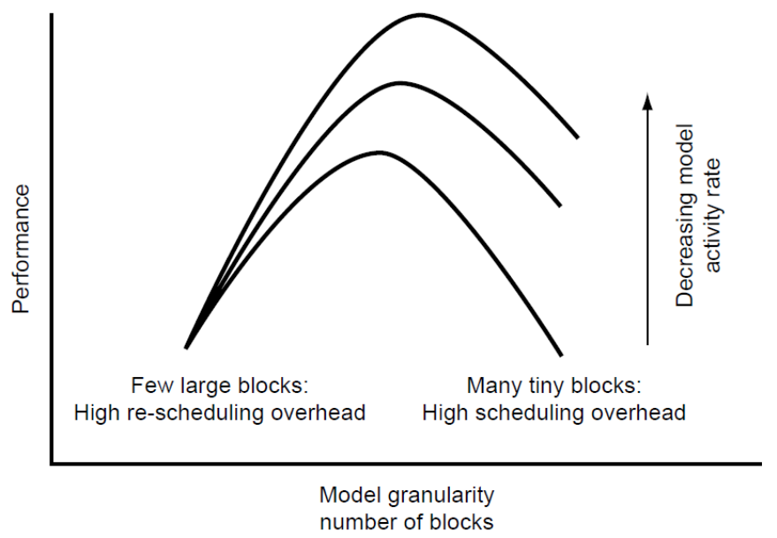
Poboljšanje performansi simulacije
S obzirom na to da je simulacija vođena događajima u veoma širokoj upotrebi, metode za optimizaciju njenih performansi su dobro poznate
Brzina simulacije direktno zavisi od granularnosti modela i učestalosti dinamičkih promena u samom modelu
Kod modela sa malim brojem krupnih (monolitnih) blokova često dolazi do neefikasnosti; povratne sprege u topologiji primoravaju simulator na učestalo ponavljanje procesa zakazivanja, što usporava rad
Ista funkcija DUV-a modelovana pomoću velikog broja primitivnih blokova dovešće do pada brzine, jer simulator mora da prati ogroman broj aktivnosti zakazivanja
Optimalne performanse se nalaze negde između ova dva ekstremna pristupa
Smanjenje dinamičke aktivnosti u modelu značajnije ubrzava simulaciju u slučajevima kada je model visoko detaljan (sačinjen od velikog broja elementarnih blokova)
Notes:
Figure illustrates the sensitivity of simulation performance in relationship to the granularity of the model. For the case of many small blocks, most time in simulation will be spent on scheduling overhead while the actual block evaluations are trivial. For the cases of large processes (VHDL) or always blocks (Verilog), the model topology will increasingly be fraught with feedback loops. Although the amount of scheduling activity is low compared with the time spent inside the code of the model blocks, the blocks are evaluated multiple times until the model converges to a steady state.
The activity rate of the model is another big factor for the performance of event-driven simulation, and therefore, figure illustrates it as another dimension. Obviously, a low activity rate helps simulation speed. The primary advantage of event-driven simulation is the ability to skip unnecessary model evaluations; however, a model with few monolithic blocks of sequential code can take less advantage of a low activity rate than can a model with finer granularity. Performance gain from low activity is only possible if there are distinct blocks of work that the engine can skip. In contrast, with a model of the finest granularity, the scheduling overhead will again cause loss of efficiency compared with a model that has an optimal balance in model block size.

Slide 26
Jezici za opis hardvera i simulatori
3
Simulacije na nivou takta

Slide 27
Uvod
Simulacija na nivou takta predstavlja specijalizovanu tehniku za značajno unapređenje efikasnosti procesa simulacije
Razlog za superiorne performanse ovih simulatora u poređenju sa onima koji su vođeni događajima leži u jednostavnosti samog algoritma i potpunoj optimizaciji ka specifičnom stilu hardverskog projektovanja – sinhronom dizajnu
Kao i uvek, drastično povećanje brzine dolazi uz cenu gubitka univerzalne primenjivosti na sve tipove dizajna
Glavni nedostatak simulacije na nivou takta je taj što postavlja stroga ograničenja na HDL stil kojim je opisan DUV
Ovaj tip simulatora ne uzima u obzir vremenska kašnjenja signala, strogo ograničava upotrebu sekvencijalnih konstrukcija i ne podržava većinu naprednih HDL funkcionalnosti koje se koriste za razvoj testnog okruženja
Notes:
Cycle-based simulation is a specialized technique to improve simulation efficiency. It has a long history of development and successful application on the largest design and verification projects. The reason for the superior performance of cycle-based simulation engines compared with event-driven simulation is the simplicity of the algorithm and the total optimization toward a specific hardware design style - synchronous design. Therefore, as always, a tremendous speedup comes with the disadvantage of trading off general-purpose applicability.
On designs and projects in which cycle-based simulation applies, the speedup can be large. A speedup of 10 to 20 times and a DUV model size compression of more than 10 times are typically quoted; some sources even put the speedup at 100 times that of traditional event- simulation.
The downside of cycle-based simulation is that it puts severe constraints on the HDL style of the DUV. Pure cycle-based simulation engines do not support or ignore delay controls, limit sequential constructs significantly, and do not allow most test bench-specific features of the HDLs. Projects with large synchronous designs, however, can productively use cycle-based engines to speed up the DUV simulation, while leaving the test bench writing to the use of special-purpose test bench languages outside the realm of HDLs.

Slide 28
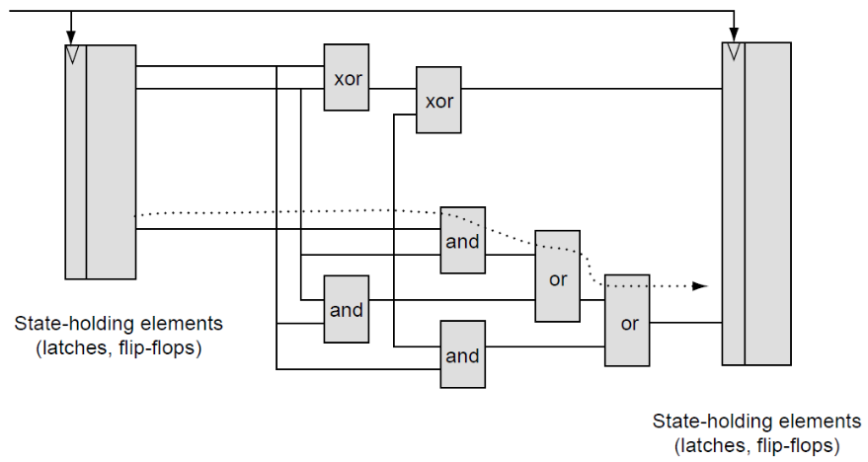
Sinhroni dizajn
Princip sinhronog projektovanja jasno razdvaja elemente koji čuvaju stanje (leč kola, flip-flopove, memorijske blokove) od kombinacione logike
Kombinaciona logika je uvek „okružena” elementima za čuvanje stanja
Dodatno, unutar same kombinacione logike ne smeju postojati povratne sprege
Glavna karakteristika sinhronog dizajna je mogućnost potpunog razdvajanja vremenske (timing) od funkcionalne verifikacije
Ovo razdvajanje fizičkih aspekata od funkcionalnih predstavlja osnovu za ekstremnu optimizaciju performansi i pojednostavljenje koje nudi simulacija na nivou takta
Fragment mrežnog modela sinhronog dizajna. Kombinaciona logika između elemenata koji čuvaju stanje mora biti u stanju da propagira promene brže od frekvencije takta leč kola ili flip-flopova. Isprekidana strelica prikazuje putanju sa najdužim kašnjenjem – kritičnu putanju kašnjenja ovog dela dizajna.
Notes:
The foundation of cycle-based simulation rests on a fundamental methodology restriction that applies to many modern designs, the synchronous design principle. If we separate the state-holding elements (latches, flip-flops, memory arrays) of a design from the combinational logic, it becomes clear that the function of the combinational portion is identical to the state transition and output generation function of a FSM.
The clock signal used to update the state-holding elements synchronizes the FSM update and the progression of the design through the state space. In a first approximation, we consider a clock signal that is central and occurs at the same time for all state-holding elements, which we simply call latches. We refer to such a clock signal as a synchronous clock.
The longest delay along any update path through the combinational logic of a design defines the maximum frequency for the clock signal of a synchronous design (see figure). We call the calculation of this maximum frequency under which the design still functions correctly timing verification. The critical delay path is the longest delay path allowed from latch to latch. Any path with a longer delay leads to incorrect functioning of the circuit because the combinational result will not arrive in time to update the target latch correctly. The scheme also implies that combinational feedback loops are not possible.
Therefore, rather than using dynamic techniques that would have to apply all possible combinational input patterns, timing verification can be done with static, pattern-independent techniques. Timing verification tools process the physical netlist topologically as a graph and do not apply Boolean patterns at all. Thus, this process can be separated completely from the discipline of functional verification. Timing verification guarantees that the maximum clock frequency is low enough to enable correct electrical function of the circuit, whereas functional verification can focus exclusively on the functional content of the design.
This separation of physical from functional concerns is the foundation for the extreme performance optimization and simplification that cycle-based simulation engines offer.

Slide 29
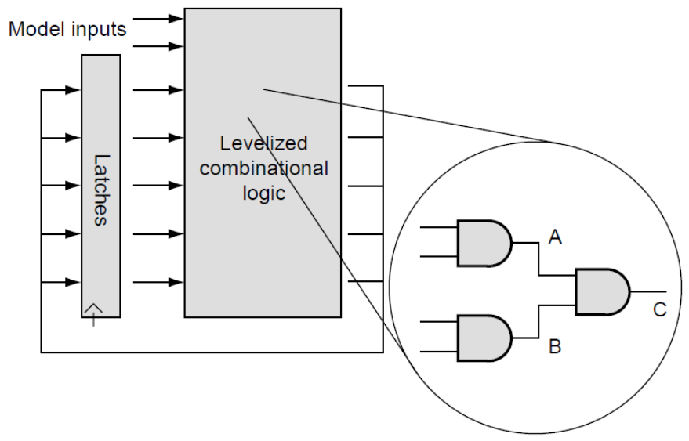
Algoritam simulacije na nivou takta
Opis kombinacione logike u modelu za simulaciju na nivou takta ne sadrži instrukcije za kontrolu kašnjenja. To je specifikacija sa nultim kašnjenjem (zero-delay) i bez povratnih sprega unutar kombinacionih blokova
Koristeći primarne ulaze i trenutne vrednosti elemenata koji čuvaju stanje kao početne tačke, a primarne izlaze i buduće vrednosti elemenata koji čuvaju stanje kao krajnje tačke, moguće je strogo ili slojevito urediti (levelize) sve blokove u mreži modela
Tehnički posmatrano, ovakav model predstavlja usmereni aciklični graf (DAG – Directed Acyclic Graph)
Simulator na nivou takta napreduje iz ciklusa u ciklus tako što vrši evaluaciju grafa kombinacionih funkcija i izračunava nove vrednosti leč kola i primarnih izlaza
U poređenju sa algoritmom vođenim događajima, simulator na nivou takta nema potrebu za zakazivanjem blokova jer je na osnovu njihove pozicije u grafu unapred poznato kada je njihova evaluacija neophodna
Mrežni model za simulaciju na nivou takta. Polazeći od mrežnog modela dizajna koji se verifikuje (DUV), proces uređivanja modela grupiše sve elemente koji čuvaju stanje (označeni kao leč kola) i vrši raspoređivanje blokova kombinacione logike po slojevima. Određivanje redosleda počinje od prvog sloja (nivo 1) koji obuhvata sve blokove povezane isključivo na ulaze modela ili na leč kola. Svaki naredni sloj n sadrži samo one blokove čiji su ulazi povezani na izlaze blokova iz prethodnih slojeva (najviše do nivoa n-1).
Ovaj proces rezultuje uređenim usmerenim acikličnim grafom (DAG), kao što je prikazano u uveličanom prikazu na slici
Notes:
The separation of timing and functional verification allows the HDL specification to be purely functional. This means that the HDL of a synchronous design needs to specify timing only for the clock signal. Even for this signal, the delay time, or cycle time, is rather arbitrary because the real cycle time can change with any iteration in the physical design process. In fact, for functional simulation all that is needed is the separation from a time at cycle “n” to the time at cycle “n + 1.” Therefore, many cycle-based simulation engines do not reference physical time measures but simply an integer that denotes the current cycle.
It is evident that this abstract view of the DUV has a close affinity to Algorithm 1 shown in Slide 20. A possible cycle-based algorithm can take the cycle as the finest time granularity and simply update the model once per cycle.
The combinational logic description of a cycle-based model is devoid of timing control statements. It is a zero-delay specification and free of combinational feedback loops. By using the primary inputs and the current values of the state-holding elements as the starting points, as well as the primary outputs and the next values of the state-holding elements as the end points, it is possible to strictly order, or levelize, all blocks of the model network. Technically speaking the model is a directed acyclic graph (DAG). Figure illustrates the basic view of this graph. By using simple gates as an example for combinational function, the magnifying glass cut-out in the figure shows the ordering of the graph, which illustrates that if signals A and B are evaluated first, signal C needs to be evaluated once only per evaluation of the state machine function.
The cycle-based simulation engine proceeds from cycle to cycle by evaluating the combinational function graph and calculating the new latch and primary output values.
In comparison to the event-driven algorithm, the cycle-based engine does not need to schedule blocks because it is clear from their position in the graph when their evaluation is necessary. Although it is possible to use an event-driven scheme within the combinational function evaluation, most cycle-based simulation engines have implemented what the literature calls the oblivious simulation algorithm. The oblivious scheme calculates all the combinational function at every simulation cycle and thus foregoes any dynamic event scheduling whatsoever. The algorithm trades off the redundant work of evaluating those parts of the model that do not change from cycle to cycle for the omission of complicated management of the to-do lists and time wheel management that are key to event-driven simulation. The oblivious algorithm is extremely simple and, most importantly, a good basis for further optimization.

Slide 30
Kreiranje testnih okruženja
4
4
Razvoj testnih okruženja korišćenjem HDL jezika

Slide 31
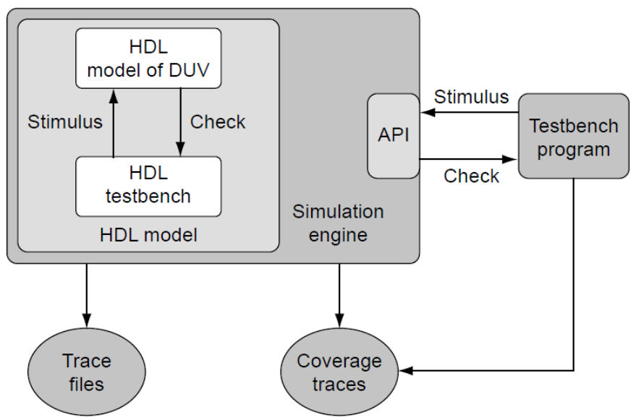
Alati za razvoj testnih okruženja
Već smo uveli osnovne koncepte testnih okruženja i principe njihove strukture, kako bi rezultujuće simulaciono okruženje bilo fleksibilno i produktivno
Sada ćemo razmotriti alate koji su na raspolaganju verifikacionom inženjeru za uspešno obavljanje ovog zadatka
Slika desno ponovo ističe odnos između simulatora, koji sadrži model DUV-a, i različitih formi testnih okruženja
Detaljnije ćemo analizirati funkcionalnosti VHDL-a i Veriloga koje podržavaju samu implementaciju drajvera i komponenti za proveru
Na kraju ćemo se ukratko osvrnuti na razvoj testnih okruženja izvan HDL-a i samog simulatora
Odnos između testnog okruženja i simulatora. Testno okruženje napisano u jeziku za opis hardvera integrisano je sa modelom DUV-a, dok eksterno testno okruženje koristi programski interfejs simulatora za interakciju sa modelom.

Slide 32
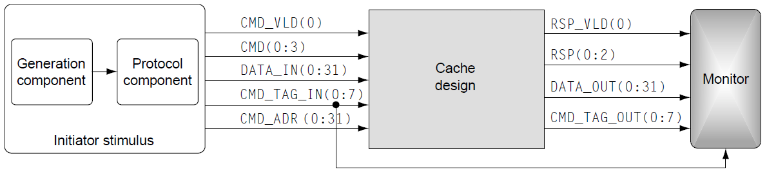
HDL jezici kao alati za razvoj testnog okruženja
Od samog početka, tvorci HDL jezika su ih koncipirali kao simulacione jezike koji podržavaju i opis dizajna i razvoj testnih okruženja
Pogledaćemo neke od fundamentalnih koncepata ovih jezika
U HDL okruženju, sve komponente testnog okruženja – generatori stimulusa, monitori, komponente za proveru i tabele rezultata (scoreboards) – strukturno se povezuju sa DUV-om putem signala
Pored tri instance – DUV-a, monitora i komponente za stimulus, kao i njihovih međusobnih signala – kod testnog okruženja sadrži i kontrolu centralnog takta
Proces clk_gen generiše taktni signal sa periodom od 100 ns
// Testbench
entity cache_test
end entity;
architecture beh of cache_test is
constant cycle_time_c 100 ns;
signal clk_s, cmd_vld_s, rsp_vld_s: std_logic;
signal rsp_s: std_logic_vector(2 downto 0);
signal cmd_s: std_logic_vector(3 downto 0);
signal cmd_tag_in_s, cmd_tag_out_s: std_logic_vector(7 downto 0);
signal data_in_s, data_out_s, cmd_addr_s: std_logic_vector(31 downto 0);
begin
// Instances of testbench components
stimulus: entity work.stim(beh)
port map (clk => clk_s, cmd_vld_o => cmd_vld_s, cmd_o => cmd_s,
data_in_o => data_in_s, cmd_tag_in_o => cmd_tag_in_s,
cmd_addr_o => cmd_addr_s);
monitor: entity work.mon(beh)
port map (clk => clk_s, rsp_vld_i => rsp_vld_s, rsp_i => rsp_s,
data_o => data_out_s, cmd_tag_o => cmd_tag_out_s);
// Instance of cache design
cache_unit: entity work.cache(rtl)
port map (clk => clk_s, cmd_vld_i => cmd_vld_s, cmd_i => cmd_s,
data_i => data_in_s, cmd_tag_i => cmd_tag_in_s,
cmd_addr_i => cmd_addr_s, rsp_vld_o => rsp_vld_s,
rsp_o => rsp_s, data_o => data_out_s,
cmd_tag_o => cmd_tag_out_s);
// Clock generator
clk_gen: process
begin
clk_s <= '0', '1' after cycle_time_c/2;
wait for cycle_time_c;
end process;
end architecture beh;
Notes:
From the beginning, the creators of HDLs conceived them as simulation languages to support both design and test bench writing. Verilog and VHDL are both very large languages, and at least half of the language definition is devoted to test bench writing. The following discussion does intend to introduce some of the fundamental concepts.
In an HDL environment, all test bench components - stimulus generators, monitors, checkers, and scoreboards - connect to the DUV structurally via signals (VHDL) or wires (Verilog). The explicit specification of the structural connection certainly is a basic capability of any HDL. Returning to the cache design example used earlier, VHDL code shows the implementation of the top level of a VHDL test bench shown on the figure.
In addition to the three instances - DUV, monitor, stimulus component, and their interconnecting signals - the test bench code also contains the control of a central clock. The clk_gen process drives the clock signal with the period of 100 ns. The use of a symbolically defined constant for the cycle time is a simple example of how to create parameters in the HDL with a single point of control for change.

Slide 33
Jednostavna komponenta generatora
Kod sa desne strane prikazuje implementaciju jednostavne komponente generatora u VHDL-u
Na samom početku simulacije, proces read_patterns učitava sadržaj tekstualne datoteke u niz patterns_s koristeći proceduru Load_Patterns
Datoteka „cache.patterns“ predstavlja stvarni testni primer i može sadržati skup regresionih test vektora, ručno pisane testove ili obrasce koje je generisao poseban program
Komponenta generatora je koncipirana tako da učita 1.024 komande i prosledi ih komponenti za stimulus
Nakon obrade svih obrazaca, generator čeka 1.000 ns i zatim zaustavlja rad simulatora
entity generator
port (clk: in std_logic;
request_i: in std_logic;
cmd_o: out std_logic_vector(3 downto 0);
data_o: out std_logic_vector(63 downto 0);
addr_o: out std_logic_vector(31 downto 0);
tag_o: out std_logic_vector(7 downto 0));
end entity generator
architecture beh of generator is
type patterns_t is array (0 to 1023) of std_logic_vector(107 downto 0);
signal patterns_s: patterns_t;
signal ptr_s: integer := 0;
signal n_patt_s: std_logic_vector(107 downto 0);
begin
read_patterns: process
begin
Load_Patterns ("cache.patterns", patterns_s);
wait;
end process;
stim_gen: process
begin
wait until rising_edge(clk);
if (request_i = '1') then
if (ptr_s < 1024) then
n_patt_s <= patterns_s(ptr_s);
ptr_s <= ptr_s + 1;
cmd_o <= n_patt_s(3 downto 0);
data_o <= n_patt_s(67 downto 4);
addr_o <= n_patt_s(99 downto 68);
tag_o <= n_patt_s(107 downto 100);
else
wait for 1000 ns;
report "END OF SIMULATION!"
severity failure;
end if;
end if;
end process;
end architecture beh;
Notes:
This certainly is a very crude form of hard-coded control. What happens if it takes more than these time steps to process commands that might be pending in the DUV? A real production test bench must implement a more appropriate test case control, most likely in the checker component.

Slide 34
Komponenta za stimulus za cache DUV
Entitet stim instancira komponentu generatora unutar komponente za stimulus
Proces protocol_component unutar entiteta stim implementira protokolnu komponentu
Ovaj proces preuzima testni obrazac ili komandu koju je isporučio generator i primenjuje je na izlaz komponente za stimulus, poštujući pritom dva taktna ciklusa koja zahteva ulazni protokol za cache DUV
Primer koda prikazan na prethodna tri slajda ilustruje samo osnovni skelet stvarne komponente za stimulus unutar testnog okruženja
Nakon Verilog primera, prikazaćemo i opise dodatnih faktora koje bi verifikacioni inženjer uključio kako bi ovaj primer učinio robusnim i primenljivim u realnom proizvodnom okruženju
entity stim
port (clk: in std_logic;
cmd_vld_o: out std_logic;
cmd_o: out std_logic_vector(3 downto 0);
data_in_o: out std_logic_vector(63 downto 0);
cmd_addr_o: out std_logic_vector(31 downto 0);
cmd_tag_in_o: out std_logic_vector(7 downto 0));
end entity stim;
architecture beh of stim is
signal n_cmd_s: std_logic_vector(3 downto 0) := (others => '0');
signal n_data_in_s: std_logic_vector(63 downto 0) := (others => '0');
signal n_addr_s: std_logic_vector(31 downto 0) := (others => '0');
signal n_tag_s: std_logic_vector(7 downto 0) := (others => '0');
signal request_s: std_logic := '1';
begin
gen: entity work.generator(beh)
port map (clk => clk, request_i => request_s, cmd_o => n_cmd_s,
data_o => n_data_in_s, addr_o => n_addr_s,
tag_o => n_tag_s);
protocol_component: process
begin
cmd_vld_o <= '0';
cmd_o <= (others => '0');
data_in_o <= (others => '0');
cmd_addr_o <= (others => '0');
cmd_tag_in_o <= (others => '0');
loop
wait until rising_edge(clk);
cmd_vld_o <= '1';
cmd_o <= n_cmd_s;
data_in_o <= n_data_in_s(31 downto 0);
cmd_addr_o <= n_addr_s;
cmd_tag_in_o <= n_tag_s;
request_s <= '0';
wait until rising_edge(clk);
cmd_vld_o <= '0';
cmd_o <= (others => '0');
data_in_o <= n_data_in_s(63 downto 32);
cmd_addr_o <= (others => '0');
cmd_tag_in_o <= n_tag_s;
request_s <= '1';
end loop;
end process;
end architecture beh;
Notes:
Figure instantiates this generator inside the stimulus component. We explained that it is important to separate the generator and the protocol components. Such a structure reflects the different areas of concern addressed by these components. If the generation process needs to be changed radically, the protocol component should remain untouched and vice versa.

Slide 35
Verilog testno okruženje
// Testbench
module cache_test;
`define CYCLE_TIME 100
wire CMD_VLD, [0:3]CMD, [0:31]DATA_IN, [0:7]CMD_TAG_IN, [0:31]CMD_ADDR;
wire RSP_VLD, [0:2]RSP, [0:31]DATA_OUT, [0:7]CMD_TAG_OUT;
reg CLK;
// instances of testbench components
stim STIM (CLK, CMD_VLD, CMD, DATA_IN, CMD_TAG_IN, CMD_ADDR);
mon MON (CLK, RSP_VLD, RSP, DATA_OUT, CMD_TAG_OUT);
// instance of cache design
cache CACHE (CLK, CMD_VLD, CMD, DATA_IN, CMD_TAG_IN, CMD_ADDR,
RSP_VLD, RSP, DATA_OUT, CMD_TAG_OUT);
// clock control
initial begin
forever begin
CLK = 0;
#CYCLE_TIME/2; // this is where the time progress is controlled
CLK = 1;
#CYCLE_TIME/2;
end
end
endmodule
Notes:
From the beginning, the creators of HDLs conceived them as simulation languages to support both design and test bench writing. Verilog and VHDL are both very large languages, and at least half of the language definition is devoted to test bench writing. The following discussion does intend to introduce some of the fundamental concepts.
In an HDL environment, all test bench components - stimulus generators, monitors, checkers, and scoreboards - connect to the DUV structurally via signals (VHDL) or wires (Verilog). The explicit specification of the structural connection certainly is a basic capability of any HDL. Returning to the cache design example used earlier, VHDL code shows the implementation of the top level of a VHDL test bench shown on the figure.
In addition to the three instances - DUV, monitor, stimulus component, and their interconnecting signals - the test bench code also contains the control of a central clock. The clk_gen process drives the clock signal with the period of 100 ns. The use of a symbolically defined constant for the cycle time is a simple example of how to create parameters in the HDL with a single point of control for change.

Slide 36
Verilog komponenta generatora
// Stimulus Component
module generator(CLK, REQUEST, CMD, DATA, ADDR, TAG)
input CLK, REQUEST;
output [0:3]CMD, [0:63]DATA, [0:31]ADDR, [0:7]TAG;
reg [0:3]CMD, [0:63]DATA, [0:31]ADDR, [0:7]TAG;
reg [0:107] patterns[0:1023], [0:10]ptr;
reg [0:107] n_patt;
intial begin
$readmemh("cache.patterns", patterns); ptr = 0; ready = 1;
end
always @(posedge CLK)
begin
if (REQUEST)
begin
if(ptr < 1024)
begin
n_patt = patterns[ptr]; ptr = ptr + 1;
CMD = n_patt[0:3]; DATA=n_patt[4:67]; ADDR=n_patt[68:99]; TAG=n_patt[100:107];
end
else begin
#1000;
$display("Simulation Done!");
$finish();
end
end
end
endmodule
Notes:
This certainly is a very crude form of hard-coded control. What happens if it takes more than these time steps to process commands that might be pending in the DUV? A real production test bench must implement a more appropriate test case control, most likely in the checker component.

Slide 37
Verilog Stim komponenta
module stim (CLK, CMD_VLD, CMD, DATA_IN, CMD_TAG_IN, CMD_ADDR) ;
input CLK;
output CMD_VLD, [0:3]CMD, [0:31]DATA_IN, [0:7]CMD_TAG_IN, [0:31]CMD_ADDR;
reg CMD_VLD, [0:3]CMD, [0:31]DATA_IN, [0:7]CMD_TAG_IN, [0:31]CMD_ADDR;
reg [0:3]N_CMD, [0:63]N_DATA_IN, [0:31]N_ADDR, [0:7]N_TAG_IN;
reg REQUEST;
// instantiate generator
generator GENERATOR(REQUEST, N_CMD, N_DATA_IN, N_ADDR, N_TAG_IN);
task write_command; // protocol component
begin
@(posedge CLK);
CMD_VLD = 1; CMD = N_CMD;
DATA_IN = N_DATA_IN[0:31]; CMD_ADDR = N_ADDR; CMD_TAG_IN = N_TAG_IN;
REQUEST = 0;
@(posedge CLK);
CMD_VLD = 0; CMD = 0;
DATA_IN = N_DATA_IN[32:63]; CMD_ADDR = 0; CMD_TAG_IN = N_TAG_IN;
REQUEST = 1;
end
endtask
initial begin
CMD_VLD = 0; CMD = 0; DATA_IN = 0; CMD_TAG_IN = 0; CMD_ADDR = 0;
N_CMD = 0; N_DATA_IN = 0; N_ADDR = 0; N_TAG_IN = 0; REQUEST = 1;
forever begin
write_command(); // apply command using correct protocol
end
end
endmodule
Notes:
Figure instantiates this generator inside the stimulus component. We explained that it is important to separate the generator and the protocol components. Such a structure reflects the different areas of concern addressed by these components. If the generation process needs to be changed radically, the protocol component should remain untouched and vice versa.

Slide 38
Dodatna razmatranja - Parametrizacija
Razdvajanje ključnih parametara od samog programskog koda i njihovo definisanje putem konfiguracionih vrednosti značajno olakšava prilagođavanje testnog okruženja različitim situacijama
Na primer, znatno je efikasnije učitavati naziv datoteke sa testnim primerom "cache.patterns" spolja, umesto da on bude fiksno zapisan u kodu
Na ovaj način verifikacioni tim može istovremeno čuvati veliki broj različitih datoteka sa testnim primerima u istom direktorijumu
Ovakvu kolekciju testnih primera nazivamo skupom testova (test case bucket)

Slide 39
Dodatna razmatranja – Generisanje datoteka za debagovanje
I VHDL i Verilog poseduju niz funkcionalnosti za ispisivanje informacija namenjenih za debagovanje
Na primer, komande report i write omogućavaju korisniku ispis teksta i vrednosti signala direktno u konzolu
U Verilogu, sistemske funkcije $monitor i $fmonitor sa listom signala ispisuju parove naziv/vrednost na ekranu ili u datoteku pri svakoj promeni referenciranih signala
Ovakvi mehanizmi za praćenje toka simulacije omogućavaju verifikacionom inženjeru efikasnije debagovanje i bržu analizu nepravilnosti
Podrazumeva se da verifikacioni inženjeri mogu koristiti i sistemske trace datoteke, pod uslovom da ih primenjeni simulator direktno podržava

Slide 40
Dodatna razmatranja – Randomizacija I
Prikazano generisanje stimulusa je potpuno determinističko, ali za ispunjenje bilo kog iole kompletnog plana verifikacije, stvarni testovi moraju varirati po brojnim svojstvima interfejsa cache dizajna
  Potrebno je testirati različite komande i različite sekvence komandi
  Neophodno je varirati vremenske razmake između komandi, na primer do osam uzastopnih komandi u nizu, uz različit broj praznih ciklusa između njih
  Takođe je neophodno testirati različite i konfliktne ciljne adrese, dok velike varijacije u samim vrednostima podataka verovatno nisu od presudnog značaja
Sa trenutnim testnim okruženjem, verifikacioni tim bi ove varijacije mogao postići samo kreiranjem velikog broja različitih „cache.patterns“ datoteka koje pokrivaju navedene slučajeve
Međutim, moguće je prebaciti deo te varijabilnosti direktno u kôd samog testnog okruženja
Verilog nudi niz sistemskih funkcija koje podržavaju randomizaciju, od kojih je najpoznatija $random(), koja vraća nasumično odabranu 32-bitnu celobrojnu vrednost
VHDL nema ugrađene konstrukcije za randomizaciju, ali fleksibilnost jezika omogućava različite načine za definisanje generatora slučajnih brojeva (npr. putem namenskih paketa)
Ove funkcije podržavaju parametar „seed“ (početna vrednost), čiji je značaj objašnjen na narednom slajdu

Slide 41
Dodatna razmatranja – Randomizacija II
Važan aspekt rada sa verifikacijom zasnovanom na slučajnim vrednostima jeste mogućnost ponovnog izvršavanja bilo koje simulacije
Ukoliko simulacija otkrije grešku u dizajnu (ili u samom testnom okruženju), neophodno je ponoviti tu simulaciju, često i više puta, radi lakšeg debagovanja i kasnije potvrde da je greška ispravljena
Za kompleksnije bagove, poželjno je sačuvati uslove koji su doveli do problema kako bi se isti scenario mogao precizno ponoviti u okviru regresionog testiranja
Ponovljivost je trivijalna kod unapred generisanih testova koji se čuvaju kao datoteke, međutim, kada se koristi randomizacija u toku rada (runtime), ključno je proslediti početne vrednosti (seeds) funkcijama za generisanje slučajnih brojeva. Korišćenje iste početne vrednosti garantuje da će simulator generisati identičnu sekvencu slučajnih brojeva
Ako testno okruženje koristi randomizaciju na više različitih mesta, preporučuje se eksplicitno upravljanje početnim vrednostima (seed management). To podrazumeva da kôd treba da prikuplja i postavlja sve početne vrednosti na jednom ili nekoliko centralnih mesta
Ovakva organizacija olakšava kontrolisano i identično ponavljanje simulacionog testa u svrhe debagovanja ili regresije
Notes:
Verification engineers can use randomization either to pre-generate deterministic tests or during the runtime of a test bench-driven simulation. In either case, it is important, for the completion of the verification plan, that the project tracks which of the cases the stimulus component actually applied. The methods and techniques of this verification coverage tracking will be discussed in the second half of this chapter.
It is important that test bench writers understand the statistical characteristics of the random distribution they select in their stimulus components. This is even more important if there are holes suspected in the coverage tracking done by the project. HDL test bench implementations whose random distributions are deficient can leave dangerous coverage holes if a project relies on a specific distribution.

Slide 42
Generatori slučajnih brojeva
Generator pseudoslučajnih brojeva (PRNG) je algoritam za generisanje sekvence brojeva koja aproksimira svojstva slučajnih brojeva
Sekvenca nije istinski slučajna, jer je potpuno određena relativno malim skupom početnih vrednosti, koji se naziva stanje generatora
Početna vrednost (seed ili stanje generatora) je broj ili vektor koji se koristi za inicijalizaciju generatora pseudoslučajnih brojeva
Uobičajeno je da generatori kreiraju brojeve prema uniformnoj raspodeli verovatnoće
Takođe postoje i generatori koji generišu slučajne brojeve prema drugačijim raspodelama verovatnoće, kao što su normalna, eksponencijalna, Poasonova i druge

Slide 43
Kreiranje testnih okruženja
5
Jezici za verifikaciju visokog nivoa

Slide 44
Jezici za verifikaciju visokog nivoa (HVL) I
Tokom proteklih nekoliko godina, jezici specijalizovane namene za razvoj testnih okruženja postali su izuzetno popularni i dobili su značajnu pažnju u industriji
Ovi HVL jezici predstavljaju domen-specifične jezike koji poseduju ugrađene funkcionalnosti namenjene isključivo jednoj specifičnoj oblasti primene
Osnovna ideja je da korisnici, ukoliko je vokabular jezika direktno prilagođen oblasti primene, lakše nauče njegovo korišćenje i postanu produktivniji u poređenju sa upotrebom programskih jezika opšte namene

Slide 45
Jezici za verifikaciju visokog nivoa (HVL) II
Trenutno najpopularniji HVL jezici su:
  SystemVerilog: Apsolutno dominantan jezik u industriji. On objedinjuje funkcije HDL-a (za dizajn) i HVL-a (za verifikaciju), a njegova snaga leži u nativnoj podršci za logičke tvrdnje (assertions) i objektno-orijentisano programiranje.
  UVM (Universal Verification Methodology): Iako je tehnički biblioteka klasa napisana u SystemVerilog-u, UVM je postao industrijski standard za razvoj testnih okruženja. Skoro svaka moderna verifikacija kompleksnih čipova (Intel, Qualcomm, NVIDIA) podrazumeva korišćenje UVM-a.
  SystemC: Koristi se prvenstveno za verifikaciju na sistemskom nivou (system-level) i kreiranje brzih referentnih modela. Sve je popularnija varijanta UVM-SystemC za simulaciju gde je potreban balans između performansi softvera i preciznosti hardvera.
  Python (putem biblioteka kao što je cocotb): Sve popularnija alternativa za projektante dizajna koji žele da pišu testna okruženja u Python-u umesto u kompleksnom SystemVerilog-u. Python se koristi za brzu izradu prototipova i povezivanje sa AI/ML alatima za generisanje testova.
  e (Specman): Iako je bio pionir randomizacije, danas se uglavnom koristi u nasleđenim (legacy) projektima u određenim kompanijama, ali ga SystemVerilog ubrzano potiskuje iz novih dizajna

Slide 46
Karakteristike HVL jezika
Svi jezici za verifikaciju visokog nivoa (HVL) po pravilu pružaju sledeće osnovne funkcionalnosti:
Nezavisnost od simulatora
Ovo je fundamentalno svojstvo svakog ovakvog jezika. Ono omogućava verifikacionom inženjeru da razvije testno okruženje koje je portabilno između različitih simulatora različitih proizvođača.
Potpuna vidljivost svih objekata HDL modela
Neophodna je za kontrolu svih aspekata DUV-a (signali, registri, nizovi, itd.). Mora postojati mogućnost čitanja i upisa u ove elemente modela.
Mogućnosti programskih jezika visokog nivoa
Korišćenje složenih tipova podataka, definisanje objektno-orijentisanih klasa i modularnost su zahtevi koje ispunjavaju svi popularni HVL jezici.

Slide 47
Napredne funkcionalnosti HVL jezika
Vremenski izrazi (Temporal Expressions)
Specifikacija sekvenci događaja kroz vreme predstavlja srž provere složenih logičkih tvrdnji. HVL jezici poseduju ugrađene konstrukcije za koncizno izražavanje ovakvih vremenskih relacija.
Slučajno generisanje uz ograničenja (Constrained Random Generation)
- Slučajno generisanje stimulusa jedna je od ključnih mogućnosti efikasnog testnog okruženja.
  Dosadašnja diskusija o randomizaciji bila je ograničena na probabilistički izbor pojedinačne vrednosti, ali interfejsi realnih DUV-ova ne dozvoljavaju potpuno slobodnu randomizaciju ulaznih signala i magistrala. Postoje dve dimenzije ograničenja na ulaznim interfejsima:
        Zavisnost vrednosti između različitih signala u istom trenutku
        Zavisnost vrednosti kroz vreme
  HVL jezici nude ugrađene funkcije za definisanje ovih ograničenja, čime se značajno povećava produktivnost pri pisanju koda za drajvere.
Prikupljanje pokrivenosti (Coverage Collection)
Jedan od najvažnijih indikatora uspešnosti verifikacionog ciklusa je stepen pokrivenosti funkcionalnosti dizajna ostvaren tokom rada simulatora. HVL jezici nude ugrađene mehanizme za definisanje informacija o pokrivenosti koje treba prikupljati tokom vremena. Ovi podaci pružaju verifikacionom timu uvid u to koji su ciljevi testnog okruženja ostvareni tokom rada simulatora.

Slide 48
Kreiranje testnih okruženja
Ostali alati za testno okruženje

Slide 49
Skript jezici
Pre nego što su EDA kompanije identifikovale verifikaciju kao glavno usko grlo u projektima hardvera i razvile HVL jezike, verifikacioni timovi su koristili skript jezike za razvoj testnih okruženja i generisanje testova
U domenu otvorenog koda (open source), postoji niz skript jezika koji podržavaju brz razvoj softvera, kao što su Perl, TCL i Python
Prednosti skript jezika su obično:
  Interpretirano izvršavanje: ne postoji ciklus kompajliranja i povezivanja (link)
  Slabo tipizirani sistemi: nema potrebe za zamornim deklaracijama tipova podataka za varijable
  Tipovi podataka visokog nivoa: liste, rečnici (dictionaries), heš-mape
  Snažna podrška za obradu teksta
  Jednostavan pristup servisima operativnog sistema: datotekama, direktorijumima i sistemima za upravljanje podacima
Međutim, tipično postoji jaz u performansama od 5 do 10 puta između interpretiranih skript jezika i kompajliranih programskih jezika. Ovaj značajan nedostatak ozbiljno je ograničio uspeh skript jezika kao primarnih alata za razvoj testnih okruženja
Notes:
Simulation runs are usually not standalone activities. There is a need to maintain the HDL and test bench code in source code libraries. Setting up a simulation run is preceded by a checkout of source code, compile, model build, and job distribution to a host simulation machine, and in the end the collection and triage of simulation results. Many of these data management and preparation activities can greatly benefit from the use of the flexible, highly productive scripting languages. Therefore, a verification engineer should be fluent in at least one or two of them.

Slide 50
Editori talasnih oblika
Postojali su brojni pokušaji da se koriste grafički jezici za specifikaciju ponašanja testnog okruženja
Talasni oblici ili vremenski dijagrami su veoma popularna metoda za prikaz očekivanih ili generisanih promena signala u dokumentaciji hardverskih interfejsa
U skladu sa tim, editori talasnih oblika su se smatrali obećavajućim pristupom za grafički razvoj testnih okruženja
Jedno od glavnih ograničenja striktno grafičkih prikaza je to što oni mogu da definišu samo jedan specifičan scenario
Kada se završi rad na složenijoj specifikaciji, svakodnevno održavanje i ažuriranje (poput promene naziva signala ili njihovih svojstava) obično zahteva mnogo više truda u grafičkom nego u tekstualnom formatu
Zbog toga su vremenski dijagrami i editori talasnih oblika uglavnom ograničeni na simulacije manjih blokova dizajna
6
Notes:
On the other hand, timing diagrams are a powerful and efficient communication medium between designers and verification engineers. Because of the popularity of waveforms in their informal use with paper and pencil, there remains hope that at some point an effective user interface technology will open timing diagram specification to a wider verification audience.

