Slide 1
Funkcionalna verifikacija hardvera
Predavanje IV - dodatak

Slide 2
Lecture Content
System Verilog Assertions (SVA)
  Short introduction
  Basic assertions
  Basic properties
  Basic Sequences
  Assertion system functions and tasks
  Parametrization

Slide 3
System Verilog Assertions
Introduction

Slide 4
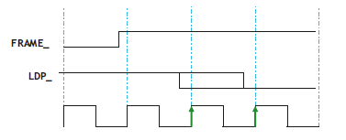
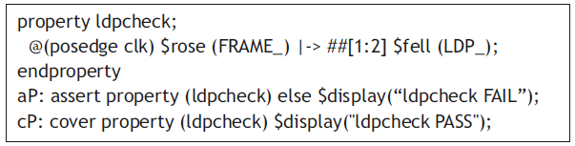
Introduction
An assertion is simply a check against the specification of your design that you want to make sure never violates
If the specs are violated, you want to see a failure
Example: Whenever FRAME_ is de-asserted (i.e., goes High), the Last Data Phase (LDP_) must be asserted (i.e., goes Low) within the next two clocks
SVA language is precisely designed to tackle such sequential temporal domain scenarios and modeling such a check is far easier in SVA than in Verilog or VHDL
Why SVA? They are easier to write than standard Verilog/VHDL (increasing design productivity), productivity), easier to debug (thereby increasing debug productivity), while providing functional coverage, and simulating faster
Notes:
Design engineers normally use an HDL to define the function and the structure of a design under verification (DUV). Specifying a design in the text format of an HDL, an activity called design entry, allows the engineer to document the DUV unambiguously and later execute it as a model in a simulation engine. The HDL version of the DUV is also the basis for the physical implementation of the design. To better support the simulation task, HDLs have features that go beyond the mere description of the design and include the specification of stimulus and checking components, which form an HDL test bench. When we characterize the typical elements of HDLs as design specification tools in this lecture, using VHDL as prime example.
There are a variety of algorithms available to build simulation engines. Because the simulation engine plays such a crucial role in the center of the simulation-based flow, typical architectures of such engines are discussed in this lecture. It is important that verification engineers understand the characteristics of such tools at their disposal. Electronic design automation (EDA) developers build tools such as simulation engines around different sets of tradeoffs, many of which select between accuracy and speed. The verification team must choose those tools that are most adequate for their given project.
Many simulation engines offer an interactive graphical user interface (GUI), which lets the user apply individual stimulus and check commands manually in between simulation steps of the model. Such interfaces, which support a detailed debug mode, are effective mainly on smaller models or very specific debug situations. When working with larger-sized DUVs, the verification engineer lets the simulation engine save the results of a simulation run to trace files, which capture simulated model states over time. As also shown in the figure, waveform viewer tools let the user browse through these results files in various ways, for example, forward and backward in simulation time, to inspect and debug the model behavior in detail.
For many verification tasks, the users do not find the test bench features of the HDL sufficient. Therefore, most simulation engines provide open interfaces that support the application of checks and stimuli from a programming or test bench authoring language.
It is already apparent from the figure that many simulation tools present an interactive GUI to the designer. A very common approach is to integrate the different GUI tasks under one single master GUI, which then gives the user the view of a single integrated HDL and verification development environment even if the implementation underneath consists of separate tools.
All major EDA companies offer many of these tools, often integrated into one GUI framework. The benefit of the Institute of Electrical and Electronics Engineers (IEEE) standardization of the HDLs is that many simulation engines are largely interchangeable with each other. The differentiation comes from simulation speed and value-add features such as the integration of the other simulation tasks: coverage, test bench program support, and user-friendliness for debug.

Slide 5
System Verilog Assertions
Basic assertions

Slide 6
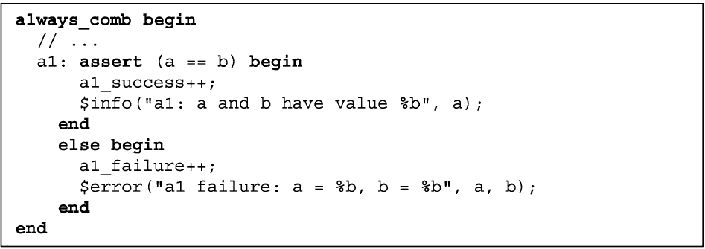
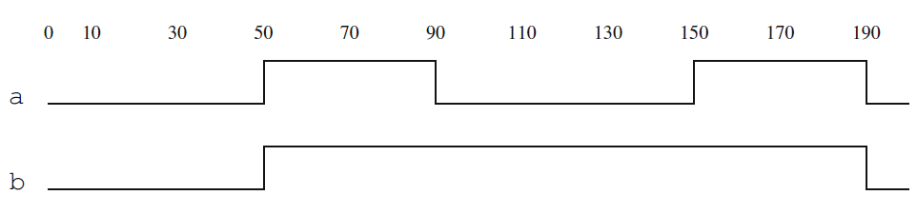
Immediate assertions
Immediate assertions are the simplest kind of assertions. These assertions are Boolean and unclocked, and they tightly follow the simulation flow
Immediate assertions may be placed only in procedural code
always_comb procedure executes unconditionally at time 0, and at time 0 both a and b have the value 1’b0. Therefore, assertion passes - counter a1_success is incremented and a message printed "a1: a and b have value 0"
Because always_comb is sensitive to the arguments of assertion a1, each time the value of either a or b changes, a reevaluation of the assertion condition is prompted, followed by the execution of the appropriate action block
Thus, the pass action is executed at time 50, 150, and 190, while the fail action block is executed at 90
Notes:
Design engineers normally use an HDL to define the function and the structure of a design under verification (DUV). Specifying a design in the text format of an HDL, an activity called design entry, allows the engineer to document the DUV unambiguously and later execute it as a model in a simulation engine. The HDL version of the DUV is also the basis for the physical implementation of the design. To better support the simulation task, HDLs have features that go beyond the mere description of the design and include the specification of stimulus and checking components, which form an HDL test bench. When we characterize the typical elements of HDLs as design specification tools in this lecture, using VHDL as prime example.
There are a variety of algorithms available to build simulation engines. Because the simulation engine plays such a crucial role in the center of the simulation-based flow, typical architectures of such engines are discussed in this lecture. It is important that verification engineers understand the characteristics of such tools at their disposal. Electronic design automation (EDA) developers build tools such as simulation engines around different sets of tradeoffs, many of which select between accuracy and speed. The verification team must choose those tools that are most adequate for their given project.
Many simulation engines offer an interactive graphical user interface (GUI), which lets the user apply individual stimulus and check commands manually in between simulation steps of the model. Such interfaces, which support a detailed debug mode, are effective mainly on smaller models or very specific debug situations. When working with larger-sized DUVs, the verification engineer lets the simulation engine save the results of a simulation run to trace files, which capture simulated model states over time. As also shown in the figure, waveform viewer tools let the user browse through these results files in various ways, for example, forward and backward in simulation time, to inspect and debug the model behavior in detail.
For many verification tasks, the users do not find the test bench features of the HDL sufficient. Therefore, most simulation engines provide open interfaces that support the application of checks and stimuli from a programming or test bench authoring language.
It is already apparent from the figure that many simulation tools present an interactive GUI to the designer. A very common approach is to integrate the different GUI tasks under one single master GUI, which then gives the user the view of a single integrated HDL and verification development environment even if the implementation underneath consists of separate tools.
All major EDA companies offer many of these tools, often integrated into one GUI framework. The benefit of the Institute of Electrical and Electronics Engineers (IEEE) standardization of the HDLs is that many simulation engines are largely interchangeable with each other. The differentiation comes from simulation speed and value-add features such as the integration of the other simulation tasks: coverage, test bench program support, and user-friendliness for debug.

Slide 7
Concurrent assertions
Concurrent assertions are clocked with general structure
concurrent_assertion_body ::=
[clocking_event] [ disable iff (reset)] property
In example:
a1: assert property (@(posedge clk)
disable iff (rst) a |-> nexttime[2] b);
Clocking event is posedge clk, disabling condition rst, while assertion property is a |-> nexttime[2] b
They can be placed:
  In always procedures
  In initial procedures
  standalone (also called static)—outside any procedure
Initial procedure is used for evaluating the assertion only once. For example, assertion a1 checks that ready is low at the first tick of the clock
Notes:
Design engineers normally use an HDL to define the function and the structure of a design under verification (DUV). Specifying a design in the text format of an HDL, an activity called design entry, allows the engineer to document the DUV unambiguously and later execute it as a model in a simulation engine. The HDL version of the DUV is also the basis for the physical implementation of the design. To better support the simulation task, HDLs have features that go beyond the mere description of the design and include the specification of stimulus and checking components, which form an HDL test bench. When we characterize the typical elements of HDLs as design specification tools in this lecture, using VHDL as prime example.
There are a variety of algorithms available to build simulation engines. Because the simulation engine plays such a crucial role in the center of the simulation-based flow, typical architectures of such engines are discussed in this lecture. It is important that verification engineers understand the characteristics of such tools at their disposal. Electronic design automation (EDA) developers build tools such as simulation engines around different sets of tradeoffs, many of which select between accuracy and speed. The verification team must choose those tools that are most adequate for their given project.
Many simulation engines offer an interactive graphical user interface (GUI), which lets the user apply individual stimulus and check commands manually in between simulation steps of the model. Such interfaces, which support a detailed debug mode, are effective mainly on smaller models or very specific debug situations. When working with larger-sized DUVs, the verification engineer lets the simulation engine save the results of a simulation run to trace files, which capture simulated model states over time. As also shown in the figure, waveform viewer tools let the user browse through these results files in various ways, for example, forward and backward in simulation time, to inspect and debug the model behavior in detail.
For many verification tasks, the users do not find the test bench features of the HDL sufficient. Therefore, most simulation engines provide open interfaces that support the application of checks and stimuli from a programming or test bench authoring language.
It is already apparent from the figure that many simulation tools present an interactive GUI to the designer. A very common approach is to integrate the different GUI tasks under one single master GUI, which then gives the user the view of a single integrated HDL and verification development environment even if the implementation underneath consists of separate tools.
All major EDA companies offer many of these tools, often integrated into one GUI framework. The benefit of the Institute of Electrical and Electronics Engineers (IEEE) standardization of the HDLs is that many simulation engines are largely interchangeable with each other. The differentiation comes from simulation speed and value-add features such as the integration of the other simulation tasks: coverage, test bench program support, and user-friendliness for debug.

Slide 8
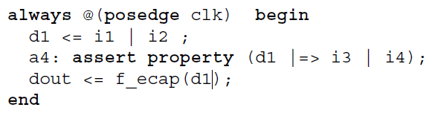
Concurrent assertions
In other cases, the assertion is monitored continuously: at each tick of its clock.
For example, assertion a3 checks that ok is high at every tick of the clock
Or, an assertion monitored continuously can be placed in an always procedure as the the one on the right
Notes:
Design engineers normally use an HDL to define the function and the structure of a design under verification (DUV). Specifying a design in the text format of an HDL, an activity called design entry, allows the engineer to document the DUV unambiguously and later execute it as a model in a simulation engine. The HDL version of the DUV is also the basis for the physical implementation of the design. To better support the simulation task, HDLs have features that go beyond the mere description of the design and include the specification of stimulus and checking components, which form an HDL test bench. When we characterize the typical elements of HDLs as design specification tools in this lecture, using VHDL as prime example.
There are a variety of algorithms available to build simulation engines. Because the simulation engine plays such a crucial role in the center of the simulation-based flow, typical architectures of such engines are discussed in this lecture. It is important that verification engineers understand the characteristics of such tools at their disposal. Electronic design automation (EDA) developers build tools such as simulation engines around different sets of tradeoffs, many of which select between accuracy and speed. The verification team must choose those tools that are most adequate for their given project.
Many simulation engines offer an interactive graphical user interface (GUI), which lets the user apply individual stimulus and check commands manually in between simulation steps of the model. Such interfaces, which support a detailed debug mode, are effective mainly on smaller models or very specific debug situations. When working with larger-sized DUVs, the verification engineer lets the simulation engine save the results of a simulation run to trace files, which capture simulated model states over time. As also shown in the figure, waveform viewer tools let the user browse through these results files in various ways, for example, forward and backward in simulation time, to inspect and debug the model behavior in detail.
For many verification tasks, the users do not find the test bench features of the HDL sufficient. Therefore, most simulation engines provide open interfaces that support the application of checks and stimuli from a programming or test bench authoring language.
It is already apparent from the figure that many simulation tools present an interactive GUI to the designer. A very common approach is to integrate the different GUI tasks under one single master GUI, which then gives the user the view of a single integrated HDL and verification development environment even if the implementation underneath consists of separate tools.
All major EDA companies offer many of these tools, often integrated into one GUI framework. The benefit of the Institute of Electrical and Electronics Engineers (IEEE) standardization of the HDLs is that many simulation engines are largely interchangeable with each other. The differentiation comes from simulation speed and value-add features such as the integration of the other simulation tasks: coverage, test bench program support, and user-friendliness for debug.

Slide 9
System Verilog Assertions
Basic properties

Slide 10
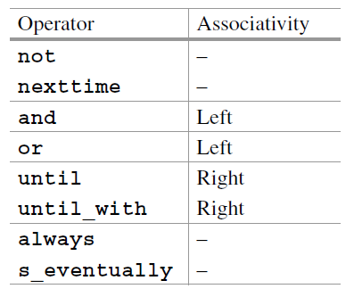
Property
Properties play a central role in SVA because they form the bodies of concurrent assertions
A property is a temporal formula that can be either true or false on a given trace
The property operators described here are summarized in the table on the right
They are grouped by their precedence, from highest to lowest
Properties can be built from simpler properties in a recursive manner
Notes:
Design engineers normally use an HDL to define the function and the structure of a design under verification (DUV). Specifying a design in the text format of an HDL, an activity called design entry, allows the engineer to document the DUV unambiguously and later execute it as a model in a simulation engine. The HDL version of the DUV is also the basis for the physical implementation of the design. To better support the simulation task, HDLs have features that go beyond the mere description of the design and include the specification of stimulus and checking components, which form an HDL test bench. When we characterize the typical elements of HDLs as design specification tools in this lecture, using VHDL as prime example.
There are a variety of algorithms available to build simulation engines. Because the simulation engine plays such a crucial role in the center of the simulation-based flow, typical architectures of such engines are discussed in this lecture. It is important that verification engineers understand the characteristics of such tools at their disposal. Electronic design automation (EDA) developers build tools such as simulation engines around different sets of tradeoffs, many of which select between accuracy and speed. The verification team must choose those tools that are most adequate for their given project.
Many simulation engines offer an interactive graphical user interface (GUI), which lets the user apply individual stimulus and check commands manually in between simulation steps of the model. Such interfaces, which support a detailed debug mode, are effective mainly on smaller models or very specific debug situations. When working with larger-sized DUVs, the verification engineer lets the simulation engine save the results of a simulation run to trace files, which capture simulated model states over time. As also shown in the figure, waveform viewer tools let the user browse through these results files in various ways, for example, forward and backward in simulation time, to inspect and debug the model behavior in detail.
For many verification tasks, the users do not find the test bench features of the HDL sufficient. Therefore, most simulation engines provide open interfaces that support the application of checks and stimuli from a programming or test bench authoring language.
It is already apparent from the figure that many simulation tools present an interactive GUI to the designer. A very common approach is to integrate the different GUI tasks under one single master GUI, which then gives the user the view of a single integrated HDL and verification development environment even if the implementation underneath consists of separate tools.
All major EDA companies offer many of these tools, often integrated into one GUI framework. The benefit of the Institute of Electrical and Electronics Engineers (IEEE) standardization of the HDLs is that many simulation engines are largely interchangeable with each other. The differentiation comes from simulation speed and value-add features such as the integration of the other simulation tasks: coverage, test bench program support, and user-friendliness for debug.

Slide 11
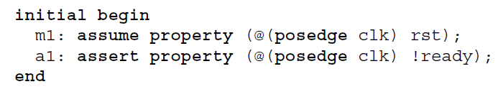
Boolean property
The behavior manifested by a Boolean property alone when placed in an initial procedure is useful because only one property evaluation attempt is executed
Placing such an assertion elsewhere would lead to unconditional evaluation of the Boolean at every assertion clock tick
Example below checks that initially the reset rst is active, and check that initially the value of ready is low
Notes:
Design engineers normally use an HDL to define the function and the structure of a design under verification (DUV). Specifying a design in the text format of an HDL, an activity called design entry, allows the engineer to document the DUV unambiguously and later execute it as a model in a simulation engine. The HDL version of the DUV is also the basis for the physical implementation of the design. To better support the simulation task, HDLs have features that go beyond the mere description of the design and include the specification of stimulus and checking components, which form an HDL test bench. When we characterize the typical elements of HDLs as design specification tools in this lecture, using VHDL as prime example.
There are a variety of algorithms available to build simulation engines. Because the simulation engine plays such a crucial role in the center of the simulation-based flow, typical architectures of such engines are discussed in this lecture. It is important that verification engineers understand the characteristics of such tools at their disposal. Electronic design automation (EDA) developers build tools such as simulation engines around different sets of tradeoffs, many of which select between accuracy and speed. The verification team must choose those tools that are most adequate for their given project.
Many simulation engines offer an interactive graphical user interface (GUI), which lets the user apply individual stimulus and check commands manually in between simulation steps of the model. Such interfaces, which support a detailed debug mode, are effective mainly on smaller models or very specific debug situations. When working with larger-sized DUVs, the verification engineer lets the simulation engine save the results of a simulation run to trace files, which capture simulated model states over time. As also shown in the figure, waveform viewer tools let the user browse through these results files in various ways, for example, forward and backward in simulation time, to inspect and debug the model behavior in detail.
For many verification tasks, the users do not find the test bench features of the HDL sufficient. Therefore, most simulation engines provide open interfaces that support the application of checks and stimuli from a programming or test bench authoring language.
It is already apparent from the figure that many simulation tools present an interactive GUI to the designer. A very common approach is to integrate the different GUI tasks under one single master GUI, which then gives the user the view of a single integrated HDL and verification development environment even if the implementation underneath consists of separate tools.
All major EDA companies offer many of these tools, often integrated into one GUI framework. The benefit of the Institute of Electrical and Electronics Engineers (IEEE) standardization of the HDLs is that many simulation engines are largely interchangeable with each other. The differentiation comes from simulation speed and value-add features such as the integration of the other simulation tasks: coverage, test bench program support, and user-friendliness for debug.

Slide 12
Nexttime property
Property nexttime p, as its name suggests, is true in clock tick i iff property p is true in clock tick i + 1
It can be used in a sequence like nexttime nexttime nexttime p which means that p holds in clock tick 3
SVA a shortcut nexttime[n] to simplify notation, like below where we show how to check if rst is low in clock clk tick 9
This property does not say anything about the behavior of rst in clock ticks 0–8
Notes:
Design engineers normally use an HDL to define the function and the structure of a design under verification (DUV). Specifying a design in the text format of an HDL, an activity called design entry, allows the engineer to document the DUV unambiguously and later execute it as a model in a simulation engine. The HDL version of the DUV is also the basis for the physical implementation of the design. To better support the simulation task, HDLs have features that go beyond the mere description of the design and include the specification of stimulus and checking components, which form an HDL test bench. When we characterize the typical elements of HDLs as design specification tools in this lecture, using VHDL as prime example.
There are a variety of algorithms available to build simulation engines. Because the simulation engine plays such a crucial role in the center of the simulation-based flow, typical architectures of such engines are discussed in this lecture. It is important that verification engineers understand the characteristics of such tools at their disposal. Electronic design automation (EDA) developers build tools such as simulation engines around different sets of tradeoffs, many of which select between accuracy and speed. The verification team must choose those tools that are most adequate for their given project.
Many simulation engines offer an interactive graphical user interface (GUI), which lets the user apply individual stimulus and check commands manually in between simulation steps of the model. Such interfaces, which support a detailed debug mode, are effective mainly on smaller models or very specific debug situations. When working with larger-sized DUVs, the verification engineer lets the simulation engine save the results of a simulation run to trace files, which capture simulated model states over time. As also shown in the figure, waveform viewer tools let the user browse through these results files in various ways, for example, forward and backward in simulation time, to inspect and debug the model behavior in detail.
For many verification tasks, the users do not find the test bench features of the HDL sufficient. Therefore, most simulation engines provide open interfaces that support the application of checks and stimuli from a programming or test bench authoring language.
It is already apparent from the figure that many simulation tools present an interactive GUI to the designer. A very common approach is to integrate the different GUI tasks under one single master GUI, which then gives the user the view of a single integrated HDL and verification development environment even if the implementation underneath consists of separate tools.
All major EDA companies offer many of these tools, often integrated into one GUI framework. The benefit of the Institute of Electrical and Electronics Engineers (IEEE) standardization of the HDLs is that many simulation engines are largely interchangeable with each other. The differentiation comes from simulation speed and value-add features such as the integration of the other simulation tasks: coverage, test bench program support, and user-friendliness for debug.

Slide 13
Always property
Property always p is true in clock tick i iff p is true in all clock ticks j >= i
For example, what is the meaning of nexttime always p? According to the definition of nexttime property, always p should hold in clock tick 1. Therefore, property p should hold in every clock tick starting from clock tick 1
All concurrent assertions placed outside procedural code are continuously monitored. This means that there is an implicit outermost always operator which defines a series of evaluation attempts
Consequently, the following assertions a1 and a2 are equivalent in the sense that either both pass or both fail:
Notes:
Design engineers normally use an HDL to define the function and the structure of a design under verification (DUV). Specifying a design in the text format of an HDL, an activity called design entry, allows the engineer to document the DUV unambiguously and later execute it as a model in a simulation engine. The HDL version of the DUV is also the basis for the physical implementation of the design. To better support the simulation task, HDLs have features that go beyond the mere description of the design and include the specification of stimulus and checking components, which form an HDL test bench. When we characterize the typical elements of HDLs as design specification tools in this lecture, using VHDL as prime example.
There are a variety of algorithms available to build simulation engines. Because the simulation engine plays such a crucial role in the center of the simulation-based flow, typical architectures of such engines are discussed in this lecture. It is important that verification engineers understand the characteristics of such tools at their disposal. Electronic design automation (EDA) developers build tools such as simulation engines around different sets of tradeoffs, many of which select between accuracy and speed. The verification team must choose those tools that are most adequate for their given project.
Many simulation engines offer an interactive graphical user interface (GUI), which lets the user apply individual stimulus and check commands manually in between simulation steps of the model. Such interfaces, which support a detailed debug mode, are effective mainly on smaller models or very specific debug situations. When working with larger-sized DUVs, the verification engineer lets the simulation engine save the results of a simulation run to trace files, which capture simulated model states over time. As also shown in the figure, waveform viewer tools let the user browse through these results files in various ways, for example, forward and backward in simulation time, to inspect and debug the model behavior in detail.
For many verification tasks, the users do not find the test bench features of the HDL sufficient. Therefore, most simulation engines provide open interfaces that support the application of checks and stimuli from a programming or test bench authoring language.
It is already apparent from the figure that many simulation tools present an interactive GUI to the designer. A very common approach is to integrate the different GUI tasks under one single master GUI, which then gives the user the view of a single integrated HDL and verification development environment even if the implementation underneath consists of separate tools.
All major EDA companies offer many of these tools, often integrated into one GUI framework. The benefit of the Institute of Electrical and Electronics Engineers (IEEE) standardization of the HDLs is that many simulation engines are largely interchangeable with each other. The differentiation comes from simulation speed and value-add features such as the integration of the other simulation tasks: coverage, test bench program support, and user-friendliness for debug.

Slide 14
S_eventually property
Property s_eventually p is true in clock tick i iff p is true in some clock tick j >= I
It follows that property s_eventually p is true iff property p is true in some clock tick
For example, following assertion is used to check if reset rst will eventually be deactivated
Notes:
Design engineers normally use an HDL to define the function and the structure of a design under verification (DUV). Specifying a design in the text format of an HDL, an activity called design entry, allows the engineer to document the DUV unambiguously and later execute it as a model in a simulation engine. The HDL version of the DUV is also the basis for the physical implementation of the design. To better support the simulation task, HDLs have features that go beyond the mere description of the design and include the specification of stimulus and checking components, which form an HDL test bench. When we characterize the typical elements of HDLs as design specification tools in this lecture, using VHDL as prime example.
There are a variety of algorithms available to build simulation engines. Because the simulation engine plays such a crucial role in the center of the simulation-based flow, typical architectures of such engines are discussed in this lecture. It is important that verification engineers understand the characteristics of such tools at their disposal. Electronic design automation (EDA) developers build tools such as simulation engines around different sets of tradeoffs, many of which select between accuracy and speed. The verification team must choose those tools that are most adequate for their given project.
Many simulation engines offer an interactive graphical user interface (GUI), which lets the user apply individual stimulus and check commands manually in between simulation steps of the model. Such interfaces, which support a detailed debug mode, are effective mainly on smaller models or very specific debug situations. When working with larger-sized DUVs, the verification engineer lets the simulation engine save the results of a simulation run to trace files, which capture simulated model states over time. As also shown in the figure, waveform viewer tools let the user browse through these results files in various ways, for example, forward and backward in simulation time, to inspect and debug the model behavior in detail.
For many verification tasks, the users do not find the test bench features of the HDL sufficient. Therefore, most simulation engines provide open interfaces that support the application of checks and stimuli from a programming or test bench authoring language.
It is already apparent from the figure that many simulation tools present an interactive GUI to the designer. A very common approach is to integrate the different GUI tasks under one single master GUI, which then gives the user the view of a single integrated HDL and verification development environment even if the implementation underneath consists of separate tools.
All major EDA companies offer many of these tools, often integrated into one GUI framework. The benefit of the Institute of Electrical and Electronics Engineers (IEEE) standardization of the HDLs is that many simulation engines are largely interchangeable with each other. The differentiation comes from simulation speed and value-add features such as the integration of the other simulation tasks: coverage, test bench program support, and user-friendliness for debug.

Slide 15
Basic Boolean property connectives
The following Boolean connectives between properties exist in SVA:
  not—negation
  not p is true iff p is false.
  and—conjunction
  p and q is true iff both p and q are true.
  or—disjunction
  p or q is true iff either p or q (or both) are true.
For example: Reset rst must be asserted during the first two cycles
Notes:
Design engineers normally use an HDL to define the function and the structure of a design under verification (DUV). Specifying a design in the text format of an HDL, an activity called design entry, allows the engineer to document the DUV unambiguously and later execute it as a model in a simulation engine. The HDL version of the DUV is also the basis for the physical implementation of the design. To better support the simulation task, HDLs have features that go beyond the mere description of the design and include the specification of stimulus and checking components, which form an HDL test bench. When we characterize the typical elements of HDLs as design specification tools in this lecture, using VHDL as prime example.
There are a variety of algorithms available to build simulation engines. Because the simulation engine plays such a crucial role in the center of the simulation-based flow, typical architectures of such engines are discussed in this lecture. It is important that verification engineers understand the characteristics of such tools at their disposal. Electronic design automation (EDA) developers build tools such as simulation engines around different sets of tradeoffs, many of which select between accuracy and speed. The verification team must choose those tools that are most adequate for their given project.
Many simulation engines offer an interactive graphical user interface (GUI), which lets the user apply individual stimulus and check commands manually in between simulation steps of the model. Such interfaces, which support a detailed debug mode, are effective mainly on smaller models or very specific debug situations. When working with larger-sized DUVs, the verification engineer lets the simulation engine save the results of a simulation run to trace files, which capture simulated model states over time. As also shown in the figure, waveform viewer tools let the user browse through these results files in various ways, for example, forward and backward in simulation time, to inspect and debug the model behavior in detail.
For many verification tasks, the users do not find the test bench features of the HDL sufficient. Therefore, most simulation engines provide open interfaces that support the application of checks and stimuli from a programming or test bench authoring language.
It is already apparent from the figure that many simulation tools present an interactive GUI to the designer. A very common approach is to integrate the different GUI tasks under one single master GUI, which then gives the user the view of a single integrated HDL and verification development environment even if the implementation underneath consists of separate tools.
All major EDA companies offer many of these tools, often integrated into one GUI framework. The benefit of the Institute of Electrical and Electronics Engineers (IEEE) standardization of the HDLs is that many simulation engines are largely interchangeable with each other. The differentiation comes from simulation speed and value-add features such as the integration of the other simulation tasks: coverage, test bench program support, and user-friendliness for debug.

Slide 16
System Verilog Assertions
Basic sequences

Slide 17
What are sequences
A sequence is a rule defining a series of values in time. A sequence does not have a truth value, it has one initial point and zero or more match, or tight satisfaction points
Like properties, sequences are clocked
If the clock is not written explicitly, we assume that the sequence inherits this clock from the property to which it belongs
Example1: sequence a ##[1:2] b defines the following scenario: a is followed by b in one or two clock ticks. Let the initial point of this sequence be clock tick 2. Then this sequence has a match if a is true in clock tick 2 and either b is true in clock tick 3 or b is true in clock tick 4
Example2: req ##1 rtry ##1 ack - a sequence capturing the following scenario: request req, immediately followed by retry rtry, immediately followed by acknowledgment ack
Instead of a single delay ##1, multiple delays (##m) can be used
For example: Reset rst must be initially high and be low in clock tick 20
Notes:
Design engineers normally use an HDL to define the function and the structure of a design under verification (DUV). Specifying a design in the text format of an HDL, an activity called design entry, allows the engineer to document the DUV unambiguously and later execute it as a model in a simulation engine. The HDL version of the DUV is also the basis for the physical implementation of the design. To better support the simulation task, HDLs have features that go beyond the mere description of the design and include the specification of stimulus and checking components, which form an HDL test bench. When we characterize the typical elements of HDLs as design specification tools in this lecture, using VHDL as prime example.
There are a variety of algorithms available to build simulation engines. Because the simulation engine plays such a crucial role in the center of the simulation-based flow, typical architectures of such engines are discussed in this lecture. It is important that verification engineers understand the characteristics of such tools at their disposal. Electronic design automation (EDA) developers build tools such as simulation engines around different sets of tradeoffs, many of which select between accuracy and speed. The verification team must choose those tools that are most adequate for their given project.
Many simulation engines offer an interactive graphical user interface (GUI), which lets the user apply individual stimulus and check commands manually in between simulation steps of the model. Such interfaces, which support a detailed debug mode, are effective mainly on smaller models or very specific debug situations. When working with larger-sized DUVs, the verification engineer lets the simulation engine save the results of a simulation run to trace files, which capture simulated model states over time. As also shown in the figure, waveform viewer tools let the user browse through these results files in various ways, for example, forward and backward in simulation time, to inspect and debug the model behavior in detail.
For many verification tasks, the users do not find the test bench features of the HDL sufficient. Therefore, most simulation engines provide open interfaces that support the application of checks and stimuli from a programming or test bench authoring language.
It is already apparent from the figure that many simulation tools present an interactive GUI to the designer. A very common approach is to integrate the different GUI tasks under one single master GUI, which then gives the user the view of a single integrated HDL and verification development environment even if the implementation underneath consists of separate tools.
All major EDA companies offer many of these tools, often integrated into one GUI framework. The benefit of the Institute of Electrical and Electronics Engineers (IEEE) standardization of the HDLs is that many simulation engines are largely interchangeable with each other. The differentiation comes from simulation speed and value-add features such as the integration of the other simulation tasks: coverage, test bench program support, and user-friendliness for debug.

Slide 18
Sequences
You should be very careful when using sequential properties in continuously monitored assertions and assumptions since their meaning may be different from your intent. For example:
Since this assertion is continuously monitored (has an implicit outermost always operator), sequential property a ##1 b must be true in each clock tick. Hence, a must be true in each clock tick, and b must be true starting form clock tick 1
Sequence fusion is an overlapping concatenation. The fusion of sequences r and s, denoted as r ##0 s, is matched iff for some match of sequence r there is a match of sequence s starting from the clock tick where the match of r happened
Initial delay ##n s is used to skip n cycles before matching sequence s. For example, the value of a should be always true starting from clock tick 2:
Notes:
Design engineers normally use an HDL to define the function and the structure of a design under verification (DUV). Specifying a design in the text format of an HDL, an activity called design entry, allows the engineer to document the DUV unambiguously and later execute it as a model in a simulation engine. The HDL version of the DUV is also the basis for the physical implementation of the design. To better support the simulation task, HDLs have features that go beyond the mere description of the design and include the specification of stimulus and checking components, which form an HDL test bench. When we characterize the typical elements of HDLs as design specification tools in this lecture, using VHDL as prime example.
There are a variety of algorithms available to build simulation engines. Because the simulation engine plays such a crucial role in the center of the simulation-based flow, typical architectures of such engines are discussed in this lecture. It is important that verification engineers understand the characteristics of such tools at their disposal. Electronic design automation (EDA) developers build tools such as simulation engines around different sets of tradeoffs, many of which select between accuracy and speed. The verification team must choose those tools that are most adequate for their given project.
Many simulation engines offer an interactive graphical user interface (GUI), which lets the user apply individual stimulus and check commands manually in between simulation steps of the model. Such interfaces, which support a detailed debug mode, are effective mainly on smaller models or very specific debug situations. When working with larger-sized DUVs, the verification engineer lets the simulation engine save the results of a simulation run to trace files, which capture simulated model states over time. As also shown in the figure, waveform viewer tools let the user browse through these results files in various ways, for example, forward and backward in simulation time, to inspect and debug the model behavior in detail.
For many verification tasks, the users do not find the test bench features of the HDL sufficient. Therefore, most simulation engines provide open interfaces that support the application of checks and stimuli from a programming or test bench authoring language.
It is already apparent from the figure that many simulation tools present an interactive GUI to the designer. A very common approach is to integrate the different GUI tasks under one single master GUI, which then gives the user the view of a single integrated HDL and verification development environment even if the implementation underneath consists of separate tools.
All major EDA companies offer many of these tools, often integrated into one GUI framework. The benefit of the Institute of Electrical and Electronics Engineers (IEEE) standardization of the HDLs is that many simulation engines are largely interchangeable with each other. The differentiation comes from simulation speed and value-add features such as the integration of the other simulation tasks: coverage, test bench program support, and user-friendliness for debug.

Slide 19
Suffix implication
A suffix implication is built from a sequence (s) and a property (p)
s is called the antecedent, and p is called the consequent
A suffix implication is true when its consequent is true upon completion of its antecedent
There are two versions of suffix implication: overlapping, denoted as s |-> p, and nonoverlapping, denoted as s |=> p
Example 1: When rdy is asserted rst must be low
Example 2: done must be asserted in the next clock tick after sent has been asserted
Notes:
Design engineers normally use an HDL to define the function and the structure of a design under verification (DUV). Specifying a design in the text format of an HDL, an activity called design entry, allows the engineer to document the DUV unambiguously and later execute it as a model in a simulation engine. The HDL version of the DUV is also the basis for the physical implementation of the design. To better support the simulation task, HDLs have features that go beyond the mere description of the design and include the specification of stimulus and checking components, which form an HDL test bench. When we characterize the typical elements of HDLs as design specification tools in this lecture, using VHDL as prime example.
There are a variety of algorithms available to build simulation engines. Because the simulation engine plays such a crucial role in the center of the simulation-based flow, typical architectures of such engines are discussed in this lecture. It is important that verification engineers understand the characteristics of such tools at their disposal. Electronic design automation (EDA) developers build tools such as simulation engines around different sets of tradeoffs, many of which select between accuracy and speed. The verification team must choose those tools that are most adequate for their given project.
Many simulation engines offer an interactive graphical user interface (GUI), which lets the user apply individual stimulus and check commands manually in between simulation steps of the model. Such interfaces, which support a detailed debug mode, are effective mainly on smaller models or very specific debug situations. When working with larger-sized DUVs, the verification engineer lets the simulation engine save the results of a simulation run to trace files, which capture simulated model states over time. As also shown in the figure, waveform viewer tools let the user browse through these results files in various ways, for example, forward and backward in simulation time, to inspect and debug the model behavior in detail.
For many verification tasks, the users do not find the test bench features of the HDL sufficient. Therefore, most simulation engines provide open interfaces that support the application of checks and stimuli from a programming or test bench authoring language.
It is already apparent from the figure that many simulation tools present an interactive GUI to the designer. A very common approach is to integrate the different GUI tasks under one single master GUI, which then gives the user the view of a single integrated HDL and verification development environment even if the implementation underneath consists of separate tools.
All major EDA companies offer many of these tools, often integrated into one GUI framework. The benefit of the Institute of Electrical and Electronics Engineers (IEEE) standardization of the HDLs is that many simulation engines are largely interchangeable with each other. The differentiation comes from simulation speed and value-add features such as the integration of the other simulation tasks: coverage, test bench program support, and user-friendliness for debug.

Slide 20

Nested implications
If start is asserted two clock ticks before send, then acknowledgment ack should arrive in three clock ticks after send was asserted
Nested suffix implication is unambiguous: the antecedent of the outermost implication is start, and not start |-> ##2 send because the latter expression is a property, and not a sequence, whereas the antecedent must be a sequence
The same assertion may be reformulated in the following way: each time send is issued two cycles after start, ack should arrive three cycles after send, and the assertion can be rewritten as
Notes:
Design engineers normally use an HDL to define the function and the structure of a design under verification (DUV). Specifying a design in the text format of an HDL, an activity called design entry, allows the engineer to document the DUV unambiguously and later execute it as a model in a simulation engine. The HDL version of the DUV is also the basis for the physical implementation of the design. To better support the simulation task, HDLs have features that go beyond the mere description of the design and include the specification of stimulus and checking components, which form an HDL test bench. When we characterize the typical elements of HDLs as design specification tools in this lecture, using VHDL as prime example.
There are a variety of algorithms available to build simulation engines. Because the simulation engine plays such a crucial role in the center of the simulation-based flow, typical architectures of such engines are discussed in this lecture. It is important that verification engineers understand the characteristics of such tools at their disposal. Electronic design automation (EDA) developers build tools such as simulation engines around different sets of tradeoffs, many of which select between accuracy and speed. The verification team must choose those tools that are most adequate for their given project.
Many simulation engines offer an interactive graphical user interface (GUI), which lets the user apply individual stimulus and check commands manually in between simulation steps of the model. Such interfaces, which support a detailed debug mode, are effective mainly on smaller models or very specific debug situations. When working with larger-sized DUVs, the verification engineer lets the simulation engine save the results of a simulation run to trace files, which capture simulated model states over time. As also shown in the figure, waveform viewer tools let the user browse through these results files in various ways, for example, forward and backward in simulation time, to inspect and debug the model behavior in detail.
For many verification tasks, the users do not find the test bench features of the HDL sufficient. Therefore, most simulation engines provide open interfaces that support the application of checks and stimuli from a programming or test bench authoring language.
It is already apparent from the figure that many simulation tools present an interactive GUI to the designer. A very common approach is to integrate the different GUI tasks under one single master GUI, which then gives the user the view of a single integrated HDL and verification development environment even if the implementation underneath consists of separate tools.
All major EDA companies offer many of these tools, often integrated into one GUI framework. The benefit of the Institute of Electrical and Electronics Engineers (IEEE) standardization of the HDLs is that many simulation engines are largely interchangeable with each other. The differentiation comes from simulation speed and value-add features such as the integration of the other simulation tasks: coverage, test bench program support, and user-friendliness for debug.

Slide 21
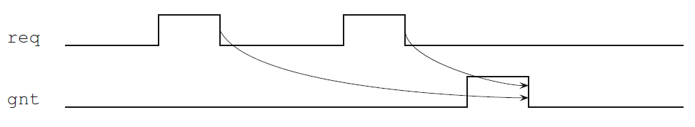

Examples
Request req should be active until grant is asserted
Request req must be granted. This assertion means that each time request req is high, grant gnt should be high in some clock tick in the future
After request req has been sent, acknowledgment ack should come before data (data_ready)
Notes:
Design engineers normally use an HDL to define the function and the structure of a design under verification (DUV). Specifying a design in the text format of an HDL, an activity called design entry, allows the engineer to document the DUV unambiguously and later execute it as a model in a simulation engine. The HDL version of the DUV is also the basis for the physical implementation of the design. To better support the simulation task, HDLs have features that go beyond the mere description of the design and include the specification of stimulus and checking components, which form an HDL test bench. When we characterize the typical elements of HDLs as design specification tools in this lecture, using VHDL as prime example.
There are a variety of algorithms available to build simulation engines. Because the simulation engine plays such a crucial role in the center of the simulation-based flow, typical architectures of such engines are discussed in this lecture. It is important that verification engineers understand the characteristics of such tools at their disposal. Electronic design automation (EDA) developers build tools such as simulation engines around different sets of tradeoffs, many of which select between accuracy and speed. The verification team must choose those tools that are most adequate for their given project.
Many simulation engines offer an interactive graphical user interface (GUI), which lets the user apply individual stimulus and check commands manually in between simulation steps of the model. Such interfaces, which support a detailed debug mode, are effective mainly on smaller models or very specific debug situations. When working with larger-sized DUVs, the verification engineer lets the simulation engine save the results of a simulation run to trace files, which capture simulated model states over time. As also shown in the figure, waveform viewer tools let the user browse through these results files in various ways, for example, forward and backward in simulation time, to inspect and debug the model behavior in detail.
For many verification tasks, the users do not find the test bench features of the HDL sufficient. Therefore, most simulation engines provide open interfaces that support the application of checks and stimuli from a programming or test bench authoring language.
It is already apparent from the figure that many simulation tools present an interactive GUI to the designer. A very common approach is to integrate the different GUI tasks under one single master GUI, which then gives the user the view of a single integrated HDL and verification development environment even if the implementation underneath consists of separate tools.
All major EDA companies offer many of these tools, often integrated into one GUI framework. The benefit of the Institute of Electrical and Electronics Engineers (IEEE) standardization of the HDLs is that many simulation engines are largely interchangeable with each other. The differentiation comes from simulation speed and value-add features such as the integration of the other simulation tasks: coverage, test bench program support, and user-friendliness for debug.

Slide 22
Consecutive repetition
Write a sequence stating that a transmission phase lasting three consecutive cycles is followed by a receiving phase lasting two consecutive cycles. The transmission phase is represented by signal trn, and the receiving phase is represented by signal rcv:
In SVA, there is a special operator to denote a consecutive repetition of a sequence s n times, where n is a nonnegative constant: s[*n]
Previous example can be then rewritten as
Example from before “Reset rst must be asserted during first two cycles” may be more elegantly expressed using sequences
Notes:
Design engineers normally use an HDL to define the function and the structure of a design under verification (DUV). Specifying a design in the text format of an HDL, an activity called design entry, allows the engineer to document the DUV unambiguously and later execute it as a model in a simulation engine. The HDL version of the DUV is also the basis for the physical implementation of the design. To better support the simulation task, HDLs have features that go beyond the mere description of the design and include the specification of stimulus and checking components, which form an HDL test bench. When we characterize the typical elements of HDLs as design specification tools in this lecture, using VHDL as prime example.
There are a variety of algorithms available to build simulation engines. Because the simulation engine plays such a crucial role in the center of the simulation-based flow, typical architectures of such engines are discussed in this lecture. It is important that verification engineers understand the characteristics of such tools at their disposal. Electronic design automation (EDA) developers build tools such as simulation engines around different sets of tradeoffs, many of which select between accuracy and speed. The verification team must choose those tools that are most adequate for their given project.
Many simulation engines offer an interactive graphical user interface (GUI), which lets the user apply individual stimulus and check commands manually in between simulation steps of the model. Such interfaces, which support a detailed debug mode, are effective mainly on smaller models or very specific debug situations. When working with larger-sized DUVs, the verification engineer lets the simulation engine save the results of a simulation run to trace files, which capture simulated model states over time. As also shown in the figure, waveform viewer tools let the user browse through these results files in various ways, for example, forward and backward in simulation time, to inspect and debug the model behavior in detail.
For many verification tasks, the users do not find the test bench features of the HDL sufficient. Therefore, most simulation engines provide open interfaces that support the application of checks and stimuli from a programming or test bench authoring language.
It is already apparent from the figure that many simulation tools present an interactive GUI to the designer. A very common approach is to integrate the different GUI tasks under one single master GUI, which then gives the user the view of a single integrated HDL and verification development environment even if the implementation underneath consists of separate tools.
All major EDA companies offer many of these tools, often integrated into one GUI framework. The benefit of the Institute of Electrical and Electronics Engineers (IEEE) standardization of the HDLs is that many simulation engines are largely interchangeable with each other. The differentiation comes from simulation speed and value-add features such as the integration of the other simulation tasks: coverage, test bench program support, and user-friendliness for debug.

Slide 23
Consecutive repetition range
Instead of a fixed number of repetitions one can specify a repetition range: finite s[*m:n] and infinite s[*n:$]. m and n should be constants, m <= n, and $ stands for an “infinite number”
There are shortcuts s[*] provided for s[*0:$] (zero or more times), and s[+] for s[*1:$] (one or more times) that we will widely use
Example1: Describe a transaction as a sequence. A transaction starts with Beginning Of Transaction signal (bot) and ends with End Of Transaction signal (eot). Each transaction is at least two cycles long, and transactions cannot overlap
Solution: Since the transaction is at least two cycles long, bot and eot of the same transaction cannot be asserted in the same clock cycle. The fact that transactions cannot overlap means that between bot and the next eot there are no other occurrences of bot. We allow bot of the next transaction to occur in the same clock cycle with eot of the previous transactions. Transactions should also be well formed; therefore no two eot should occur without a bot occurrence between them. Therefore, the sequence describing the transaction is
Notes:
Design engineers normally use an HDL to define the function and the structure of a design under verification (DUV). Specifying a design in the text format of an HDL, an activity called design entry, allows the engineer to document the DUV unambiguously and later execute it as a model in a simulation engine. The HDL version of the DUV is also the basis for the physical implementation of the design. To better support the simulation task, HDLs have features that go beyond the mere description of the design and include the specification of stimulus and checking components, which form an HDL test bench. When we characterize the typical elements of HDLs as design specification tools in this lecture, using VHDL as prime example.
There are a variety of algorithms available to build simulation engines. Because the simulation engine plays such a crucial role in the center of the simulation-based flow, typical architectures of such engines are discussed in this lecture. It is important that verification engineers understand the characteristics of such tools at their disposal. Electronic design automation (EDA) developers build tools such as simulation engines around different sets of tradeoffs, many of which select between accuracy and speed. The verification team must choose those tools that are most adequate for their given project.
Many simulation engines offer an interactive graphical user interface (GUI), which lets the user apply individual stimulus and check commands manually in between simulation steps of the model. Such interfaces, which support a detailed debug mode, are effective mainly on smaller models or very specific debug situations. When working with larger-sized DUVs, the verification engineer lets the simulation engine save the results of a simulation run to trace files, which capture simulated model states over time. As also shown in the figure, waveform viewer tools let the user browse through these results files in various ways, for example, forward and backward in simulation time, to inspect and debug the model behavior in detail.
For many verification tasks, the users do not find the test bench features of the HDL sufficient. Therefore, most simulation engines provide open interfaces that support the application of checks and stimuli from a programming or test bench authoring language.
It is already apparent from the figure that many simulation tools present an interactive GUI to the designer. A very common approach is to integrate the different GUI tasks under one single master GUI, which then gives the user the view of a single integrated HDL and verification development environment even if the implementation underneath consists of separate tools.
All major EDA companies offer many of these tools, often integrated into one GUI framework. The benefit of the Institute of Electrical and Electronics Engineers (IEEE) standardization of the HDLs is that many simulation engines are largely interchangeable with each other. The differentiation comes from simulation speed and value-add features such as the integration of the other simulation tasks: coverage, test bench program support, and user-friendliness for debug.

Slide 24


Consecutive repetition range … cont
Example2: Write the following assertion: rdy becomes asserted the first time when the reset sequence is over. The reset sequence is represented by the high value of rst
Or more intuitively:
Example3: We revisit example from before: ready should be low until rst becomes inactive for the first time
Notes:
Design engineers normally use an HDL to define the function and the structure of a design under verification (DUV). Specifying a design in the text format of an HDL, an activity called design entry, allows the engineer to document the DUV unambiguously and later execute it as a model in a simulation engine. The HDL version of the DUV is also the basis for the physical implementation of the design. To better support the simulation task, HDLs have features that go beyond the mere description of the design and include the specification of stimulus and checking components, which form an HDL test bench. When we characterize the typical elements of HDLs as design specification tools in this lecture, using VHDL as prime example.
There are a variety of algorithms available to build simulation engines. Because the simulation engine plays such a crucial role in the center of the simulation-based flow, typical architectures of such engines are discussed in this lecture. It is important that verification engineers understand the characteristics of such tools at their disposal. Electronic design automation (EDA) developers build tools such as simulation engines around different sets of tradeoffs, many of which select between accuracy and speed. The verification team must choose those tools that are most adequate for their given project.
Many simulation engines offer an interactive graphical user interface (GUI), which lets the user apply individual stimulus and check commands manually in between simulation steps of the model. Such interfaces, which support a detailed debug mode, are effective mainly on smaller models or very specific debug situations. When working with larger-sized DUVs, the verification engineer lets the simulation engine save the results of a simulation run to trace files, which capture simulated model states over time. As also shown in the figure, waveform viewer tools let the user browse through these results files in various ways, for example, forward and backward in simulation time, to inspect and debug the model behavior in detail.
For many verification tasks, the users do not find the test bench features of the HDL sufficient. Therefore, most simulation engines provide open interfaces that support the application of checks and stimuli from a programming or test bench authoring language.
It is already apparent from the figure that many simulation tools present an interactive GUI to the designer. A very common approach is to integrate the different GUI tasks under one single master GUI, which then gives the user the view of a single integrated HDL and verification development environment even if the implementation underneath consists of separate tools.
All major EDA companies offer many of these tools, often integrated into one GUI framework. The benefit of the Institute of Electrical and Electronics Engineers (IEEE) standardization of the HDLs is that many simulation engines are largely interchangeable with each other. The differentiation comes from simulation speed and value-add features such as the integration of the other simulation tasks: coverage, test bench program support, and user-friendliness for debug.

Slide 25
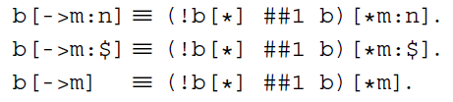
Go-to repetition
There is a special sequence operator, a goto repetition, stating that the condition e must happen for the first time: e[->1]. For an arbitrary integer constant n > 0, e[->n], where e is a Boolean, is a shortcut for (!e[*] ## e)[*n]
Example: After request req is serviced by done asserted, signal ready should be asserted
Can be rewritten as:
It is also possible to specify ranges in goto repetition: e[->m:n], 0 <= m <= n
Notes:
Design engineers normally use an HDL to define the function and the structure of a design under verification (DUV). Specifying a design in the text format of an HDL, an activity called design entry, allows the engineer to document the DUV unambiguously and later execute it as a model in a simulation engine. The HDL version of the DUV is also the basis for the physical implementation of the design. To better support the simulation task, HDLs have features that go beyond the mere description of the design and include the specification of stimulus and checking components, which form an HDL test bench. When we characterize the typical elements of HDLs as design specification tools in this lecture, using VHDL as prime example.
There are a variety of algorithms available to build simulation engines. Because the simulation engine plays such a crucial role in the center of the simulation-based flow, typical architectures of such engines are discussed in this lecture. It is important that verification engineers understand the characteristics of such tools at their disposal. Electronic design automation (EDA) developers build tools such as simulation engines around different sets of tradeoffs, many of which select between accuracy and speed. The verification team must choose those tools that are most adequate for their given project.
Many simulation engines offer an interactive graphical user interface (GUI), which lets the user apply individual stimulus and check commands manually in between simulation steps of the model. Such interfaces, which support a detailed debug mode, are effective mainly on smaller models or very specific debug situations. When working with larger-sized DUVs, the verification engineer lets the simulation engine save the results of a simulation run to trace files, which capture simulated model states over time. As also shown in the figure, waveform viewer tools let the user browse through these results files in various ways, for example, forward and backward in simulation time, to inspect and debug the model behavior in detail.
For many verification tasks, the users do not find the test bench features of the HDL sufficient. Therefore, most simulation engines provide open interfaces that support the application of checks and stimuli from a programming or test bench authoring language.
It is already apparent from the figure that many simulation tools present an interactive GUI to the designer. A very common approach is to integrate the different GUI tasks under one single master GUI, which then gives the user the view of a single integrated HDL and verification development environment even if the implementation underneath consists of separate tools.
All major EDA companies offer many of these tools, often integrated into one GUI framework. The benefit of the Institute of Electrical and Electronics Engineers (IEEE) standardization of the HDLs is that many simulation engines are largely interchangeable with each other. The differentiation comes from simulation speed and value-add features such as the integration of the other simulation tasks: coverage, test bench program support, and user-friendliness for debug.

Slide 26
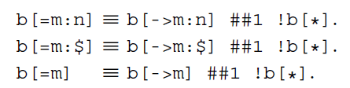
Non-Consecutive repetition
Non-consecutive repetition [=n] is another useful operator (just as the consecutive operator) and used very frequently
In many applications, we want to check that a signal remains asserted or de-asserted a number of times and that we need not know when exactly these transitions take place
Almost the same as goto repetition but allowing that condition is not met at the end of the sequence (with goto repetition the last occurrence must happen at the end of the sequence:
Notes:
Design engineers normally use an HDL to define the function and the structure of a design under verification (DUV). Specifying a design in the text format of an HDL, an activity called design entry, allows the engineer to document the DUV unambiguously and later execute it as a model in a simulation engine. The HDL version of the DUV is also the basis for the physical implementation of the design. To better support the simulation task, HDLs have features that go beyond the mere description of the design and include the specification of stimulus and checking components, which form an HDL test bench. When we characterize the typical elements of HDLs as design specification tools in this lecture, using VHDL as prime example.
There are a variety of algorithms available to build simulation engines. Because the simulation engine plays such a crucial role in the center of the simulation-based flow, typical architectures of such engines are discussed in this lecture. It is important that verification engineers understand the characteristics of such tools at their disposal. Electronic design automation (EDA) developers build tools such as simulation engines around different sets of tradeoffs, many of which select between accuracy and speed. The verification team must choose those tools that are most adequate for their given project.
Many simulation engines offer an interactive graphical user interface (GUI), which lets the user apply individual stimulus and check commands manually in between simulation steps of the model. Such interfaces, which support a detailed debug mode, are effective mainly on smaller models or very specific debug situations. When working with larger-sized DUVs, the verification engineer lets the simulation engine save the results of a simulation run to trace files, which capture simulated model states over time. As also shown in the figure, waveform viewer tools let the user browse through these results files in various ways, for example, forward and backward in simulation time, to inspect and debug the model behavior in detail.
For many verification tasks, the users do not find the test bench features of the HDL sufficient. Therefore, most simulation engines provide open interfaces that support the application of checks and stimuli from a programming or test bench authoring language.
It is already apparent from the figure that many simulation tools present an interactive GUI to the designer. A very common approach is to integrate the different GUI tasks under one single master GUI, which then gives the user the view of a single integrated HDL and verification development environment even if the implementation underneath consists of separate tools.
All major EDA companies offer many of these tools, often integrated into one GUI framework. The benefit of the Institute of Electrical and Electronics Engineers (IEEE) standardization of the HDLs is that many simulation engines are largely interchangeable with each other. The differentiation comes from simulation speed and value-add features such as the integration of the other simulation tasks: coverage, test bench program support, and user-friendliness for debug.

Slide 27
System Verilog Assertions
Assertion system Functions and Tasks

Slide 28
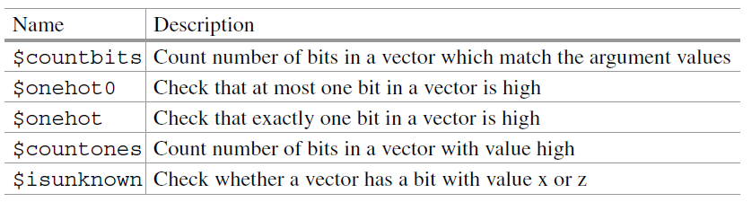
Bit vector functions
All functions from below with the exception of $countbits, have a bit vector as their single argument. Function $countbits requires an additional list of arguments to specify the control values to match
Example: read and write requests cannot appear together
Notes:
Design engineers normally use an HDL to define the function and the structure of a design under verification (DUV). Specifying a design in the text format of an HDL, an activity called design entry, allows the engineer to document the DUV unambiguously and later execute it as a model in a simulation engine. The HDL version of the DUV is also the basis for the physical implementation of the design. To better support the simulation task, HDLs have features that go beyond the mere description of the design and include the specification of stimulus and checking components, which form an HDL test bench. When we characterize the typical elements of HDLs as design specification tools in this lecture, using VHDL as prime example.
There are a variety of algorithms available to build simulation engines. Because the simulation engine plays such a crucial role in the center of the simulation-based flow, typical architectures of such engines are discussed in this lecture. It is important that verification engineers understand the characteristics of such tools at their disposal. Electronic design automation (EDA) developers build tools such as simulation engines around different sets of tradeoffs, many of which select between accuracy and speed. The verification team must choose those tools that are most adequate for their given project.
Many simulation engines offer an interactive graphical user interface (GUI), which lets the user apply individual stimulus and check commands manually in between simulation steps of the model. Such interfaces, which support a detailed debug mode, are effective mainly on smaller models or very specific debug situations. When working with larger-sized DUVs, the verification engineer lets the simulation engine save the results of a simulation run to trace files, which capture simulated model states over time. As also shown in the figure, waveform viewer tools let the user browse through these results files in various ways, for example, forward and backward in simulation time, to inspect and debug the model behavior in detail.
For many verification tasks, the users do not find the test bench features of the HDL sufficient. Therefore, most simulation engines provide open interfaces that support the application of checks and stimuli from a programming or test bench authoring language.
It is already apparent from the figure that many simulation tools present an interactive GUI to the designer. A very common approach is to integrate the different GUI tasks under one single master GUI, which then gives the user the view of a single integrated HDL and verification development environment even if the implementation underneath consists of separate tools.
All major EDA companies offer many of these tools, often integrated into one GUI framework. The benefit of the Institute of Electrical and Electronics Engineers (IEEE) standardization of the HDLs is that many simulation engines are largely interchangeable with each other. The differentiation comes from simulation speed and value-add features such as the integration of the other simulation tasks: coverage, test bench program support, and user-friendliness for debug.

Slide 29

Bit vector functions .. cont
Example: Check that a control state of an FSM has a one-hot encoding when rst is low
System function $isunknown returns 1’b1 if any bit of its argument has the value x or z
Example: All bits of data should have known values (i.e., 0 or 1) when read is active
Notes:
Design engineers normally use an HDL to define the function and the structure of a design under verification (DUV). Specifying a design in the text format of an HDL, an activity called design entry, allows the engineer to document the DUV unambiguously and later execute it as a model in a simulation engine. The HDL version of the DUV is also the basis for the physical implementation of the design. To better support the simulation task, HDLs have features that go beyond the mere description of the design and include the specification of stimulus and checking components, which form an HDL test bench. When we characterize the typical elements of HDLs as design specification tools in this lecture, using VHDL as prime example.
There are a variety of algorithms available to build simulation engines. Because the simulation engine plays such a crucial role in the center of the simulation-based flow, typical architectures of such engines are discussed in this lecture. It is important that verification engineers understand the characteristics of such tools at their disposal. Electronic design automation (EDA) developers build tools such as simulation engines around different sets of tradeoffs, many of which select between accuracy and speed. The verification team must choose those tools that are most adequate for their given project.
Many simulation engines offer an interactive graphical user interface (GUI), which lets the user apply individual stimulus and check commands manually in between simulation steps of the model. Such interfaces, which support a detailed debug mode, are effective mainly on smaller models or very specific debug situations. When working with larger-sized DUVs, the verification engineer lets the simulation engine save the results of a simulation run to trace files, which capture simulated model states over time. As also shown in the figure, waveform viewer tools let the user browse through these results files in various ways, for example, forward and backward in simulation time, to inspect and debug the model behavior in detail.
For many verification tasks, the users do not find the test bench features of the HDL sufficient. Therefore, most simulation engines provide open interfaces that support the application of checks and stimuli from a programming or test bench authoring language.
It is already apparent from the figure that many simulation tools present an interactive GUI to the designer. A very common approach is to integrate the different GUI tasks under one single master GUI, which then gives the user the view of a single integrated HDL and verification development environment even if the implementation underneath consists of separate tools.
All major EDA companies offer many of these tools, often integrated into one GUI framework. The benefit of the Institute of Electrical and Electronics Engineers (IEEE) standardization of the HDLs is that many simulation engines are largely interchangeable with each other. The differentiation comes from simulation speed and value-add features such as the integration of the other simulation tasks: coverage, test bench program support, and user-friendliness for debug.

Slide 30
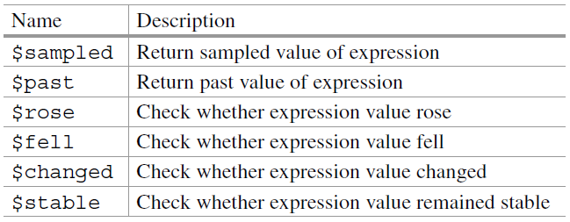
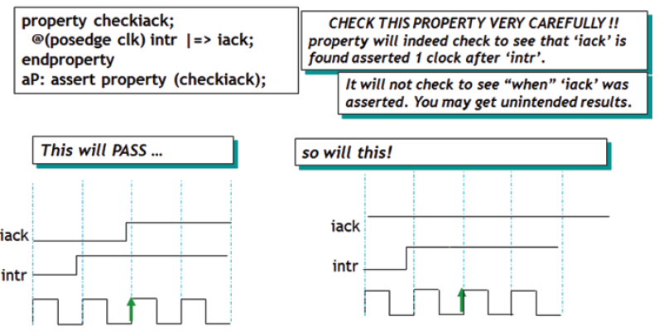
Sampled value functions
Notes:
Design engineers normally use an HDL to define the function and the structure of a design under verification (DUV). Specifying a design in the text format of an HDL, an activity called design entry, allows the engineer to document the DUV unambiguously and later execute it as a model in a simulation engine. The HDL version of the DUV is also the basis for the physical implementation of the design. To better support the simulation task, HDLs have features that go beyond the mere description of the design and include the specification of stimulus and checking components, which form an HDL test bench. When we characterize the typical elements of HDLs as design specification tools in this lecture, using VHDL as prime example.
There are a variety of algorithms available to build simulation engines. Because the simulation engine plays such a crucial role in the center of the simulation-based flow, typical architectures of such engines are discussed in this lecture. It is important that verification engineers understand the characteristics of such tools at their disposal. Electronic design automation (EDA) developers build tools such as simulation engines around different sets of tradeoffs, many of which select between accuracy and speed. The verification team must choose those tools that are most adequate for their given project.
Many simulation engines offer an interactive graphical user interface (GUI), which lets the user apply individual stimulus and check commands manually in between simulation steps of the model. Such interfaces, which support a detailed debug mode, are effective mainly on smaller models or very specific debug situations. When working with larger-sized DUVs, the verification engineer lets the simulation engine save the results of a simulation run to trace files, which capture simulated model states over time. As also shown in the figure, waveform viewer tools let the user browse through these results files in various ways, for example, forward and backward in simulation time, to inspect and debug the model behavior in detail.
For many verification tasks, the users do not find the test bench features of the HDL sufficient. Therefore, most simulation engines provide open interfaces that support the application of checks and stimuli from a programming or test bench authoring language.
It is already apparent from the figure that many simulation tools present an interactive GUI to the designer. A very common approach is to integrate the different GUI tasks under one single master GUI, which then gives the user the view of a single integrated HDL and verification development environment even if the implementation underneath consists of separate tools.
All major EDA companies offer many of these tools, often integrated into one GUI framework. The benefit of the Institute of Electrical and Electronics Engineers (IEEE) standardization of the HDLs is that many simulation engines are largely interchangeable with each other. The differentiation comes from simulation speed and value-add features such as the integration of the other simulation tasks: coverage, test bench program support, and user-friendliness for debug.

Slide 31

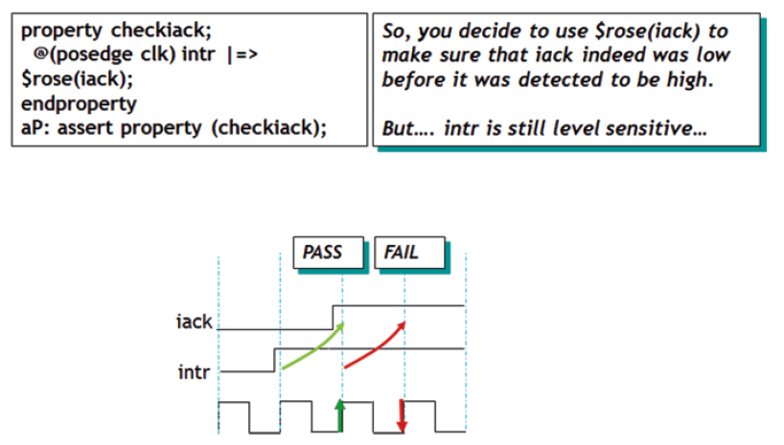
Sampled value functions
Solution:
Notes:
Design engineers normally use an HDL to define the function and the structure of a design under verification (DUV). Specifying a design in the text format of an HDL, an activity called design entry, allows the engineer to document the DUV unambiguously and later execute it as a model in a simulation engine. The HDL version of the DUV is also the basis for the physical implementation of the design. To better support the simulation task, HDLs have features that go beyond the mere description of the design and include the specification of stimulus and checking components, which form an HDL test bench. When we characterize the typical elements of HDLs as design specification tools in this lecture, using VHDL as prime example.
There are a variety of algorithms available to build simulation engines. Because the simulation engine plays such a crucial role in the center of the simulation-based flow, typical architectures of such engines are discussed in this lecture. It is important that verification engineers understand the characteristics of such tools at their disposal. Electronic design automation (EDA) developers build tools such as simulation engines around different sets of tradeoffs, many of which select between accuracy and speed. The verification team must choose those tools that are most adequate for their given project.
Many simulation engines offer an interactive graphical user interface (GUI), which lets the user apply individual stimulus and check commands manually in between simulation steps of the model. Such interfaces, which support a detailed debug mode, are effective mainly on smaller models or very specific debug situations. When working with larger-sized DUVs, the verification engineer lets the simulation engine save the results of a simulation run to trace files, which capture simulated model states over time. As also shown in the figure, waveform viewer tools let the user browse through these results files in various ways, for example, forward and backward in simulation time, to inspect and debug the model behavior in detail.
For many verification tasks, the users do not find the test bench features of the HDL sufficient. Therefore, most simulation engines provide open interfaces that support the application of checks and stimuli from a programming or test bench authoring language.
It is already apparent from the figure that many simulation tools present an interactive GUI to the designer. A very common approach is to integrate the different GUI tasks under one single master GUI, which then gives the user the view of a single integrated HDL and verification development environment even if the implementation underneath consists of separate tools.
All major EDA companies offer many of these tools, often integrated into one GUI framework. The benefit of the Institute of Electrical and Electronics Engineers (IEEE) standardization of the HDLs is that many simulation engines are largely interchangeable with each other. The differentiation comes from simulation speed and value-add features such as the integration of the other simulation tasks: coverage, test bench program support, and user-friendliness for debug.

Slide 32
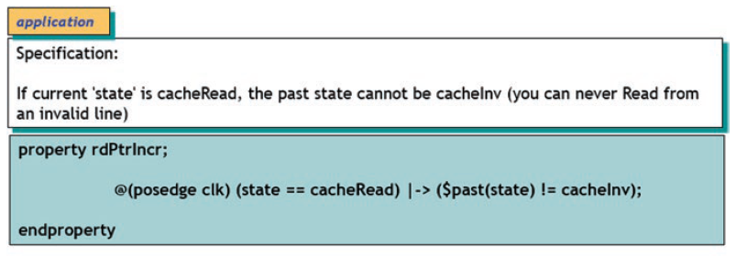
Sampled value functions
Example of using $past:
Notes:
Design engineers normally use an HDL to define the function and the structure of a design under verification (DUV). Specifying a design in the text format of an HDL, an activity called design entry, allows the engineer to document the DUV unambiguously and later execute it as a model in a simulation engine. The HDL version of the DUV is also the basis for the physical implementation of the design. To better support the simulation task, HDLs have features that go beyond the mere description of the design and include the specification of stimulus and checking components, which form an HDL test bench. When we characterize the typical elements of HDLs as design specification tools in this lecture, using VHDL as prime example.
There are a variety of algorithms available to build simulation engines. Because the simulation engine plays such a crucial role in the center of the simulation-based flow, typical architectures of such engines are discussed in this lecture. It is important that verification engineers understand the characteristics of such tools at their disposal. Electronic design automation (EDA) developers build tools such as simulation engines around different sets of tradeoffs, many of which select between accuracy and speed. The verification team must choose those tools that are most adequate for their given project.
Many simulation engines offer an interactive graphical user interface (GUI), which lets the user apply individual stimulus and check commands manually in between simulation steps of the model. Such interfaces, which support a detailed debug mode, are effective mainly on smaller models or very specific debug situations. When working with larger-sized DUVs, the verification engineer lets the simulation engine save the results of a simulation run to trace files, which capture simulated model states over time. As also shown in the figure, waveform viewer tools let the user browse through these results files in various ways, for example, forward and backward in simulation time, to inspect and debug the model behavior in detail.
For many verification tasks, the users do not find the test bench features of the HDL sufficient. Therefore, most simulation engines provide open interfaces that support the application of checks and stimuli from a programming or test bench authoring language.
It is already apparent from the figure that many simulation tools present an interactive GUI to the designer. A very common approach is to integrate the different GUI tasks under one single master GUI, which then gives the user the view of a single integrated HDL and verification development environment even if the implementation underneath consists of separate tools.
All major EDA companies offer many of these tools, often integrated into one GUI framework. The benefit of the Institute of Electrical and Electronics Engineers (IEEE) standardization of the HDLs is that many simulation engines are largely interchangeable with each other. The differentiation comes from simulation speed and value-add features such as the integration of the other simulation tasks: coverage, test bench program support, and user-friendliness for debug.

Slide 33
Sampled value functions
For a burst cycle, when the “read” signal is high until burst read is complete that during this period, the rd_addr is incremented by one in every clock cycle:
sequence check_rd_adr;
((rd_addr == $past(rd_addr)+1) && read) [∗0:$] ##1 $fell(read);
endsequence
sequence read_cycle;
($rose(read) && reset_);
endsequence
property burst_check;
@(posedge clk) read_cycle |-> check_rd_adr;
endproperty
Sequence “check_rd_adr” checks to see that current rd_addr is past rd_addr+1.
That is done using the $past sampled value function. We then continue to check this behavior “consecutively” until $fell(read) occurs (which is the end of the read cycle). So, every clock, the entire expression “(rd_addr == $past (rd_addr)+1) && read” is consecutively checked until “read” goes low
Notes:
Design engineers normally use an HDL to define the function and the structure of a design under verification (DUV). Specifying a design in the text format of an HDL, an activity called design entry, allows the engineer to document the DUV unambiguously and later execute it as a model in a simulation engine. The HDL version of the DUV is also the basis for the physical implementation of the design. To better support the simulation task, HDLs have features that go beyond the mere description of the design and include the specification of stimulus and checking components, which form an HDL test bench. When we characterize the typical elements of HDLs as design specification tools in this lecture, using VHDL as prime example.
There are a variety of algorithms available to build simulation engines. Because the simulation engine plays such a crucial role in the center of the simulation-based flow, typical architectures of such engines are discussed in this lecture. It is important that verification engineers understand the characteristics of such tools at their disposal. Electronic design automation (EDA) developers build tools such as simulation engines around different sets of tradeoffs, many of which select between accuracy and speed. The verification team must choose those tools that are most adequate for their given project.
Many simulation engines offer an interactive graphical user interface (GUI), which lets the user apply individual stimulus and check commands manually in between simulation steps of the model. Such interfaces, which support a detailed debug mode, are effective mainly on smaller models or very specific debug situations. When working with larger-sized DUVs, the verification engineer lets the simulation engine save the results of a simulation run to trace files, which capture simulated model states over time. As also shown in the figure, waveform viewer tools let the user browse through these results files in various ways, for example, forward and backward in simulation time, to inspect and debug the model behavior in detail.
For many verification tasks, the users do not find the test bench features of the HDL sufficient. Therefore, most simulation engines provide open interfaces that support the application of checks and stimuli from a programming or test bench authoring language.
It is already apparent from the figure that many simulation tools present an interactive GUI to the designer. A very common approach is to integrate the different GUI tasks under one single master GUI, which then gives the user the view of a single integrated HDL and verification development environment even if the implementation underneath consists of separate tools.
All major EDA companies offer many of these tools, often integrated into one GUI framework. The benefit of the Institute of Electrical and Electronics Engineers (IEEE) standardization of the HDLs is that many simulation engines are largely interchangeable with each other. The differentiation comes from simulation speed and value-add features such as the integration of the other simulation tasks: coverage, test bench program support, and user-friendliness for debug.

Slide 34
System Verilog Assertions
Parametrization

Slide 35
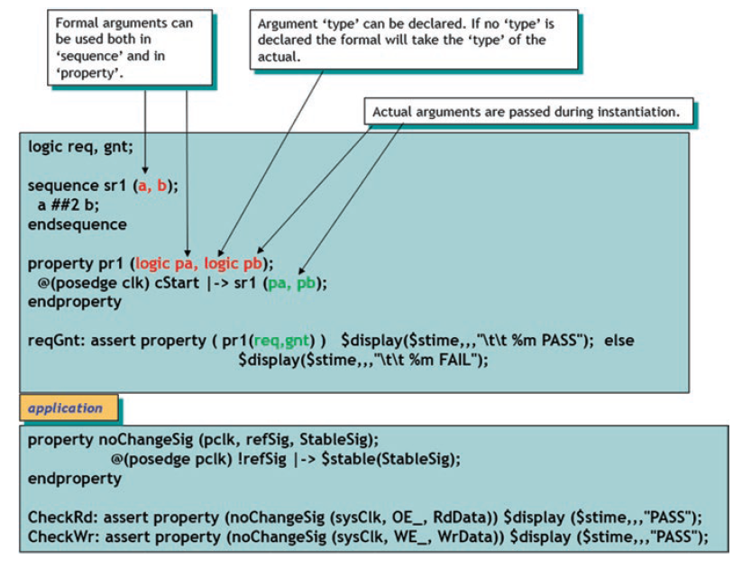
Formal arguments
One of the key features of assertions is that they can be parameterized
In other words, assertions can be designed with formal arguments to keep them generic enough for use with different actual arguments:
Notes:
Design engineers normally use an HDL to define the function and the structure of a design under verification (DUV). Specifying a design in the text format of an HDL, an activity called design entry, allows the engineer to document the DUV unambiguously and later execute it as a model in a simulation engine. The HDL version of the DUV is also the basis for the physical implementation of the design. To better support the simulation task, HDLs have features that go beyond the mere description of the design and include the specification of stimulus and checking components, which form an HDL test bench. When we characterize the typical elements of HDLs as design specification tools in this lecture, using VHDL as prime example.
There are a variety of algorithms available to build simulation engines. Because the simulation engine plays such a crucial role in the center of the simulation-based flow, typical architectures of such engines are discussed in this lecture. It is important that verification engineers understand the characteristics of such tools at their disposal. Electronic design automation (EDA) developers build tools such as simulation engines around different sets of tradeoffs, many of which select between accuracy and speed. The verification team must choose those tools that are most adequate for their given project.
Many simulation engines offer an interactive graphical user interface (GUI), which lets the user apply individual stimulus and check commands manually in between simulation steps of the model. Such interfaces, which support a detailed debug mode, are effective mainly on smaller models or very specific debug situations. When working with larger-sized DUVs, the verification engineer lets the simulation engine save the results of a simulation run to trace files, which capture simulated model states over time. As also shown in the figure, waveform viewer tools let the user browse through these results files in various ways, for example, forward and backward in simulation time, to inspect and debug the model behavior in detail.
For many verification tasks, the users do not find the test bench features of the HDL sufficient. Therefore, most simulation engines provide open interfaces that support the application of checks and stimuli from a programming or test bench authoring language.
It is already apparent from the figure that many simulation tools present an interactive GUI to the designer. A very common approach is to integrate the different GUI tasks under one single master GUI, which then gives the user the view of a single integrated HDL and verification development environment even if the implementation underneath consists of separate tools.
All major EDA companies offer many of these tools, often integrated into one GUI framework. The benefit of the Institute of Electrical and Electronics Engineers (IEEE) standardization of the HDLs is that many simulation engines are largely interchangeable with each other. The differentiation comes from simulation speed and value-add features such as the integration of the other simulation tasks: coverage, test bench program support, and user-friendliness for debug.

Slide 36
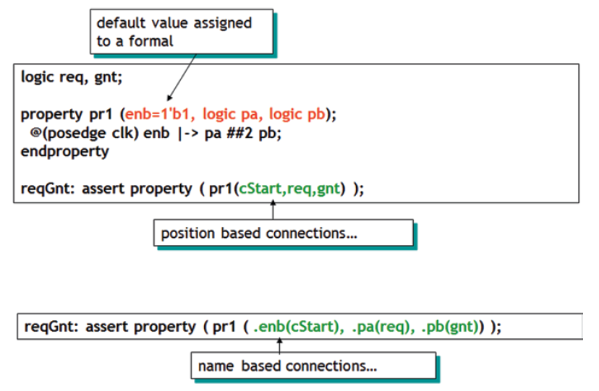
Formal and actual arguments
Default value can be used and connection based on position or name
Notes:
Design engineers normally use an HDL to define the function and the structure of a design under verification (DUV). Specifying a design in the text format of an HDL, an activity called design entry, allows the engineer to document the DUV unambiguously and later execute it as a model in a simulation engine. The HDL version of the DUV is also the basis for the physical implementation of the design. To better support the simulation task, HDLs have features that go beyond the mere description of the design and include the specification of stimulus and checking components, which form an HDL test bench. When we characterize the typical elements of HDLs as design specification tools in this lecture, using VHDL as prime example.
There are a variety of algorithms available to build simulation engines. Because the simulation engine plays such a crucial role in the center of the simulation-based flow, typical architectures of such engines are discussed in this lecture. It is important that verification engineers understand the characteristics of such tools at their disposal. Electronic design automation (EDA) developers build tools such as simulation engines around different sets of tradeoffs, many of which select between accuracy and speed. The verification team must choose those tools that are most adequate for their given project.
Many simulation engines offer an interactive graphical user interface (GUI), which lets the user apply individual stimulus and check commands manually in between simulation steps of the model. Such interfaces, which support a detailed debug mode, are effective mainly on smaller models or very specific debug situations. When working with larger-sized DUVs, the verification engineer lets the simulation engine save the results of a simulation run to trace files, which capture simulated model states over time. As also shown in the figure, waveform viewer tools let the user browse through these results files in various ways, for example, forward and backward in simulation time, to inspect and debug the model behavior in detail.
For many verification tasks, the users do not find the test bench features of the HDL sufficient. Therefore, most simulation engines provide open interfaces that support the application of checks and stimuli from a programming or test bench authoring language.
It is already apparent from the figure that many simulation tools present an interactive GUI to the designer. A very common approach is to integrate the different GUI tasks under one single master GUI, which then gives the user the view of a single integrated HDL and verification development environment even if the implementation underneath consists of separate tools.
All major EDA companies offer many of these tools, often integrated into one GUI framework. The benefit of the Institute of Electrical and Electronics Engineers (IEEE) standardization of the HDLs is that many simulation engines are largely interchangeable with each other. The differentiation comes from simulation speed and value-add features such as the integration of the other simulation tasks: coverage, test bench program support, and user-friendliness for debug.

Slide 37
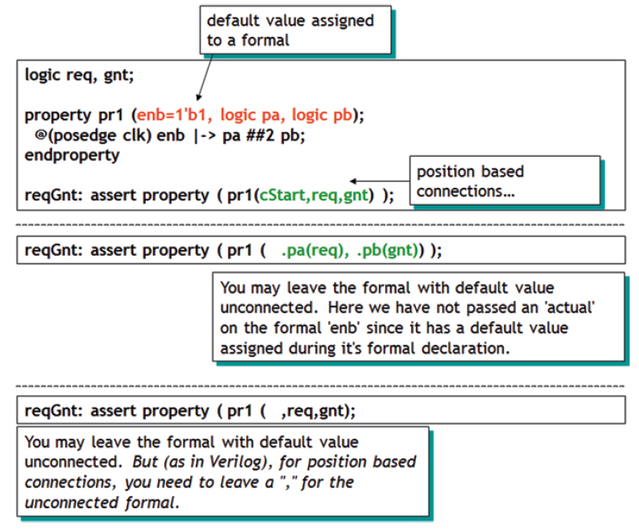
Position based connection with default value
Notes:
Design engineers normally use an HDL to define the function and the structure of a design under verification (DUV). Specifying a design in the text format of an HDL, an activity called design entry, allows the engineer to document the DUV unambiguously and later execute it as a model in a simulation engine. The HDL version of the DUV is also the basis for the physical implementation of the design. To better support the simulation task, HDLs have features that go beyond the mere description of the design and include the specification of stimulus and checking components, which form an HDL test bench. When we characterize the typical elements of HDLs as design specification tools in this lecture, using VHDL as prime example.
There are a variety of algorithms available to build simulation engines. Because the simulation engine plays such a crucial role in the center of the simulation-based flow, typical architectures of such engines are discussed in this lecture. It is important that verification engineers understand the characteristics of such tools at their disposal. Electronic design automation (EDA) developers build tools such as simulation engines around different sets of tradeoffs, many of which select between accuracy and speed. The verification team must choose those tools that are most adequate for their given project.
Many simulation engines offer an interactive graphical user interface (GUI), which lets the user apply individual stimulus and check commands manually in between simulation steps of the model. Such interfaces, which support a detailed debug mode, are effective mainly on smaller models or very specific debug situations. When working with larger-sized DUVs, the verification engineer lets the simulation engine save the results of a simulation run to trace files, which capture simulated model states over time. As also shown in the figure, waveform viewer tools let the user browse through these results files in various ways, for example, forward and backward in simulation time, to inspect and debug the model behavior in detail.
For many verification tasks, the users do not find the test bench features of the HDL sufficient. Therefore, most simulation engines provide open interfaces that support the application of checks and stimuli from a programming or test bench authoring language.
It is already apparent from the figure that many simulation tools present an interactive GUI to the designer. A very common approach is to integrate the different GUI tasks under one single master GUI, which then gives the user the view of a single integrated HDL and verification development environment even if the implementation underneath consists of separate tools.
All major EDA companies offer many of these tools, often integrated into one GUI framework. The benefit of the Institute of Electrical and Electronics Engineers (IEEE) standardization of the HDLs is that many simulation engines are largely interchangeable with each other. The differentiation comes from simulation speed and value-add features such as the integration of the other simulation tasks: coverage, test bench program support, and user-friendliness for debug.

