Slide 1
Funkcionalna verifikacija hardvera
Predavanje IV - dodatak

Slide 2
Sadržaj predavanja
System Verilog Assertions (SVA)
  Kratak uvod
  Osnovne logičke tvrdnje
  Osnovna svojstva
  Osnovne sekvence
  Funkcije i taskovi u vezi sa tvrdnjama
  Parametrizacija

Slide 3
System Verilog Assertions
Uvod

Slide 4
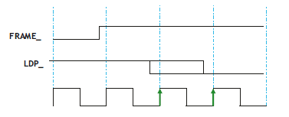
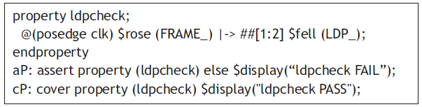
Uvod
Logička tvrdnja (assertion) je provera specifikacije dizajna koju želimo da nikada ne prekršimo
Ukoliko dođe do kršenja specifikacije, želimo da vidimo grešku
Primer: Kad god se signal FRAME_ deaktivira (postane visok), poslednja faza podataka (LDP_) mora biti aktivirana (postati nizak) u naredna dva takta
SVA je jezik dizajniran za jednostavno modelovanje ovakvih sekvencijalnih vremenskih provera, mnogo lakši za pisanje nego u Verilogu ili VHDL-u
Zašto SVA? Lakši su za pisanje, povećavaju produktivnost dizajna, lakši su za debagovanje, omogućavaju funkcionalnu pokrivenost i bržu simulaciju
Notes:
Design engineers normally use an HDL to define the function and the structure of a design under verification (DUV). Specifying a design in the text format of an HDL, an activity called design entry, allows the engineer to document the DUV unambiguously and later execute it as a model in a simulation engine. The HDL version of the DUV is also the basis for the physical implementation of the design. To better support the simulation task, HDLs have features that go beyond the mere description of the design and include the specification of stimulus and checking components, which form an HDL test bench. When we characterize the typical elements of HDLs as design specification tools in this lecture, using VHDL as prime example.
There are a variety of algorithms available to build simulation engines. Because the simulation engine plays such a crucial role in the center of the simulation-based flow, typical architectures of such engines are discussed in this lecture. It is important that verification engineers understand the characteristics of such tools at their disposal. Electronic design automation (EDA) developers build tools such as simulation engines around different sets of tradeoffs, many of which select between accuracy and speed. The verification team must choose those tools that are most adequate for their given project.
Many simulation engines offer an interactive graphical user interface (GUI), which lets the user apply individual stimulus and check commands manually in between simulation steps of the model. Such interfaces, which support a detailed debug mode, are effective mainly on smaller models or very specific debug situations. When working with larger-sized DUVs, the verification engineer lets the simulation engine save the results of a simulation run to trace files, which capture simulated model states over time. As also shown in the figure, waveform viewer tools let the user browse through these results files in various ways, for example, forward and backward in simulation time, to inspect and debug the model behavior in detail.
For many verification tasks, the users do not find the test bench features of the HDL sufficient. Therefore, most simulation engines provide open interfaces that support the application of checks and stimuli from a programming or test bench authoring language.
It is already apparent from the figure that many simulation tools present an interactive GUI to the designer. A very common approach is to integrate the different GUI tasks under one single master GUI, which then gives the user the view of a single integrated HDL and verification development environment even if the implementation underneath consists of separate tools.
All major EDA companies offer many of these tools, often integrated into one GUI framework. The benefit of the Institute of Electrical and Electronics Engineers (IEEE) standardization of the HDLs is that many simulation engines are largely interchangeable with each other. The differentiation comes from simulation speed and value-add features such as the integration of the other simulation tasks: coverage, test bench program support, and user-friendliness for debug.

Slide 5
System Verilog Assertions
Osnovne logičke tvrdnje

Slide 6
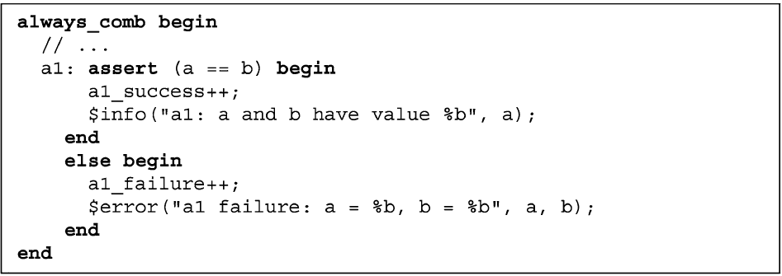
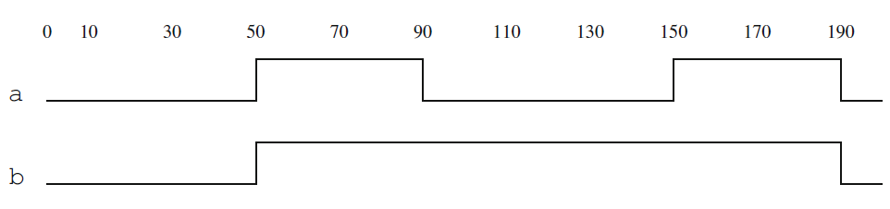
Osnovne logičke tvrdnje
Osnovne logičke tvrdnje (Immediate assertions) su najjednostavnije tvrdnje, ne zavise od takta i prate tok simulacije
Mogu se koristiti samo u proceduralnom kodu
Primer: always_comb procedura se izvršava u vremenu 0, i tada su promenljive a i b 0, pa tvrdnja prolazi i povećava brojač uspeha
Svaki put kada se promeni vrednost a ili b, tvrdnja se ponovo proverava i izvršava odgovarajuća akcija (uspeh ili neuspeh)
U skladu sa tim, tvrdnja prolazi u simulacionim trenucima 50, 150 I 190, dok će biti neuspešna u trenutku 90
Notes:
Design engineers normally use an HDL to define the function and the structure of a design under verification (DUV). Specifying a design in the text format of an HDL, an activity called design entry, allows the engineer to document the DUV unambiguously and later execute it as a model in a simulation engine. The HDL version of the DUV is also the basis for the physical implementation of the design. To better support the simulation task, HDLs have features that go beyond the mere description of the design and include the specification of stimulus and checking components, which form an HDL test bench. When we characterize the typical elements of HDLs as design specification tools in this lecture, using VHDL as prime example.
There are a variety of algorithms available to build simulation engines. Because the simulation engine plays such a crucial role in the center of the simulation-based flow, typical architectures of such engines are discussed in this lecture. It is important that verification engineers understand the characteristics of such tools at their disposal. Electronic design automation (EDA) developers build tools such as simulation engines around different sets of tradeoffs, many of which select between accuracy and speed. The verification team must choose those tools that are most adequate for their given project.
Many simulation engines offer an interactive graphical user interface (GUI), which lets the user apply individual stimulus and check commands manually in between simulation steps of the model. Such interfaces, which support a detailed debug mode, are effective mainly on smaller models or very specific debug situations. When working with larger-sized DUVs, the verification engineer lets the simulation engine save the results of a simulation run to trace files, which capture simulated model states over time. As also shown in the figure, waveform viewer tools let the user browse through these results files in various ways, for example, forward and backward in simulation time, to inspect and debug the model behavior in detail.
For many verification tasks, the users do not find the test bench features of the HDL sufficient. Therefore, most simulation engines provide open interfaces that support the application of checks and stimuli from a programming or test bench authoring language.
It is already apparent from the figure that many simulation tools present an interactive GUI to the designer. A very common approach is to integrate the different GUI tasks under one single master GUI, which then gives the user the view of a single integrated HDL and verification development environment even if the implementation underneath consists of separate tools.
All major EDA companies offer many of these tools, often integrated into one GUI framework. The benefit of the Institute of Electrical and Electronics Engineers (IEEE) standardization of the HDLs is that many simulation engines are largely interchangeable with each other. The differentiation comes from simulation speed and value-add features such as the integration of the other simulation tasks: coverage, test bench program support, and user-friendliness for debug.

Slide 7
Konkurentne tvrdnje (Concurrent assertions)
Konkurentne tvrdnje su taktovane i imaju opštu strukturu
concurrent_assertion_body ::= [clocking_event] [ disable iff (rst)] property
Primer:
a1: assert property (@(posedge clk) disable iff (rst) a |-> nexttime[2] b);
clocking_event je posedge clk, uslov za deaktivaciju rst, dok je svojstvo (property) tvrdnje a |-> nexttime[2] b
Mogu se koristiti u:
  U always procedurama
  U initial procedurama
  samostalno (static)—van svake procedure
Notes:
Design engineers normally use an HDL to define the function and the structure of a design under verification (DUV). Specifying a design in the text format of an HDL, an activity called design entry, allows the engineer to document the DUV unambiguously and later execute it as a model in a simulation engine. The HDL version of the DUV is also the basis for the physical implementation of the design. To better support the simulation task, HDLs have features that go beyond the mere description of the design and include the specification of stimulus and checking components, which form an HDL test bench. When we characterize the typical elements of HDLs as design specification tools in this lecture, using VHDL as prime example.
There are a variety of algorithms available to build simulation engines. Because the simulation engine plays such a crucial role in the center of the simulation-based flow, typical architectures of such engines are discussed in this lecture. It is important that verification engineers understand the characteristics of such tools at their disposal. Electronic design automation (EDA) developers build tools such as simulation engines around different sets of tradeoffs, many of which select between accuracy and speed. The verification team must choose those tools that are most adequate for their given project.
Many simulation engines offer an interactive graphical user interface (GUI), which lets the user apply individual stimulus and check commands manually in between simulation steps of the model. Such interfaces, which support a detailed debug mode, are effective mainly on smaller models or very specific debug situations. When working with larger-sized DUVs, the verification engineer lets the simulation engine save the results of a simulation run to trace files, which capture simulated model states over time. As also shown in the figure, waveform viewer tools let the user browse through these results files in various ways, for example, forward and backward in simulation time, to inspect and debug the model behavior in detail.
For many verification tasks, the users do not find the test bench features of the HDL sufficient. Therefore, most simulation engines provide open interfaces that support the application of checks and stimuli from a programming or test bench authoring language.
It is already apparent from the figure that many simulation tools present an interactive GUI to the designer. A very common approach is to integrate the different GUI tasks under one single master GUI, which then gives the user the view of a single integrated HDL and verification development environment even if the implementation underneath consists of separate tools.
All major EDA companies offer many of these tools, often integrated into one GUI framework. The benefit of the Institute of Electrical and Electronics Engineers (IEEE) standardization of the HDLs is that many simulation engines are largely interchangeable with each other. The differentiation comes from simulation speed and value-add features such as the integration of the other simulation tasks: coverage, test bench program support, and user-friendliness for debug.

Slide 8
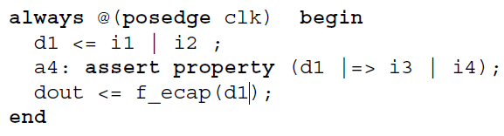
Konkurentne tvrdnje
Initial procedura proverava tvrdnju samo jednom, npr. da je signal ready nizak na prvom taktu
U ostalim slučajevima tvrdnje se prate konkurentno, na svakom taktu
Primer: tvrdnja a3 proverava da je signal ok visok na svakom taktu
Takve tvrdnje mogu biti smeštene u always proceduru
Notes:
Design engineers normally use an HDL to define the function and the structure of a design under verification (DUV). Specifying a design in the text format of an HDL, an activity called design entry, allows the engineer to document the DUV unambiguously and later execute it as a model in a simulation engine. The HDL version of the DUV is also the basis for the physical implementation of the design. To better support the simulation task, HDLs have features that go beyond the mere description of the design and include the specification of stimulus and checking components, which form an HDL test bench. When we characterize the typical elements of HDLs as design specification tools in this lecture, using VHDL as prime example.
There are a variety of algorithms available to build simulation engines. Because the simulation engine plays such a crucial role in the center of the simulation-based flow, typical architectures of such engines are discussed in this lecture. It is important that verification engineers understand the characteristics of such tools at their disposal. Electronic design automation (EDA) developers build tools such as simulation engines around different sets of tradeoffs, many of which select between accuracy and speed. The verification team must choose those tools that are most adequate for their given project.
Many simulation engines offer an interactive graphical user interface (GUI), which lets the user apply individual stimulus and check commands manually in between simulation steps of the model. Such interfaces, which support a detailed debug mode, are effective mainly on smaller models or very specific debug situations. When working with larger-sized DUVs, the verification engineer lets the simulation engine save the results of a simulation run to trace files, which capture simulated model states over time. As also shown in the figure, waveform viewer tools let the user browse through these results files in various ways, for example, forward and backward in simulation time, to inspect and debug the model behavior in detail.
For many verification tasks, the users do not find the test bench features of the HDL sufficient. Therefore, most simulation engines provide open interfaces that support the application of checks and stimuli from a programming or test bench authoring language.
It is already apparent from the figure that many simulation tools present an interactive GUI to the designer. A very common approach is to integrate the different GUI tasks under one single master GUI, which then gives the user the view of a single integrated HDL and verification development environment even if the implementation underneath consists of separate tools.
All major EDA companies offer many of these tools, often integrated into one GUI framework. The benefit of the Institute of Electrical and Electronics Engineers (IEEE) standardization of the HDLs is that many simulation engines are largely interchangeable with each other. The differentiation comes from simulation speed and value-add features such as the integration of the other simulation tasks: coverage, test bench program support, and user-friendliness for debug.

Slide 9
System Verilog Assertions
Osnovna svojstva

Slide 10
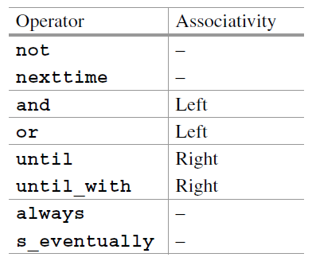
Osnovna svojstva
Svojstva imaju centralnu ulogu u SVA jer čine jezgro konkurentnih tvrdnji
Svojstvo je vremenska formula koja može biti tačna ili netačna na datom tragu (trace)
Operatori svojstava opisani ovde su sažeti u tabeli sa desne strane
Grupisani su po prioritetu, od najvišeg do najnižeg
Svojstva se mogu graditi rekurzivno od jednostavnijih svojstava
Notes:
Design engineers normally use an HDL to define the function and the structure of a design under verification (DUV). Specifying a design in the text format of an HDL, an activity called design entry, allows the engineer to document the DUV unambiguously and later execute it as a model in a simulation engine. The HDL version of the DUV is also the basis for the physical implementation of the design. To better support the simulation task, HDLs have features that go beyond the mere description of the design and include the specification of stimulus and checking components, which form an HDL test bench. When we characterize the typical elements of HDLs as design specification tools in this lecture, using VHDL as prime example.
There are a variety of algorithms available to build simulation engines. Because the simulation engine plays such a crucial role in the center of the simulation-based flow, typical architectures of such engines are discussed in this lecture. It is important that verification engineers understand the characteristics of such tools at their disposal. Electronic design automation (EDA) developers build tools such as simulation engines around different sets of tradeoffs, many of which select between accuracy and speed. The verification team must choose those tools that are most adequate for their given project.
Many simulation engines offer an interactive graphical user interface (GUI), which lets the user apply individual stimulus and check commands manually in between simulation steps of the model. Such interfaces, which support a detailed debug mode, are effective mainly on smaller models or very specific debug situations. When working with larger-sized DUVs, the verification engineer lets the simulation engine save the results of a simulation run to trace files, which capture simulated model states over time. As also shown in the figure, waveform viewer tools let the user browse through these results files in various ways, for example, forward and backward in simulation time, to inspect and debug the model behavior in detail.
For many verification tasks, the users do not find the test bench features of the HDL sufficient. Therefore, most simulation engines provide open interfaces that support the application of checks and stimuli from a programming or test bench authoring language.
It is already apparent from the figure that many simulation tools present an interactive GUI to the designer. A very common approach is to integrate the different GUI tasks under one single master GUI, which then gives the user the view of a single integrated HDL and verification development environment even if the implementation underneath consists of separate tools.
All major EDA companies offer many of these tools, often integrated into one GUI framework. The benefit of the Institute of Electrical and Electronics Engineers (IEEE) standardization of the HDLs is that many simulation engines are largely interchangeable with each other. The differentiation comes from simulation speed and value-add features such as the integration of the other simulation tasks: coverage, test bench program support, and user-friendliness for debug.

Slide 11
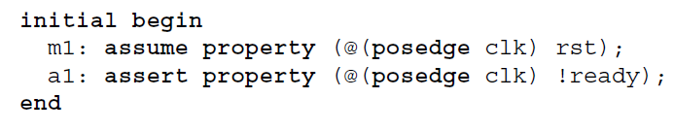
Boolean svojstvo
Ponašanje koje manifestuje Boolean svojstvo kada se koristi u initial proceduri je korisno jer se izvršava samo jedan pokušaj evaluacije svojstva
Postavljanje takve tvrdnje na drugo mesto dovelo bi do bezuslovne evaluacije Boolean vrednosti na svakom taktu tvrdnje
Primer ispod proverava da je na početku reset (rst) aktivan i da je vrednost signala ready na početku niska
Notes:
Design engineers normally use an HDL to define the function and the structure of a design under verification (DUV). Specifying a design in the text format of an HDL, an activity called design entry, allows the engineer to document the DUV unambiguously and later execute it as a model in a simulation engine. The HDL version of the DUV is also the basis for the physical implementation of the design. To better support the simulation task, HDLs have features that go beyond the mere description of the design and include the specification of stimulus and checking components, which form an HDL test bench. When we characterize the typical elements of HDLs as design specification tools in this lecture, using VHDL as prime example.
There are a variety of algorithms available to build simulation engines. Because the simulation engine plays such a crucial role in the center of the simulation-based flow, typical architectures of such engines are discussed in this lecture. It is important that verification engineers understand the characteristics of such tools at their disposal. Electronic design automation (EDA) developers build tools such as simulation engines around different sets of tradeoffs, many of which select between accuracy and speed. The verification team must choose those tools that are most adequate for their given project.
Many simulation engines offer an interactive graphical user interface (GUI), which lets the user apply individual stimulus and check commands manually in between simulation steps of the model. Such interfaces, which support a detailed debug mode, are effective mainly on smaller models or very specific debug situations. When working with larger-sized DUVs, the verification engineer lets the simulation engine save the results of a simulation run to trace files, which capture simulated model states over time. As also shown in the figure, waveform viewer tools let the user browse through these results files in various ways, for example, forward and backward in simulation time, to inspect and debug the model behavior in detail.
For many verification tasks, the users do not find the test bench features of the HDL sufficient. Therefore, most simulation engines provide open interfaces that support the application of checks and stimuli from a programming or test bench authoring language.
It is already apparent from the figure that many simulation tools present an interactive GUI to the designer. A very common approach is to integrate the different GUI tasks under one single master GUI, which then gives the user the view of a single integrated HDL and verification development environment even if the implementation underneath consists of separate tools.
All major EDA companies offer many of these tools, often integrated into one GUI framework. The benefit of the Institute of Electrical and Electronics Engineers (IEEE) standardization of the HDLs is that many simulation engines are largely interchangeable with each other. The differentiation comes from simulation speed and value-add features such as the integration of the other simulation tasks: coverage, test bench program support, and user-friendliness for debug.

Slide 12
Nexttime svojstvo
Svojstvo nexttime p, kao što ime sugeriše, je tačno u taktu i ako je svojstvo p tačno u taktu i + 1
Može se koristiti u sekvenci kao nexttime nexttime nexttime p, što znači da p važi u taktu 3
U SVA postoji skraćenica nexttime[n] za pojednostavljenje notacije, kao u primeru ispod gde proveravamo da li je signal rst nizak u 9. taktu clk
Ovo svojstvo ne govori ništa o ponašanju signala rst u taktovima 0 - 8
Notes:
Design engineers normally use an HDL to define the function and the structure of a design under verification (DUV). Specifying a design in the text format of an HDL, an activity called design entry, allows the engineer to document the DUV unambiguously and later execute it as a model in a simulation engine. The HDL version of the DUV is also the basis for the physical implementation of the design. To better support the simulation task, HDLs have features that go beyond the mere description of the design and include the specification of stimulus and checking components, which form an HDL test bench. When we characterize the typical elements of HDLs as design specification tools in this lecture, using VHDL as prime example.
There are a variety of algorithms available to build simulation engines. Because the simulation engine plays such a crucial role in the center of the simulation-based flow, typical architectures of such engines are discussed in this lecture. It is important that verification engineers understand the characteristics of such tools at their disposal. Electronic design automation (EDA) developers build tools such as simulation engines around different sets of tradeoffs, many of which select between accuracy and speed. The verification team must choose those tools that are most adequate for their given project.
Many simulation engines offer an interactive graphical user interface (GUI), which lets the user apply individual stimulus and check commands manually in between simulation steps of the model. Such interfaces, which support a detailed debug mode, are effective mainly on smaller models or very specific debug situations. When working with larger-sized DUVs, the verification engineer lets the simulation engine save the results of a simulation run to trace files, which capture simulated model states over time. As also shown in the figure, waveform viewer tools let the user browse through these results files in various ways, for example, forward and backward in simulation time, to inspect and debug the model behavior in detail.
For many verification tasks, the users do not find the test bench features of the HDL sufficient. Therefore, most simulation engines provide open interfaces that support the application of checks and stimuli from a programming or test bench authoring language.
It is already apparent from the figure that many simulation tools present an interactive GUI to the designer. A very common approach is to integrate the different GUI tasks under one single master GUI, which then gives the user the view of a single integrated HDL and verification development environment even if the implementation underneath consists of separate tools.
All major EDA companies offer many of these tools, often integrated into one GUI framework. The benefit of the Institute of Electrical and Electronics Engineers (IEEE) standardization of the HDLs is that many simulation engines are largely interchangeable with each other. The differentiation comes from simulation speed and value-add features such as the integration of the other simulation tasks: coverage, test bench program support, and user-friendliness for debug.

Slide 13
until i until_with svojstvo
Glavna razlika između until i until_with u SVA je u tome da li se uslov sa leve strane mora ispuniti i u trenutku kada desni uslov postane tačan
until (Non-overlapping) : levi izraz mora biti tačan u svakom taktu do (ali ne uključujući) takt u kojem desni izraz postane tačan
until_with (Overlapping) : Levi izraz mora biti tačan u svakom taktu uključujući i onaj takt u kojem desni izraz postane tačan
Primer 1: b until !c -> b mora biti 1 sve do ciklusa pre nego što !c postane tačno. U samom trenutku kada c padne na 0, vrednost signala b više nije bitna
Primer 2: b until_with !c -> b mora biti 1 sve vreme, uključujući i ciklus u kojem c postane 0. Ako b padne na 0 u istom taktu kada i c, tvrdnja će pasti
Notes:
Design engineers normally use an HDL to define the function and the structure of a design under verification (DUV). Specifying a design in the text format of an HDL, an activity called design entry, allows the engineer to document the DUV unambiguously and later execute it as a model in a simulation engine. The HDL version of the DUV is also the basis for the physical implementation of the design. To better support the simulation task, HDLs have features that go beyond the mere description of the design and include the specification of stimulus and checking components, which form an HDL test bench. When we characterize the typical elements of HDLs as design specification tools in this lecture, using VHDL as prime example.
There are a variety of algorithms available to build simulation engines. Because the simulation engine plays such a crucial role in the center of the simulation-based flow, typical architectures of such engines are discussed in this lecture. It is important that verification engineers understand the characteristics of such tools at their disposal. Electronic design automation (EDA) developers build tools such as simulation engines around different sets of tradeoffs, many of which select between accuracy and speed. The verification team must choose those tools that are most adequate for their given project.
Many simulation engines offer an interactive graphical user interface (GUI), which lets the user apply individual stimulus and check commands manually in between simulation steps of the model. Such interfaces, which support a detailed debug mode, are effective mainly on smaller models or very specific debug situations. When working with larger-sized DUVs, the verification engineer lets the simulation engine save the results of a simulation run to trace files, which capture simulated model states over time. As also shown in the figure, waveform viewer tools let the user browse through these results files in various ways, for example, forward and backward in simulation time, to inspect and debug the model behavior in detail.
For many verification tasks, the users do not find the test bench features of the HDL sufficient. Therefore, most simulation engines provide open interfaces that support the application of checks and stimuli from a programming or test bench authoring language.
It is already apparent from the figure that many simulation tools present an interactive GUI to the designer. A very common approach is to integrate the different GUI tasks under one single master GUI, which then gives the user the view of a single integrated HDL and verification development environment even if the implementation underneath consists of separate tools.
All major EDA companies offer many of these tools, often integrated into one GUI framework. The benefit of the Institute of Electrical and Electronics Engineers (IEEE) standardization of the HDLs is that many simulation engines are largely interchangeable with each other. The differentiation comes from simulation speed and value-add features such as the integration of the other simulation tasks: coverage, test bench program support, and user-friendliness for debug.

Slide 14
Always svojstvo
Svojstvo always p je tačno u taktu i ako je p tačno u svim taktovima j ≥ i
Na primer, šta znači nexttime always p? Prema definiciji svojstva nexttime, always p treba da važi u taktu 1. Dakle, svojstvo p treba da važi u svakom taktu počevši od takta 1
Sve konkurentne tvrdnje smeštene van proceduralnog koda prate se konkurentno. To znači da postoji implicitni spoljašnji always operator koji definiše niz pokušaja evaluacije
Shodno tome, sledeće tvrdnje a1 i a2 su ekvivalentne u smislu da ili obe prolaze ili obe padaju
Notes:
Design engineers normally use an HDL to define the function and the structure of a design under verification (DUV). Specifying a design in the text format of an HDL, an activity called design entry, allows the engineer to document the DUV unambiguously and later execute it as a model in a simulation engine. The HDL version of the DUV is also the basis for the physical implementation of the design. To better support the simulation task, HDLs have features that go beyond the mere description of the design and include the specification of stimulus and checking components, which form an HDL test bench. When we characterize the typical elements of HDLs as design specification tools in this lecture, using VHDL as prime example.
There are a variety of algorithms available to build simulation engines. Because the simulation engine plays such a crucial role in the center of the simulation-based flow, typical architectures of such engines are discussed in this lecture. It is important that verification engineers understand the characteristics of such tools at their disposal. Electronic design automation (EDA) developers build tools such as simulation engines around different sets of tradeoffs, many of which select between accuracy and speed. The verification team must choose those tools that are most adequate for their given project.
Many simulation engines offer an interactive graphical user interface (GUI), which lets the user apply individual stimulus and check commands manually in between simulation steps of the model. Such interfaces, which support a detailed debug mode, are effective mainly on smaller models or very specific debug situations. When working with larger-sized DUVs, the verification engineer lets the simulation engine save the results of a simulation run to trace files, which capture simulated model states over time. As also shown in the figure, waveform viewer tools let the user browse through these results files in various ways, for example, forward and backward in simulation time, to inspect and debug the model behavior in detail.
For many verification tasks, the users do not find the test bench features of the HDL sufficient. Therefore, most simulation engines provide open interfaces that support the application of checks and stimuli from a programming or test bench authoring language.
It is already apparent from the figure that many simulation tools present an interactive GUI to the designer. A very common approach is to integrate the different GUI tasks under one single master GUI, which then gives the user the view of a single integrated HDL and verification development environment even if the implementation underneath consists of separate tools.
All major EDA companies offer many of these tools, often integrated into one GUI framework. The benefit of the Institute of Electrical and Electronics Engineers (IEEE) standardization of the HDLs is that many simulation engines are largely interchangeable with each other. The differentiation comes from simulation speed and value-add features such as the integration of the other simulation tasks: coverage, test bench program support, and user-friendliness for debug.

Slide 15
s_eventually svojstvo
Svojstvo s_eventually p je tačno u taktu i ako je p tačno u nekom taktu j ≥ i
Iz toga sledi da je svojstvo s_eventually p tačno ako je svojstvo p tačno u nekom taktu
Na primer, sledeća tvrdnja se koristi da proveri da li će reset (rst) kad tad biti deaktiviran
Notes:
Design engineers normally use an HDL to define the function and the structure of a design under verification (DUV). Specifying a design in the text format of an HDL, an activity called design entry, allows the engineer to document the DUV unambiguously and later execute it as a model in a simulation engine. The HDL version of the DUV is also the basis for the physical implementation of the design. To better support the simulation task, HDLs have features that go beyond the mere description of the design and include the specification of stimulus and checking components, which form an HDL test bench. When we characterize the typical elements of HDLs as design specification tools in this lecture, using VHDL as prime example.
There are a variety of algorithms available to build simulation engines. Because the simulation engine plays such a crucial role in the center of the simulation-based flow, typical architectures of such engines are discussed in this lecture. It is important that verification engineers understand the characteristics of such tools at their disposal. Electronic design automation (EDA) developers build tools such as simulation engines around different sets of tradeoffs, many of which select between accuracy and speed. The verification team must choose those tools that are most adequate for their given project.
Many simulation engines offer an interactive graphical user interface (GUI), which lets the user apply individual stimulus and check commands manually in between simulation steps of the model. Such interfaces, which support a detailed debug mode, are effective mainly on smaller models or very specific debug situations. When working with larger-sized DUVs, the verification engineer lets the simulation engine save the results of a simulation run to trace files, which capture simulated model states over time. As also shown in the figure, waveform viewer tools let the user browse through these results files in various ways, for example, forward and backward in simulation time, to inspect and debug the model behavior in detail.
For many verification tasks, the users do not find the test bench features of the HDL sufficient. Therefore, most simulation engines provide open interfaces that support the application of checks and stimuli from a programming or test bench authoring language.
It is already apparent from the figure that many simulation tools present an interactive GUI to the designer. A very common approach is to integrate the different GUI tasks under one single master GUI, which then gives the user the view of a single integrated HDL and verification development environment even if the implementation underneath consists of separate tools.
All major EDA companies offer many of these tools, often integrated into one GUI framework. The benefit of the Institute of Electrical and Electronics Engineers (IEEE) standardization of the HDLs is that many simulation engines are largely interchangeable with each other. The differentiation comes from simulation speed and value-add features such as the integration of the other simulation tasks: coverage, test bench program support, and user-friendliness for debug.

Slide 16
Osnovni logički operatori između svojstava
Osnovni logički operatori između svojstava u SVA su:
  not — negacija
  not p je tačno ako i samo ako je p netačno
  and — konjunkcija
  p and q je tačno ako su oba, p i q, tačna
  or — disjunkcija
  p or q je tačno ako je bar jedno od p ili q (ili oba) tačno
Na primer: reset (rst) mora biti aktiviran tokom prva dva ciklusa
Notes:
Design engineers normally use an HDL to define the function and the structure of a design under verification (DUV). Specifying a design in the text format of an HDL, an activity called design entry, allows the engineer to document the DUV unambiguously and later execute it as a model in a simulation engine. The HDL version of the DUV is also the basis for the physical implementation of the design. To better support the simulation task, HDLs have features that go beyond the mere description of the design and include the specification of stimulus and checking components, which form an HDL test bench. When we characterize the typical elements of HDLs as design specification tools in this lecture, using VHDL as prime example.
There are a variety of algorithms available to build simulation engines. Because the simulation engine plays such a crucial role in the center of the simulation-based flow, typical architectures of such engines are discussed in this lecture. It is important that verification engineers understand the characteristics of such tools at their disposal. Electronic design automation (EDA) developers build tools such as simulation engines around different sets of tradeoffs, many of which select between accuracy and speed. The verification team must choose those tools that are most adequate for their given project.
Many simulation engines offer an interactive graphical user interface (GUI), which lets the user apply individual stimulus and check commands manually in between simulation steps of the model. Such interfaces, which support a detailed debug mode, are effective mainly on smaller models or very specific debug situations. When working with larger-sized DUVs, the verification engineer lets the simulation engine save the results of a simulation run to trace files, which capture simulated model states over time. As also shown in the figure, waveform viewer tools let the user browse through these results files in various ways, for example, forward and backward in simulation time, to inspect and debug the model behavior in detail.
For many verification tasks, the users do not find the test bench features of the HDL sufficient. Therefore, most simulation engines provide open interfaces that support the application of checks and stimuli from a programming or test bench authoring language.
It is already apparent from the figure that many simulation tools present an interactive GUI to the designer. A very common approach is to integrate the different GUI tasks under one single master GUI, which then gives the user the view of a single integrated HDL and verification development environment even if the implementation underneath consists of separate tools.
All major EDA companies offer many of these tools, often integrated into one GUI framework. The benefit of the Institute of Electrical and Electronics Engineers (IEEE) standardization of the HDLs is that many simulation engines are largely interchangeable with each other. The differentiation comes from simulation speed and value-add features such as the integration of the other simulation tasks: coverage, test bench program support, and user-friendliness for debug.

Slide 17
System Verilog Assertions
Osnovne sekvence

Slide 18
Šta su sekvence?
Sekvenca je pravilo koje definiše niz vrednosti kroz vreme. Sekvenca nema vrednost istinitosti, već ima jednu početnu tačku i nula ili više tačaka podudaranja (match) ili tačaka stroge satisfakcije (tight satisfaction)
Kao i svojstva, sekvence su taktovane
Ako takt nije eksplicitno naveden, pretpostavlja se da sekvenca nasleđuje takt od svojstva kojem pripada
Primer 1:
Sekvenca a ##[1:2] b definiše sledeći scenario: a je praćeno sa b u jednom ili dva takta. Neka početna tačka ove sekvence bude takt 2. Onda ova sekvenca ima podudaranje ako je a tačno u taktu 2 i ako je b tačno u taktu 3 ili u taktu 4
Primer 2:
Sekvenca req ##1 rtry ##1 ack opisuje sledeći scenario: zahtev (request) req, odmah praćen ponovnim pokušajem (retry) rtry, odmah praćen potvrdom (acknowledgment) ack
Umesto jednog kašnjenja ##1, mogu se koristiti višestruka kašnjenja ##m
Na primer: reset (rst) mora biti inicijalno visok i biti nizak u taktu 20
Notes:
Design engineers normally use an HDL to define the function and the structure of a design under verification (DUV). Specifying a design in the text format of an HDL, an activity called design entry, allows the engineer to document the DUV unambiguously and later execute it as a model in a simulation engine. The HDL version of the DUV is also the basis for the physical implementation of the design. To better support the simulation task, HDLs have features that go beyond the mere description of the design and include the specification of stimulus and checking components, which form an HDL test bench. When we characterize the typical elements of HDLs as design specification tools in this lecture, using VHDL as prime example.
There are a variety of algorithms available to build simulation engines. Because the simulation engine plays such a crucial role in the center of the simulation-based flow, typical architectures of such engines are discussed in this lecture. It is important that verification engineers understand the characteristics of such tools at their disposal. Electronic design automation (EDA) developers build tools such as simulation engines around different sets of tradeoffs, many of which select between accuracy and speed. The verification team must choose those tools that are most adequate for their given project.
Many simulation engines offer an interactive graphical user interface (GUI), which lets the user apply individual stimulus and check commands manually in between simulation steps of the model. Such interfaces, which support a detailed debug mode, are effective mainly on smaller models or very specific debug situations. When working with larger-sized DUVs, the verification engineer lets the simulation engine save the results of a simulation run to trace files, which capture simulated model states over time. As also shown in the figure, waveform viewer tools let the user browse through these results files in various ways, for example, forward and backward in simulation time, to inspect and debug the model behavior in detail.
For many verification tasks, the users do not find the test bench features of the HDL sufficient. Therefore, most simulation engines provide open interfaces that support the application of checks and stimuli from a programming or test bench authoring language.
It is already apparent from the figure that many simulation tools present an interactive GUI to the designer. A very common approach is to integrate the different GUI tasks under one single master GUI, which then gives the user the view of a single integrated HDL and verification development environment even if the implementation underneath consists of separate tools.
All major EDA companies offer many of these tools, often integrated into one GUI framework. The benefit of the Institute of Electrical and Electronics Engineers (IEEE) standardization of the HDLs is that many simulation engines are largely interchangeable with each other. The differentiation comes from simulation speed and value-add features such as the integration of the other simulation tasks: coverage, test bench program support, and user-friendliness for debug.

Slide 19
Sekvence
Treba biti veoma pažljiv pri korišćenju sekvencijalnih svojstava u konkurentno praćenim tvrdnjama jer njihovo značenje može biti drugačije od vaše namere. Na primer:
Pošto se ova tvrdnja kontinuirano prati (ima implicitni spoljašnji always operator), sekvencijalno svojstvo a ##1 b mora biti tačno u svakom taktu. Dakle, a mora biti tačno u svakom taktu, a b mora biti tačno počevši od takta 1.
Spajanje sekvenci je preklapajuća konkatenacija. Spajanje sekvenci r i s, označena kao r ##0 s važi ako postoji podudaranje sekvence r i podudaranje sekvence s koje počinje tačno u taktu u kojem se završava podudaranje sekvence r. Drugim rečima, sekvenca s počinje odmah nakon završetka sekvence r, bez vremenskog razmaka između njih.
Početno kašnjenje ##n s se koristi da preskoči n ciklusa pre nego što se podudari sekvenca s. Na primer, vrednost signala a treba da bude uvek tačna počevši od takta 2.
Notes:
Design engineers normally use an HDL to define the function and the structure of a design under verification (DUV). Specifying a design in the text format of an HDL, an activity called design entry, allows the engineer to document the DUV unambiguously and later execute it as a model in a simulation engine. The HDL version of the DUV is also the basis for the physical implementation of the design. To better support the simulation task, HDLs have features that go beyond the mere description of the design and include the specification of stimulus and checking components, which form an HDL test bench. When we characterize the typical elements of HDLs as design specification tools in this lecture, using VHDL as prime example.
There are a variety of algorithms available to build simulation engines. Because the simulation engine plays such a crucial role in the center of the simulation-based flow, typical architectures of such engines are discussed in this lecture. It is important that verification engineers understand the characteristics of such tools at their disposal. Electronic design automation (EDA) developers build tools such as simulation engines around different sets of tradeoffs, many of which select between accuracy and speed. The verification team must choose those tools that are most adequate for their given project.
Many simulation engines offer an interactive graphical user interface (GUI), which lets the user apply individual stimulus and check commands manually in between simulation steps of the model. Such interfaces, which support a detailed debug mode, are effective mainly on smaller models or very specific debug situations. When working with larger-sized DUVs, the verification engineer lets the simulation engine save the results of a simulation run to trace files, which capture simulated model states over time. As also shown in the figure, waveform viewer tools let the user browse through these results files in various ways, for example, forward and backward in simulation time, to inspect and debug the model behavior in detail.
For many verification tasks, the users do not find the test bench features of the HDL sufficient. Therefore, most simulation engines provide open interfaces that support the application of checks and stimuli from a programming or test bench authoring language.
It is already apparent from the figure that many simulation tools present an interactive GUI to the designer. A very common approach is to integrate the different GUI tasks under one single master GUI, which then gives the user the view of a single integrated HDL and verification development environment even if the implementation underneath consists of separate tools.
All major EDA companies offer many of these tools, often integrated into one GUI framework. The benefit of the Institute of Electrical and Electronics Engineers (IEEE) standardization of the HDLs is that many simulation engines are largely interchangeable with each other. The differentiation comes from simulation speed and value-add features such as the integration of the other simulation tasks: coverage, test bench program support, and user-friendliness for debug.

Slide 20
Implikacija sufiksa (Suffix implication)
Implikacija sufiksa se gradi od sekvence (s) i svojstva (p)
Sekvenca s se naziva pretpostavka (antecedent), a svojstvo p se naziva posledica (consequent)
Implikacija sufiksa je tačna kada je posledica p tačna po završetku pretpostavke s
Postoje dve verzije suffix implication:
  Overlapping (preklapajuća), označena kao s |-> p
  Nonoverlapping (nepreklapajuća), označena kao s |=> p
Primer 1: Kada je signal rdy aktiviran (asserted), signal rst mora biti nizak (low).
Primer 2: Signal done mora biti aktiviran u sledećem taktu nakon što je signal sent aktiviran.
Ove dve verzije implikacije sufiksa se razlikuju u tome da li se posledica p proverava u istom taktu kada se završava sekvenca s (overlapping) ili u sledećem taktu (nonoverlapping)
Notes:
Design engineers normally use an HDL to define the function and the structure of a design under verification (DUV). Specifying a design in the text format of an HDL, an activity called design entry, allows the engineer to document the DUV unambiguously and later execute it as a model in a simulation engine. The HDL version of the DUV is also the basis for the physical implementation of the design. To better support the simulation task, HDLs have features that go beyond the mere description of the design and include the specification of stimulus and checking components, which form an HDL test bench. When we characterize the typical elements of HDLs as design specification tools in this lecture, using VHDL as prime example.
There are a variety of algorithms available to build simulation engines. Because the simulation engine plays such a crucial role in the center of the simulation-based flow, typical architectures of such engines are discussed in this lecture. It is important that verification engineers understand the characteristics of such tools at their disposal. Electronic design automation (EDA) developers build tools such as simulation engines around different sets of tradeoffs, many of which select between accuracy and speed. The verification team must choose those tools that are most adequate for their given project.
Many simulation engines offer an interactive graphical user interface (GUI), which lets the user apply individual stimulus and check commands manually in between simulation steps of the model. Such interfaces, which support a detailed debug mode, are effective mainly on smaller models or very specific debug situations. When working with larger-sized DUVs, the verification engineer lets the simulation engine save the results of a simulation run to trace files, which capture simulated model states over time. As also shown in the figure, waveform viewer tools let the user browse through these results files in various ways, for example, forward and backward in simulation time, to inspect and debug the model behavior in detail.
For many verification tasks, the users do not find the test bench features of the HDL sufficient. Therefore, most simulation engines provide open interfaces that support the application of checks and stimuli from a programming or test bench authoring language.
It is already apparent from the figure that many simulation tools present an interactive GUI to the designer. A very common approach is to integrate the different GUI tasks under one single master GUI, which then gives the user the view of a single integrated HDL and verification development environment even if the implementation underneath consists of separate tools.
All major EDA companies offer many of these tools, often integrated into one GUI framework. The benefit of the Institute of Electrical and Electronics Engineers (IEEE) standardization of the HDLs is that many simulation engines are largely interchangeable with each other. The differentiation comes from simulation speed and value-add features such as the integration of the other simulation tasks: coverage, test bench program support, and user-friendliness for debug.

Slide 21

Ugnježdene implikacije
Ako je signal start aktiviran dva takta pre signala send, tada potvrda (ack) treba da stigne tri takta nakon što je send aktiviran:
Ugneždena implikacija sufiksa je jednoznačna. Pretpostavka spoljnog (najvišeg) implikacionog izraza je start, a ne izraz start |-> ##2 send, jer je ovaj drugi izraz svojstvo (property), a ne sekvenca (sequence).
Po definiciji, pretpostavka mora biti sekvenca, a ne svojstvo, zbog čega izraz start |-> ##2 send nije validan kao pretpostavka
Ista tvrdnja može se preformulisati na sledeći način: Svaki put kada se send dogodi dva ciklusa nakon start, ack treba da stigne tri ciklusa nakon send
Notes:
Design engineers normally use an HDL to define the function and the structure of a design under verification (DUV). Specifying a design in the text format of an HDL, an activity called design entry, allows the engineer to document the DUV unambiguously and later execute it as a model in a simulation engine. The HDL version of the DUV is also the basis for the physical implementation of the design. To better support the simulation task, HDLs have features that go beyond the mere description of the design and include the specification of stimulus and checking components, which form an HDL test bench. When we characterize the typical elements of HDLs as design specification tools in this lecture, using VHDL as prime example.
There are a variety of algorithms available to build simulation engines. Because the simulation engine plays such a crucial role in the center of the simulation-based flow, typical architectures of such engines are discussed in this lecture. It is important that verification engineers understand the characteristics of such tools at their disposal. Electronic design automation (EDA) developers build tools such as simulation engines around different sets of tradeoffs, many of which select between accuracy and speed. The verification team must choose those tools that are most adequate for their given project.
Many simulation engines offer an interactive graphical user interface (GUI), which lets the user apply individual stimulus and check commands manually in between simulation steps of the model. Such interfaces, which support a detailed debug mode, are effective mainly on smaller models or very specific debug situations. When working with larger-sized DUVs, the verification engineer lets the simulation engine save the results of a simulation run to trace files, which capture simulated model states over time. As also shown in the figure, waveform viewer tools let the user browse through these results files in various ways, for example, forward and backward in simulation time, to inspect and debug the model behavior in detail.
For many verification tasks, the users do not find the test bench features of the HDL sufficient. Therefore, most simulation engines provide open interfaces that support the application of checks and stimuli from a programming or test bench authoring language.
It is already apparent from the figure that many simulation tools present an interactive GUI to the designer. A very common approach is to integrate the different GUI tasks under one single master GUI, which then gives the user the view of a single integrated HDL and verification development environment even if the implementation underneath consists of separate tools.
All major EDA companies offer many of these tools, often integrated into one GUI framework. The benefit of the Institute of Electrical and Electronics Engineers (IEEE) standardization of the HDLs is that many simulation engines are largely interchangeable with each other. The differentiation comes from simulation speed and value-add features such as the integration of the other simulation tasks: coverage, test bench program support, and user-friendliness for debug.

Slide 22
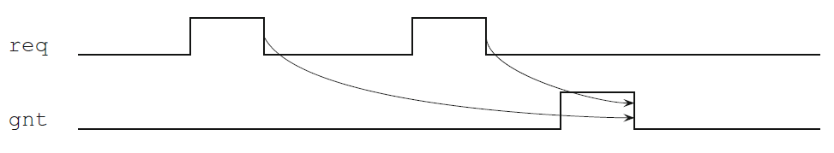

Primeri
Signal req (request) treba da bude aktivan sve dok signal grant ne bude aktiviran (asserted).
Signal req (request) mora biti odobren (granted). Ovo svojstvo znači da svaki put kada je req visok (high), signal grant treba biti visok u nekom budućem taktu
Nakon što je zahtev (req) poslat, potvrda (ack) treba da stigne pre nego što podaci (data_ready) budu spremni
Notes:
Design engineers normally use an HDL to define the function and the structure of a design under verification (DUV). Specifying a design in the text format of an HDL, an activity called design entry, allows the engineer to document the DUV unambiguously and later execute it as a model in a simulation engine. The HDL version of the DUV is also the basis for the physical implementation of the design. To better support the simulation task, HDLs have features that go beyond the mere description of the design and include the specification of stimulus and checking components, which form an HDL test bench. When we characterize the typical elements of HDLs as design specification tools in this lecture, using VHDL as prime example.
There are a variety of algorithms available to build simulation engines. Because the simulation engine plays such a crucial role in the center of the simulation-based flow, typical architectures of such engines are discussed in this lecture. It is important that verification engineers understand the characteristics of such tools at their disposal. Electronic design automation (EDA) developers build tools such as simulation engines around different sets of tradeoffs, many of which select between accuracy and speed. The verification team must choose those tools that are most adequate for their given project.
Many simulation engines offer an interactive graphical user interface (GUI), which lets the user apply individual stimulus and check commands manually in between simulation steps of the model. Such interfaces, which support a detailed debug mode, are effective mainly on smaller models or very specific debug situations. When working with larger-sized DUVs, the verification engineer lets the simulation engine save the results of a simulation run to trace files, which capture simulated model states over time. As also shown in the figure, waveform viewer tools let the user browse through these results files in various ways, for example, forward and backward in simulation time, to inspect and debug the model behavior in detail.
For many verification tasks, the users do not find the test bench features of the HDL sufficient. Therefore, most simulation engines provide open interfaces that support the application of checks and stimuli from a programming or test bench authoring language.
It is already apparent from the figure that many simulation tools present an interactive GUI to the designer. A very common approach is to integrate the different GUI tasks under one single master GUI, which then gives the user the view of a single integrated HDL and verification development environment even if the implementation underneath consists of separate tools.
All major EDA companies offer many of these tools, often integrated into one GUI framework. The benefit of the Institute of Electrical and Electronics Engineers (IEEE) standardization of the HDLs is that many simulation engines are largely interchangeable with each other. The differentiation comes from simulation speed and value-add features such as the integration of the other simulation tasks: coverage, test bench program support, and user-friendliness for debug.

Slide 23
Uzastopno ponavljanje
Napiši sekvencu koja izražava da faza prenosa koja traje tri uzastopna ciklusa bude praćena fazom prijema koja traje dva uzastopna ciklusa. Faza prenosa je predstavljena signalom trn, a faza prijema signalom rcv:
U SVA postoji poseban operator koji označava uzastopno ponavljanje sekvence s tačno n puta, gde je n nenegativna konstanta: s[*n].
Prethodni primer se tada može preformulisati kao:
Primer od ranije „Reset rst mora biti aktiviran tokom prva dva ciklusa“ može se elegantnije izraziti korišćenjem sekvenci.
Notes:
Design engineers normally use an HDL to define the function and the structure of a design under verification (DUV). Specifying a design in the text format of an HDL, an activity called design entry, allows the engineer to document the DUV unambiguously and later execute it as a model in a simulation engine. The HDL version of the DUV is also the basis for the physical implementation of the design. To better support the simulation task, HDLs have features that go beyond the mere description of the design and include the specification of stimulus and checking components, which form an HDL test bench. When we characterize the typical elements of HDLs as design specification tools in this lecture, using VHDL as prime example.
There are a variety of algorithms available to build simulation engines. Because the simulation engine plays such a crucial role in the center of the simulation-based flow, typical architectures of such engines are discussed in this lecture. It is important that verification engineers understand the characteristics of such tools at their disposal. Electronic design automation (EDA) developers build tools such as simulation engines around different sets of tradeoffs, many of which select between accuracy and speed. The verification team must choose those tools that are most adequate for their given project.
Many simulation engines offer an interactive graphical user interface (GUI), which lets the user apply individual stimulus and check commands manually in between simulation steps of the model. Such interfaces, which support a detailed debug mode, are effective mainly on smaller models or very specific debug situations. When working with larger-sized DUVs, the verification engineer lets the simulation engine save the results of a simulation run to trace files, which capture simulated model states over time. As also shown in the figure, waveform viewer tools let the user browse through these results files in various ways, for example, forward and backward in simulation time, to inspect and debug the model behavior in detail.
For many verification tasks, the users do not find the test bench features of the HDL sufficient. Therefore, most simulation engines provide open interfaces that support the application of checks and stimuli from a programming or test bench authoring language.
It is already apparent from the figure that many simulation tools present an interactive GUI to the designer. A very common approach is to integrate the different GUI tasks under one single master GUI, which then gives the user the view of a single integrated HDL and verification development environment even if the implementation underneath consists of separate tools.
All major EDA companies offer many of these tools, often integrated into one GUI framework. The benefit of the Institute of Electrical and Electronics Engineers (IEEE) standardization of the HDLs is that many simulation engines are largely interchangeable with each other. The differentiation comes from simulation speed and value-add features such as the integration of the other simulation tasks: coverage, test bench program support, and user-friendliness for debug.

Slide 24
Opseg uzastopnog ponavljanja (Consecutive repetition range)
U SVA, umesto fiksnog broja ponavljanja, može se specificirati opseg ponavljanja:
  konačno ponavljanje: s[m:n]
  beskonačno ponavljanje: s[n:$]
Gde su m i n konstante, sa uslovom m ≤ n, a znak $ označava „beskonačan broj“.
Postoje i prečice:
  s[*] je skraćeni zapis za s[0:$] (nula ili više puta)
  s[+] je skraćeni zapis za s[1:$] (jedan ili više puta)
Ove prečice ćemo često koristiti
Notes:
Design engineers normally use an HDL to define the function and the structure of a design under verification (DUV). Specifying a design in the text format of an HDL, an activity called design entry, allows the engineer to document the DUV unambiguously and later execute it as a model in a simulation engine. The HDL version of the DUV is also the basis for the physical implementation of the design. To better support the simulation task, HDLs have features that go beyond the mere description of the design and include the specification of stimulus and checking components, which form an HDL test bench. When we characterize the typical elements of HDLs as design specification tools in this lecture, using VHDL as prime example.
There are a variety of algorithms available to build simulation engines. Because the simulation engine plays such a crucial role in the center of the simulation-based flow, typical architectures of such engines are discussed in this lecture. It is important that verification engineers understand the characteristics of such tools at their disposal. Electronic design automation (EDA) developers build tools such as simulation engines around different sets of tradeoffs, many of which select between accuracy and speed. The verification team must choose those tools that are most adequate for their given project.
Many simulation engines offer an interactive graphical user interface (GUI), which lets the user apply individual stimulus and check commands manually in between simulation steps of the model. Such interfaces, which support a detailed debug mode, are effective mainly on smaller models or very specific debug situations. When working with larger-sized DUVs, the verification engineer lets the simulation engine save the results of a simulation run to trace files, which capture simulated model states over time. As also shown in the figure, waveform viewer tools let the user browse through these results files in various ways, for example, forward and backward in simulation time, to inspect and debug the model behavior in detail.
For many verification tasks, the users do not find the test bench features of the HDL sufficient. Therefore, most simulation engines provide open interfaces that support the application of checks and stimuli from a programming or test bench authoring language.
It is already apparent from the figure that many simulation tools present an interactive GUI to the designer. A very common approach is to integrate the different GUI tasks under one single master GUI, which then gives the user the view of a single integrated HDL and verification development environment even if the implementation underneath consists of separate tools.
All major EDA companies offer many of these tools, often integrated into one GUI framework. The benefit of the Institute of Electrical and Electronics Engineers (IEEE) standardization of the HDLs is that many simulation engines are largely interchangeable with each other. The differentiation comes from simulation speed and value-add features such as the integration of the other simulation tasks: coverage, test bench program support, and user-friendliness for debug.

Slide 25
Opseg uzastopnog ponavljanja … nastavak
Primer 1: Opis transakcije kao sekvence
  Transakcija počinje signalom bot (Beginning Of Transaction) i završava se signalom eot (End Of Transaction). Svaka transakcija traje najmanje dva ciklusa, i transakcije se ne preklapaju
Rešenje:
  Pošto transakcija traje najmanje dva ciklusa, bot i eot iste transakcije ne mogu biti aktivirani u istom taktu
  Zabrana preklapanja transakcija znači da između bot i narednog eot nema drugih pojavljivanja bot
  Dozvoljavamo da bot naredne transakcije može biti aktiviran u istom taktu kada se završava prethodna transakcija sa eot
  Takođe, transakcije treba da budu pravilno formirane, što znači da ne smeju postojati dva eot bez bot između njih
  Zbog toga, sekvenca koja opisuje transakciju je:
Notes:
Design engineers normally use an HDL to define the function and the structure of a design under verification (DUV). Specifying a design in the text format of an HDL, an activity called design entry, allows the engineer to document the DUV unambiguously and later execute it as a model in a simulation engine. The HDL version of the DUV is also the basis for the physical implementation of the design. To better support the simulation task, HDLs have features that go beyond the mere description of the design and include the specification of stimulus and checking components, which form an HDL test bench. When we characterize the typical elements of HDLs as design specification tools in this lecture, using VHDL as prime example.
There are a variety of algorithms available to build simulation engines. Because the simulation engine plays such a crucial role in the center of the simulation-based flow, typical architectures of such engines are discussed in this lecture. It is important that verification engineers understand the characteristics of such tools at their disposal. Electronic design automation (EDA) developers build tools such as simulation engines around different sets of tradeoffs, many of which select between accuracy and speed. The verification team must choose those tools that are most adequate for their given project.
Many simulation engines offer an interactive graphical user interface (GUI), which lets the user apply individual stimulus and check commands manually in between simulation steps of the model. Such interfaces, which support a detailed debug mode, are effective mainly on smaller models or very specific debug situations. When working with larger-sized DUVs, the verification engineer lets the simulation engine save the results of a simulation run to trace files, which capture simulated model states over time. As also shown in the figure, waveform viewer tools let the user browse through these results files in various ways, for example, forward and backward in simulation time, to inspect and debug the model behavior in detail.
For many verification tasks, the users do not find the test bench features of the HDL sufficient. Therefore, most simulation engines provide open interfaces that support the application of checks and stimuli from a programming or test bench authoring language.
It is already apparent from the figure that many simulation tools present an interactive GUI to the designer. A very common approach is to integrate the different GUI tasks under one single master GUI, which then gives the user the view of a single integrated HDL and verification development environment even if the implementation underneath consists of separate tools.
All major EDA companies offer many of these tools, often integrated into one GUI framework. The benefit of the Institute of Electrical and Electronics Engineers (IEEE) standardization of the HDLs is that many simulation engines are largely interchangeable with each other. The differentiation comes from simulation speed and value-add features such as the integration of the other simulation tasks: coverage, test bench program support, and user-friendliness for debug.

Slide 26


Opseg uzastopnog ponavljanja … nastavak
Primer 2: Napiši sledeću tvrdnju: rdy postaje aktivan prvi put kada se reset sekvenca završi. Reset sekvenca je predstavljena visokim stanjem signala rst.
Ili intuitivnije:
Primer 3: Ponovo razmatramo prethodni primer: ready treba da bude nizak dok rst prvi put ne postane neaktivan:
Notes:
Design engineers normally use an HDL to define the function and the structure of a design under verification (DUV). Specifying a design in the text format of an HDL, an activity called design entry, allows the engineer to document the DUV unambiguously and later execute it as a model in a simulation engine. The HDL version of the DUV is also the basis for the physical implementation of the design. To better support the simulation task, HDLs have features that go beyond the mere description of the design and include the specification of stimulus and checking components, which form an HDL test bench. When we characterize the typical elements of HDLs as design specification tools in this lecture, using VHDL as prime example.
There are a variety of algorithms available to build simulation engines. Because the simulation engine plays such a crucial role in the center of the simulation-based flow, typical architectures of such engines are discussed in this lecture. It is important that verification engineers understand the characteristics of such tools at their disposal. Electronic design automation (EDA) developers build tools such as simulation engines around different sets of tradeoffs, many of which select between accuracy and speed. The verification team must choose those tools that are most adequate for their given project.
Many simulation engines offer an interactive graphical user interface (GUI), which lets the user apply individual stimulus and check commands manually in between simulation steps of the model. Such interfaces, which support a detailed debug mode, are effective mainly on smaller models or very specific debug situations. When working with larger-sized DUVs, the verification engineer lets the simulation engine save the results of a simulation run to trace files, which capture simulated model states over time. As also shown in the figure, waveform viewer tools let the user browse through these results files in various ways, for example, forward and backward in simulation time, to inspect and debug the model behavior in detail.
For many verification tasks, the users do not find the test bench features of the HDL sufficient. Therefore, most simulation engines provide open interfaces that support the application of checks and stimuli from a programming or test bench authoring language.
It is already apparent from the figure that many simulation tools present an interactive GUI to the designer. A very common approach is to integrate the different GUI tasks under one single master GUI, which then gives the user the view of a single integrated HDL and verification development environment even if the implementation underneath consists of separate tools.
All major EDA companies offer many of these tools, often integrated into one GUI framework. The benefit of the Institute of Electrical and Electronics Engineers (IEEE) standardization of the HDLs is that many simulation engines are largely interchangeable with each other. The differentiation comes from simulation speed and value-add features such as the integration of the other simulation tasks: coverage, test bench program support, and user-friendliness for debug.

Slide 27
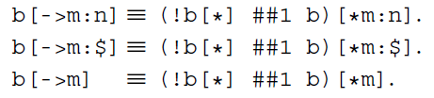
Go-to ponavljanje
Postoji poseban operator sekvence, tzv. goto ponavljanje, koji označava da uslov e mora da se desi prvi put: e[->1]. Za proizvoljnu celobrojnu konstantu n > 0, izraz e[->n], gde je e Booleova promenljiva, predstavlja skraćeni zapis za (!e[*] ##1 e)[*n]
Primer: Nakon što je zahtev req obrađen signalom done koji je aktiviran, signal ready treba da bude aktiviran:
Može se preformulisati kao:
Takođe je moguće specificirati opsege u goto ponavljanju: e[->m:n], gde važi 0 ≤ m ≤ n.
Notes:
Design engineers normally use an HDL to define the function and the structure of a design under verification (DUV). Specifying a design in the text format of an HDL, an activity called design entry, allows the engineer to document the DUV unambiguously and later execute it as a model in a simulation engine. The HDL version of the DUV is also the basis for the physical implementation of the design. To better support the simulation task, HDLs have features that go beyond the mere description of the design and include the specification of stimulus and checking components, which form an HDL test bench. When we characterize the typical elements of HDLs as design specification tools in this lecture, using VHDL as prime example.
There are a variety of algorithms available to build simulation engines. Because the simulation engine plays such a crucial role in the center of the simulation-based flow, typical architectures of such engines are discussed in this lecture. It is important that verification engineers understand the characteristics of such tools at their disposal. Electronic design automation (EDA) developers build tools such as simulation engines around different sets of tradeoffs, many of which select between accuracy and speed. The verification team must choose those tools that are most adequate for their given project.
Many simulation engines offer an interactive graphical user interface (GUI), which lets the user apply individual stimulus and check commands manually in between simulation steps of the model. Such interfaces, which support a detailed debug mode, are effective mainly on smaller models or very specific debug situations. When working with larger-sized DUVs, the verification engineer lets the simulation engine save the results of a simulation run to trace files, which capture simulated model states over time. As also shown in the figure, waveform viewer tools let the user browse through these results files in various ways, for example, forward and backward in simulation time, to inspect and debug the model behavior in detail.
For many verification tasks, the users do not find the test bench features of the HDL sufficient. Therefore, most simulation engines provide open interfaces that support the application of checks and stimuli from a programming or test bench authoring language.
It is already apparent from the figure that many simulation tools present an interactive GUI to the designer. A very common approach is to integrate the different GUI tasks under one single master GUI, which then gives the user the view of a single integrated HDL and verification development environment even if the implementation underneath consists of separate tools.
All major EDA companies offer many of these tools, often integrated into one GUI framework. The benefit of the Institute of Electrical and Electronics Engineers (IEEE) standardization of the HDLs is that many simulation engines are largely interchangeable with each other. The differentiation comes from simulation speed and value-add features such as the integration of the other simulation tasks: coverage, test bench program support, and user-friendliness for debug.

Slide 28
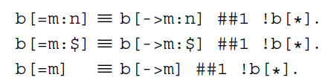
Neuzastopno ponavljanje
Neuzastopno ponavljanje [=n] je još jedan koristan operator (poput operatora za uzastopno ponavljanje) i koristi se veoma često
U mnogim primenama želimo da proverimo da li signal ostaje aktiviran ili deaktiviran određeni broj puta, a nije nam potrebno da znamo tačno kada se te promene dešavaju
Ovaj operator je skoro isti kao goto ponavljanje, ali dozvoljava da uslov ne mora biti ispunjen na kraju sekvence (dok kod goto ponavljanja poslednje pojavljivanje mora da se desi na kraju sekvence)
Notes:
Design engineers normally use an HDL to define the function and the structure of a design under verification (DUV). Specifying a design in the text format of an HDL, an activity called design entry, allows the engineer to document the DUV unambiguously and later execute it as a model in a simulation engine. The HDL version of the DUV is also the basis for the physical implementation of the design. To better support the simulation task, HDLs have features that go beyond the mere description of the design and include the specification of stimulus and checking components, which form an HDL test bench. When we characterize the typical elements of HDLs as design specification tools in this lecture, using VHDL as prime example.
There are a variety of algorithms available to build simulation engines. Because the simulation engine plays such a crucial role in the center of the simulation-based flow, typical architectures of such engines are discussed in this lecture. It is important that verification engineers understand the characteristics of such tools at their disposal. Electronic design automation (EDA) developers build tools such as simulation engines around different sets of tradeoffs, many of which select between accuracy and speed. The verification team must choose those tools that are most adequate for their given project.
Many simulation engines offer an interactive graphical user interface (GUI), which lets the user apply individual stimulus and check commands manually in between simulation steps of the model. Such interfaces, which support a detailed debug mode, are effective mainly on smaller models or very specific debug situations. When working with larger-sized DUVs, the verification engineer lets the simulation engine save the results of a simulation run to trace files, which capture simulated model states over time. As also shown in the figure, waveform viewer tools let the user browse through these results files in various ways, for example, forward and backward in simulation time, to inspect and debug the model behavior in detail.
For many verification tasks, the users do not find the test bench features of the HDL sufficient. Therefore, most simulation engines provide open interfaces that support the application of checks and stimuli from a programming or test bench authoring language.
It is already apparent from the figure that many simulation tools present an interactive GUI to the designer. A very common approach is to integrate the different GUI tasks under one single master GUI, which then gives the user the view of a single integrated HDL and verification development environment even if the implementation underneath consists of separate tools.
All major EDA companies offer many of these tools, often integrated into one GUI framework. The benefit of the Institute of Electrical and Electronics Engineers (IEEE) standardization of the HDLs is that many simulation engines are largely interchangeable with each other. The differentiation comes from simulation speed and value-add features such as the integration of the other simulation tasks: coverage, test bench program support, and user-friendliness for debug.

Slide 29
System Verilog Assertions
Funkcije i taskovi

Slide 30
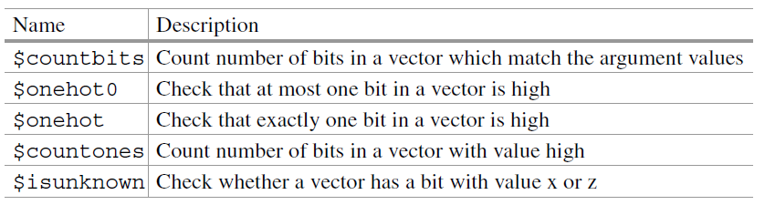
Funkcije za rad sa bit-vektorima
Sve funkcije navedene dole, osim $countbits, imaju bit vektor kao jedini argument. Funkcija $countbits zahteva dodatnu listu argumenata za specificiranje kontrolnih vrednosti koje treba da se poklope.
Primer:
Zahtevi za čitanje i pisanje ne mogu se pojaviti istovremeno.
Notes:
Design engineers normally use an HDL to define the function and the structure of a design under verification (DUV). Specifying a design in the text format of an HDL, an activity called design entry, allows the engineer to document the DUV unambiguously and later execute it as a model in a simulation engine. The HDL version of the DUV is also the basis for the physical implementation of the design. To better support the simulation task, HDLs have features that go beyond the mere description of the design and include the specification of stimulus and checking components, which form an HDL test bench. When we characterize the typical elements of HDLs as design specification tools in this lecture, using VHDL as prime example.
There are a variety of algorithms available to build simulation engines. Because the simulation engine plays such a crucial role in the center of the simulation-based flow, typical architectures of such engines are discussed in this lecture. It is important that verification engineers understand the characteristics of such tools at their disposal. Electronic design automation (EDA) developers build tools such as simulation engines around different sets of tradeoffs, many of which select between accuracy and speed. The verification team must choose those tools that are most adequate for their given project.
Many simulation engines offer an interactive graphical user interface (GUI), which lets the user apply individual stimulus and check commands manually in between simulation steps of the model. Such interfaces, which support a detailed debug mode, are effective mainly on smaller models or very specific debug situations. When working with larger-sized DUVs, the verification engineer lets the simulation engine save the results of a simulation run to trace files, which capture simulated model states over time. As also shown in the figure, waveform viewer tools let the user browse through these results files in various ways, for example, forward and backward in simulation time, to inspect and debug the model behavior in detail.
For many verification tasks, the users do not find the test bench features of the HDL sufficient. Therefore, most simulation engines provide open interfaces that support the application of checks and stimuli from a programming or test bench authoring language.
It is already apparent from the figure that many simulation tools present an interactive GUI to the designer. A very common approach is to integrate the different GUI tasks under one single master GUI, which then gives the user the view of a single integrated HDL and verification development environment even if the implementation underneath consists of separate tools.
All major EDA companies offer many of these tools, often integrated into one GUI framework. The benefit of the Institute of Electrical and Electronics Engineers (IEEE) standardization of the HDLs is that many simulation engines are largely interchangeable with each other. The differentiation comes from simulation speed and value-add features such as the integration of the other simulation tasks: coverage, test bench program support, and user-friendliness for debug.

Slide 31

Funkcije za rad sa bit-vektorima .. nastavak
Primer: Proveriti da li je kontrolno stanje FSM one-hot kodirano kada je rst nizak:
Sistemska funkcija $isunknown vraća 1’b1 ako bilo koji bit njenog argumenta ima vrednost x ili z.
Primer: Svi bitovi podataka (vektor data) treba da imaju poznate vrednosti (tj. 0 ili 1) kada je read aktivan.
Notes:
Design engineers normally use an HDL to define the function and the structure of a design under verification (DUV). Specifying a design in the text format of an HDL, an activity called design entry, allows the engineer to document the DUV unambiguously and later execute it as a model in a simulation engine. The HDL version of the DUV is also the basis for the physical implementation of the design. To better support the simulation task, HDLs have features that go beyond the mere description of the design and include the specification of stimulus and checking components, which form an HDL test bench. When we characterize the typical elements of HDLs as design specification tools in this lecture, using VHDL as prime example.
There are a variety of algorithms available to build simulation engines. Because the simulation engine plays such a crucial role in the center of the simulation-based flow, typical architectures of such engines are discussed in this lecture. It is important that verification engineers understand the characteristics of such tools at their disposal. Electronic design automation (EDA) developers build tools such as simulation engines around different sets of tradeoffs, many of which select between accuracy and speed. The verification team must choose those tools that are most adequate for their given project.
Many simulation engines offer an interactive graphical user interface (GUI), which lets the user apply individual stimulus and check commands manually in between simulation steps of the model. Such interfaces, which support a detailed debug mode, are effective mainly on smaller models or very specific debug situations. When working with larger-sized DUVs, the verification engineer lets the simulation engine save the results of a simulation run to trace files, which capture simulated model states over time. As also shown in the figure, waveform viewer tools let the user browse through these results files in various ways, for example, forward and backward in simulation time, to inspect and debug the model behavior in detail.
For many verification tasks, the users do not find the test bench features of the HDL sufficient. Therefore, most simulation engines provide open interfaces that support the application of checks and stimuli from a programming or test bench authoring language.
It is already apparent from the figure that many simulation tools present an interactive GUI to the designer. A very common approach is to integrate the different GUI tasks under one single master GUI, which then gives the user the view of a single integrated HDL and verification development environment even if the implementation underneath consists of separate tools.
All major EDA companies offer many of these tools, often integrated into one GUI framework. The benefit of the Institute of Electrical and Electronics Engineers (IEEE) standardization of the HDLs is that many simulation engines are largely interchangeable with each other. The differentiation comes from simulation speed and value-add features such as the integration of the other simulation tasks: coverage, test bench program support, and user-friendliness for debug.

Slide 32
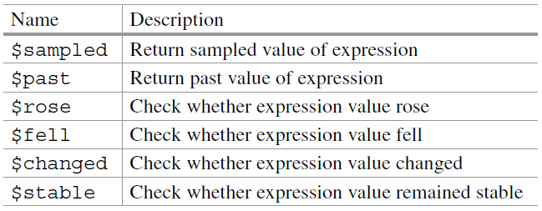
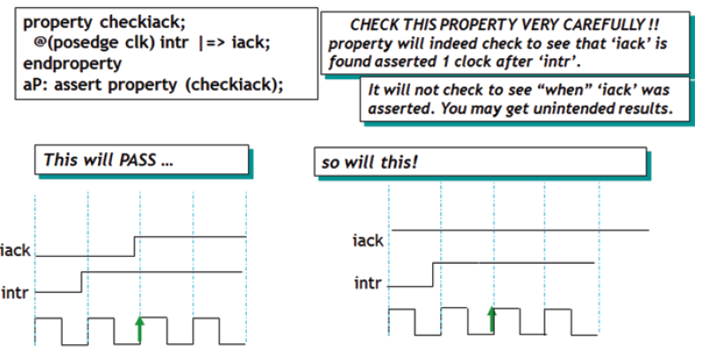
Funkcije uzorkovanih vrednosti
Notes:
Design engineers normally use an HDL to define the function and the structure of a design under verification (DUV). Specifying a design in the text format of an HDL, an activity called design entry, allows the engineer to document the DUV unambiguously and later execute it as a model in a simulation engine. The HDL version of the DUV is also the basis for the physical implementation of the design. To better support the simulation task, HDLs have features that go beyond the mere description of the design and include the specification of stimulus and checking components, which form an HDL test bench. When we characterize the typical elements of HDLs as design specification tools in this lecture, using VHDL as prime example.
There are a variety of algorithms available to build simulation engines. Because the simulation engine plays such a crucial role in the center of the simulation-based flow, typical architectures of such engines are discussed in this lecture. It is important that verification engineers understand the characteristics of such tools at their disposal. Electronic design automation (EDA) developers build tools such as simulation engines around different sets of tradeoffs, many of which select between accuracy and speed. The verification team must choose those tools that are most adequate for their given project.
Many simulation engines offer an interactive graphical user interface (GUI), which lets the user apply individual stimulus and check commands manually in between simulation steps of the model. Such interfaces, which support a detailed debug mode, are effective mainly on smaller models or very specific debug situations. When working with larger-sized DUVs, the verification engineer lets the simulation engine save the results of a simulation run to trace files, which capture simulated model states over time. As also shown in the figure, waveform viewer tools let the user browse through these results files in various ways, for example, forward and backward in simulation time, to inspect and debug the model behavior in detail.
For many verification tasks, the users do not find the test bench features of the HDL sufficient. Therefore, most simulation engines provide open interfaces that support the application of checks and stimuli from a programming or test bench authoring language.
It is already apparent from the figure that many simulation tools present an interactive GUI to the designer. A very common approach is to integrate the different GUI tasks under one single master GUI, which then gives the user the view of a single integrated HDL and verification development environment even if the implementation underneath consists of separate tools.
All major EDA companies offer many of these tools, often integrated into one GUI framework. The benefit of the Institute of Electrical and Electronics Engineers (IEEE) standardization of the HDLs is that many simulation engines are largely interchangeable with each other. The differentiation comes from simulation speed and value-add features such as the integration of the other simulation tasks: coverage, test bench program support, and user-friendliness for debug.

Slide 33
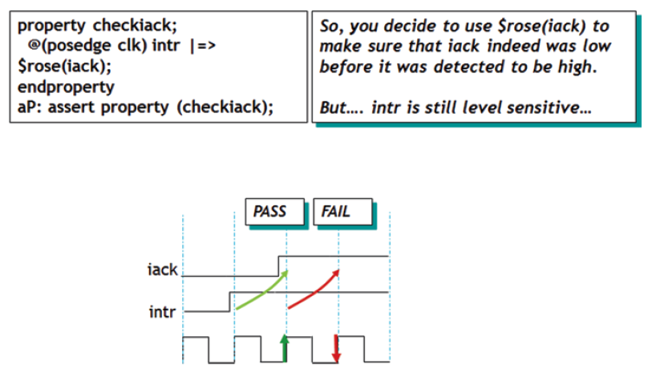

Funkcije uzorkovanih vrednosti
Rešenje:
Notes:
Design engineers normally use an HDL to define the function and the structure of a design under verification (DUV). Specifying a design in the text format of an HDL, an activity called design entry, allows the engineer to document the DUV unambiguously and later execute it as a model in a simulation engine. The HDL version of the DUV is also the basis for the physical implementation of the design. To better support the simulation task, HDLs have features that go beyond the mere description of the design and include the specification of stimulus and checking components, which form an HDL test bench. When we characterize the typical elements of HDLs as design specification tools in this lecture, using VHDL as prime example.
There are a variety of algorithms available to build simulation engines. Because the simulation engine plays such a crucial role in the center of the simulation-based flow, typical architectures of such engines are discussed in this lecture. It is important that verification engineers understand the characteristics of such tools at their disposal. Electronic design automation (EDA) developers build tools such as simulation engines around different sets of tradeoffs, many of which select between accuracy and speed. The verification team must choose those tools that are most adequate for their given project.
Many simulation engines offer an interactive graphical user interface (GUI), which lets the user apply individual stimulus and check commands manually in between simulation steps of the model. Such interfaces, which support a detailed debug mode, are effective mainly on smaller models or very specific debug situations. When working with larger-sized DUVs, the verification engineer lets the simulation engine save the results of a simulation run to trace files, which capture simulated model states over time. As also shown in the figure, waveform viewer tools let the user browse through these results files in various ways, for example, forward and backward in simulation time, to inspect and debug the model behavior in detail.
For many verification tasks, the users do not find the test bench features of the HDL sufficient. Therefore, most simulation engines provide open interfaces that support the application of checks and stimuli from a programming or test bench authoring language.
It is already apparent from the figure that many simulation tools present an interactive GUI to the designer. A very common approach is to integrate the different GUI tasks under one single master GUI, which then gives the user the view of a single integrated HDL and verification development environment even if the implementation underneath consists of separate tools.
All major EDA companies offer many of these tools, often integrated into one GUI framework. The benefit of the Institute of Electrical and Electronics Engineers (IEEE) standardization of the HDLs is that many simulation engines are largely interchangeable with each other. The differentiation comes from simulation speed and value-add features such as the integration of the other simulation tasks: coverage, test bench program support, and user-friendliness for debug.

Slide 34
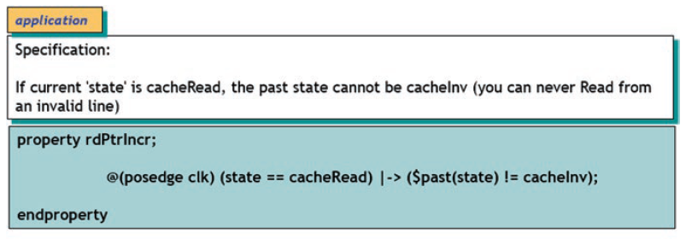
Funkcije uzorkovanih vrednosti
Primer korišćenja funkcije $past:
Notes:
Design engineers normally use an HDL to define the function and the structure of a design under verification (DUV). Specifying a design in the text format of an HDL, an activity called design entry, allows the engineer to document the DUV unambiguously and later execute it as a model in a simulation engine. The HDL version of the DUV is also the basis for the physical implementation of the design. To better support the simulation task, HDLs have features that go beyond the mere description of the design and include the specification of stimulus and checking components, which form an HDL test bench. When we characterize the typical elements of HDLs as design specification tools in this lecture, using VHDL as prime example.
There are a variety of algorithms available to build simulation engines. Because the simulation engine plays such a crucial role in the center of the simulation-based flow, typical architectures of such engines are discussed in this lecture. It is important that verification engineers understand the characteristics of such tools at their disposal. Electronic design automation (EDA) developers build tools such as simulation engines around different sets of tradeoffs, many of which select between accuracy and speed. The verification team must choose those tools that are most adequate for their given project.
Many simulation engines offer an interactive graphical user interface (GUI), which lets the user apply individual stimulus and check commands manually in between simulation steps of the model. Such interfaces, which support a detailed debug mode, are effective mainly on smaller models or very specific debug situations. When working with larger-sized DUVs, the verification engineer lets the simulation engine save the results of a simulation run to trace files, which capture simulated model states over time. As also shown in the figure, waveform viewer tools let the user browse through these results files in various ways, for example, forward and backward in simulation time, to inspect and debug the model behavior in detail.
For many verification tasks, the users do not find the test bench features of the HDL sufficient. Therefore, most simulation engines provide open interfaces that support the application of checks and stimuli from a programming or test bench authoring language.
It is already apparent from the figure that many simulation tools present an interactive GUI to the designer. A very common approach is to integrate the different GUI tasks under one single master GUI, which then gives the user the view of a single integrated HDL and verification development environment even if the implementation underneath consists of separate tools.
All major EDA companies offer many of these tools, often integrated into one GUI framework. The benefit of the Institute of Electrical and Electronics Engineers (IEEE) standardization of the HDLs is that many simulation engines are largely interchangeable with each other. The differentiation comes from simulation speed and value-add features such as the integration of the other simulation tasks: coverage, test bench program support, and user-friendliness for debug.

Slide 35
Funkcije uzorkovanih vrednosti
Za burst ciklus, kada je signal „read“ visok dok se burst čitanje ne završi, tokom tog perioda, rd_addr se uvećava za jedan u svakom taktu
sequence check_rd_adr;
((rd_addr == $past(rd_addr)+1) && read) [∗0:$] ##1 $fell(read);
endsequence
sequence read_cycle;
($rose(read) && reset_);
endsequence
property burst_check;
@(posedge clk) read_cycle |-> check_rd_adr;
endproperty
Sekvenca „check_rd_adr“ proverava da li je trenutna vrednost rd_addr za jedan veća od prethodne vrednosti (da li je rd_addr pomeren za jedan unapred)
Ovo se postiže korišćenjem funkcije uzorkovanih vrednosti $past. Zatim se ovo ponašanje proverava uzastopno sve dok ne dođe do pada signala read (što označava kraj ciklusa čitanja). Dakle, u svakom taktu se proverava ceo izraz: “(rd_addr == $past (rd_addr)+1) && read” i ta provera se nastavlja uzastopno dok signal read ne postane nizak
Notes:
Design engineers normally use an HDL to define the function and the structure of a design under verification (DUV). Specifying a design in the text format of an HDL, an activity called design entry, allows the engineer to document the DUV unambiguously and later execute it as a model in a simulation engine. The HDL version of the DUV is also the basis for the physical implementation of the design. To better support the simulation task, HDLs have features that go beyond the mere description of the design and include the specification of stimulus and checking components, which form an HDL test bench. When we characterize the typical elements of HDLs as design specification tools in this lecture, using VHDL as prime example.
There are a variety of algorithms available to build simulation engines. Because the simulation engine plays such a crucial role in the center of the simulation-based flow, typical architectures of such engines are discussed in this lecture. It is important that verification engineers understand the characteristics of such tools at their disposal. Electronic design automation (EDA) developers build tools such as simulation engines around different sets of tradeoffs, many of which select between accuracy and speed. The verification team must choose those tools that are most adequate for their given project.
Many simulation engines offer an interactive graphical user interface (GUI), which lets the user apply individual stimulus and check commands manually in between simulation steps of the model. Such interfaces, which support a detailed debug mode, are effective mainly on smaller models or very specific debug situations. When working with larger-sized DUVs, the verification engineer lets the simulation engine save the results of a simulation run to trace files, which capture simulated model states over time. As also shown in the figure, waveform viewer tools let the user browse through these results files in various ways, for example, forward and backward in simulation time, to inspect and debug the model behavior in detail.
For many verification tasks, the users do not find the test bench features of the HDL sufficient. Therefore, most simulation engines provide open interfaces that support the application of checks and stimuli from a programming or test bench authoring language.
It is already apparent from the figure that many simulation tools present an interactive GUI to the designer. A very common approach is to integrate the different GUI tasks under one single master GUI, which then gives the user the view of a single integrated HDL and verification development environment even if the implementation underneath consists of separate tools.
All major EDA companies offer many of these tools, often integrated into one GUI framework. The benefit of the Institute of Electrical and Electronics Engineers (IEEE) standardization of the HDLs is that many simulation engines are largely interchangeable with each other. The differentiation comes from simulation speed and value-add features such as the integration of the other simulation tasks: coverage, test bench program support, and user-friendliness for debug.

Slide 36
System Verilog Assertions
Primer: I2C upis

Slide 37
I2C okvir prilikom upisa
I2C koristi dve linije SCL (takt) i SDA (podaci)
I2C upis počinje sa start uslovom (start condition) => opadajuća ivica na SDA liniji dok je SCL visok
Nakon toga sledi 7-bitna adresa "slave" uređaja u koji se upisuje
R/W bit (1 čitanje, 0 upis)
ACK od strane "slave" uređaja koji se odaziva na datu adresu (SDA postavljen na "0" od strane "slave" uređaja
8 bita podataka
NACK od strane master uređaja (SDA postavljen na "1") da označi da je kraj prenosa (ne šalje se novi bajt)
Završava se stop uslovom (stop condition) => rastuća ivica na SDA liniji dok je SCL visok
Zadatak: Napisati tvrdnju za proveru I2C upisa na adresu iz opsega 0x0A – 0x0F uz prikaz podatka koji je poslat
Notes:
Design engineers normally use an HDL to define the function and the structure of a design under verification (DUV). Specifying a design in the text format of an HDL, an activity called design entry, allows the engineer to document the DUV unambiguously and later execute it as a model in a simulation engine. The HDL version of the DUV is also the basis for the physical implementation of the design. To better support the simulation task, HDLs have features that go beyond the mere description of the design and include the specification of stimulus and checking components, which form an HDL test bench. When we characterize the typical elements of HDLs as design specification tools in this lecture, using VHDL as prime example.
There are a variety of algorithms available to build simulation engines. Because the simulation engine plays such a crucial role in the center of the simulation-based flow, typical architectures of such engines are discussed in this lecture. It is important that verification engineers understand the characteristics of such tools at their disposal. Electronic design automation (EDA) developers build tools such as simulation engines around different sets of tradeoffs, many of which select between accuracy and speed. The verification team must choose those tools that are most adequate for their given project.
Many simulation engines offer an interactive graphical user interface (GUI), which lets the user apply individual stimulus and check commands manually in between simulation steps of the model. Such interfaces, which support a detailed debug mode, are effective mainly on smaller models or very specific debug situations. When working with larger-sized DUVs, the verification engineer lets the simulation engine save the results of a simulation run to trace files, which capture simulated model states over time. As also shown in the figure, waveform viewer tools let the user browse through these results files in various ways, for example, forward and backward in simulation time, to inspect and debug the model behavior in detail.
For many verification tasks, the users do not find the test bench features of the HDL sufficient. Therefore, most simulation engines provide open interfaces that support the application of checks and stimuli from a programming or test bench authoring language.
It is already apparent from the figure that many simulation tools present an interactive GUI to the designer. A very common approach is to integrate the different GUI tasks under one single master GUI, which then gives the user the view of a single integrated HDL and verification development environment even if the implementation underneath consists of separate tools.
All major EDA companies offer many of these tools, often integrated into one GUI framework. The benefit of the Institute of Electrical and Electronics Engineers (IEEE) standardization of the HDLs is that many simulation engines are largely interchangeable with each other. The differentiation comes from simulation speed and value-add features such as the integration of the other simulation tasks: coverage, test bench program support, and user-friendliness for debug.

Slide 38
I2C okvir prilikom upisa - rešenje
property p_i2c_write;
logic [6:0] addr = 7'b0;
logic [7:0] data = 8'b0;
// 1. Detekcija START (SDA pada dok je SCL visok)
@(posedge sys_clk) ($fell(sda) && scl) |=>
// 2. Prikupljanje 7 bita adrese na svakom POSEDGE SCL
(##[1:10] ($rose(scl), addr = {addr[5:0], sda}, $display("[%0t] address=0x%h", $time, addr)))[*7]
// 3. Provera R/W bita (mora biti 0) i Address Range (na sledećem posedge scl)
##[1:10] $rose(scl) ##0 (sda == 1'b0 && addr >= 7'h0A && addr <= 7'h0F) ##0 (1'b1,$display("[%0t] Address valid: 0x%h", $time, addr))
// 4. Wait for Slave ACK (SDA=0 na sledećem posedge scl)
##[1:10] $rose(scl) ##0 (sda == 1'b0) ##0 (1'b1,$display("[%0t] Detected slave ACK", $time)) ##0
// 5. Prikupljanje 8 bita podataka
(##[1:10] ($rose(scl), data = {data[6:0], sda}, $display("[%0t] data=0x%h", $time, data)))[*8]
// 6. Master sends NACK (SDA=1 na sledećem posedge scl)
##[1:10] $rose(scl) ##0 (sda == 1'b1) ##0 (1'b1,$display("[%0t] Detected master NACK", $time))
// 7. Detekcija STOP (SDA raste dok je SCL visok)
##[1:100] ($rose(sda) && scl) ##0 (1'b1,$display("[%0t] Detected STOP condition", $time)) ##0
(1'b1, $display("T:%0t | SUCCESS: Addr=0x%h, Data=0x%h", $time, addr, data));
endproperty
Notes:
Design engineers normally use an HDL to define the function and the structure of a design under verification (DUV). Specifying a design in the text format of an HDL, an activity called design entry, allows the engineer to document the DUV unambiguously and later execute it as a model in a simulation engine. The HDL version of the DUV is also the basis for the physical implementation of the design. To better support the simulation task, HDLs have features that go beyond the mere description of the design and include the specification of stimulus and checking components, which form an HDL test bench. When we characterize the typical elements of HDLs as design specification tools in this lecture, using VHDL as prime example.
There are a variety of algorithms available to build simulation engines. Because the simulation engine plays such a crucial role in the center of the simulation-based flow, typical architectures of such engines are discussed in this lecture. It is important that verification engineers understand the characteristics of such tools at their disposal. Electronic design automation (EDA) developers build tools such as simulation engines around different sets of tradeoffs, many of which select between accuracy and speed. The verification team must choose those tools that are most adequate for their given project.
Many simulation engines offer an interactive graphical user interface (GUI), which lets the user apply individual stimulus and check commands manually in between simulation steps of the model. Such interfaces, which support a detailed debug mode, are effective mainly on smaller models or very specific debug situations. When working with larger-sized DUVs, the verification engineer lets the simulation engine save the results of a simulation run to trace files, which capture simulated model states over time. As also shown in the figure, waveform viewer tools let the user browse through these results files in various ways, for example, forward and backward in simulation time, to inspect and debug the model behavior in detail.
For many verification tasks, the users do not find the test bench features of the HDL sufficient. Therefore, most simulation engines provide open interfaces that support the application of checks and stimuli from a programming or test bench authoring language.
It is already apparent from the figure that many simulation tools present an interactive GUI to the designer. A very common approach is to integrate the different GUI tasks under one single master GUI, which then gives the user the view of a single integrated HDL and verification development environment even if the implementation underneath consists of separate tools.
All major EDA companies offer many of these tools, often integrated into one GUI framework. The benefit of the Institute of Electrical and Electronics Engineers (IEEE) standardization of the HDLs is that many simulation engines are largely interchangeable with each other. The differentiation comes from simulation speed and value-add features such as the integration of the other simulation tasks: coverage, test bench program support, and user-friendliness for debug.

Slide 39
I2C okvir prilikom upisa - rešenje
assert property (p_i2c_write)
else $error("T:%0t | I2C Write Violation!", $time);
System Verilog modul koji bi mogao da generiše jednu takvu I2C write sekvencu bi izgledao ovako:
module i2c_sys_clk_test;
bit sys_clk, sda, scl;
// Brzi sistemski takt (npr. 100MHz)
always #5 sys_clk = ~sys_clk;
// --- TESTBENCH STIMULUS ---
task send_bit(input bit b);
sda = b;
#30; // Setup time: SDA se stabilizuje pre SCL
scl = 1;
#40; // Hold time: SCL je visok dovoljno dugo za sys_clk
scl = 0;
#20; // Pauza između bitova
endtask
Notes:
Design engineers normally use an HDL to define the function and the structure of a design under verification (DUV). Specifying a design in the text format of an HDL, an activity called design entry, allows the engineer to document the DUV unambiguously and later execute it as a model in a simulation engine. The HDL version of the DUV is also the basis for the physical implementation of the design. To better support the simulation task, HDLs have features that go beyond the mere description of the design and include the specification of stimulus and checking components, which form an HDL test bench. When we characterize the typical elements of HDLs as design specification tools in this lecture, using VHDL as prime example.
There are a variety of algorithms available to build simulation engines. Because the simulation engine plays such a crucial role in the center of the simulation-based flow, typical architectures of such engines are discussed in this lecture. It is important that verification engineers understand the characteristics of such tools at their disposal. Electronic design automation (EDA) developers build tools such as simulation engines around different sets of tradeoffs, many of which select between accuracy and speed. The verification team must choose those tools that are most adequate for their given project.
Many simulation engines offer an interactive graphical user interface (GUI), which lets the user apply individual stimulus and check commands manually in between simulation steps of the model. Such interfaces, which support a detailed debug mode, are effective mainly on smaller models or very specific debug situations. When working with larger-sized DUVs, the verification engineer lets the simulation engine save the results of a simulation run to trace files, which capture simulated model states over time. As also shown in the figure, waveform viewer tools let the user browse through these results files in various ways, for example, forward and backward in simulation time, to inspect and debug the model behavior in detail.
For many verification tasks, the users do not find the test bench features of the HDL sufficient. Therefore, most simulation engines provide open interfaces that support the application of checks and stimuli from a programming or test bench authoring language.
It is already apparent from the figure that many simulation tools present an interactive GUI to the designer. A very common approach is to integrate the different GUI tasks under one single master GUI, which then gives the user the view of a single integrated HDL and verification development environment even if the implementation underneath consists of separate tools.
All major EDA companies offer many of these tools, often integrated into one GUI framework. The benefit of the Institute of Electrical and Electronics Engineers (IEEE) standardization of the HDLs is that many simulation engines are largely interchangeable with each other. The differentiation comes from simulation speed and value-add features such as the integration of the other simulation tasks: coverage, test bench program support, and user-friendliness for debug.

Slide 40
I2C okvir prilikom upisa - rešenje
initial begin
$dumpfile("dump.vcd"); $dumpvars(0);
sda = 1; scl = 1;
#50;
// START
sda = 0; #20; scl = 0; #20;
// Addr: 0x0A (0001010), R/W: 0
send_bit(0); send_bit(0); send_bit(0);
send_bit(1); send_bit(0); send_bit(1); send_bit(0);
send_bit(0);
// ACK
send_bit(0);
// Data: 0x55 (01010101)
send_bit(0); send_bit(1); send_bit(0); send_bit(1);
send_bit(0); send_bit(1); send_bit(0); send_bit(1);
// NACK
send_bit(1);
#1 sda=0;
// STOP
#10; scl = 1; #20; sda = 1;
#100; $finish;
end
endmodule
Notes:
Design engineers normally use an HDL to define the function and the structure of a design under verification (DUV). Specifying a design in the text format of an HDL, an activity called design entry, allows the engineer to document the DUV unambiguously and later execute it as a model in a simulation engine. The HDL version of the DUV is also the basis for the physical implementation of the design. To better support the simulation task, HDLs have features that go beyond the mere description of the design and include the specification of stimulus and checking components, which form an HDL test bench. When we characterize the typical elements of HDLs as design specification tools in this lecture, using VHDL as prime example.
There are a variety of algorithms available to build simulation engines. Because the simulation engine plays such a crucial role in the center of the simulation-based flow, typical architectures of such engines are discussed in this lecture. It is important that verification engineers understand the characteristics of such tools at their disposal. Electronic design automation (EDA) developers build tools such as simulation engines around different sets of tradeoffs, many of which select between accuracy and speed. The verification team must choose those tools that are most adequate for their given project.
Many simulation engines offer an interactive graphical user interface (GUI), which lets the user apply individual stimulus and check commands manually in between simulation steps of the model. Such interfaces, which support a detailed debug mode, are effective mainly on smaller models or very specific debug situations. When working with larger-sized DUVs, the verification engineer lets the simulation engine save the results of a simulation run to trace files, which capture simulated model states over time. As also shown in the figure, waveform viewer tools let the user browse through these results files in various ways, for example, forward and backward in simulation time, to inspect and debug the model behavior in detail.
For many verification tasks, the users do not find the test bench features of the HDL sufficient. Therefore, most simulation engines provide open interfaces that support the application of checks and stimuli from a programming or test bench authoring language.
It is already apparent from the figure that many simulation tools present an interactive GUI to the designer. A very common approach is to integrate the different GUI tasks under one single master GUI, which then gives the user the view of a single integrated HDL and verification development environment even if the implementation underneath consists of separate tools.
All major EDA companies offer many of these tools, often integrated into one GUI framework. The benefit of the Institute of Electrical and Electronics Engineers (IEEE) standardization of the HDLs is that many simulation engines are largely interchangeable with each other. The differentiation comes from simulation speed and value-add features such as the integration of the other simulation tasks: coverage, test bench program support, and user-friendliness for debug.

Slide 41
System Verilog Assertions
Parametrizacija

Slide 42
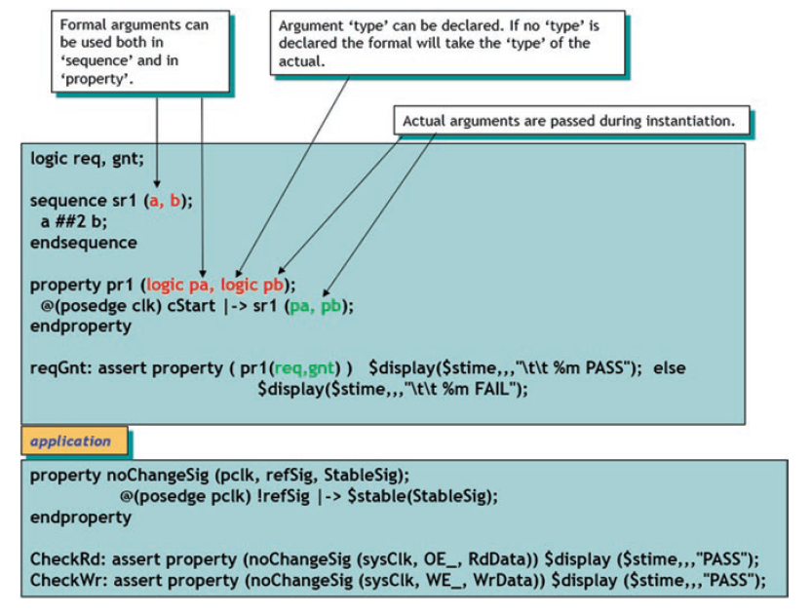
Formalni argumenti
Jedna od ključnih karakteristika tvrdnji je ta što mogu biti parametarski definisane
Drugim rečima, tvrdnje se mogu dizajnirati sa formalnim argumentima kako bi bile dovoljno generičke za upotrebu sa različitim stvarnim argumentima
Notes:
Design engineers normally use an HDL to define the function and the structure of a design under verification (DUV). Specifying a design in the text format of an HDL, an activity called design entry, allows the engineer to document the DUV unambiguously and later execute it as a model in a simulation engine. The HDL version of the DUV is also the basis for the physical implementation of the design. To better support the simulation task, HDLs have features that go beyond the mere description of the design and include the specification of stimulus and checking components, which form an HDL test bench. When we characterize the typical elements of HDLs as design specification tools in this lecture, using VHDL as prime example.
There are a variety of algorithms available to build simulation engines. Because the simulation engine plays such a crucial role in the center of the simulation-based flow, typical architectures of such engines are discussed in this lecture. It is important that verification engineers understand the characteristics of such tools at their disposal. Electronic design automation (EDA) developers build tools such as simulation engines around different sets of tradeoffs, many of which select between accuracy and speed. The verification team must choose those tools that are most adequate for their given project.
Many simulation engines offer an interactive graphical user interface (GUI), which lets the user apply individual stimulus and check commands manually in between simulation steps of the model. Such interfaces, which support a detailed debug mode, are effective mainly on smaller models or very specific debug situations. When working with larger-sized DUVs, the verification engineer lets the simulation engine save the results of a simulation run to trace files, which capture simulated model states over time. As also shown in the figure, waveform viewer tools let the user browse through these results files in various ways, for example, forward and backward in simulation time, to inspect and debug the model behavior in detail.
For many verification tasks, the users do not find the test bench features of the HDL sufficient. Therefore, most simulation engines provide open interfaces that support the application of checks and stimuli from a programming or test bench authoring language.
It is already apparent from the figure that many simulation tools present an interactive GUI to the designer. A very common approach is to integrate the different GUI tasks under one single master GUI, which then gives the user the view of a single integrated HDL and verification development environment even if the implementation underneath consists of separate tools.
All major EDA companies offer many of these tools, often integrated into one GUI framework. The benefit of the Institute of Electrical and Electronics Engineers (IEEE) standardization of the HDLs is that many simulation engines are largely interchangeable with each other. The differentiation comes from simulation speed and value-add features such as the integration of the other simulation tasks: coverage, test bench program support, and user-friendliness for debug.

Slide 43
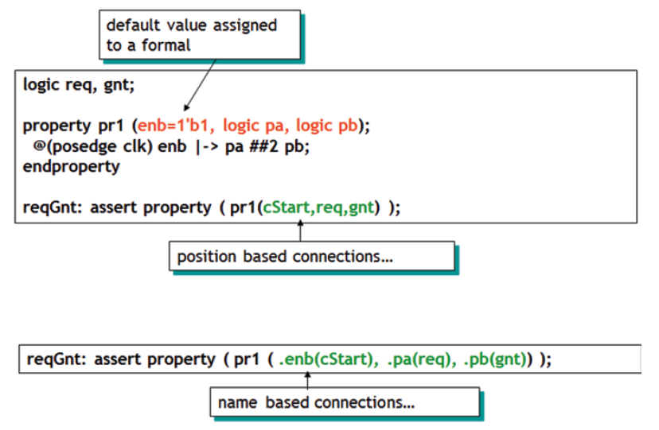
Formalni i stvarni argumenti
Podrazumevana vrednost može da se koristi, a povezivanje može biti zasnovano na poziciji ili na imenu:
Notes:
Design engineers normally use an HDL to define the function and the structure of a design under verification (DUV). Specifying a design in the text format of an HDL, an activity called design entry, allows the engineer to document the DUV unambiguously and later execute it as a model in a simulation engine. The HDL version of the DUV is also the basis for the physical implementation of the design. To better support the simulation task, HDLs have features that go beyond the mere description of the design and include the specification of stimulus and checking components, which form an HDL test bench. When we characterize the typical elements of HDLs as design specification tools in this lecture, using VHDL as prime example.
There are a variety of algorithms available to build simulation engines. Because the simulation engine plays such a crucial role in the center of the simulation-based flow, typical architectures of such engines are discussed in this lecture. It is important that verification engineers understand the characteristics of such tools at their disposal. Electronic design automation (EDA) developers build tools such as simulation engines around different sets of tradeoffs, many of which select between accuracy and speed. The verification team must choose those tools that are most adequate for their given project.
Many simulation engines offer an interactive graphical user interface (GUI), which lets the user apply individual stimulus and check commands manually in between simulation steps of the model. Such interfaces, which support a detailed debug mode, are effective mainly on smaller models or very specific debug situations. When working with larger-sized DUVs, the verification engineer lets the simulation engine save the results of a simulation run to trace files, which capture simulated model states over time. As also shown in the figure, waveform viewer tools let the user browse through these results files in various ways, for example, forward and backward in simulation time, to inspect and debug the model behavior in detail.
For many verification tasks, the users do not find the test bench features of the HDL sufficient. Therefore, most simulation engines provide open interfaces that support the application of checks and stimuli from a programming or test bench authoring language.
It is already apparent from the figure that many simulation tools present an interactive GUI to the designer. A very common approach is to integrate the different GUI tasks under one single master GUI, which then gives the user the view of a single integrated HDL and verification development environment even if the implementation underneath consists of separate tools.
All major EDA companies offer many of these tools, often integrated into one GUI framework. The benefit of the Institute of Electrical and Electronics Engineers (IEEE) standardization of the HDLs is that many simulation engines are largely interchangeable with each other. The differentiation comes from simulation speed and value-add features such as the integration of the other simulation tasks: coverage, test bench program support, and user-friendliness for debug.

Slide 44
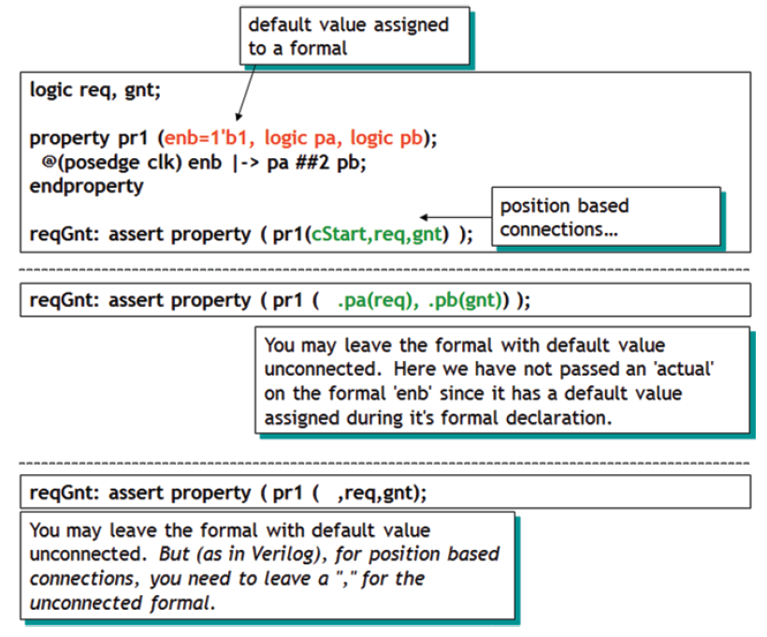
Povezivanje zasnovano na poziciji sa podrazumevanim vrednostima
Notes:
Design engineers normally use an HDL to define the function and the structure of a design under verification (DUV). Specifying a design in the text format of an HDL, an activity called design entry, allows the engineer to document the DUV unambiguously and later execute it as a model in a simulation engine. The HDL version of the DUV is also the basis for the physical implementation of the design. To better support the simulation task, HDLs have features that go beyond the mere description of the design and include the specification of stimulus and checking components, which form an HDL test bench. When we characterize the typical elements of HDLs as design specification tools in this lecture, using VHDL as prime example.
There are a variety of algorithms available to build simulation engines. Because the simulation engine plays such a crucial role in the center of the simulation-based flow, typical architectures of such engines are discussed in this lecture. It is important that verification engineers understand the characteristics of such tools at their disposal. Electronic design automation (EDA) developers build tools such as simulation engines around different sets of tradeoffs, many of which select between accuracy and speed. The verification team must choose those tools that are most adequate for their given project.
Many simulation engines offer an interactive graphical user interface (GUI), which lets the user apply individual stimulus and check commands manually in between simulation steps of the model. Such interfaces, which support a detailed debug mode, are effective mainly on smaller models or very specific debug situations. When working with larger-sized DUVs, the verification engineer lets the simulation engine save the results of a simulation run to trace files, which capture simulated model states over time. As also shown in the figure, waveform viewer tools let the user browse through these results files in various ways, for example, forward and backward in simulation time, to inspect and debug the model behavior in detail.
For many verification tasks, the users do not find the test bench features of the HDL sufficient. Therefore, most simulation engines provide open interfaces that support the application of checks and stimuli from a programming or test bench authoring language.
It is already apparent from the figure that many simulation tools present an interactive GUI to the designer. A very common approach is to integrate the different GUI tasks under one single master GUI, which then gives the user the view of a single integrated HDL and verification development environment even if the implementation underneath consists of separate tools.
All major EDA companies offer many of these tools, often integrated into one GUI framework. The benefit of the Institute of Electrical and Electronics Engineers (IEEE) standardization of the HDLs is that many simulation engines are largely interchangeable with each other. The differentiation comes from simulation speed and value-add features such as the integration of the other simulation tasks: coverage, test bench program support, and user-friendliness for debug.

