Slide 1
Funkcionalna verifikacija hardvera
Predavanje V

Slide 2
Lecture Content
Introduction to UVM
  What is and what is not UVM?
  Verification Methodologies History
  Key Technical Highlights of UVM

Slide 3
Introduction to UVM
Verification Methodologies

Slide 4
What is UVM?
UVM (Universal Verification Methodology) is a methodology for writing modular, scalable, configurable and reusable testbenches, based on verification components with standardized interfaces, for a design that could be written using VHDL, Verilog or SystemC
UVM environment supports migration from directed testing towards Coverage Driven Verification (CDV), which consists of automated stimulus generation, independent result checking and coverage collection
UVM itself is written in SystemVerilog – has a SystemVerilog Base Class Library (BCL)
UVM is a methodology and therefore could be implemented in many different languages, such as:
  SystemC
  VHDL, …

Slide 5
What is not UVM?
Infrastructure offering tests or scenario’s out-of-the-box: all behavior has to be implemented by user
Coverage-based verification templates: application is responsible for coverage and randomization definition; UVM only offers the hooks and technology (classes)
Verification management of requirements, test items or scenario’s is outside the scope of UVM?
Test item execution and regression – automation via e.g. the command line interface or “regression cockpit” is a shell around UVM

Slide 6
Constrained Random Verification I
UVM supports Constrained Random Verification (CRV)
Central idea of CRV is using random vectors in verification, which currently represents the state-of-the-art in the simulation based functional verification
CRV is based on the idea of randomization of at least some element of test vectors that are used during the simulation
There is two key benefits from randomizing test vectors:
Constrained random simulation is great for finding unexpected bugs – if you have to plan all the details of the test vectors that you will use during the simulation, you will only find bugs that you are really looking for. By using CRV you randomize test vectors and therefore push DUT into states you have never thought of.
Automating stimulus generation – this enables running long simulations (for example over nights) without have to manually apply test vectors yourself, they can be generated automatically.

Slide 7
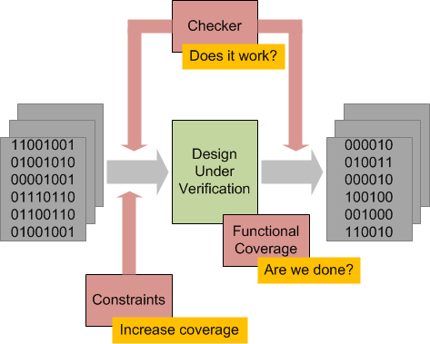
Constrained Random Verification II
How does the CRV work? Answer is CCC – Checkers, Coverage and Constraints.
  Checkers - if you got random vectors its critical that you automate checking, by writing self-checking testbenches
  Coverage – answering the question “Are we done yet?”. Coverage records what is going on during the verification run and identifying how thoroughly we have exercised the design.
  Constraints – if you have “Coverage Holes”, meaning that we haven’t exercised the design thoroughly enough, by using constraints we need to be able to constrain test vectors in order to increase test coverage.
UVM is the methodology that enables all these tasks

Slide 8
UVM is an Industry Standard
UVM is an industry standard
It was developed by Accellera, a standards body of the EDA industry
A lot of “Big Names” of the electronics industry are involved in developing the UVM, like Cadence, Mentor, Synopsys, Intel, AMD, Cisco and Freescale
UVM is pure SystemVerilog code
It is distributed under the open-source license model
It has a comprehensive documentation, comes with complete Reference Manual and User Guide

Slide 9
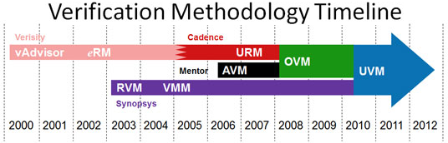
Verification Methodologies History I
The world of verification changed dramatically in 2000, with the emergence of new company Verisity
It invented both a dedicated verification language called e, and the associated e Reuse Methodology
The prescribed rules enabled verification teams to create testbenches that randomized a design’s inputs subject to a set of user-specified constraints
This largely automated the verification process, especially if the tests were self-checking and coverage metrics helped to gauge verification thoroughness
Notes:
Before UVM there were different methodologies which were used in the electronic industry and they mostly originated from the three biggest companies in this field, namely Cadence, Synopsys and Mentor Graphics. One of the first verification solutions came from the Verisity Design (part of Cadence Design Systems, Inc. today) and it saw the light of day in 2000. Its name was vAdvisor and it represented a collection of best verification practices for the e HVL, such as stimulus generation, coverage, self-testing verification environment creation and others, consolidated together into an HTML document.
Soon it was noticed that these practices, even though useful, could be improved by being implemented into a code library, which would accompany the mentioned document and that way boost the acceptance rate and employment of the methodology. Thus, in 2002 Verisity introduced the first verification methodology, the e Reuse Methodology, or eRM shorthand. This methodology consisted of a best practices document, which described packaging guidelines, architecture requirements and many other things, as well as a code library written in e language, which was at that time proprietary. This library possessed implemented monitor, agent and driver models, had sequences, messaging facilities and objection mechanisms and represented the antecedent of modern methodologies, such as OVM and UVM.

Slide 10
Verification Methodologies History II
Synopsys took a similar approach with its dedicated verification language VERA, developing the Reference Verification Methodology (RVM)
When the Accellera language standards organization decided to create SystemVerilog rather than standardize either e or VERA, Synopsys adapted the RVM to the new language
Verification Methodology Manual (VMM) for SystemVerilog, published jointly by Synopsys and ARM, was the spur for rapid evolution in the industry
Mentor Graphics responded with the Advanced Verification Methodology (AVM), which supported both SystemVerilog and SystemC
Notes:
In 2003, Synopsys decided to catch up and revealed its Reuse Verification Methodology (RVM), written for the Vera HVL. The code library contained base classes for the verification components, messaging facilities and some other features, but didn’t support sequences, objection mechanisms, etc. Because of this most users viewed RVM as a subset of eRM. When SystemVerilog appeared and started gaining attention RVM, together with corrections and additions, was converted by the Synopsys company into a new methodology named Verification Methodology Manual or VMM abbreviated. This methodology was formed in 2006 and contained a document of best practices and a proprietary library, and was completely reliant on the evolving SystemVerilog standard.
Realizing the potential of SystemVerilog, Mentor decided to gain ground and in 2006 released the Advanced Verification Methodology (AVM). This methodology, as the ones before, consisted of a collection of best practices and a verification library written in SystemVerilog HDVL. The library brought novelties such as designing verification environments with TLM or transaction level modeling, but left out other high-level constructs, such as the ones seen in eRM. Although AVM didn't represent a high level abstraction methodology it was still significant, because it denoted the first open-source verification solution.

Slide 11
Verification Methodologies History III
Cadence, after initially advocating SystemC for verification, acquired Verisity and transformed the eRM into the Universal Reuse Methodology (URM), which supported SystemVerilog in addition to e and SystemC
Industry convergence began in 2008, when Cadence and Mentor collaborated on the Open Verification Methodology (OVM), notable for being available as open source with simple licensing
When Accellera decided to tackle verification standardization, it selected the OVM as the baseline while including key VMM features. The result is the widely adopted Universal Verification Methodology (UVM).
Notes:
A year before AVM came out Cadence bought Verisity and started developing a SystemVerilog version of eRM. Later, in the beginning of 2007 Cadence unveiled its Universal Verification Methodology (URM). In addition to being open-source, URM used TLM and had a great number of proven eRM capabilities, such as the use of verification components, IP packaging guidelines, sequences, etc. URM brought with itself some new concepts such as the factory, configuration mechanism, test classes, class automation and several other ideas which presented a significant upgrade over the base SystemVerilog capabilities.
In January of 2008, Cadence and Mentor companies joined forces and released a mutual methodology named Open Verification Methodology (OVM). OVM represented the unification of the URM and AVM methodologies, with the URM getting a bigger share, because of its ESL constructs. OVM was the first solution that was supported by more than one of the electronic industry giants. This in itself was a huge step towards creating portable verification environments, which can be executed on different simulators, independent of the vendor. Together with the verification library, examples and documentation, companies that promoted OVM put in additional effort and organized forums and sites on which users of the methodology could inform themselves, share ideas and contribute to the development of OVM. In addition, OVM was the first methodology that supported extensions that enabled communication between three different HVLs, namely SystemVerilog, e and SystemC. This marked the beginning of multi-language verification environment development on RT and ES level. All of these benefits contributed to OVM adoption by a large number of companies, which incorporated it in their hardware design and verification flows. This methodology represented a significant stride towards a goal of a singular methodology and vendor and tool neutrality.
The development of the latest verification solution started in 2009. It was decided that its name would be Universal Verification Methodology (UVM), that OVM 2.1.1 standard would serve as the basis and that it would be developed and promoted by the Accellera organization. Mentor Graphics company decided to join Cadence and Synopsys in the implementation of the new methodology and donated its VMM. The first version of UVM, named UVM-1.0EA, came out in May of 2010. This version represents an early adopter variant, that is, a version which is used for testing and bug correction purposes. The final initial variant of UVM, by the name of UVM-1.0, came out in February 2011, a year after the approval of the Accellera organization. This version includes the UVM standard, class library which implements the aforementioned standard and a UVM User Guide document, which represents guidelines on the correct use of the methodology. UVM-1.0 corrects many bugs of OVM, adds best VMM practices and brings various novelties, such as register modeling, new phase mechanisms, TLM-2.0 implementation for the SystemVerilog language, sequence library, etc. Also, all deprecated features of OVM have been removed and with that the new methodology started with a clean, clearly defined and compacted library.
What makes UVM unique is the fact that at last, after many years, we have a single verification methodology supported by all three giants of the electronic industry. The consequence of this is that a verification environment written for one simulator can be run without modification on another simulator, which means that the code of the testbench is vendor and tool independent. Concerning the history of verification methodologies this is an unprecedented feat. As such, UVM found a large number of supporters and companies, which were ready to adopt it. By being supported by major players in the electronic industry gives smaller companies a dose of confidence in adopting UVM. There also exists a large number of resources, that consists of user content, presentations, documents and forums, which can be accessed by users from the official website. In addition to this, there are various blogs and internet sites that contain tutorials and explanations for the correct UVM use. All of this contributes to better methodology promotion and adoption by the community.

Slide 12
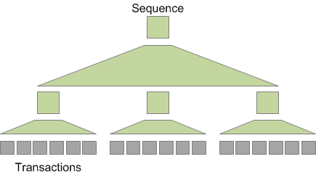
Key Technical Highlights of UVM – Layered Stimulus
UVM features a layered approach to generating test vectors using so-called sequences
Sequence generates transactions, but a sequence is also an object that can be manipulated, so sequences are both a function and an object, so-called function-object
Sequences can be built-up out of other sequences, to have a hierarchical or a layered structure sequences
As sequences get instantiated they can be overridden and controlled in order to constrain precisely the set of test vectors that get generated

Slide 13
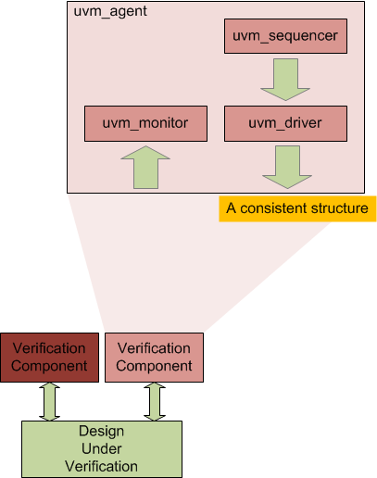
Key Technical Highlights of UVM – Verification Reuse
The other big thing in UVM is verification reuse – reuse of verification components (also called Verification IP)
A testbench for a Design Under Verification (DUV) will be built out of verification components
Those verification components you could build from the scratch, or you might reuse them from previous projects, or can try and buy them
UVM offers standardized, consistent structure for building verification components

Slide 14
Key Technical Highlights of UVM – Verification Reuse
One of those standardized structures is the uvm_agent
Uvm_agent consists from:
  Sequencer - that generates sequences, and those sequences generate transactions that are passed out to drivers
  Driver - that toggles pins of the DUV
  Monitor – that watches interfaces of the DUV, extracts transactions and then sends those transactions to the rest of the verification environment
Consistency, and not reinventing of the wheel, is an important element of the UVM

Slide 15
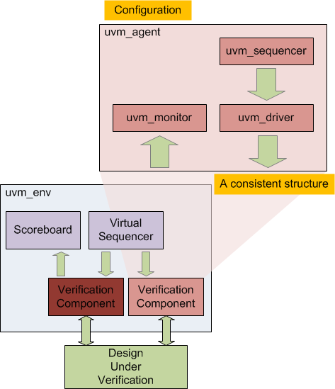
Key Technical Highlights of UVM – Easy Reconfiguration of Verification Components
UVM component gets reused as a part of a bigger verification environment, which is defined by the uvm_env class
As it is being reused it can be configured to the precise needs of that verification environment
One of the big highlights of the UVM is the ability to reconfigure verification components without needing to go in and “hack the source code” of those components

Slide 16
Key Technical Highlights of UVM – Easy Reconfiguration of Verification Components
The verification environment contains a number of standardized structures, including components such as virtual sequencers and scoreboards
Virtual sequencer is a component that coordinates the activity of other sequencers
Scoreboard is a component doing things like collecting functional coverage and checking

Slide 17
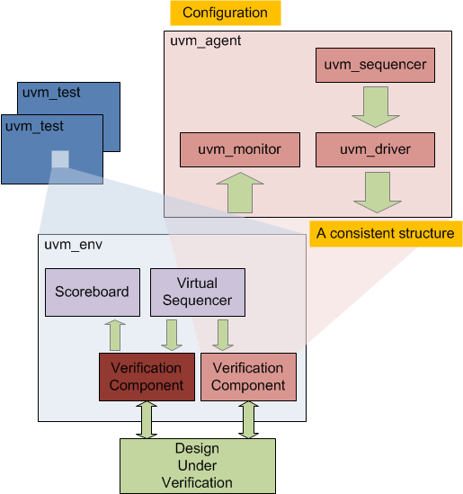
Key Technical Highlights of UVM – Separation of Tests from the rest of Verification Environment
The overall verification environment
in UVM is reused, within the uvm_test class, according to the demands of the specific tests
On of the features of UVM is the separation of test from the rest of reusable verification environment
Again, the same kind of configuration mechanism can be applied, to reuse verification environment for individual tests
There are a couple of ways to do that. One is the resource database – this
is a general way of reusing resources between the UVM components

Slide 18
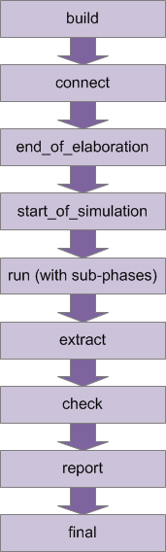
Key Technical Highlights of UVM – Standardized Execution Phases
There is also a standardized set of execution phases in UVM
Build phase – builds the hierarchical structure of the components
Connect phase – connects together ports on those components
Build and connect phases together are bit like elaboration phase in VHDL and Verilog
Then comes couple of “House Keeping” phases: end_of_elaboration, start_of_simulation
Run phase follows, where the dynamic things happen, and sequences execute
After the Run phase, there is a number of “House Keeping” phases to tidy things up: extract, check, report and final

Slide 19
Key Technical Highlights of UVM – Other Features
UVM also supports Transaction Level Modeling and communication, which is borrowed from SystemC
Message reporting – with possibility of easily controlling the verbosity of generated reports
End-of-test mechanism, also known as “objections”, so each component raises an objection when it is busy, and drops it when it is finished
Register Layer – which is borrowed from VMM Register Abstraction Layer

