Slide 1
Funkcionalna verifikacija hardvera
Predavanje VI-VII

Slide 2
Lecture Content
Strategies for Simulation-Based Stimulus Generation
  Calc2 overview
    Calc2 specification
    Calc2 verification plan
  Strategies for stimulus generation
    Types of stimulus generation
    General algorithms for stimulus components
    Applying four types of stimulus generation to Calc2
    Seeding random test cases
    Constraint solving in random environments
    Coverage techniques in random environments
    Making rare events occur

Slide 3
Strategies for Simulation-Based Stimulus Generation
Calc2 Overview

Slide 4
Introduction
Complex designs require robust stimulus generation components. Together with the checking components, stimulus generation is critical for discovering design problems. This lecture describes methods for creating simulation-based stimulus generation in complex designs.
This lecture introduces four corners of stimulus generation, which range from deterministic to random generation and from predetermined to on-the-fly verification environments. This lecture should enable the reader to plan a stimulus environment that appropriately matches the requirements of the design under verification.
When devising a stimulus environment, the verification engineer must understand the interrelationship of events and interface activity on the DUV. Often, the design places restrictions on the inputs, requiring intelligence in creating stimulus components. This is called constraint solving and is an integral part of complex stimulus generation. This lecture describes the process for evaluating design constraints and the methods for properly tuning the stimulus components to exploit these constraints.
No stimulus component is complete without coverage feedback, which provides invaluable insight into the quality of the stimulus components by highlighting areas of the design that the components have not exercised. Without coverage, the verification team can only speculate on the scenarios the stimulus components create. With coverage, they know for sure. This lecture demonstrates coverage’s use to tune stimulus generation.

Slide 5
Calc2 Overview
The Calc2 design builds on the Calc1 example detailed earlier.
On the surface, Calc2 has just a single, relatively simple specification change over Calc1. However, the change adds substantial complexity to the design.
The Calc1 design allowed only one command from each of the four port requestors at a time. All ports needed to wait until the calculator completed execution of the current command before sending another command.
In the new design, the port requestor can send up to four commands into Calc2 from each of the four ports. Hence, this calculator could (theoretically) work on up to 16 commands at a single time.
To correlate the responses to the correct commands, the specification calls for adding a 2-bit tag to the input and output protocols. This tag shall be a unique identifier for each of the commands from each port.
Notes:
This single design change has major implications to the system. Because there are two internal arithmetic pipelines in the calculator (one for add/sub and one for shifts), it is possible for commands sent from a single port to be executed out of order. For example, if all four ports send in three add commands followed by a shift command, the calculator is likely to execute the shift commands before the older add commands. However, the specification dictates that commands from the same port that use the same pipeline (add/sub or shift) must return in order.
To correlate the responses to the correct commands, the specification calls for adding a 2-bit tag to the input and output protocols. This tag shall be a unique identifier for each of the commands from each port. Therefore, each port requestor must keep track of the outstanding tags it has sent to the DUV to ensure that it never allows duplicate tags.

Slide 6
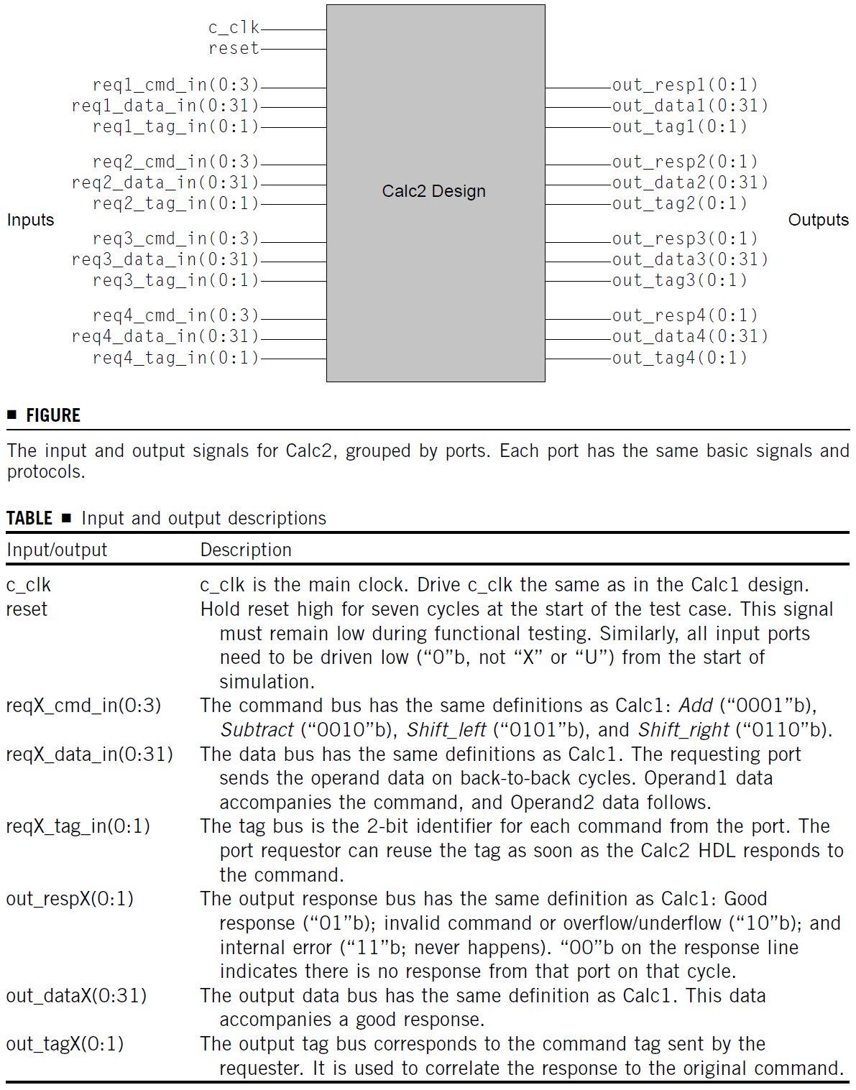
Calc2 Specification and Details of HDL Design
Figure shows the input and output description of Calc2. Table describes each of the input and output busses.
In Calc1, the HDL design merely had to latch the single incoming command from a given port and hold it until the priority logic forwarded the command to the adder or shifter ALU.
The Calc2 design requires a more complicated structure. Now, the HDL design must implement a pair of queues to hold multiple commands.
Rather than creating four individual queues for each port, the HDL implementation uses two queues, one for each ALU.
As the port requestors issue commands, the Calc2 logic places the commands and data into either the add/sub queue or the shift queue.
This guarantees the integrity of the order of operations because the HDL design places new commands directly into the queues as it receives them.

Slide 7
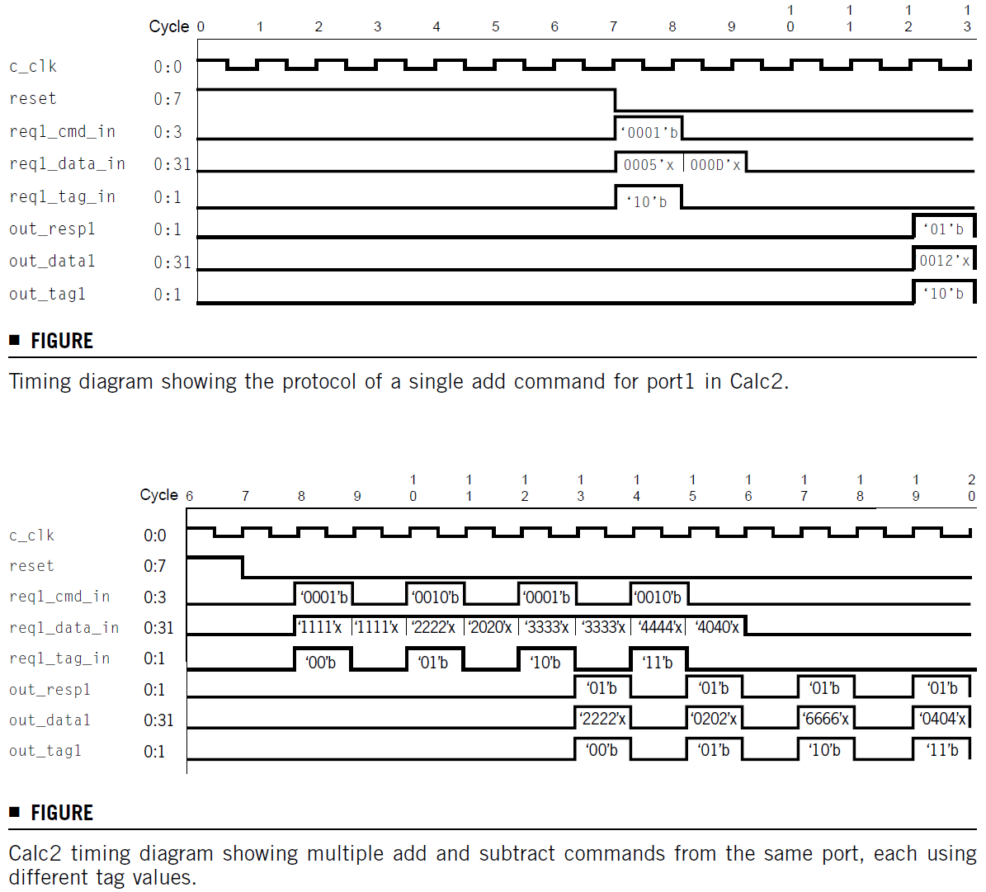
Calc2 Timing Diagrams
Although a port can now send up to four commands without receiving a response, the port requestor cannot send these commands in four consecutive cycles.
This is because each command still requires two cycles to send both data operands.
Top figure shows the timing of a single add command on port 1, and the bottom figure shows multiple add and sub commands from port 1.
Note that in the bottom figure, each command uses a different tag value.
Notes:
Because all of the commands in bottom figure are adds and subtracts, this sequence only uses one of the two ALUs. As a result, the commands return in the same order that they were initiated. If other ports were to send commands, it would be possible for a single port not to receive responses on back-to-back cycles. This would give a far less predictable response timing compared with in bottom figure, where the responses come every-other cycle.
Finally, there are some non-obvious implications of the changes to the design. Often, these implications are not in the specification, and the verification engineer realizes interesting cases only after simulation starts. A good example of this occurs in Calc2. The combination of parallelization of commands across two execution pipelines and multiple commands from a single port creates the potential for very interesting special cases, also called window conditions. Given the right state of the queues when commands arrive from a single port, it is now possible that the next command in both the add and shift queues is from the same port requestor. If the priority logic dispatched both commands simultaneously, the results from the adder ALU and the shifter ALU would collide at the output driver. To avoid this bug, either the priority logic must prevent the simultaneous dispatch of commands from the same port, or the output driver logic must be able to serialize the responses. In any case, the verification engineer must ensure that the stimulus component creates this special case during simulation and should document this in the verification plan.
The potential for this type of problem exists in most of today’s designs. During the test plan development phase, the verification engineer must hunt for these scenarios. The key characteristic in these cases is resources shared across multiple paths.

Slide 8
Strategies for Simulation-Based Stimulus Generation
Calc2 Verification Plan

Slide 9
Calc2 Verification Plan
Calc2 presents a greater verification challenge than does Calc1.
Multiple outstanding commands, which can complete out of order, require a more sophisticated environment than do the deterministic driving and checking mechanisms used in Calc1.
Because each port can send four commands, the variability on the interface timings increases such that the verification engineer needs to build an automated, programmed environment.
With all the possible timings between four commands and four operations across four ports, the state space explodes to a point that the verification engineer cannot conjure up all of the necessary permutations manually.

Slide 10
Description of Verification Levels
Full verification of Calc2 requires two levels of verification. We will focus this verification plan on the top level.
However, in a real project, the verification work would include unit-level plans for the priority logic, which is substantially more complicated than in Calc1.
The verification team might consider unit-level verification for the two ALU units.
However, in this case, Calc2 reuses both the add and shift ALUs from the Calc1 design.
It is common in the design world to carry forward design blocks from previous projects. This makes both the design and verification job easier.

Slide 11
Required Tools
Calc2 has the same simulation engine and license requirements as does Calc1.
However, the added complexity of Calc2 requires a programming or high-level verification language (HVL) infrastructure.
If multiple people share the verification effort, this infrastructure must include a code revision tool (Git, Subversion - SVN, CVS, etc).
This allows the verification team to control the data management of the environment code via check-in and check-out from a centrally shared repository.

Slide 12
Risks and Dependencies
As this is a course exercise, there are none of the risks associated with normal industry products.
In industry, this project might have risks such as not obtaining the required verification staffing or the lack of on-time delivery of HDL.
Similarly, most of the dependencies inherent in industry designs do not enter into this exercise.
Under normal conditions, the verification plan would explicitly state the following dependencies:
  Verification of the unit-level priority logic depends on the delivery of its specification.
  Chip-level verification depends on the completion of the unit-level verification.
  Tool and license availability.

Slide 13
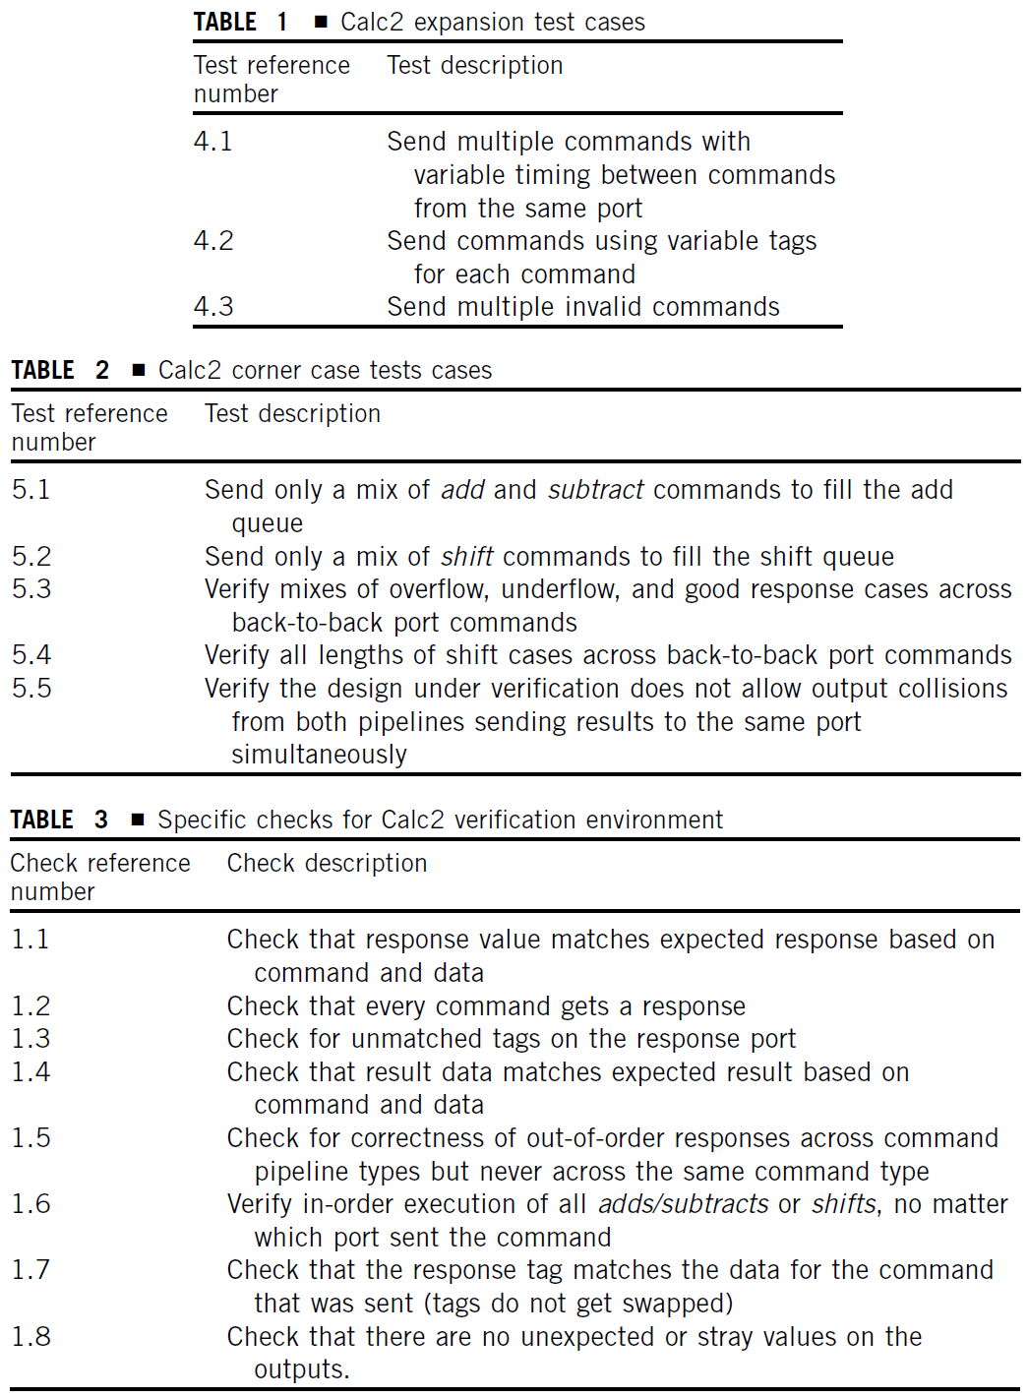
Functions To Be Verified
The verification engineer must verify the following functions in addition to those listed for the Calc1 exercise.
This verification listing builds on the tests presented earlier for Calc1 (see Lecture about the verification plan). Therefore, the tests in Tables 1,2 and 3 on the slide 22 serve as the foundation for the Calc2 test matrix.
Table 1 lists the first set of expanded test cases required for Calc2. The test case reference numbers begin with the number 4 because the Calc1 set of tests (tests 1 through 3) serve as the base for Calc2.
In addition, there are interesting corner cases that the verification environment must create. Table 2 describes these cases.
The checking for Calc2 must verify that the design handles multiple interesting cases, along with the basic command-data-response checking. Table 3 shows some of the required checks.
Notes:
Note that this test plan calls for verifying all lengths of shift operations, but not all different add or subtract operands. This is because there are just 32 different possible shift operand2 values, whereas there are 2³² different add/sub operands.

Slide 14
Specific Tests and Methods: Environment I
The Calc2 verification environment will take a grey box approach.
All stimulus generation will occur at the top-level interface, driving the specified Calc2 inputs.
Although most checkers and monitors will also be at the top level, some verification code will peek inside the DUV. Specifically, we have already stated in the test plan the desire to fill the queues, indicating a case for monitoring the internal state of the queues.
The Calc2 design goes beyond the limits of the capability of deterministic verification.
Therefore we choose a random-based environment for this design.
Construction of the stimulus initiators for any random environment should allow a bypass for deterministic verification.
For Calc2, early simulations should be restricted to simple scenarios to verify the most basic functions of the DUV. The random controls will allow deterministic scenarios.
Notes:
Randomization controls will enable the test case automation to choose command and data values rather than placing the burden on the test case writer. This provides a level of abstraction and a broader range of data and control stimulus. However, the environment needs the ability to limit, or constrain, the randomization, so that the verification engineer can steer the test case into interesting cases. The following inputs to Calc2 must allow for constrained random values:
Operand data
Command types
Tag values
Delay between commands
The environment duplicates these randomization controls for each port, allowing for independence across the requestors. Furthermore, the mechanism to choose the values must have a bias control (parameterized-random) to give the verification engineer influence over the statistical distribution of the values. This will allow control over such cases as the percentage of invalid commands sent in a particular test case.
The need for constrained random input values (versus pure random) is required on the tag values. The stimulus initiator may pick any tag value for a given port as long as that value is not already in use. Therefore, the stimulus initiator must have access to the record of outstanding tags, and must constrain itself to choosing unused tags.

Slide 15
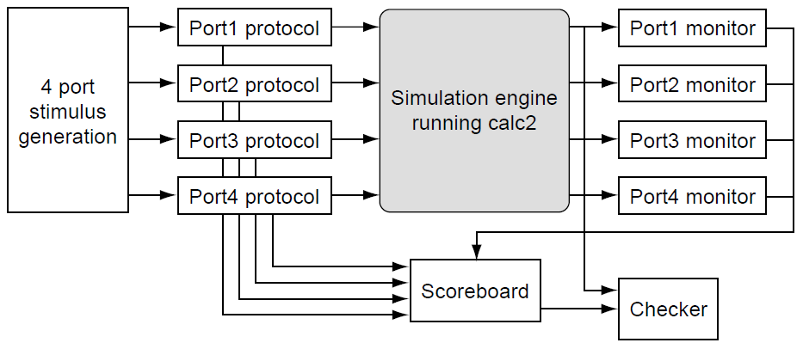
Specific Tests and Methods: Environment II
The Calc2 environment will use the packet level of abstraction.
The stimulus initiator for Calc2 will consist of two parts.
  The first is a random, packet-level stimulus generator. The “brains” of the stimulus initiator, the stimulus generator creates the packets, keeps track of port and tag availability, and posts inputs to the scoreboard.
  The second part is the interface protocol driver. This routine is the slave to the packet generator and converts the packets into the bit-level interface protocols. The verification environment will instantiate the protocol driver four times, once for each port.
The verification environment for Calc2 will use the transaction-based approach to checking. The transactions correspond to the packet-driven stimulus.
As with the stimulus, the environment will perform checking at the packet level. The checking component on each port follows a simpler, but similar model to the stimulus generator.
Notes:
The Calc2 environment will use the packet level of abstraction. The stimulus initiator for Calc2 will consist of two parts. The first is a random, packet-level stimulus generator. The “brains” of the stimulus initiator, the stimulus generator creates the packets, keeps track of port and tag availability, and posts inputs to the scoreboard. The second part is the interface protocol driver. This routine is the slave to the packet generator and converts the packets into the bit-level interface protocols. The verification environment will instantiate the protocol driver four times, once for each port.
The verification environment for Calc2 will use the transaction-based approach to checking. The transactions correspond to the packet-driven stimulus. Each transaction is a single command, tag, and data operation sent by the stimulus initiator. This method was chosen over a cycle accurate reference model approach because the cycle accurate reference model approach would require cycle accurate output predictions, which complicates the verification code beyond the requirements. Predicting the exact cycle of each Calc2 response is a cumbersome task that requires constant tuning with each change in the HDL. Our transaction-based approach verifies the correct answers for all operands, as well as the correct ordering of responses. Initially, the transaction approach might provide less accurate checking capability than does the cycle accurate reference model. However, the verification engineer can easily bolster the transaction-based approach by maintaining latency statistics (measurements of how many cycles each operation took). These statistics verify that the Calc2 pipeline has no unexpected stalls or delays, while bypassing the coding overhead of a cycle accurate reference model.
As with the stimulus, the environment will perform checking at the packet level. The checking component on each port follows a simpler, but similar model to the stimulus generator. One routine will package the response and data coming out of the DUV, and the second routine checks that the values are correct according to the data in the scoreboard. The output-checking component must verify all of the checks outlined in Table 3 from Slide 13.
In addition, the checking routine must inform the stimulus initiator (via the scoreboard) when tags are made available.
Finally, a monitor must track the state of the two queues. The verification team will use this information for coverage feedback, as well as checking that the queue does not overflow.

Slide 16
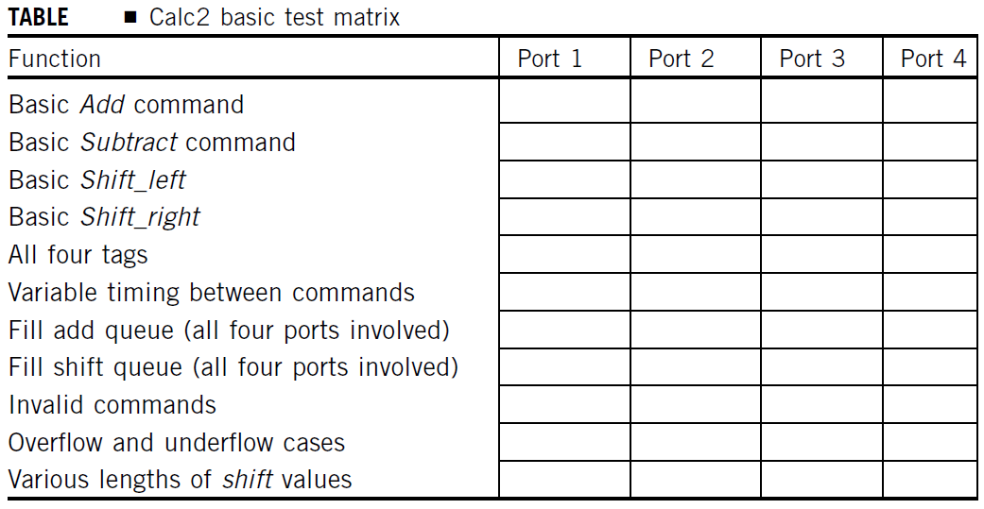
Test Scenarios: Matrix
Early verification of Calc2 should constrain the environment’s randomization parameters such that it drives the basic functions identified in the test plan.
Table shows a test matrix for the basic functions.
The verification team checks off each box of the matrix as test cases complete.
The team runs most of the basic tests (except those denoted) on a port-by-port basis.
Notes:
As a few deterministic test cases complete successfully, the verification team starts to remove constraints from the environment’s randomization controls. This allows the stimulus components to create a wider variance of cases simultaneously across all four ports. In practice, a verification team will migrate from the deterministic tests to an unconstrained environment. As the test cases become less constrained, the team uses coverage statistics to track the test matrix as well as other interesting scenarios. The following section of the test plan documents the tracking of the interesting cases performed under this method.

Slide 17
Coverage Requirements
The preceding test matrix articulates the most basic set of test case scenarios for Calc2.
This is not enough to guarantee that the verification team fully exercises the HDL.
Because of the many permutations of interesting events, Calc2 requires tracking functional coverage.
This section of the test plan suggests only a few of the many functional coverage models for Calc2.
  Model 1: Number of commands in each queue.
  Model 2: Number of concurrent invalid commands.
  Model 3: Permutations of ports at the top of each queue.
Notes:
The preceding test matrix articulates the most basic set of test case scenarios for Calc2. This is not enough to guarantee that the verification team fully exercises the HDL. Because of the many permutations of interesting events, Calc2 requires tracking functional coverage. This section of the test plan suggests only a few of the many functional coverage models for Calc2. The creation of further functional coverage models, including those dealing with tags, ports, command sequencing, and data ranges, are given as reader exercises.
Model 1: Number of commands in each queue. This model has an initial set of combinations of 17 * 17 = 289. This space is based on the total number of commands that each queue can hold (0 to 16). However, 136 of the permutations are illegal—those in which the total number of outstanding commands is greater than 16. Hence, the legal set of combinations for this model is 153.
Model 2: Number of concurrent invalid commands. The verification plan dedicates most of the Calc2 stimulus to valid commands. However, it would be interesting to track that the stimulus components send multiple invalid commands concurrently across all four ports. This model has a theoretical size limit of 17 (0 to 16 concurrent invalid commands). But because the Calc2 DUV responds quickly to invalid commands (they bypass the ALUs), it is unlikely that it is possible to have a large number of concurrent invalid commands.
Model 3: Permutations of ports at the top of each queue. This model tracks which port sent the commands on the top of the two internal queues. The model size is 5 * 2 = 10, based on the five possible port values (four ports plus the case of an empty queue) on the top of two queues. All cases are legal. Of particular interest are the cases in which both commands at the top of the queues are from the same port.

Slide 18
Resource Requirements
For the Calc2 exercise, the resource requirements call for either one or two verification engineers.
If two people work on the project, one should construct the stimulus components while the other writes the checking components.
Because both components require access to the scoreboard, either engineer can write the scoreboard function.
The compute resources call for a single workstation on which the simulation engine runs.
This project also requires other basic simulation-based tools, such as the debugger, a compiler (for either the programming language or the HVL), and a simulation engine.

Slide 19
Schedule Details
Depending on the experience level of the verification engineer, the Calc2 project will take between 15 and 40 hours of work by a single person. Existence of an initial code skeleton can significantly reduce the work.
This schedule is derived by breaking the work into its parts. The verification engineers will dedicate significant time to
  environment development and
  to DUV debug.
We can break the environment development down into individual components, consisting of the stimulus, checking, and scoreboard components.
The scoreboard component is the simplest of these because it is a table driven by the stimulus and checking routines. The stimulus and checking components should take from 5 to 10 hours of coding each. Here, the verification engineer will focus on a single port and copy most of the code for the other three ports.
The debug schedule for Calc2 will vary based on the quality of the stimulus, checking, and error messages within the environment. With a quality environment in place, a verification engineer should be able to identify and debug Calc2 within 5 hours.

Slide 20
Calc2 and the Strategies for Stimulus Generation
The Calc2 test plan specifically calls for a random-based environment and a grey box approach.
However, to illustrate the multiple strategies for stimulus generation, the Calc2 design will be used as a sample for each stimulus paradigm.
Although a random-based environment is indeed the best fit for Calc2, it is feasible to verify portions of the DUV by using the various strategies described in the next section.

Slide 21
Strategies for Simulation-Based Stimulus Generation
Strategies for Stimulus Generation

Slide 22
Types of Stimulus Generation
Verification can never compete with the number of cycles that the real hardware will encounter. In just a few seconds of runtime, the real hardware will exceed the aggregate number of simulation cycles run under verification.
To battle these odds, the verification team needs a robust strategy for creating stimulus for the relatively small number of available simulation cycles. The fundamental mantra behind the strategy is to stress the hardware more vigorously during every simulation test than it will ever be stressed again.
Therefore, the verification team must take this approach to heart at each level. The lower levels of verification must create more stress on the smaller pieces of the design than the next levels will create on the aggregate of the smaller pieces. If this holds true, then each higher level of verification should uncover only those bugs caused by stitching logic together. The verification team should find bugs internal to a single portion of logic at the lowest level that contains that portion.
We have stated that finding these bugs requires a coordinated effort between stimulus creation and checking.
The verification test plan articulates the proposed verification environment for each level in the hierarchy. During that planning phase, the verification leaders make basic choices on stimulus generation. Two of the most fundamental decisions are:
  Deterministic versus random stimulus generation
  Pregenerated test cases versus on-the-fly test case generation
Notes:
Verification can never compete with the number of cycles that the real hardware will encounter. In just a few seconds of runtime, the real hardware will exceed the aggregate number of simulation cycles run under verification. Yet the customer expects the verification “warrantee” to last the life of the machine. Therefore, from a practical standpoint, every verification effort is handicapped by a limited number of simulation cycles across a short delivery schedule.
To battle these odds, the verification team needs a robust strategy for creating stimulus for the relatively small number of available simulation cycles. The fundamental mantra behind the strategy is to stress the hardware more vigorously during every simulation test than it will ever be stressed again. This mantra holds when comparing stimulus stress across different simulation levels or during the lifetime of the part. The verification suite must contain more permutations, drive more interactions, and create more extraordinary cases over a short period of cycles than will be encountered in normal program or application activity. The ability to drive intricate scenarios is more acute at the lowest levels of simulation. When dealing with smaller portions of HDL, the verification engineer can control more of the internals via the input signals. Furthermore, at the lower levels of verification, the test suite is more likely to exercise a higher percentage of the entire HDL state space, as the total size of the state space is comparatively small. As the size of the design grows to the system level, it becomes more challenging for the verification engineer to overstress internals of the design and hit odd permutations.
Therefore, the verification team must take this approach to heart at each level. The lower levels of verification must create more stress on the smaller pieces of the design than the next levels will create on the aggregate of the smaller pieces. If this holds true, then each higher level of verification should uncover only those bugs caused by stitching logic together. The verification team should find bugs internal to a single portion of logic at the lowest level that contains that portion.

Slide 23
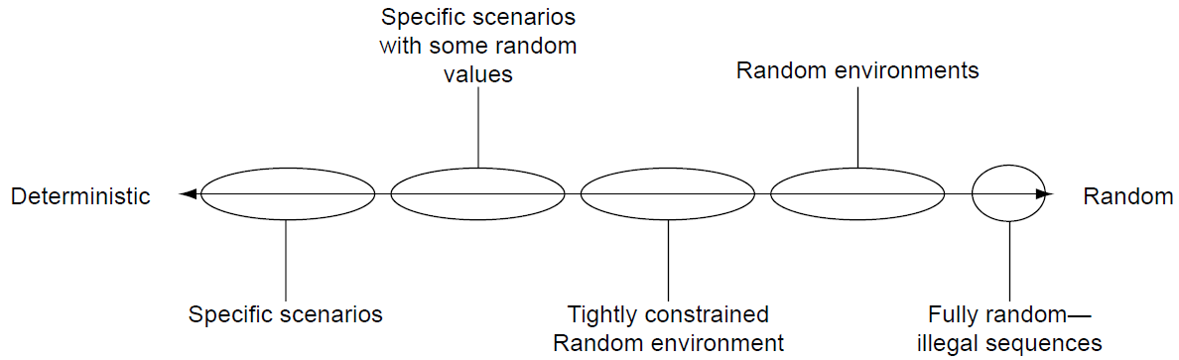
Deterministic Versus Random Stimulus Generation
Deterministic tests create specific scenarios that the verification engineer wants to see. The scenarios are “determined” before running the simulation.
Random environments contain stimulus generation components that use pseudorandom number generators and probability tables to make decisions on input stimulus.
There is a broad range of possibilities between deterministic and completely random input stimulus. Figure shows the range of stimulus generation between deterministic and random.
Most verification plans initially call for deterministic test cases. After the basic scenario test cases pass successfully on complex DUVs, the verification team will enable random generation to hit more of the state space. Therefore, testing tends to go from left to right on the axis shown in the figure.
The range of stimulus generation goes from deterministic or specific scenarios on the left to fully random sequences on the right. Verification engineers choose a mix of the extremes for their specific environment, depending on the test plan and design under verification requirements.
Notes:
Deterministic tests create specific scenarios that the verification engineer wants to see. The scenarios are “determined” before running the simulation.
Random environments contain stimulus generation components that use pseudorandom number generators and probability tables to make decisions on input stimulus. The verification team programs intelligence about the DUV protocols into the stimulus components to limit the input scenarios to legal scenarios. The probability tables, which the verification engineer may adjust before runtime, bias the components’ decisions on what inputs to send and how often to send them.
Most verification environments avoid completely random stimulus generation. In most cases, completely random stimulus does not adhere to the DUV’s input protocols, rendering illegal scenarios. Therefore, random environments generally use constraints to limit scenarios to the legal subset of the input space.
There is a broad range of possibilities between deterministic and completely random input stimulus. Even in deterministic environments, verification engineers routinely use pseudorandom number generation to create data. Conversely, verification engineers can tightly constrain random environments to create specific, nearly deterministic sequences. Figure shows the range of stimulus generation between deterministic and random.
Most verification plans initially call for deterministic test cases. After the basic scenario test cases pass successfully on complex DUVs, the verification team will enable random generation to hit more of the state space. Therefore, testing tends to go from left to right on the axis shown in the figure.
The verification team defines the deterministic tests based on scenarios they can conceive. However, there are too many cases beyond the bounds of the team’s imagination and time constraints to verify without the use of automated, programmed environments. This is where random environments help. Random environments with constraint directives are effective at hitting a wide range of stimulus, which tends to find many bugs in areas that the engineer did not consider. The key is to have programmable constraints and enough compute resources for the random environment to explore the interesting state space.
In the early stages of verification, when the DUV and the test environment are relatively unstable and incomplete, the team will use the biasing parameters to constrain the environment so that the simulation is effectively a directed test. Later, when the design is more stable, the team relaxes those constraints.
Any time the stimulus components use random approaches, coverage metrics guide the team to search in untouched corners of the design. After all the simulation cycles, the coverage data may point to specific corners of the design’s state space that the test suite has not exercised. Here again, it may be necessary for the team to write deterministic test cases to cover the holes.
Across each level of the verification hierarchy, the verification team needs to decide their strategy on deterministic versus random stimulus generation. At the lowest levels, deterministic test cases may cover the entire interesting state space. As the design size grows, the team will need to incorporate more and more randomization controls to hit the broad spectrum of input possibilities.

Slide 24
Pregenerated Test Cases Versus On-The-Fly Test Case Generation
Pregenerated test cases are those in which the input stimulus and output checking exist before running the simulation job.
The alternative to predetermined test cases are those created on-the-fly, or while the simulation job is running.
On-the-fly test cases use input constraint directives to create stimulus and make decisions on a cycle-by-cycle basis.
At first glance, there appears to be a one-to-one relationship between predetermined test cases and deterministic test generation.
Similarly, random stimulus generation appears to have a tightly coupled relationship with on-the-fly generation.
However, this is not the case.
Notes:
Pregenerated test cases are those in which the input stimulus and output checking exist before running the simulation job. The verification engineer can read the test case and know exactly what it will do. These tests drive very specific scenarios. The stimulus creates unambiguous cases in the DUV such that the verification engineer can pregenerate the checking as well.
The alternative to predetermined test cases are those created on-the-fly, or while the simulation job is running. On-the-fly test cases use input constraint directives to create stimulus and make decisions on a cycle-by-cycle basis. These environments require a high amount of programmed intelligence in the stimulus components. Each cycle, the stimulus component makes decisions about what stimulus it will send for this cycle. The programmed intelligence within the stimulus component knows the legal input choices for a given cycle. The stimulus component will continue to send multicycle commands or data initiated on previous cycles and decide whether to initiate new commands. The constraint directives guide these decisions, allowing the verification engineer to control each test case to the desired level. The verification team uses the scoreboard or a cycle accurate reference model to communicate the generated stimulus to the checking components.
At first glance, there appears to be a one-to-one relationship between predetermined test cases and deterministic test generation. Similarly, random stimulus generation appears to have a tightly coupled relationship with on-the-fly generation. However, this is not the case. Predetermined and on-the-fly define when the verification team creates the test case with respect to the simulation run. Alternatively, deterministic and random define how the verification team creates the test case. It is common to generate predetermined, yet random test cases. For example, there are complex programs, called test case generators, that use bias-control input parameters and random number generators to create predetermined test cases. Good test case generators may create hundreds of different predetermined test cases from a single template (a single set of bias parameters). Each of these test cases differs, depending on the parameters and the initial value used to seed the random number generator.
On the other end of the spectrum, deterministic tests can use some on-the-fly generation to drive inputs less critical to the test case intent. For example, a test case written to verify control logic may use on-the-fly generation for data packets. This style uses the same scoreboard checking techniques as a randomly generated, on-the-fly test case.

Slide 25
Four Paradigms of Stimulus Generation
For this discussion, deterministic-leaning test cases are defined as those written to test a specific scenario but may have randomization on some data or timings.
Random-leaning test cases are defined as those with the freedom to create differing scenarios based on the pseudorandom numbers in the generation programs.
By using those definitions, figure to the right describes the four paradigms of input generation controls that result from the cross between pre-generation versus on-the-fly generation and deterministic-leaning versus random-leaning test cases.
Notes:
For this discussion, deterministic-leaning test cases are defined as those written to test a specific scenario but may have randomization on some data or timings. Random-leaning test cases are defined as those with the freedom to create differing scenarios based on the pseudorandom numbers in the generation programs. By using those definitions, figure to the right describes the four paradigms of input generation controls that result from the cross between pre-generation versus on-the-fly generation and deterministic-leaning versus random-leaning test cases.
There are appropriate times to use each of these four paradigms, as there are pros and cons to each. Pre-generated, deterministic tests are appropriate for designs with very few input signals or a small internal state space. This style of test case provides exact scenarios and precise control. Pre-generation (either deterministic or random) provides the verification team with a library of tests with a known set of input scenarios - what you see is what you get. However, pre-generation does have drawbacks with its inability to use the current state of the design to tailor the input stimulus. Pre-generated tests often use the most conservative input timing to control sequences in order to avoid creating illegal input scenarios. To avoid these over-constraint cases, verification engineers couple pre-generation with some on-the-fly capabilities. Pre-generation also requires maintenance over the life of the test case library as the design and specification changes. For these reasons, verification teams continue to migrate toward on-the-fly generated test cases, as evidenced by the growing popularity of HVLs that provide these capabilities.
Although the functional capability of the test case generation is the most important factor when choosing a test case type, the verification team must consider two other factors: memory usage and simulation performance. Both of these factors contribute to the verification team’s ability to run test cases on their simulation engines. Simulation engines run on general-purpose computers (e.g., workstations), which have large but finite memory. On-the-fly generation techniques tend to use more memory as the test case environment must save the generated input (usually in the scoreboard or in a cycle accurate reference model) during simulation until the transaction or command completes. Pre-generation does not have this problem as the generation program and simulation run at different times.
The throughput (performance) of their verification suite is also a concern for the verification team. Here, the choice is between when the generation work occurs - either before the simulation job (pre-generation) or during the simulation (on-the-fly). A pre-generated test case will complete slightly faster than an on-the-fly test case running the same number of cycles against the same design because on-the-fly test case generation takes additional runtime workstation horsepower. However, verification teams often accept this trade-off because of the abundance of workstations and the additional capabilities of on-the-fly generation.

Slide 26
General Algorithms for Stimulus Components
No matter which stimulus generation paradigm the verification team chooses, the stimulus components, and especially the protocol component, use a similar algorithm for basic input transactions.
The differences occur in step 3, listed below, when the environment initiates a new transaction or input sequence.
Stimulus generation programs follow this general decision-making order:
  1. Check for global environment changes such as resets.
  2. Continue required stimulus initiated on previous cycles.
  3. Check if DUV can accept new stimulus and, if so, initiate based on generation paradigm.
Figure shows a flow chart of this generalized decision-making algorithm.
A stimulus generation component’s general decision-making algorithm for the beginning of each cycle.
Notes:
The flow chart shows only a single action on any given cycle. However, some DUV protocols may allow multiple actions in a single cycle. In that case, the order still holds, but the program may jump to the next decision after performing an action block.
If the environment takes the “Y” branch of the “new action allowed” decision block, the source of the “generate new stimulus” block in the figure is the test case in a pre-generated paradigm, or a randomly chosen command in an on-the-fly paradigm. In both cases, the protocol component drives the inputs based on the new stimulus, applying the correct transaction protocols.
Stimulus responder components follow a slightly different algorithm, as these routines never initiate an action. Instead, the stimulus responder reacts to actions from the DUV. Stimulus responders follow this general decision-making order:
1. Check for global environment changes such as resets.
2. Continue response sequences for previous activity/requests from the DUV.
3. Initiate new response sequence for activity/requests that just occurred from the DUV.
Again, step 3 for stimulus responder components depends on the generation paradigm. In pre-generated tests, the stimulus responder sequence’s source is the test case. In on-the-fly generation, the stimulus responder component may randomly choose a response based on the test case constraints or parameters.

Slide 27
Strategies for Simulation-Based Stimulus Generation
Applying Four Types of Stimulus Generation to Calc2

Slide 28
Applying the Four Types of Stimulus Generation to Calc2
The Calc2 test plan called for the verification effort to use a random environment.
Nevertheless, for illustration purposes, we will step through an implementation of each of the generation paradigms using the Calc2 design as an example.
Rather than look at the entire design, the focus will be on a single port and the logic sequence and state transitions for that port.
In all cases, the verification team must replicate the stimulus generation for a single port across the other three.
Figure shows the flow control for a single Calc2 input port.
The stimulus generation algorithm for a single port on Calc2. The stimulus component uses this algorithm at the start of each cycle.
Notes:
The Calc2 test plan called for the verification effort to use a random environment. Nevertheless, for illustration purposes, we will step through an implementation of each of the generation paradigms using the Calc2 design as an example. Rather than look at the entire design, the focus will be on a single port and the logic sequence and state transitions for that port. In all cases, the verification team must replicate the stimulus generation for a single port across the other three.
Figure shows the flow control for a single Calc2 input port. Each port’s input flow feeds the Calc2 priority logic via the ADD_SUB queue and the SHIFT queue. Inputs to the port logic include the command, operand data, and tag lines. Outputs include the controls to write to the shift and add queues (which are located in the neighboring priority logic design). Other outputs are the signals that bypass the priority logic in the case of invalid commands. There are also environmental internal state machine controls that indicate that the stimulus component sent an add or shift command during the previous cycle. These controls allow the stimulus component to send the second operand data.
The different shading after major decisions indicates a state that the stimulus generation component enters. Consistent shading across the figures is used in this section to indicate the choice of shift commands, add commands, illegal commands, idle cycles, resets, and the second cycles for sending both add/sub and shift commands.
A major decision in the figure is the “new command?” choice. This decision first requires knowledge of whether or not the stimulus component sent a command on the previous cycle and if there are already four outstanding commands from this port. If either is true, then the “N” branch of “new command?” must be taken. If both cases are false, there is still the decision of whether or not to send a new command on this cycle. If we choose not to send a new command, the stimulus component will drive idle values on the inputs. Otherwise, the stimulus component will take the “Y” side of the “new command?” decision block and initiate a new command.

Slide 29
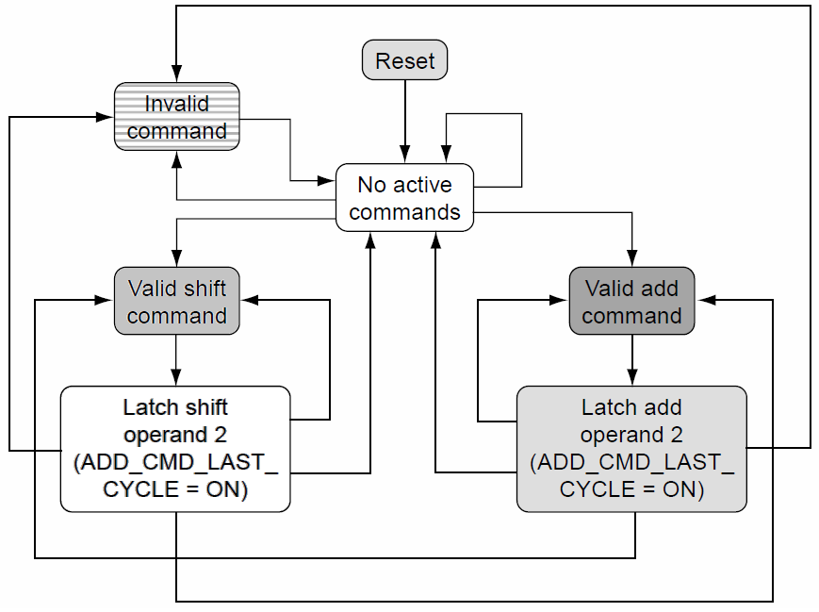
Stimulus Generator Algorithm’s State Machine
The flow control shown in the figure in the previous slide translates to the state machine diagram shown in figure on the right.
This diagram indicates the legal transitions across six state FSM machine in addition to the reset state.
Because the design can enter the reset state at any time, all states have an implied (not pictured) transition back to the reset state.
The state machine diagram shows the two-cycle input sequence required for all add, subtract, shift left, or shift right commands.
The Calc2 single port stimulus generation algorithm’s state machine diagram.
Notes:
Because the design can enter the reset state at any time, all states have an implied (not pictured) transition back to the reset state machine. All other transitions not explicitly shown are illegal input sequences. For example, no valid command can follow an invalid command, as the protocols require that the cycle that follows a command (valid or illegal) be a null command. Therefore, it would break the protocol to follow an illegal command with another command the next cycle. This is interesting to note because the Calc2 DUV explicitly handles cases in which the input command is not a legal add, subtract, or shift command; however, the DUV does not handle cases in which the input stimulus sends commands on consecutive cycles. In the latter case, the Calc2 behavior is undefined.
The state machine diagram shows the two-cycle input sequence required for all add, subtract, shift left, or shift right commands. After receiving the second operand, the DUV internal logic ships the complete command packet (data, command, and tag) to the priority logic’s ADD_SUB queue or SHIFT queue. On the following cycle, the logic can then accept a new command from the port inputs as long as there are available tags (less than four outstanding port requests). The inputs may also be idle, entering the logic into the “no active commands” state.

Slide 30
Exploded View of the State Machine Diagram
Figure shows an exploded view of the state machine diagram. This figure shows how the possible execution state space explodes rather quickly. It depicts a portion of the legal transitions as defined in state machine diagram for seven cycles.
The dashed line shows a single path taken during simulation. Any type of stimulus generation (random or deterministic, pregenerated or on-the-fly) can create this path. However, each uses different methods to create the stimulus for the test case.

Slide 31
Deterministic Test Cases
Bottom figure shows a predetermined, deterministic test case for the dashed line path in top figure.
This paradigm gives complete control to the test case writer.
There is no automation beyond the parsing of the command and bit-level stimulus translation.
The test case writer makes all decisions on input values, including commands, timings, tag values, and data.
This is an excellent method for testing specific short scenarios but becomes cumbersome for verifying a wide assortment of possible input scenarios.
Notes:
This exploded state machine view of top figure repeats for all four Calc2 ports, although each port will follow different paths along the tree. For the following deterministic test case example, Port1 is assumed. Bottom figure shows a predetermined, deterministic test case for the dashed line path in top figure.
As with Calc1, the verification environment handles the reset sequence at the start of each test case. The DelayN field indicates the number of cycles to wait until initiating the command.
A deterministic test case may continue beyond the sequence in top figure. It may also contain simultaneous commands from other ports. It is the job of the test case writer to define explicitly the sequences and expected results desired for each test case.
This paradigm gives complete control to the test case writer. There is no automation beyond the parsing of the command and bit-level stimulus translation. The test case writer makes all decisions on input values, including commands, timings, tag values, and data. This is an excellent method for testing specific short scenarios but becomes cumbersome for verifying a wide assortment of possible input scenarios. For example, test cases with more than four commands from a single port may cause headaches when trying to get hard-coded tags correct. Hard-coded tags require predicting the timing on responses in out-of-order cases. This requires trial-and-error, along with maintenance whenever the internals of the Calc2 priority logic changes.

Slide 32
Deterministic Test Cases with On-The-Fly Generation I
It is easy for the verification engineer to generate a short test case by hand. However, writing a long, deterministic test case becomes quite tiresome. Imagine typing the syntax of bottom figure from previous slide for 100 commands.
Creating the data and hand calculating the results is a time-consuming and monotonous job for long, deterministic tests.
This is where the power of on-the-fly generation helps, even when coupled with deterministic testing. Rather than generating data and tags by hand, the stimulus component can do it. The following test case keeps the verification engineer’s deterministic intent, while freeing the writer to focus on the sequence, not the data.
Top figure shows an example deterministic test case with randomization for Calc2 Port1. Bottom figure shows the verification environment that utilizes the test case in top figure.
Example deterministic test case with randomization for Calc2 Port1.
The Calc2 verification environment for deterministic test cases.
Notes:
In this environment, the port protocol component replaces the “x” tag values and the stimulus generation component replaces the “rand” keyword operands. In few cases, the writer uses hard-coded values (“Port1.2” and “00000000”X data) in which the intent of the test case requires specific values. When this test case runs, the environment generates tags based on their availability.
The stimulus component needs to be intelligent when it creates data values as well. The “good” or “Overflow/Underflow” keywords in the response column imply constraints on the operands. In the case of a good response for an add command, the environment must generate two operands whose sum is less than “FFFFFFFF”X (unsigned). The straightforward approach to this is to first pick a number between zero and “FFFFFFFF”X and assign this value to Operand1. The algorithm then calculates Operand2’s value by choosing a random number between zero and “FFFFFFFF”X - Operand1. The environment calculates operands for a “good” response for the sub command using an even simpler algorithm. After choosing Operand1, Operand2 must be less than or equal to Operand1. Overflow or underflow responses require breaking the above constraints. In the add case, operand1 may be between 1 and “FFFFFFFF”X, and Operand2 must be a number greater than “FFFFFFFF”X - Operand1. For the underflow case on the sub command, Operand2 must be greater than Operand1 (therefore, Operand1 cannot be “FFFFFFFF”X). The verification team builds these algorithms into the environment.
Because the environment generates the operands, there is no “Result” value column in the test case. The environment must perform the result value check based on the operand values created by the stimulus component.
This check is simple enough to code into the environment. The stimulus component needs to post the tag, command, and operands to the scoreboard so that the checker component can calculate the expected value when the DUV returns a response.
Although this test case generation approach contained some use of randomly created values, it is still deterministic because the test case writer dictated the specific scenario.

Slide 33
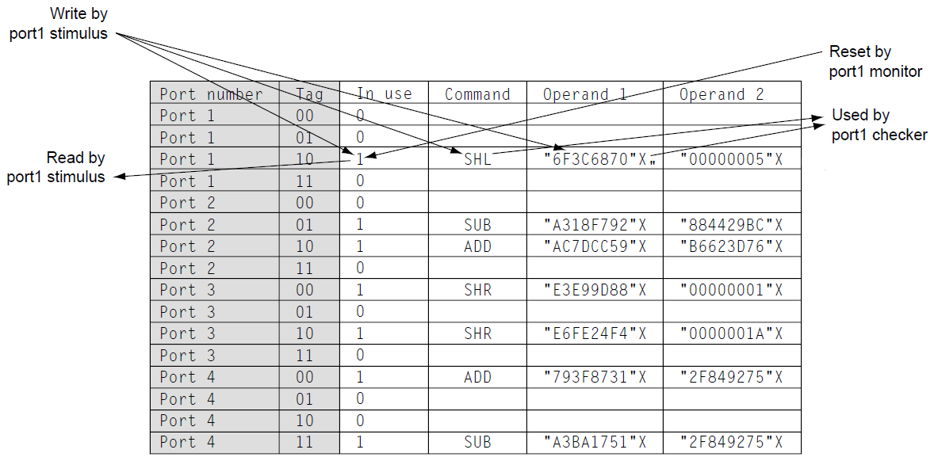
Deterministic Test Cases with On-The-Fly Generation II – Scoreboard Implementation Details
Because the DUV may return commands out of order, predicting the sequence of returning tags on a long test case is a waste of time, requiring extensive trial and error simulation jobs.
Instead, the verification team builds the intelligence into the environment with a simple table that tracks outstanding command tags. If no tags are available, the environment cannot send in a new command until the DUV completes one. Otherwise, the protocol component simply uses an available tag to replace the “x” value in the test case.
This is an elegant and efficient method that avoids duplicating the DUV priority and control logic, which would have to predict the ordering of the responses.
This is a common approach used in many verification environments, with the scoreboard serving as a fine choice for placing the tag table.
Notes:
Because the DUV may return commands out of order, predicting the sequence of returning tags on a long test case is a waste of time, requiring extensive trial and error simulation jobs. Furthermore, the test case would need ongoing maintenance each time internal DUV changes altered the response timings. Instead, the verification team builds the intelligence into the environment with a simple table that tracks outstanding command tags. If no tags are available, the environment cannot send in a new command until the DUV completes one. Otherwise, the protocol component simply uses an available tag to replace the “x” value in the test case. This is an elegant and efficient method that avoids duplicating the DUV priority and control logic, which would have to predict the ordering of the responses. Implementation of this algorithm involves communication between the protocol component and the monitor component. Therefore, the environment requires that the tag table be in a global area that both components can update. The stimulus component must write to the table to remove tag availability each time it sends a new command. The monitor component must free the tag in the table when the response comes from the DUV. This is a common approach used in many verification environments, with the scoreboard serving as a fine choice for placing the tag table.
The scoreboard is simply a data structure used by multiple verification components to communicate with each other. It is required whenever stimulus components create values on-the-fly. Figure shows a scoreboard for Calc2, implemented as a table. Each row of the table corresponds to a tag from a particular port. The verification components read and write to the fields: “tag in use,” “command,” “Operand1,” and “Operand2”. This setup allows quick indexing into the scoreboard by the stimulus, checker, and monitor components.
The stimulus component reads the tag “in use” value to check for availability. If available, it sets the value to “in use” and writes the command and operand values when it sends the command. When the DUV completes the command, the monitor resets the “in-use” value, and the checker reads the command and operand values to perform the check.
This static table method works well for small, densely populated values such as this. In larger, sparsely populated scoreboard spaces, the scoreboard implementation requires a linked list or hash table with a search algorithm to find the desired value. Verification of designs such as caches requires this, as the simulation does not use the entire array but rather randomly chosen portions. Implementing the cache scoreboard as a static table might exhaust the workstation memory while utilizing very little of the reserved memory space.

Slide 34
Pregenerated Random Test Cases I
Random stimulus generation uses an entirely different approach.
The verification team automates the generation of the command and associated result values into either a test case generator (predetermined) or the stimulus components (on-the-fly).
A test case generator program runs separately from the simulation environment, whereas an on-the-fly generation style integrates into the simulation environment.
Random-based test case generation requires programming the stimulus and checking algorithm intelligence into stand-alone software. There are generally two types of inputs to a test case generator:
  a template, or map of the desired test case, and
  a more general set of parameter inputs used to bias certain randomizations.
The test case generation environment uses a template file and randomization controls as input. The test case generator’s output is a test case, complete with stimulus and checking.
Notes:
Random-based test case generation requires programming the stimulus and checking algorithm intelligence into stand-alone software. There are generally two types of inputs to a test case generator: a template, or map of the desired test case, and a more general set of parameter inputs used to bias certain randomizations. Depending on the DUV, the team may choose to embed the parameter in the template input file. In the examples for Calc2, the parameter bias controls are separate from the template. The output of the test case generator is a test case (or test cases) that contains all the stimulus and checking information required for the simulation environment.
The test cases created by the generator use the same style of verification environment components as deterministic test cases. The test case parser will change to match the different format, but the concepts of the environment remain the same. The test case generator includes an internal, or reference, model of the DUV. The generator uses this model to precalculate the expected results given the inputs it creates. Depending on the complexity of the design, these models may be quite complex. Figure shows the inputs and outputs of the test case generator.
Verification engineers commonly use test case generation to verify microprocessors or embedded controllers. Although microprocessors have a far more complex instruction set than do the few used in Calc2, Calc2 serves as a good demonstration of the test case generation technique.

Slide 35
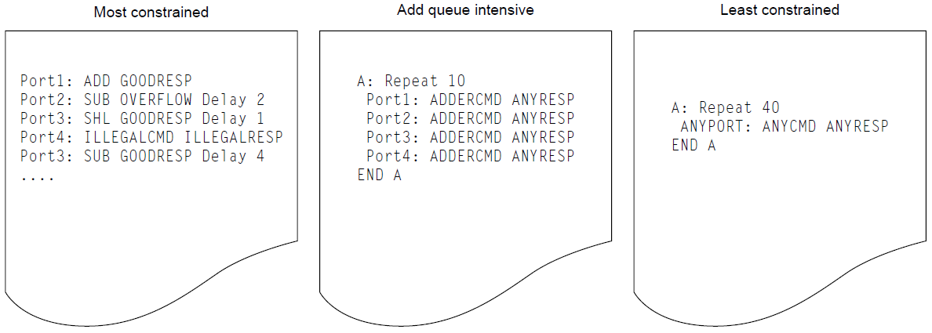
Pregenerated Random Test Cases II
Top figure shows three example template files for a test case generator for Calc2.
The first template, called “most constrained,” uses the test case generator to create a deterministic test case.
The second template, “add queue intensive,” is an example of the most common mode used in test case generation.
The third template, “least constrained,” allows the test case generator’s randomization capabilities to dictate most of the resulting test case.
Three possible template files for a Calc2 test case generator.
A “most constrained” test case from generator.
The Calc2 test case generation list creates shorthand keywords for the template writer. Each keyword contains a list of possible values.
Notes:
Templates provide a roadmap for the test case generator. The result is one or more test cases that follow the roadmap. The test cases run separately against the Calc2 DUV, using the verification environment to parse the port commands, drive stimulus, and check results. The actual test case format, shown in middle figure, is a variation of the format shown earlier in case of deterministic stimulus generation.
The test case generator in this example defers control of the tag specification to the verification environment. The test case specifies all other values, including the delays between commands. Some of these values originate from the template file (ports, command, delays, and responses). The test case generator creates the rest of the values (operands and results).
The second template, “add queue intensive,” is a more interesting and common use of test case generation. Here, the template calls for the use of groups and randomizations in test case construction. Bottom figure shows the definitions of the groups cited in this test case, ADDERCMD and ANYRESP, along with other groupings that verification might use.
The first definition, ANYCMD, includes a second-level grouping, ANYGOODCMD, which encompasses the four defined CALC2 commands. ANYCMD also includes illegal command types.
The command grouping used in the “add queue intensive” template, ADDERCMD, lists the add and sub commands. This group is interesting because the DUV directs these commands toward the adder ALU, whereas the commands in SHIFTERCMD use the shift ALU. Therefore, the intent of this template is to stress the adder ALU and the priority paths that lead to it. A resulting test case creates interesting scenarios that not only will keep the adder ALU busy but also because it forces all of the command traffic into a single control and data path, ensuring that intense corner cases occur.
Finally, the “add queue intensive” template uses the ANYRESP group, which encompasses all command response types. The test case generator uses the GOODRESP and OVERFLOW response types to guide the selection of operand data. The ILLEGALRESP is used only when the test case generator calls for an illegal command.

Slide 36
Pregenerated Random Test Cases III
The final input file, randomization controls, defines the biasing between the selections that the test case generator makes.
Figure shows a sample randomization control file.
The randomization controls dictate the average ratio between the choices.
Together with a pseudorandom number generator, the test case generator uses these bias controls to choose specific values each time it creates a command.
Therefore, on average, a template using the ANYCMD keyword will choose legal commands 90% of the time and illegal commands in the remaining 10%.
Of the 90% legal commands, the add command is selected 30% of the time, and so forth.
The test case randomization controls defines the probabilities of each choice within a generation list.

Slide 37
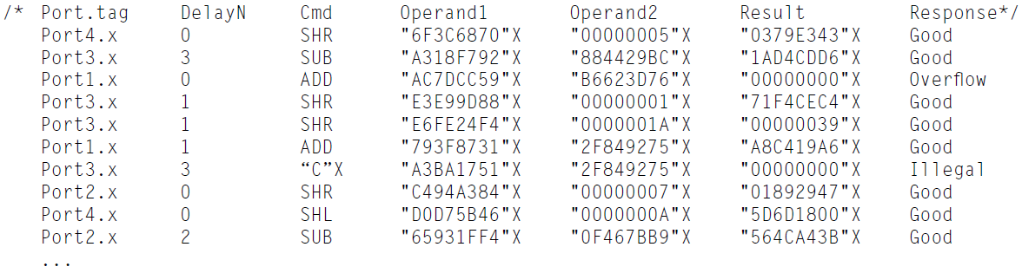
Pregenerated Random Test Cases IV
Top figure shows a possible test case created using the “add queue intensive” template.
Note that after the reset, all commands must be add or sub as defined in the template. The delay values, as defined in the randomization control file, range from zero to five.
The data selections appear to be random across a 32-bit range. However, closer inspection reveals that the response type constrains the operand values.
The “least constrained” template gives few constraints to the test case generator. The generator will create a test case with 40 commands of any type, with any possible response, from any combination of ports.
Bottom figure shows the first 10 commands from a single test case created using this template. However, the random control biasing shown in previous slide still hold.
An “add queue intensive” test case from generator.
A “least constrained” test case from generator.
Notes:
The “add queue intensive” template calls for 40 commands (top figure lists only the first 12). Note the regularity of the port command ordering (1, 2, 3, 4, 1, 2, 3, 4 . . .). The template dictated this ordering. The user could use another randomization control, called “ANYPORT” in the “least constrained” template, which would leave the port number selection to the test case generator under random biasing controls.
A single template file such as “add queue intensive” can spawn hundreds of unique test cases. Although top figure shows a single example, the generator can re-run, using a different initial seed, creating a different test case that still follows the template. This capability enhances the verification team’s ability to hit corner conditions in the design. In this example, the template will focus test cases on DUV controls such as filling the add queue and interactions between ALU data and control under stressful, back-to-back conditions. This is less valuable with the “most constrained” test case example, in which the only deviation would be in the data value randomizations.
Even in this randomly generated test case, the stimulus components still must ensure that the inputs adhere to the DUV protocols. The timing between port commands is a prime example of this. The port stimulus component cannot send Calc2 a new command if no tags are available, regardless of the “DelayN” value dictated by the test case. Here, the definition of the DelayN field changes. It now indicates a minimum number of cycles between commands from the same port. After waiting DelayN cycles, the port stimulus component sends the new command if there is an available tag. Otherwise, the port stimulus component continues to hold the command until there is an available tag.

Slide 38
On-the-Fly Random Test Cases I
On-the-fly generated random test cases have similarities to test case generation in that it uses constraint directives to make stimulus decisions.
However, on-the-fly random generation makes these decisions while running simulation, rather than before the simulation, requiring the verification team to build generation intelligence into the stimulus components.
The main advantage of on-the-fly generation is that the verification environment can create stimulus in reaction to the state of the DUV.
In the on-the-fly random generation environment, the stimulus component receives biasing parameters as input and makes the stimulus decisions each cycle.
The output prediction programming moves from the test case generation program into the stimulus, scoreboard, and checking components as well.
In the on-the-fly paradigm, the verification environment calls the stimulus component programs at the beginning of each simulation cycle. The stimulus generation components must track the state of the DUV and decide whether to send new stimulus, send complete stimulus that started on a previous cycle, or not send any stimulus.
This is the same algorithm shown in slide 26.
Notes:
The final type of stimulus generation is on-the-fly generated random. This is the paradigm chosen in our verification plan and is the best fit for Calc2. On-the-fly generated random test cases have similarities to test case generation in that it uses constraint directives to make stimulus decisions. However, on-the-fly random generation makes these decisions while running simulation, rather than before the simulation, requiring the verification team to build generation intelligence into the stimulus components. The main advantage of on-the-fly generation is that the verification environment can create stimulus in reaction to the state of the DUV.
In the test case generation environment, the test case parser reads the predetermined test case and forwards the port commands to the stimulus component. In the on-the-fly random generation environment, the stimulus component receives biasing parameters as input and makes the stimulus decisions each cycle. The output prediction programming moves from the test case generation program into the stimulus, scoreboard, and checking components as well.
In the on-the-fly paradigm, the verification environment calls the stimulus component programs at the beginning of each simulation cycle. The stimulus generation components must track the state of the DUV and decide whether to send new stimulus, send complete stimulus that started on a previous cycle, or not send any stimulus. This is the same algorithm shown in slide 26. Some of these generation choices may be limited based on how busy the DUV is (e.g., four outstanding port commands from a single port in Calc2) or on stimulus sent on previous cycles (e.g., the Calc2 requirement to send the second operand data on the cycle after the initial command and data). The protocol components translate the transaction-level decisions of the generation component into bit-level stimulus, maintaining good parity and protocols no matter what choices the generation component made.

Slide 39
On-the-Fly Random Test Cases II
Figure on the left shows the algorithm for generating commands on-the-fly for Calc2.
The flowchart represents a single port’s stimulus. The verification team duplicates this for each port.
Figure on the right shows a randomization control file. This sample indicates the bias controls for the Delay_Count.
An on-the-fly generation algorithm for a stimulus generation on a single Calc2 port.
The randomization controls for the Calc2 on-the-fly stimulus generation component.
Notes:
Each port has individualized constraint directives. These bias controls affect the outcome of the “send new command?” block, the “choose command” block, the “choose response type” block, and the “choose operand” block. In addition, the constraint directives may control the usage of specific tags by a port. The constraints may differ from port to port, altering the biasing of each instance.
The algorithm first checks to see if the stimulus component initiated a command on the previous cycle (2nd_Cmd_Cycle is ON). If so, it must complete the operation by sending the second operand. In this state, the stimulus component also uses the randomization controls to choose a Delay_Count, which indicates the between-command cycle gap on the port.
To choose a value based on the randomization controls, the stimulus component first uses a pseudorandom number generation to pick a number between 1 and the sum of the individual weights (30 + 25 + 20 + 15 + 5 + 5 = 100 in the case of Delay_Count). The stimulus component uses the chosen number to index to the particular Delay_Count value. In our example, a random number between 1 and 30 would give a 0 delay, between 31 and 55 would give a 1-cycle delay; between 56 and 75 would give a 2-cycle delay, and so forth. Note that the sum of the weights need not total 100 as in the case of RESPONSE. This method of choosing a value for a variable works for any bias control table.
If 2nd_Cmd_Cycle is OFF, the stimulus component checks the scoreboard to see if there is an available tag. If no tag is available, then the stimulus component’s work is complete for this cycle. If a tag is available, it checks to see if the Delay_Count is zero. A zero count indicates that the between-command cycle gap has been met. If the delay count is not zero, then it is decremented. Otherwise, the stimulus component chooses a command based on the randomization controls. In our example, there is a 10% chance that the stimulus component chooses to send an illegal command, a 30% chance of an add command, and so on. After choosing a command value, the stimulus component chooses a response value unless the command was an illegal value - in that case, the response must be “illegal.” Finally, by using the response value (“good” or “overflow/underflow”), the stimulus component chooses operands using the same algorithm described earlier. The order of decisions, in which the algorithm chooses the response type before the operand data, may seem odd. However, there is good reason for this ordering, as choosing data first will lock in a response type (e.g., overflow/underflow for add/sub). The verification engineer’s intent is to have control over the average probability of good responses versus overflow/underflow responses, so the algorithm makes that decision first. The effect of one decision on others falls under constraint solving, described in a later slide (“Constraint Solving in Random Environments”).
After choosing all of the values, the stimulus component’s protocol driver sends the command, tag, and first operand. It also sets 2nd_Cmd_Cycle to ON, indicating that the stimulus component must complete the command send sequence the following cycle.
The SHIFTOP2 values are of particular interest in the randomization control file. Here, the verification engineer indicates that there are special values within the range of Operand2 values for shift commands. Instead of an even distribution of numbers between 0 and 31, the two endpoints have a higher probability than the values in-between.

Slide 40
On-the-Fly Random Test Cases III
In an on-the-fly generation environment, the stimulus component continues to send commands until one of two events occur:
  The checker or monitor components encounter an unexpected DUV value.
  The environment hits its predetermined limit based on either the number of cycles or the number of transactions.
When one of these events occurs, the stimulus component will not initiate any new commands.
If the stimulus component is in the middle of sending a command, it will complete the transaction as dictated by the protocols, and then become quiet.
A quiet stimulus component will not initiate any new commands but may complete any transactions started on previous cycles.
Notes:
In the case of an error, the test case will complete a few cycles after detection of the error. It is good practice to allow the test case to run for a nominal number of cycles (10 or so) before stopping the simulation. This practice assists in debugging, as a designer or verification engineer can view traces of the HDL’s behavior just after the environment detects the error. The reason this is important is that the HDL could arrive in a particular state from multiple paths. Allowing the test case to run beyond the error condition may assist in pointing to the exact path and cause of the bug.
In the case of the predetermined cycle or transaction limit, the test case completes when the DUV completes all commands. The environment relies on the scoreboard to indicate when the DUV has completed all commands or transactions.
Either method of ending a successful test case is acceptable. Verification environments with cycle-based limits run until a predetermined number of cycles have passed. This is called the quiesce cycle. Alternatively, verification environments with transaction limits send a predetermined number of transactions before the environment quiesces.

Slide 41
Strategies for Simulation-Based Stimulus Generation
Seeding Random Test Cases

Slide 42
Seeding Random Test Cases I
Random test cases, similar to all verification jobs, must be repeatable. Repeatability is required because it is necessary to reproduce failures both for analysis and for fix verification.
Re-running a deterministic, predetermined test case is not a concern. The test case exists before the simulation run, so the verification team can save it for later use when the designer makes the required updates. However, in on-the-fly random, in which stimulus components make decisions during the course of simulation, there is no predetermined test case to “save”.
To meet the repeatability requirement, a single initial seed value must be the root for all of the random number generators used by all environment components.
Using an initial seed guarantees that the random number generators produce the same sequence of values when rerunning the test case.
Rather than saving a test case, the verification team saves the seed that generates the test case.
In addition, the verification team must save the randomization control file along with the seed. Using the same seed with the same randomization control file against the same simulation model will produce an identical test case. Conversely, a change in randomization control parameters will likely change the entire test case, even if the initial seed is the same.

Slide 43
Seeding Random Test Cases II
Seeding each stimulus component requires careful planning and an understanding of random number generators’ behavior.
Given the same initial seed, a random number generator will produce the same sequence of numbers.
Each time the stimulus component calls the random number generation function, it uses the previous random number to seed the next call. This gives a repeatable, but pseudorandom sequence of numbers.
The good side of this is that it allows the verification engineer to reproduce a test case; however, each stimulus component must use different seeds or the components will act in concert.
Using Calc2 as an example, we will show three possible methods for seeding the individual port stimulus generators.

Slide 44
Seeding Random Test Cases – Method 1
Method 1, shown in bottom figure uses the initial test case seed directly for each of the four port stimulus generators.
In this case, all four ports will initially send identical commands rather than make personalized decisions.
Because all four ports use the same random number generation function, they will continually produce the same sequence of decisions.
Rather than acting independently, the stimulus components are harmonic. This is not the verification engineer’s intent.
Method 1 will significantly handicap the verification environment’s ability to drive interesting scenarios.

Slide 45
Seeding Random Test Cases – Method 2
Method 2 appears to avoid Method 1’s problem. The environment uses the initial test case seed to create different initial seeds for each stimulus component.
Therefore, each stimulus component starts with its own seed. However, this method also has undesirable side effects.
Because the random number generator uses the previous seed to generate the next number, all of the stimulus components under Method 2 create a similar set of random numbers, just offset by one, two, or three calls to the routine. Given the initial seed value of “a”, the random number generator will produce values “b”, “c”, “d”, “e”, “f”, “g”, etc, in that order. Therefore, the initial test case seed, “a”, will seed port1 with seed b, port2 with seed c, port3 with seed d, and port4 with seed e. On the surface, this seems okay.
However, port1’s sequence of random numbers will be c, d, e, f, g, etc. Port2 will be offset only slightly: d, e, f, g, h. . . . This may lead to less than desired randomization across the ports.

Slide 46
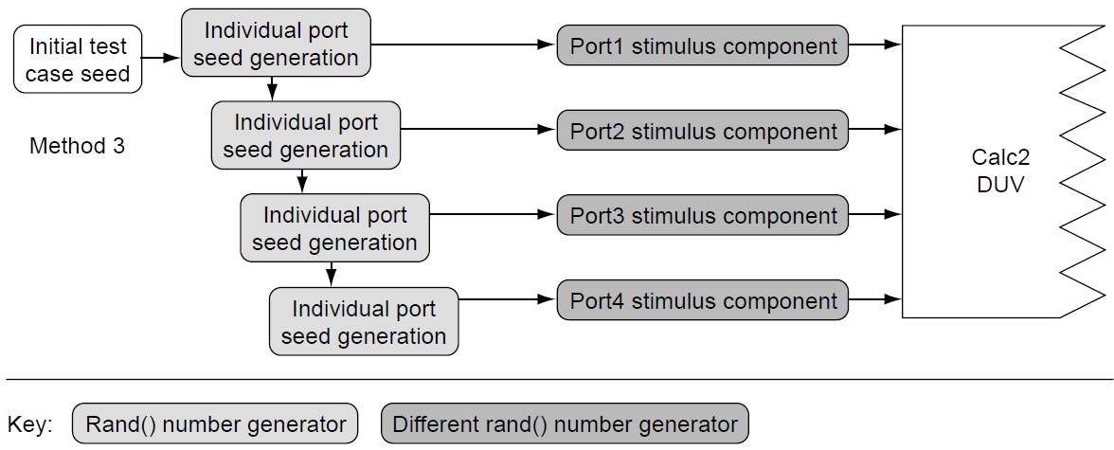
Seeding Random Test Cases – Method 3
Method 3 fixes the problem by introducing a second random number generator.
The second random number generator produces an entirely different sequence of numbers than does the first, even when seeded with the same value as the other generator.
By using the first generator to seed the individual ports with different values and the second generator to make on-the-fly random biasing decisions, Method 3 achieves the verification engineer’s intent of independent, randomly driven ports.

Slide 47
Strategies for Simulation-Based Stimulus Generation
Constraint Solving in Random Environments

Slide 48
Constraint Solving in Random Environments
Every time a stimulus component chooses a value to drive into the DUV, there are restrictions on the possible choices. The most basic restriction is the number of input bits for that value. However, most input lines have further restrictions on the content of the control or data signals. These restrictions are based on the content and context of the input.
These restrictions are called constraints. Most verification environments have some sort of constraint solving challenge.
In verification, there are two categories of constraint solving engines.
  The first is a general-purpose constraint solver. HVLs (Specman, Vera, etc.) use powerful, general-purpose constraint solvers to aid in the attack of the exploding state space challenges faced by test bench authors. General-purpose constraint solving engines require a deep background and are beyond the realm of this course.
  The second approach is to embed constraint-solving mechanisms in the test bench code. This category includes code written by verification engineers to solve constraints on the DUV. To this end, we offer approaches and examples.
Notes:
A constraint solving challenge consists of a finite set of variables and a set of constraints. There is a range of possible values for each variable; however, choosing a particular value for one variable may restrict the realm of possible values for another variable. These implications are constraints. A constraint solving challenge occurs when a relationship exists between multiple input values.
In verification, there are two categories of constraint solving engines.
The first is a general-purpose constraint solver. HVLs (Specman, Vera, etc.) use powerful, general-purpose constraint solvers to aid in the attack of the exploding state space challenges faced by test bench authors. General-purpose constraint solving engines require a deep background and are beyond the realm of this course.
The second approach is to embed constraint-solving mechanisms in the test bench code. This category includes code written by verification engineers to solve constraints on the DUV. To this end, we offer approaches and examples.
In the course of creating verification environments for specific DUVs, engineers constantly deal with input constraints, which may restrict the value of a single variable or restrict other variables based on a relationship between them. Constraints may also exist over time, restricting inputs for a period of cycles or requiring responses with a number of cycles. Ignoring constraints in stimulus generation leads to illegal conditions and protocol violations. The most basic constraint on most designs is the set of legal decode values. The Calc2 design constrains the 4-bit command bus to five legal inputs: zero (no op) and the four command codes for add, subtract, shift left, and shift right. All other values are illegal commands. A more complex constraint in Calc2 is the restriction that each port may have no more than four commands outstanding at a given time. This is a temporal constraint, to which the verification environment must constantly abide. However, this is still a relatively simple constraint.
In Calc2, the case in which the operand data generation requires intelligence is our first venture into constraint solving between multiple variables. Here, the possible Operand2 values had to be tailored based on the type of response already chosen. The operands both have a large set of possible values (2³²), whereas there are two possible values for the responses for add and subtract commands: good and overflow/underflow. However, once the stimulus component makes a choice for one variable, it limits the other variable’s legal solution space. For example, a “good” response for the subtract command constrains the second operand to be less than the first operand.

Slide 49
Importance of the Sequence of Solving Variable Constraints
When creating random environments, the order that the stimulus component assigns values to variables is a key decision made by the verification engineer.
Choosing variable values in the wrong sequence may unduly limit the input stimulus.
Such a limitation can handicap a verification environment so that certain areas of the DUV remain unexercised.
It is therefore imperative that the verification engineer understand the constraint relationships between variables.
Notes:
The data and response variables in Calc2 are a simple, yet powerful example of the implication of the sequence in which the stimulus component assigns values to constrained variables. The randomization table in Slide 39 shows that for add and subtract commands, it is the verification engineer’s intent that the stimulus component creates “good” responses for 75% of the commands and “overflow/underflow” responses on the remaining 15% of the commands. Consider the two possible sequences: choose the operand data first, or choose the response first. If the stimulus component chooses the operand data first, then there is a 50% probability that the operands would produce an overflow or underflow response. Randomly chosen operand values in the range of 0 to 2³²-1 automatically constrain the response value; that is, once the stimulus component chooses operands without constraints, the response value is determined. Therefore, the correct sequence to implement the verification engineer’s intent is first to choose the value for the response variable.
Then, the stimulus component uses a constrained algorithm for choosing operands discussed in Slide 32. The flowchart in Slide 39 indicates the correct sequence.

Slide 50
Constraint Solving in Stimulus Components
Constraint solving for specific DUV applications requires a three-step process:
  1. Understand the interdependencies.
  2. Prioritize the variables.
  3. Analyze the implications.
The first step is to map all of the interdependencies of the input variables.
This entails understanding which variables are closely coupled, loosely coupled, or unrelated.
Closely coupled variables imply that when the stimulus component selects the value of one variable, another variable’s (or variables’) value is restricted to a small range.
Loosely coupled variables imply fewer restrictions on the second variable’s value.
Choices between unrelated variables have no effect on the other.
Notes:
Generally, the best method for understanding interdependencies on a particular DUV is to first group related input signals. A DUV may have dozens of input signals, but many of these are unrelated to each other. Group together those that are related. Stimulus components may act independently on these groups. These stimulus components may even be in separate modules. The four ports on Calc2 are an example of grouping related inputs. Within each port, input signals (data, command, and tag) values are coupled. However, across each port, these input signals are unrelated. Port1’s signals imply no constraints on any other port.
Continuing down the path of understanding the interdependencies, the verification engineer should now map the closely coupled variables to each other. The loosely coupled variables follow. For every set of variables that constrain each other, test that the constraints are reciprocal; that is, validate that all of the same constraints apply regardless of which variable value is chosen first. Closely coupled constraints are generally reciprocal. For loosely coupled constraints, the order in which variable values are chosen matters.
On Calc2, the specifications imply coupling the signals on each port. Looking closer at the relationships within a port, we see a relationship between the response values and the commands. There is a 1-to-1 relationship between the shift operation and the good response (a shift command only gets a good response). The add and subtract commands have a looser coupling to the response codes, as the data and response values are coupled. We have already discussed the loosely coupled constraint relationship between the add/subtract operand values and the good/overflow/underflow responses.

Slide 51
Prioritizing the Variables
Prioritization of the variables dictates the order in which the verification environment assigns values to variables.
Understanding the implications of the sequencing of value choices is the heart of the prioritization process.
Three factors dictate priority:
  Intent of the test
  The relationship between groups of coupled variables
  The relationship within variables in a group
Notes:
The most important factor in sequencing variables is the intent of the test case. If the intent is very specific, the constraints on variable values are tight. Conversely, if the verification engineer’s intent is to hit a broad range of the DUV space, then the variable values tend to be constrained only by the DUV specification. An example of a tightly constrained test case for Calc2 would be one written to verify a Shift_left of zero places from Port1. Here, only the tag and Operand1 values are unconstrained. The port, command (Shift_left), and Operand2 data (“00000000”x) are tightly constrained. On the other hand, the “least constrained” test case is a template for a test case constrained only by the Calc2 specification. However, even that template can run tightly constrained, depending on the values in the randomization control file. In either case, the intent of the test case dictates a sequence of choices for variable values.
The relationship between groups of coupled variables and the relationship within variables in a group have equal priority when sequencing constraint solving. In many DUV specifications, there may be only weak constraints between groups of variables. This is the case on Calc2, in which the only constraining values that exist between the four ports are the reset line and the clock signal. Fundamentally, these two signals have little impact on Calc2 test cases except when the intent is to verify the reset or the clock.
Although there may not be constraints across groups of coupled variables, there are always constraints between variables in a group (otherwise, the variables would not be grouped together). Here, the order that the verification environment assigns values to variables is key in assuring the proper stimulus generation. The rule of thumb (after accounting for test case intent) is to sequence the variables by first choosing values for the variables that least constrain the other variables. This method leaves the largest available state space for choosing values for variables late in the sequence.
For a general-purpose Calc2 test case, this rule dictates the following sequence for choosing variable values within a single port. First, choose the tag value. Its value has no implication on the other values. (If there is no available tag, then the stimulus is tightly constrained to no new commands.) Next, choose the command, which will place constraints on the possible response values. The choice of response value follows. Finally, based on the chosen response value, choose the values for the two operand variables. Although the intent of the test case may alter this general-purpose sequence, this order of variable choices follows the rule of choosing the least constraining variables first.

Slide 52
Analyzing the Implications
After mapping the constraints and sequencing the variables, the final step is to analyze the implications of the sequence.
This step searches for overconstrained variables, as well as constraints that unintentionally restrict the stimulus components from exploring states within the DUV.
There are two types of overconstrained variables:
  those groups whose valid state space is null, and
  those groups with an unintentionally limited state space.
There are cases in which the intent of the test case overconstrains the variables.
In these cases, no set of variable values exists that meets the intent of the test case. This occurs most often when the constraints on any single variable seem reasonable but the mix of constraint values unexpectedly creates an unsolvable state space.
In other cases, the design rules or implementation make certain constraint solving tasks difficult or impossible.
Notes:
Groups whose constraints unintentionally limit the state space are actually more dangerous for the verification engineer than those groups with unsolvable constraints, because the stimulus component’s constraint solver will flag the unsolvable constraints but not the unintentionally limited constraints.
There are cases in which the intent of the test case overconstrains the variables. In these cases, no set of variable values exists that meets the intent of the test case. This occurs most often when the constraints on any single variable seem reasonable but the mix of constraint values unexpectedly creates an unsolvable state space. In other cases, the design rules or implementation make certain constraint solving tasks difficult or impossible. Here are several examples from Calc2:
Overconstrained owing to architecture specification
The case of a SHL or SHR command with an overflow/underflow response is invalid, and
The design specifies that an illegal command will only get an “illegal command” response not a good response.
Overconstrained Owing To Microarchitecture
The verification plan calls for filling the add queue and shift queue. However, it turns out that no matter what constraints the verification engineer places on the stimulus component, it is impossible to fill the 16-deep internal queue! This is because the Calc2 priority logic continuously dispatches the top entry in the queue. Given the case in which all four ports have sent four commands and all of these commands are the same type (add/sub or shift), one command will be in the adder, one command will be entering the response output logic, and one will be on the Calc2 output signals. This leaves a maximum of 13 commands in the queue. No matter how fast the stimulus component sends commands, it can never fill the queue.

Slide 53
Strategies for Simulation-Based Stimulus Generation
Coverage Techniques in Random Environments

Slide 54
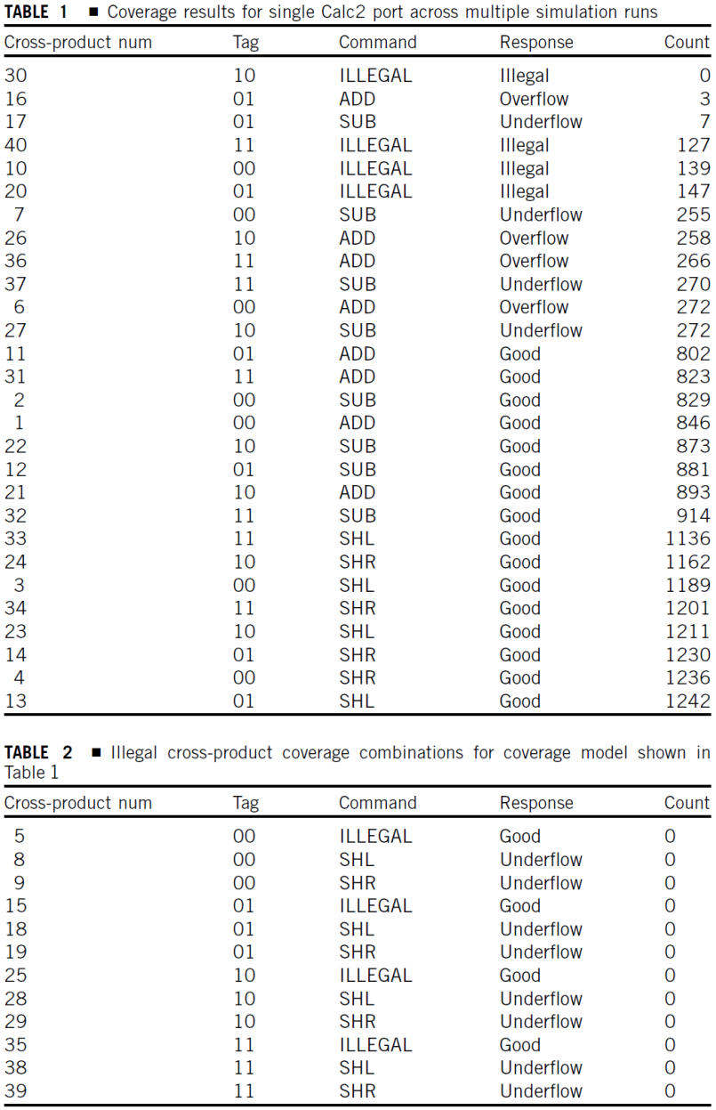
Coverage Techniques in Random Environments
Although analyzing the implications of the constraints is an important step, it is not foolproof. Therefore, the verification team needs back-up in the form of runtime coverage techniques used to track the stimulus and DUV internal states.
The ideal target of the coverage mechanisms in this realm is the cross-product of the grouped variables. Verification engineers should look for unexpected holes in the cross-product matrix.
The need for coverage in verification environments cannot be overstated. Verification engineers use coverage data to point to holes in their environments, test matrix, random bias controls, or constraint solvers.
Coverage results allow the verification team to compare what simulations actually ran versus what the team expected to run.
Tables 1 and 2 display the coverage results from a set of Calc2 simulation runs.
Notes:
Although analyzing the implications of the constraints is an important step, it is not foolproof. Therefore, the verification team needs back-up in the form of runtime coverage techniques used to track the stimulus and DUV internal states. The ideal target of the coverage mechanisms in this realm is the cross-product of the grouped variables. Verification engineers should look for unexpected holes in the cross-product matrix.
The need for coverage in verification environments cannot be overstated. Verification engineers use coverage data to point to holes in their environments, test matrix, random bias controls, or constraint solvers. Errors in program coding, oversights in constraint solving, or typographical errors in bias controls can all lead to missed test scenarios. Coverage results allow the verification team to compare what simulations actually ran versus what the team expected to run.
Table 1 displays the coverage results from a set of Calc2 simulation runs. The results track the number of occurrences of each of the 40 possible cross-product variable values on a single port. This coverage model tracks only control values, not data values. Therefore, the coverage table derives the 40 values from the cross-product of the four tags, five commands, and two responses (4 * 5 * 2 = 40). The cross-product number field shows the number assigned to each of the 40 cross-products. Note that Table 1 only shows 28 of the 40 possible cross-products. The other 12 cases are illegal cases, shown in Table 2. These cross-products are illegal because the result value cannot occur with the given command (illegal command with good response, or a shift command with an overflow response). A nonzero count field for any of the illegal cases in Table 2 would indicate a problem in the DUV.
The coverage results in Table 1 are ordered by the count field. This directs the verification engineer to unexpected count values.
The intent of the coverage model is to identify holes in the stimulus component that may have come about because of unintentionally limited constraints. Analysis of these coverage results does show three anomalies. Cross-product number 30 (tag “10”b, Illegal command, and Illegal response) has a zero-count value, whereas the illegal command and illegal response counts for the other three tags (cross-product numbers 10, 20, and 40) all have totals in the 100s. The verification engineer must investigate why the stimulus component is not creating this combination. The other two anomalies also require investigation. The results for cross-product numbers 16 and 17 show abnormally low count values compared with the other add and sub commands with overflow/underflow responses. These anomalies often indicate a constraint solving error in the stimulus component.
Coverage counts such as those shown in Tables 1 and 2, serve many purposes beyond the search for overconstrained values. Coverage data also provides insight into the workings of the environment’s randomization controls. Over a long period of simulation cycles, coverage data should echo the probability ranges dictated by the randomization control files. Any significant deviation from the values of the randomization control file requires investigation.
Therefore, the data shown in Table 1 indicates an approximate 3:1 ratio of good responses to overflow/underflow responses for add and subtract commands. The data also indicates about a 1:1 ratio between add/subtract commands and shift commands. If the coverage data and the probability tables do not correlate, then the verification engineers must examine the stimulus component.

Slide 55
Making Rare Events Occur
Many simulation runs ought to be dedicated to running the DUV in a “normal mode” of operation, which is characterized by a ratio of stimulus that reflects the expected load on the DUV when running an average workload.
However, verification must take advantage of its ability to deviate into the unexpected, making normally rare events occur at a heightened pace.
The fundamental reason to increase the rate of occurrence of rare events is that this is where nasty bugs lurk.
As the designer writes the initial specification and proceeds with the HDL, the focus is on the normal mode of operation. Designers center their performance optimizations (bandwidth, throughput, latency) on the normal cases. Good designers also consider the odd cases, but it is difficult for a designer to think of all possible cases in a complex system. These rare occurrences are also known as corner cases and window conditions.
The verification team must allocate a substantial amount of effort toward driving corner cases. There are three prongs to this effort:
  probes of the design for special cases;
  examinations of coverage data; and
  automations that modify the randomization controls.
Notes:
Many simulation runs ought to be dedicated to running the DUV in a “normal mode” of operation, which is characterized by a ratio of stimulus that reflects the expected load on the DUV when running an average workload. However, verification must take advantage of its ability to deviate into the unexpected, making normally rare events occur at a heightened pace. As stated in the introduction to this lecture, the verification suite must contain more permutations, drive more interactions, and create more extraordinary cases over a short period of time when compared to normal program or application activity. This indicates the desire to make rare events occur often in verification.
The fundamental reason to increase the rate of occurrence of rare events is that this is where nasty bugs lurk. As the designer writes the initial specification and proceeds with the HDL, the focus is on the normal mode of operation. Designers center their performance optimizations (bandwidth, throughput, latency) on the normal cases. Good designers also consider the odd cases, but it is difficult for a designer to think of all possible cases in a complex system. These rare occurrences are also known as corner cases and window conditions.
The verification team must allocate a substantial amount of effort toward driving corner cases. There are three prongs to this effort: probes of the design for special cases; examinations of coverage data; and automations that modify the randomization controls.
The most powerful lead in the search for corner case bugs is the design itself. The verification engineer must probe and investigate the DUV’s microarchitecture and understand all of the various stimulus events. The microarchitecture includes queues, buffers, state machines, data paths, and controls. Stimulus events include all of the separate input commands and response codes, as well as interrupts and service support (resets, clocking, and initialization). Each of these items requires attention not only at the single event level (“has the buffer been filled?”) but also at a cross-product level (“what happens when we take an interrupt when the buffer is filled?”).
From a microarchitecture standpoint, rare events occur when independent single events align, there are data or control path collisions, or there are unusually busy conditions. These three areas require the attention of the verification team.
This requirement on verification highlights the need for stimulus components to run in modes that are independent of the hardware’s base applications and programs. Although it is good to run some simulation with application-like mix of stimulus, this mode must be restricted to a minority of the verification effort. The specialized stimulus components that we have described act on the rules of the microarchitecture, which are different from the profile of the average application. Continuously changing the bias controls and stimulus parameters drives further divergence in stimulus profile, allowing the environment to create a wide range of internal DUV cases.
The Calc2 design contains multiple corner conditions that the verification team must stimulate. Under normal conditions, these cases are rare events that could contain DUV bugs. We now examine a few of these cases.
In the category of alignment of independent single events, the verification team would want to create the case in which the next command in both internal queues contain an add and a shift command from the same port. This will verify that the priority logic does not dispatch both commands simultaneously, causing a collision on the output bus. Similarly, the verification team should create the case in which the DUV forwards an invalid command (which the DUV should not place in either queue) directly to the output at the same time it completes an add or shift command from the same port. This is another potential data collision case caused by two independent commands.

Slide 56
Summary
Verification engineers have an array of choices for personalizing stimulus components to the DUV. These choices range across two axes:
  determinism versus randomness and
  pregeneration versus on-the-fly generation.
No matter which paradigm the verification team chooses, it is imperative that they understand the constraints on the inputs of the design.
Constraints describe the interrelationship between input signals and the limitations across a period of cycles.
Finally, robust coverage metrics point to weaknesses in the verification environments stimulus generation controls.
This feedback allows the verification team to update their stimulus components no matter which generation paradigm they choose.

