Slide 1
Funkcionalna verifikacija hardvera
Predavanje VIII-IX

Slide 2
Lecture Content
Strategies for Result Checking in Simulation-Based Verification
  Types of result checking
  Debug
Re-Use Strategies
  Guidelines for re-use
  Horizontal and vertical re-use
  Applying re-use to Calc2

Slide 3
Strategies for Result Checking in Simulation-Based Verification
Types of Result Checking

Slide 4
Strategies for Result Checking in Simulation-Based Verification
A customer expects the verification “warranty” to last the life of the system. At the same time, the limited number of simulation cycles (compared to the life of the system) handicaps the verification effort.
To combat this, the verification team needs a robust strategy for creating stressful stimulus during the relatively small number of available simulation cycles. However, the additional challenge beyond creating the stimulus is that the environment must identify all the bugs triggered by this stress.
Driving the stimulus is only half of the equation. Remember the yin and yang of verification: not only must the stimulus aggravate the DUV, the checking components also must recognize when a bug exists in the design.
After creating the stimulus and checking components, the verification team can begin to debug the design under verification (DUV) and the verification components.
When the results of the DUV and the checking component disagree, the verification engineer must investigate the miscompare.
This investigation is the debug phase, and during this phase, the verification team reaps the fruits of their component-building labor.

Slide 5
Types of Result Checking
During the planning phase of the verification test bench, verification leaders must make the basic choices on stimulus generation. These choices, such as when the generation occurs, affect the results checking portion of the test bench.
In addition, there is another aspect of results checking - when the verification environment performs the checking. The two choices are:
  1 throughout the life of the test case (on-the-fly checking) or
  2 at the end of the test (end-of-test checking).
Remember there are three different types of self-checking test benches:
  Golden vectors
    A test bench in which some knowledge base of valid output vectors is stored in the scoreboard. The checking component compares the DUV results to this knowledge base by calling the scoreboard and requesting the expected vectors. The checker does this either every cycle or every transaction.
  Cycle accurate reference models
    A test bench in which the reference model calculates all expected outputs based on the input stimulus. The reference model re-implements the function of the DUV, usually in a high-level programming language (HVL). The checking component compares the outputs of both the DUV and the reference model.
  Transaction based
    A test bench in which the DUV has identifiable transactions. The test bench uses a scoreboard to track commands and data driven on the inputs of the DUV. The scoreboard component performs the transformation from inputs to outputs, and the checking component then performs a callback to the scoreboard to retrieve a transaction to check.
Notes:
We will discuss how the type of checking (either end-of-test case or on-the-fly) and test case generation affect the three different types of test benches.

Slide 6
On-the-Fly Checking Versus End-of-Test Case Checking
An important aspect of the test bench is when to perform the checking - either on-the-fly or at the end of the test case.
In the on-the-fly paradigm, the verification environment performs checking during the simulation.
The stimulus components initiate transactions, and as these transactions complete, the checking components immediately verify the correctness of the transaction.
If the checking component detects any type of error, it records the time, transaction, and any other useful information for debug.
End-of-test case checking performs at the completion of the simulation test, either within the simulation (end of simulation checking) or in a separate job (post-analysis checking).

Slide 7
On-the-Fly Checking
On-the-fly checking is most applicable to a DUV that operates on transactions and performs some type of data transformation on that transaction.
Figure on the right illustrates this type of paradigm.
There are multiple benefits of on-the-fly checking that lead to this paradigm’s common usage:
  Debug is easier with on-the-fly checking because the simulation stops when the checker detects an error during the simulation, rather than at the end. This assists in debug, which is discussed in more detail later.
  The overall simulation requires less memory with
  on-the-fly checking because the checking component does not need to keep the expected data until the end of simulation: as soon as the checker finishes with a transaction, the checker releases that memory.
  Because less memory is required, the simulation tends to run faster than a pure end-of-test case checking paradigm.
On-the-fly checking.
The stimulus component initiates a transaction that lasts for three cycles on cycle t + 1 and t + 6. Each transaction completes on the outputs of the design under verification (DUV) in one cycle after the end of the transaction. The checking component senses the end of the output transaction and at that time compares the actual outputs versus the expected outputs. These expected outputs could be pre-calculated by using golden vectors, calculated from a scoreboard as in a transaction-based test bench, or generated in a cycle accurate reference model.

Slide 8
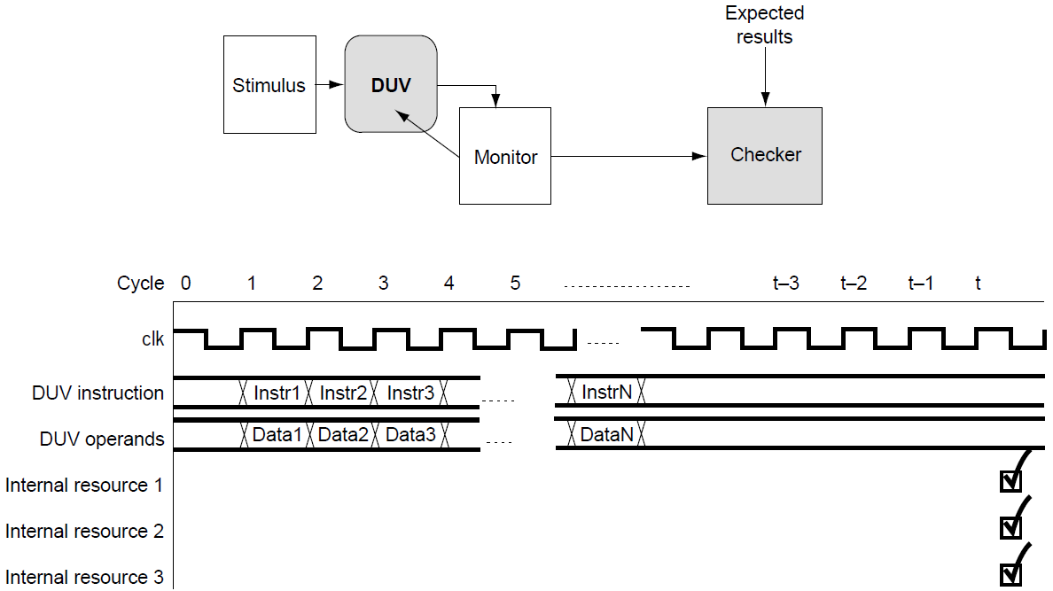
End-of-Test Case Checking I
End-of-test case checking applies when the checking components need to check the state of the test bench after the test completes.
End-of-test case checking tends to be used when any of the following conditions exist:
  The results remain persistent within the DUV’s memory until the end of the test.
  Signal access is limited (e.g., acceleration or emulation).
  Check of the ending state of the test bench and/or DUV (queues being empty, reference model comparison, etc.) is required.
  Functions have system aspects (e.g., arbitration, latency, performance).
When using the end of simulation checking paradigm, the verification environment calls an end-of-test case checking routine when all the checking components have finished. This
end-of-test routine will then perform any
user-defined checks on the test bench and DUV.
Figure on the right illustrates this paradigm.
End-of-test checking: end of simulation.
The stimulus component sends instructions and data to the design under verification (DUV) throughout the simulation. The monitor observes the DUV outputs throughout the simulation. Whenever the monitor sees a transaction on the outputs of the DUV, it captures the transaction and saves it to memory. (The monitor must capture the pertinent data for this transaction and cycle number.) On completion of the simulation, the environment calls the checking component. The checking component validates the transactions captured by the monitor throughout the test case.
Notes:
In addition to the monitor observing the DUV outputs in the figure, the monitor may also capture internal DUV data for end of test case results checking. This allows the checking component to compare internal DUV resources (such as general-purpose registers) to the expected results. The environment predicts the expected results based on the type of test bench: golden vectors, transaction based, or cycle accurate reference model.

Slide 9
End-of-Test Case Checking II
A different method of performing end-of-test case checking is to perform the checks outside of the simulation engine.
It is similar to the end-of-test case checking within the simulation engine, except the simulation engine and verification environment programs complete before a separate program performs the checking.
A monitor collects the transactions on the output of the DUV, but instead of writing it to memory, it writes to a file.
Once the simulation completes, the simulation program exits (note that in the figure the checking is not performed in the simulation wave window).
Now a post-processing routine, independent from the simulation environment, invokes checking by using the expected results file and actual results file as inputs. This program checks for correctness of the results.
End-of-test checking: postanalysis program.
Some of the results checking is performed by an external program that is invoked after the simulation engine has finished and terminated.
Notes:
As with the end of simulation method, the monitor can also probe into the DUV at the end of simulation to add any necessary states or conditions that it may need to check. Once again, the source of the expected results depends on the checking paradigm: golden vectors, transaction based, or cycle accurate reference model.
End-of-test case checking applies well to functions having system aspects, for example, performance verification. Performance has different meanings depending on the application. In a data transmission system, the environment typically measures performance in both bandwidth and latency. Bandwidth is the amount of data successfully moved across the bus over a given timeframe, and latency is the amount of time the DUV takes to process each transaction. In a processor system, performance is the amount of work that the processor can perform in a given amount of time. This work may mean the number of instructions or the number of useful operations.
The common point between both a data transmission system and a processor system is that the measure of performance is over time. In calculating performance, monitors compute the average time of every transaction during the steady state of the system. Monitors typically ignore the simulation ramp-up and ramp-down times. If the calculation uses the ramp-up and ramp-down times, it skews the overall average to be less optimal. Because the performance goal is an average, it only makes sense for the verification engineer to apply this same strategy to the checking. That is, either post-process all the transactions response times to calculate the average, or compute the average of the transactions response times during the simulation and at the end of the test and compare this to the performance target. Because the verification environment must look at the average performance for the entire simulation, this is end-of-test case checking.

Slide 10
Combining On-the-Fly and End-of-Test Case Checking
It is more likely that a test bench will require a combination of on-the-fly and end-of-test case checking.
The key is that the test bench contains the services to be able to perform these types of checks.
Recall that the three types of test benches are golden vectors, transaction based, and cycle accurate reference models.
Let us look at what facilities need to exist to perform on-the-fly and/or end-of-test case checking within these test benches.

Slide 11
Golden Vector Test Bench
In a golden vector approach, the environment calculates expected results by an external test case generation program or by hand (regardless of on-the-fly or end-of-test case paradigm).
The environment loads the golden vectors into a scoreboard and/or the checker. As the DUV drives its outputs, the checker detects a transaction on the outputs of the DUV and captures it. The checker then calls a scoreboard function that returns the next expected data. The scoreboard will need to provide the expected data to the checker in the correct order.
The environment can match the scoreboard transaction to the DUV output by implicit ordering of transactions within the golden vectors, by numbering each transaction, or by attaching an absolute time to each transaction. If the transformation allows for out of order data, then the scoreboard may require a search algorithm that correlates the transaction.
Once the scoreboard returns the correct expected data to the checker, it then releases the memory that it had allocated for this data. The checker then compares the expected data to the actual data. In the case of a miscompare (expected is different from actual), the checker logs pertinent information for debug. This continues until the stimulus component does not initiate any more transactions.
At this point, the test case is over and any end-of-test case checking occurs. For end-of-test case checking, the scoreboard will, at a minimum, need to contain a method that ensures that the scoreboard is empty and no outstanding transactions exist. If any outstanding transactions exist, the scoreboard should flag an error.

Slide 12
Transaction-Based Test Bench
A transaction-based test bench is very similar to that of a golden vector test bench when a scoreboard is used. The main difference is how the expected data is calculated.
In a transaction-based test bench, the environment gathers the expected results on-the-fly. Instead of loading the scoreboard with the expected data, it monitors the inputs to the DUV.
The environment then performs the necessary transformation on the transaction sent by the stimulus component. This becomes the expected data for what the DUV will output.
The scoreboard continues collecting and transforming the inputs to the DUV and will need to hand the correct expected data to the checker.
The environment also needs to contain an end-of-test case checking method similar to the golden vector approach.

Slide 13
Cycle Accurate Reference Model Test Bench
When using a cycle accurate reference model test bench, the reference model receives the same inputs as the DUV.
The reference model then produces the expected results at the same time as the DUV. The checker does not request any expected data; the checker simply compares the outputs of the DUV to the outputs of the reference model every cycle.
If at any time they do not match, the checker indicates an error.
At the end of the test, a method should exist to compare any function specific contents of the reference model to the DUV. This depends on the contents of the reference model.
Reference models can be deep or shallow in function.
A deep function cycle accurate reference model will be a pure white box approach, closely mimicking the DUVs activities.
A shallow function cycle accurate reference model abstracts as much as possible, verifying the intent over the DUV implementation.

Slide 14
Pregenerated Test Cases Versus On-the-Fly Generated
Test Cases
Checking does not depend on the type of test case generation - it can be deterministic or random - but it does depend on when the generation occurs, whether pregeneration or on-the-fly.
The dependency on when generation occurs limits what type of checking may be applied.
Golden vectors are restricted to pre-generated test cases. On-the-fly generation does not apply to golden vectors, as the expected results are not available before running the test cases.
Transaction-based and cycle accurate reference models, can be applied to either pre-generated or on-the-fly generation test cases.
Notes:
Another factor that limits golden vectors are situations in which the stimulus component requires feedback from the design. A verification engineer could treat this type of stimulus as “reactive.” In these types of environments, pre-generation is not a good choice because of the false constraints. Because pre-generation is not a good choice, neither are golden vectors.
Either a transaction-based or cycle accurate reference model test bench can be applied to pre-generated or on-the-fly generated test cases. This is because both of these checking environments capture the transactions on-the-fly and do not require anything before the test case starting. The major difference between these two types of environments is that a transaction-based test bench has a higher level of abstraction (black box application), whereas a cycle accurate reference model environment contains precise DUV implementation details (white box approach). The cycle accurate reference model implies that the verification environment encodes quite a bit of the implementation (e.g., queue depths, pipeline stages). Verification teams should limit their choice of cycle accurate reference models to stable DUVs in which the implementation does not constantly change.

Slide 15
Strategies for Result Checking in Simulation-Based Verification
Applying the Checking Strategies to Calc2

Slide 16
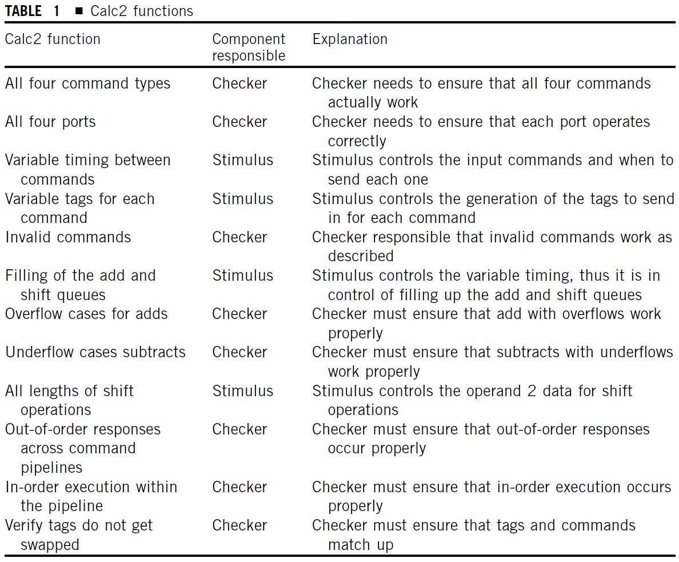
Applying the Checking Strategies to Calc2
In the same way as was covered in the section on stimulus generation, the verification engineer must fully understand the design intent in order to create robust checkers.
When writing checking components, it is necessary to understand the verification requirements as specified in the verification plan.
Table 1 recaps the Calc2 functions that were created when the verification plan was created and highlights which component is responsible for that item.
The verification team must elaborate on each checking component responsibility function so that the team can specify the actual checking requirements.
Notes:
Any function that lists the checker as the responsible component assumes that the stimulus component will make that scenario occur. However, if the stimulus component creates the scenario and if the test bench does not contain the proper checks, then it will not find any errors.
The verification team must elaborate on each checking component responsibility function so that the team can specify the actual checking requirements. The elaboration of “all four command types” and “all four ports” indicates that the environment must check that
The data and response is correct for a non-overflow add operation on each port.
The response is correct for an overflow add operation on each port.
The data and response is correct for a non-underflow subtract operation on each port.
The response is correct for an underflow subtract operation on each port.
The data and response is correct for a Shift left operation on each port.
The data and response is correct for a Shift right operation on each port.
Continuing down the list, the checking component must validate that invalid commands are handled correctly. The component must verify that the DUV returns the “illegal command” response code any invalid command.
The checking component must validate that responses across command pipelines are performed either in order or out-of-order, depending on the command streams across all four ports. It must also validate that all responses from a command stream to the two pipelines are always in-order.
The last item to verify is that the DUV correctly processes every command/tag pair across all ports, meaning that the design does not give any superfluous response/tags pairs and that every command receives a response. If the checking component receives an unrecognized tag, then it must indicate an error. Similarly, if the design ever drops a tag, then the checking component must indicate that the DUV lost the command.

Slide 17
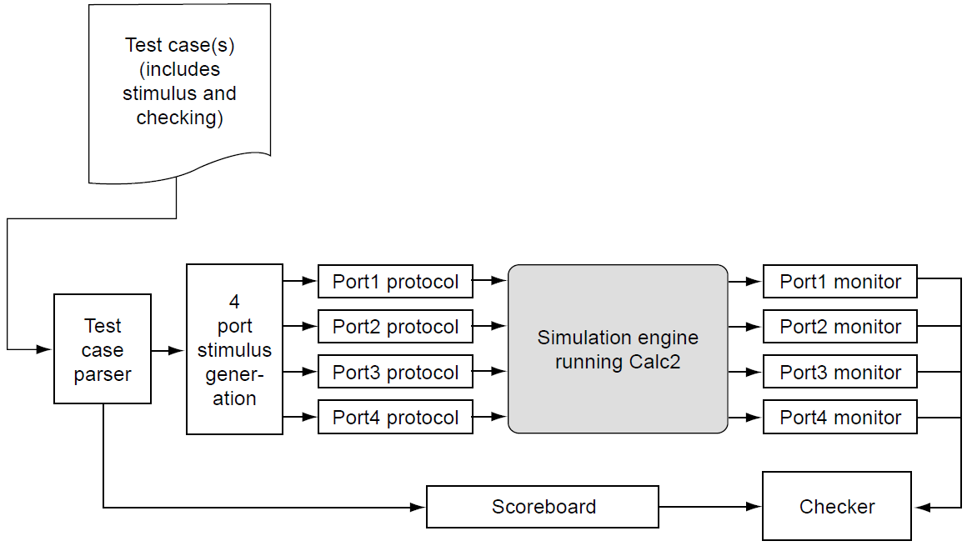
Golden Vectors Test Bench – On-the-Fly Checking
As shown in the flow of bottom figure, the test case parser loads information into the scoreboard.
This path contains various fields and expected data for each command. This information comes directly from the test case.
As the test case runs, the port monitors observe the outputs.
They capture the actual OUT_TAG, OUT_RESP, and OUT_DATA. The monitors pass this data, in addition to the time (cycle number), to the checker.
The checker uses the data from the monitor to request that port’s next expected data from the scoreboard. The checker then compares the expected data to the actual data. This continues until the end of the test.
Pre-determined, deterministic example for Calc2 Port1.
Calc2 verification environment using golden vectors test bench.
Notes:
Recall the pre-determined, deterministic test case for Calc2 Port1, as shown in top figure. Notice the last two columns in the test case format: “Result” and “Response”. This implies that in addition to the stimulus, this pre-determined test case generated the expected results for data and response. Because the expected results exist before the simulation runs, a golden vector test bench becomes a prime candidate to create for this type of test case. Bottom figure shows the verification environment that the verification team would create to support this pre-determined, deterministic test case for port 1.
As shown in the flow of bottom figure, the test case parser loads information into the scoreboard. This path contains various fields and expected data for each command. This information comes directly from the test case. The scoreboard also requires the DelayN field so it can order the expected data for the checker. When the command emerges from the DUV on the outputs, the checker component requires information on the port number, tag, expected response, and expected results to determine if the outputs are correct for a particular command. The only information that the checker does not require is the command, Operand1, and Operand2 fields because the test case has already calculated the expected data.
As the test case runs, the port monitors observe the outputs. They capture the actual OUT_TAG, OUT_RESP, and OUT_DATA. The monitors pass this data, in addition to the time (cycle number), to the checker. The checker uses the data from the monitor to request that port’s next expected data from the scoreboard. The checker then compares the expected data to the actual data. This continues until the end of the test.
Once the test is complete, the checking component calls the scoreboard’s end-of-test case checking routines. In addition, the checker queries the number of transactions outstanding in the DUV’s arithmetic, shift, and invalid queues; these should all be zero. If any queue contains unresolved transactions, then the checker indicates an error. In this type of test bench, all of the end-of-test case checking is within the components.
The approach described above meets the functional requirements because the checks for all the combinations exist (given that all combinations of stimulus occur). For any given command, data, and tag combination, the checking components verify the correct response, results, and tag combination on the outputs. This ensures that the checking components verify the following functional requests: all four command types, all four ports, invalid commands, overflow cases for adds, underflow cases subtracts and tags do not get swapped.
It is worth mentioning the algorithm the Calc2 verification environment uses to maintain order within each queue. This is required to verify two items: out-of-order responses across command pipelines and in-order execution within the pipeline. The plan must detail a specialized function that verifies that Calc2 DUV completes commands in the appropriate order. The simplest method for performing this check (remember, do not re-implement the design) is to track in the scoreboard, via a time stamp, the cycle number that the stimulus component initiates each command. This is the sent cycle for a given command. By ensuring that the time stamps complete in order within a queue, the checking component verifies the order within a queue. The checking component merely needs to confirm that, for each response, the sent cycle value is never less than the sent cycle from this queue’s previous response. That is, as commands complete, the sent cycle time stamps always are higher than the previous.
However, in the golden vector paradigm, the scoreboard has no direct method of sampling the sent cycle. Instead of using the sent cycle, the scoreboard utilizes the fact that within a port, the commands must complete in order (with respect to the queues). So the scoreboard creates three first in, first out (FIFO) queues for each port—one for adds and subtracts (arithmetic FIFO), one for the shift lefts and rights (logical FIFO), and the last for any other command (invalid FIFO). The checking component then requests from the scoreboard the next expected data for a particular port/tag pair. The scoreboard compares this with the heads of the three FIFOs to decide what to return to the checking component. This method works because for a particular port, only one outstanding tag can be in use.
To create these FIFOs, the scoreboard sorts the test case file from top to bottom: first by port number and then by command type. This needs to be done because the scoreboard only knows the delay from one command to the next (DelayN), it does not know anything about absolute time due to the pre-generation of the test case. Thus, it cannot predict the sent cycle. This scheme will validate the functional requirement for the in-order execution within the pipelines.

Slide 18
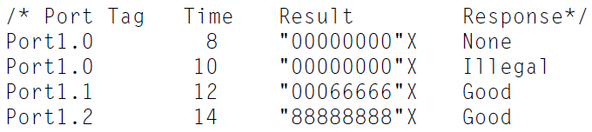
Golden Vectors Test Bench – End-of-Test Checking
Another golden vector test bench approach exists that does not use a scoreboard. In this approach, it does the checking at the end of the test case within an external checking program.
The verification environment uses a separate post-processing program to perform the checking.
The test begins and the stimulus components initiate transactions. When the monitors detect activity, they record the port information into a file.
For a given port, the monitor might record the data shown in bottom figure.
The monitors continue to capture the outputs until the end of the test case. At this time, the simulation ends and invokes the external checking program.
The program uses the information from the test case and the results that the port monitors collected to validate that the results were correct.
Calc2 verification environment using golden vectors and end-of-test checking.
Port 1 monitor output. Each line indicates when a transaction
occurred on the outputs of the particular port.
Notes:
Another golden vector test bench approach exists that does not use a scoreboard. In this approach, it does the checking at the end of the test case within an external checking program. Top figure shows the test bench environment.
The verification environment uses a separate post-processing program to perform the checking. In this paradigm, the flow commences when the test parser reads in the test case and then loads the stimulus components (identical to the previous approach). The test begins and the stimulus components initiate transactions. The monitors observe the outputs (again, identical to the above approach) for any activity. When the monitors detect activity (a change in the OUT_TAG or OUT_RESP signals), they record the port information into a file. The content of the file is similar to the data captured earlier. For a given port, the monitor might record the data shown in bottom figure.
The monitors continue to capture the outputs until the end of the test case. At this time, the simulation ends and invokes the external checking program. The program uses the information from the test case and the results that the port monitors collected to validate that the results were correct.
By looking at the test case format, many of the required checking functions are easy to formulate. To check for responses, the checking program uses the tags to correlate the cmd field from the test case input file (see top figure in the previous slide) and response field from what the monitors captured. The test case shows that the checker can determine if the actual result and responses for the various commands across the ports match the expected results by correlating the port and tag. This validates everything but the in-order and out-of-order functionality. To validate this, the checking program uses the time stamps. It calculates the time stamps from the DelayN field in the test case. The results file already has the time stamp in the file. The checker must process all the ports’ outputs to determine if the order is correct. To check the ordering within a queue, the program would first sort the output file results into buckets based on queue type (adds or subtracts go in order into the arithmetic bucket, shifts go into the shift bucket, and all other commands go into the invalid bucket). Then the program would sort each of these buckets based on the time stamp. The checker would perform this same type of sort for the test case. Now it compares the three buckets from the test case and output file from top to bottom. This verifies the ordering of the commands.

Slide 19
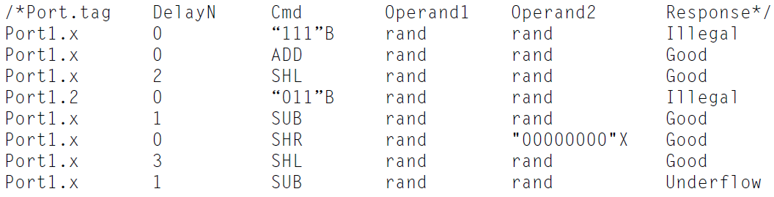
Transaction-Based Test Bench – On-the-Fly Checking
A golden vector test bench is only applicable when the expected data is available before simulation begins using pre-generation.
If the verification team chooses to implement an on-the-fly generation scheme, then the team must utilize a different style of checking component.
The flow shown in bottom figure is similar to the golden vector test bench except that instead of the test case parser loading the scoreboard with all the data, now the scoreboard collects the information on-the-fly.
During simulation, as the stimulus component initiates a transaction to the DUV, it also informs the scoreboard of this transaction.
Deterministic test case with randomization example for Calc2 Port 1.
Calc2 verification environment using transaction-based test bench.
Notes:
A golden vector test bench is only applicable when the expected data is available before simulation begins using pre-generation. If the verification team chooses to implement an on-the-fly generation scheme, then the team must utilize a different style of checking component.
On-the-fly generated test cases as in top figure, no longer define the tag as a specific value. Instead, they specify the tag value per port as an “X,” which means use the next available tag. In the golden vector test bench, the tag was important in correlating input commands to output responses. Now that the stimulus model chooses the tag during simulation, the test case cannot supply this information to the scoreboard and to the checking component. Now the scoreboard must collect the tags during the simulation. Bottom figure shows this test bench.
The flow shown in bottom figure is similar to the golden vector test bench except that instead of the test case parser loading the scoreboard with all the data, now the scoreboard collects the information on-the-fly. During simulation, as the stimulus component initiates a transaction to the DUV, it also informs the scoreboard of this transaction.
This scheme simplifies the major complexity that existed under the golden vector paradigm: the scoreboard’s inability to calculate the sent cycle. The scoreboard had to maintain multiple FIFOs per port and sort the information from the test case into these FIFOs. By having the scoreboard receive all of its information from the stimulus component and not from the test case loader, the scoreboard can calculate the expected data. Now that the verification environment captures the sent cycle, the checking component can now perform its checks as described previously.
In addition, this change also allows the verification environment to be robust enough to handle pre-generated or on-the-fly test cases (it becomes independent on the type of generation). To do this, the scoreboard must analyze each transaction sent into the DUV and create the expected data on-the-fly. With this change, the test case is now just a set of stimulus constraints.
Under the golden vectors paradigm, the verification environment did not perform priority checking across queues. The change to a full, on-the-fly checking paradigm enables this checking. The verification engineer could look at the problem using a statistical approach. If the verification team performs a statistical analysis across the ports, it should show that for a given set of fair inputs (on average, the two queues have the same number of transactions), the logic should give equal priority to the two queues because the two queues have an equal number of entries. This means that the latency from command to response across the two queues should be about equal over the life of the simulation. The use of time stamps assist in verifying this property. A modification to the scoreboard could allow it to track the latency for each port within the queues and analyze the data at the end of the test case. The checker can call an additional end-of-test case checking routine to determine that it fairly serviced each port. The only caveat to this approach is that the distribution of queue type (number of add/sub and shift commands) must be fair across ports. If the stimulus component sends all of one queue type, then this check will fail. Hence, a dependency on the generation constraint exists for the checking component. The checking component should only perform this latency verification routine when the stimulus component has sent an even distribution of traffic.

Slide 20
Transaction-Based Test Bench – End-of-Test Checking
If the verification team really prefers the golden vector approach with a post-processing program, the above transaction-based environment supports this method.
This environment deviates from the strict golden vector paradigm in that the stimulus generation component creates the transaction stream sent into the DUV instead of the test case.
The post processing program remains the same.
Figure to the right shows this test bench.
Calc2 verification environment using a transaction-based test bench with a post processing program.

Slide 21
Cycle Accurate Reference Model Test Bench
In the cycle accurate reference model type of environment, the reference model receives all inputs that the DUV receives and determines what the outputs should be on a cycle-by-cycle basis.
In the reference model paradigm, the checker is simple - it only compares all outputs of the DUV with the outputs of the reference model. If there is a mismatch, the checker indicates an error.
However, the reference model can be extremely complex.
This approach is advantageous for a certain class of checking, in particular if the verification plan calls for checking on the exact timing of outputs.
Given the level of detail required in the reference model, it is extremely important to remember to implement the reference model differently than the design!
Calc2 verification environment using a reference model
Calc2 single command timing diagram
Notes:
In the cycle accurate reference model type of environment, the reference model receives all inputs that the DUV receives and determines what the outputs should be on a cycle-by-cycle basis. Top figure shows the test bench that uses a cycle accurate reference model instead of a scoreboard.
In the reference model paradigm, the checker is simple - it only compares all outputs of the DUV with the outputs of the reference model. If there is a mismatch, the checker indicates an error. However, the reference model can be extremely complex. This approach is advantageous for a certain class of checking, in particular if the verification plan calls for checking on the exact timing of outputs. If the DUV is out of step with the reference model for any reason (it may not be a critical bug), the cross-check with the reference model will catch it. Take, for example, the Calc2 single command timing diagram in bottom figure.
The stimulus generation component sends a command on port 1 at time 7. The DUV outputs its response six cycles later at time 13 as opposed to 12 (originally, the output was described to be on cycle 12 as denoted by the dashed lines in bottom figure); the reference model would issue an error that at time 12 a command response was expected but none was received. In the transaction approach, the scoreboard-based checker would not verify the exact latency and would allow the response at time 13.
The latency check seems easy as long as a single command is considered on a single port. However, the complexity can explode: what would the latency be of port 1 given an example in which there are 12 shift commands in one queue and 7 add commands in the other. If the environment has to calculate the latency for all commands all the time, the reference model complexity converges on that of the DUV.
With a reference model approach, the environment checks all functions within the design (including the algorithm Calc2 uses for maintaining order within each queue) inherently owing to the timely prediction of all outputs. Given the level of detail required in the reference model, it is extremely important to remember to implement the reference model differently than the design!

Slide 22
Strategies for Result Checking in Simulation-Based Verification
Debug

Slide 23
Debug
Debug is the process of locating and correcting problems in the DUV or test bench.
Debug is important because a swift and effective debug process saves time and schedule. Because quick debug saves schedule time, the measure is how fast the verification team determines the cause of the failure.
Thus far this lecture has presented different checking component algorithms that lead to failure reporting. This section discusses what happens after that.
A failure could be from any of the existing environments. Once a test fails, the verification team must analyze the failure to find the cause of the problem. When a test fails, a bug could exist in one (or more) of the following areas:
  Design
  Environment
  Specification
  Tools
A verification engineer’s job is to find the bugs in the HDL and report only these to the designer.
If the verification team were to report all failures to the design team, they would soon lose credibility. Therefore, a verification engineer is responsible for sorting out the failures and determining what are design bugs versus test bench bugs.
Notes:
The area listed last, tools, is a rare source of bugs, so this is usually the last place to investigate. An example of a tool bug is when the simulation engine does not correctly calculate the proper value of a latch or signal in the design. This type of bug is rare because of the broad use of verification tools and is usually confined to beta or new releases of tools. A bug in the tools reveals itself when a calculated value in the DUV or environment does not match the input values of the HDL or program.
A verification engineer’s job is to find the bugs in the HDL and report only these to the designer. In most cases, the verification team is best suited to differentiate between HDL bugs and environment bugs. Designers own plenty of tasks, but deciding what is a design bug versus a test bench problem is typically not one of them. If the verification team were to report all failures to the design team, they would soon lose credibility. Therefore, a verification engineer is responsible for sorting out the failures and determining what are design bugs versus test bench bugs. Only when a design bug exists does the verification engineer report it to the designer for repair. When a test bench bug exists, the verification team performs the fix. Because the verification engineer must have intimate knowledge of the function in order to create appropriate stimulus and checking, it makes sense for him or her to “dig-in” and assist the designer in locating the proximity of the bug.
In some cases, the source of the bug is owing to an ambiguous specification. In these cases, the architect must provide a more precise definition of the intent in the specification.
A good debug process is also important because the sooner the verification engineer locates and fixes the bugs, the more schedule time exists to run random simulations. The more simulations run in a random environment, the higher the overall quality of the design. The better the design, the smaller chance of hard-to-detect bugs that escape to the lab. Therefore, to reduce overall verification time and increase overall verification productivity, the verification engineer should concentrate on ways to improve debug.

Slide 24
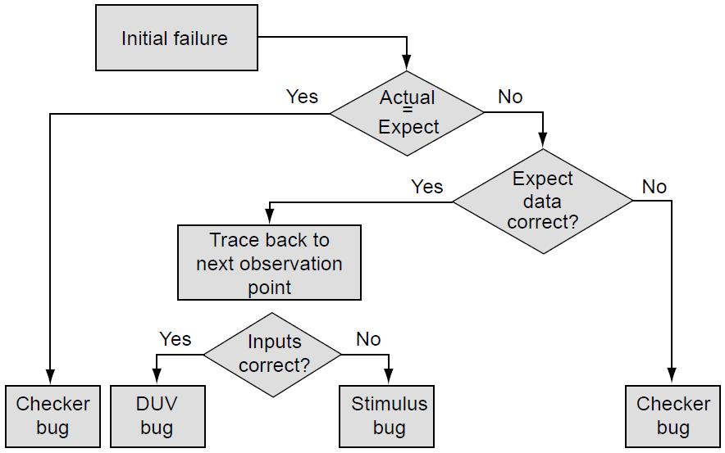
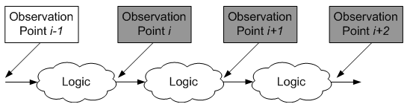
Debug Process I
The basic debug process flow starts at the point of failure and traces back to the origin of what caused the failure. Figure to the right illustrates the process.
The main philosophy behind debug is the following question: why did a test fail? This will determine what to fix - the HDL, the verification components, the specification, or, in rare instances, the tools.
Although this flow seems straightforward, the complexity of the debug process lies in determining which branch of the flow to take in the “Expected Data Correct?” and “Inputs Correct?” blocks.
Notes:
When debugging a test case, it is common to see multiple checkers flagging a problem. Typically, the verification engineer can assume that all failures after the first one are side effects of the initial failure. This is primarily because of the difficulty in re-synchronizing the reference model/scoreboard once it differs from the DUV. Therefore, the verification team only needs to focus on the first failure reported from the test case. If subsequent failures exist, they will remain in the DUV, and the same test case will encounter them after re-running the simulation to test the initial fix.
Following the diagram flow in figure, a checker indicates an initial failure. The first step for the verification engineer is to compare manually the actual and expected data by using the simulation trace output. These data can be from a single point in time or gathered over many simulation cycles. If the actual data equal the expected data, then the verification environment requires updating as the check that indicated the error is incorrect. If the actual data do not equal the expected data, then the verification engineer must determine which is correct: the DUV data or the verification environment’s expected data.
The heart of the debug process lies in the validation of which results are correct. To determine if the DUV’s or verification environment’s results are correct, the verification engineer must trace the failure back to the input stimulus values. For example, to determine if the Calc2 DUV calculated a shift operation correctly, the verification engineer must match the result’s tag to the initial stimulus to ascertain the actual command and data values. From there, the verification engineer must independently calculate the result and compare it to the DUV’s and environment’s values. If the expected data are wrong again, the checking component contains the bug. However, if the actual data are incorrect, this does not immediately indicate a design bug. It is still possible that an incorrect stimulus condition affected the design. An example of this in Calc2 could be if the stimulus component initiated two commands with the same tag, an illegal case with indeterminate results. In that case, the verification team must fix the stimulus component. In the end, the verification engineer must determine why the actual data are incorrect.
To do this, the verification engineer starts at the observation point determined by the failure. In black box verification, this is a DUV output. In white or grey box verification, the observation point could be internal to the design or a DUV output. In any case, the verification engineer must find the logic that feeds the observation point. In the best of cases, the verification engineer can correlate the observation point to a particular stimulus value or sequence; in the worst of cases, there may be a large convergence across the logic, meaning many paths might feed a single observation point. The verification engineer then spends time determining if the logic that feeds the observation point is correct. If that logic is correct, then the engineer must go back even further. The engineer must validate that all of these are correct (or incorrect). This continues until the verification engineer encounters a previous observation point in the test bench or the input stimulus. If the verification engineer reaches a previous observation point at which a checking component did not fire, then the area of the failure must be between the two observation points. The bug exists after this point (because this check did not fail) and before the area at which the check failed. However, the verification engineer must determine if the previous observation point is faulty. This traceback process continues until the verification engineer finds the point in which the DUV or the verification environment miscalculated a value. This is the source of the bug.
In some instances, the specification is ambiguous, and both the checker and the design can be correct from an interpretation standpoint. In these scenarios, the specification is the source of the bug, and the verification engineer must consult the architect to fix the ambiguity in the specification.

Slide 25
Debug Process II
The debug process determines the specific failure by tracing a miscompare or unexpected value back to the point of origin.
Therefore, the identification of the failure point (point of origin) is a critical step. The closer the specific failure is to the observation point (the checker at which the environment detected the miscompare value), the faster the debug process proceeds.
Therefore, the verification team could streamline the process by adding more observation points to isolate the failure point quickly.
To take this to an extreme, every node in the circuit could have a check on it. However, this extreme case creates difficulties on multiple fronts:
  First, if the verification team imbeds internal checks throughout the design, the team tips the scales too far toward verifying the design’s implementation rather than the design’s intent.
  Second, maintenance of the extensive checkers becomes difficult, as the verification team must update internal checkers with every change in the design.
The other extreme is black box, in which no observation points exist within the design. This approach would just check the outputs. However, unless the design is small, it is likely that the failure point is logically distant from the observation point.
Therefore, the verification team must strike a balance between the quantity of checkers and debug efficiency. The “meeting point” of these two approaches is the gray box paradigm.
Notes:
Let us take Calc2 as an example. The previous approaches of checking using golden vectors, transaction based, and reference model all assume use of a black box. To illustrate the importance of observation points, as well as shed some light into the black box, more details of implementation are required. The Calc2 design captures the command and data in two consecutive cycles and then enqueues this data into one of two internal buffers: one handles the addition/subtraction pipeline; the other, the shift pipeline. A priority block exists inside the DUV to dispatch commands from the buffers to the pipelines.
Previously we discussed mechanisms to check the in-order and out-of-order functional requirements. Now that the box is gray, observation points (monitors) can be placed on the input of the priority block, as well as a checker on the output of the priority block. By doing this, the previous discussion on the methods of checking the in-order and out-of-order function in the various checking paradigms becomes much simpler. The output checking of the DUV (versus the priority block) can concentrate on the correctness of commands because the internal checks will now validate the order of execution is correct. The other advantage is that if and when the priority checks fail, the verification engineer knows exactly where the bug exists.

Slide 26
General Guidelines for Placing Observation Points
Here are some general guidelines for deciding where to place observation points in the design to aid in debug and provide additional checking:
  Aim for mechanisms defined in the design’s architecture. Observation points on these structures are stable and require less maintenance.
  Space observation points evenly throughout the design.
  Use observation points to augment the design team’s assertions. Do not create redundant observation points for logic that already contains assertions.

Slide 27
Additional Aspect of Checkers That Assist in Debug
Previously, this lecture described the construction of effective checkers relative to a basic verification environment. There are additional aspects of checking component construction that assist in debugging.
This includes how and when a checking component reports a failure, which is critical in assisting the verification engineer during debug.
The more information that the checking component provides, the faster the verification engineer can debug the failure.
Just indicating that a failure exists is not enough. When a verification component reports the failure is equally important because the debug process goes faster when a checker reports a failure when the failure occurred.
Conversely, if the failure occurred early in the simulation but the checking component indicated a failure near the end, the tracing back through time (i.e., many transactions) is time-consuming and wastes simulation cycles that the verification team could use for other test cases.
This indicates an inherent disadvantage for end-of-test case checking.

Slide 28
Reporting a Failure – The Bad and Good Way
For example, a test case ends and reports the following:
  Simulation completed:
  100 transactions sent
  100 transactions received
  1 error
This reporting style does not assist the verification engineer in debugging with respect to how and when the checker encountered a failure. These messages do not even point the verification engineer to the observation point.
In this case, the verification engineer must debug the failure by viewing the trace file with no indication of what the error was or when it occurred.
Instead, the checker should log complete data about the failure. This should include many of the following items: the current cycle, the verification model, a failure message, the design hierarchy in which the checker encountered the failure, the nets involved in the check, the actual DUV values, and the expected values. For example:
  ERROR (Time 50): Checker: Port 1 — Wrong response
  ERROR (Time 50): Checker: Port 1 — Expected Response: Good
  ERROR (Time 50): Checker: Port 1 — Actual Response: Overflow
  ERROR (Time 50): Checker: Port 1 — Expected Result: “0F12023F’’X
  ERROR (Time 50): Checker: Port 1 — Actual Result: “0F12023E’’X
The information on the “how and when” of the error cuts down on debug time. This message style gives much more detail and steers the initiation of the debug process.
Notes:
The information on the “how and when” of the error cuts down on debug time. This message style gives much more detail and steers the initiation of the debug process. The verification engineer knows to start debugging at cycle 50. The engineer also knows that the checking component found the error on port 1 and exactly what signal values did not match the expected values. This level of messaging speeds the initial portion of the debug process, quickly directing the verification engineer to the miscompare and assisting in localizing the failure point.

Slide 29
Debugging Tools
There are multiple tools in the arsenal that assist the verification engineer in discovering the “how and when” of a miscompare.
These tools exist as mechanisms to reduce debug time and range from basic messaging to more advanced tools that allow for graphical debug of the test bench.
The following are a set of debug tools:
  Print
  Assertions (not discussed in this course)
  Waveform viewers
  Memory viewers (not discussed in this course)

Slide 30
Print
The most basic reporting mechanism is print. To implement this mechanism for debug, the verification engineer simply adds print statements into the environment components to log test bench activity.
The print statements echo the values of the verification components at different times via some logging mechanism. This logging mechanism captures the information and directs it to a simulation log file or a dedicated log file.
Verification engineers use dedicated log files for individual verification components (rather than a global log file that captures all components’ messages), giving them the ability to sort through many messages quickly.
The down side to logging messages is that they tend to be very verbose. Components can generate thousands of lines of messages in a log file. This can also negatively affect the simulation engine’s performance owing to the file input/output (I/O) throughout the test case.
A solution to this is to include programmed debug levels in the environment code, a technique the software industry has used for years.
When running a test case in the default mode, the components use the lowest message level at which checkers only report errors - no other pertinent information. However, when an error occurs, the verification engineer reruns the simulation, applying a higher level of debug messaging.
Notes:
The most basic reporting mechanism is print. To implement this mechanism for debug, the verification engineer simply adds print statements into the environment components to log test bench activity. The print statements echo the values of the verification components at different times via some logging mechanism. This logging mechanism captures the information and directs it to a simulation log file or a dedicated log file. Verification engineers use dedicated log files for individual verification components (rather than a global log file that captures all components’ messages), giving them the ability to sort through many messages quickly. This is especially useful during early component debug. Verification teams may also choose to use dedicated log files to sort logically separate data streams. In Calc2, for example, there are four independent requestors on four different ports. The team could choose to create the environment such that each of the four stimulus components logs every transaction into separate files. This way, if a failure occurs on port 2, debugging commences on the log file for port 2, bypassing potentially extraneous data from other ports. However, the verification engineer cannot discount the potential that other ports’ inputs may affect each other. Therefore, the potential exists that while debugging a port 2 failure, the verification engineer traces commands from other ports’ log files.
The down side to logging messages is that they tend to be very verbose. Components can generate thousands of lines of messages in a log file. This can also negatively affect the simulation engine’s performance owing to the file input/output (I/O) throughout the test case.
A solution to this is to include programmed debug levels in the environment code, a technique the software industry has used for years. When running a test case in the default mode, the components use the lowest message level at which checkers only report errors - no other pertinent information. However, when an error occurs, the verification engineer reruns the simulation, applying a higher level of debug messaging. Now the components print detailed information to the log files, aiding the debug process. All units throughout the environment can use debug levels - not just checkers. This may include stimulus, scoreboards, checkers, and/or monitors. However, a global messaging method can easily lead to information overload with all the verification components logging information for the test case. Instead, the verification team may consider a more granular message logging paradigm in which parameters enable debug messages only for a subset of the verification components. This may assist in controlling the amount of information written to the log file while also avoiding the performance problem.
It is important to note that the verification team needs to plan this fine-grained control of debug message levels before writing the actual test bench code. It is very time-consuming to add such debug message control into already released code.

Slide 31
Waveform Viewers
Often it is necessary to get more details when a test case goes awry.
Many times when debugging, the verification engineer needs to view signals within the design and their values at different times within the simulation.
To accomplish this, the verification engineer can use a visual tool and view the DUV’s internal values in a waveform.
A waveform viewer is now a mainstream tool packaged with every simulation engine.
Electronic design automation (EDA) companies provide waveform viewers mainly because they are the most common type of debugger.
Waveform viewers within the debug process display the signals and latches that are of interest after a test fails and, when tracing back through the logic, help determine the correctness of the actual outputs.
Once it captures these signals and latches, the engineer compares these values to the ones that the checking component indicated was an error.
Another use of a waveform viewer during the debug process is to view the internals of the verification components.
Stimulus components, monitor components, and checking components may have internal state machines just as a design might. A waveform viewer is a useful debug tool for a designer (to look at the HDL); it can be just as useful for the verification engineers to look at their code.
Notes:
By using a waveform viewer to show internal variables/states of the verification components over time, the verification engineer can identify bugs (just as a designer would) within the environment. This ability is very powerful and may show the source of a problem much more quickly than just using print statements.

Slide 32
How Different Types of Test Benches Affect Debug
The stimulus and checking paradigms affect the debug process.
Although all environment types require similar DUV approaches, the different stimulus and checking techniques require different approaches when debugging the verification components themselves.
Specifically, the type of generation (pre-generation versus on-the-fly generation) and type of checking (on-the-fly versus end-of-test case checking) drive different internal debug strategies based on the information provided by the test case.
When using a pre-generation strategy, all the facilities and stimulus are available before running any simulation cycles.
On the other hand, on-the-fly generation components must run simulation cycles in order to decide if the stimulus is correct.
Next, we will provide details and insight on the differences between debugging pre-generation test cases, on-the-fly generation, and checking.

Slide 33
Debugging Pre-Generated Test Cases
Determining if stimulus is correct with a pre-generation stimulus component is the easier and less time-consuming than on-the-fly generation.
Before running any simulation cycles, the verification engineer can observe the transactions that the stimulus component will send into the DUV.
The verification engineer expects the stimulus component to send these specific scenarios in a legal format.
If, through debugging, the verification engineer finds that the test case contains an error, then the generator (or writer) needs to fix the generation problem.
If the test case is correct but the inputs to the DUV are not, then the verification engineer must fix the stimulus component.
Notes:
However, debugging pre-generated test benches is often not so simple. Complexities arise in environments in which stimulus components require feedback from the design. In these cases, the stimulus component cannot send in the next transaction until it receives an acknowledgement from the DUV. Because of the timing and interaction between the stimulus component and the DUV, the verification engineer must determine if the pacing is correct at simulation runtime. Therefore, in these situations, pre-generation debug may only get the verification team part way. The verification engineer must debug the test case stimulus through run-time debugging methods.

Slide 34
Debugging On-the-Fly Generated Test Cases
Debugging on-the-fly stimulus component is not as quick as pre-generation. The reason is turn-around time.
Because the verification engineer must run simulation in order to debug the stimulus component, there is an upfront wait time to determine if the stimulus is correct.
In addition, the verification engineer must wait until after re-running the test case to the same point to determine if the fix was actually good.
Notes:
For example, a test case that fails after 3 hours is determined to have a stimulus component bug. The verification engineer fixes the component and re-runs the simulation - another 3 hours - to determine the success of the fix. At this pace, the verification engineer can only perform one fix a day. Moreover, this does not even account for the debug time to determine that the stimulus component contained the issue. However, the verification engineer is not limited to just using print messaging and waveform viewers. In on-the-fly generation, the verification engineer can also perform source code debug by using standard programming or HVL interactive debuggers. In very complex stimulus components, this may outweigh the turn-around time.

Slide 35
Debugging On-the-Fly and End-of-Test Case Checking
Debugging end-of-test case and on-the-fly checking require similar methods. Both require tracing back to the origin of failure.
Thus, it is advisable to use debug tools, such as print statements, within the verification environment.
These tools allow the verification team to trace a transaction from its conception (generation) through the environment to the checker.
Many times, the verification team will add special fields to the data structures used within the verification environment.
The sole purpose of these special fields is to assist in tracing back to the origin of the failure.
Notes:
The verification team uses different mechanisms to perform this trace. One mechanism is to direct all the transactions to one log file. In this scheme, the verification team parses through this file looking for port transactions relative to the failure based on addresses, transaction types, or other events related to the failure. A different method is to correlate similar functions and direct each one to its own trace file. For example, in Calc2, the verification components could direct the printing of transaction information (i.e., trace information) to a log file on an individual port basis. At the end of simulation, four trace files exist, one for each port. If the verification team needs to perform debug on port 1, all the transactions that port 1 performed are contained in a single file. The trace file would contain pertinent information for every transaction such as cycle transaction was sent into the design, cycle at which the scoreboard performed its dispatch, cycle at which the checking component received its response, and cycle at which the check was performed. However, this scheme makes it more difficult to debug failures with roots in multiple port operations.
It is imperative that all the verification component authors stay “on the same page” when creating the print statements for these trace files. If the stimulus component creates four separate trace files (one per port) but the checking components log everything to one file, then additional burden is placed on the verification team to correlate everything.

Slide 36
Re-Use Strategies
Introduction

Slide 37
Introduction
Re-use allows the verification team to leverage verification components and design blocks across a chip or across multiple chips in a system.
As it does for design, the concept of “create once, use in many places” applies to verification components as well.
The result is improved time to market and reduced resource requirements.
Figure on the right illustrates an example of design re-use (verification aspects of re-use follow).
Design re-use. Multiple usage of a single unit (many instances) within a chip or within multiple chips.
Notes:
In this example, unit A is used across the two chips, X and Y, and many times within a single chip, X. The re-use of unit A allows for better resource utilization. The development team for chip X only needs to design two units: A and B. The development team for chip Y only needs to design one unit, C, because it re-uses unit A from chip X. This type of design re-use is called horizontal re-use, because the team uses the design blocks across a single chip (as in unit A within chip X) and across multiple chips (unit A used in both chip X and Y).

Slide 38
Verification Re-Use: Horizontal Re-Use
Because verification is a large part of the design effort, it makes sense that the same concepts for design re-use apply.
Applying re-use concepts to verification reduces the duration of a project.
So, in general, horizontal re-use occurs when a team uses a design unit or verification component multiple times at the same level of the hierarchy.
Figure to the right is an example of horizontal re-use within verification.
Horizontal verification re-use: using verification components across a level of verification.
(a) A chip in which three units, A, B, and C, interface to a shared bus.
(b) The interface to this shared bus is identical, so the verification team creates a re-usable stimulus component for the three unit verification
environments.
Notes:
In this example, units A, B, and C all connect to a common shared bus. Because the units have a common shared bus, there is no need for each verification team to develop its own stimulus component. Instead, a verification team can create a re-usable stimulus component for each unit test bench. This concept can expand to include other common verification components such as interface monitors and checkers. This is an example of horizontal re-use because the team utilizes a set of verification components across the same level of the verification hierarchy (in this case, unit test benches). More details of how to achieve horizontal re-use are discussed later.

Slide 39
Verification Re-Use: Vertical Re-Use
Another form of re-use, vertical re-use, is unique to verification.
Vertical verification component re-use is the usage of verification components up the levels of hierarchy.
Vertical re-use is important to system simulation because it allows for the verification team to leverage what has already been implemented.
This, as in horizontal re-use, allows for optimization of resources.
Figure on the right shows a simple example of vertical verification re-use.
Vertical verification re-use: using verification components up the levels of hierarchy (from unit up to system).
Notes:
As shown in figure, unit A’s test bench has two verification components associated with it: a stimulus component and an interface monitor/checker. This design unit is at the periphery of the chip. This means that the chip level verification team can re-use the stimulus component from the unit test bench in their test bench. In addition to the stimulus component, the chip level verification team also utilizes the interface monitor/checker to assist in their debug activities. Therefore, vertical re-use occurs when a higher verification level utilizes verification components from a lower level. More details of how to achieve vertical re-use are discussed later.

Slide 40
Re-Usable Verification IPs
Verification components that can be re-used both horizontally and vertically are referred to as re-usable verification IP.
Re-usable verification IP allows companies to maximize the verification work.
This may occur when a company develops multiple chips that use an industry standard interface such as peripheral component interconnect (PCI) and share the stimulus and checking components across projects.
Alternatively, if many groups within a company develop the same verification components, resources are wasted.
To go one step further, a company can purchase re-usable verification IP from vendors.
This IP may seem expensive at first, but usually in the end it saves money. These companies have a magnitude of uses for these components (thus enhancing their function), more than a local team would ever get.
With this broader use, the quality of their product increases. Additionally, purchased verification IP is most likely to follow the interface specification, because many different verification teams test it against their different design implementations. There is a level of safety in the higher number of users.
Notes:
As inefficient as it may seem, many reasons exist for why multiple groups may develop similar verification components independently.
It could be that the different groups utilize different hardware description language (HDL) and/or verification languages or that the different groups require different functionality from the verification components.
However, if one group concentrates on developing re-usable verification IP, then all groups within the company can leverage that expertise and reduce overall resources.

Slide 41
Guidelines for Re-Use
Re-use may seem very easy, because the concepts are simple.
In reality, few companies and groups achieve a high degree of re-usability because they fail to put guidelines in place.
The following guidelines allow test bench components to be re-usable:
  Independent stimulus components
  Configurable logging of messages
  Dynamic mapping of signals into verification components
  Packaging verification components
  Documentation

Slide 42
Independent Stimulus Components
Stimulus components need to be independent of all other verification components.
They should not communicate with any other component nor should any other component communicate with the stimulus component.
Figure to the right shows an example of why independent stimulus components are critical for re-use.
Independent stimulus components.
(a) A stimulus component for unit B that communicates directly to a scoreboard.
(b) The usage of unit B at a higher level (where some intermediate checking is desired for debug); the scoreboard is now nonfunctional.
Notes:
In the Figure (a), unit B’s test bench contains a stimulus component that directly communicates to the scoreboard. This works well at the unit level and also has advantages because the developer of the stimulus component already knows much information of what is to be driven into the design under verification (DUV). However, looking at Figure (b) shows the usage of unit B at the next higher level of verification. At this level, internal checking is desired for debug. It can be seen that the ability to re-use the scoreboard at this level now has issues. The chip level cannot re-use the scoreboard because it requires the stimulus component, which is now replaced with the design, to communicate with the scoreboard.
Adhering to this guideline allows for vertical re-use of any verification component. Many verification engineers are tempted to provide the data sent into the DUV to the scoreboard component directly from the stimulus component. Their reasoning is valid: Why create another verification component to monitor the inputs when the stimulus component already contains the data sent into the DUV and can directly inform the stimulus component of new data? However, if the verification team wishes to re-use the scoreboard or checker components at a higher level where the real HDL design replaces the stimulus component in the test bench, then the scoreboard component will not receive any data. Therefore, the best solution for re-use maximization is to add a monitor component to the interface between the stimulus component and the DUV. The monitor component spies the data on the interface and informs the scoreboard. The verification team then re-uses the monitor component at the higher hierarchical level to drive the scoreboard, even in the absence of the stimulus component.

Slide 43
Configurable Logging of Messages
When re-using verification components, the requirement of debugging and informational messages exists as with any other environment.
However, there are additional issues to consider:
  The first issue is that the components need the ability to have configurable and controllable messaging (including debug level and filters).
    This helps prevent information overload of debug messages.
  Another issue, from the developer’s standpoint, is that the verification component needs to have debug messages for when it is determined that there is a bug in the component.
    For this, the component needs a debug level to give detailed messages that are useful to the developers of the component. The end user will not care about any internally specific messages that the component might produce.
  The last issue to consider is the ability to customize how the messaging occurs.
    The developer of the verification component does not know the end environment or how it will be utilized.
    It may be that one particular user wishes to capture all the debug messages from the various components into a single simulation log file, whereas another user requires each verification component to log its information into its own separate file.
    This ability requires the developer of the verification components to create a message handler that can handle configurable debug levels as well as different logging mechanisms.

Slide 44
Dynamic Mapping of Signals Into Verification Components
The names of the interface signals in which the monitors, checkers, and stimulus components interact must be configurable to allow for re-use either horizontally or vertically.
In a horizontal scope, a single verification component may be instantiated numerous times within an environment, or a single verification component may connect to different units where each unit may have different signal names. In either case, the connections to the verification component are different. Calc 2 design is a good example of this, as shown in top figure.
For vertical re-use, most unit environment’s top level is the unit itself. However, when this unit is within the chip, extra levels of hierarchy exist. Thus, verification components need to be “attached” to the different levels. Bottom figure shows an example of the vertical naming issue.
Horizontal naming issues. By keeping names generic, the same component can attach to many units or to the same unit many times to help facilitate horizontal re-use.
Vertical naming issues. By keeping names generic, the same model can attach up the levels of verification to help facilitate horizontal re-use.
(a) A unit level verification environment where the interface checker is monitoring net B.
(b) The same interface checker is re-used but now it needs to monitor Net Top/B.
Notes:
Calc 2 design is a good example of this, as shown in top figure. Each port has a different set of names (REQX_CMD_IN, REQX_TAG_IN, REQX_DATA_IN, where X is the port number), but a single stimulus component could be created to attach to each port. The stimulus component outputs must map to each of the four different ports on the DUV. By allowing for dynamic mapping, the end-user would only need to “configure” the component for its specific mapping. Without this mapping, the end-user would need to copy and paste individual components and modify each one. This leads to higher maintenance and reduces the overall benefit of re-use.
For vertical re-use, most unit environment’s top level is the unit itself. However, when this unit is within the chip, extra levels of hierarchy exist. Thus, verification components need to be “attached” to the different levels. Bottom figure shows an example of the vertical naming issue.
In this example, the signal name to which the common interface checker attaches changes its name because of hierarchy prefixes. If the verification components have a static interface (i.e., directly connects to specific design signals), then it would be difficult to re-use the verification components up the hierarchy.
The ability to have a dynamic mapping mechanism is crucial for reuse. This way, the component can attach to any of the necessary signals at any level, either horizontally or vertically.

Slide 45
Packaging Verification Components
Packaging a verification component gives the end-user the ability to instantiate and easily use the component. Packaging includes all the structures and documentation that the verification team requires to bring the verification component into production seamlessly.
If it is not easy to use the components, the likelihood is that the verification team writes their own. Packaging verification components allows the end-user to apply them more efficiently and instantiate the verification components into different environments easily.
The package should be a self-contained structure for the components. If the component has dependencies on any specific environment, then the verification team must carry these dependencies to any environment that will contain this component. If not, then the component will not work.
Two different packaging approaches exist:
  One method is to encapsulate the re-usable components (stimulus, monitor, scoreboard, and checker) into one package that behaves differently based on constraints.
  The other method is to package each verification component separately. This allows the end user to select the exact components to put in the test bench. This provides the greatest flexibility to the end user. Unlike the previous model, this only uses necessary components.
The basic difference between the two methods is the placement of the work emphasis.
  The complete package paradigm requires the developer(s) to perform more work (including more modes) and to solve any intercomponent dependency issues.
  The independent component package paradigm shifts this responsibility to the end user.
Notes:
Two different packaging approaches exist. One method is to encapsulate the re-usable components (stimulus, monitor, scoreboard, and checker) into one package that behaves differently based on constraints. In this scheme, the verification team would create the components with the packaging method in mind. For instance, the dynamic mapping structure mentioned above is re-used across all the components. This also means that the verification team also needs to add “mode” switches that operate differently based on the package constraints. These switches turn different parts of the components on and off. The verification team could create a mode for the stimulus component. This mode would control the enabling of the stimulus component. By doing this, it allows the end user to activate the stimulus component based on the environment. A unit test bench would require an active stimulus model, but within the chip level test bench the stimulus model is passive because the real logic drives the interface. However, the other components of the package (monitors and/or checkers) remain active. Taking the “modes” one-step further, the verification team can include constraint-controllable levels of checking and monitoring in the package.
The other method is to package each verification component separately. This allows the end user to select the exact components to put in the test bench. This provides the greatest flexibility to the end user. Unlike the previous model, this only uses necessary components. Hence, some of the above-mentioned modes are not required. A verification team would not need to turn on or off the stimulus model. If the test bench at the next higher level does not require the stimulus component (because the real logic exists), then the verification team would not instantiate it. A disadvantage to this paradigm is that the end user must now create and configure all the separate components individually. This may be inefficient when components share similar interfaces.
The basic difference between the two methods is the placement of the work emphasis. Re-use requires a little more planning and work for implementation. The complete package paradigm requires the developer(s) to perform more work (including more modes) and to solve any intercomponent dependency issues. The independent component package paradigm shifts this responsibility to the end user. In many cases, it makes sense for the developer to perform this work because they are the most familiar with the individual components. It may take the end-user more time in using the components because they are not familiar with any inter-dependencies between them.
The advantage to having the developer do the work and having a more integrated package is that the end-user only has to worry about configuring one big component. All inter-dependencies of the inner components are in the packaging (if any cross-constraints exist). The disadvantage is that the developers creating these components need to do more work. However, the more times that verification teams re-use the components, the more worthwhile the pre-packaged method becomes.
In addition to deciding on a packaging mechanism, the verification team must also reflect upon and document the scope in which they will use the verification IP. The verification team must take into consideration any dependencies, such as simulation engines, high-level verification language (HVL)/HDL, operating system, and compiler. Any of these aspects may limit the usage of the verification IP. These limitations may be acceptable depending on the targeted user audience, but the users need to know about them.

Slide 46
Documentation
Documentation is advantageous to any design and verification endeavor, but it is necessary for re-usable verification components.
The end user must be aware of what constraints and controls they have over the components.
Documentation is a fundamental requirement for re-use.
If the end user does not know how the components behave or how to control their behavior, then the user will not trust the verification IP.
Documentation is also important in informing the end user on any limitations or configuration options that are available.
The following is a list of features that, at a minimum, should be documented:
  Basic function
  Usage notes and limitations
  Modes and constraints
  Release notes
Notes:
Documentation of the basic function of the verification component should exist so that the end user knows what the verification component is intended to do. If developing a verification IP for sale, then this basic function can exist in some “glossy” that marketing and sales use to promote the IP. However, if this IP is used only for internal purposes, then the documentation could simply be text file (a “README” file) that explains the basic concepts and purpose of the IP.
In addition to the function, usage notes and any known limitations need to be listed so the end user does not try to use the verification IP in the wrong way. The usage notes explain how to use the verification IP. It describes how to instantiate the component into a test bench, how to compile it (if applicable), and how to link it into any specific simulation engines. Any limitations should also be noted here, such as limitations on what operating systems are supported. The end user can use the verification IP more effectively once they know the limitations.
The documentation needs to explain any modes and constraints that are available to the end user. The end user needs to know how to control the verification IP, what variations are available in the parameters, and what they do when changed. This allows the end user to direct the verification IP for their specific implementation and purposes.
Release notes are important because they allow the end user to know what is new in a particular release. It could be that an end user has an issue with a particular release of a verification component and will upgrade once a new feature has been included in the component. An easy way to convey this information is to put it into a set of release notes that indicate the reasons for this release and how it differs from previous releases.

Slide 47
Re-Use Strategies
Horizontal and Vertical Re-Use

Slide 48
Horizontal Re-Use
Horizontal re-use is defined by the use of the same verification components across the same level of verification hierarchy.
Horizontal re-use occurs when multiple units exploit a single verification component in the same hierarchical level.
In this section the additional complexities that exist when developing verification components for horizontal re-use are discussed.
Different scopes of horizontal re-use exist and, depending on the scope of re-use, different complexities exist. Verification engineers apply horizontal re-use within the following scopes:
  Re-use across units (within a chip)
  Re-use across chips (within a company)
  Re-use across companies (realm of electronic design automation (EDA) IP developers–third-party IP)
Notes:
Re-use across units has the narrowest scope. This means that a single team understands the functionality that the verification components must support. At a minimum, the teams all fall under the same project scope.
The scope of function that the components must support broadens when re-using components across chips (but within a company). Here, the teams may not fall under the same project, leading to conflicts due to prioritization of function requirements, resources, and schedule. This paradigm requires communications and a unified decision-making process that maximizes company effectiveness.
The broadest scope is a verification component that is fully re-usable. This is where the component supports all the capabilities of the protocol and interface (it is fully compliant in that it follows and supports the complete specification). This scope focuses on third-party verification IP. Many EDA companies have created a business model around writing verification IP. Because their customers demand high-quality IP (verification engineers expect a high degree of quality from what they purchase!), these companies not only focus on the protocol and checks of the verification IP they are developing, but also in documentation and packaging. They know that the easier it is for their customers to use their IP, the broader use it receives. If the verification IP is hard to use and control, then customers will not purchase the IP and the company will lose market share.
Horizontal re-use has its own complexities because many times the components are not all encompassing in terms of functions supported. For example, a verification team working on chip A that contains a PCI interface is going to create re-usable verification PCI components for their company. Chip A’s function specifies support for single beat reads and writes only (this is a certain type of PCI bus transaction). Thus, this team concentrates on this function for the verification components. Somewhere else in the company, a team is designing chip B that also contains a PCI interface. Chip B’s verification team heard of this common verification component and now depends on it to meet their schedule. However, chip B, in addition to single beat reads and writes, also supports burst length reads and writes. To make the component re-usable, chip A’s PCI verification team must now add additional function because of chip B’s requirements. If they were to leave this out of the verification components, then chip B could not use it and would have to create their own component, thus creating additional work. Alternatively, chip B’s verification team could copy the components and add their functionality to it—which in the end may be the faster approach.

Slide 49
Vertical Re-Use
As mentioned earlier, using the same verification components up the levels of verification hierarchy is vertical re-use.
This can occur when the chip level team uses internal checks and monitors from the unit levels or exploits a stimulus component from a unit.
The difficulty in vertical re-use is that the requirements for a stimulus component at the unit level are typically different from the top level, especially for stimulus components that must initiate transactions.
Within a unit test bench, stimulus components tend to focus randomization at individual transactions and generate these transactions randomly across the DUV interface. The randomization at the next level is across transaction sequences, not on the transactions themselves.
Vertical re-use of components in a unit test bench that have no external interfaces at the next higher verification level are typically limited to monitors and checkers.
This is because in the next level of hierarchy, the DUV replaces the stimulus components with the real design. However, checkers and monitors remain valid if the verification team follows the re-use guidelines in the construction of the verification components.
The verification team doing the next level of verification simply includes these components into the test bench. The desire to do this is to try to reduce the debug time for the system level of verification.
Notes:
The difficulty in vertical re-use is that the requirements for a stimulus component at the unit level are typically different from the top level, especially for stimulus components that must initiate transactions (as opposed to reactors). Most unit environments want a highly randomized stimulus component with a small set of directed tests to achieve high functional verification coverage. However, at a chip and system level, the verification teams desire randomization “on a higher level.” This means that within a unit test bench, stimulus components tend to focus randomization at individual transactions and generate these transactions randomly across the DUV interface. At the next level, the stimulus components require more control in generating specific sequences. The randomization at this level is across transaction sequences, not on the transactions themselves. Or the desire is to create random sequences involving more than one type of stimulus component (hence needing the ability to coordinate different stimulus components to create a desired higher level sequence). This requires the verification team to produce a stimulus component capable of either type of randomization control.
Vertical re-use of components in a unit test bench that have no external interfaces at the next higher verification level are typically limited to monitors and checkers. This is because in the next level of hierarchy, the DUV replaces the stimulus components with the real design. However, checkers and monitors remain valid if the verification team follows the re-use guidelines in the construction of the verification components. The verification team doing the next level of verification simply includes these components into the test bench. The desire to do this is to try to reduce the debug time for the system level of verification.

Slide 50
Re-Use Strategies
Applying Re-Use to Calc2

Slide 51
Applying Re-Use to Calc2
Calc2 is used, as an example of applying the re-use guidelines to a verification environment.
In this example, Calc2 is a unit within a chip.
Figure to the right shows the next level of hierarchy that uses the Calc2 unit.
The verification team performing this level of verification wishes to reuse the checkers from the unit level of Calc2 within their verification environment.
They choose to do this because of debug time.
They believe that by re-using the checkers, they reduce their coding and debugging time considerably.
Calc2 processing engine. The potential usage is shown of the Calc2 design at a higher level where the designers architected it to have two dispatch units. Each can dispatch two items at a time. The memory controller unit interfaces with the dispatch and Calc2 unit.
Notes:
Calc2, along with three other units, forms a processing engine. This basic flow of the processing engine is that attached to the memory controller unit is some memory. The dispatcher units fetch the “next” transaction by issuing a series of reads from different addresses from the memory controller unit. The memory controller unit responds by providing the data for each read. Once the dispatcher units acquire all the necessary data, they initiate transactions to the Calc2 unit, and upon these transactions being finished, the memory controller unit updates its memory.

Slide 52
Applying Re-Use to Calc2 –
Original Verification Environment
To do this, the original verification environment first described in Lecture 11 needs to change because of the challenges of vertical re-use. Bottom figure shows the original Calc2 verification environment.
The original verification environment for Calc2 using a transaction-based test bench had the following verification components: one stimulus generation component and four port protocol components, a scoreboard, a checker, and four output port monitors.
The original Calc2 verification environment does not support re-use.
  The stimulus component is dependent on other verification components - the output port monitors. Remember that the output port monitors sent the completed command’s tag back to the stimulus component so that the stimulus component could recycle the tag.
  In addition, the scoreboard component is also depended on the stimulus component. It received its transactions directly from the stimulus components; thus, in our new environment when the real logic (the dispatcher units) drives transactions, the scoreboard will not receive any.
  Another re-use rule violation is that the unit team hard-coded the port monitors to observe the signals at the unit level. This violates re-use, because at the next level of verification the signal names are different.

Slide 53
Applying Re-Use to Calc2 –
Re-Use Friendly Verification Environment
The unit team must revamp the Calc2 unit environment to support reuse. From a verification architectural level, these changes create an environment as shown in figure on the right. This figure shows the new re-use friendly Calc2 unit environment.
To fix the independent stimulus component violation of re-use, the team adds two new verification components per port::
  an input port monitor (Port iMonitor) and
  an output port monitor for the stimulus component (Port Stim Monitor).
The reason for the input port monitor is to disconnect the direct communication between the scoreboard and the stimulus component.
The new output port monitors for the stimulus components removes the stimulus and output port monitor dependency.
Notes:
The reason for the input port monitor is to disconnect the direct communication between the scoreboard and the stimulus component. Now, the input port monitors observe the input buses directly and then interact with the scoreboard. At the next higher level, when the stimulus component does not exist, the input port monitors still capture the inputs to the Calc2 portion of the DUV and pass those transactions to the scoreboard. The new output port monitors for the stimulus components removes the stimulus and output port monitor dependency. At the new level of verification where the stimulus components do not exist, the output port monitor is not able to communicate with the removed stimulus component.
The hard-coded paths to the inputs and outputs of the DUV need to be removed as well. This is accomplished using a dynamic mapping mechanism whereby an input file supplies the monitor with a virtual (the name that the component uses) to real (the signal name within the test bench) signal mapping. Then, the next level of verification only needs to specify a new mapping within a file that would be specific to the components and the hierarchical level. This same change is made to the input port monitors and the stimulus protocol components (the reason for the latter will be seen momentarily).
One additional change splits the port stimulus generation component into four separate components - one for each port. Now each port contains a stimulus model (which has a generation and protocol component), input port monitor (Port iMonitor), output port stimulus monitor (Port Stim Monitor), and output port monitor (Port oMonitor). The I/O port monitors communicate with the scoreboard and checker and does not interact with the stimulus components. Now the stimulus components are not specific to any port.
Because of the changes (including the change to the stimulus protocol component for dynamic signal mapping), the verification engineers for the unit can concentrate on one set of components and instantiate them as many times as required - in this case, four. If in the future the design were to change to support more ports, the environment scales quickly. The verification team concentrates on making changes to functional portions of the environment–scoreboard and checker - and then simply changes the number of port component instantiations within the test bench. The stimulus components themselves do not need changes.

Slide 54
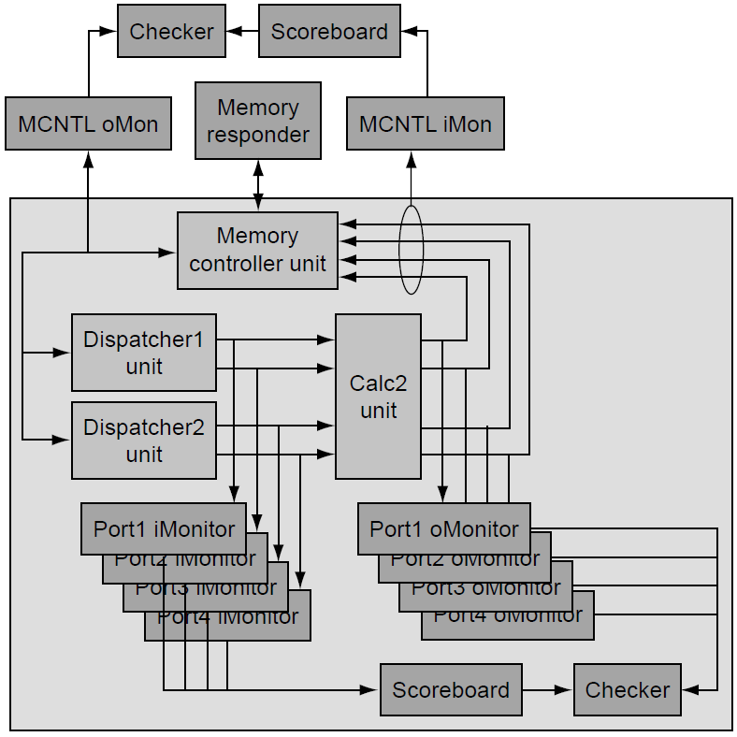
Applying Re-Use to Calc2 –
Next Level Verification
The next level of verification now exploits the appropriate verification components as shown in the figure to the right.
The next level of verification utilizes the port I/O monitors in conjunction with the scoreboard and checker. The monitors and checkers flag any failure within this area immediately and reduce the overall debug time.
In addition to the Calc2 unit, the next level test bench also has other components it is re-using.
In this case, the memory controller unit’s verification components are also being re-used for the same purpose as the Calc2 unit.
With these components being reused, the only component this team must provide is the memory responder verification component.
Notes:
By utilizing these internal monitors and checkers, this verification team leverages existing verification components that allow them to reduce overall verification time because the debug time is reduced. This can further be expanded upon to include the monitors and checkers from the dispatcher units.

